Slide 1
iRegulon: From a Gene List to a Gene Regulatory Network Using Large Motif and Track Collections
Rekin’s Janky et al
Stein Aerts Lab
Group Seminar 09.09.2015
Tom Hait

Slide 2
Papers
[1] iRegulon: From a Gene List to a Gene Regulatory Network Using Large Motif and Track Collections
[2] Robust target gene discovery through transcriptome perturbations and genome-wide enhancer predictions in drosophila uncovers a regulatory basis for sensory specification

Slide 3
Overview
Motivation
Experimental Methods for identifying TF’s target genes
iRegulon – Workflow
How can I contribute?
Summary

Slide 4
Motivation
Identify enriched transcription factor motifs
Identify the transcriptional regulatory network underlying co-expressed gene set
Mapping and characterization of the TF’s target genes (regulon) can provides insights into the biological process that the TF controls
In cancer ~40% of the driver mutations affect TFs
Possible discovery of a therapeutic target genes
Computational Challenge – most of the Binding Sites (BSs) are located in non-coding regions. In mouse and human ~98% of the DNA is non-coding.

Slide 5
Experimental Methods for identifying TF’s target genes
ChIP-Seq
Identifies targets of known TF
Applies on cells in culture rather than to the actual biological sample (e.g., tumor cells)
Focus on a single apriori selected TF
Gene Expression Profiling
Identify co-expressed target genes
Search for shared and common motifs in the co-expressed genes
Discover the unknown TFs sharing the common motifs

Slide 6
iRegulon – Workflow
iRegulon combines:
cisTargetX method – Ranking of whole genome genes and Recovering a set of target genes
motif2TF mapping procedure:
increase number of TFs using orthologues comparisons to other species
Add 247 more TFs to the 944 directly annotated TFs in human
Increase the number of motifs per TF

Slide 7
cisTargetX^{[2]}

Slide 8
Ranking of whole genome genes
G – Dmel genes, I – species, K – regions on the genome
The total K regions includes ±500 bp, ±10 kb and ±20 kb around the TSS and introns.
$∀g∈G$ scan g with Cluster-Buster (CB) to predict TF Binding Sites (BS) – cis-regulatory module (CRM)/motif clusters
$∀i∈I,g_{i}$ ortholog of g is scanned with CB
Each region $k∈K$ receives $I+1$ values of:
$S_{k,i}$ - CB score of region k in species $i$
$R_{k,i}$ - Rank of region k in species $i$
The final region rank $R_{k }$is an integration of all $I+1$ ranks using Order Statistics
Each gene g is given the highest ranking region among all regions in its search space
For N PWMs we get N lists of gene rankings

Slide 9
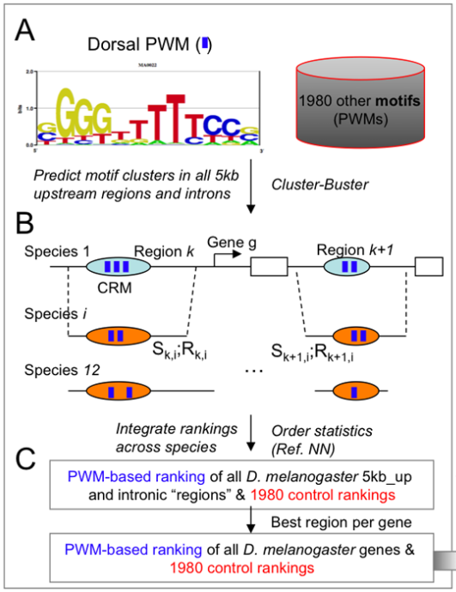
[2]

Slide 10
Recovering the TF
Main idea:
Input:
G’ - subset of target genes
Whole genome ranked list of motif m.
Plot genomic ranks of G’ in a cumulative recovery curve
Output: Normalized Enrichment Score (NES) – How well enriched the target genes in the leading edge

Slide 11
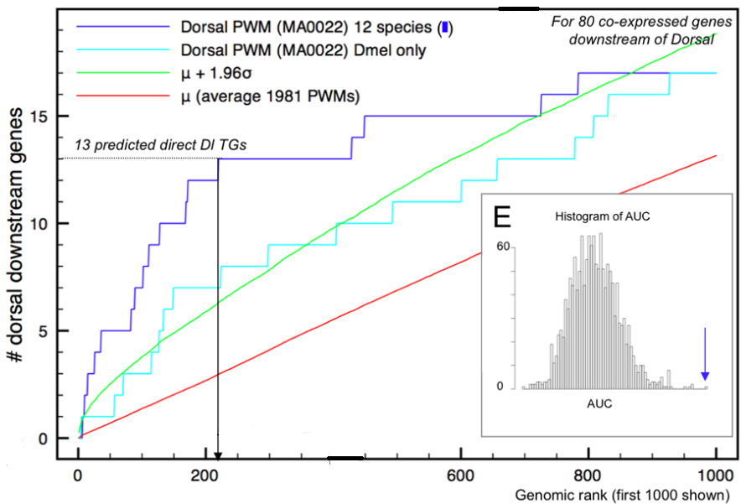
[2]
Search for maximum distance between the blue and the red curves

Slide 12
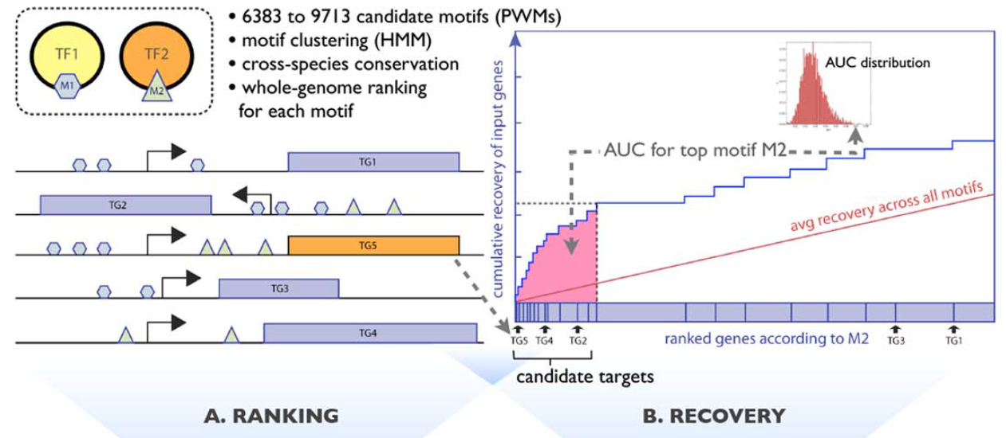
[1]
Search for maximum distance between the blue and the red curves
3% of the total AUC – wasn’t clear
What is the rank threshold? The paper claims that the maximum distance
between the curves is actually the 3% rank threshold – proof reference was not given

Slide 13
ENCODE ChIP-Seq Datasets
115 tracks of sequence-specific TFs from the ENCODE ChIP-Seq data
Each target set was investigated whether the ChIP’ped TF can be correctly recovered
Peaks scores are used for the ranking instead of PWMs and CB scores
We refer to ChIP-Seq data as track

Slide 14
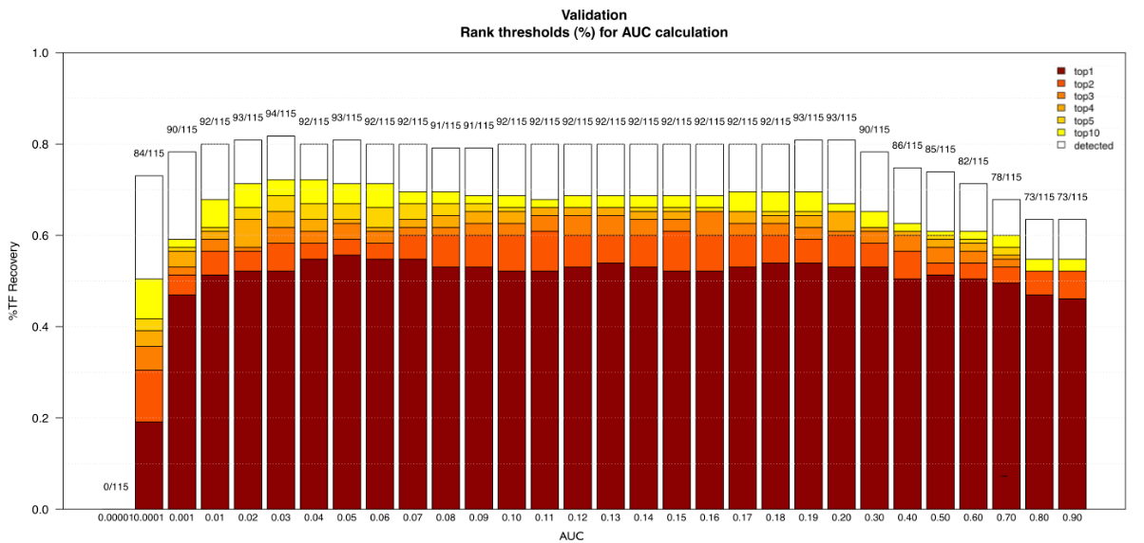
Rank Threshold^{[1]}
Good TF recovery:
depends on the data
What is the percentage of the total AUC that gives a “good” TF recovery
White box – detected TFs with rank > 10 and NES > 3.0

Slide 15
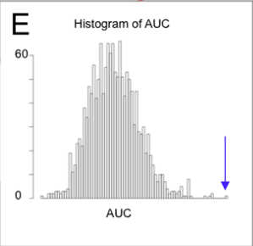
Normalized Enrichment Score
Defined as:
$NES=\frac{AUC\left[{motif}/{track}\right]−\overline{AUCs}\left[{motifs}/{tracks}\right]}{std(AUCs\left[{motifs}/{tracks}\right])}$
If the AUCs are normally distributed then $NES≡z−score$
What if the AUCs are
not normally distributed?

Slide 16
NES cutoff
FDR is calculated as follows:
$FDR=\frac{\#TF recovery in control datasets}{\#TF recovery in biological datasets}$
$control datasets$ – gene sets without a ChIP-Seq peaks from ENCODE
$biological datase$ – gene sets with a ChIP-Seq peaks from ENCODE
Problem? The NES cutoff depends on the ENCODE data

Slide 17
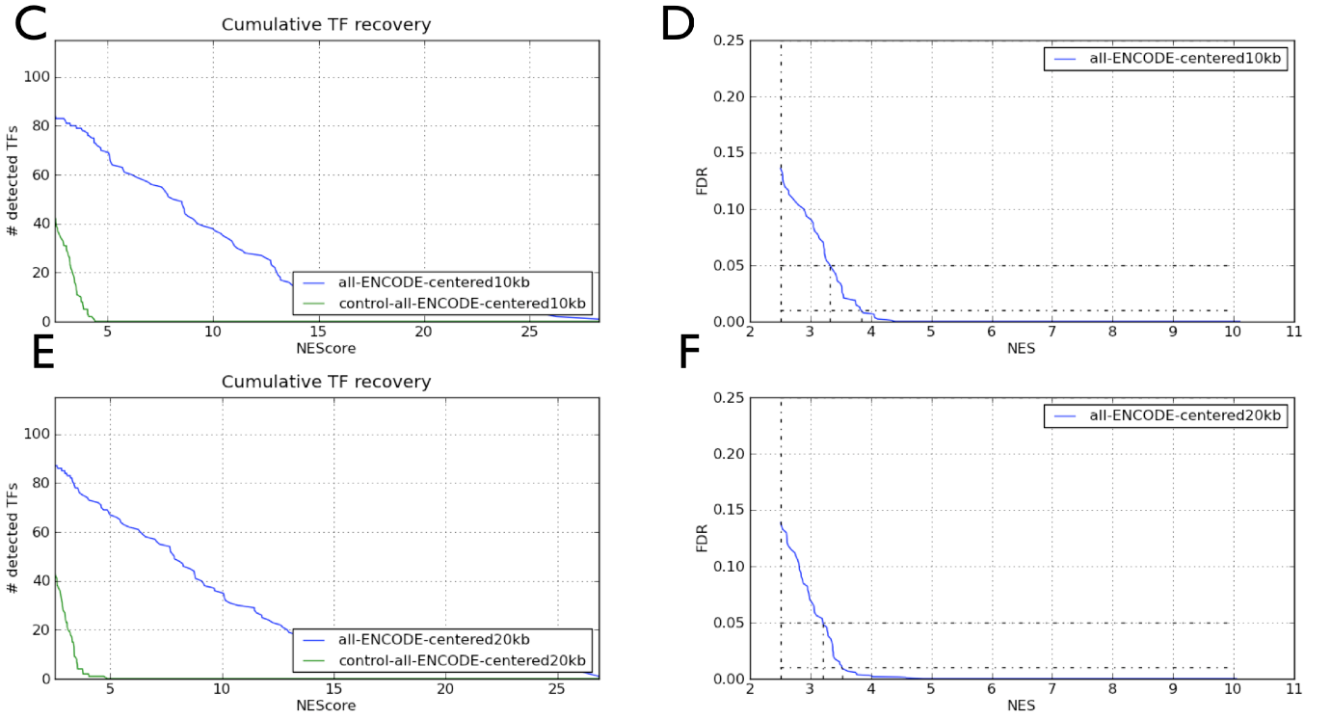
FDR plot example^{[1]}

Slide 18
Motif2TF^{[1]}
Makes a use of network of associations:
Motif-TF edges – direct annotations
TF-TF edges – homology %identity – Ensembl gene trees
Motif-Motif edges – similarity using TomTom p-value

Slide 19
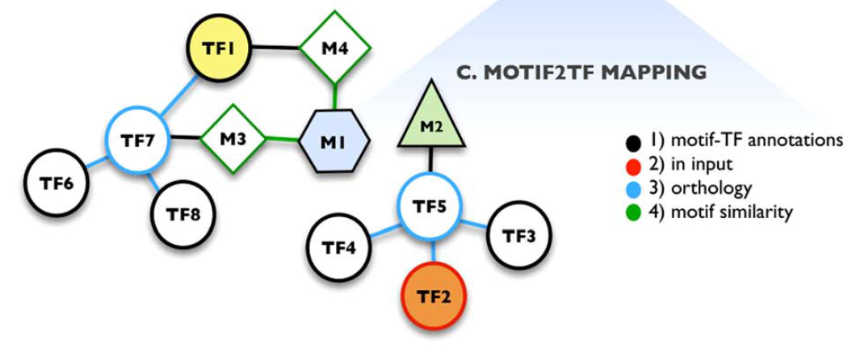
Motif2TF
TF7 is ortholog of TF1,6,8
M1 motif with unknown TF
TF5 is ortholog of TF2-4
Encoded by TG5 in the input set of genes – Priority is given

Slide 20
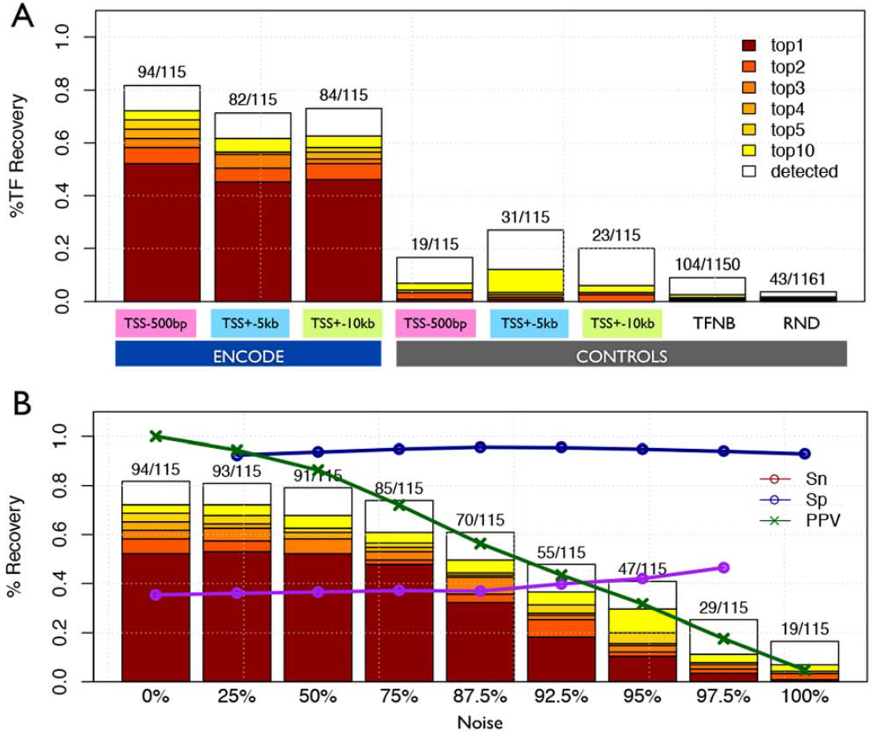
Evaluation of iRegulon^{[1]}
Sn – sensitivity - Positive genes, with peak, with the correct TF recovery
Sp – Specificity - Negative genes, without peak, without the correct TF recovery
PPV – Positive Predictive Value (Precision) – Fraction of identified positive genes
out of all identified genes having the correct TF

Slide 21
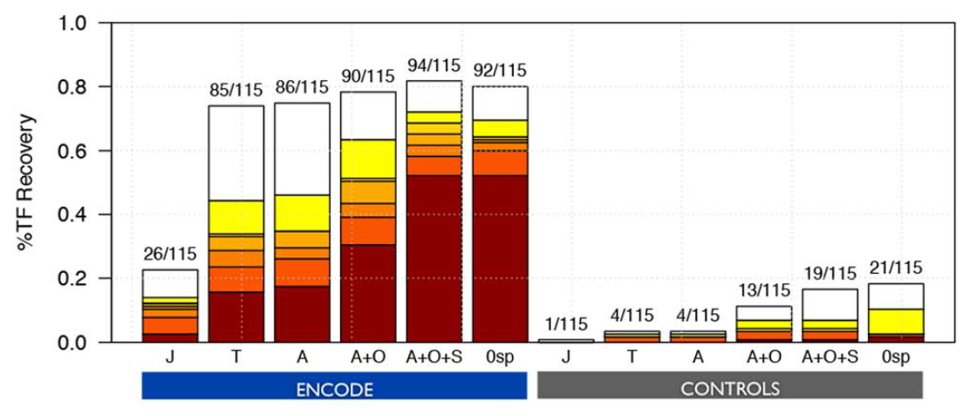
Motif2TF increase performance
Homology threshold on %identity
Threshold on %identity and on the similarity p-value
0 specificity – Negative genes with the correct TF
J=JASPAR, T=TRANSFAC, A=J+T and other DBs, O=Orthology, S=Similarity

Slide 22
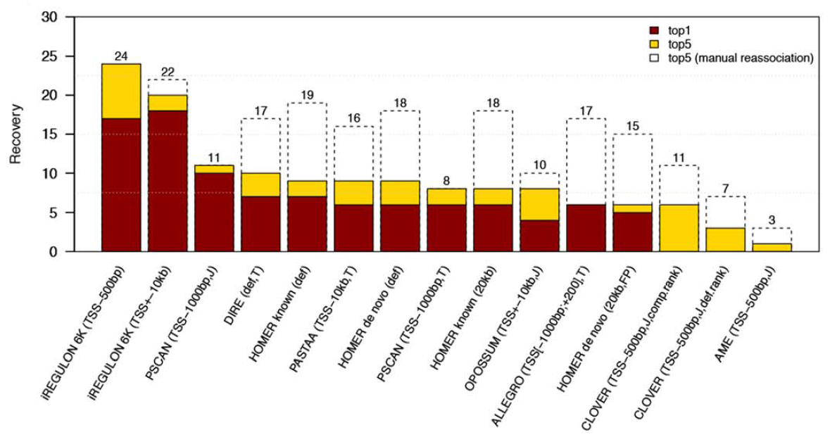
Comparison to other tools
30 gene sets constructed as top 200 target genes based on ChIP-Seq peak occurrences
White top5 box – similar motifs are manually re-associated to the query TF

Slide 23
Multiple Transcript Per gene?
iRegulon computes motif clusters across the search space for each annotated transcript
Each transcript score is represented by a motif cluster giving the highest score among all motif clusters in the same transcript
Each gene is represented by the transcript with the highest score among all transcripts
Each gene is ranked by a specific motif score in the motif cluster

Slide 24
Problems?
The selected transcript doesn’t necessarily the transcript being expressed in the sample
Possible bias to large transcripts? Genes sharing overlapped transcripts?
iRegulon focuses on homotypic Cis-Regulatory Modules (CRMs):
What if we want to test multiple TFs working together (heterotypic CRMs)?
Need to calculates new gene ranks based on multiple motifs for multiple TFs
Computationally hard
A comparison was made to show similar performance using homotypic and heterotypic CRMs^{[2]}

Slide 25
How can I contribute?
Method for selection of one TSS
per gene and per tissue/cell based on RNA-Seq data
covering numerous samples
Prima
Motif finders

Slide 26
Summary
Pros:
A fast running time tool covering up to 20kb search space
Can be used to detect Enhancer-promoter associations
Up to ~10k motif-TF DB using motif2TF tool
Increased TF recovery performance when using cross-species ranking

Slide 27
Cons:
Statistically problematic:
If the AUCs are not normally distributed, how to interpret the NES scores?
Even if the AUCs are normally distributed, what is a good NES cutoff for being sure that the correct TFs were recovered?
NES cutoff and rank threshold depend on the data and on all motif collections (even with repeated motifs with different PWMs)
Biology people “love” p-value – perhaps should perform some iterations and to take each time a subset of motif collection rather than just taking all motif collections as background?
Co-Factor analysis:
Homotypic vs heterotypic CRMs – iRegulon finds homotypic CRMs
It was shown how to analyze GE data in order to find co-factors, however it is not straightforward^{[1]}

Slide 29
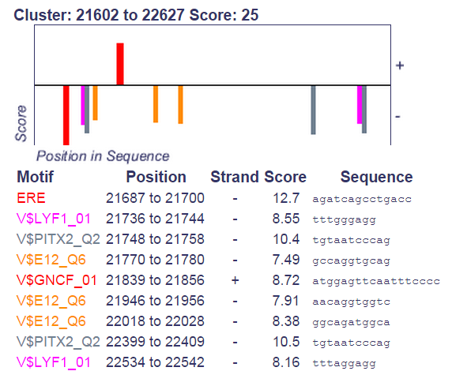
Cluster-Buster
http://zlab.bu.edu/cluster-buster/

