Slide 1
Analysis and design of RNA sequencing experiments for identifying isoform regulation
Yarden Katz, Eric T Wang, Edoardo M Airoldi and Christopher B Burge
Group Seminar 1.07.2015
Tom Hait

Slide 2
Overview
Molecular Biology
Motivation
Estimator
MISO Estimator
Exon centric
Isoform centric
Summary

Slide 3
Molecular Biology

Slide 4
Gene structure
5’ end
TSS
Gene Transcript
TTS
TF
TF
5UTR
Exon
Intron
Exon
Intron
Exon
3UTR
3’ end
Promoter
CDS start
CDS end

Slide 5
RNA-Seq reads alignments
Reads
Align to reference genome
Forward strand
Intron
Intron
Exon
Exon
Exon
5UTR
3UTR
Reverse strand
Splice Junction

Slide 6
Exon
Exon
Exon
Reads can be mapped to forward and reverse strands
Reads can be mapped to spliced junctions – purple reads
Reads can be mapped as single ends (SEs) or as Paired Ends (PE’s)
Library insert length

Slide 7
We start with Exon centric problem and then we extend it to isoform centric problem
Exon centric – only one alternative exon
Isforom centric – multiple alternative exons

Slide 8
The basic two isoform options – Exon centric
Inclusion Isoform
Splice Junction
Splice Junction
Alternative Exon
Splice Junction
Exclusion Isoform
SJ = Splice Junction

Slide 9
Motivation
Development
Differentiation to specific tissues
Disease classification based on isoform expression

Slide 10
Estimator

Slide 11
Number of reads supporting the inclusion isoform
including reads mapped to the body of the alternative exon
Number of reads supporting the exclusion isoform
Note:
Those numbers do not include reads fully mapped to the body
of the constitutive exons (denoted as ):
Why not?
Those reads could come from either Isoform – Inclusion or Exclusion
Does it mean we should ignore them entirely?

Slide 12
Density of the inclusion reads
Density of the Exclusion reads
Denominators – Number of start positions
that a read can be mapped to the isoform
Alternative exon length
Read length
Overhang constraint placed on spliced junctions – minimum number of bps
Overlapping between two exons in a spliced junction

Slide 13
Toy Example

Slide 14
Toy Example

Slide 16
Total inclusion checks = 5
The same is done for Exclusion start positions:

Slide 17
The estimated relative read density between the density
of the inclusion reads, relative to the density
of both inclusion and exclusion reads:
Reminder:
Does not include reads fully mapped to the body
of the constitutive exons – latent information
So, how to capture this latent information as well as
the library insert length in PE’s data?
Bayesian Inference – MISO model

Slide 18
MISO Estimator

Slide 19
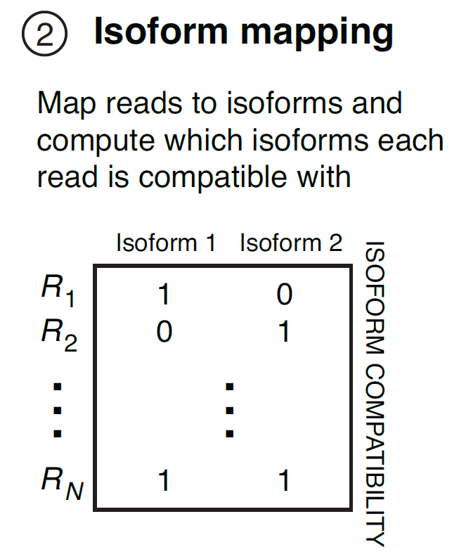
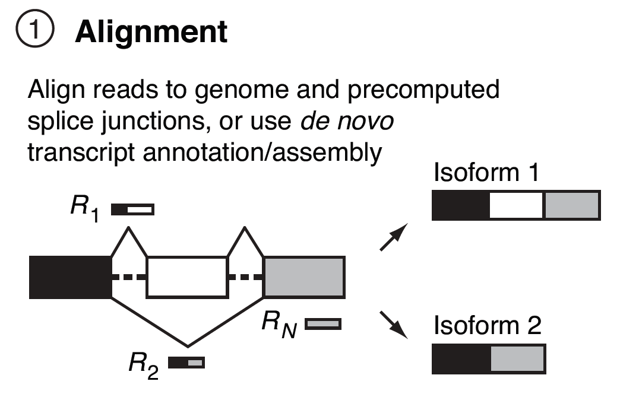
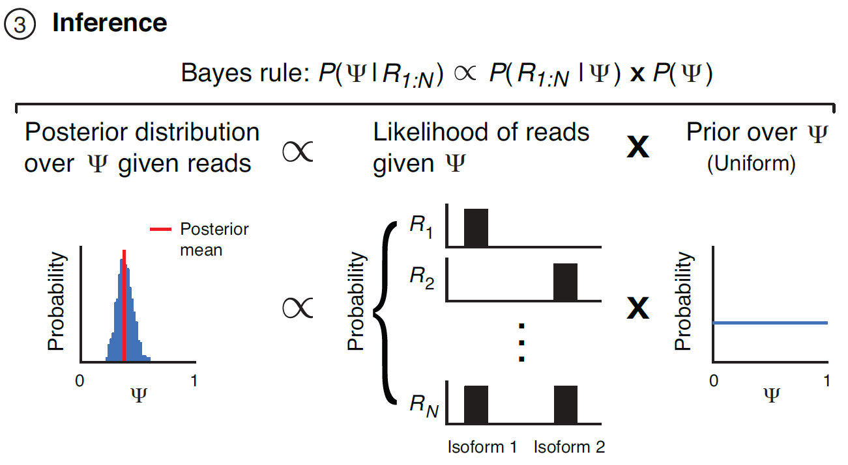
Overview of the MISO model

Slide 20
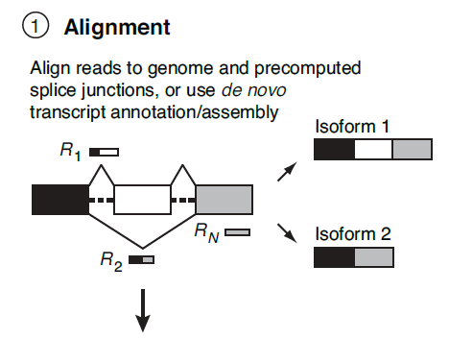
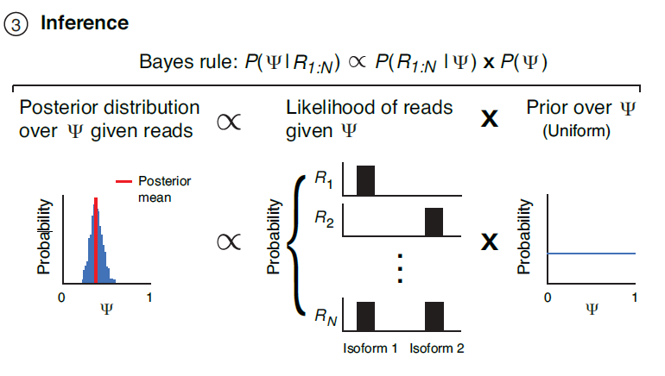
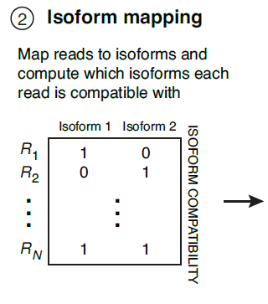
Overview of the MISO model

Slide 21
Model parameters
𝛹 - Percentage spliced in (PSI): Fraction of mRNAs that represent the inclusion isoform
Reads aligned to the alternative exon or to its SJs with adjacent constitutive exons support the Inclusive Isoform
Reads aligned to the single SJ between the adjacent constitutive exons support the Exclusive Isoform

Slide 22
We have:
- Isoforms
- Reads, where each read
Is associated with a vector of components:
- Fraction of mRNA corresponding to the
isoform
In our case, we have:

Slide 23
How can we compare between two Isoforms that differ in length?
Length = 16 bp
Length = 10 bp
The paper claims:
The probability of sampling a read from an mRNA
increases approximately linearly with the mRNA’s length

Slide 24
Resacling isoform abundance
Length of isoform k
Read length
Number of positions of reads of length that could be mapped to isoform k:
We get the rescaled values for two isoforms case:
For convenient we denote:

Slide 25
Denotes the isoform from which the n^{th} read was sequenced
The probability that the n^{th} read was generated from the k^{th} Isoform given the PSI (accounting for fragmentation) is:
Rescaled abundances
The prior distribution of
is assumed to be uniform over [0,1]
Why? – This prior is unbiased, not favoring any particular abundance value
Denotes the number reads positions (of length )
observable from isoform
The probability of observing read from the k^{th} Isoform is:
Where denotes the fixed parameters of the experiments , .

Slide 26
Latent data
Reads aligned to the body of constitutive exons:
Library insert length in PEs reads
Note: needs to account also for positions in constitutive exons and PEs reads with a fixed library insert length

Slide 27
Bayes rule – For single ends
MLE
Prior=1
Posterior
We wish to find the value maximizing the MAP or the MLE:

Slide 28
We will find the MLE of instead of the MLE of
Using eq (1) we get:
In the paper it was:
We get:
Where:

Slide 29
We maximize the log-likelihood:
Differentiating and comparing to zero yields:
Equivalently (2) can be rewritten in terms of:

Slide 30
The MISO estimator
Substituting in will result with estimator

Slide 31
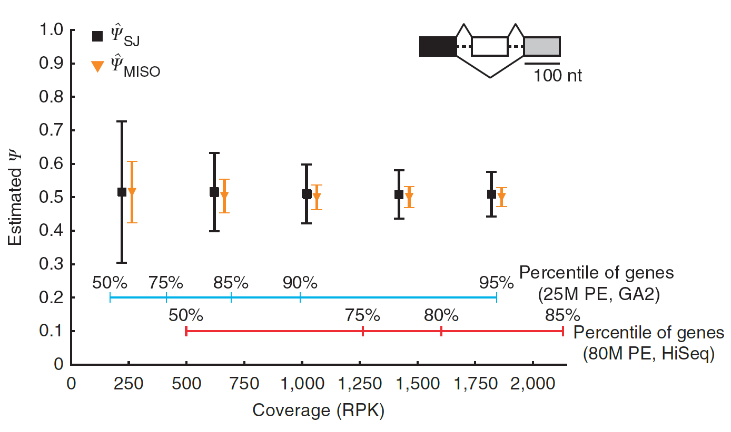
Comparison between and
Reads per kilobase of exon model

Slide 32
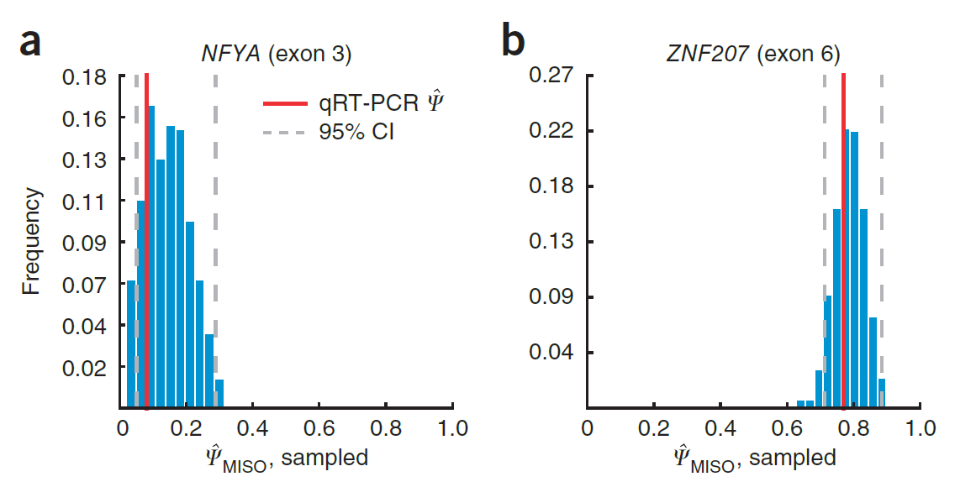
MISO CIs for and qRT-PCR validation Breast Cancer RNA-Seq

Slide 33
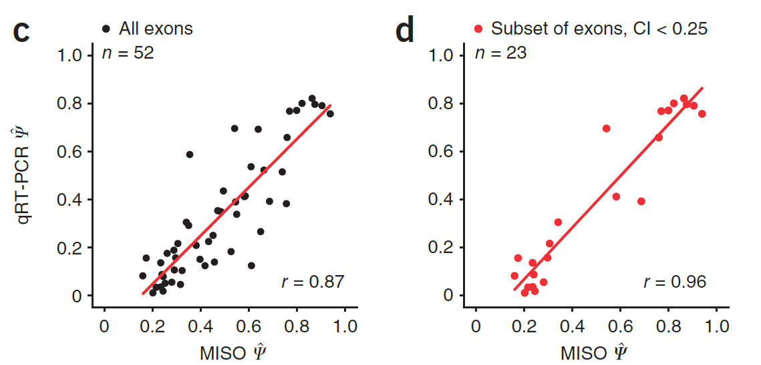

Slide 34
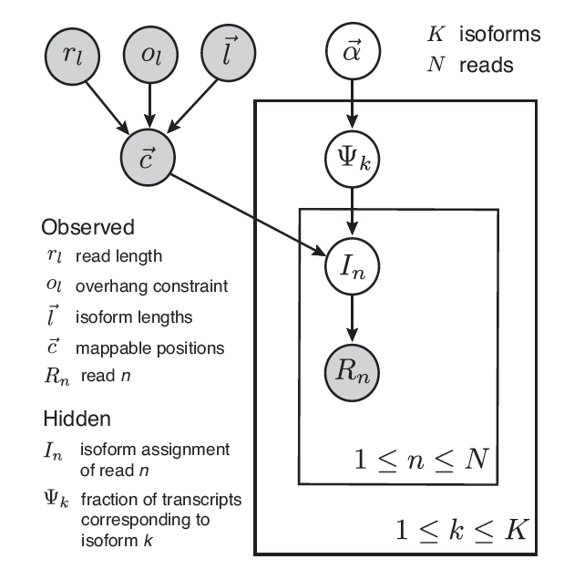
MISO model – Isoform centric*
Mean and Variance of Insert length
Observed Inserted fragment length
(*) Presenter modified the figure (Not from the paper)

Slide 35
How to extend to Isoform Centric?
prior for every gene where is a vector of parameters fixed to encode a uniform prior.
for every read n that maps to gene g.
for every read n that maps to gene g.
The corrected abundances :

Slide 36
The posterior is now:
All possible combinations of
isoform assignment of reads
What if we have 1000 isoforms
per gene?
MCMC
Where denotes the fixed parameters of the experiments , .

Slide 37
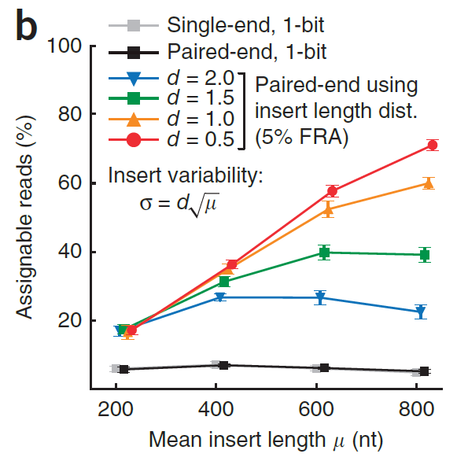
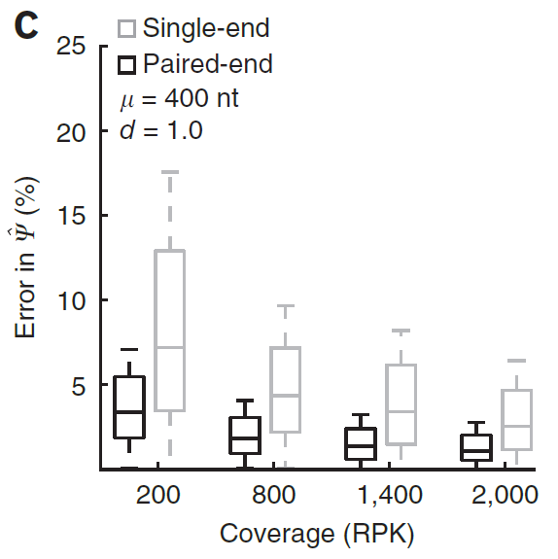
Improved model using PEs insert length

Slide 38
Incorporation of paired-end information
Each read is now a pair of paramteres :
the same binary vector as before
a vector of observed inserted fragment length
equal to the insert length implied by isoform k for the n^{th} read pair
Estimate insert length distribution :
Mapping PEs to a long constitutive exons in 3’ UTR

Slide 39
Instead of we have:
Instead of we have:
empirical fragment length distributed as discretized

Slide 40
The new posterior is*:
The old posterior is:
(*) Presenter modified the formula (Not from the paper)

Slide 41
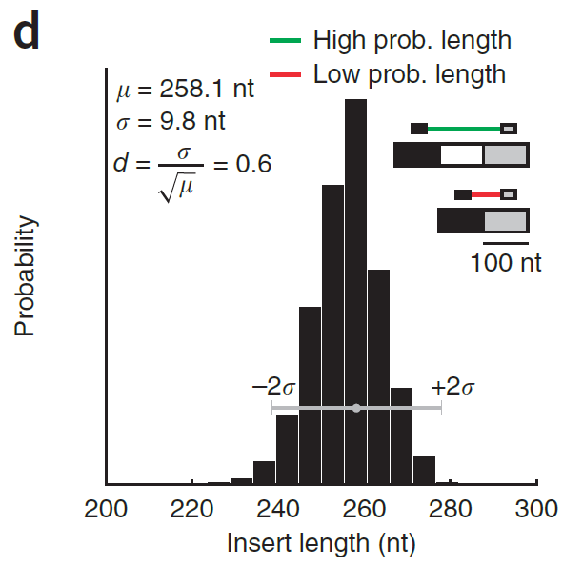

Slide 42
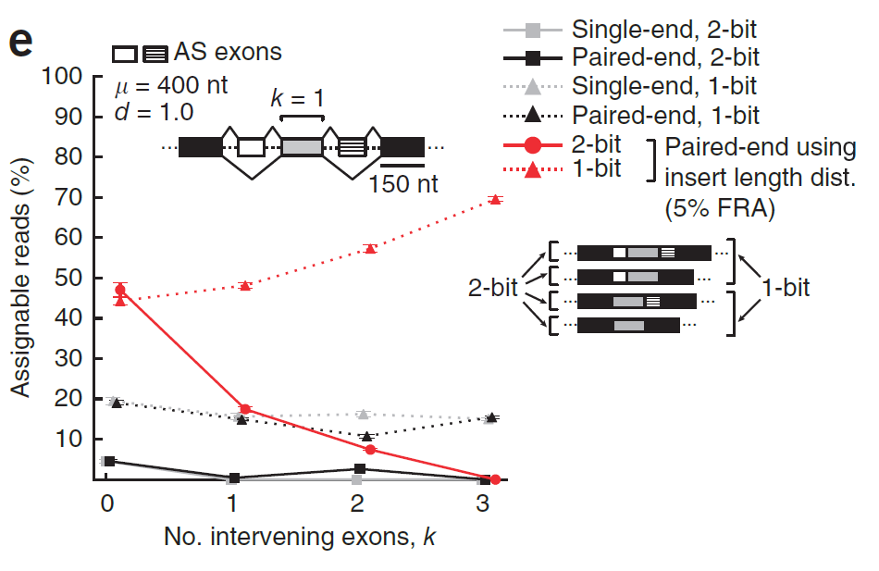
Insert length data increases assignable reads
False read assignment

Slide 43
Markov Chain Monte Carlo
Conjugacy properties of Dirichlet-Multinomial are being violated by the use of:
Isoform length correction
PEs insert length
Standard Gibbs sampler is not possible
Hybrid-MCMC:
Metropolis-Hastings (MH)
Gibbs sampler

Slide 44
Metropolis-Hastings (MH)
Target Distribution:
Proposal distribution Q: logistic-normal distribution
Construct random walk in the simplex space
Propose parameters for Dirichlet distribution
Preserves:
Sum of is 1
Transition probability (MH ratio):

Slide 45
Summary
MISO model shows:
Increased accuracy of Exon/Isoform abundance using the latent data:
Library insert length
Common reads
Can be used to infer differential expressed alternative exons or isoforms in hypothesis testing with Bayes Factor
No comparisons to other methods (e.g., cufflinks) in evaluating the expression levels or in the most explainable isoform by the data

Slide 46
How well it performs when comparing multiple cell lines/tissues?
The paper performed only on Breast Cancer tissue VS a normal breast tissue
Is it also differentially expressed between multiple tissues?

