Slide 1
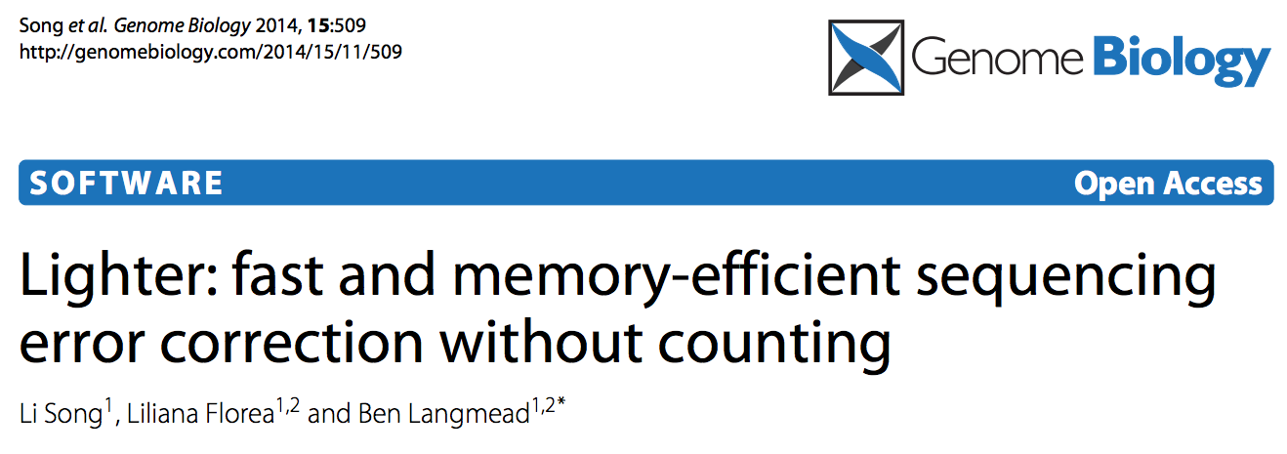
Shamir lab meeting, 28/1/15

Slide 2
Motivation: error correction of short reads
Improves accuracy of alignment to known reference sequences
Reduces resource use
Often a pre-processing step for de novo assembly by de Bruijn graphs
Most often done by k-mer counting

Slide 3
K-mer counting for error correction
Count (typically with a hash) k-mer appearances in read where k is long enough (~20) to be rare in the genome
Separate k-mers by multiplicity – k-mers at or past threshold considered solid, otherwise weak
Uniform sampling, high coverage assumed - weak k-mers likely to be the result of sequencing error
Correct errors by replacing rare k-mers with most likely common substitutions – either by dynamic programming or heuristic/greedy approach
Notes:
3 * 20 base → 3* 40 bit kmers, 32 bit ints * 10^9 → 27GB just for human genome hash key/values, doesn’t include pointer overhead or unfilled buckets
for fully occupied hash, more for pointers to deal with

Slide 4
Bloom Filters
memory efficient probabilistic data structure
bit array of size m, h hash functions, n entries
operations:
insert(s) - mark k positions hashed to with 1
query(s) - if k positions are marked 1, BF ‘accepts’ s
due to possibility of collisions, probability of false positive accept F≈ (1-e^{-hn/m})^{h}

Slide 5
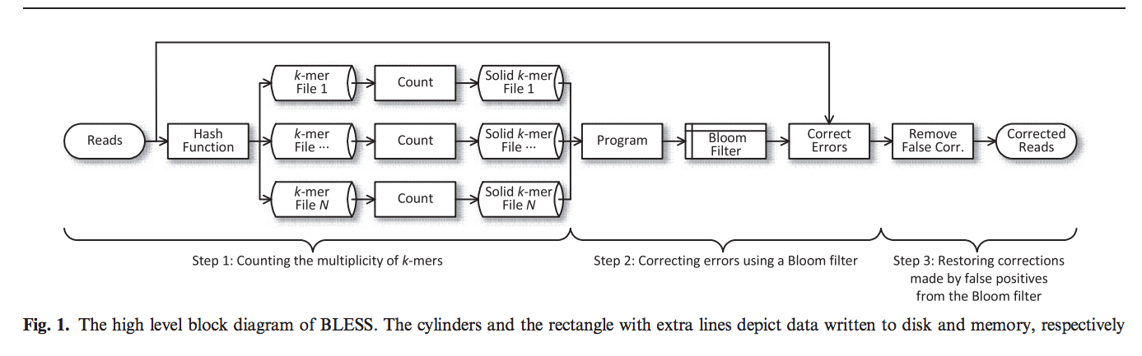
Bloom filter based error correction, still counting k-mers
Yeo et al, Bioinformatics, 2014

Slide 6
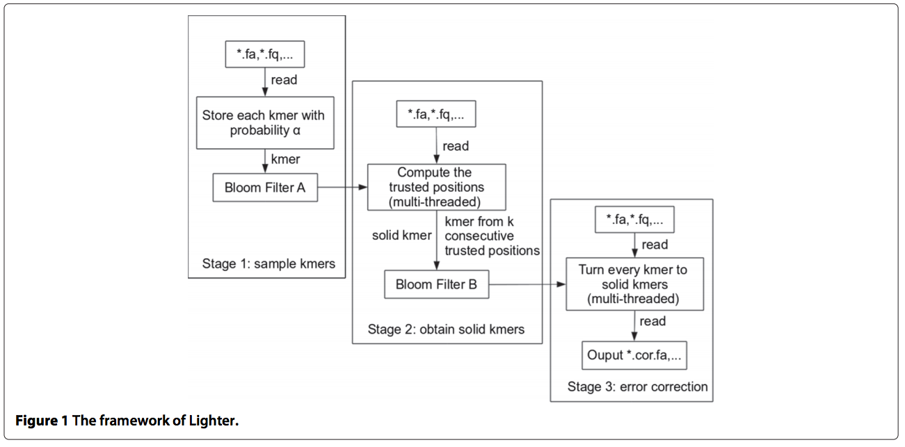
Lighter: Bloom filters – yes, counting – no!
Notes:
Second pass – don’t count but do use threshold based on neighbors of read
Threshold based on modeled distribution

Slide 7
Sequencing Model
K = number of sequenced k-mers
ε = fraction of incorrect k-mers
α = fraction of k-mers sampled (& inserted)
G = number of k-mers in genome (assumed distinct
κ_{c} [~ Poisson((1-ε)K/G) ] = multiplicity of a given correct k-mer
κ'_{c} [~ Poisson(α(1-ε)K/G) ] = multiplicity of a given correct k-mer sampled
Similarly, κ_{e ,} κ’_{e} drawn from larger space H represent error k-mers

Slide 8
First pass – sub-sampling
α – user defined sampling fraction
From all reads, insert α out of all k-mers to A
Intuition: each incorrect k-mer rare (although there may be many), correct k-mers frequent, by sampling more likely to get rid of errors than lose correct k-mers
Authors advise to adjust α inversely with depth of coverage

Slide 9
Second pass – finding solid k-mers
Test how many out of x (in [1,k]) flanking k-mers are in BF A.
Only positions which have more than threshold y_{x} are called trusted
Wish to add runs of k consecutive trusted positions as solid k-mers to B
B_{e,x} = number of k-mers appearing in A for untrusted position
Set y_{x} for each x based on B_{e,x} ~ Binom(x,P*(α)) to get p(B_{e,x} ≤ y_{x} -1) ≥ 0.995

Slide 10
Second pass details
B_{e,x} ~ Binom(x,P*(α))
β = BF false positive rate; P(α) = probability of a k-mer being added to A
P*(α) = P(α) + β(1- P(α))
P(α) = 1 – (1- α)^{f(α)}; f(α) = max{2, 0.2/α}
obtained by considering typical weak k-mer multiplicity
Simplifies scaling description (used later):
P(α/z) ≈ P(α)

Slide 11
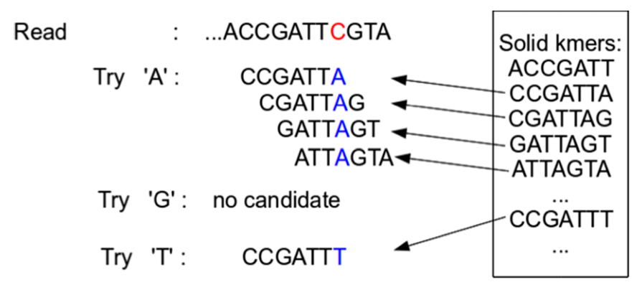
Third pass – correcting errors, greedily

Slide 12
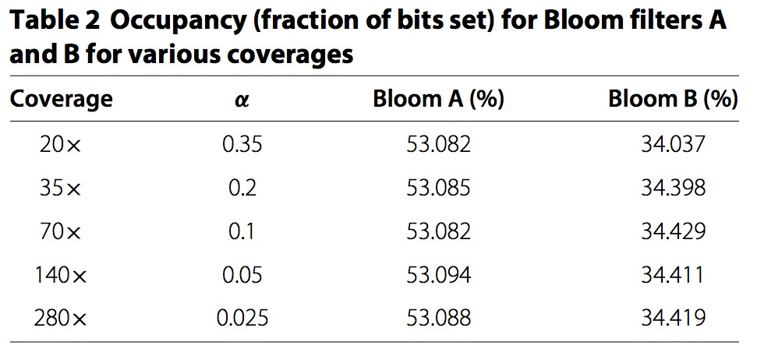
Scaling with depth
Adjust α inversely with increasing K→ e.g., if K₂ = zK₁, use α₂ = α₁/z (where z is a constant > 1)
Contents of A constant:
κ'_{c} ~ Poisson(α(1-ε)K/G) remains constant because αK constant, similarly for κ’_{e}

Slide 13
Scaling with depth
Accuracy of trusted/untrusted classifications persists
α small, P(α₁) ≈ P(α₁/z) = P(α₂) → P*(α₁) ≈ P*(α₂) → y_{x} thresholds don't change
p_{c} = probability correct k-mer sampled = p(κ’_{c} ≥ 1)/p(κ_{c} ≥ 1) ≈ 1 -e ^{-α(1-ε)K/G} → constant because αK constant → B_{e,x} constant → trusted position probabilities constant
Similarly for p_{e} with errors

Slide 14
Results: accuracy on simulated reads
Procedure: simulate reads with known error rates, make corrections with each tool, count TP,FP,FN
Accuracy Measures:
Recall = TP/(TP + FN)
Precision = TP/(FP + TP)
F score = 2 * recall * precision/(recall + precision)
Gain = (TP-FP) / (TP+FN)

Slide 15
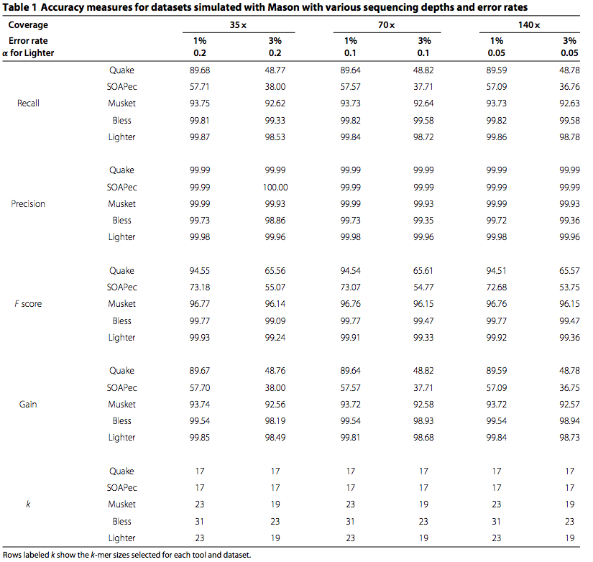

Slide 17
Results: real data
Procedure: apply correction methods to different datasets, test increase in reads aligning and assembly statistics using corrected reads as input

Slide 18
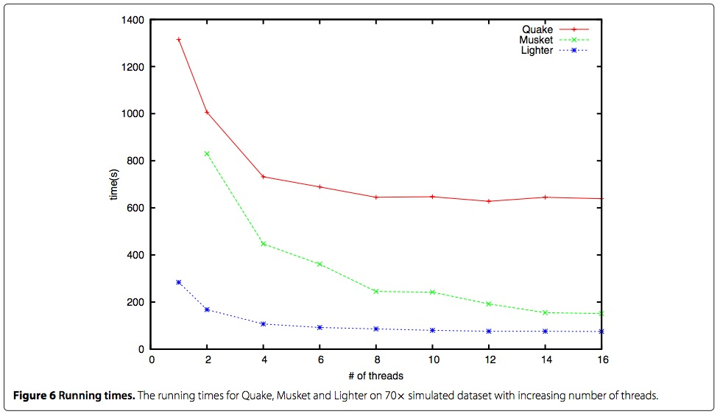
Results: resources (the punch line) – RAM, disk, time
Measure RAM/disk use during error correction, varying data size

