Slide 1
Checking Bloom filters to improve de novo assembly memory use and speed
Shamir group meeting, 13/5/15

Slide 2
Bloom filters reminder
Operations: insert, query
Low memory use, optimal insertion, query time O(length of sequence)
One sided error – false positives, no false negatives: F ≈ (1-e-^{nh/m} )^{h}
Can optimize parameter choice (m – array size, n-number of elements to insert, h – number of hash functions, F – false positive rate) – for fixed m/n, choose h minimizing F → h = (ln2)m/n

Slide 3
Most dBG assemblers store only dBG nodes
Hashed kmer nodes
Reads
Implied edges
ACG
CGT
GTT
ACA
CAT
ATA
CCG
GTA
.
.
.
ACGTT
k=3
query hash
ACATA
A
C
G
T
CCGTA
A|CG?
.
.
.
.

Slide 4
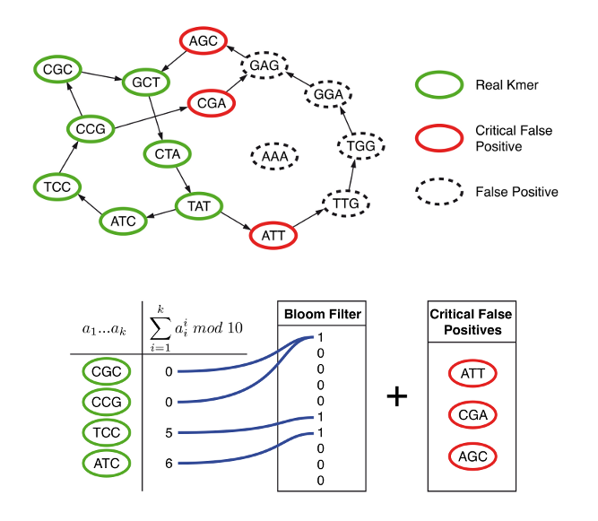
Minia algorithm
http://minia.genouest.org/

Slide 5
Minia algorithm details
split reads to k-mers, count, insert solids to BF
store solids on disk
ID critical false positives (cFPs) relative to BF before assembling - must validate BF positives against solids in batches (to keep memory use low)
only BF + cFPs + complex nodes (e.g., starts, junctions, ends) in memory during run
traverse reads to generate long paths (various heuristics employed)

Slide 6
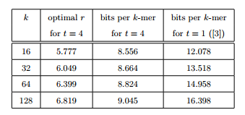
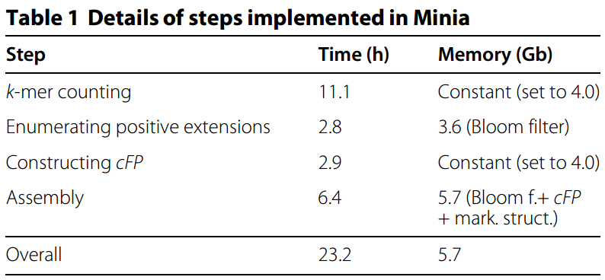
Minia results
low memory use (improved by cascading BFs)
slow run-time
Comparable assembly results to early dBG assemblers - Abyss, Velvet, SOAPdenovo

Slide 7
Room for improvement
Can we make assembly faster?
Can we get rid of some critical nodes? most??
validating nodes makes assembly slower
holding cFP list increases memory

Slide 8
Double check: demand accepts have at least one extension
k-mers in BF
ACG
CGT
GTT
ACA
CAT
ATA
CCG
GTA
.
.
.
If one of extensions
of CGC accepted,
accept
Else, reject as false
positive
A
C
G
T
query BF on 3-mer extensions of
real k-mer ACG
GC
A
C
G
T
A|CG?
CGC accepted by BF
Note: this idea was mentioned in Chikhi et al., 2013

Slide 9
Double check properties
for double check to be false, need node to be false and some extension to be accepted (true or false)
F_{eff.} ≈ F(1-(1-F)⁴)≈ F(1-e^{-4F}) [assuming extensions in only one direction]
========================================
Simulation:
length 56100 contig, all contig k-mers hashed to BF, starting from real node and accepting only double checked extensions (e.g., building tree induced by BF), calculating observed FP count
param. mean FP2 mean FP2 calc
0.0001 0.000000 0.000000
0.0010 0.000003 0.000004
0.0100 0.000310 0.000374
0.0500 0.007279 0.007417
0.1000 0.029251 0.024689
0.1500 0.070380 0.048813
0.2000 0.113303 0.111107
========================================
Stronger effect on low F values
No reason to step at single extension…

Slide 10
Checking up to level j: prospects
Better memory use 1 – less cFPs → less in memory during minia run
Better memory use 2 – lower effective F means smaller (less bits per element) BF can be used
Issue: minia already enables de novo assembly of large genomes on desktops, further improvements perhaps useful for parallelization
more interesting: keep memory use low and have assembly be fast

Slide 11
j-check
A
C
G
T
A
C
G
T
A
C
G
T
CGA?
k-mers in BF
…
ACG
CGT
GTT
ACA
CAT
ATA
CCG
GTA
.
.
.
A
C
G
T
query BF on 3-mer extensions of
real k-mer ACG
A
C
G
T
A
C
G
T
|--j -1--|
…
A
C
G
T
A
C
G
T
CGG?
A|CG?
A
C
G
T
A
C
G
T
Accept extension only if it has some extension j steps forward
CGT?
.
.
.

Slide 12
Buffered j-checking
Scan each read separately to avoid building graph
use a (j+1)-level BFS buffer to avoid recalculating extensions of past nodes
always extend last buffer state instead of recalculating from scratch (except once per read in each direction)
Identify junctions that have extensions up to j-th level, ignore others

Slide 13
Buffered j-checking: Intuition
Read sequence
Back -- Buffer level 1:
Extensions of current node
Front -- Buffer level j+1: j-th
extensions of level 1 nodes

Slide 14
Buffered j-checking: Observations
Read sequence
Buffer level 1:
Extensions of current node
Buffer level j+1: j-th
extensions of level 1 nodes
Nodes that don’t reach front (level j+1) are ignored
Only need to check candidates when there are at least 2 nodes in front and back (level 1)
Only need to validate (check there are no FPs) paths that differ from read sequence reaching front
Only interested in validating paths that branched at back and made it to front – others will be checked later
Once validated, alternates removed from buffer (record their starting nodes for traversal)

Slide 15
Buffered j-checking: candidate path-finding Algorithm
initialize: traverse j steps using BFS; insert to each buffer level the set of BFS level nodes
while some level not empty (e.g., back isn’t last k-mer of read):
- if (at least 2 (k-j)-mers common to front and back):
add k-mers of each alternate (diff from read sequence) path to validation set
- extend buffer front, remove back

Slide 16
Invariant (k-j)-mers
k-j-1
A
j
j
k-j-1
A
j
k-j
…
j
k-j-1
G
k-j-1
G
j
back
front

Slide 17
100k reads test results
j | total candidates | false joins (list, set) | real junctions (list, set)
1 | 13351 | 29,28 | 13322, 6483
2 | 18496 | 47, 30 | 18449, 6442
4 | 31670 | 126, 64 | 31544, 6377
8 | 68710 | 249,142 | 68461, 6236
16 | 207468 | 861,380 | 206607, 5983
Parameters: k = 27, F = 0.01, 100 nt. Reads simulated from human chr20 (~60 Mb)
longest run took ~8 minutes
total number candidates grows with j, but mostly repeats of seen junctions → will be beneficial to sort & cache results
real junction count decreases slowly → don’t need to use large j to get most benefit

Slide 18
Status, next steps
Implemented in python – slow! – need to re-implement & optimize further
Add sorting & caching of reads – should help speed more
Other buffer applications: estimate coverage?

