Slide 1
Inferring Noncoding RNA Families and Classes by Means of Genome-Scale Structure-Based Clustering
Sebastian Will, Kristin Reiche, Ivo L. Hofacker, Peter F. Stadler, Rolf Backofen
Seminar Presentation – Maor Dan
6/5/15

Slide 2
Motivation
Improving Time complexity
Sankoff’s algorithm – O(N⁶) (More later…)
Clustering
Novel RNA families

Slide 3
Outline
Motivation
Secondary structure – Overview
RFAM – RNA FAMilies database.
LocARNA algorithm
mLocARNA – Clustering and multiple alignment
Results and Discussion
Bibliography

Slide 4
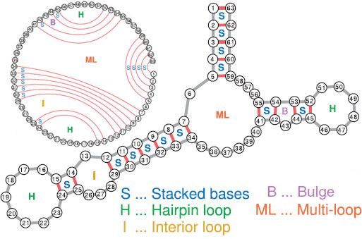
Secondary Structure – Overview

Slide 5
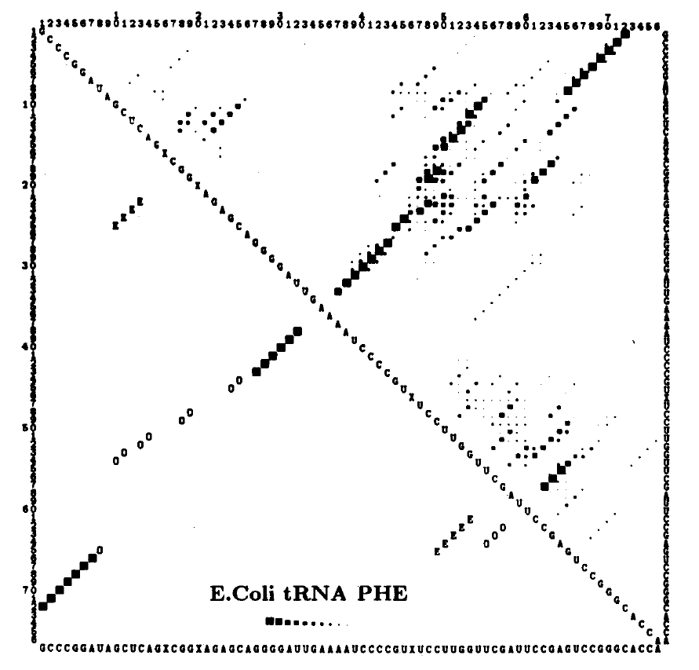
Secondary Structure – Overview
Minimum Energy
McCaskill Algorithm
Time – O(N³(
Space – O(N²)

Slide 6
LocARNA – Local Alignment of RNA
Goal:
Input: Two RNA sequences (Q,T)
Output:
A – an alignment $\left\{\left(i,j\right) \right| Q_{i} aligned with T_{j}\}$
S – the consensus secondary structure.
$\left\{\left(ij;kl\right) \right| \left(i,j\right)∈A, \left(k,l\right)∈A ∧(i and k are a base pair and so are j and l)\}$
A_{s} – set of pairs in A that are not part of any base pair
Maximizing some score

Slide 7

LocARNA score
$Ψ_{ij}=\left\{\begin{matrix}{\log{\frac{P_{ij}}{p_{0}}}}/{\log{\frac{1}{p_{0}}}} & P_{ij}≥p^{∗} \\ −∞ & otherwise\end{matrix}\right.$

Slide 8
Sparsity
Key assumption in LocARNA
Number of significant base pair probabilities – m = O(n)

Slide 9
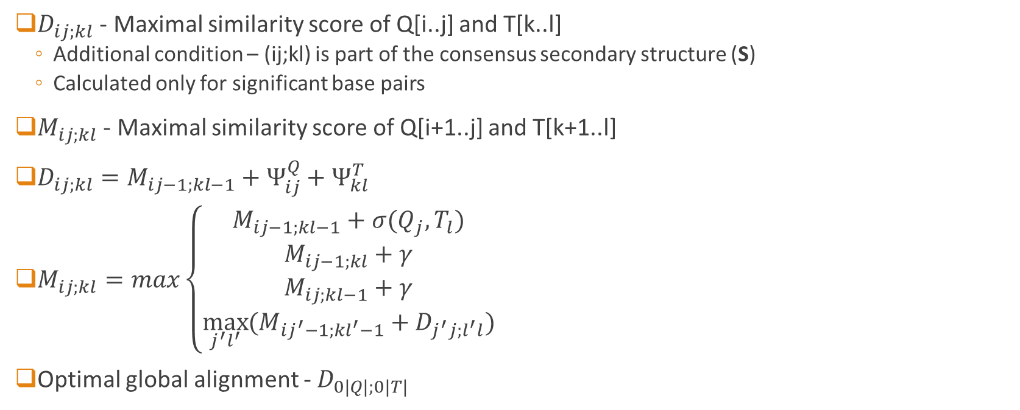
Dynamic Programming
$D_{ij;kl}$ - Maximal similarity score of Q[i..j] and T[k..l]
Additional condition – (ij;kl) is part of the consensus secondary structure (S)
Calculated only for significant base pairs
$M_{ij;kl}$ - Maximal similarity score of Q[i+1..j] and T[k+1..l]
$D_{ij;kl}=M_{ij−1;kl−1}+Ψ_{ij}^{Q}+Ψ_{kl}^{T}$
$M_{ij;kl}=max\left\{\begin{aligned}M_{ij−1;kl−1}+σ(Q_{j},T_{l}) \\ M_{ij−1;kl}+γ \\ M_{ij;kl−1}+γ \\ \max_{j^{′}l^{′}}{(M_{ij^{′}−1;kl^{′}−1}+D_{j^{′}j;l^{′}l})}\end{aligned}\right.$
Optimal global alignment - $D_{0|Q|;0|T|}$

Slide 10

Matrix slice calculation
$D_{i∙;k∙}$ - slice of D having i and k fixed.
$M_{i∙;k∙}$ - slice of M having i and k fixed.
$D_{i∙;k∙}$ depends only on $M_{i∙;k∙}$
$M_{i∙;k∙}$ slices can be calculated one at a time.
Slice calculation complexity:
Space – O(n² + m²)
Time – O(n² + m²)

Slide 11
Time and Space complexity
For all slices:
Time - O( n² (n² + m²) )
Space – O(n² + m²)
Backtracking

Slide 12

Local Alignment of RNA
$M_{ij;kl}=max\left\{\begin{matrix}\begin{matrix}0 & i=k=0 \\ M_{ij−1;kl−1}+σ\left(Q_{j},T_{l}\right) & \\ \begin{aligned}M_{ij−1;kl}+γ \\ M_{ij;kl−1}+γ \\ \max_{j^{′}l^{′}}\left(M_{ij^{′}−1;kl^{′}−1}+D_{j^{′}j;l^{′}l}\right)\end{aligned} & \end{matrix}\end{matrix}\right.$
Optimal local alignment - $\max_{jl}{{(M}_{0j;0l}})$

Slide 13
Bibliography
Will S, Reiche K, Hofacker IL, Stadler PF, Backofen R (2007) Inferring noncoding RNA families and classes by means of genome-scale structure-based clustering. PLoS Comput Biol 3(4): e65. doi:10.1371/journal.pcbi.0030065
WIREs RNA 2012. doi: 10.1002/wrna.1134 (http://compbio.mit.edu/publications/79_Washietl_WileyRNA_12.pdf)
McCaskill JS (1990) The equilibrium partition function and base pair binding probabilities for RNA secondary structure. Biopolymers 29: 1105–1119.

