Slide 1
Fast non-coding RNA sequence alignment using sequence and structure information
Maor dan, Ron shamir, Yaron orenstein
16/9/15

Slide 2
Motivation
Structure and sequence based motif finding.
Current standard tool time complexity
O(N⁴) [LocaRNA (Will ,PLOS 07)]
Takes hours or days for some input
Doesn’t allow high throughput applications
Not limited to one most probable molecule structure

Slide 3
Outline
Motivation
Secondary structure – Overview
RNAplfold tool
Our work
Future work
Conclusion

Slide 4
Secondary Structure – Overview
[David, JSTAT 08]

Slide 5
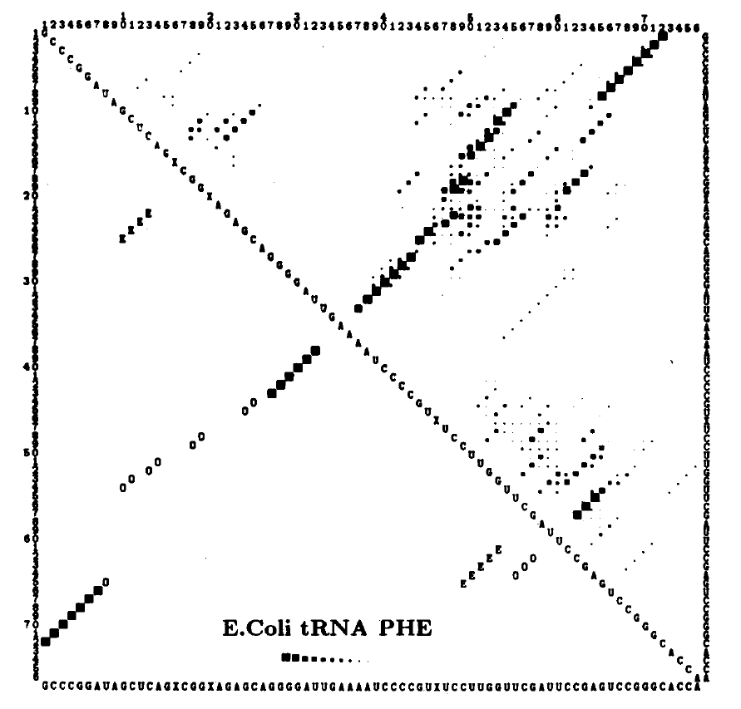
Secondary Structure – Overview
Minimum Energy
McCaskill’s Algorithm [Biopolymers 90]
Time – O(N³(
Space – O(N²)
[McCaskill ,Biopolymers 90]

Slide 6
LocaRNA reminder
[Will, PLOS 07]
$D_{ij;kl}=M_{ij−1;kl−1}+Ψ_{ij}^{Q}+Ψ_{kl}^{T}$
$M_{ij;kl}=max\left\{\begin{aligned}M_{ij−1;kl−1}+σ(Q_{j},T_{l}) \\ M_{ij−1;kl}+γ \\ M_{ij;kl−1}+γ \\ \max_{j^{′}l^{′}}{(M_{ij^{′}−1;kl^{′}−1}+D_{j^{′}j;l^{′}l})}\end{aligned}\right.$
Optimal global alignment - $M_{0|Q|;0|T|}$
Confined LocaRNA – limit deviation from given alignment

Slide 7
RNAplfold [ViennaRNA package, AMB 2011]
Single-base pairing probabilities
Results are averaged over all fixed size windows containing the base pair
Sum of probabilities:
Probability that a base is in the structure exterior (not in any loop or stem)
Probability that a base is in a loop

Slide 8
First Attempt
accessible binding sites oriented
Modified Smith Waterman (Local alignment)
Input: (sequence + probabilities vector) X 2
Prefers short accessible sequences to long matches of paired bases
(Score function in next slide)
Alignment results should be narrowed to binding site area only

Slide 9
Score function (1)
Definitions:
S = RNA sequence 1 (size n)
T = RNA sequence 2 (size m)
Sp = plfold probabilities for sequence 1 (size n)
Tp = plfold probabilities for sequence 2 (size m)
Parameters: match, mismatch, gap, offset
$\text{M}\text{[}\text{i}\text{,}\text{j}\text{] }\text{= }\text{max}\left\{\begin{aligned}0 \\ M\left[i−1,j−1\right]+σ\left(i,j\right)−offset \\ M\left[i,j−1\right]+g_{S}\left(j\right)−offset \\ M\left[i−1,j\right]+g_{T}\left(i\right)−offset\end{aligned}\right.$
$σ\left(i,j\right)=geo_avg(Sp\left[i\right],Tp\left[j\right]) ∙\left\{\begin{matrix}match & S\left[i\right]=T[j] \\ mismatch & else\end{matrix}\right.$
$g_{S}\left(j\right)=gap∙Tp\left[j\right]$
$g_{T}\left(i\right)=gap∙Sp\left[i\right]$

Slide 10
CLIP-Seq
[https://en.wikipedia.org/wiki/CLIP]

Slide 11
Data (1)
CLIP experiments results
Hundreds or thousands of ~50bp long sequences
We used proteins which are known (experimentally) to have an accessible BS
Mapped to the reference genome and extended to ±150bp
For each sequence a probabilities vector is calculated using RNAplfold

Slide 12
Benchmarking (1)
RNACompete
Alignment quality: Average over all 7-mers
Total quality: Sum of all qualities

Slide 13
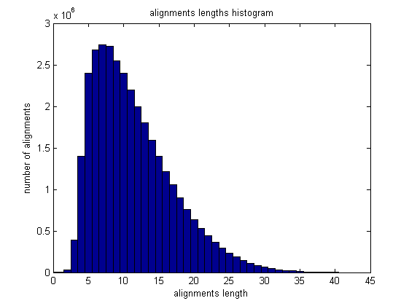
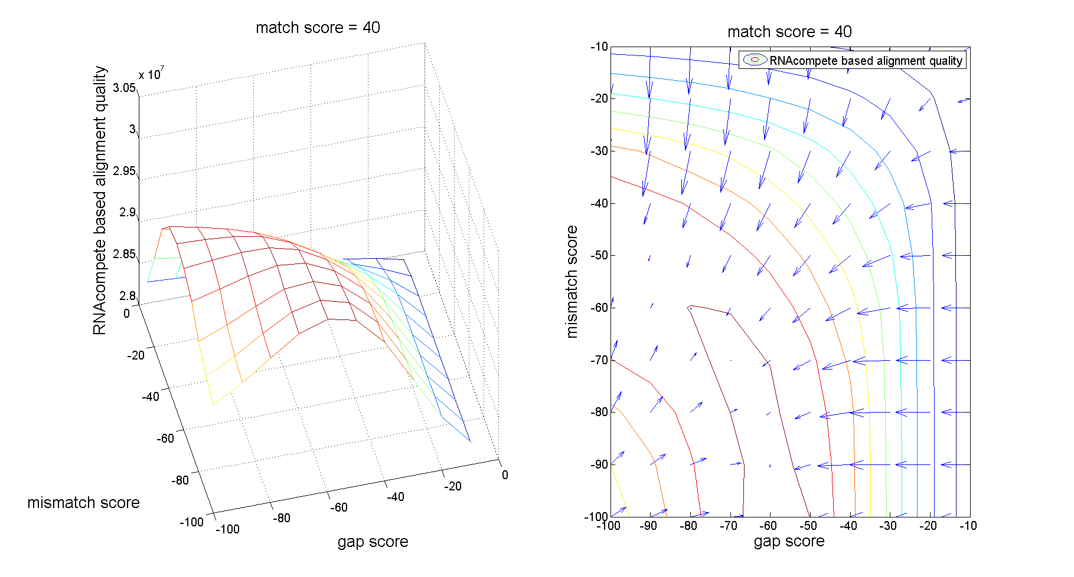
Results (1)

Slide 14
Results (1)
Classic LA gave better results!
Classic local alignment | Our best result
3.1058 e+07 | 3.0074 e+07

Slide 15
Second Attempt
Modified Needleman Wunsch (Global alignment)
Input: (sequence + probabilities vector) X 2
Adds probabilities similarity to the match score
(Score function on next slide)
No pin-pointing to binding site

Slide 16
Score function (2)
Definitions:
S = RNA sequence 1 (size n)
T = RNA sequence 2 (size m)
Sp = plfold probabilities for sequence 1 (size n)
Tp = plfold probabilities for sequence 2 (size m)
Parameters: match, mismatch, gap, ratio
$\text{M}\text{[}\text{i}\text{,}\text{j}\text{] }\text{= }\text{max}\left\{\begin{aligned}M\left[i−1,j−1\right]+σ\left(i,j\right)+match ×ratio×(1−\left|Sp\left[i\right]−Tp\left[j\right]\right|) \\ M\left[i,j−1\right]+gap \\ M\left[i−1,j\right]+gap\end{aligned}\right.$
$σ\left(i,j\right)=\left\{\begin{matrix}match & S\left[i\right]=T[j] \\ mismatch & else\end{matrix}\right.$

Slide 17
Data and Benchmarking (2)
BRAlibase II
Manually curated alignments – used as “Gold Standard” (2-5 sequences per alignment)
Categorized to 4 ncRNA families (g2intron, tRNA, rRNA, U5)
A secondary structure is also given for each alignment
Split into all possible sequence pairs (within each multiple alignment)
For each sequence a probabilities vector is calculated using RNAplfold
SPS (benchmark)
Percentage of reference alignments pairs found in result alignment
Averaged over all pairwise-alignment

Slide 18
Data (2) - tRNA

Slide 19
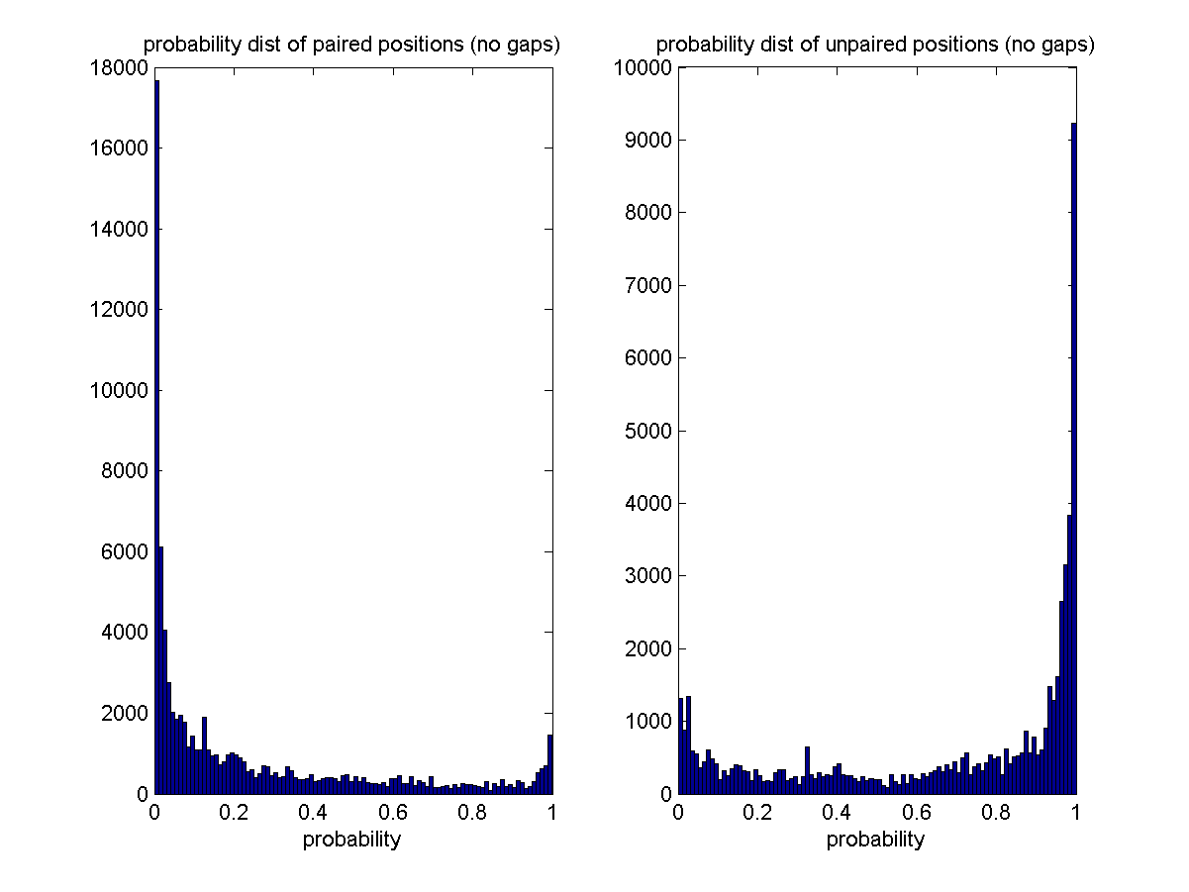
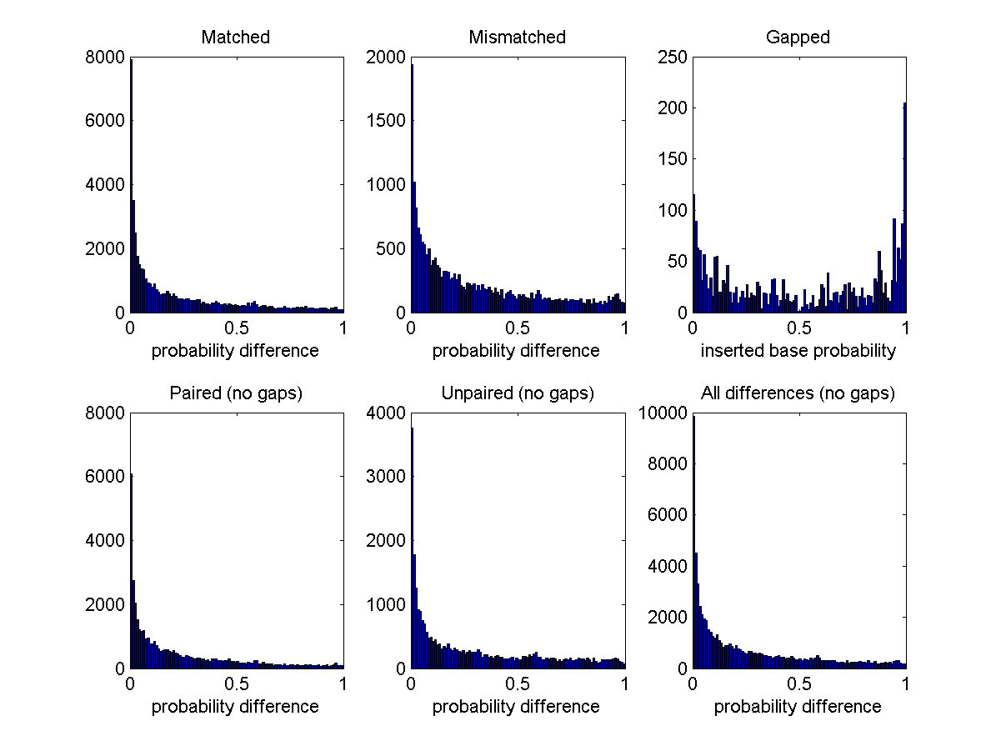
Data (2) - tRNA

Slide 20
Results (2)

Slide 21
Results (2)

Slide 22
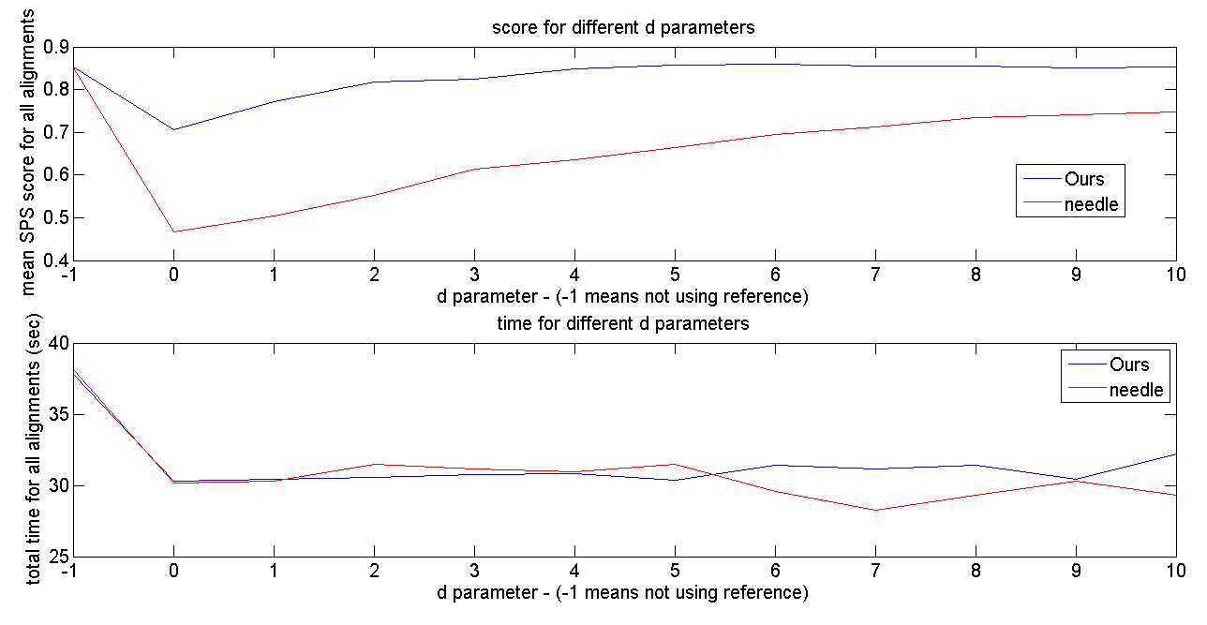
Applications
MSA
Confined LocaRNA
For ~500bp long sequences – 10 times faster
Gives better results compared to when using classic alignment as reference
Runtime Comparison
(~1000 pairs)
LocaRNA | Ours
8 minutes | ~7 seconds

Slide 23
Future Work
MSA
Progressive MSA using UPGMA hierarchy as guide tree
Consensus probability vector

Slide 24
Conclusion
O(N²) time complexity – same as Needleman-Wuncsh
Verified to be much faster then LocaRNA
More accurate results then classic, sequence based alignment

Slide 25
Questions?

Slide 26
Bibliography
doi:10.1088/1742-5468/2008/04/P04008 (http://iopscience.iop.org/1742-5468/2008/04/P04008/fulltext/)
McCaskill JS (1990) The equilibrium partition function and base pair binding probabilities for RNA secondary structure. Biopolymers 29: 1105–1119.
Will S, Reiche K, Hofacker IL, Stadler PF, Backofen R (2007) Inferring noncoding RNA families and classes by means of genome-scale structure-based clustering. PLoS Comput Biol 3(4): e65. doi:10.1371/journal.pcbi.0030065
A.F. Bompfuenewerer, R. Backofen, S.H. Bernhart, J. Hertel, I.L. Hofacker, P.F. Stadler, S. Will (2007), "Variations on RNA Folding and Alignment: Lessons from Benasque", J. Math. Biol.
Mückstein, U., Tafer, H., Hackermüller, J., Bernhart, S., Stadler, P.F., Hofacker, I.L.: Thermodynamics of RNA-RNA binding. Bioinformatics 22, 1177–1182 (2006)
R. Lorenz, S.H. Bernhart, C. Hoener zu Siederdissen, H. Tafer, C. Flamm, P.F. Stadler and I.L. Hofacker (2011), "ViennaRNA Package 2.0", Algorithms for Molecular Biology: 6:26

