Slide 1
Enhancer-Promoter Interactome
Shamir Seminar – Kobi Perl, 25.03.15
Notes:
University of Wisconsin, Madison, USA

Slide 2
Articles
He, B., Chen, C., Teng, L., & Tan, K. (2014). Global view of enhancer-promoter interactome in human cells. Proceedings of the National Academy of Sciences of the United States of America, 111(21), E2191–9. doi:10.1073/pnas.1320308111
Notes:
April 2014

Slide 3
The Plan
Background
Competing methods
IM-PET model
Random Forest
Performance Assessment
Observations Over Predictions
Discussion

Slide 4
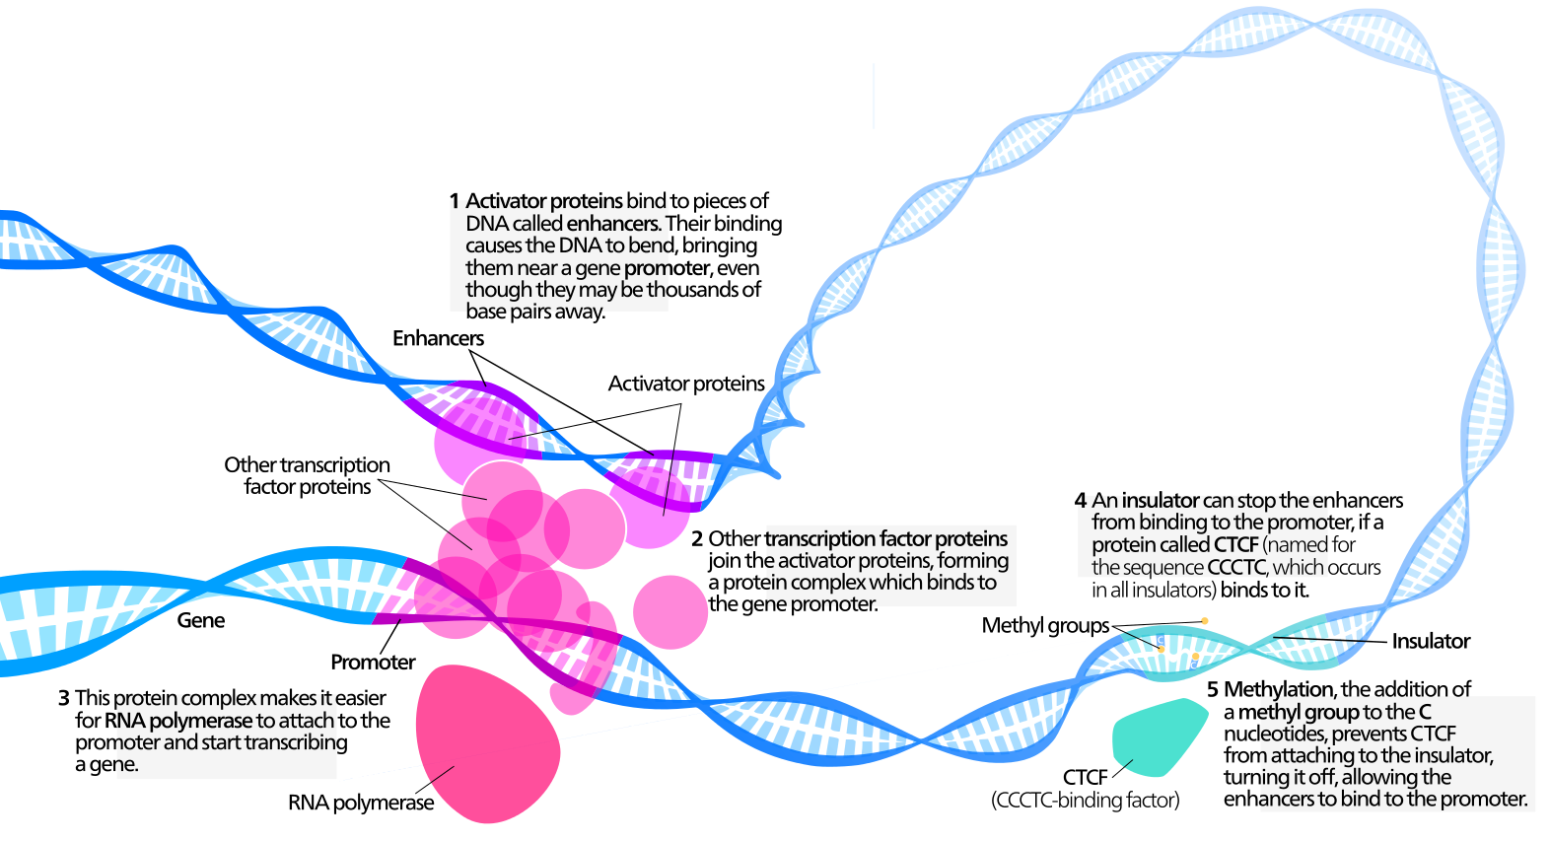
Background
Notes:
"Transcription Factors" by Kelvinsong - Own work. Licensed under CC BY 3.0 via Wikimedia Commons - http://commons.wikimedia.org/wiki/File:Transcription_Factors.svg#/media/File:Transcription_Factors.svg

Slide 5
Background
Enhancers are hypothesized to fine-tune target transcript levels.
Number of putative enhancers in a cell: 50,000-100,000
How enhancers select specific promoters for activation?
Not only adjacent promoters – but promoters positioned tens of kilobases away.
Upstream or downstream from the promoters.
Cell-type specific pairs.
Notes:
in a cell (mammalian)
Taken from:
Corradin, O., Saiakhova, A., Akhtar-zaidi, B., Myeroff, L., Willis, J., Á, R. C., … Scacheri, P. C. (2014). Combinatorial effects of multiple enhancer variants in linkage disequilibrium dictate levels of gene expression to confer susceptibility to common traits, 1–13. doi:10.1101/gr.164079.113.

Slide 6
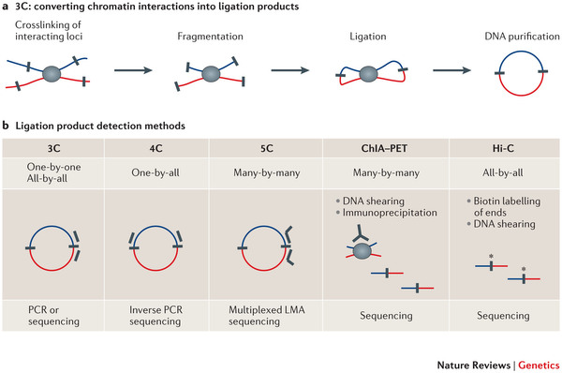
Background
Experimental methods to measure direct physical contact:
Notes:
From:
Exploring the three-dimensional organization of genomes: interpreting chromatin interaction data
Job Dekker, Marc A. Marti-Renom & Leonid A. Mirny
Explanation:
In chromosome conformation capture (3C)-based methods (see panel a of the figure), cells are crosslinked with formaldehyde to link chromatin segments covalently that are in close spatial proximity. Next, chromatin is fragmented by restriction digestion or sonication. Crosslinked fragments are then ligated to form unique hybrid DNA molecules. Finally, the DNA is purified and analysed. The different 3C-based methods differ only in the way that hybrid DNA molecules, each corresponding to an interaction event of a pair of loci, are detected and quantified (see panel b of the figure). In classical 3C experiments, single ligation products are detected by PCR one at the time using locus-specific primers. Given that 3C can be laborious, most 3C analyses typically cover only tens to several hundreds of kilobases. 4C (also known as 'circular 3C' or '3C-on-chip') uses inverse PCR to generate genome-wide interaction profiles for single loci^{48, 105, 106}. 5C combines 3C with hybrid capture approaches to identify up to millions of interactions in parallel between two large sets of loci: for example, between a set of promoters and a set of distal regulatory elements^{46, 107, 108}. 4C approaches are genome-wide but are anchored on a single locus. 5C analyses typically involve two sets of hundreds to thousands of restriction fragments to interrogate up to millions of long-range interactions that can cover up to tens of megabases and that can be contiguous or scattered among loci of interest throughout the genome. The Hi-C method was the first unbiased and genome-wide adaptation of 3C and includes a unique step in which, after restriction digestion, the staggered DNA ends are filled in with biotinylated nucleotides (as shown by the asterisks)⁶⁴. This facilitates selective purification of ligation junctions that are then directly sequenced. Hi-C provides a true all-by-all genome-wide interaction map, but the resolution of this map depends on the depth of sequencing. When several hundred million read pairs are obtained, as is currently routine, chromatin interactions in the mouse or human genome can be detected at 100 kb resolution.
Other 3C variants have recently been described that differ in molecular details but that all generate comprehensive and genome-wide interaction maps^{28, 47, 57, 75}. Interestingly, technology development has now gone full circle back to 3C: the classical 3C method is no longer used only for analysing interactions one at the time by PCR but is now also used for genome-wide interaction mapping as the resulting complete 3C DNA ligation mixture can be directly sequenced on modern deep-sequencing platforms⁵⁷. Finally, various approaches combine 3C with chromatin immunoprecipitation to enrich for chromatin interactions between loci bound by specific proteins of interest^{109, 110}. For instance, the chromatin interaction analysis by paired-end tag sequencing (ChIA–PET) method allows for genome-wide analysis of long-range interactions between sites bound by a protein of interest. Because ChIA–PET data represent a selected subset of interactions that occur in the genome, the three analysis approaches described in this article cannot directly be applied to this data type. LMA, ligation-mediated amplification.
ChIA-PET = Chromatin Interaction Analysis by Paired-End Tag Sequencing

Slide 7
Background
Pros and Cons:
3C and 4C are not genome-wide.
Hi-C
Genome-Wide.
BUT has 1Mbp resolution.
ChIA-PET
High resolution like 3C, focusing on interactions of interest.
BUT technically challenging and have high FNR.
Solution:
Computational work?
Notes:
FNR = False negative rate

Slide 8
Previous Experimental Works
Standard Method – Nearest promoter.
PreSTIGE - pairing cell type-specific H3K4me1 signals with genes that are specifically expressed in each cell type across a panel.
Ernst et al. - histone modification profile correlation between nearest candidate pairs with 125-kbp distance.
Thurman et al. - predicts EP pairs using DNase I hypersensitive site (DHS) correlation of all candidate pairs within 500-kbp distance.
Notes:
PreSTIGE – מעצם ספציפי לתא לכל הפרומוטורים לגנים ספציפיים לתא, בתוך טווח של 100kb שלא נקטע ע"י CTCF.

Slide 9
Previous Experimental Works
Problems:
Some methods focus only on nearest promoter.
Methods only use limited types of genomic features.
No performance comparison!

Slide 10
IM-PET
Random-Forest classifier to distinguish real enhancer-promoter pairs from all pairs
Positive set (~1000 pairs for each dataset):
Based on ChIA-PET data for K562 and MCF-7 cells (anti-RNA polymerase II antibody).
Pairs were selected using stringent ChIA-PET threshold and evidence of active enhancers and promoters.
Negative set (matched):
Contact frequency between two non-interacting genomic loci in a chromatin fiber is a function of the site separation distance s:
$$f\left(s\right)=k∗s^{−\frac{3}{2}}∗e^{−\frac{1,400}{s^{2}}}$$
For each enhancer → randomly select a site based on the contact frequency distribution → select the closest promoter to that site (not detected by ChIA-PET) as the candidate target.
Notes:
K562 – Leukemia, MCF-7 – Breast cancer.
Stringent threshold: CSI-ANN to identify enhancers + 1. cis interactions with ≥ 5 PET counts. 2. one interacting site contains p300 site but not promoter, and the other interacting site contains promoter but not p300 site. 3. promoters need to be expressed based on matching RNA-Seq.
Negative set: We want to differ between non-specific interactions and specific interactions, not between non-interacting and interacting, and that is why it is important to use this interaction distribution to begin with.

Slide 11
IM-PET - Features
Enhancer and target promoter activity profile correlation (EPC).
Transcription factor and target promoter correlation (TPC).
Coevolution of enhancer and target promoter (COEV).
Distance constraint between enhancer and target promoter (DIS).

Slide 12
IM-PET - Features
Enhancer and target promoter activity profile correlation (EPC)
Enhancer activity –
Score computed by the authors previously developed CSI-ANN algorithm for predicting enhancers.
Using histone modification signature.
Promoter activity –
Using FPKM values.
Comment 1: CSI-ANN was trained to identify enhancers, not to predict their activity level.
Comment 2: The authors are not using promoter modification patterns, although they may be relevant.
Notes:
Comment = my comment
CSI-ANN chromatin signature identification by artificial neural network
אומן להחליט מה הוא enhancer ומה לא, עפ"י מידע על 6 מודיפיקציות היסטונים.
שיפור בטרנספורמציית המידע לעומת כלים קודמים – הקודמים השתמשו ללמידה רק ברמה הממוצעת של המודיפיקציות בחלון, ואילו הם גם משתמשים במדד של אנרגיה שאומד גם את השינוי בחלון.
שיפור ב-Feature Extraction – לא משתמש בכל המודיפיקציות בנפרד כפיצ'רים אלא מבצע טכניקה של הורדת מימד בשם FDA.
שימוש באלגוריתם למידה מסוג time-delay neural networks – כדי לקבל אלגוריתם שפועל באופן דומה ל-HMM.
65.5% רגישות ו 66.3% Positive Predictive Value, שיפור ב 5.9% ו11.6% על שיטות שקדמו למאמר.
חשוב לציין כי ה-score שהם מדברים עליו התקבל מתהליך למידה של "מהו enhancer" ולא "כמה enhancer חזק".

Slide 13
IM-PET - Features
Transcription factor and target promoter correlation (TPC)
For an enhancer to regulate a protein TFs are needed.
For transcription factors that bind to an enhancer.
According to the motif.
calculating binding probabilities → top 5 TFs for an enhancer.
Transcription factor activity –
Using TF expression (FPKM).
Promoter activity –
Using FPKM values.
Notes:
More details about calculating binding probabilities from the PSSM – in the text.

Slide 14
IM-PET - Features
Coevolution of enhancer and target promoter (COEV)
The hypothesis is that true EP pairs tend to coevolve.
Measures of co-evolvement:
Sequence similarity
Conserved synteny - preserved co-localization of genes on chromosomes of different species.
Integrating to a single COEV score.
$$COEV=\sum_{s=1}^{14}{δ_{s}∗AS_{e,s}∗AS_{p,s}}$$
$δ_{s}$ - synteny score. 1 if the distance between an enhancer and a promoter is less than 2 Mbp in species s, otherwise 0.
$AS_{e,s}$\$AS_{p,s}$ - Normalized sequence similarity scores for enhancer\promoter.
Notes:
Sequence similarity is not enough as – TFBS within enhancers and promoters have high turn-over rate.
14 homologous species.
alignment free algorithm ALF - to compute sequence similarity scores (48). Important – because the order of TFBS in enhancers and promoters is not necessarily conserved.
synteny score, δs, for each EP pair in species s. It equals to 1 if the distance between an enhancer and a promoter is less than 2 Mbp in species s, otherwise 0. We used the Liftover tool to find the syntenic regions covering every enhancer and promoter, and computed synteny scores for each EP pair in the training set based.

Slide 15
IM-PET - Features
Distance constraint between enhancer and target promoter (DIS)
The location relative to the target promoter is not strictly constrained.
Empirical data do show a trend toward shorter distance -
Showing a monotonic decline in the frequency of EP pairs with increasing distance.
Comment: No use of CTCF data to define region borders within EP interactions can occur.
Notes:
CTCF data is used for instance in PreSTIGE

Slide 16
IM-PET - Features
Notes:
“real pairs,” pairs selected using K562 and MCF-7 ChIA-PET data;
“non-pairs,” noninteracting pairs according to ChIA-PET data;
“all pairs,” EP pairs formed by extracting all promoters within 2 Mbp of an enhancer.
“nearest pair,” EP pair in which the promoter is closest to the enhancer among all promoters in the genome.
מאד מבלבל – איך ל-all pairs יש ממוצע נמוך יותר של EPC, גם מ-real pairs וגם מ-non-pairs.
P-values – t-tests.
להתמקד על DIST.

Slide 17
ML - Tree
world state
is it raining?
no
yes
is the sprinkler on?
P(wet)
= 0.95
no
yes
P(wet) = 0.1
P(wet) = 0.9
Taken from: http://www.iis.ee.ic.ac.uk/~tkkim/iccv09_tutorial
Notes:
Taken from: http://www.iis.ee.ic.ac.uk/~tkkim/iccv09_tutorial

Slide 18
ML - Randomized Learning
Recursively split examples at node n
set I_{n} indexes labelled training examples (v_{i}, l_{i}):
At node n, P_{n}(c) is histogram of example labels l_{i}
left split
right split
threshold
function of
example i’s feature vector
Taken from: http://www.iis.ee.ic.ac.uk/~tkkim/iccv09_tutorial

Slide 19
ML - Randomized Learning
left split
right split
Features $f\left(v\right)$ chosen at random from feature pool $f∈F$
Thresholds t chosen in range
Choose f and t to maximize gain in information
Entropy E calculated from histogram of labels in I
Taken from: http://www.iis.ee.ic.ac.uk/~tkkim/iccv09_tutorial

Slide 20
ML - Randomized Learning
How many features and thresholds to try?
just one = “extremely randomized” [Geurts et al. 06]
few -> fast training, may under-fit, maybe too deep
many -> slower training, may over-fit
When to stop growing the tree?
maximum depth
minimum entropy gain
delta class distribution
pruning
Taken from: http://www.iis.ee.ic.ac.uk/~tkkim/iccv09_tutorial

Slide 21
ML - Forest
leaf nodes
Forest is ensemble of several decision trees
classification is
split nodes
v
v
tree t₁
tree t_{T}
……
category c
category c
$$\frac{1}{T}$$
Taken from: http://www.iis.ee.ic.ac.uk/~tkkim/iccv09_tutorial

Slide 22
ML – Forest Learning
Divide training examples into T subsets $I_{t}⊆I$
improves generalization
reduces memory requirements & training time
Train each decision tree t on subset I_{t}
same decision tree learning as before
Multi-core friendly
Taken from: http://www.iis.ee.ic.ac.uk/~tkkim/iccv09_tutorial
Notes:
This is the bagging part.
Sometimes – a subset of the features is selected for each tree.

Slide 23
IM-PET Forest Learning
Rule for deciding on the number of random features used for building each tree = square root of the number of features available.
Two level of randomness (dataset selection + Feature selection) → Robustness to noise, outliers, and overfitting.
Thousands of trees in the RF model –
Using ~4000 data points (~1000 pos. + ~1000 matched neg. * 2 cell types)
Overfitting should not be a problem under this scenario.
Notes:
Enhancers – מ-CSI-ANN (FDR 5%) אורך 2kbp, Promoters (מ-GENCODE, 2kbp מעל TSS ו-0.5kbp מתחת).
בשימוש במודל – מגבילים את ההסתכלות 2Mbp קדימה ואחורה, זה constraint על מרחק שנועד בעיקר לקצר זמן חישוב.
לנקודה הראשונה: לוודא שהם זוכרים שזה 2.
כל עץ השתמשו ב-2/3מהמידע.

Slide 24
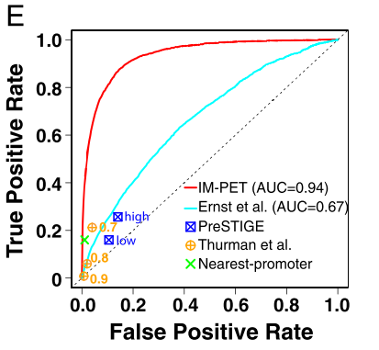
Performance Assessment
Comparison: 5-fold CV, Visualization: ROC curves
TP/(TP+FN)
IM-PET – 94%
Ernst et al. – 67%
FP/(FP+TN)

Slide 25
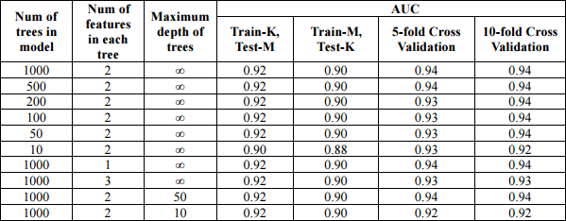
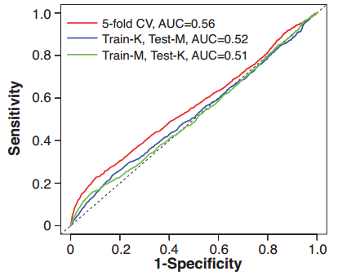
Performance Assessment
Robustness to parameter change
Train by one dataset and test on another – shows minor overfitting
Training using scrambled training data gives very poor results in predicting real pairs.
Notes:
Scrambled training data – positive promoters are matched to a different enhancer than the original one (with same spatial, and histone modification properties)
Not shown here: they tried SVM and logistic regression – also good ROC curves. Also best using all 4 features.

Slide 26
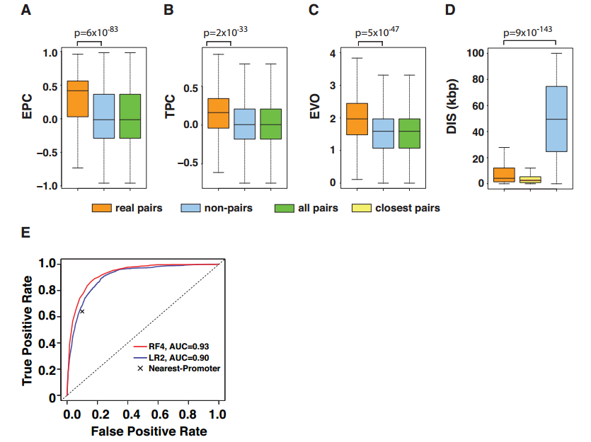
Performance Assessment
The four features are also good for prediction in drosophila.

Slide 27
Prediction EP Pairs –
12 human cell types
Total enhancer number (CSI-ANN): ~208 K
Averaging 17 K enhancers per cell type.
84% overlap with at least one other mark of enhancers (distal DHS, sequence conservation, p300 site).
Total promoter number (RNA-seq+GENCODE): ~162 K
Total EP-pairs (IM-PET, FDR 0.01): ~442 K
Averaging 37 K pairs per cell type.

Slide 28
EP Pairs Validation
Using orthogonal databases based on:
ChIA-PET (K562, MCF-7, CD4+ T cells)
Hi-C (IMR90 cells)
Expression quantitative trait locus (GM12878, Hep2 cells)
$$F_{1}=2⋅\frac{\text{precision}⋅\text{recall}}{\text{precision}+\text{recall}}$$
Notes:
eQTLs are genetic variants associated with the expression of a gene.

Slide 29
EP Pairs Validation
Experimental validation (Using 3C-qPCR):
Nine randomly selected predictions.
GM12878 – four pairs, K562 – three pairs, Both – one pair
None are nearest-pairs
None were previously detected using 5C or ChIA-PET studies
3C-qPCR in both cell types, 16 experiments in total
81% validation rate (13 / 16)
Comparable to the estimated FPR on one 5C experiment (20-47%)
Notes:
למטה דוגמא לקשר שקיים ב-K562 ולא ב-GM12878 לפי החיזוי. מימין ניסוי הולידציה שלו (פריימרים של Ctrl אינם ממוקמים על ה-enhancer אלא לידו)

Slide 30
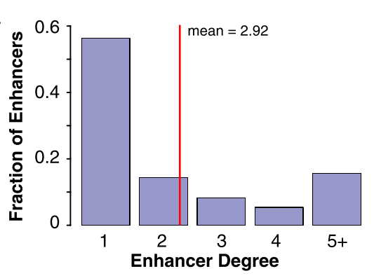
Observations Over Predictions
Enhancers participate in multiple EP-pairs:
Notes:
(ממצא שולי, אבל נחוץ כדי לקבל תמונה מלאה)

Slide 31
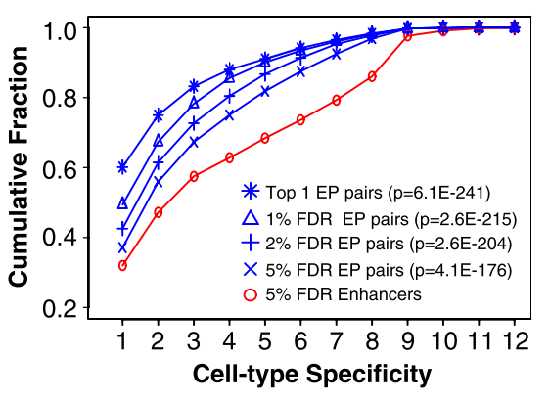
Observations Over Predictions
EP Interactions Have Higher Cell Type Specificity than Enhancers:
For example:
32% of enhancers are unique to a single cell type.
49% of EP-Pairs are unique to a single cell type.
Notes:
רואים שה-enhancers הם פחות cell type specific (הם מופיעים ביותר cell types). ההשוואה בין העקומות היא באמצעות KS test.

Slide 32
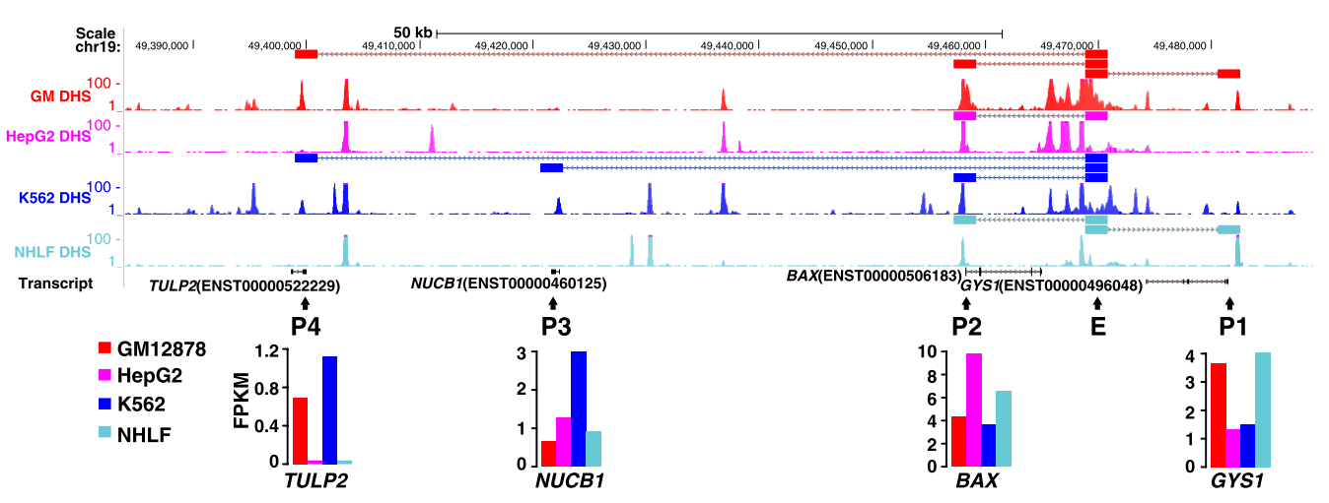
Observations Over Predictions
Notes:
דוגמא ל-enhancer שהוא Non-specific כי הוא מופיע ב-4 סוגי תאים, אבל בכל אחד המטרות קצת שונות.
בחלק התחתון – ערכי ה-FPKM שמאשרים את הפעילות הייחודית.

Slide 33
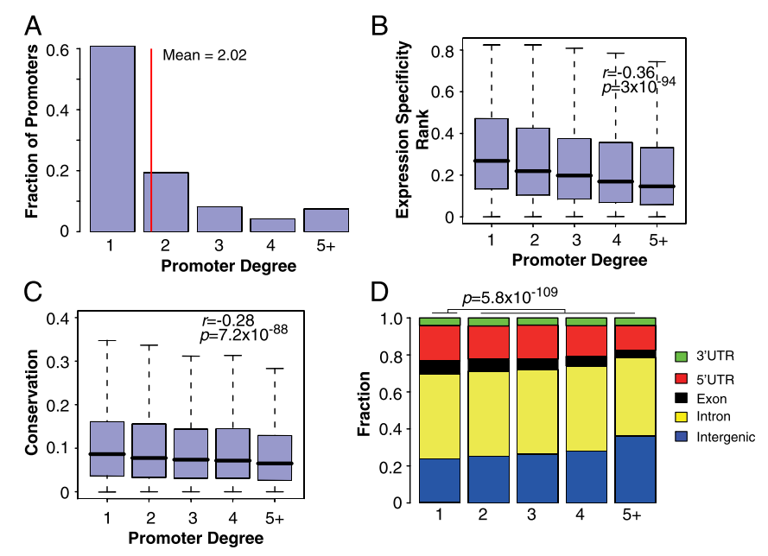
Observations Over Predictions
Promoters with High Expression Specificity Are Regulated by Multiple Enhancers That Have Lower Conservation Levels.
High degree → More specific expression
High degree → Enhancers located in intergenic regions
High degree → Less enhancer conservation
Notes:
Specifity:
using an entropy-based measure that quantifies the skewness of expression level toward a given cell type.
(בעיקרון אם יש אנטרופיה נמוכה, וגם ביטוי יחסי מאד גבוה ב-cell line מסויים, נאמר שהוא cell specific)
A – רואים ש-promoter-ים מושפעים ע"י מספר enhancers (בממוצע 2), 40% מושפעים מיותר מ-1.
B – פרומוטר שמושפע מהרבה enhancers – מייצר ביטוי יותר ספציפי (מבחן קורלציה). (גם הפרומוטורים הללו מקושרים לגנים עם GO enrichment שקשור לאותו סוג תא)
C - פרומוטר שמושפע מהרבה enhancers – אותם enhancers פחות שמורים (מבחן קורלציה).
D - פרומוטר שמושפע מהרבה enhancers – אותם enhancers נוטים להיות intergenic (מבחן פרופורציה).
השערה: ה-shadow promoters מספקים מנגנון גיבוי לביטוי הספציפי לסוג תא. לכן, צריך הרבה בגנים שיותר חשוב שיהיו ספציפיים.

Slide 34
Observations Over Predictions
Cohesin Mediates Chromatin Loop Formation and Regulates Cell Type-Specific Gene Expression in the Absence of CTCF.
CTCF has been suggested to mediate EP loop formation.
Cohesin complex colocalize with CTCF and is facilitating.
Cohesin was recently suggested to work alone.
Using ChIP-Seq data:
Found pairs of CTCF and cohesin binding sites that overlap with the predicted EP pairs
Cohesin-not-CTCF (CNC), cohesion-and-CTCF (CAC)

Slide 35
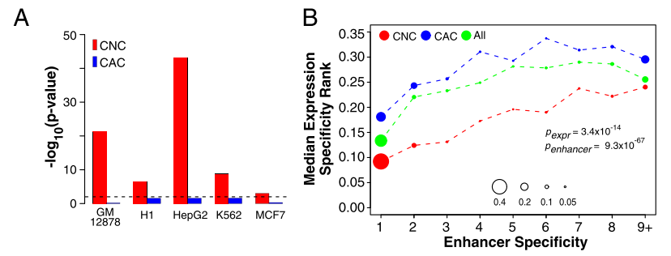
Observations Over Predictions
Mirrored CNC but not CAC sites significantly overlap with predicted EP pairs
CNC involved enhancers and promoters, are cell-type specific.
TFs overlapping CNC sites show higher expression specificity than those overlapping CAC sites.

Slide 36
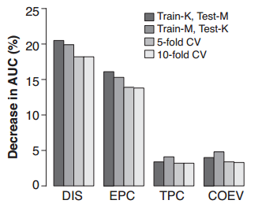
Discussion
Required data:
Genome sequence
Three histone modification ChIP-Seq
RNA-Seq/microarray data
Distance constraint:
Distance should not be a strict constraint.
Features:
DIC and EPC contribute the most.
Possible features to incorporate:
Preference of enhancers for certain classes of promoters
Existence of tethering elements in promoters that capture enhancers
Notes:
Data – The later two becomes more and more available. Also histone modification data can be replaced (with DHS + transcriptional activator)

Slide 37
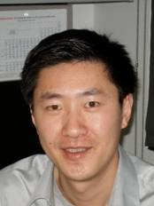
Availability
List of predicted EP pairs:
www.healthcare. uiowa.edu/labs/tan/EP_predictions.xlsx
Software:
www. healthcare.uiowa.edu/labs/tan/IM-PET_Package.tgz
Kai Tan
kai-tan@uiowa.edu
Ph.D., Washington U., Saint Louis
Notes:
Kai Tan – PI, corresponding author

Slide 38
Why this is interesting?
This is a new field:
The prediction algorithm can probably be improved.
The full potential of using the predicted targets was not explored.
Importance in GWAS:
Loci with signature enhancer features are highly enriched for genetic risk variants relative to other chromatin-defined elements.
Risk variants preferentially map to enhancers specific to disease-relevant cell types in both cancer and other common diseases
Corradin, O., Saiakhova, A., Akhtar-zaidi, B., Myeroff, L., Willis, J., Á, R. C., … Scacheri, P. C. (2014). Combinatorial effects of multiple enhancer variants in linkage disequilibrium dictate levels of gene expression to confer susceptibility to common traits, 1–13. doi:10.1101/gr.164079.113.
Notes:
Corradin, O., Saiakhova, A., Akhtar-zaidi, B., Myeroff, L., Willis, J., Á, R. C., … Scacheri, P. C. (2014). Combinatorial effects of multiple enhancer variants in linkage disequilibrium dictate levels of gene expression to confer susceptibility to common traits, 1–13. doi:10.1101/gr.164079.113.

Slide 39
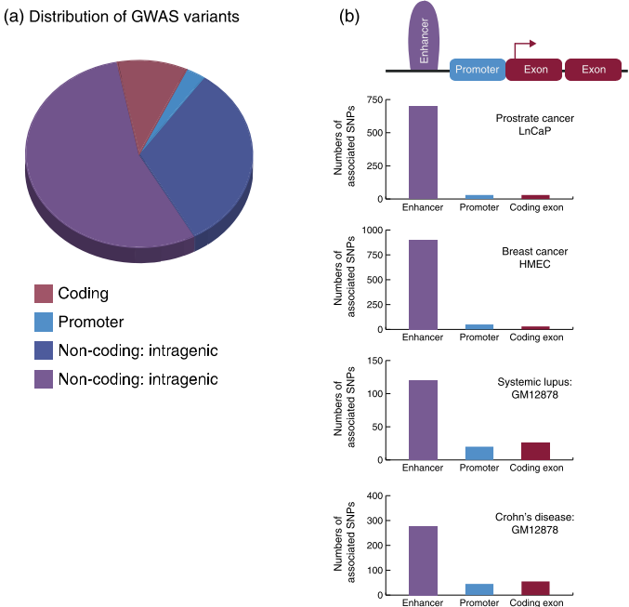
Why this is interesting?
My idea:
Two-step GWAS:
First stage – enhancer variants
Second stage – Focusing on their targets, can a variant in these can also be causative?
Corradin, O., Saiakhova, A., Akhtar-zaidi, B., Myeroff, L., Willis, J., Á, R. C., … Scacheri, P. C. (2014). Combinatorial effects of multiple enhancer variants in linkage disequilibrium dictate levels of gene expression to confer susceptibility to common traits, 1–13. doi:10.1101/gr.164079.113.
Notes:
Corradin, O., Saiakhova, A., Akhtar-zaidi, B., Myeroff, L., Willis, J., Á, R. C., … Scacheri, P. C. (2014). Combinatorial effects of multiple enhancer variants in linkage disequilibrium dictate levels of gene expression to confer susceptibility to common traits, 1–13. doi:10.1101/gr.164079.113.

Slide 40
Kobi Perl
kobipe3@gmail.com
Department of Human Molecular Genetics and Biochemistry
Sackler School of Medicine
Tel Aviv University

