Slide 1
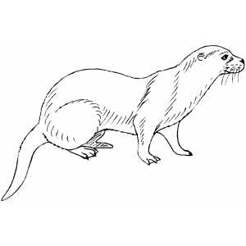
Mink: a streaming de novo assembler for paired-end reads
Gil Goldshlager, Roye Rozov
Shamir Group Meeting 12/8/2015

Slide 2
Contents
Overview
Background info
Our method
Results
Next steps

Slide 3
Part 1: Overview

Slide 4
De novo assembly
Given a short-read data set, re-construct the source genome
Current solutions vary in assembly quality and resource use
Some application specific de novo assemblers available – RNA-Seq, metagenomes – which diverge mainly on coverage assumptions

Slide 5
De novo assembly scaling issues
Stark trade-off between low resource use and good quality
Assemblers that explicitly represent all k-mers or all reads require huge amounts of memory for large genomes and metagenomes
All current tools require storing the whole read set on disk

Slide 6
Goal: high quality streaming assembly
Assemble a dataset without storing it on disk
Pull down reads one by one, storing only the assembly graph locally
Under these restrictions, still produce a high quality assembly!
Capture paired end and read-length-level info
Make intelligent decisions about simplifying the assembly graph

Slide 7
Part 2: Background

Slide 8
De Bruijn graph representation of a read set
ACTCCG
GACT
CGAC
CCGA
ACTCAAG
ACTC
CTCC
TCCG
CAAGACTC
TCCGACTC
CTCA
TCAA
CAAG
Genome: CTCCGACTCAAGACT, or
CTCAAGACTCCGACT
GACT
AGAC
AAGA

Slide 9
Bloom filter review
Low memory set membership data structure, allows you to
Insert element to set
Query whether an element is in the set
But has false positives! Some extra elements will look like they’re in the set.

Slide 10
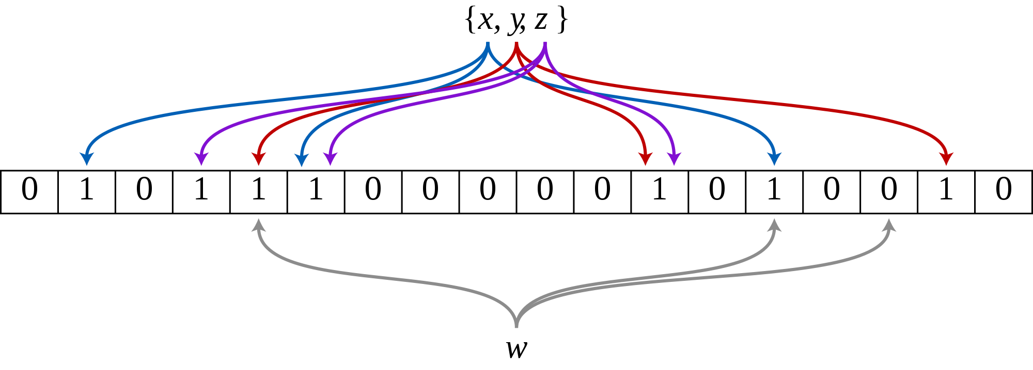
Bloom Filter Data Structure

Slide 11
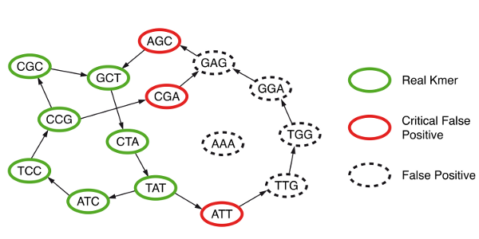
Bloom Filter DBG Representation

Slide 12
Minia review
Identify all solid k-mers in the reads, write to disk
Query every neighbor of every k-mer in the reads to find the set of solid k-mers + critical false positives
Use solid k-mers to filter and obtain set of only FPs
Simple traversal of the resulting de Bruijn graph to produce an assembly

Slide 13
Identifying false positives
Potential CFPs
AAC CGC
Solid k-mers
A
C
G
T
A
C
G
T
GCG GTC
A
C
G
T
ACG
CGT
GTT
ACA
CAT
A
C
G
T
TGG TTC
A
C
G
T
A
C
G
T
AAC TAC CAT CAA CAG CAC
A
C
G
T
A
C
G
T
A
C
G
T
A
C
G
T
TCA ATG ATT

Slide 14
Part 3: Our Method

Slide 15
Overall algorithm
First pass of reads: for each read, insert all k-mers seen into a Bloom filter
Gives summary of read k-mer content
Scan reads again; along each read, query the bloom filter for extensions to find junctions
Gives coverage, branching, and pairing info
Build, clean, and simplify graph
Output contigs

Slide 16
Step 1: Load bloom filter
Problem: at high coverage there are too many errors to store every k-mer seen
Solution: use two Bloom filters:
Insert every k-mer seen into the first filter
Insert into the second filter only if the first already contains the element
Result: only keep k-mers that occur at least twice, plus a few extra from false positives

Slide 17
Step 2: Scan the reads
For each read, first make sure every k-mer on the read is in the Bloom filter
If so, process the read for junctions, left to right

Slide 18
Processing one read
ACTTTGGCTACCTAGACGACGCTTATCTAATGACTAAGAAAAATGTTGTGTGGCACATGA
Identify junctions in forward and reverse complement directions
Update coverage counts at each extension out of each junction
Store distances between adjacent junctions
Store auxiliary junction pairing info to aid in graph simplification later on
This Read
Other reads
False positive
Junction
Junction link

Slide 19
Read scan: read with no junctions
ACTTTGGCTACCTAGACGACGCTTATCTAATGACTAAGAAAAATGTTGTGTGGCACATGA
We rely on junctions to speed up processing when we see the same sequence over and over
Problem: on long linear regions of the genome, there are no junctions
Solution: create a fake junction with skipping info to the beginning and end of the read
Fake junctions are treated the same as real junctions, but are eliminated before graph simplification and assembly
This Read
Other reads
False positive
Fake Junction
Junction link

Slide 20
Removing dependence on k: junction pairs
Goal: capture long distance information to clean graph later on
Each read represents a valid path in the genome
Paired end reads represent longer connections that we would like to follow if possible

Slide 21
Processing two paired end reads
ACTTTGGCTACCTAGACGACGCT
XXXXXXXXXXXXXXXXXXXXXXXXXXXXXXXXXX
ACTTCGATTTACTAGGGGACGCT
Steps:
Identify pairs of junctions that will be informative for graph simplification
Throw them into a bloom filter!
Sequenced read
Unsequenced
Other reads
False positive
Junction
Junction Link
Junction Pair

Slide 22
Step 3: Graph simplification
Use coverage and structure of graph to simplify
Remove tips, bubbles
Remove connections that look like errors

Slide 23
More simplification: resolving tangles
A
C
B
D
4 possible paths: A-C, A-D, B-C, B-D
Which are valid? Consult paired info.
Only A-C and B-D!

Slide 24
Disentanglement

Slide 25
Part 4: Results

Slide 26
30M reads simulated from chr20
Program | Time to run (minutes) | Peak memory use | NGA50 | % reference covered by contigs | Genome covered by misassembled contigs | Longest alignment (kbp)
Mink | 73 | .5 GB | 919 | 64% | 0% | 10
Minia 1.6 | 72 | .1 GB | 1386 | 68% | 0% | 20
Minia 2.0 (1 thread) | 35 | 1.5 GB | 1387 | 68% | 0% | 20
SPAdes (16 threads) | > 250 | 18 GB | 17664 | 91% | 1.6% | 200

Slide 27
90M reads from human genome
Program | Time to run (minutes) | Peak memory use
Mink | 390 | 8GB
Minia 1.6 | 170 | 2.2GB
Minia 2.0 (1 thread) | 580 | 20GB
SPAdes | Didn’t finish | Needed more than 128GB RAM

Slide 28
50x coverage of whole human genome
Program | Days to run | Peak memory use | Disk space used during run
Mink | 3 | 28 GB | < 1 GB for run
Minia 1.6 | 1 | 5.7GB | > 100 GB

Slide 29
Part 5: Next Steps

Slide 30
Flesh out assembly using paired ends
When can a tangle be resolved?
When can a tip be trimmed?
When can a bubble be collapsed?
Use coverage and paired ends to answer these questions

Slide 31
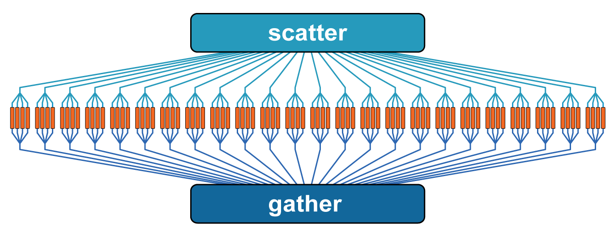
Parallelization
Bloom filter load is very parallelizable
Graph simplification mostly parallelizable since it happens locally in the graph
Read scan not as straightforward- can run separate threads on separate parts of the read set, but need to resolve the results

Slide 32
Thanks!

