Slide 1
Tutorial: Large scale inference
David Amar
Group meeting
March 2015

Slide 2
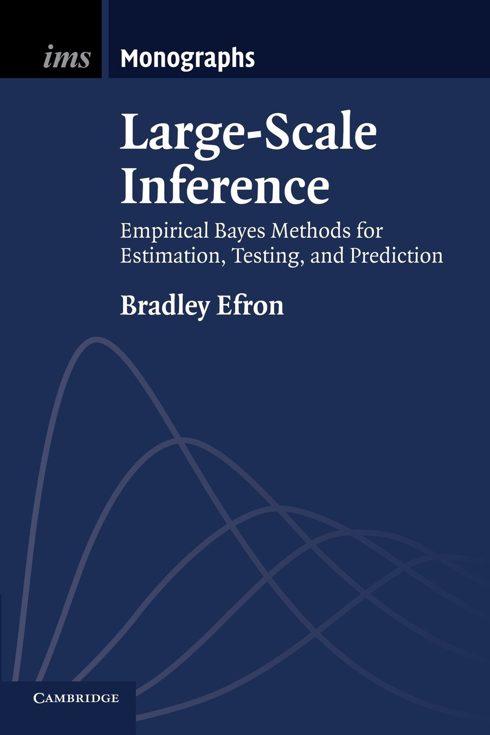
Main source
Bradley Efron
Statistics, Stanford
Pioneer of many fields
Bootstrap
Empirical Bayes
Inference methods
Statistical learning
I will focus on basic concepts
See my summary with proofs and exercises in gaga/davidama/paper_and_book_reports/large_scale_inference/efron_book_sammray.pdf

Slide 3
Empirical Bayes

Slide 4
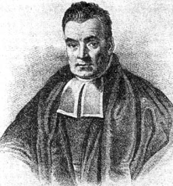
Statistical estimation
Observed data D
We wish to learn a parameter θ
MLE: find an estimator that maximizes L(θ) = P(D;θ)
Bayesian: treat θ as a random variable
Possible estimators: MAP, Posterior expected value, etc.
likelihood
Bayes Theorem:
Pr(θ|D) = Pr(D|θ) . Pr(θ)
Pr(D)
posterior
prior

Slide 5
Empirical Bayes
We usually don’t know the prior distribution
Estimate it from the data!
Theoretical justification: James-Stein (1961)
Data: a single vector of size N - z, assume:
A standard situation: a set of independently corrupted parameters
MLE?

Slide 6
James-Stein estimators
The key point: look at f(z)
Wait, we can now estimate A!
…

Slide 7
Big deal, so what?!
Total squared error is a frequentist way to measure goodness of estimator
This is the expected MSE if we treat µ as an unknown fixed value
MSE depends on the bias and variance; MLE has no bias, but it has a high variance
We are beating the MLE in its own game!

Slide 8
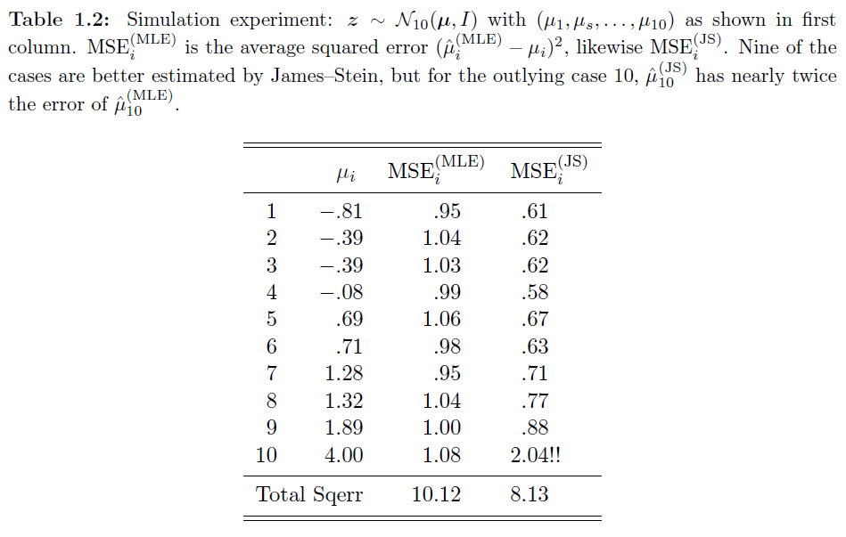
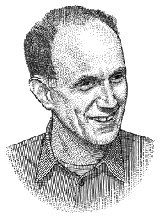
An example
This is an example of a shrinkage effect
A word from Efron
Classic statistics are conservative in protecting individual inferences
Large scale analysis favors group inferences

Slide 9
Take home messages
Emp Bayes methods learn the prior from the data
Interesting theoretical justification
Better than MLE for normal dist, under freq measures
Favor group-level inference over single cases

Slide 10
Large scale hypothesis testing

Slide 11
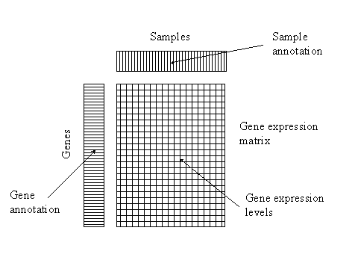
Large scale hypothesis testing
Example: the prostate cancer data (Singh et al. 2002)
6,033 genes, 50 controls and 52 prostate samples
T-test statistic:
Useful: we can always transform to z-values
Let F₁₀₀(t_{i}) be P(x < t_{i})

Slide 12
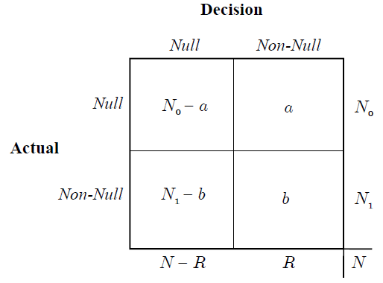
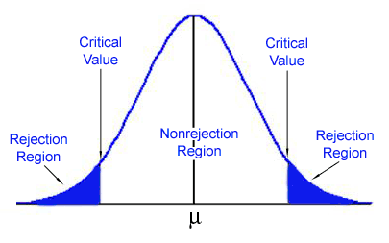
Large scale hypothesis testing
We have N z-scores, we need a rejection region (decision rule)
FWER = P(a>0)
Find a region such that FWER is low (e.g., 5%)
Large scale analysis can look at it vertically, e.g., a/R a.k.a
False Discovery Rate

Slide 13
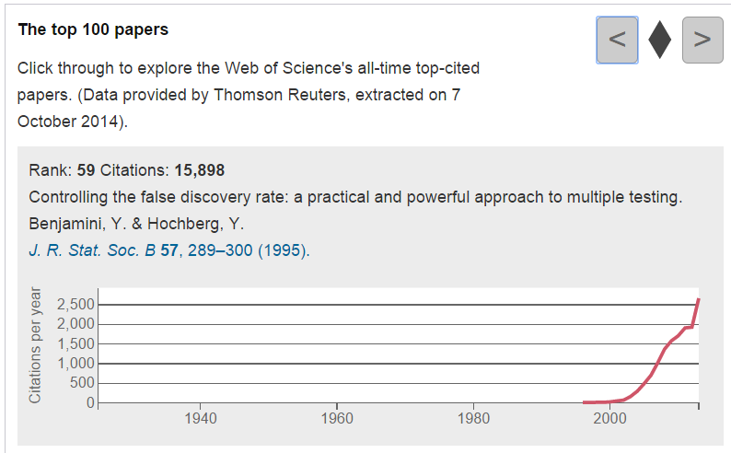
The Benjamini-Hochberg algorithm
Appears in Nature’s top 100 cited papers
Can you guess which is the highest ranking statistical method?
Can you guess which is the highest ranking bioinformatic algorithm?

Slide 14
The Benjamini-Hochberg algorithm
Find a decision rule that gives low a/R values
The BH algorithm: rank all p-values and find the largest i index that satisfies:
Reject all p-values < the selected threshold
BH showed that if the tests are independent the expected value of this decision rule satisfies:
Fdr: false discovery rate
Fdp: false discovery proportion
Exact definitions later

Slide 15
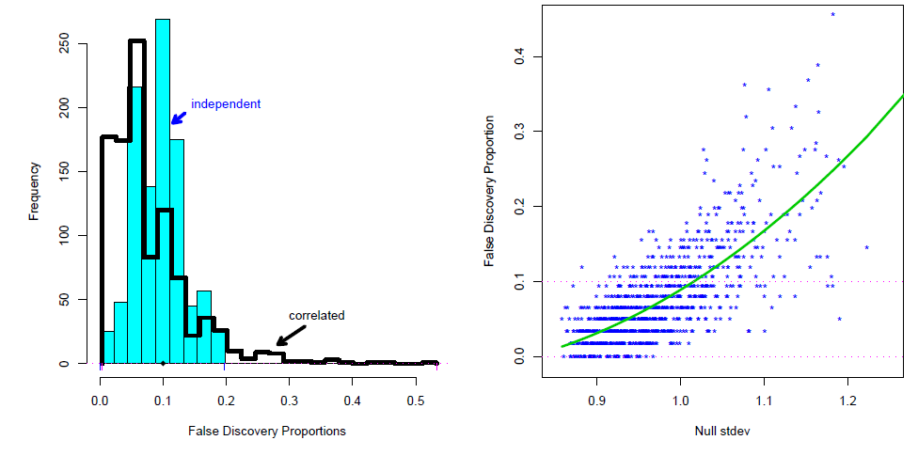
BH drawbacks
Independence assumption
Empirical null often does not agree with the theory
We completely neglect the variance of the Fdr
Simulation: 1000 repeats. In each run sample 2850 z-scores from the null N(0,1), and add 150 z-scores from N(2.5,1).
Measure the observed fdp when using BH with q=0.1.

Slide 16
BH drawbacks
High variance is alarming, some points have a real Fdr > 0.3
A word from Efron
The price of dependence is usually higher variance
We should interpret Fdr as an estimation problem and not hypothesis testing

Slide 17
The two groups model
A different way of looking at large scale tests
Each of the N z-scores is either null or non-null
Null prior probability: π₀
Null distribution: f₀, non-null distribution: f₁
Fdr is now a probability:
Rejection area. E.g., |z| > 3

Slide 18
Fdr goes Bayesian
We can even define the local Fdr of a single z-score
The relation between Fdr and fdr

Slide 19
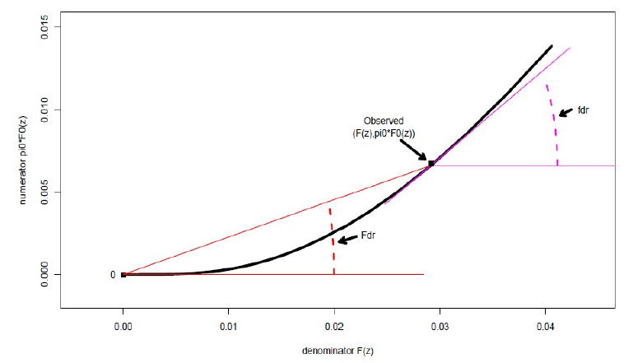
Fdr vs. fdr
We are typically interested in small values of both
An observed point z
Red slope: the Fdr (by definition)
Blue slope: fdr (taking derivatives)
Fdr is lower than fdr in low values
π₀ F0(Z)
F(Z)
Working with densities is very powerful, applications later

Slide 20
Empirical approach
Use the standard normal distribution for f₀
In the two groups model we do not know f and π₀
Estimate F from the empirical distribution
Set the prior to 1 for now
No independence assumption

Slide 21
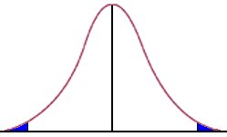
Theoretical justification: notations
Input:
N z-scores
A rejection region Z (blue area)
N₀(Z) – number of null cases in Z
e₀(Z) – expected number of null cases in Z
N₁(Z) – number of non-null cases in Z
e₁(Z) – expected number of non-null cases in Z
N₊(Z) – number of cases in Z

Slide 22
Fdr vs. Fdp
Fdr: the ratio between the expected values
Fdp: the proportion of nulls
The next lemmas give some insights about Fdr, Fdp, and the empirical estimation

Slide 23
Lemma 1
Assume e₀(Z) = E(N₀(Z)|N₁(Z))
Number of nulls and non-nulls are independent
Then:
Corollaries:
The empirical Fdr is an upper bound for the Fdp
No independence assumption!
The Fdr is also an upper bound for the Fdp
Less informative since the expectation is infinity

Slide 24
Lemma 2
The coefficient of variation (CV) of N₊ (the number of rejections)
Then we can approximate the accuracy of our estimations:
Thus, the empirical Fdr estimation is slightly biased upwards
No independence assumption!
The bias depends on the CV
Assuming independence we can get tighter results with almost no bias

Slide 25
BH Revisited
The BH rule – find the maximal i that satisfies:
The empirical F distribution of the i‘th z-score (after sorting) is i/N = F(z)
The i‘th p-value: p(i) = F₀(z(i)), we can write the BH rule as:
The BH rule gives the empirical Fdr!
A word from Efron
Methods with both Bayesian and freq properties prove themselves over time

Slide 26
Advantages of Bayes Fdr
Theory holds under dependence
Theory gives hints about the estimation error
Fdr as a probability: all theories hold for the true discovery rate
Next
Estimation of f and local Fdrs
Estimate the power of a dataset
Dealing with weird null distributions

Slide 27
Take home messages
Emp Bayes methods learn the prior from the data
Interesting theoretical justification
Better than MLE for normal dist, under freq measures
Favor group-level inference over single cases
The two groups model allows Bayesian view on Fdr
Strong theoretical arguments, estimate true discovery rate

Slide 29
Estimating f and π₀ and applications

Slide 30
The zero-assumption
The density of f₁ is zero around zero
Take an interval A₀ around zero and use it to get:
Practical choice of A₀:
A word from Efron
If the prior is > 0.9 this estimation would not change much

Slide 31
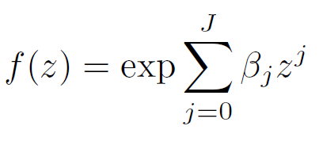
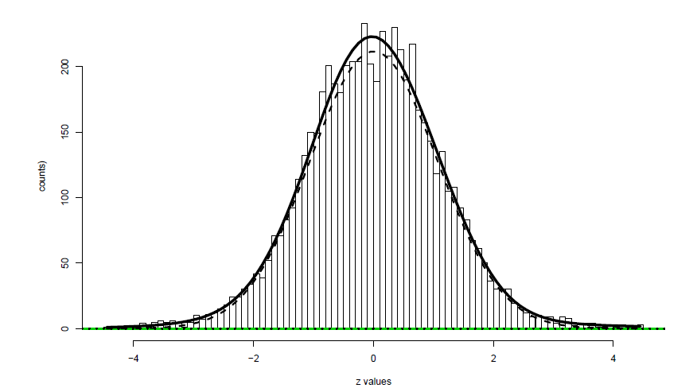
Estimating F
Assume f follows an exponential family model
In real data J should be > 3
J=2 gives normal distributions
Use standard methods for estimating f
Typically use discretization + Poisson regression

Slide 32
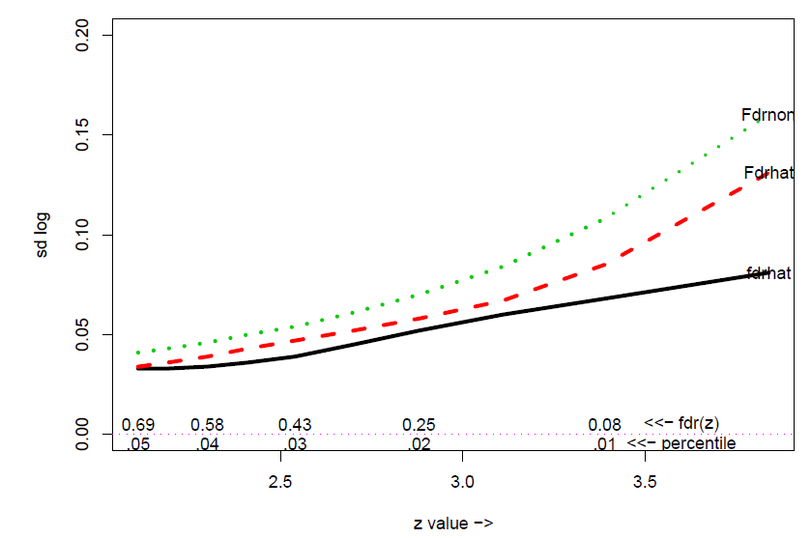
Error rate of different Fdr methods
Simulation: N=6000, f0 = N(0,1), f1 = N(2.5,1), π=0.95; 1000 repeats
For each method, for each threshold, calculate the real Fdr
The mean is as expected (like the threshold), the parametric method has a lower standard deviation

Slide 33
Estimating the power of a dataset
Reminder: tdr = 1-fdr
We can integrate over deviations from low fdr to get the expected number of non-nulls
Several ways to calculate this, a simple calculation is to use histograms
Given a bin of width d whose center is x_{k} and has y_{k} values, the expected number of non nulls is tdr(x_{k})y_{k}
Better methods exist that first smooth the histogram
We can now compare the number of rejected cases (for a given fdr threshold) to the expected number
i.e., the sum of all bins

Slide 34
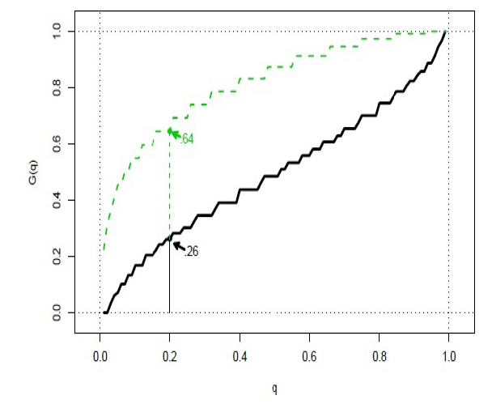
Examples: simulation+prostate data
N=6000, f0 = N(0,1), f1 = N(2.5,1), π=0.95
Real data: the prostate cancer data
In the prostate data:
23 genes have fdr<0.2
Integration over this area gives 26.8
Integration over all area gives 105
(1- π₀)N is ~97
The estimated power is <0.3

Slide 35
Take home messages
Emp Bayes methods learn the prior from the data
Interesting theoretical justification
Better than MLE for normal dist, under freq measures
Favor group-level inference over single cases
The two groups model allows Bayesian view on Fdr
Strong theoretical arguments, estimate true discovery rate
We can estimate f and the prior
Fdr estimations are more accurate than the simple empirical approach
We can calculate a score for the power of a dataset
Useful for our Adeptus project

Slide 36
Dealing with weird null distributions

Slide 37
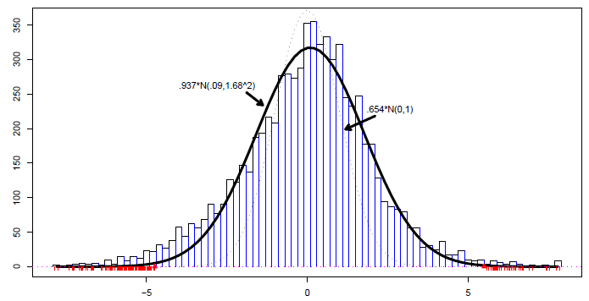
Example 1: Leukemia data
Blood gene expression
7,128 genes, 45 ALL vs. 25 AML patients
Using theoretical null – more than 1,500 differential genes
Dotted: theoretical null N(0,1)
Estimated null

Slide 38
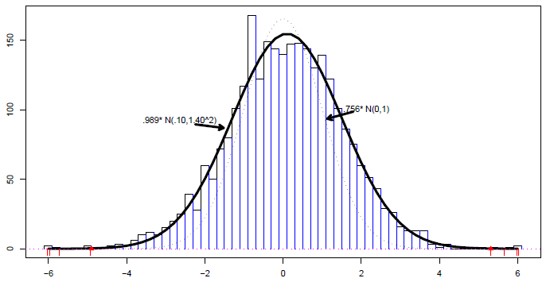
Example 2: Police data
Police racial bias , NY 2006, 2,749 policemen
P-values were calculates for racial bias in arrests
Each model was corrected for time and type
Dotted: theoretical null N(0,1)
Estimated null
Results suggest bias on both sides

Slide 39
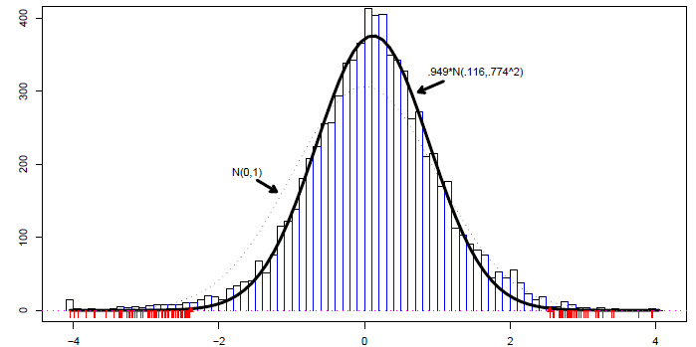
Example 3: HIV data
Blood gene expression
4 patients vs. 4 controls, ~7,000 genes
Dotted: theoretical null
Estimated null

Slide 40
Why the null may “fail”?
Wrong mathematical assumptions
Correlation among sampling units (e.g., microarrays)
Correlation across the z-values
Unknown covariates: batch, age, genetics, etc.
Filtration: preselection of “interesting” cases

Slide 41
Permutation tests
The simple case: consider the two-sample t-test case
Repeat B times
Shuffle columns and recalculate the t-scores
Get a new distribution of t-scores
Simple permutations: use the new distribution as the null
SAM: for a threshold z calculate a bound for the empirical fdr directly

Slide 42
Permutation tests to the rescue?
Mainly meant to deal with problem 1 (wrong mathematical assumptions)
Sampling promotes independence – cannot deal with problem 2
Assumes unobserved covariates are distributed randomly – a major problem
A virtue: preserve correlations among z-values
In practice often converge to N(0,1)
Might indicate strong effects of unobserved covariates

Slide 43
A question
Should extreme cases be compared to a gold standard theoretical null, or to the other cases in the study (e.g., estimate the empirical null)?

Slide 44
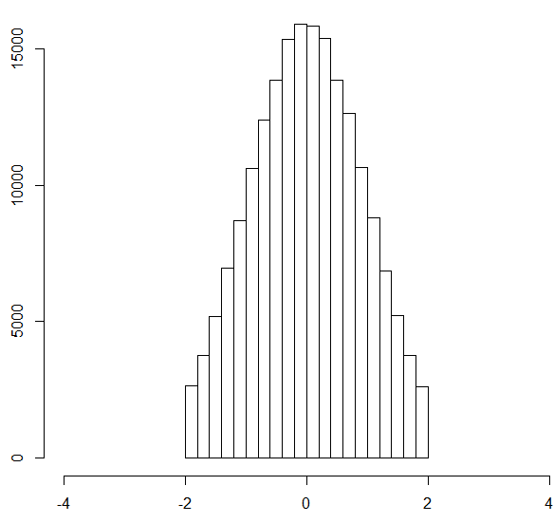
Revisit the zero assumption
Say we have an area in which we assume that the non-null density is zero, e.g., take an interval around zero
Assume that the distribution is normal and estimate parameters from the trimmed data

Slide 45
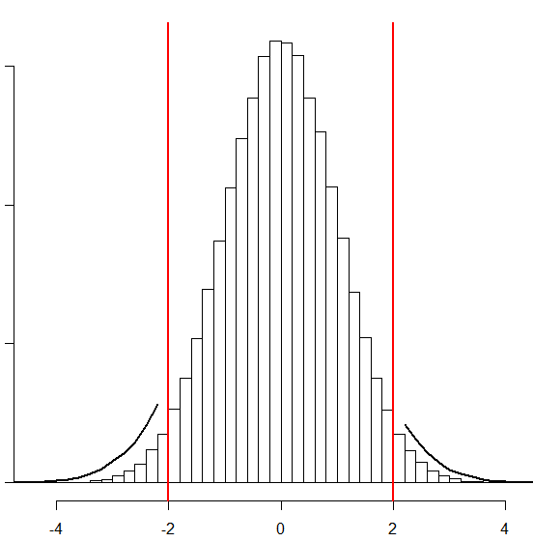
A question
In real cases with true discoveries this is a typical picture we can imagine
Estimated null distribution
Rejection threshold
Surprising cases: area in which we have more cases than expected in the null dist

Slide 46
Empirical null estimation
MLE approach
Use the zero assumption to
Estimate the prior
Interval in which we believe there are only nulls
Say N₀ cases fell in the zero interval, the likelihood is:
This is a multiplication of exponential families. Standard numerical optimization iterations find the MLE

Slide 47
Effect on the leukemia data
Using the theoretical null >1500 genes are differential (out of 7128)
173 genes are differential using the estimated null
Dotted: theoretical null N(0,1)
Estimated null

Slide 48
Our Adeptus Project
We analyze a disease D
We have ~30 gene expression studies
Standard analysis for a gene
Get a Z-score from each dataset
Merge using standard meta-analysis (Stouffer)
Observation: in some diseases we get that >60% of genes are differential
This is probably due to multiple “wrong” null distributions
We currently correct empirically using ROC scores

Slide 49
Take home messages
Emp Bayes methods learn the prior from the data
Interesting theoretical justification
Better than MLE for normal dist, under freq measures
Favor group-level inference over single cases
The two groups model allows Bayesian view on Fdr
Strong theoretical arguments, estimate true discovery rate
We can estimate f and the prior
Fdr estimations are more accurate than the simple empirical approach
We can calculate a score for the power of a dataset
Weird null distributions
Abundant in real large scale data
Many possible reasons
Permutation tests give a partial solution
Empirical null estimation give a conservative solution

Slide 50
Thank you!

