Slide 1
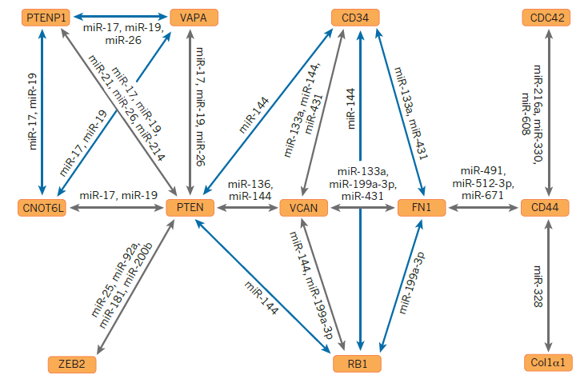
ceRNA Networks Identification
Shamir Seminar – Kobi Perl, 17.12.14
Notes:
Picture of PTEN network from: Tay, Y., Rinn, J., & Pandolfi, P. P. (2014). The multilayered complexity of ceRNA crosstalk and competition. Nature, 505(7483), 344–52. doi:10.1038/nature12986. (Grey validated, Blue predicted)

Slide 2
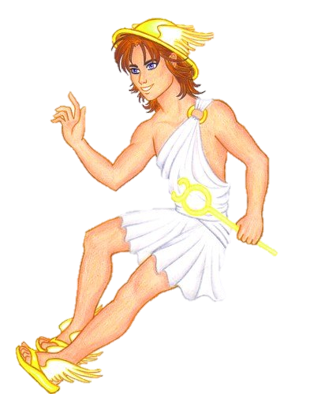

Articles
An Extensive MicroRNA-Mediated Network of RNA-RNA Interactions Regulates Established Oncogenic Pathways in Glioblastoma
  Sumazin, P., Yang, X., Chiu, H.-S., Chung, W.-J., Iyer, A., Llobet-Navas, D., … Califano, A. (2011). Cell, 147(2), 370–81. doi:10.1016/j.cell.2011.09.041
Cupid: simultaneous reconstruction of microRNA-target and ceRNA networks
  Chiu, H.-S., Llobet-Navas, D., Yang, X., Chung, W.-J., Ambesi-Impiombato, A., Iyer, A., … Sumazin, P. (2014). Genome research. doi:10.1101/gr.178194.114
Notes:
The second article is covered in a very shallow manner
First tool – called hermes, using a submodule named Cupid
Second tool – expansion of Cupid

Slide 3

The Plan
Longgg Overview
Goals
Methods
Results
Discussion + Critics
New Article Discussion
Ear Project

Slide 4
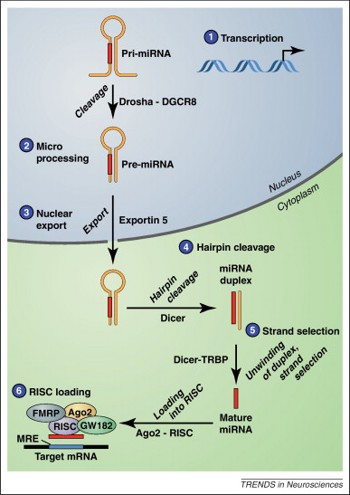
Overview - microRNAs
RNA molecules
21–23 nucleotides (nt) long
Endogenous
Noncoding
  Transcribed from independent miRNA genes \ introns of protein-coding transcripts
Posttranscriptional regulation by specifically binding target mRNAs
Notes:
Introduction based on:
Figliuzzi, M., Marinari, E., & De Martino, A. (2013). MicroRNAs as a selective channel of communication between competing RNAs: a steady-state theory. Biophysical journal, 104(5), 1203–13. doi:10.1016/j.bpj.2013.01.012

Slide 5
Overview - microRNAs
processing → mature form
Loading onto proteins → RNA-induced silencing complex (RISC)
RISC binds miRNA response elements (MREs) located in target mRNAs
  Usually located in the 3′ untranslated region (3’ UTR)
  Specific binding is based on a basepairing recognition
→ translation inhibition and mRNA destabilization.
Notes:
Specific binding – at least 6 bases complementary
Repression: mRNA degradation (target cleavage \ mRNA deandenylation) + translational repression
Effects mainly on mRNA level: mRNA degregation by microRNA account for most (>=84%) of the decreased protein production and not translational repression.
Guo, H., Ingolia, N. T., Weissman, J. S., & Bartel, D. P. (2010). Mammalian microRNAs predominantly act to decrease target mRNA levels. Nature, 466(7308), 835–40. doi:10.1038/nature09267
Introduction based on:
Figliuzzi, M., Marinari, E., & De Martino, A. (2013). MicroRNAs as a selective channel of communication between competing RNAs: a steady-state theory. Biophysical journal, 104(5), 1203–13. doi:10.1016/j.bpj.2013.01.012

Slide 6
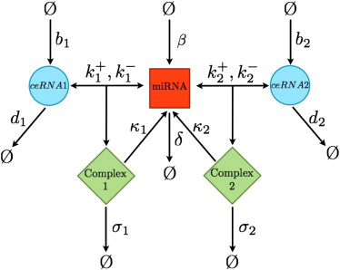
Overview - ceRNAs
miRNA-based regulation is affected by the total concentration of available targets (dilution effect).
The combination of:
  Repressive effects of miRNAs on their targets
  Weakening of such repression due to dilution effects
→ effective, positive interactions between joint targets of a given miRNA.
Notes:
Model displayed: Figliuzzi, M., Marinari, E., & De Martino, A. (2013). MicroRNAs as a selective channel of communication between competing RNAs: a steady-state theory. Biophysical journal, 104(5), 1203–13. doi:10.1016/j.bpj.2013.01.012

Slide 7
Overview - ceRNAs
ceRNAs = Competing Endogeneous RNAs
First network was described for PTEN, a tumor suppressor gene
Included the pseudo gene PTENP1
Such interactions play a central role in –
  cancer
  muscle differentiation
Notes:
We move to N ceRNAs M miRNAs model
Picture of PTEN network from: Tay, Y., Rinn, J., & Pandolfi, P. P. (2014). The multilayered complexity of ceRNA crosstalk and competition. Nature, 505(7483), 344–52. doi:10.1038/nature12986. (Grey validated, Blue predicted)
Competing Endogeneous RNAs
Competing over microRNA binding to their MREs.
Endogeneous – As artificial sponges are being used from before the discovery of ceRNAs
PTEN – Most research is in cancer
PSEUDO-GENES – suggesting noncoding RNAs (lincs and pseudogenes) compete for common miRNAs

Slide 8
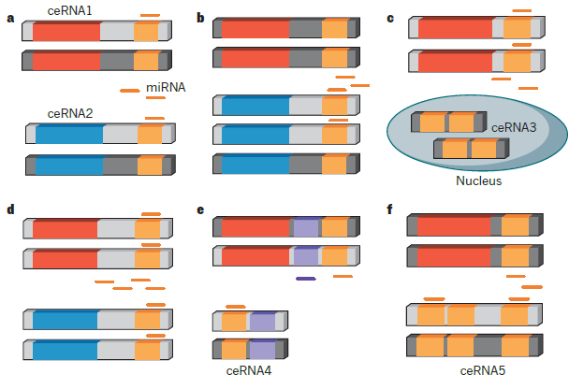
Overview - ceRNAs
Factors that may influence ceRNA effectiveness
Notes:
Picture from: Tay, Y., Rinn, J., & Pandolfi, P. P. (2014). The multilayered complexity of ceRNA crosstalk and competition. Nature, 505(7483), 344–52. doi:10.1038/nature12986. (Grey validated, Blue predicted)
B – concentration of ceRNA2 increases (less targeting of ceRNA1 → ceRNA1 increases).
C – ceRNA3 have a different subcellular localization and is not an effective ceRNA.
D – concentration of miR increases. ceRNA1 and ceRNA2 repression will increase (A small change of concentration of ceRNA2, might, in the given expression of miRNA, effect ceRNA1 concentration less).
E - ceRNA4 share multiple regulating miRNAs with ceRNA1, and might be more effective.
F – Multiple MREs for the same miRNA. Note that several models for cooperative vs. competitive binding of miRNA to adjacent sites were described for miRNAs in literature.

Slide 9
Overview - ceRNAs
Steady-state models were developed to describe this effect*
Coarse-graining of the real biological process
Very problematic to verify because the amount of parameters to estimate
  Transcription \ Degredation rates of ceRNAs \ miRNA.
  miRNA – ceRNA association rates
  Catalytic \ Stochiometric Degradation rates of complexes
  Ala, U., Karreth, F. A., Bosia, C., Pagnani, A., Taulli, R., Léopold, V., & Tay, Y. (2013). Integrated transcriptional and competitive endogenous RNA networks are cross-regulated in permissive molecular environments.
Notes:
Coarse graining - coarse-graining of the real biological processes, which typically requires multiple catalyzed elementary steps (e.g., in the formation of the RISC). However, such details may be disregarded if, in presence of many different targets, the only rate-limiting factor is the miRNA concentration.
k1 vs. sigma1 – “catalytic” degredation vs. “stochiometric” degradation.
Two models - The first one is more experimentally validated (the “general concept” of it). Second one is newer and more extent.
Ala, U., Karreth, F. A., Bosia, C., Pagnani, A., Taulli, R., Léopold, V., & Tay, Y. (2013). Integrated transcriptional and competitive endogenous RNA networks are cross-regulated in permissive molecular environments.
Figliuzzi, M., Marinari, E., & De Martino, A. (2013). MicroRNAs as a selective channel of communication between competing RNAs: a steady-state theory. Biophysical journal, 104(5), 1203–13.

Slide 10
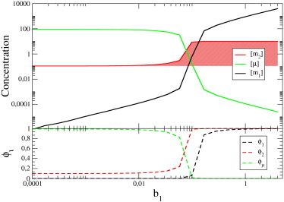
Overview - ceRNAs
Example: Dependency in the transcription rate b₁
The dynamical range of the cross-talk interaction between the two ceRNAs corresponds to the window where free and bound molecules have similar concentration
ϕ - Fractions of free molecules
Notes:
All other parameters are fixed.

Slide 11
Overview - ceRNAs
Very importantly – the models allow asymmetric regulation
  ceRNAs with higher binding affinity can unidirectionally affect ceRNAs with medium binding affinity
  ceRNAs with medium binding affinity can influence each other
  ceRNAs with lower binding affinity interact weakly with the rest of the system
This is all in a single miRNA system
Notes:
Will flactuations in one specie effect the concetrations of other.

Slide 12
Hermes - Goals
Identifying sponge and non-sponge miR-mediated interactions
Using sample-matched gene and miR expression profiles
In glioblastoma
Notes:
Non sponge:
Activation or suppression of miRISC-mediated regulation of target RNAs.
Protection from miR degradation..
Prevention of miRs from binding their targets.

Slide 13
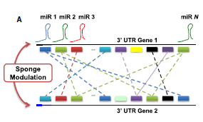
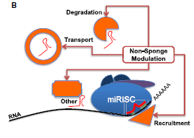
Hermes - Goals
Identifying sponge and non-sponge miR-mediated interactions.
PTENP1 , VCAN, CD44
AGO, TRC6 families
Notes:
Non sponge:
Activation or suppression of miRISC-mediated regulation of target RNAs.
Protection from miR degradation..
Prevention of miRs from binding their targets.
Implemented by proteins \ mRNAs
Bold – genetic alterations have been implicated in tumorigenesis

Slide 14

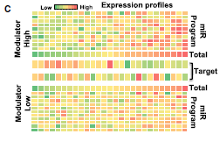
Hermes - Goals
Using sample-matched gene and miR expression profiles
  262 samples
  Level 3 Agilent gene and miR expression data for glioma tumors were obtained from TCGA (TCGA, 2008)
Notes:
(We will return to this figure later)

Slide 15
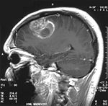
Hermes - Goals
In glioblastoma
  Dysregulation of physiologic miR activity has been shown to play an important role in gliomagenesis

Slide 16
Hermes – Statistic
Given a triplet of expression vectors:
  R – Regulator
  T – Regulated Target
  M – modulator
Estimate:
  Interaction information ΔI = CMI – MI
    Mutual Information (MI) = I[R;T]
    Conditional Mutual Information (CMI) = I[R;T|M]
Notes:
MI, CMI, ΔI (interaction information) – Measures from information theory
All are estimations and need little hats on them

Slide 17

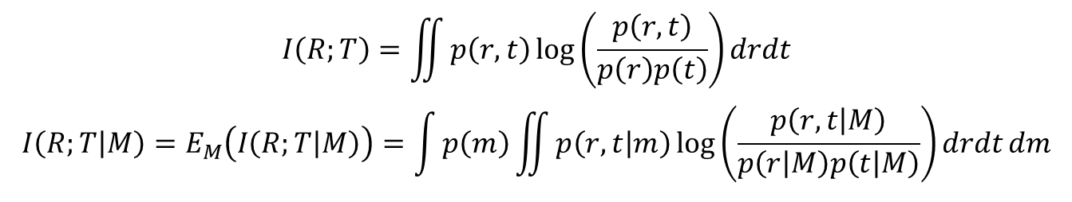
Hermes – Statistic
$$I\left(R;T\right)=\iint{p\left(r,t\right)\log\left(\frac{p\left(r,t\right)}{p\left(r\right)p\left(t\right)}\right)drdt}$$
$$I\left(R;T | M\right)=E_{M}\left(I\left(R;T | M\right)\right)=\int{p\left(m\right)}\iint{p\left(r,t | m\right)\log\left(\frac{p\left(r,t | M\right)}{p\left(r | M\right)p\left(t | M\right)}\right)drdtdm}$$
Is the MI symmetric? Is the CMI?
What is the minimal value for the MI? What is the maximal value?
What is the minimal value for the CMI?
What are the pros\cons of using the MI statistic, over using spearman correlation?
Notes:
Both are symmetric MI(R;T) = MI(T;R).
Minimal value for the MI – is 0, if R,T are independent. Maximal value is H(R) = H(T) = E(I(R)) = E(-ln(P(R)). The minimum of the entropy in general is 0.
Minimal value for CMI is 0 (It can either increase MI or decrease MI).
We don’t need real valued random variables. Doesn’t assume a linear model.

Slide 18

Hermes – Statistic
.
Both are symmetric
  MI(R;T) = MI(T;R)
  CMI(R;T|M) = CMI(T;R|M)
MI
  Minimal value for the MI is 0, if R,T are independent
  Maximal value is H(R)=H(T)=E(I(R))=E(-ln(P(R)) ≥ 0
CMI
  Minimal value for the CMI is 0
  CMI < MI: I(rain;dark|cloud) < I(rain;dark)
  CMI > MI: I(X;Y|Z) > I(X;Y)
Notes:
Examples from wikipedia:
clouds cause rain and also block the sun

Slide 19
Hermes – Statistic
Pro MI:
  Mutual Information "is not concerned" whether the association is linear or not, while Covariance may be zero and the variables may still be stochastically dependent
Pro correlation:
  Variance can be calculated directly from a data sample without the need to actually know the probability distributions involved (since it is an expression involving moments of the distribution)
Notes:
Great answer from: http://stats.stackexchange.com/questions/81659/mutual-information-versus-correlation

Slide 20
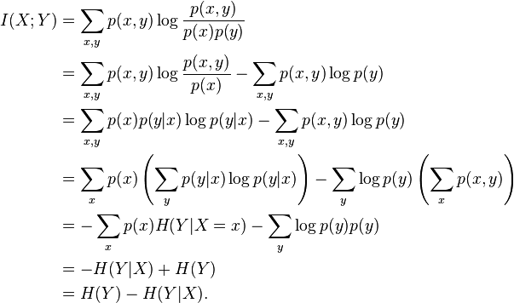
Hermes – Statistic
Note that one only needs to get estimation for entropies:
$$ΔI=−\left[H\left(R\right)+H\left(T\right)+H\left(M\right)\right]+\left[H\left(R,T\right)+H\left(R,M\right)+H\left(T,M\right)\right]−H\left(R,T,M\right)$$

Slide 21
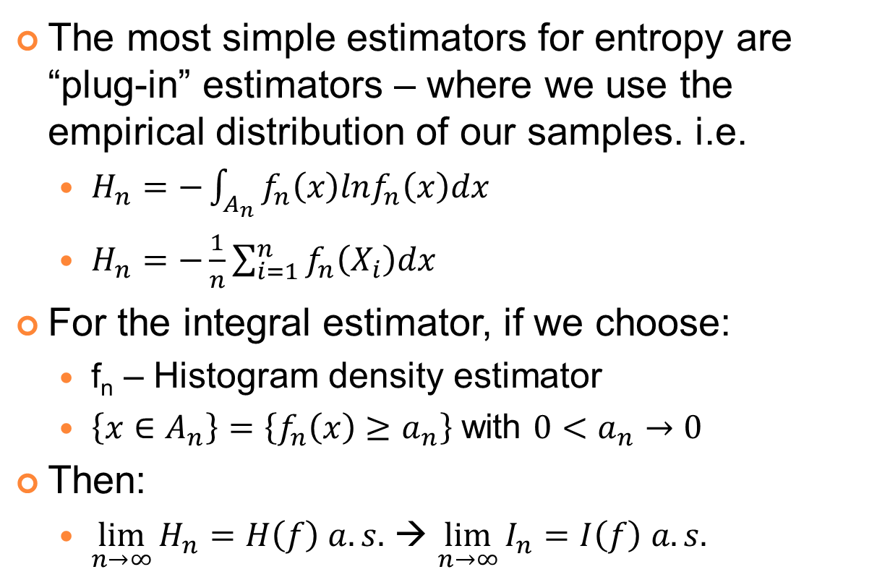
Hermes – Statistic
The most simple estimators for entropy are “plug-in” estimators – where we use the empirical distribution of our samples. i.e.
  $H_{n}=−\int_{A_{n}}{f_{n}\left(x\right)lnf_{n}\left(x\right)dx}$
  $H_{n}=−\frac{1}{n}\sum_{i=1}^{n}{f_{n}\left(X_{i}\right)dx}$
For the integral estimator, if we choose:
  f_{n} – Histogram density estimator
  $\left\{x∈A_{n}\right\}=\left\{f_{n}\left(x\right)≥a_{n}\right\}$ with ${0<a}_{n}→0$
Then:
  $\lim_{n→∞}{H_{n}=H\left(f\right) a.s.}$ → $\lim_{n→∞}{I_{n}=I\left(f\right) a.s.}$
Notes:
More plug-in estimators and more composite features in: http://jimbeck.caltech.edu/summerlectures/references/Entropy%20estimation.pdf
לא ציינתי אבל החלק השלם של האנטרופיה צריך להיות סופי
שורה אחרונה נובעת מכך שהמרחק האבסולוטי של I מהאומד שלו מוגבל בסכומי המרחקים של h(X) מהאומד שלו, h(Y) מהאומד שלו ו h(X,Y) מהאומד שלו.

Slide 22
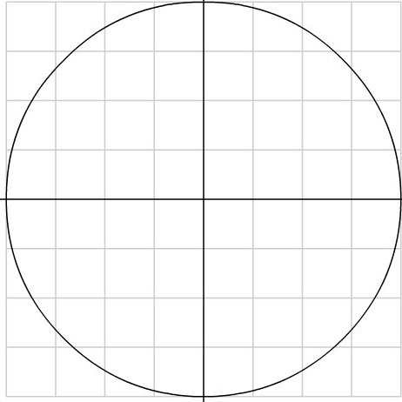
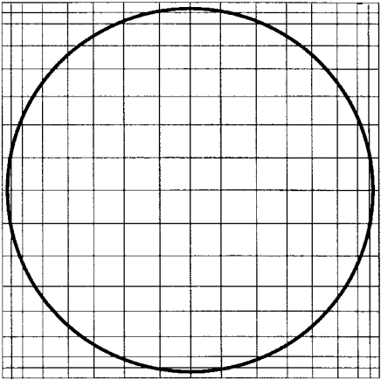
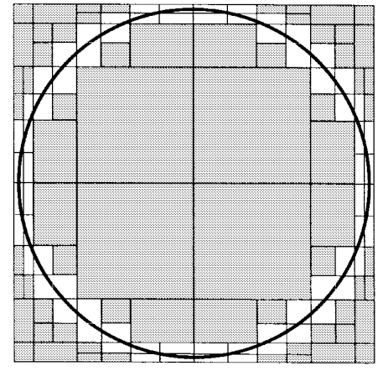

Hermes – Statistic
Darbellay, Georges A., and Igor Vajda. "Estimation of the information by an adaptive partitioning of the observation space." IEEE Transactions on Information Theory 45.4 (1999): 1315-1321.‏
But how to partition the space into cells?
  random variables X; Y taking their values in the measurable spaces $𝒳$ ; $𝒴$:
  For simplicity $𝒳=𝒴=ℝ$
  In a simple $P_{n}×Q_{n}$ partition, some cells contribute with a very little efficiency to the final estimate
  Extreme case: X=sinU, Y=cosU, U~U(0,2π)
Notes:
More plug-in estimators and more composite features in: http://jimbeck.caltech.edu/summerlectures/references/Entropy%20estimation.pdf
The dimension of the support is of a lesser dimension then $𝒳$*$𝒴$
אני די בטוח שה-MI במקרה האמור שווה ל log(pi) – 1 ביט.
משמאל – חלוקת Pn*qn לא אדפטיבית. באמצע – חלוקה אדפטיבית. מימין – חלוקה אידיאלית יותר, אבל שלא מצייתת ל-Pn*Qn.

Slide 23
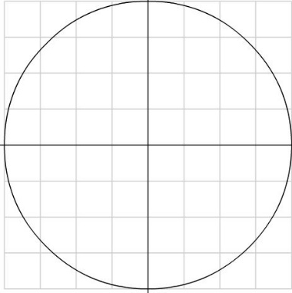
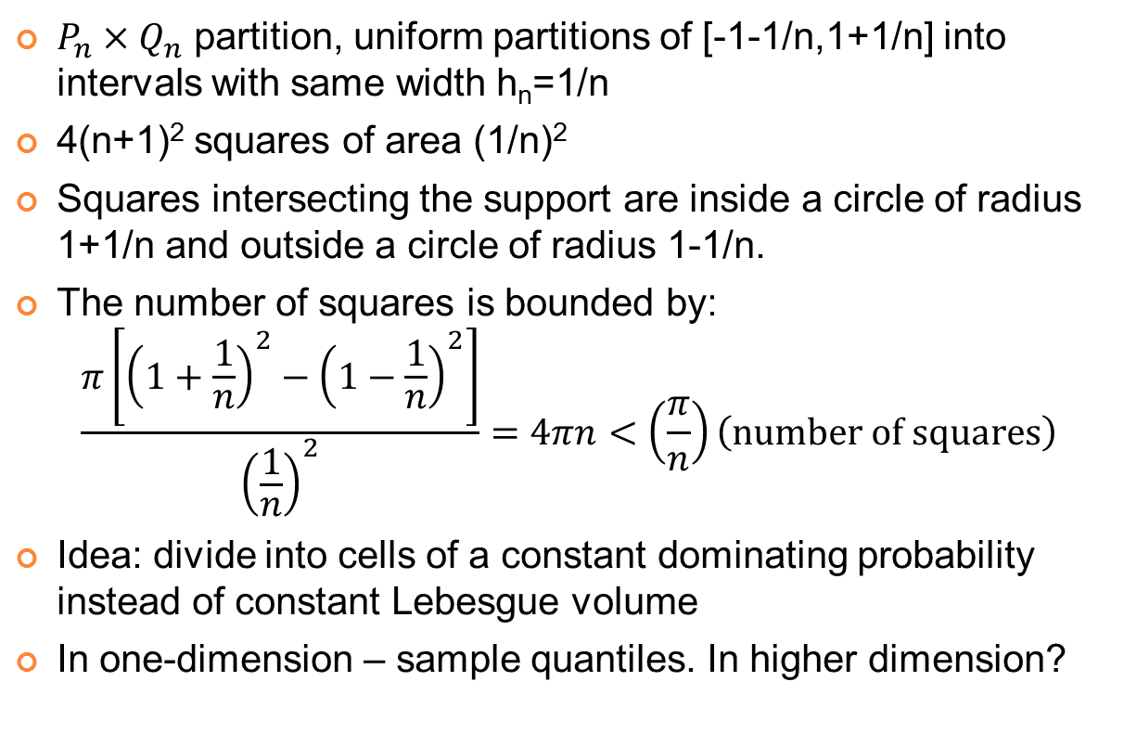
Hermes – Statistic
$P_{n}×Q_{n}$ partition, uniform partitions of [-1-1/n,1+1/n] into intervals with same width h_{n}=1/n
4(n+1)² squares of area (1/n)²
Squares intersecting the support are inside a circle of radius 1+1/n and outside a circle of radius 1-1/n.
The number of squares is bounded by:
$$\frac{π\left[{\left(1+\frac{1}{n}\right)}^{2}−{\left(1−\frac{1}{n}\right)}^{2}\right]}{{\left(\frac{1}{n}\right)}^{2}}=4πn<\left(\frac{π}{n}\right)\left(\text{number} \text{of} \text{squares}\right)$$
Idea: divide into cells of a constant dominating probability instead of constant Lebesgue volume
In one-dimension – sample quantiles. In higher dimension?

Slide 24
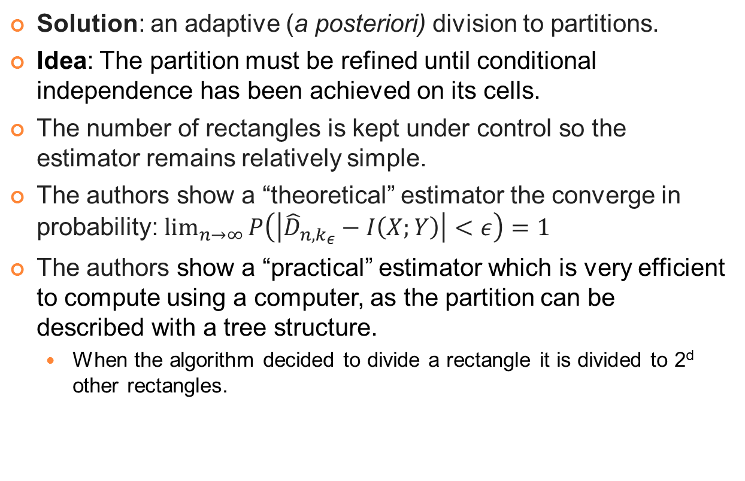
Hermes – Statistic
Solution: an adaptive (a posteriori) division to partitions.
Idea: The partition must be refined until conditional independence has been achieved on its cells.
The number of rectangles is kept under control so the estimator remains relatively simple.
The authors show a “theoretical” estimator the converge in probability: $\lim_{n→∞}{P\left(\left|{\hat{D}}_{n,k_{ε}}−I\left(X;Y\right)\right|<ε\right)=1}$
The authors show a “practical” estimator which is very efficient to compute using a computer, as the partition can be described with a tree structure.
  When the algorithm decided to divide a rectangle it is divided to 2^{d} other rectangles.
Notes:
לא בהכרח 2 בחזקת, אבל תחת הפרמטריזציה הסבירה 2^r.

Slide 25
Hermes – Statistic
Calculating ΔI (T;R;M)
  By first iteratively partitioning the 3-dimentional expression space evenly into 8 partitions per iteration until partitions are balanced (p>0.05 by chi squared test), and then summing up MI across partitions.
Calculate the significance of ΔI
  Using a null distribution calculated by shuffling the concentrations of the modulator and evaluating ΔI for each new triplet
These quantities and their associated statistical significance can be computed from > 250 samples
Notes:
לכל triplet 1000 shuffles של ריכוז המודולטורים.

Slide 26
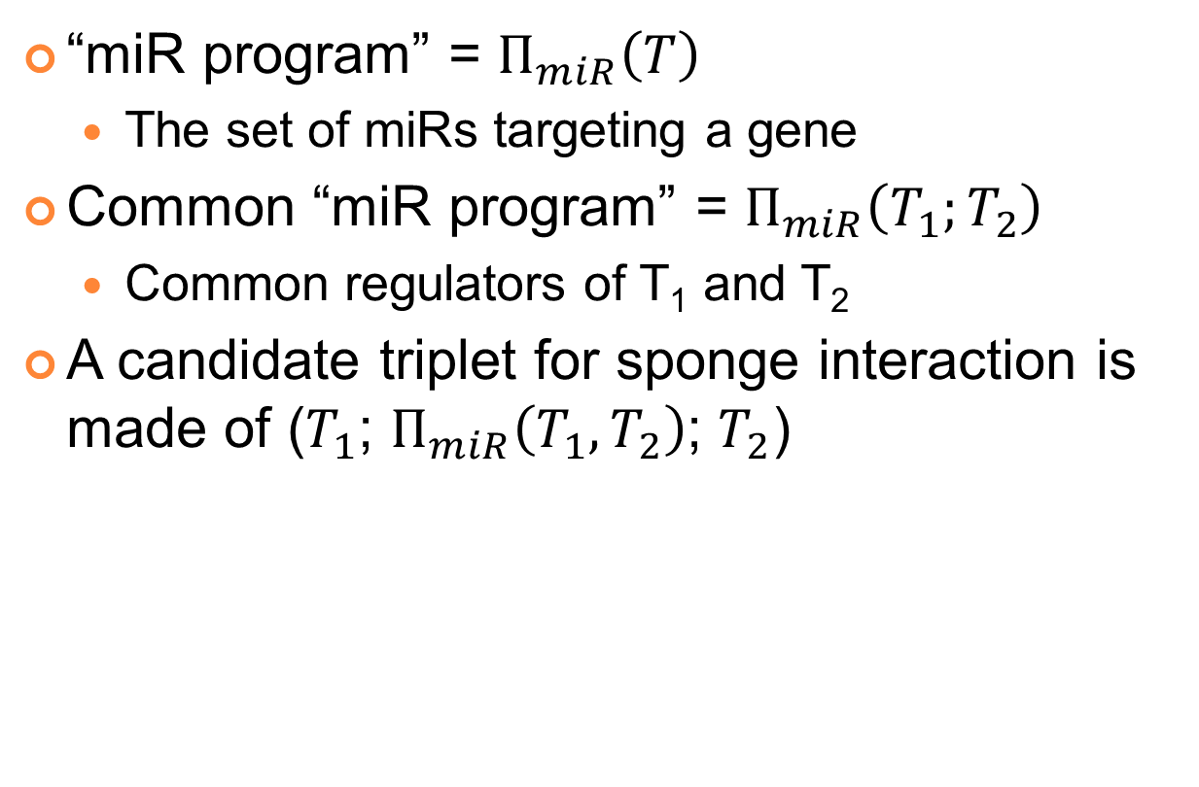
Hermes – Statistic
“miR program” = $Π_{miR}\left(T\right)$
  The set of miRs targeting a gene
Common “miR program” = $Π_{miR}\left(T_{1};T_{2}\right)$
  Common regulators of T₁ and T₂
A candidate triplet for sponge interaction is made of ($T_{1}$; $Π_{miR}\left(T_{1},T_{2}\right)$; $T_{2}$)

Slide 27
Hermes – Statistic
Schematic example of algorithm:
Notes:
Top map – strong inverse correlation between miR-program expression and target expression, consistent with an active miR program.
Bottom – negative correlation is reduced, indicative of a suppressed miR program.

Slide 28
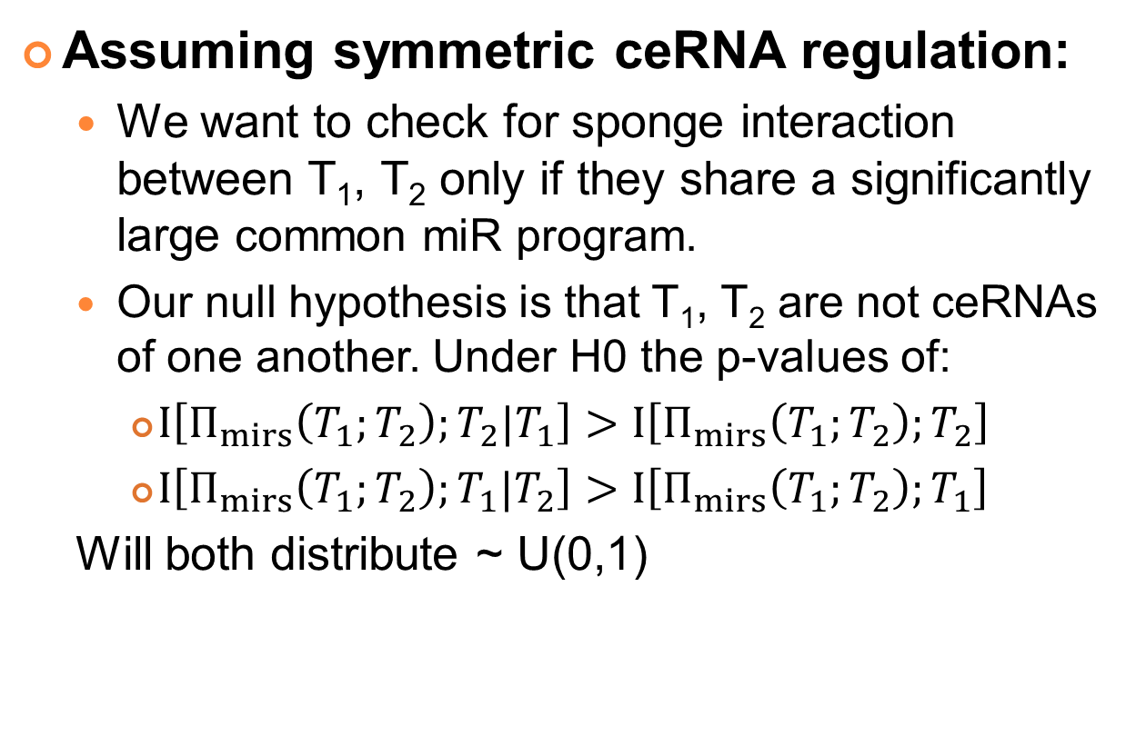
Hermes – Statistic
Assuming symmetric ceRNA regulation:
  We want to check for sponge interaction between T₁, T₂ only if they share a significantly large common miR program.
  Our null hypothesis is that T₁, T₂ are not ceRNAs of one another. Under H0 the p-values of:
    $I\left[Π_{mirs}\left(T_{1};T_{2}\right);T_{2}|T_{1}\right]>I\left[Π_{mirs}\left(T_{1};T_{2}\right);T_{2}\right]$
    $I\left[Π_{mirs}\left(T_{1};T_{2}\right);T_{1}|T_{2}\right]>I\left[Π_{mirs}\left(T_{1};T_{2}\right);T_{1}\right]$
  Will both distribute ~ U(0,1)
Notes:
סיבה לסימטריה: כדי להוריד היפותזות ומתוך תפיסת הקשר בין ceRNAs.
מבחן חי-בריבוע לחפיפה בין המטרות נוצר מראש מתוך ההנחה של סימטריה. אחרת היה יותר מתאים מבחן של "הכלה" (Containment)
במאמר Cupid החדש נראה שהם מבצעים Fisher Test אחרי משקול התוצאות, ואילו כאן לא כתוב על משקול, אז אולי זה רק מבחן יחס פרופורציה.

Slide 29
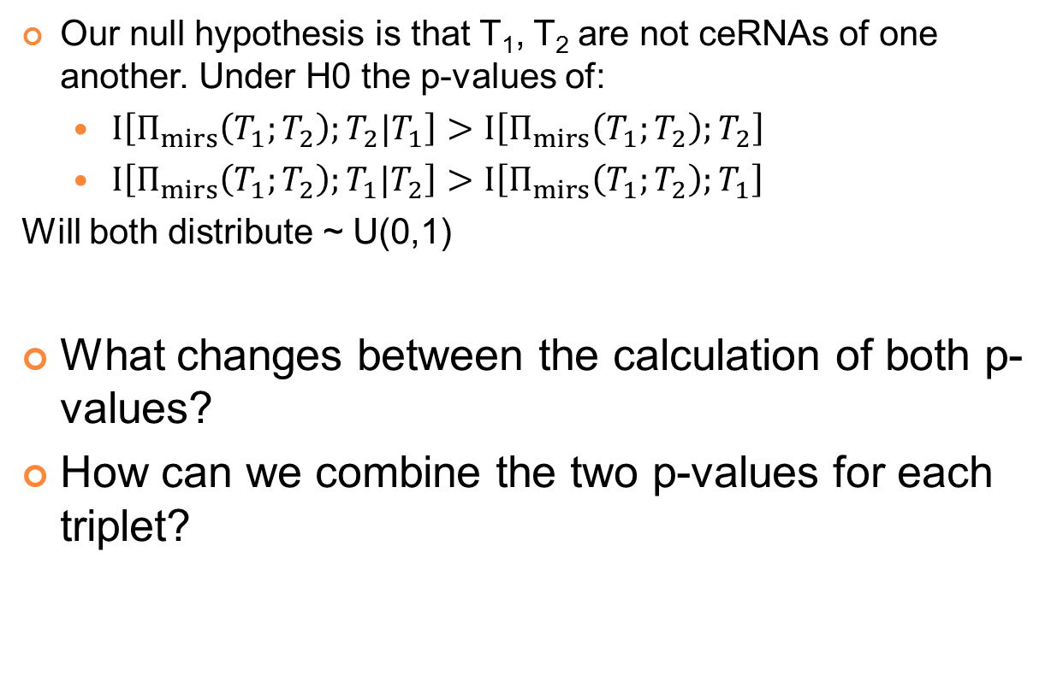
Hermes – Statistic
Our null hypothesis is that T₁, T₂ are not ceRNAs of one another. Under H0 the p-values of:
  $I\left[Π_{mirs}\left(T_{1};T_{2}\right);T_{2}|T_{1}\right]>I\left[Π_{mirs}\left(T_{1};T_{2}\right);T_{2}\right]$
  $I\left[Π_{mirs}\left(T_{1};T_{2}\right);T_{1}|T_{2}\right]>I\left[Π_{mirs}\left(T_{1};T_{2}\right);T_{1}\right]$
Will both distribute ~ U(0,1)
What changes between the calculation of both p-values?
How can we combine the two p-values for each triplet?
Notes:
We will start with the second claim…
The answer to the question – Only the null distribution… But not ΔI

Slide 30
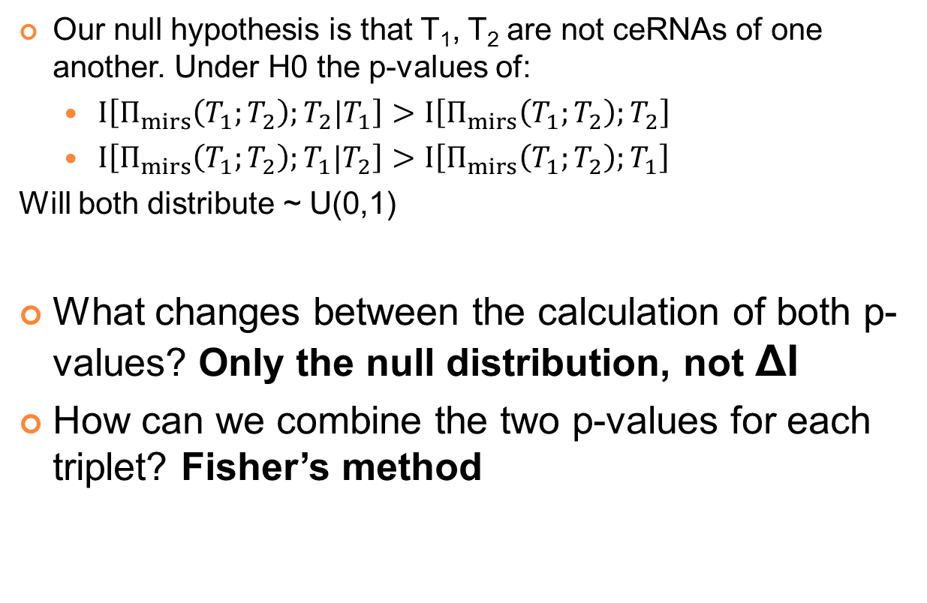
Hermes – Statistic
Our null hypothesis is that T₁, T₂ are not ceRNAs of one another. Under H0 the p-values of:
  $I\left[Π_{mirs}\left(T_{1};T_{2}\right);T_{2}|T_{1}\right]>I\left[Π_{mirs}\left(T_{1};T_{2}\right);T_{2}\right]$
  $I\left[Π_{mirs}\left(T_{1};T_{2}\right);T_{1}|T_{2}\right]>I\left[Π_{mirs}\left(T_{1};T_{2}\right);T_{1}\right]$
Will both distribute ~ U(0,1)
What changes between the calculation of both p-values? Only the null distribution, not ΔI
How can we combine the two p-values for each triplet? Fisher’s method

Slide 31
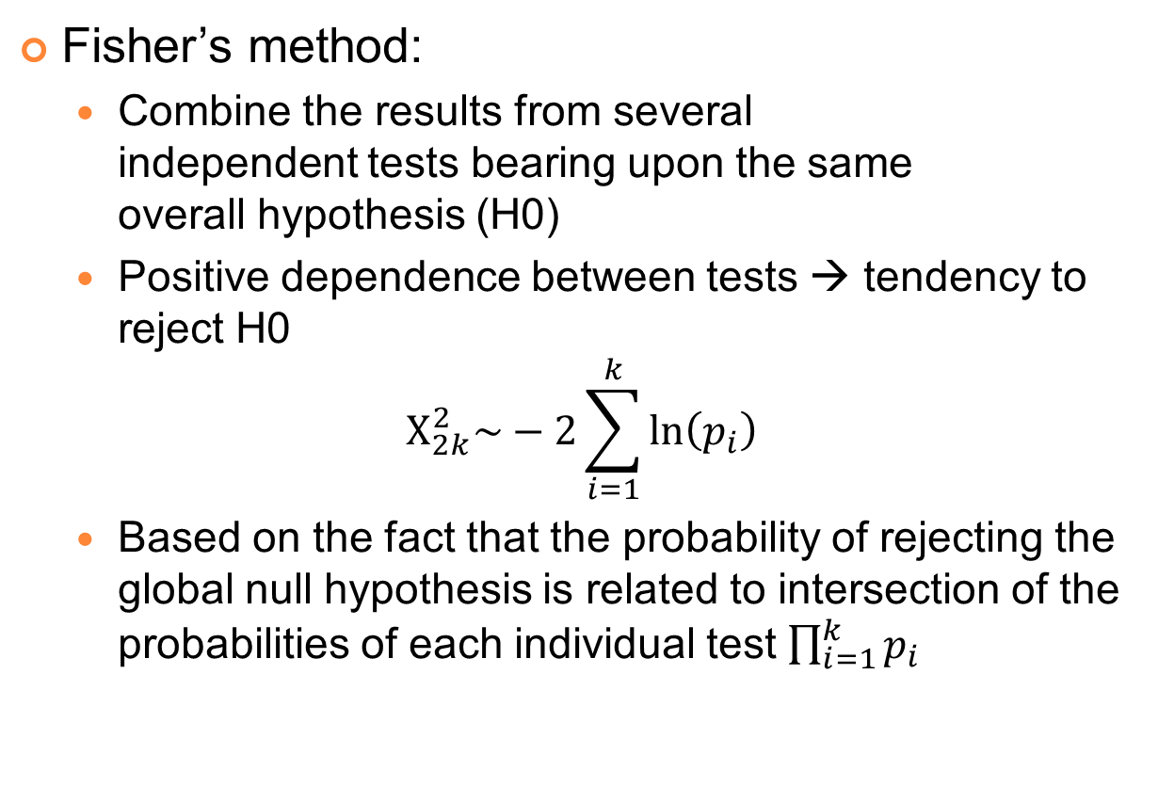
Hermes – Statistic
Fisher’s method:
  Combine the results from several independent tests bearing upon the same overall hypothesis (H0)
  Positive dependence between tests → tendency to reject H0
  $$Χ_{2k}^{2}\sim −2\sum_{i=1}^{k}{\ln\left(p_{i}\right)}$$
  Based on the fact that the probability of rejecting the global null hypothesis is related to intersection of the probabilities of each individual test $\prod_{i=1}^{k}{p_{i}}$
Notes:
אבל לגודל האחרון אנו לא יודעים את ההתפלגות.

Slide 32
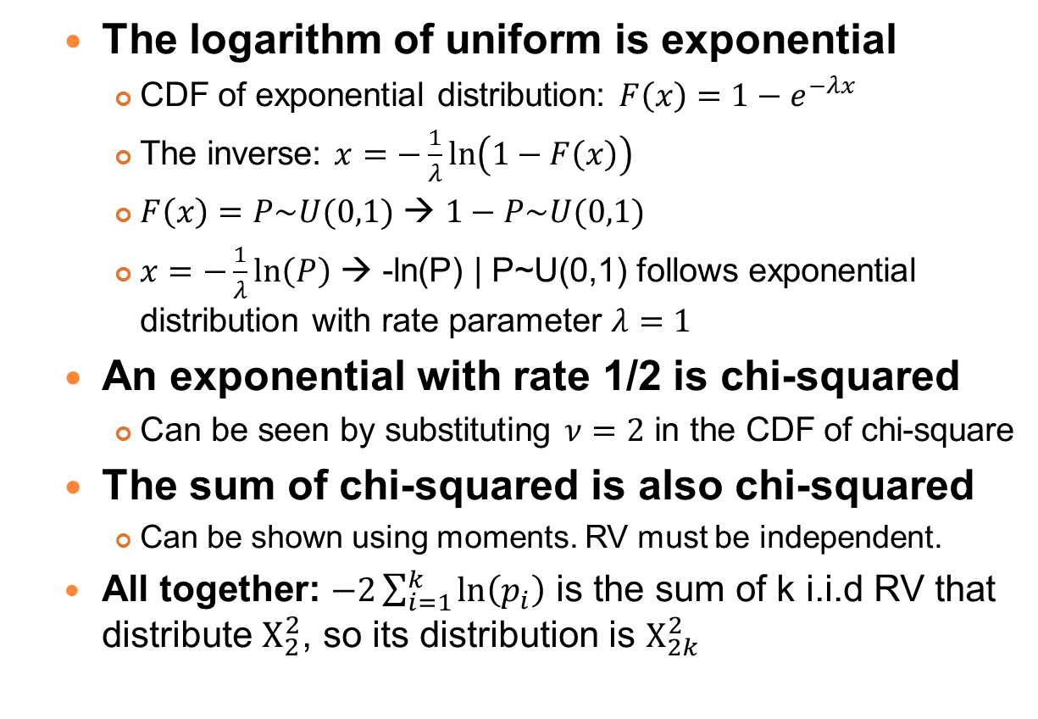
Hermes – Statistic
  The logarithm of uniform is exponential
    CDF of exponential distribution: $F\left(x\right)=1−e^{−λx}$
    The inverse: $x=−\frac{1}{λ}\ln\left(1−F\left(x\right)\right)$
    $F\left(x\right)=P\sim U(0,1)$ → $1−P\sim U(0,1)$
    $x=−\frac{1}{λ}\ln\left(P\right)$ → -ln(P) | P~U(0,1) follows exponential distribution with rate parameter $λ=1$
  An exponential with rate 1/2 is chi-squared
    Can be seen by substituting $ν=2$ in the CDF of chi-square
  The sum of chi-squared is also chi-squared
    Can be shown using moments. RV must be independent.
  All together: $−2\sum_{i=1}^{k}{\ln\left(p_{i}\right)}$ is the sum of k i.i.d RV that distribute $Χ_{2}^{2}$, so its distribution is $Χ_{2k}^{2}$
Notes:
Proof to Fisher’s method taken from: http://brainder.org/2012/05/11/the-logic-of-the-fisher-method-to-combine-p-values/

Slide 33
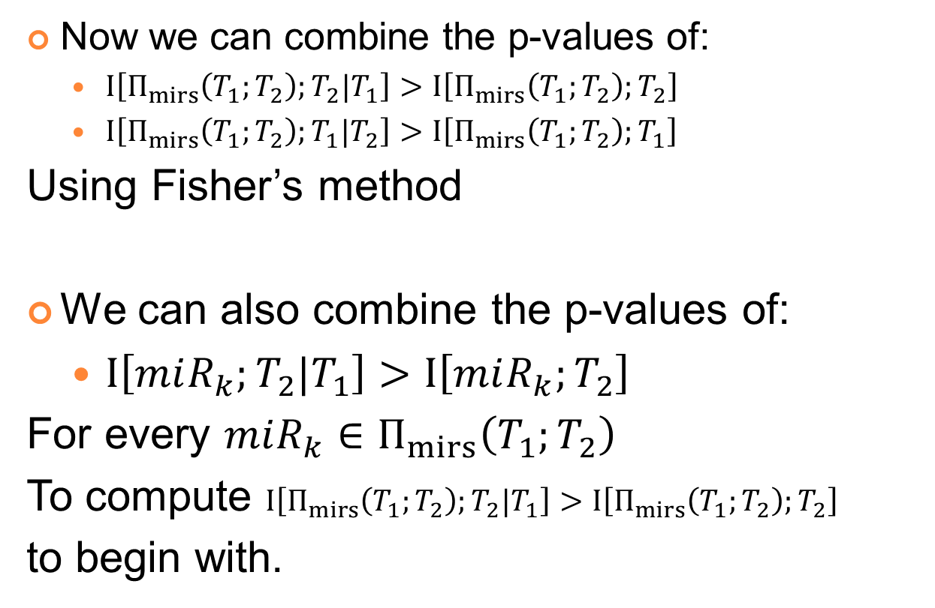
Hermes – Statistic
Now we can combine the p-values of:
  $I\left[Π_{mirs}\left(T_{1};T_{2}\right);T_{2}|T_{1}\right]>I\left[Π_{mirs}\left(T_{1};T_{2}\right);T_{2}\right]$
  $I\left[Π_{mirs}\left(T_{1};T_{2}\right);T_{1}|T_{2}\right]>I\left[Π_{mirs}\left(T_{1};T_{2}\right);T_{1}\right]$
Using Fisher’s method
We can also combine the p-values of:
  $I\left[miR_{k};T_{2}|T_{1}\right]>I\left[miR_{k};T_{2}\right]$
For every ${miR_{k}∈Π}_{mirs}\left(T_{1};T_{2}\right)$
To compute $I\left[Π_{mirs}\left(T_{1};T_{2}\right);T_{2}|T_{1}\right]>I\left[Π_{mirs}\left(T_{1};T_{2}\right);T_{2}\right]$
to begin with.
Notes:
על החלק השני – נכון לשאול Can we... כי יש תלויות במבחנים עבור miR-ים עם אותו ה-seed. מאמר ה-Cupid החדש מטפל בזה באמצעות הקטנת דרגות החופש.

Slide 34

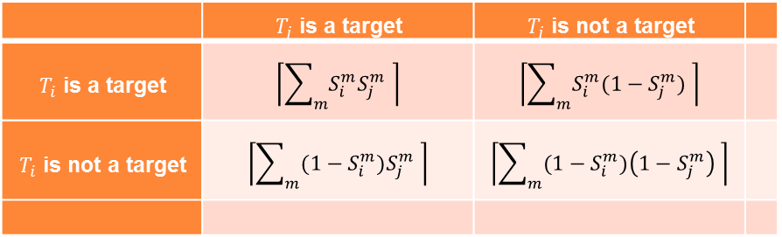
Hermes –Sponge Interactions
  No. of all possible triplets $T_{1}, T_{2},M$ is ~4.0*10¹¹ → Must filter
  Do T₁, T₂ share a significantly large Common “miR program”?
    Given that we have a list of miRs for each, we can use Fisher’s exact test on the intersection sizes.
    If we have interaction scores $S_{i}^{m}$ between miRNA $M_{m}$ and target $T_{i}$, in [0,1], we can use Fisher’s exact test on weighted scores:
 | $T_{j}$ is a target | $T_{j}$ is not a target
$T_{i}$ is a target | $$\left\lceil \sum_{m}{S_{i}^{m}S_{j}^{m}} \right\rceil$$ | $$\left\lceil \sum_{m}{S_{i}^{m}(1−S_{j}^{m})} \right\rceil$$
$T_{i}$ is not a target | $$\left\lceil \sum_{m}{{(1−S}_{i}^{m})S_{j}^{m}} \right\rceil$$ | $$\left\lceil \sum_{m}{{(1−S}_{i}^{m})\left(1−S_{j}^{m}\right) }\right\rceil$$
Notes:
And back to the first question…
Must filter – to reduce the number of hypothesis so the correction wouldn’t be so drastic + to make it computationally possible.
The first option – is what mentioned in Hermes article (though not very clearly). The second option is what presented in the new Cupid article.

Slide 35
Hermes –Sponge Interactions
One can use available target prediction software to select interactions, and to score them:
  PITA - is informed by the structure of miRISC
  miRanda - locally aligns miRNA and target sequences and estimates their binding energy
  TargetScan - uses predicted RNA structure
How to combine the predictions?
Notes:
Complementary in the way they choose their targets. All have available source code.

Slide 36
Hermes –Sponge Interactions
Train an SVM to differ between true and false targets sites using site feature, including scores from the three methods
  Predict sites and filter according to FDR1
Train an SVM to score target-miRNA interactions using site features, for sites from the previous stage
  After doing feature expansion to allow different modes of combinatorial regulation
Use scores to decide when T₁, T₂ share a significantly large Common “miR program”, filter according to FDR2
Predict ceRNAs, filter according to FDR3
Notes:
Filter according to FDR1 – It doesn’t appear in Hermes article but it does in Cupid article… So I’m really not sure.
Important: How to decide on FDR1, FDR2 and FDR3?
You don’t want to pass too many sites for the next stage on one hand.

Slide 37
Hermes –Sponge Interactions
First classifier:
  Features:
    Predicted scores from PITA, miRanda, TargetScan
    Cross-species conservation scores by PhasCons (46 vertebrate)
    Positional information relative to the 3’UTR start site.
  Output: Scores for each site in [0,1]
  Training set: 684 validated miR targets (miRecords)
How to choose FDR1?
  Because the number of hypothesis expands significantly when examining triplets, we want a very low FP rate on site prediction compared to other algorithms
Notes:
Important: How to decide on FDR1, FDR2 and FDR3?
You don’t want to pass too many sites for the next stage on one hand.

Slide 38
Hermes –Sponge Interactions
Second classifier:
  Features: Site scores summarized using an array of summary functions that model miR binding-site interactions both linearly and non-linearly.
  Output: T\F ?
  Training set: ?
FDR2 ?
There is a serious lack of information in the article. We will see a more detailed information in the new article.
Notes:
Important: How to decide on FDR1, FDR2 and FDR3?
You don’t want to pass too many sites for the next stage on one hand.

Slide 39
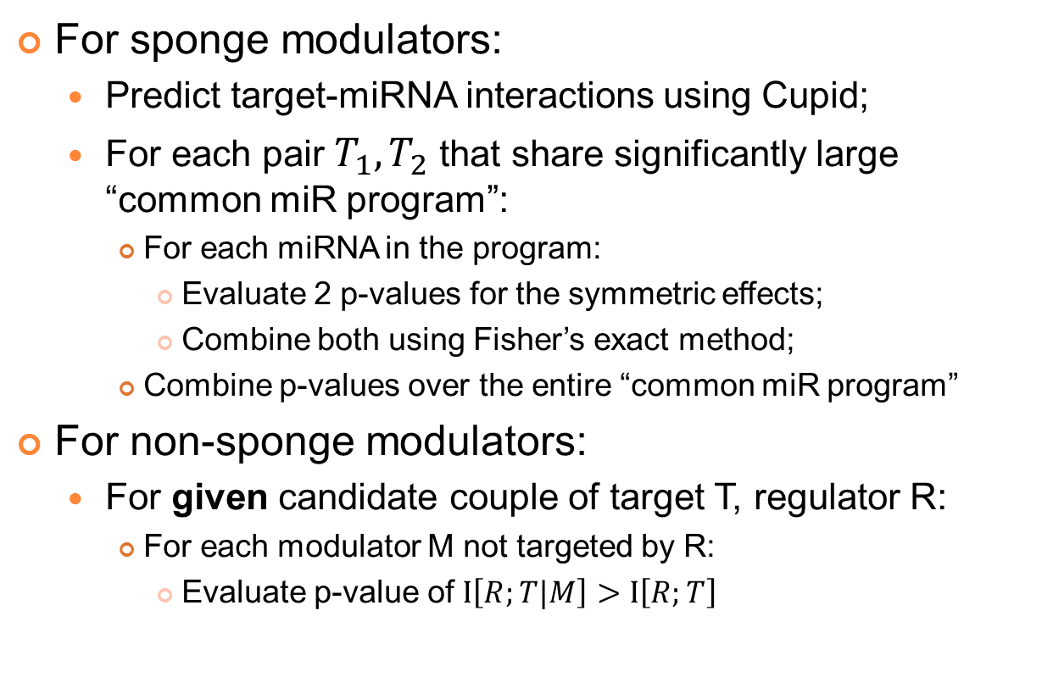
Hermes – Full Algorithm
For sponge modulators:
  Predict target-miRNA interactions using Cupid;
  For each pair $T_{1}, T_{2}$ that share significantly large “common miR program”:
    For each miRNA in the program:
      Evaluate 2 p-values for the symmetric effects;
      Combine both using Fisher’s exact method;
    Combine p-values over the entire “common miR program”
For non-sponge modulators:
  For given candidate couple of target T, regulator R:
    For each modulator M not targeted by R:
      Evaluate p-value of $I\left[R;T|M\right]>I\left[R;T\right]$
Notes:
Full algorithm
Given candidates – because the number of “all candidates” is too large, even if filtering out (M,T) that shrae significantly large “common miR program” (assuming that a non-symmetric regulation cannot occur). So (T,R) are only validated couples!
Non-sponge modulators – asymmetric by definition, so they shouldn’t share same miRNAs, or share an insignificant amount of.
Also interaction information should be evaluated asymmetrically.

Slide 40
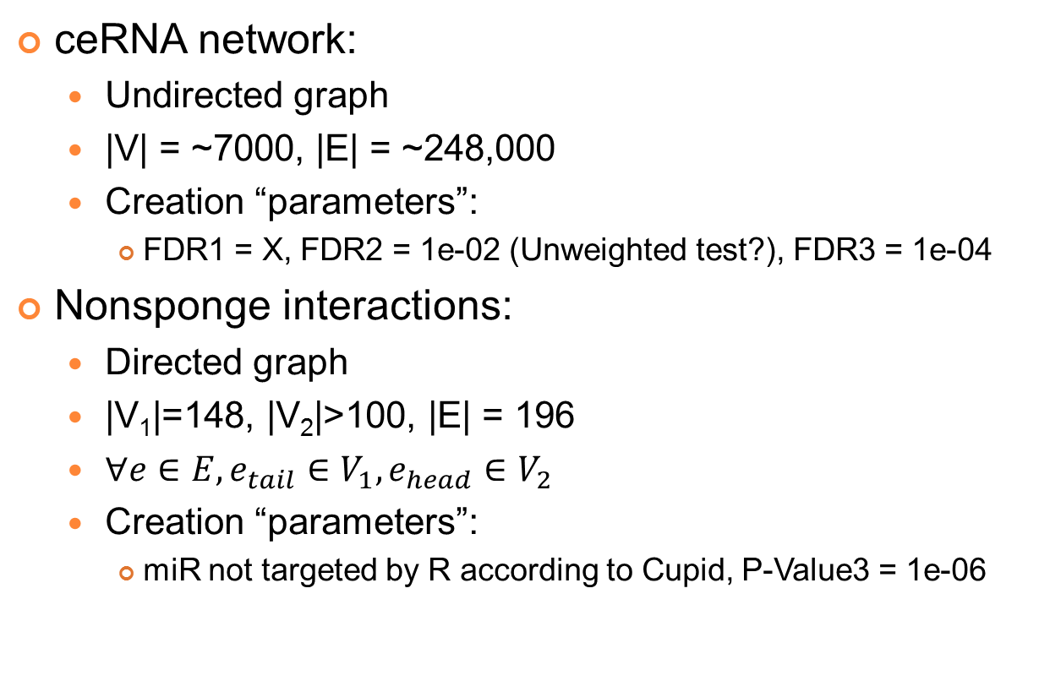
Hermes - Results
ceRNA network:
  Undirected graph
  |V| = ~7000, |E| = ~248,000
  Creation “parameters”:
    FDR1 = X, FDR2 = 1e-02 (Unweighted test?), FDR3 = 1e-04
Nonsponge interactions:
  Directed graph
  |V₁|=148, |V₂|>100, |E| = 196
  $∀e∈E,e_{tail}∈V_{1},e_{head}∈V_{2}$
  Creation “parameters”:
    miR not targeted by R according to Cupid, P-Value3 = 1e-06

Slide 41
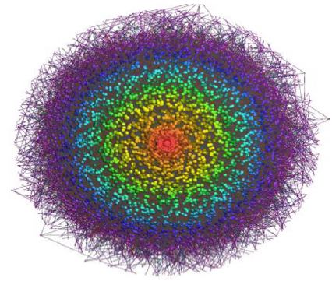
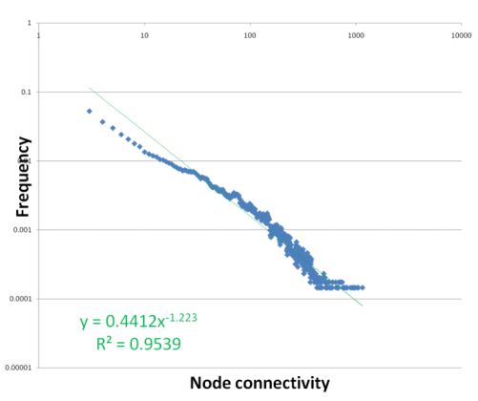
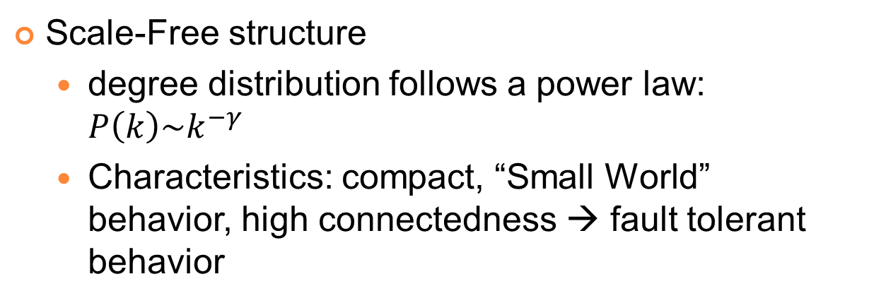
Hermes – ceRNA Network
Scale-Free structure
  degree distribution follows a power law: $P\left(k\right)\sim k^{−γ}$
  Characteristics: compact, “Small World” behavior, high connectedness → fault tolerant behavior
Notes:
To read more about power laws: http://arxiv.org/abs/0706.1062
Barabási–Albert - Showed how such networks are generated using preferential attachment.
“Roughly same size and scale-free structure of typical transcriptional regulatory networks”
Color – nodes are clustered according to subgraph connectivity. The color is connected to the size of the subgraphs.

Slide 42
Hermes – ceRNA Network
Include many dense structure:
  Largest – 564 node, 111 core subgraphs.
Coexpression of RNAs in a subgraph increases exponentially with the subgraph size
  |miR programs| supporting an edge:
    Avg 18, Max 153
Notes:
Correlation with the total concentration of its neighbors
Colors – according to the size of the subgraphs that contains it.
A structure in which each RNA is directly linked to at least 111 of the other 563 (in red).
Just to give the feeling that not all edges are the same. Not according to their weight in the statistical analysis, and not according to the participating edges

Slide 43
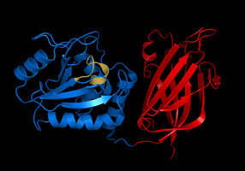
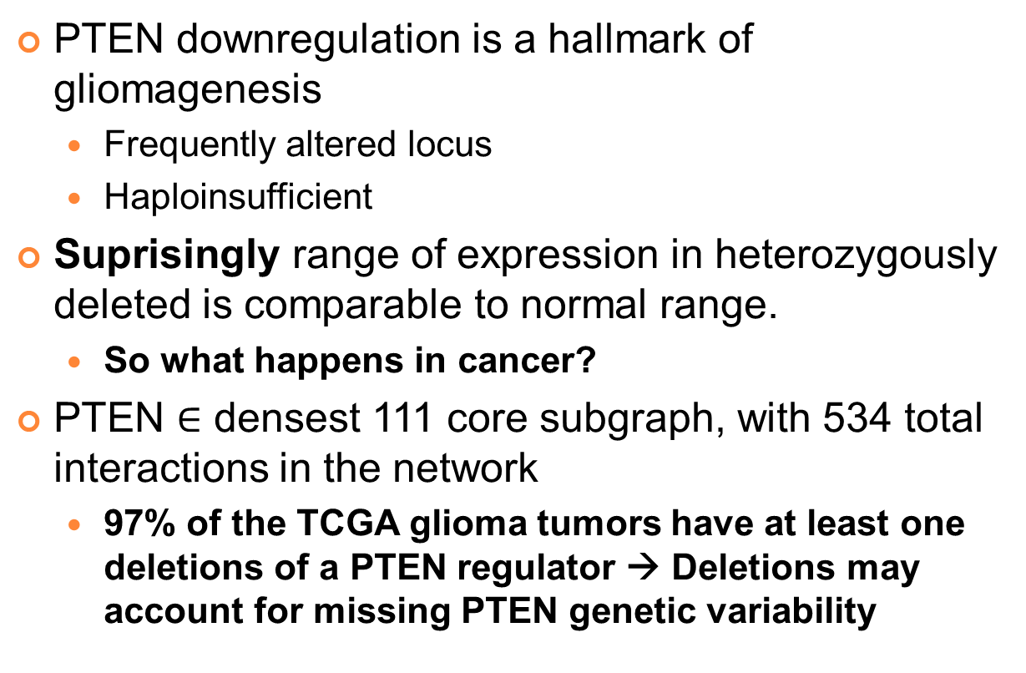
Hermes – PTEN Regulation
PTEN downregulation is a hallmark of gliomagenesis
  Frequently altered locus
  Haploinsufficient
Suprisingly range of expression in heterozygously deleted is comparable to normal range.
  So what happens in cancer?
PTEN $∈$ densest 111 core subgraph, with 534 total interactions in the network
  97% of the TCGA glioma tumors have at least one deletions of a PTEN regulator → Deletions may account for missing PTEN genetic variability
Notes:
1. Only 2% homozygous deletions
2. Changes in miR regulation – like amplifications of miR26a are found in gliomas.
97% - in ~50 tumors for which we have loci deletion data
בתמונה PTEN מויקיפדיה

Slide 44
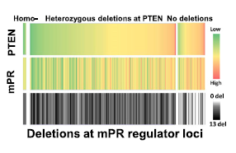
Hermes – PTEN Regulation
13 sponge regulators of PTEN with enriched locus deletions in PTEN intact tumors were chosen.
The correlation between PTEN and the number of deletions (\ total level of expression) is significant in both heterozygous and intact PTEN samples.
This correlation pattern is shown for 292 genes
Notes:
mPR – miR program regulated
More deletions → Less PTEN
We can use total expression instead of number of deletions.
Correlation of expression with no. deletions in the loci of the regulators was shown for 292 genes

Slide 45
Hermes – PTEN Regulation
Validation in cell-line:
  For 11/13 PTEN regulators:
    Repressing expression using siRNA → Significant reduction in PTEN luciferase activity
  For 10/13 PTEN regulators:
    Transfection with PTEN 3’UTR → Significant upregulation of the regulators
  Overall 13/13 were positive in either tests
  Controls were negative
Notes:
In SNB19 cells
Significant reduction compared to controls (i) Controls are not PTEN neighbors (ii) have variable length UTRs (iii) show a variety of correlation patterns with PTEN expression).
Control genes were negative + transfection with another gene 3’UTR didn’t cause effect + transfection with PTEN cDNA didn’t cause effect + checked in another cell line.
Also performed similar analysis on another gene – RUNX1.

Slide 46
Hermes – PTEN Regulation
Silencing PTEN regulators → cell proliferation.
The effect was comparable to that of siRNA-mediated PTEN silencing
Notes:
Methods – cupid second SVM

Slide 47
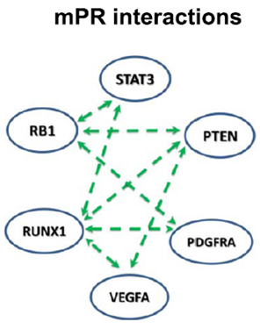
Hermes – Glioma Regulators Subgraph
Notes:
Glioma regulators form a dense subnetwork.
We can see that within the network transfection with PTEN increases there expression vs. the control.
This effect is eliminated with the silencing of DICER and DROSHA – suggesting it’s miR mediated.

Slide 48
Hermes – Glioma Regulators Subgraph
Strong cross-talk between PTEN and RB1 is suggested.
Co-ectopic expression of 3’UTR pairs at 50% concentration for each UTR shows a more than additive effect.
Cooporativity is known to exists in glioma. In particular, the loci of PTEN and RB1 are frequently deleted.
6\8 TP
5\11 FN
Notes:
Same trick for (almost) all other members in the graph.
And also the transfection of two types of UTRs (so the total concentration of the transfected species is the same) showing the effect to be synergistic and not just additive.

Slide 49
Hermes – Nonsponge Modulation
Limited by inaccurate prediction of individual miR targets
Only 148 modulators were found
Chose 3 interactions to validate:
Notes:
WNT7A for example increases PTEN by repression of the miR program.

Slide 50
Hermes – Nonsponge Modulation
Notes:
WNT7A – Only cDNA is transfected!
Silencing of DICER\DROSHA – Shows the effect is miR dependent.

Slide 51
Discussion
Using HERMES →
  Very large scale-free ceRNA network
  Very little non-sponge interactions (their “fault”?)
ceRNA network:
  Edges were formed only between genes sharing large miRNA program
  Nodes with higher connectivity were more coexpressed with neighbors in the graph
  Dense subgraph may suggest closeness in function
Validated:
  23/26 (or 20/26) sponge interactions (FPR ~10%-20%)
  5/11 in the dense subgraph were FN (FNR ~45%)
  3/3 nonsponge interactions
Notes:
FPR – is comparing favorably with available tools.
FNR – competitive with experimental false negative rates.

Slide 52
Discussion
Limitations:
  Only 3’UTR interactions
  Ignoring noncoding RNAs
Critics:
  Validation using non physiologic concentration levels
  Ignoring assymetrical interactions
    “only <0.02% of candidate sponge interactions where strictly asymmetric”
    But what about the triplet inclusion criterion?
  Nontrivial correlations among ceRNAs can emerge in experimental readouts due to transcriptional fluctuations even in the absence of miRNA-mediated cross-talk*
Notes:
*Figliuzzi, M., Marinari, E., & De Martino, A. (2013). MicroRNAs as a selective channel of communication between competing RNAs: a steady-state theory. Biophysical journal, 104(5), 1203–13. doi:10.1016/j.bpj.2013.01.012

Slide 53
Availability
Networks can be downloaded from the Supplementary Material section
HERMES source code should be available through:
  http://wiki.c2b2.columbia.edu/califanolab/index.php?title=Software/HERMES&oldid=2057
CupidTool (for the 2014 article) is available through:
  http://cupidtool.sourceforge.net/
Both tools are available through the geWorkbench interface:
  http://wiki.c2b2.columbia.edu/workbench/index.php/CeRNA_Query
  http://wiki.c2b2.columbia.edu/workbench/index.php/Cupid
Datasets for Glioblastoma (GBM), Ovarian (OV), Breast (BRCA), and Prostate (PRAD) cancer
Notes:
“Should be” – because I didn’t manage to download it.
For more databases see:
http://en.wikipedia.org/wiki/Competing_endogenous_RNA_%28ceRNA%29_databases_and_resources
Beware of ceFinder, which is oversimplistic.

Slide 54

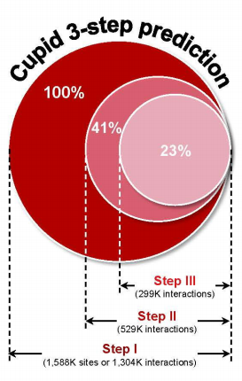
New Article - CUPID
Focus on the detection of miRNA-target interactions
Uses ceRNA cross-talk as a support for such interactions
Cupid predictions outperform other leading algorithms, based on multiple experimental assays
  High precision; Good, lower recall
Stages:
  miRNA binding site analysis
  miRNA-target interaction refinement
  Functional evidence analysis (mainly ceRNA)
Notes:
Starting with: 37M sites ~ 11M interactions
Compare themselves to many prediction software and using many experimental assays (PAR-CLIP, miRNA perturbation followed by mRNA and protein expression profiles, 3’ luciferase activity assays)
Comparing mainly using the F statistics (They have lower recall with higher precision)
They also use the new binding information to find a cancer subtype.

Slide 55
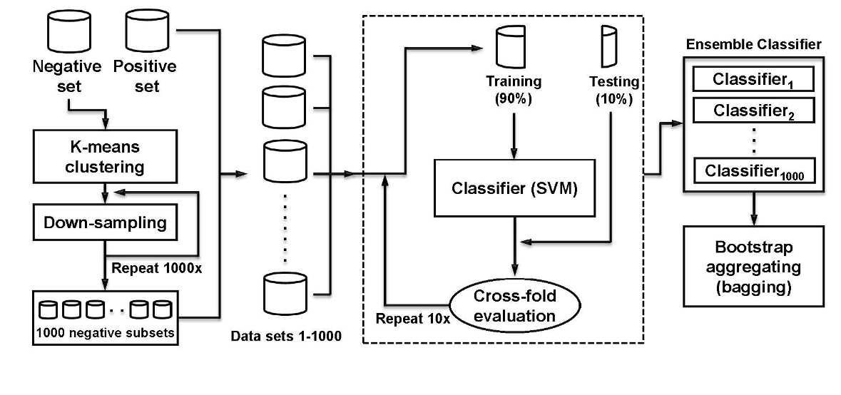
New Article - CUPID
Stage I SVM:
  Same Features: Quantile-normalized site scores (TS, PITA, miRanda), distance from 3’ UTR end, conservation scores (PhastCons)
  Better architecture*?
  Larger training set – 1,481
Notes:
THE DIFFERENCES THAT I SAW – THEY DON’T COVER THEM AT ALL
* For efficiency, sites were first clustered using K-means into 1481 clusters, matching the number of sites representing validated interactions. Euclidean-distance clustering was performed on feature vectors associated with sites. For classification with support vector machines, each cluster was represented by at least one randomly selected site, and large clusters were proportionally represented: x representatives were selected for a cluster that is x times the size of the smallest cluster.
A support vector machine classifier was then trained on selected representatives within a 10-fold cross validation framework, producing a test probability and an exclusion/inclusion decision for each binding-site candidate. The process was repeated 1000 times with cluster representatives chosen de novo at each run, producing an inclusion probability and an inclusion decision for each candidate biding site in each run. Binding site selection was based on a majority vote amongst the 1000 inclusion decisions (bagging), and binding-site scores were set to be the average probability across runs
More on the principal of downsampling in: http://pages.stern.nyu.edu/~fprovost/Papers/skew.PDF

Slide 56
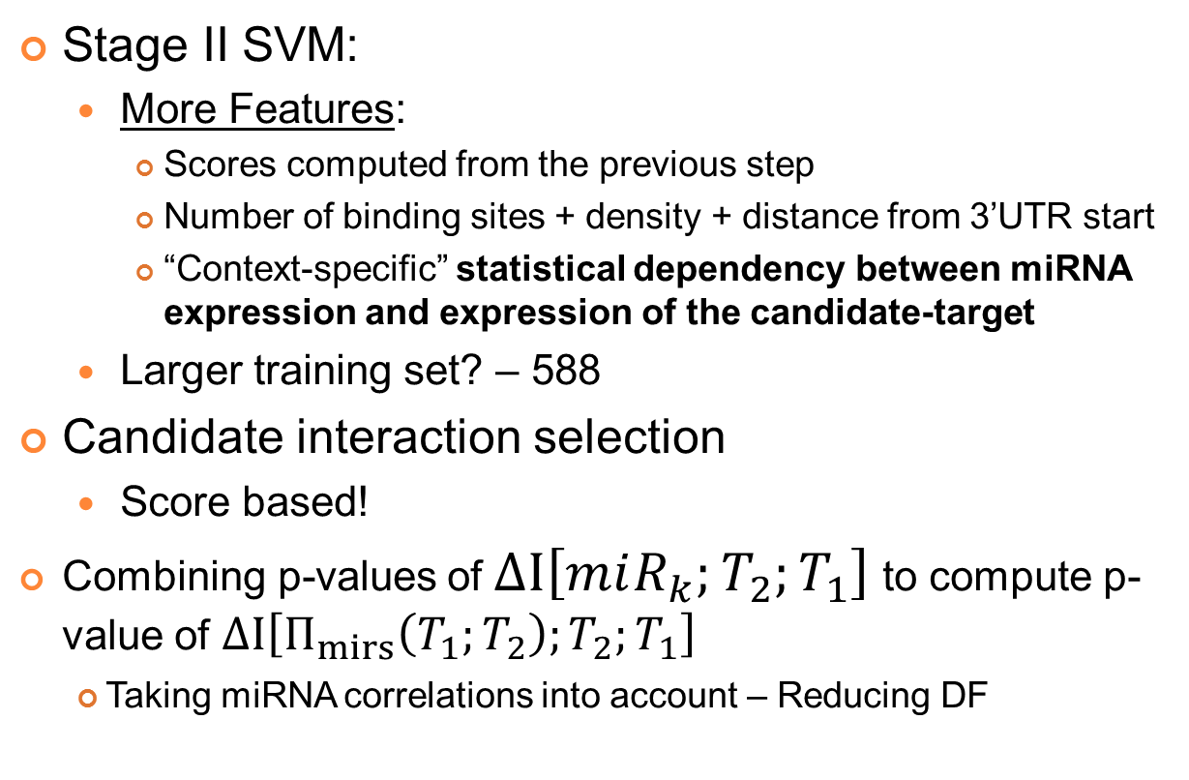
New Article - CUPID
Stage II SVM:
  More Features:
    Scores computed from the previous step
    Number of binding sites + density + distance from 3’UTR start
    “Context-specific” statistical dependency between miRNA expression and expression of the candidate-target
  Larger training set? – 588
Candidate interaction selection
  Score based!
  Combining p-values of $ΔI\left[miR_{k};T_{2};T_{1}\right]$ to compute p-value of $ΔI\left[Π_{mirs}\left(T_{1};T_{2}\right);T_{2};T_{1}\right]$
    Taking miRNA correlations into account – Reducing DF
Notes:
DF – degrees of freedom for the chi square statistic.

Slide 57
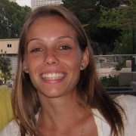
Ear Project
Not enough samples to use Hermes technique
Idea: Start with a similar tissue and filter over connections found
Focus: known deafness genes + regulatory connections
Filtering criteria:
  Distance from candidate genes
  miRNAs involved are expressed “enough” in the ear
  mRNAs involved are expressed “enough” in the ear
  Interacting mRNAs are close “enough” in their levels
  Dense subgraphs? Dense bipartitie graphs?
  mRNAs show levels variability between developmental stages
Measuring filter quality: Neighbors GO similarity
Notes:
What I am planning to do with this – EAR wise. Filtering, maybe checking if the GO distance are getting shorter vs. all sorts of random distributions.
We don’t have 250 samples for the ear. We will have two samples from two days, replicates after pooling.
GO Similarity – Right now is between the deafness genes and their remaining neighbors. Using R GOProfile package.

Slide 58

Kobi Perl
kobipe3@gmail.com
Department of Human Molecular Genetics and Biochemistry
Tel-Aviv University

Slide 60
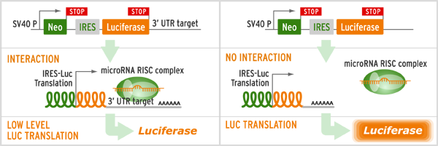
3’UTR Luciferase Reporter Assay

