Slide 1
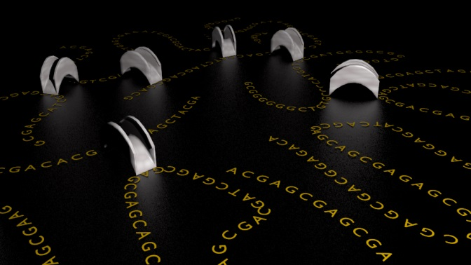
High-throughput genome scaffolding from in vivo DNA interaction frequency (Nature Biotechnology, Dec 2013) Noam Kaplan & Job Dekker University of Massachusetts
http://my5c.umassmed.edu/triangulation/
ACGT group meeting 6th Aug 2014
Yaron Orenstein

Slide 2
Outline
Introduction:
Genome scaffolding.
Hi-C data.
Problems and solutions:
Contig chromosome prediction.
Contig positions prediction.
De novo karyotyping.
De novo scaffolding.
Summary.

Slide 3
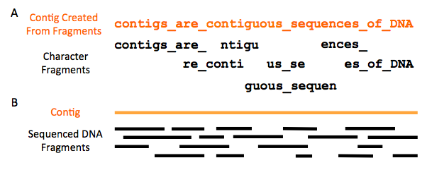
Introduction
Current assembly method use short reads.
These are constructed into contigs.
Putting contigs together is difficult due to repetitive sequences (Baker, Nat. Methods 2012).
Example: ~30 Mb of human euchromatic DNA remains unassembled.
http://gcat.davidson.edu/phast/

Slide 4
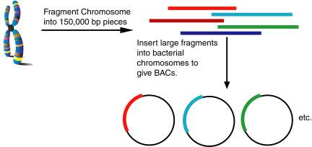
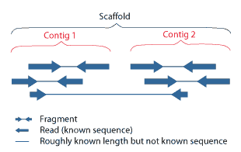
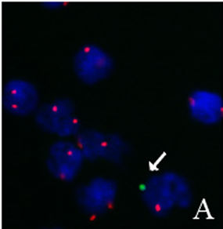
Scaffolding of contigs
Scaffolding is based on <40 kb long-insert paired-end read libraries.
Improvements by FISH and BAC sequencing.
Longer read technologies cannot bridge the gap (Bradnam et al. Gigascience 2013, Salzberg et al. GR 2012).
http://pages.towson.edu/jdrawn/chapter_1_intro_to_bioinfo.htm
(Lepez et al., PLoS one 2011)
http://bioops.info/2011/03/scaffold-or-supercontig/

Slide 5
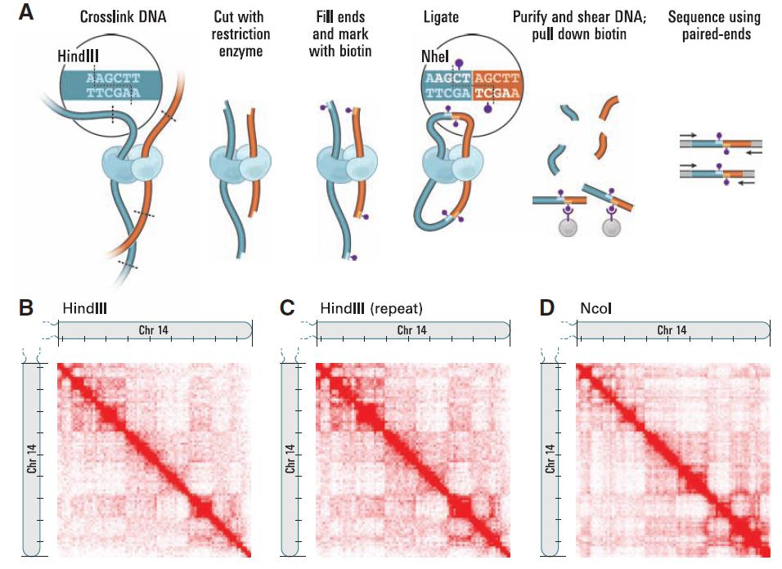
Hi-C: measure interaction freq.
(Lieberman-Aiden et al., Science 2009)

Slide 6
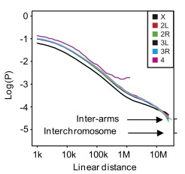
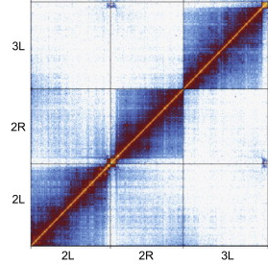
Two canonical interaction patters
Distance dependent decay (DDD) -
a general trend of decay in interaction frequency as a function of genomic distance.
Cis-trans ratio (CTR) –
a significantly higher interaction frequency between loci located on the same chromosome versus loci on different chromosomes.
(Sexton et al., Cell 2012)

Slide 7
Data
Human genome:
Human genome assembly hg19.
(international human genome consortium, Nature 2004)
Unplaced contigs from hg19 and HuRef.
(Levy et al., Plos Biology 2007)
Hi-C data (Dixon et al. Nature 2012):
Used a third of the reads available for human H1 ESC, totaling ~248 M unique mapped reads.
Normalization as in Dixon et al.

Slide 8
Problem 1 Scaffold Augmentation
Most of the genome is assumed to be correctly assembled.
The challenge: predict both the chromosome and locus of an unplaced contig.

Slide 9
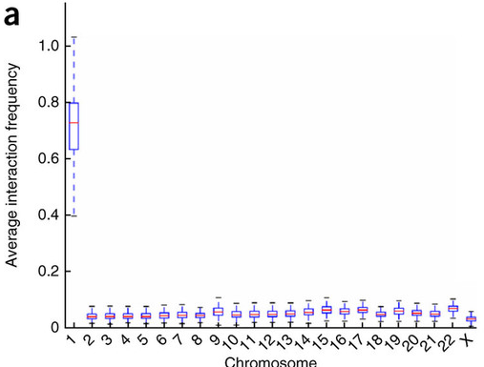
Chromosome prediction - simulations
Partitioning the human genome into 100-kb bins, each representing a large virtual contig.
Omitted its flanking 1mb on each side.
Average AUC = 0.9998

Slide 10
Chromosome prediction - classifier
(a₁, …, a₂₃) = mean interaction frequency.
A naïve Bayes classifier
c = chromosome; variables independent given c.
P(c) = prior prob. proportional to #contigs in c
Z = normalization factor
Cross-validation – leaving out the contig.
Posterior probability = confidence.

Slide 11
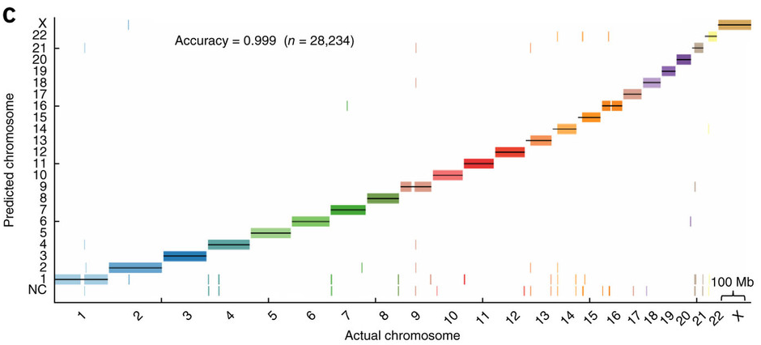
Results of classifier
Leaving out a 1-Mb flanking region on each side.
NC = not confident (posterior < 0.2).

Slide 12
Locus prediction
n interactions are sample out of m² possible interactions (m = #contigs).
p_{i,j} = probability of interactions (i,j)
x_{i,j} = # sampled interactions (i,j)
The probability mass function:
Problem: m² parameters!

Slide 13
Adding constraints
Exponential decay (α < 0):
Normalization
The complete model:
# parameters = m+1.

Slide 14
Estimating the parameters
Maximum log-likelihood approach:
Optimization function:
For position μ of a new contig, optimize:
Estimate α based on known positions and x_{i,j}.
Optimize:

Slide 15
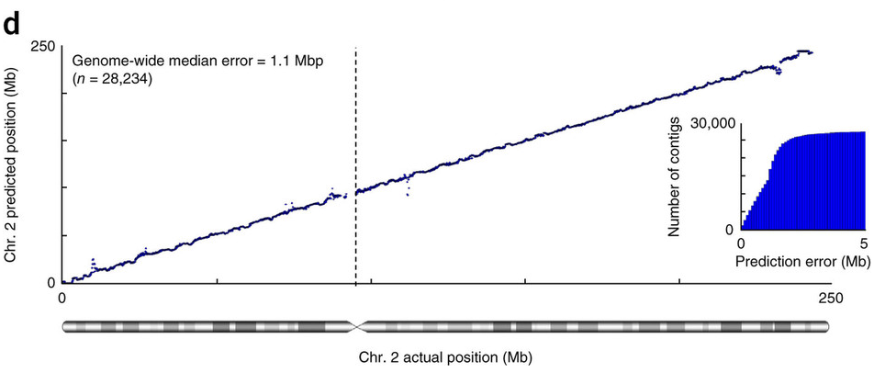
Locus prediction – simulation results
Prediction error = | predicted – actual |
89% within 2Mb, 24% within 0.5Mb

Slide 16
Real data
65 contigs (13.6Mb) that had sufficient Hi-C.
Used 100kb-bins– chose the bin with highest confidence for chromosome and locus pred..
Validation by study (Genovese, Nat. Gen. 2013) that used population admixture.
26 agreed out of 31 (placed by both methods)
24 out of 30 agreed with FISH localization.

Slide 17
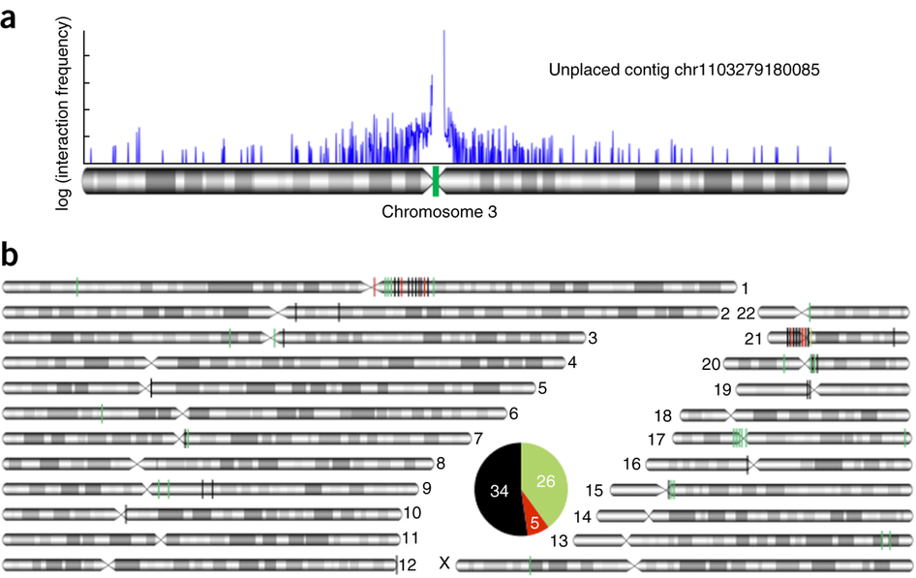
Real data (figure)

Slide 18
Problem 2 de novo genome scaffolding
Determine the karyotype:
the number of chromosomes.
the chromosomal assignment and position of all contigs.
Done simultaneously based on their mutual interaction frequencies
“Calculation of a global optimal solution cannot be guaranteed under most formulations”.

Slide 19
De novo karyotyping
Approximate distance = max {log(1+f)} - log (1 + f_{ij})
Average linkage clustering:
Merging the closest two at each step:
Distance defined as:
Determining #clusters:
Repeat 20 times: cluster 80% of the data.
Calculate the average cluster step for the final 1000 steps.
“Difference between average distances associated with consecutive clustering step”.
#chromosomes = average cluster step is maximum.

Slide 20
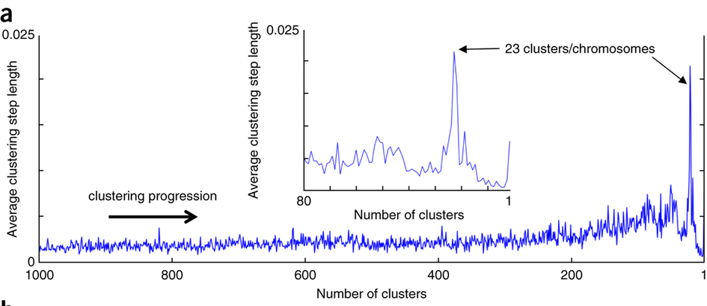
Simulation
Contigs 100kb, with 900kb gaps inbetween.

Slide 21
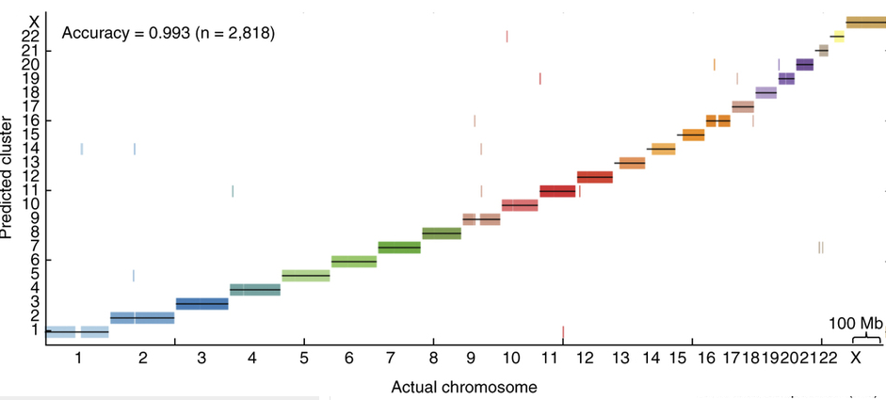
Simulation
Chromosome placement:

Slide 22
De novo chromosome scaffolding
Use the same model for locus prediction:
(nonconvex)
Initialize α in [0,-1] and s₁,…,s_{m} in [0,1].
Run L-BFGS numerical optimization.
Run multiple initialization (~2000 on ~1000 contigs) and choose the optimal solution.

Slide 23
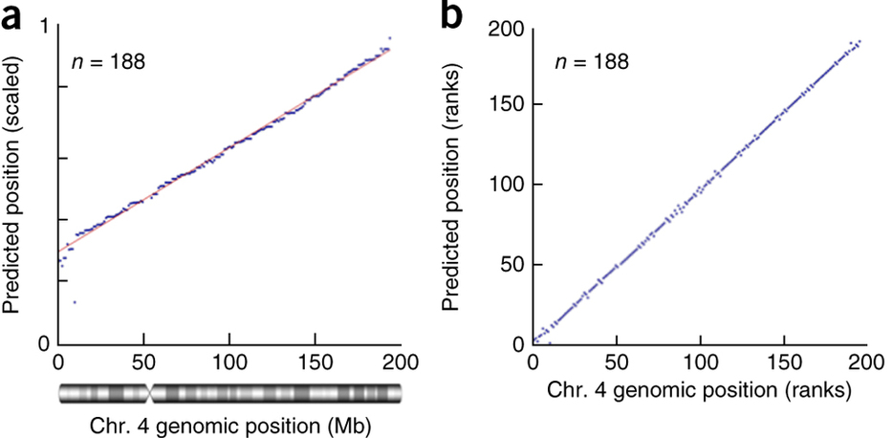
Simulation results
Contigs 100kb, with 900kb gaps inbetween.
Positions Rank
Median error rate < 2Mb
Error < 10Mb in 93% of pred.
Median error rate = 1

Slide 24
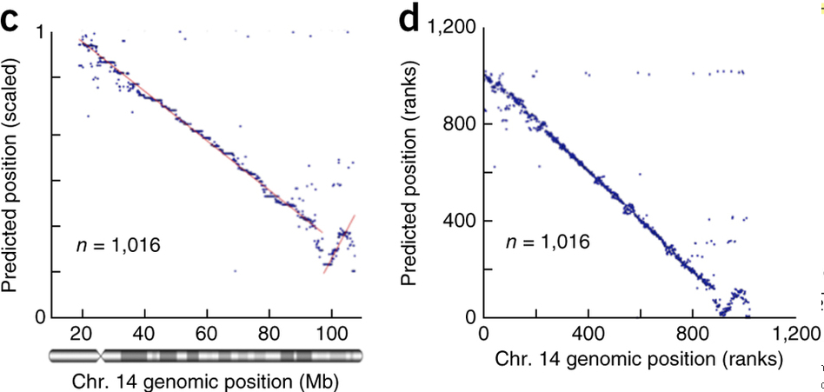
Real data - results
Chr. 14 contigs by ALLPATH-LG (Salzberg et al. GR 2012): 1,016 contigs, median contig length of 20 kb.
All Hi-C data (~ 15M unique mapped reads).
Median error < 976kb
Error < 10Mb in 96.4% of pred.
Median error rate = 6

Slide 25
Summary
Hi-C is useful for genome scaffolding thanks to the DDD and CTR properties.
Increased read coverage can help (for Hi-C) (in contrast to assembly of short reads).
Can be applied to other problems requiring long-range linkage information:
Genome assembly and haplotyping with Hi-C, Korbel and Lee, Nat. Biotech. 2013.

Slide 26
Possible extensions
Targeted assembly (4C).
Detecting assembly errors.
Detecting chromosmal aberrations.
Resolving non-unique genomic sequences.

