Slide 1
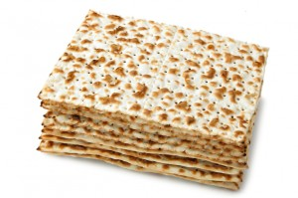
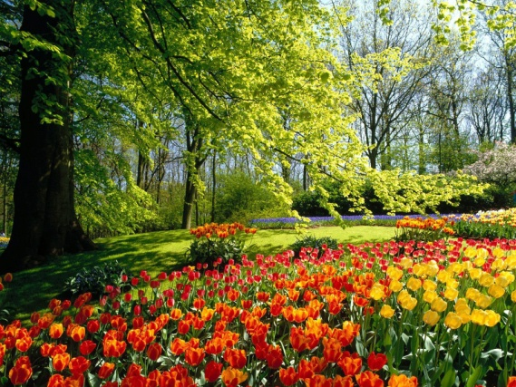
The longest sequence that does not cover a k-mer and its reverse-complement
Yaron Orenstein
After Passover ACGT group meeting 23rd April, 2014

Slide 2
Biological motivation
Oligo design that do not self-hybridize.
The desired property: k-uniqueness:
Every k-mer occurs at most once in s.
If a k-mer occurs in s, then its reverse complement does not.
Violations of k-uniqueness:
(Marianna D’Addario, Nils Kriege and Sven Rahmann, Designing q-Unique DNA sequences with Integer Linear Programs and Euler Tours in De Bruijn Graph, GCB 2012)

Slide 3
De Bruijn sequence of order k
A cyclic sequence s.t. every possible k-mer appears in it exactly once.
The most compact sequence to cover all k-mers.
Length: |∑|^{k}
DNA alphabet = {A, C, G, T}
dB sequence of order k=2:
ACGTAGAATTGGCCTC

Slide 4
De Bruijn graph of order k
Vertex = k-mer (x₁,…,x_{k}) |V|=|∑|^{k}
Directed edge for overlap of (k-1):
(x₁,x₂,…,x_{k}) → (x₂,…,x_{k},x_{k+1}) |E|=|∑|^{k+1}
∀v d⁺(v)=d⁻(v)=|∑|
AA
AC
A
CA
C
The graph is strongly connected
and each vertex is balanced
AT
AG
TA
GA
➔ Euler tour in a de Bruijn graph to generate de Bruijn sequence.
T
G
Notes:
לציין שזה רק גרף חלקי

Slide 5
ILP on DBG by D’Addario et al. to find maximum-length k-unique sequence
x_{e} = e is selected
a_{v}, z_{v} – start and end vertex of a path
γ(e) = RC of e
In(v), Out(v) = incoming and outgoing edges of v
The solution may consist of one or more cycles and at most one path.

Slide 6
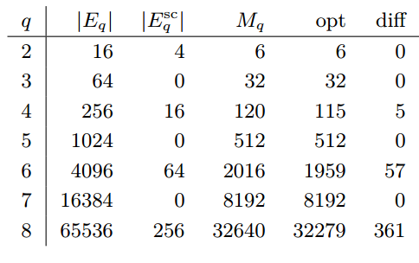
Results of ILP
Implemented with python-zibopt library.
Solved with the SCIP solver.
Single cycles for odd k.
Single paths for even k.
Upper bound:
(due to palindromes)
Upper - ILP | ILP solution | Upper bound | # palindromes | # edges

Slide 7
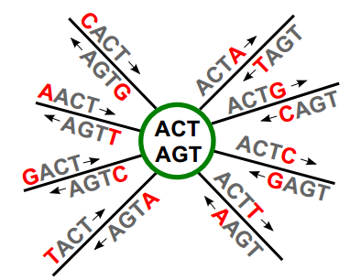
De Bruijn Quotient Graph (Anderson et al., JMB 2006)
A vertex represents a (k-1)-mer and its RC.
An edge represents a k-mer and it RC.
Admissible edge pair (e₁, e₂) =
the (k-1)-suffix of a label of e₁ is the (k-1)-prefix of a label of e₂
A self-loop is in two pairs.
(D’Addario et al., GCB 2012)

Slide 8
Euler Tours in DBQG
A vertex is balanced if all incident edges can be arranged in admissible edge pairs.
Examples for odd k:
A DBQG is Eulerian iff each vertex is balanced.
Missing: it has to be connected as well.
(D’Addario et al., GCB 2012)

Slide 9
The case of odd k
The DBGQ is an Eulerian graph.
Each Euler tour is a cycle whose overlapping concatenated edge labels specify a k-unique sequence of maximum length.
Each vertex is balanced:

Slide 10
The case of even k
The graph is not Eulerian due to unbalanced vertices
The problem: Eulerization-by-deletion.
Find an Eulerian graph G*=(V, E*) with E* subset of E s.t. |E \E*| is minimal.

Slide 11
D’Addario et al. solution for even k
“solvable via minimum-weight matching, … weight corresponds to the path length between the matched odd-degree vertices”.
“cannot be directly applied to the DBQG because of … admissible edge pairs”
WRONG: this matching does not guarantee edges-disjoint paths.

Slide 12
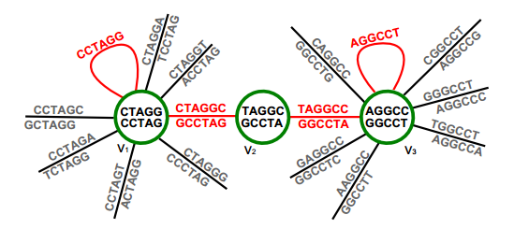
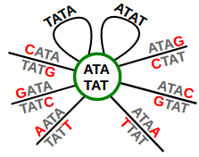
D’Addario et al. solution for even k
For each pair of palindromes, which are cyclic shifts of each other, delete their cyclic shifts.
#deleted_edges = (4^{k/2}/2-2)(k/2-1)
Missing: a proof.
(-2 due to TATA,ATAT)

Slide 13
D’Addario et al. solution for even k
“For q=6, we can manually improve … due to the symmetry of some self-complementary edges … find an alternative shorter path”
En example for k = 6: alternative path.

Slide 14
Our solution
We solved the problem of the shortest sequence to cover all k-mers.
Our algorithm works on de Bruijn graphs s.t.:
Every vertex is balanced.
There is a perfect matching of the edges.
The graph is strongly connected.
(Orenstein Yaron and Ron Shamir, Design of shortest double-stranded DNA sequences covering all k-mers with applications to protein-binding microarrays and synthetic enhancers, Bioinformatics 2013)

Slide 15
Our solution
For odd k, the de Bruijn graph satisfies these properties.
For even k, it does not due to palindromes, e.g. ACGT.
We suggest two edge-augmentation:
Sub-optimal in linear time.
Optimal in polynomial time.

Slide 16
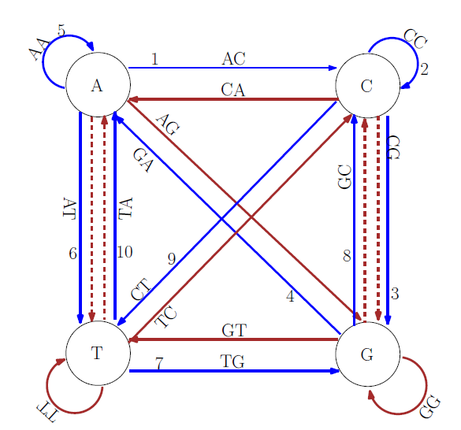
Algorithm example
Blue =
forward path
Brown =
reverse path
Numbers =
order of
traversal
RESULT: ACCGAATGCT , AGCATTCGGT

Slide 17
Our sub-optimal solution for even k
For each pair of palindromes, which are cyclic shifts of each other, delete their cyclic shifts.
Contribution 1:
A tighter bound for #deleted_edges:
Ψ(k) = set of even integers dividing k.
Example: ACGTACGT -> CGTACGTA -> GTACGTAC ->
TACGTACGT -> ACGTACGT

Slide 18
Contribution 2: a proof
For our algorithm the graph has to follow:
Every vertex is balanced.
A perfect matching of the edges.
Strong connectivity.
The first two properties:
Deleting cycles preserves the balance.
The perfect matching proved in our paper.

Slide 19
A proof of the strong connectivity
The set of deleted edges are cyclic shifts of palindromes (denote: shift edges).
For each two vertices – we start with a path in the original graph and replace shift edges.
Lemma: any edge that is either
in one hamming distance of a shift edge
has two adjacent equal positions different than a shift
is a non-shift edge.

Slide 20
How to replace a shift edge?
Denote the edge (x₀,…,x_{k-1}).
From vertex (x₀,…,x_{k-2}) traverse (x₀,…,x_{k-2},y) and then (x₁,…,x_{k-2},y,y) s.t. y≠x_{k-1} and y≠x₀.
Continue on shortest path till (y,x₁,…,x_{k-1}).
Each edge on the path is either:
in one hamming distance from a shift edge
has two adjacent equal positions different than a shift.

Slide 21
Overview of Lemma proof
Denote palindrome X-Y-RC(Y)-RC(X)
Assume mutations in Y are still palindrome: Y’-RC(Y)-RC(X)-X
=> Y’ = RC(X) AND X = RC(Y)
=> Y’ = RC(X) = Y - contradiction

Slide 22
Lemma 1
All edges in one hamming-distance of a shift edge are non-shift edges.
Proof:
1. (all indices are modulo k)
2. denote the palindrome (x₀,…,x_{k-1}) s.t. (x₀,…,x_{k/2-1})=RC(x_{k/2},…,x_{k-1})
3. In other words: x_{i}=C(x_{k-i-1})

Slide 23
Lemma 1 - continued
4. Assume contrary to the claim that (x₀,..,y_{l},..,x_{k-1}) is a shift edge => (x_{i},..,y_{l},..,x_{i-1}) is a palindrome
5. Ǝ i≠0,k/2, Ǝ l s.t. (x_{i},...,y_{l},…,x_{i+k/2-1})=RC(x_{i+k/2},…,x_{i+k-1})
6. x_{i+j} = C(x_{i+k-j-1}) = C(x_{i-j-1}) = x_{j-i}, except for j=l-i
1st = by 5, 2nd = by 1, and 3rd = by 3
7. For j = l-i: y_{l} = C(x_{2i+k-l-1}) = C(x_{2i-l-1}) = x_{l-2i}
8. By 6, x_{l-2i} = x_{l-4i} = x_{l-6i} = … = x_{l-2ki} = x_{l} (last = by 1)
9. Contradiction: y_{l} ≠ x_{l}

Slide 24
Lemma 2
All edges that have two adjacent equal positions different than a shift are non-shift edges.
Proof:
1. (all indices are modulo k)
2. denote the palindrome (x₀,…,x_{k-1}) s.t. (x₀,…,x_{k/2-1})=RC(x_{k/2},…,x_{k-1})
3. In other words: x_{i}=C(x_{k-i-1})

Slide 25
Lemma 2 - continued
4. Assume contrary to the claim that (x₀,..y_{l},y_{l+1}..,x_{k-1}) is a shift edge => (x_{i},..,y_{l},y_{l+1}..,x_{i-1}) is a palindrome
5. Ǝ i≠0,k/2, Ǝ l s.t. (x_{i}..y_{l},y_{l+1}..x_{i+k/2-1})=RC(x_{i+k/2},…,x_{i+k-1})
6. x_{i+j} = C(x_{i+k-j-1}) = C(x_{i-j-1}) = x_{j-i}, except for j=l-i,l-i+1
1st = by 5, 2nd = by 1, and 3rd = by 3
7. For j=l-i: y_{l} = C(x_{2i+k-l-1}) = C(x_{2i-l-1}) = x_{l-2i}
8. For j=l-i+1: y_{l+1} = C(x_{2i+k-l-2}) = C(x_{2i-l-2}) = x_{l-2i+1}
9. By 6, x_{l-2i} = x_{l-4i} = x_{l-6i} = … = x_{l-2ki} = x_{l} (last = by 1)
10. By 6, x_{l-2i+1} = x_{l-4i+1} = x_{l-6i+1} = … = x_{l-2ki+1} = x_{l+1} (last = by 1)
11. Contradiction: y_{l} ≠ x_{l} and y_{l+1} ≠ x_{l+1}

Slide 26
An optimal solution
After removing all palindromic edges, we are left with 4^{k/2}-4 unbalanced vertices.
Example:
Indegree | Outdegree
3 | 4 | Top
4 | 3 | Bottom

Slide 27
An optimal solution
Finding minimum weighted matching will not work – since some edges may be repeated.
Need to find a set of edge-disjoint paths, whose total length is minimum.
Reduction to minimum cost flow.

Slide 28
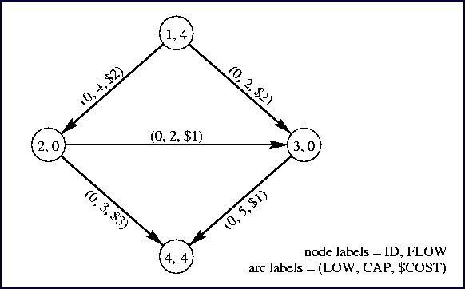
Minimum-cost flow
In addition to edge capacities, edge costs.
Find flow of size F with minimum cost.
Cost of flow = sum over all edge (flow х cost).
In our case, both
capacities and
costs are 1.
F = (4^{k/2}-4) / 2
(http://lpsolve.sourceforge.net/5.5/DIMACS_mcf.htm)

Slide 29
Algorithm for minimum cost flow: Successive Shortest Path (SSP)
While there exists an augmenting path:
Augment the flow by minimum-cost path.
Calculate residual graph:
Residual cost: if (u,v) had cost c, then (v,u) has cost -c.
Residual capacity: c‘(u,v) = c(u,v) – f(u,v)
Running time:
#iterations = F = θ(4^{k/2})
Each iteration: Bellman-Ford = θ(mn) = θ(4^{2k})

Slide 30
Correctness
Need to prove that the graph after deletion:
Every vertex is balanced.
Strongly connected.
A prefect matching of the edges.
1. The graph is balanced before deletion.
Only cycles are removed, thus it is kept balanced.

Slide 31
Perfect matching of the edges
Need to modify algorithm to insure that.
Whenever augmenting a flow through a path, send flow through the RC path.
(CTCATGAGC -> TCATGAGCT -> CATGAGCTC -> ATGAGCTCA)
(TGAGCTCAT -> GAGCTCATG -> AGCTCATGA -> GCTCATGAG)
Need to prove that the RC path is also a shortest augmenting path.

Slide 32
Lemma
Shortest paths are monotonically increasing.
Not difficult to prove.
Already proved in:
(Tobias Bruncsh, Kamiel cornleissen, Bodo Manthey and Heiko Roglin, Smoothed Analysis of the Successive Shortest Path Algorithm, SODA 2013)

Slide 33
Properties of RC path
The shortest path and it RC path are edge-disjoint (not containing palindromes).
They have the same (cost-wise) length.
Thus, the RC path is also a shortest path.

Slide 34
Strong connectivity
?
Options:
Find properties of removed edges and prove that the remaining graph is strongly connected.
Modify algorithm to insure graph is connected.
Accept more than one strongly connected component.

Slide 35
Improving the running time
Use Johnson’s algorithm to run Dijkstra.
Reduced cost c’(u,v) = c(u,v)+p(u)-p(v).
p(u) = shortest path from s to u.
Each edge on shortest augmenting path has reduced cost 0.
Iteration Running time: O(m + n log n) = O(k∙4^{k})

Slide 36
Improving the running time
n-1 => Lengths by reduced costs >= 0
Shortest paths are monotonically increasing.
A priority queue with del-min and dec-key in O(1) amortized can be implemented.
Dijkstra running time = O(m+n) = O(4^{k})
A scaling algorithm for the shortest path problem, http://www.stanford.edu/class/cs361b/files/cs361b-notes.pdf

Slide 37
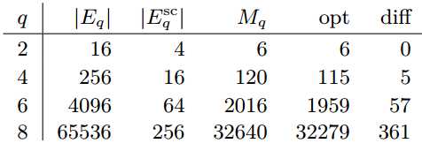
Results
10 | 8 | 6 | 4 | 2
521736 | 32274 | 1956 | 114 | 6 | Linear
521754 | 32274 | 1956 | 114 | 6 | Optimal
Solution for covering all k-mers
D’Addario et al. results

Slide 38
Empirical results for k=10
24 vertices with degree 2.
Vertices with degree 2
CGCGCGACG | ATCTATATA
GCGCGCCCG | ATGTATATA
CGACGCGCG | ATTTATATA
GCCCGCGCG | ATATATCTA
CGTCGCGCG | ATATATGTA
CGCGCGTCG | ATATATTTA
TATATAAAT | GCGCGCAGC
TATATACAT | GCAGCGCGC
TATATAGAT | CGGGCGCGC
TAAATATAT | GCTGCGCGC
TACATATAT | CGCGCGGGC
TAGATATAT | GCGCGCTGC
# cycles | Cycle length
2 | 2
6 | 4
30 | 6
108 | 8
252 | 10
72 | 12
36 | 14
0 | 16
6 | 18

Slide 39
Conclusion
Proved the correctness of a linear time sub-optimal algorithm.
Gave an polynomial-time optimal solution for the problem.
Still need to prove the graph is strongly connected after removing the edges.

