Slide 1
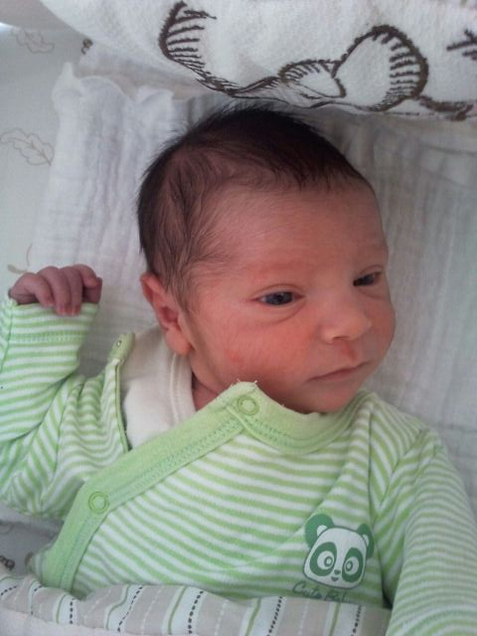
Inferring binding site motifs from HT-SELEX data
ACGT group meeting 5th February, 2014
Yaron Orenstein

Slide 2
Gene expression regulation
Transcription is regulated mainly by transcription factors (TFs) - proteins that bind to DNA subsequences, called binding sites (BSs).
TFBSs are located mainly in the gene’s promoter – the DNA sequence upstream the gene’s transcription start site (TSS).
TFs can promote or repress transcription.

Slide 3
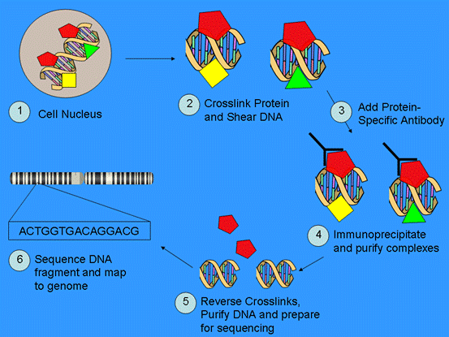
ChIP-seq
(http://shengqingshibai.blog.163.com/blog/static/1310065201258113020325/)

Slide 4
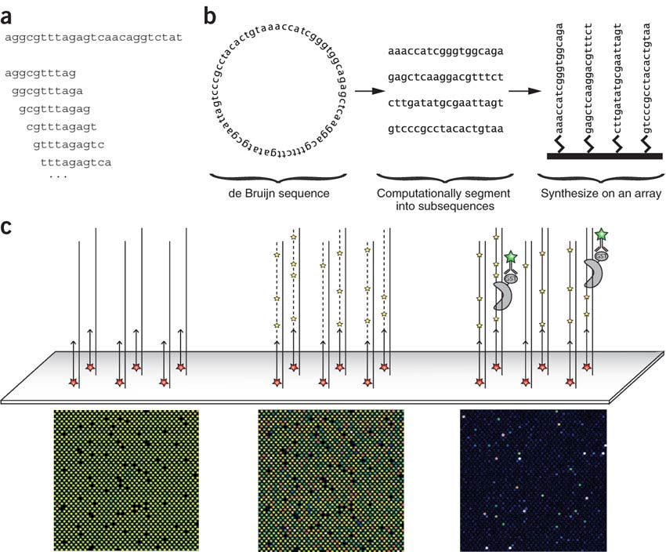
Protein binding microarray
(Berger et al., NBT 06)

Slide 5
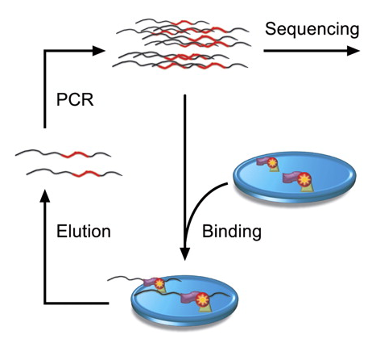
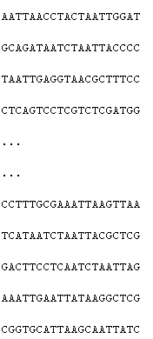
High-throughput SELEX
cycles 0-3
(Jolma et al., Genome Research 10)

Slide 6
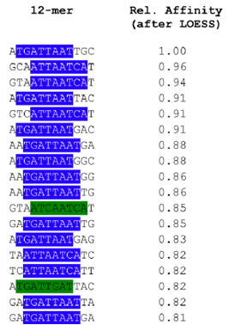
TFBS models
PWM K-mer list
Logo format:
6 | 5 | 4 | 3 | 2 | 1
0 | 0.2 | 0.7 | 0 | 0.8 | 0.1 | A
0.6 | 0.4 | 0.1 | 0.5 | 0.1 | 0 | C
0.1 | 0.4 | 0.1 | 0.5 | 0 | 0 | G
0.3 | 0 | 0.1 | 0 | 0.1 | 0.9 | T

Slide 7
Comparing PBM and HT-SELEX
(Orenstein and Shamir, NAR 2014)

Slide 8
HT-SELEX predicts PBM binding
HT-SELEX and PBM mostly agree
Average AUC over 128 PBM profiles:
On 118 (unpaired) PBM profiles: average AUC
Together: 0.875
PBM-derived models |  |  |  |  | HT-SELEX
AmadeusPBM | Seed-and-Wobble | RankMotif++ | BEEML-PBM | RAP | Jolma et al.
0.877 | 0.872 | 0.882 | 0.899 | 0.898 | 0.825
PBM-derived models | HT-SELEX
RAP | Jolma et al.
0.945 | 0.928

Slide 9
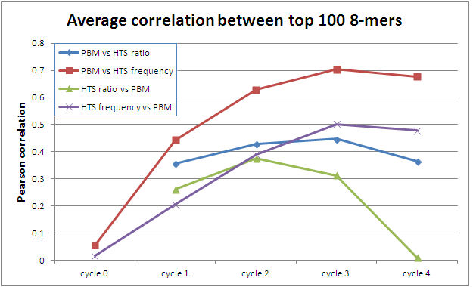
Comparing PBM and HT-SELEX top 8-mers
PBM ranks 8-mers better.
Frequency is better for HT-SELEX scores.
Over-specification in the last cycles.

Slide 10
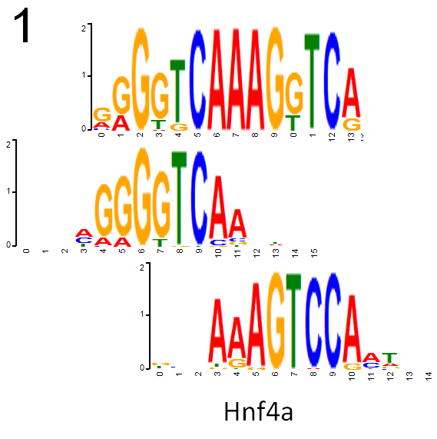
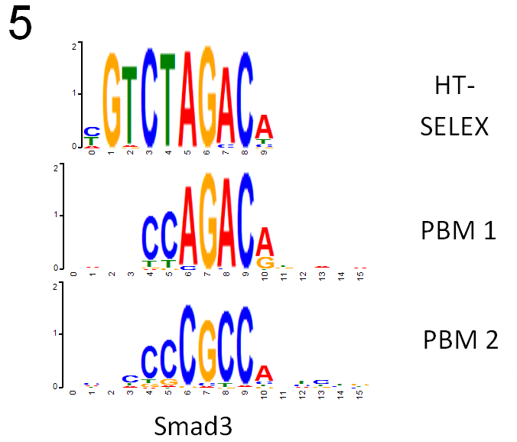
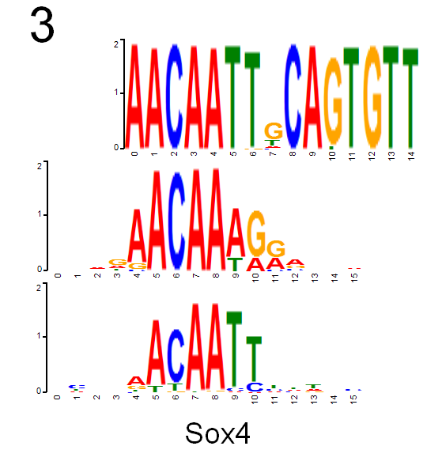
Examples of disagreement
Similar to PBM2, but longer
Similar to PBM1, but longer
Not similar

Slide 11
In vivo comparison
111 ChIP-seq experiments covering 15 TFs (downloaded from ENCODE).
Top 500 peaks as positive.
Sequences 300 bp downstream as control.

Slide 12
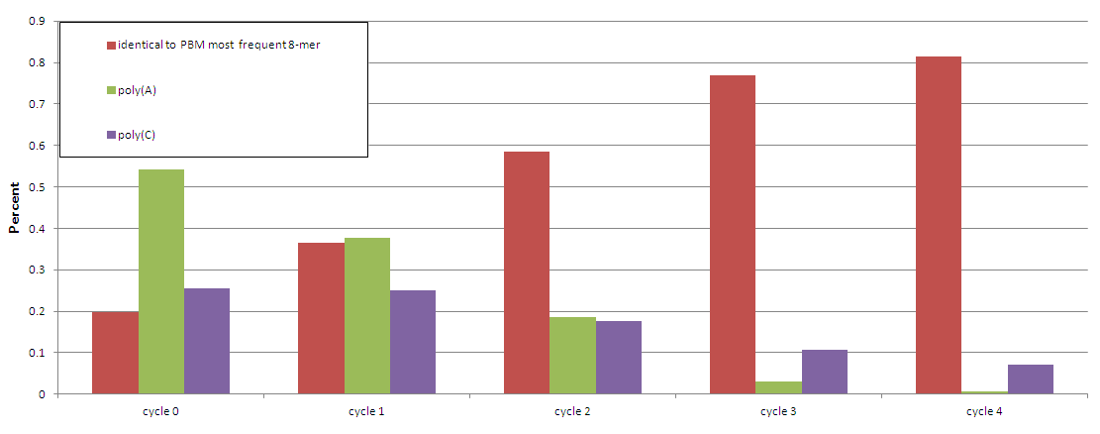
Biases in HT-SELEX
Most frequent 8-mer identification
False oligos (ATF7 example)

Slide 13
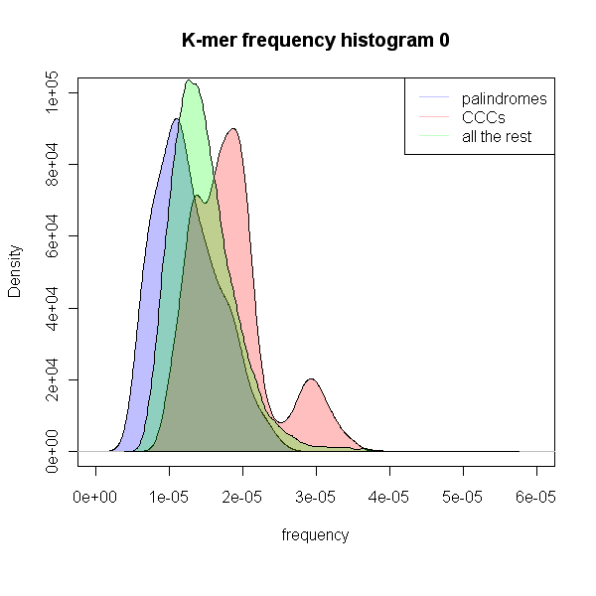
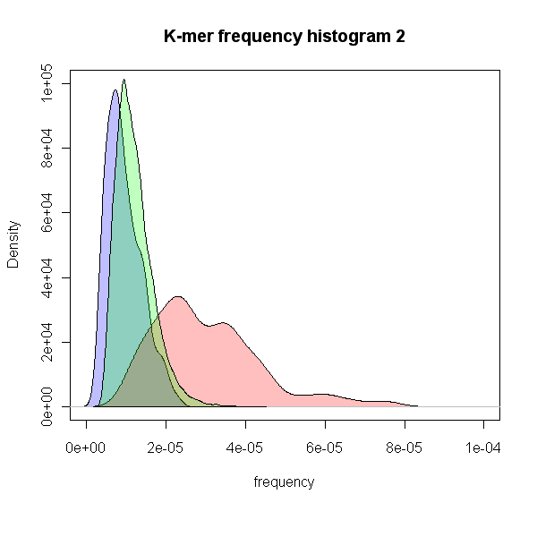
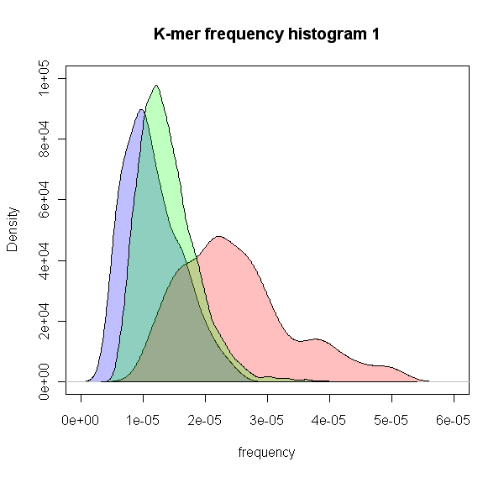
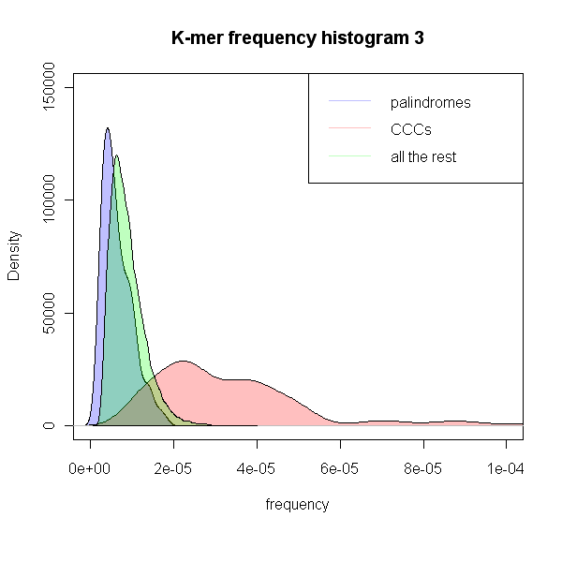
Statistics of k-mer counts
Median 8-mer counts over 520 experiments.
1 to 2
0 to 1
2 to 3

Slide 14
Inferring binding site motifs from HT-SELX data
(ongoing project)

Slide 15
Generation of Binding Models (Jolma et al., GR 10)
Generate 5-12-long PWMs using k-mers W, for which d_{H}(S, W) ≤ 1, where S is the consensus.
Correct for non-specific carryover.
Select PWM that was derived from at least 500 sequences (preferably, more than 3000), with highest information content.
Use earliest possible cycle (to avoid distortion caused by exponential enrichment).

Slide 16
Our algorithm overview
Fix k-mer counts.
Choose cycle.
Find seed.
Build PWM based on seed.
Extend PWM to side positions.
Trim uninformative side positions.

Slide 17
Fix k-mers counts
Fix k-mers counts of each cycle.
For each k-mer:
If the k-mer count > 5 * reverse complement count
Set k-mer count to the reverse complement count.
Example: SOX4, cycle 3
GGGGGGGG | CCCCCCCC
751 | 3,898
TATCATTC | GAATGATA
982 | 3,183

Slide 18
Choosing the cycle
Using KL-diverge to choose the cycle.
First cycle for which KL-dis > 0.1 (on top 100 8-mers) (or last if no cycle was chosen)

Slide 19
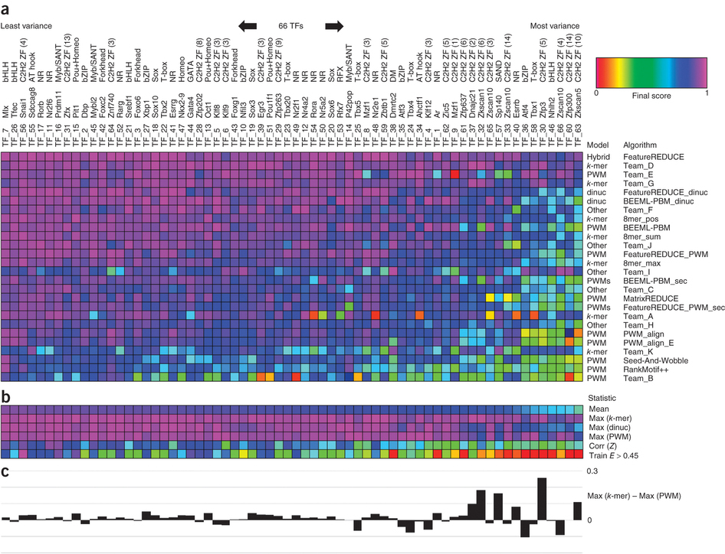
8-mer model – DREAM paper
“k-mer–based models score best overall.
Other approaches do nearly as well”
(Weirauch et al., NBT 13)

Slide 20
8-mer model, predicting in vitro
For each HT-SELEX experiment, if it has a PBM experiment on the same TF:
Predict using 8-mer model and PWM model.
Average AUC on 186 paired HT-SELEX and PBM experiments (paired):
Average AUC on 344 paired HT-SELEX and PBM experiments (in cross-validation)
PWM SELEX | PWM PBM | 8-mer SELEX | 8-mer PBM
0.831 | 0.917 | 0.844 | 0.924
PWM SELEX | PWM PBM | 8-mer SELEX | 8-mer PBM
0.940 | 0.962 | 0.948 | 0.972

Slide 21
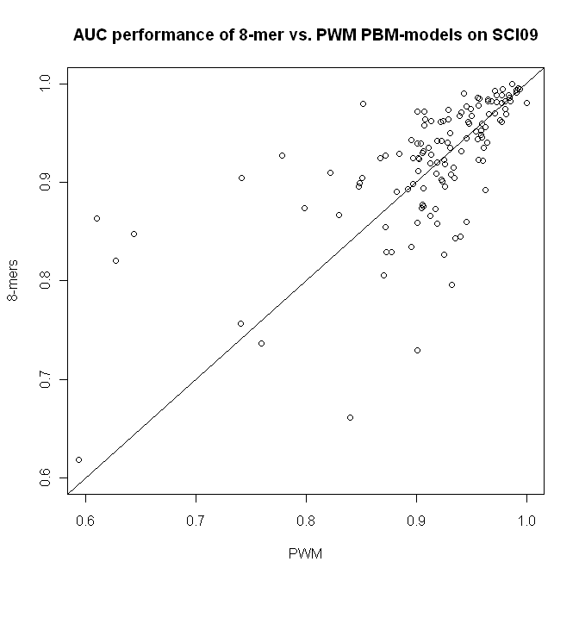
8-mer model, predicting in vitro
TO DO: color according to TF family.

Slide 22
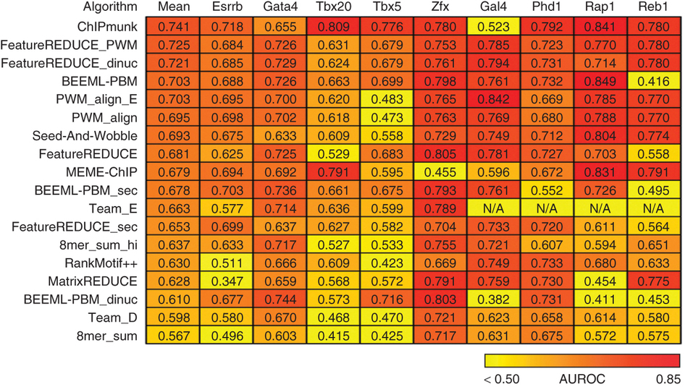
8-mer model, predicting in vivo
On 29 paired HT-SELEX and ENCODE ChIP-seq experiments on the same TF, average AUC:
PWM SELEX | PWM PBM | 8-mer SELEX | 8-mer PBM
0.779 | 0.741 | 0.728 | 0.670
(Weirauch et al., NBT 13)

Slide 23
Testing improvements on 8-mer model
8mer + fix + cycle | 8-mer + cycle | 8-mer + fix | Raw 8-mer
0.914 | 0.916 | 0.913 | 0.913
Average AUC over 518 profiles (some paired profiles and some cross-validated)
The difference between 8-mer and 8-mer + cycle is significant.
Conclusions:
Choosing the cycle helps.
Fixing k-mers does not improve (will improve seed selection).

Slide 24
Seed finding
The most frequent 8-mer in the a cycle (last or chosen) (with or without k-mer count fix)
For each HT-SELEX experiment, find the seed and test if it fits the PBM / Jolma seed
number of hits = at most 2 positions offset,
PBM seed: at most 2 mismatches
SELEX seed: at most 1 mismatch
fix + cycle | cycle | fix | -
215 | 204 | 214 | 203 | PBM (238)
517 | 506 | 516 | 507 | Jolma (546)

Slide 25
TAATGCGA 150
ATAATGCG 132
Weight
AATGCGAC 98
RAP
GATAATGC 95
TAATGTGC 85
AATGCGCC 76
TAATGTAC 74
ATGTAACC 71
 |  |  | 0.95
 |  | 0.95
 |  |  |  | 0.9
 |  |  |  |  | 0.85
PWM
(Orenstein et al., JCB 13)

Slide 26
BEEML
E_{sp}(S_{i}) = binding energy of sequence Si.
ε(b, k) = energy contribution of base b at position k
Si(b, k) = indicator variable of base b in position k in sequence Si
P(Si|s=1), P(Si) = proportion of sequence Si in cycle 1 / 0, respectively
E_{ns} = energy of non-specific binding.
μ = TF not bound concentration.
Non-linear parameter estimation (μ, ε, E_{ns}) – Levenberg-Marquardt algorithm

Slide 27
PWM generation
Possible options:
Using k-mers one hamming distance away.
RAP: using top 500 k-mers, aligning them.
BEEML: energy-based model.
BEEML (3) | Jolma style (1) | Rap style (2) | Jolma models
? | 0.843 | 0.873 | 0.883

Slide 28
Model extensions and trimming
Extend 4 positions to each side.
Analyze all oligos that contain the seed.
Build the side positions by their counts.
Trimming side positions:
IC below 0.2 OR based on less than 1000 counts.
Rap style with trim and extend | Rap style no trim and extend
0.873 | 0.799

Slide 29
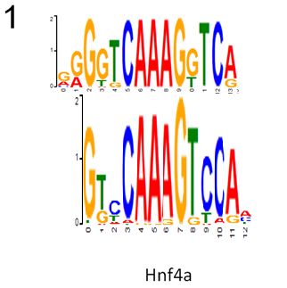
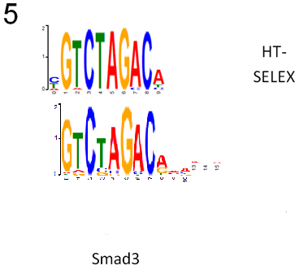
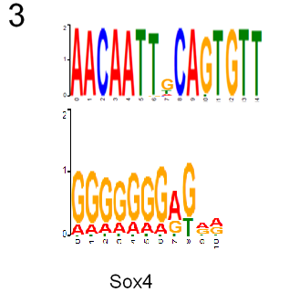
Examples
1, 5 – ours is slightly better
3 – ours is worse

Slide 30
Future plans
Run BEEML.
Choose k depending on the read coverage.
Test on ChIP data.
Use all cycles to generate a robust score.

Slide 31
Using all cycles
Denote, p = BS binding, q = non-BS binding.
N = N_{S} + N_{N} = sites in cycle 0.
Sites in cycle i = p^{i}·N_{S} + q^{i}·N_{N}
Frequency in cycle i (F_{i}) = p^{i}·N_{S}/(p^{i}·N_{S} + q^{i}·N_{N})
p/q = (N_{N}/(N_{S}(1- F_{i})))^{1/k}

Slide 32
Conclusions
Algorithm that automatically overcomes biases in the technology.
Data is explained by a single non-redundant model.
Performance – to be improved…

