Slide 1


highlights
On the representation of de Bruijn graphs
Changepoint analysis for efficient variant calling
Roye Rozov, 2/7/14
Gray colored slides
sourced from R. Chikhi,
RECOMB 2014 presentation

Slide 2
Common thread
Both papers seek to scale down cost of deep sequencing data analysis
1. aims to achieve the lower bound of memory use in de novo genome assembly
2. aims to reduce run time of variant calling by utilizing change points

Slide 3
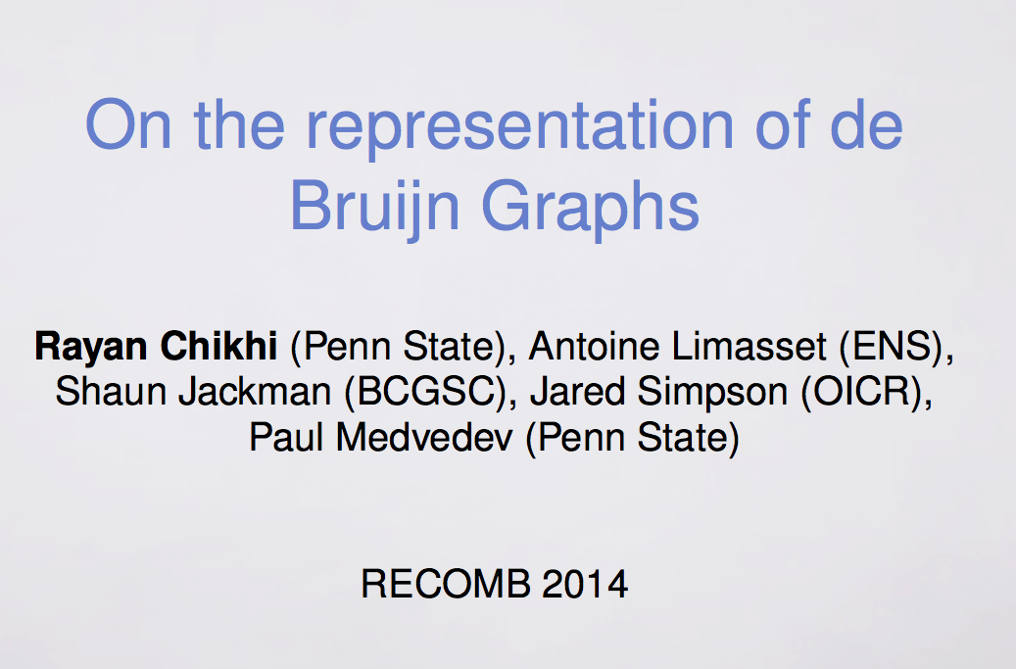
Notes:
Some slides from Rayan Chikhi

Slide 4
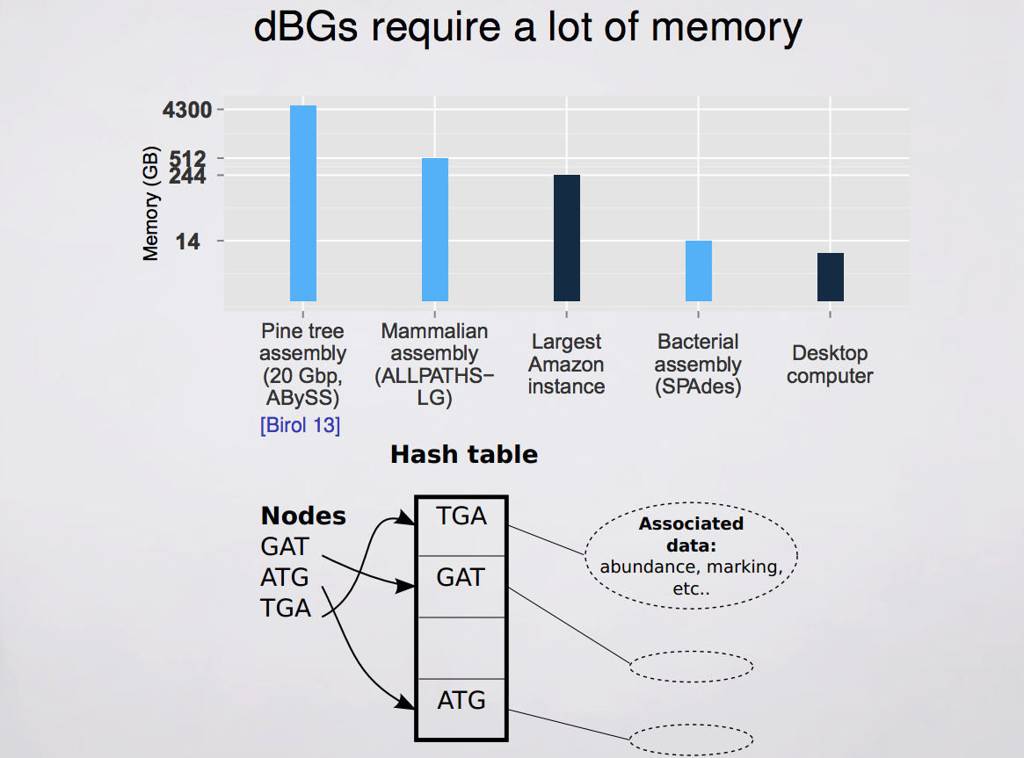

Slide 5
Lower bound of exact representation of a k-mer set
For human genome, k = 27 leads to n = 2.4 * 10^9 nodes ➔ ~28 bits/k-mer

Slide 6
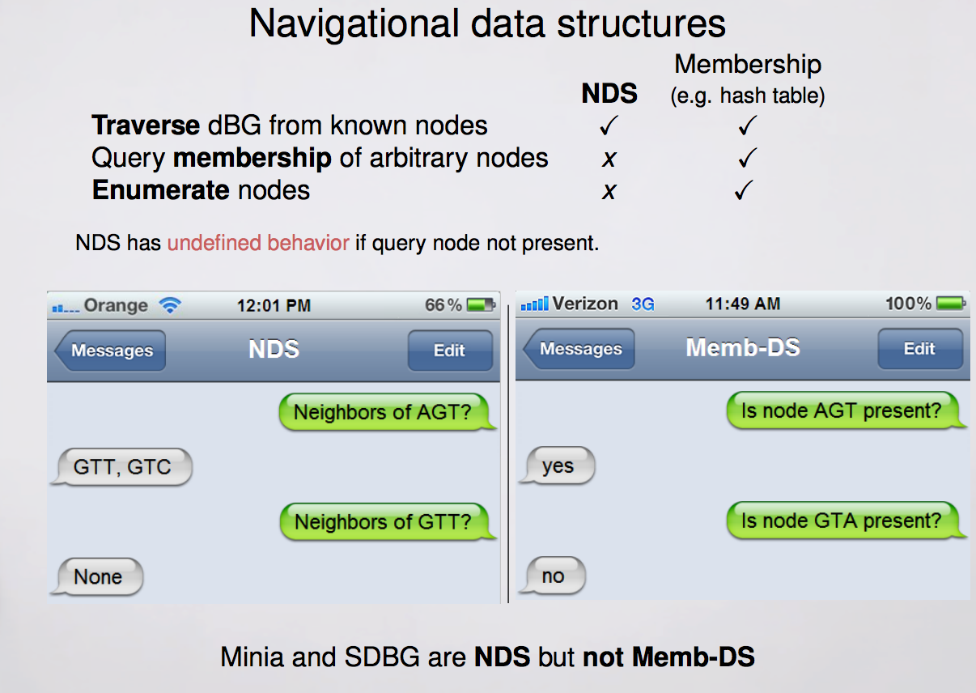

Slide 7
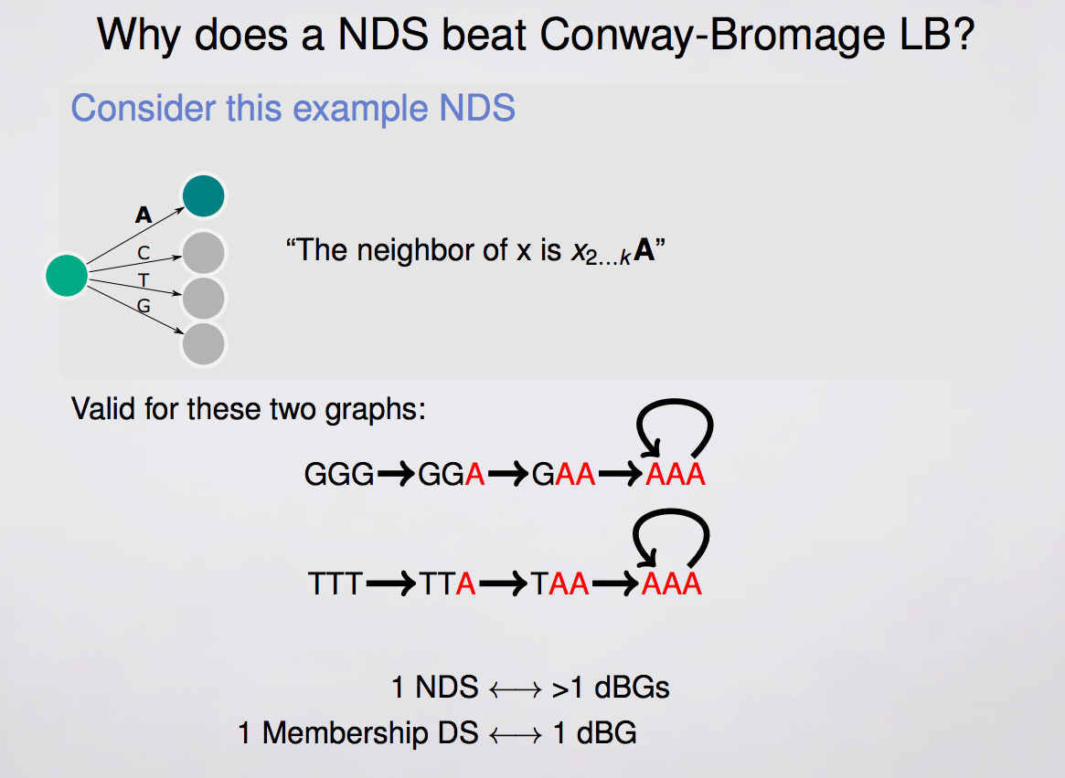

Slide 8
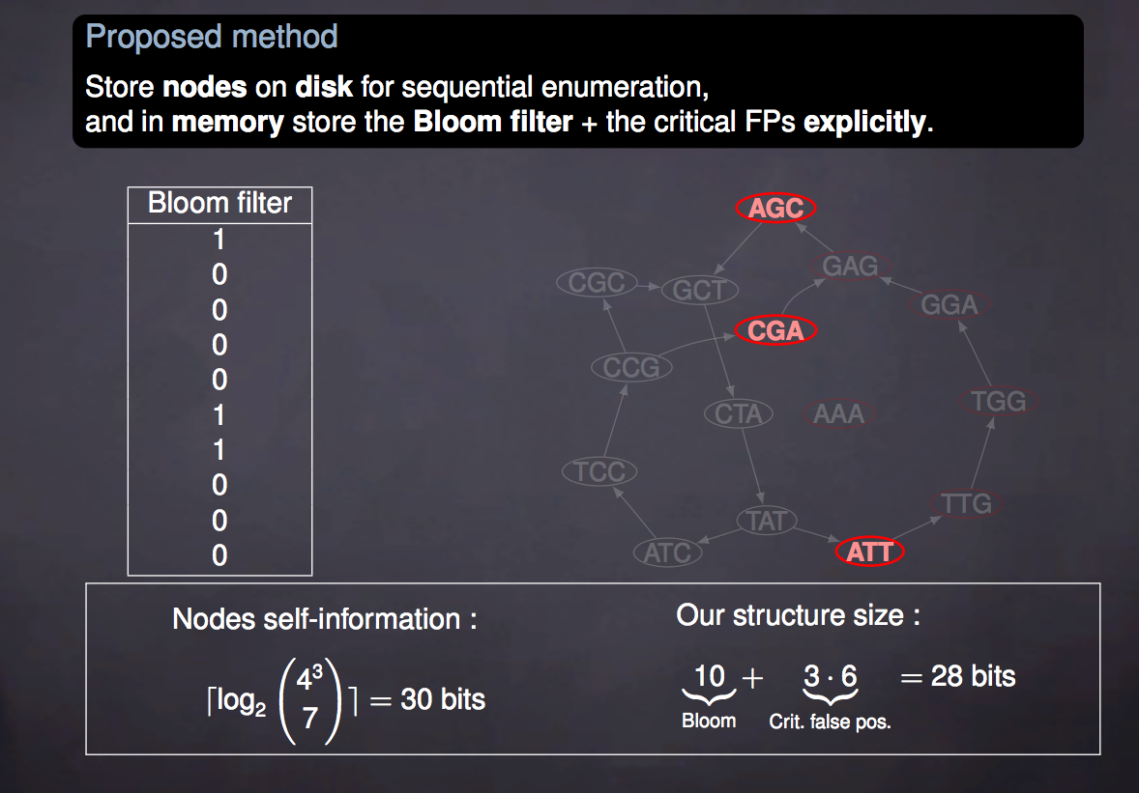
Example: Bloom filter NDS with cFPs in memory + real nodes on disk

Slide 9
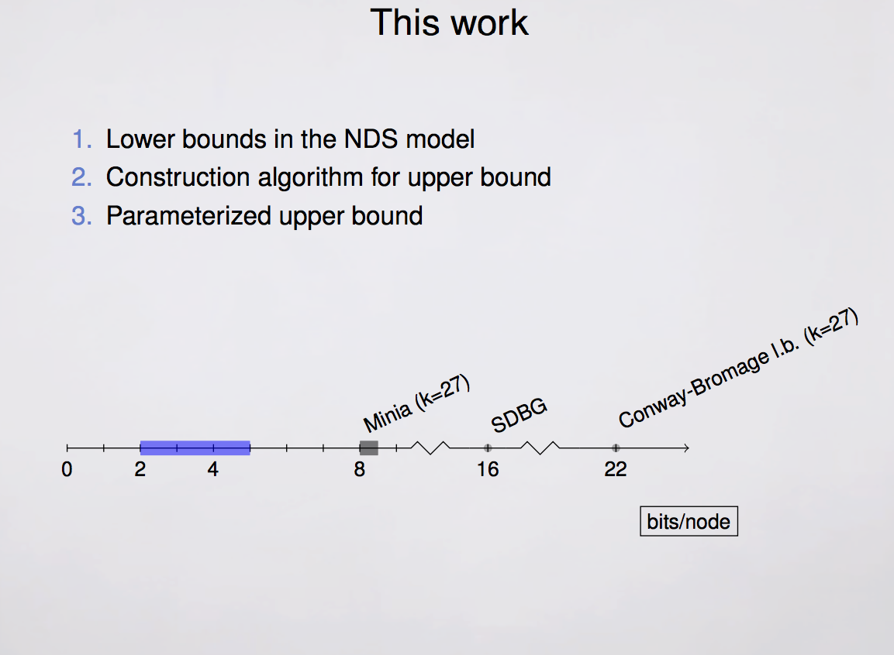

Slide 10
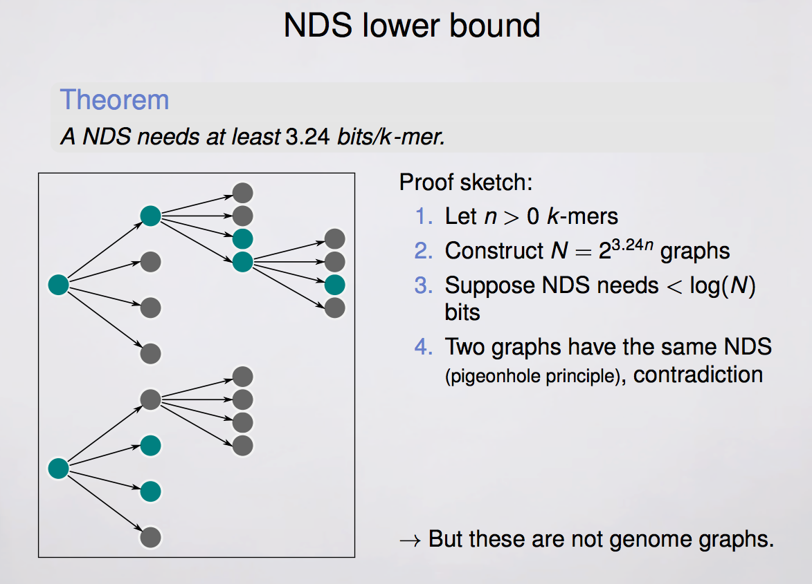
RR: Full proof in the paper – not enough time today…
Notes:
Construct a specific family for which this bound holds, implies lower bound holds generally for dBGs

Slide 11
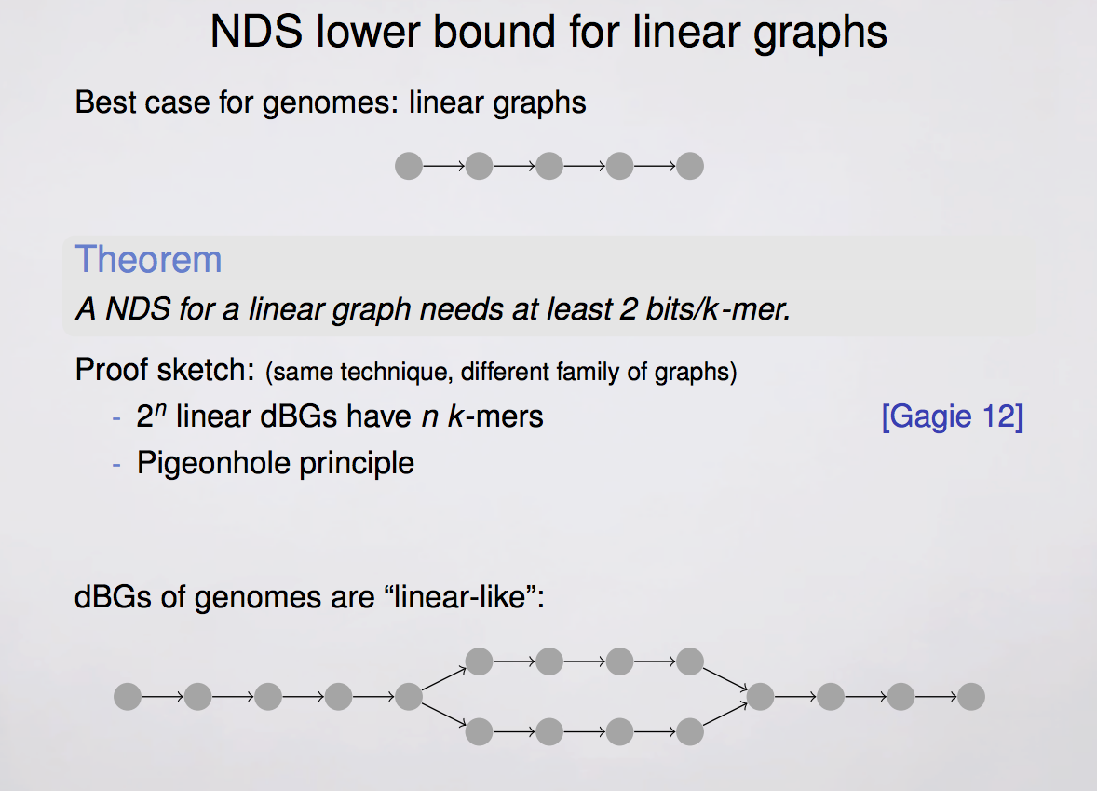
Notes:
Genomes are mostly linear stretches interrupted with bubbles due to diploid structure, sequencing errors, etc.

Slide 12
NDS Notation
Constructor CONST(S) – algorithm that, given a set of k-mers S (a dBG) outputs a bit string
Neighborhood NBR(CONST(S), k) – algorithm that takes a bit string and a k-mer, and outputs a set of k-mers (e.g., neighbors sharing the same (k-1)-mers)
If x is not in S, NBR(CONST(S), x) is undefined

Slide 13
NDS for linear dBG
A string! Length = n+k-1
2 bits per DNA character –> 2(n+k-1) bits total
Scan length of string to find desired k-mer
Not all strings of this length represent linear dBGs, need to show this is the amount of space needed in general

Slide 14
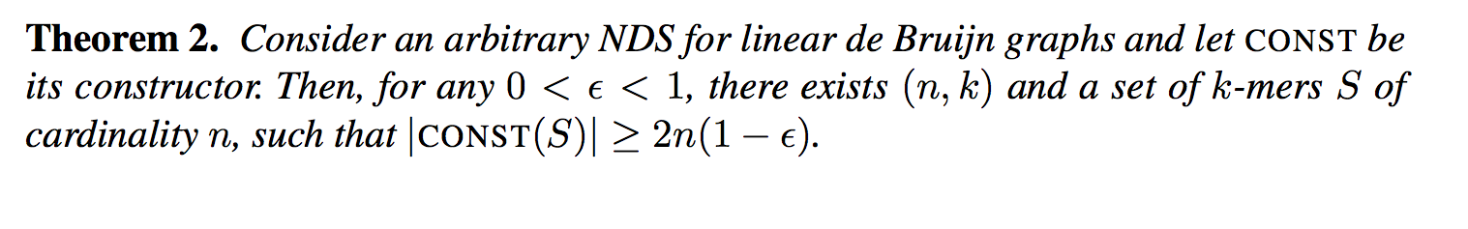
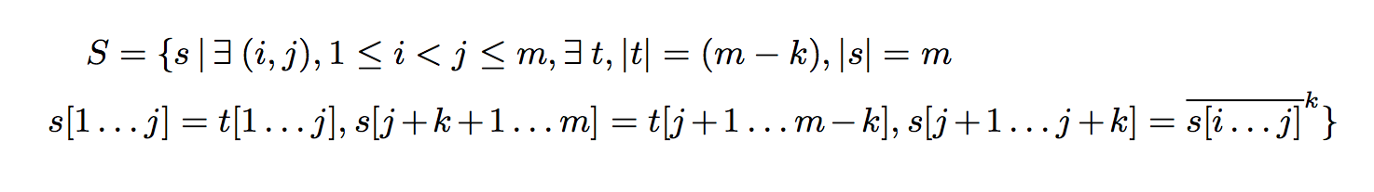
Notes:
http://www.codecogs.com/latex/eqneditor.php
\\
\mbox{let } \bar{s}^k \mbox{ be the string obtained by repeating the pattern s as many times}\\
\mbox{as needed to obtain a string of length exactly k, possibly truncating the last occurrence.}
\\
\mbox{we will show that S contains all strings with at least one repeated k-mer}

Slide 15
Let s’ be a string which contains at least one repeated k-mer
Assume that i < j are starting positions of identical k-mers (s’[j+1…j+k] = s’[i...i+k-1])
Setting t to be the concatenation of s’[1..j] and s’[j+k+1…m], it is clear s’ is in S.
Typos in paper: they say s’[j…j+k-1] = s’[i...i+k-1] ,
Switch between n and m
Notes:
\\
\mbox{since there are } \binom{n}{2} \\
\mbox{choices for (i,j) and 4^{m-k}} \\
\mbox{ choices for t, the }\\
\mbox{cardinality of S is at most } \binom{m}{2}4^{m-k} \ \square

Slide 16
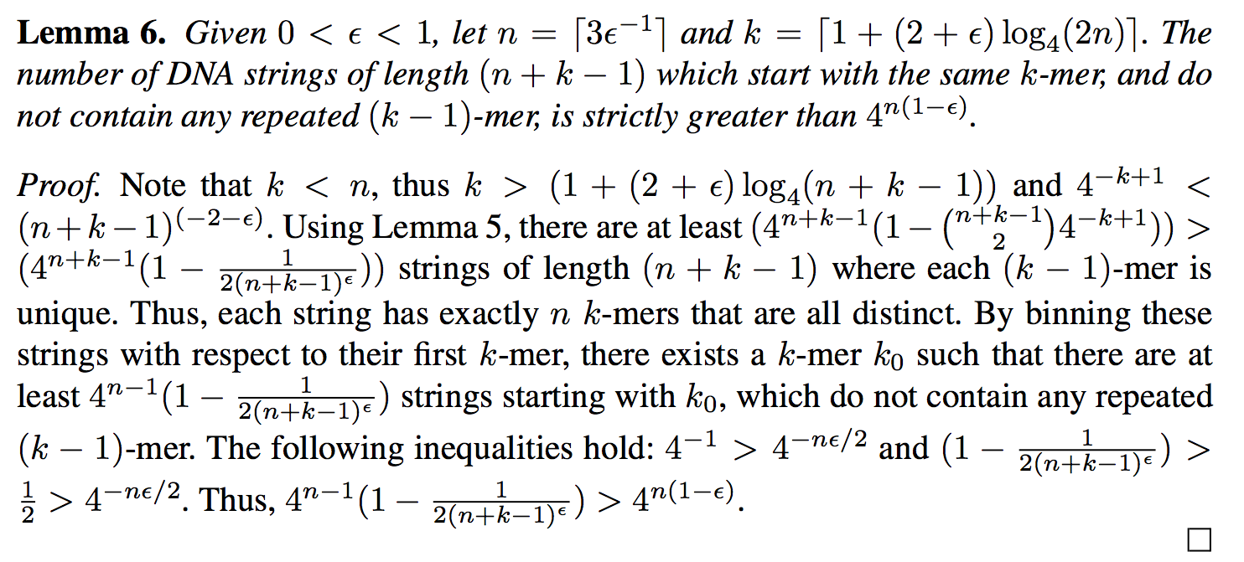
Notes:
Intuition: for given epsion, the number of strings starting with a chosen k-mer and not containing any repeated (k-1)-mer is greater than 4^n(1-eps)
point out that it’s an arithmetic argument
Explain less obvious lines if needed

Slide 17
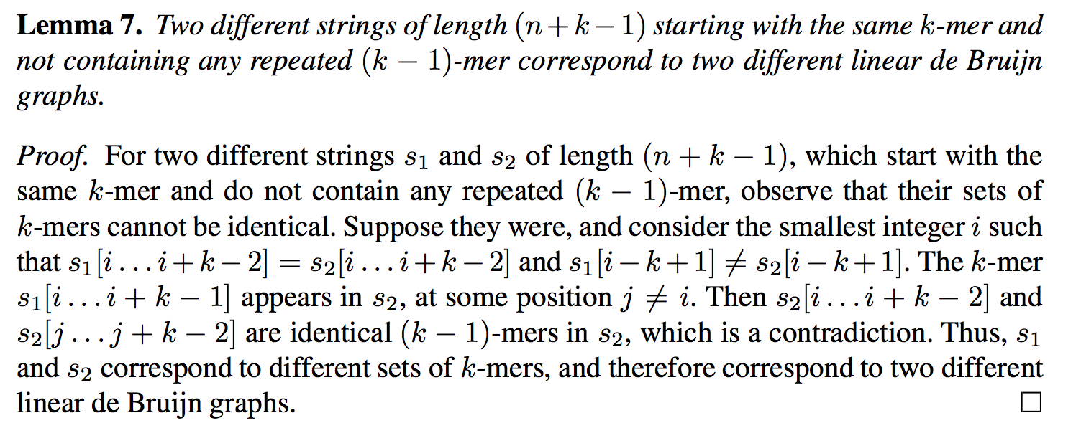
Typo above (in paper): should be s1[i+k-1] != s2[i+k-1]
instead of be s1[i-k+1] != s2[i-k+1]

Slide 18
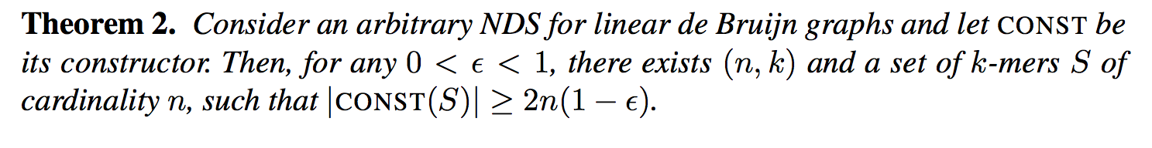
For contradiction, assume for all linear dBGs, size of output of CONST is < 2(1-e) per k-mer.
For sets of k-mers of size n, at most 2^(2n(1-e)) possible outputs
From lemma 6, there are (k, n, k0) for chosen e for which there are more
than 2^(2n(1-e)) linear dBGs starting with the same k-mer k0, having n k-mers,
and no repeated (k-1)-mers
By the pigeonhole principle, there is an NDS constructor CONST(S)
that returns* the same output on different inputs S1 (k-mers from s1) and S2, which
both start at k0 and don’t contain any repeated (k-1)-mer
From lemma 7, the sets of k-mers in s1 and s2 are different. Let p be the length of their
longest common prefix. Let k1 be the k-mer starting at position p-k+1. Since each k-mer
Can occur only once (linear dBG), and the k-mer starting at p-k differs between s1 and s2,
NBR(CONST(S1), k1) != NBR(CONST(S2), k2) →← (because CONST(S1) = CONST(S2))
*Typo: paper says “takes”
Notes:
e.g., 2 bits per k-mer is the lower bound for linear dBGs

Slide 19
Implementation
Find maximal simple paths in low memory (BCALM)
Construct FM index from paths to allow NBR queries, replace hash data structure from existing assembler (DBGFM)

Slide 20
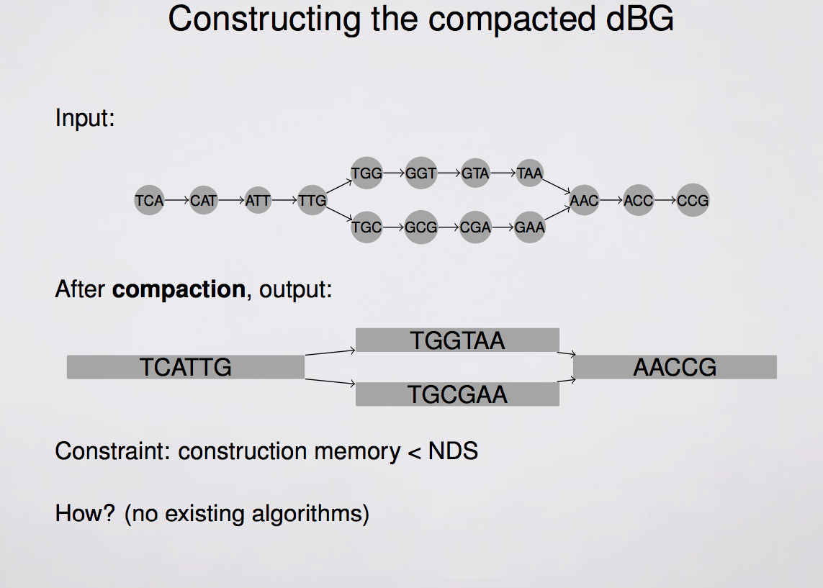

Slide 21
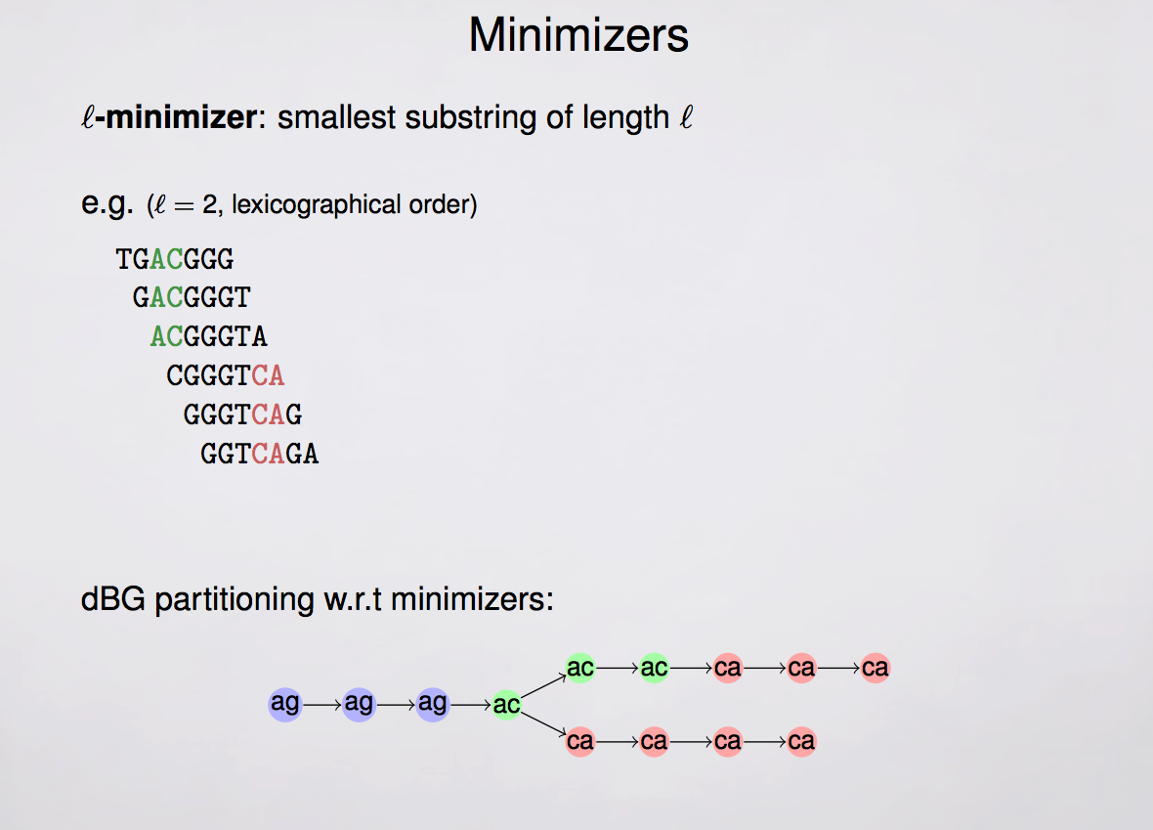
e.g., k = 7 here
Compaction functionality based on Observation:
If u→ v, then Rmin(u) = Lmin(v)
where Rmin(u) is the l-minimizer of the (k-1)-mer
prefix of u.

Slide 22
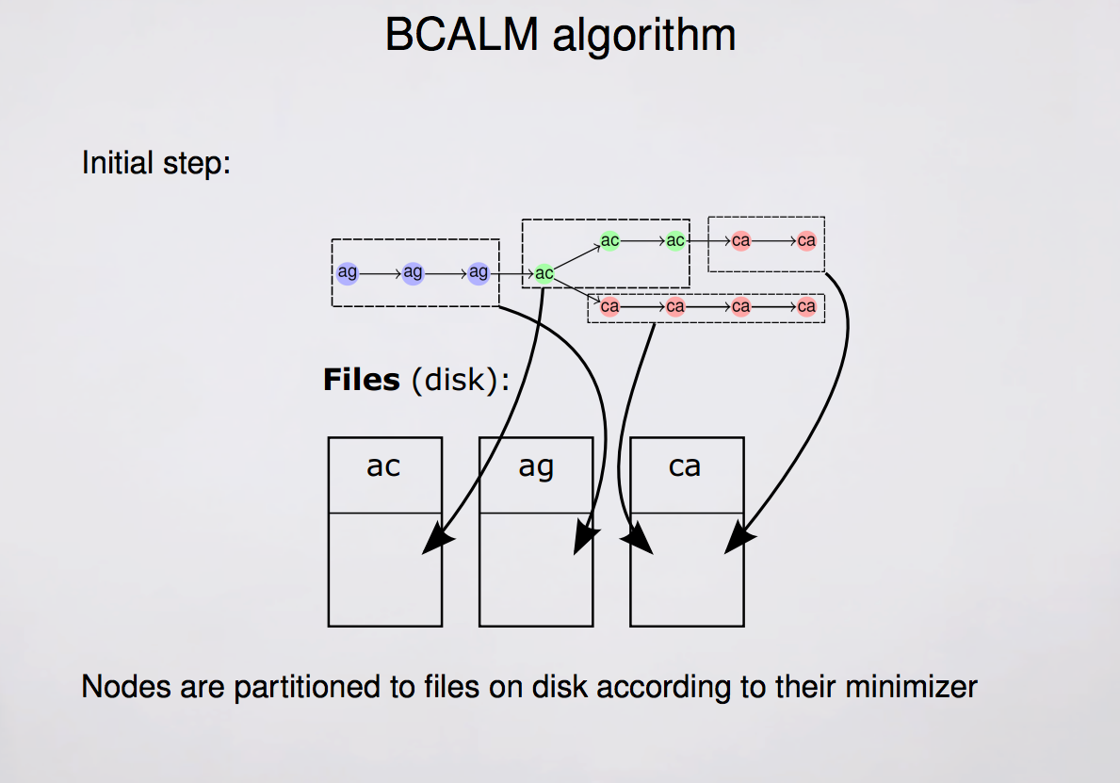

Slide 23
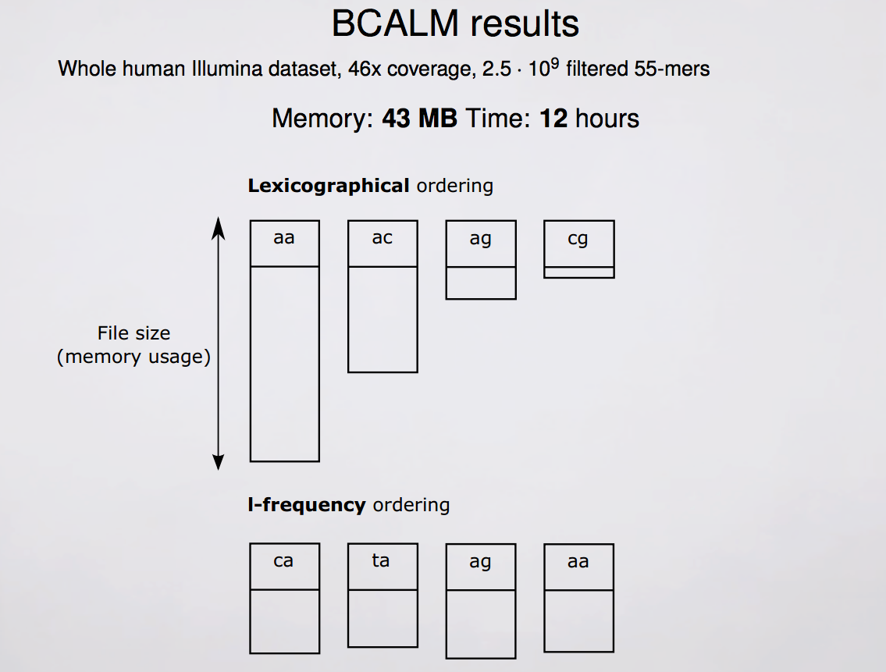

Slide 24
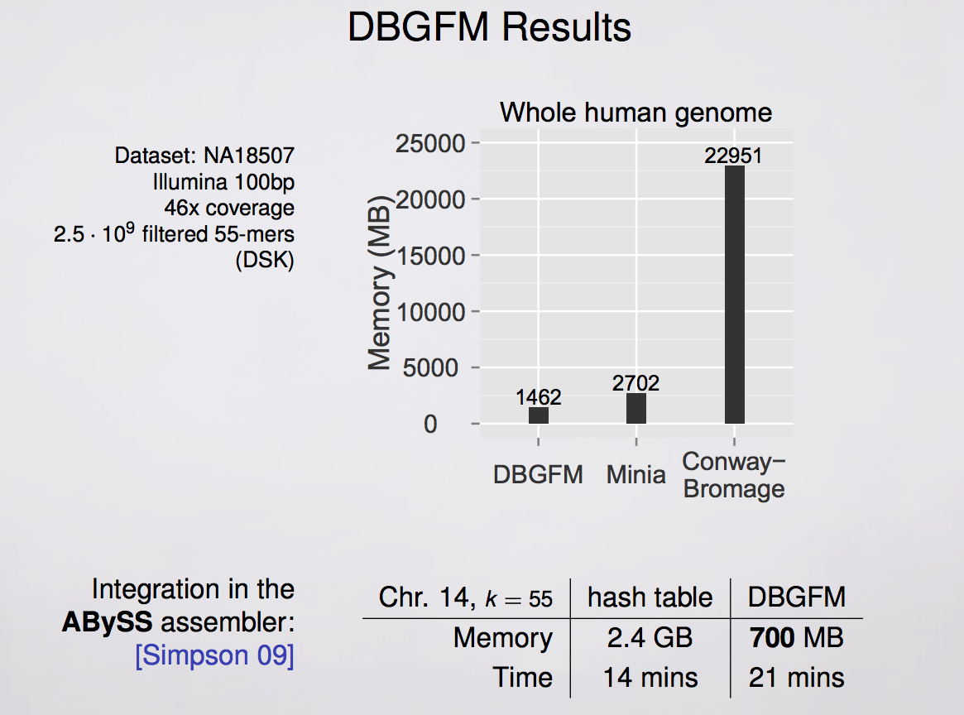

Slide 25
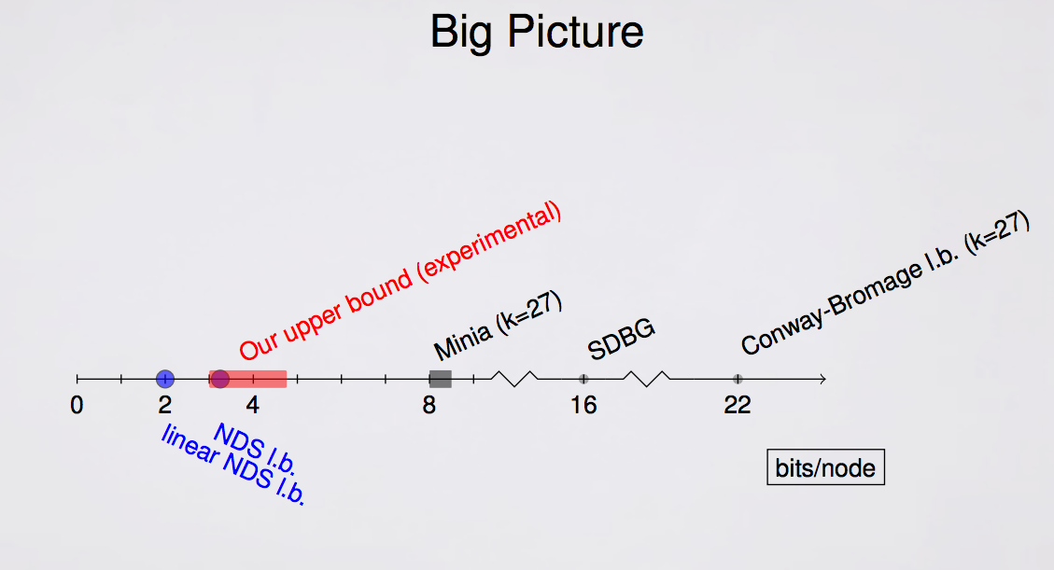

Slide 26
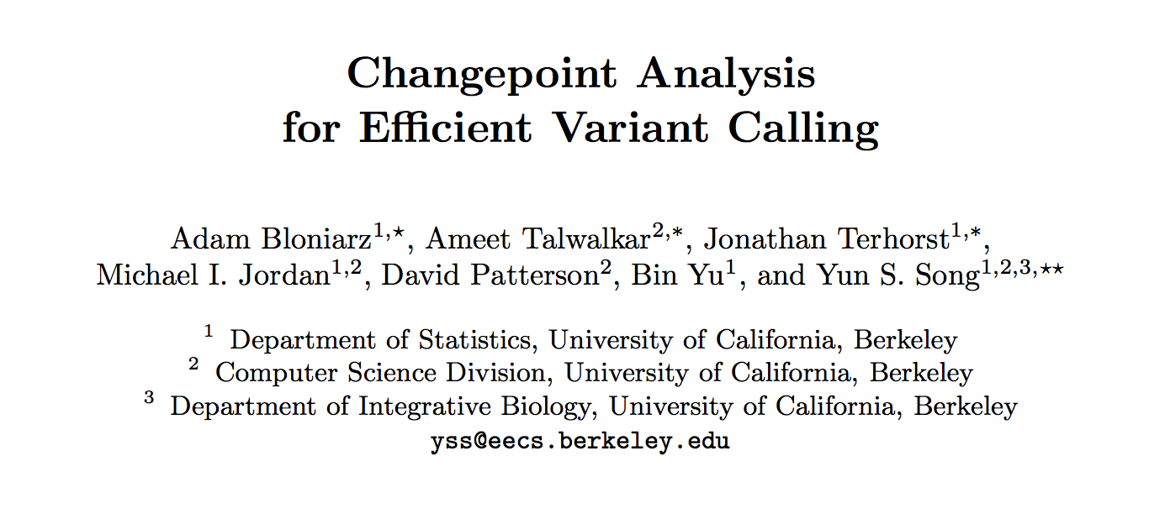

Slide 27
Overview
Variant calling is computationally demanding when high coverage deep sequencing is performed
Holding files in memory is difficult; current compression methods rarely allow analysis on compressed data
This work takes different approach: aims to focus heavy computation only on interesting parts of data - regions harboring variation

Slide 28
High level view of Change point Analysis of Genomic reads (CAGE)
Perform a first-pass analysis to isolate a small fraction of the sampled genome which is “non-reference” and complex
Pass high-complexity regions to computationally intensive variant detection
Process remaining low-complexity regions using a fast algorithm designed to detect simple variation

Slide 29
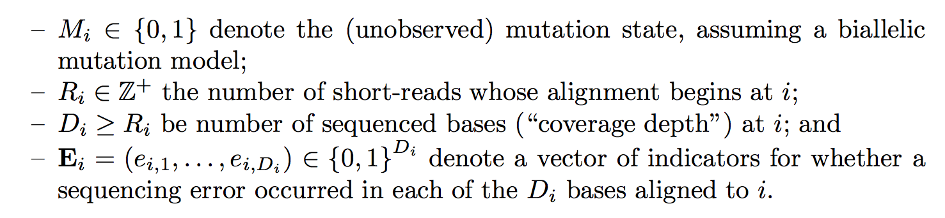
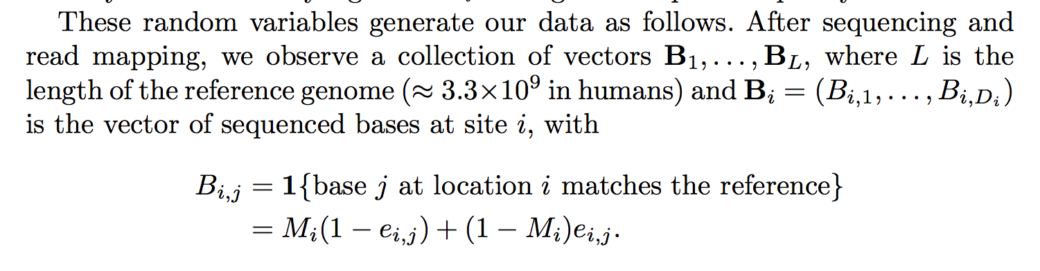

Slide 30
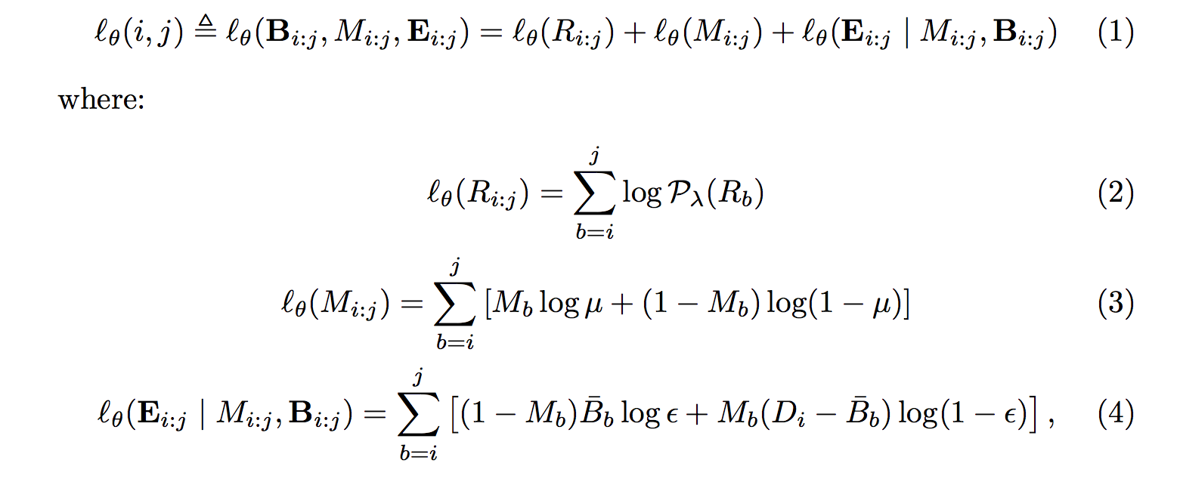
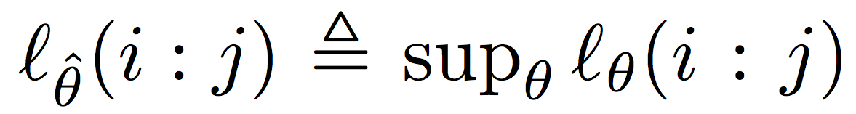
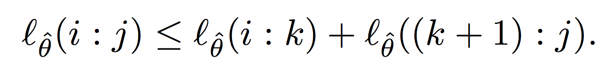
Log – likelihood to be maximized
Poisson
Bernoulli
Bernoulli
Simplified based on observation:

Slide 31
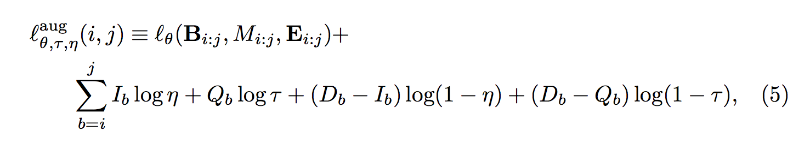
Augmented likelihood
Add parameters to account for possible indels, poorly aligned reads
Based on counts of MAPQ = 0 alignments; small indels called by aligner
Tau, nu, Bernoulli distributed

Slide 32
Heuristics, simplifications
Assume mutations (M_{i}) only at known variant positions (e.g., some variants will be considered as errors initially)
Haploid genome assumed
Genome is broken up into fixed length windows, parameters estimated for each separately
Dynamic programming on constrained (reachable) search space defines path of change points

Slide 33
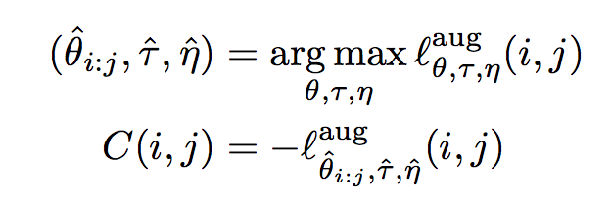
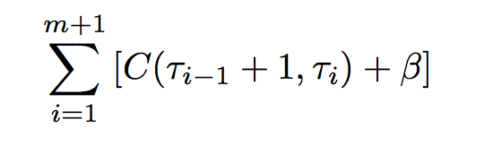
Change point detection
Estimate parameters for fixed size genome windows separately
Penalize change point additions by regularization
Minimize total cost by pruned dynamic programming (e.g., positions that are never optimal are not visited)

Slide 34
More heuristics
Hand tuned parameters used to find outlier values for windows, these are then treated as high complexity regions
Simple rule based classifier used for genotyping initialization – based on min. read counts, quality scores, etc.

Slide 35
Notes on results
Use either GATK simple genotyper or own heuristic (CAGE++) to call simple regions
Use GATK assembly based method on high complexity regions
Compare with running GATK-ug (simple) and GATK-ht alone and with considering each window separately (ALLCHANGE)
Only report run time, memory use for their method: 13 mins, 32 cores, 16 GB peak
Use their own tool, SMASH, to validate
Not clear what was training data used to achieve thresholds for heuristics

Slide 36
