Slide 1
Plasmid Re-cycling
Roye Rozov, 22/10/14
Coverage
B
A

Slide 2
What are plasmids?
Self-replicating mobile genetic elements, similar to viruses but with no protective shell
Use Pol I or III of host to self-replicate
Usually (but not always) circular, vary in size (1kb → ~1Mb), copy number (1 to 10s of copies); smaller plasmids in greater numbers per cell
maintain roughly constant copy numbers via self-regulating replication systems
Often carry transposons, allowing for horizontal gene transfer

Slide 3
Why are they interesting?
Carry non-essential (rel. to host) genes → confer selective advantage in specific environments
Protection from toxins
Generation of toxins, pathogenicity
Augment host metabolism – allow digestion to products edible by host
Very mobile – transfers between plasmid → host, plasmid →virus, plasmid → plasmid
Large role in antibiotic resistance
host → host enabled by conjugation (in some cases)
Notes:
Non-essential – e.g., in contrast with mitochondria

Slide 4
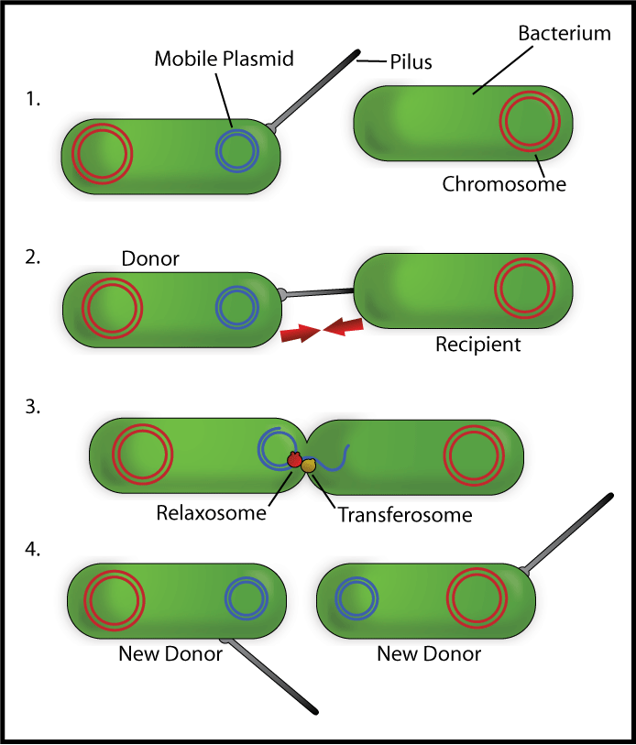
Courtesy: Wikipedia, “Bacterial Conjugation”
Notes:
Variation in hosts accepting different plasmids – can’t move to every host

Slide 5
Our project, with Dr. Itzhak Mizrahi and Aya Brown of the Volcani Institute
Study Rumen plasmidomes of ~20 cows fed 2 different diets
“plasmidome” = a metagenome in which chromosomal (linear) DNA is digested out, and only a mixture of circular elements (plasmids & phages) remains to be amplified and sequenced
Sequencing done by paired end 100 bp reads with 500 bp expected insert size
Mission: assemble!

Slide 6
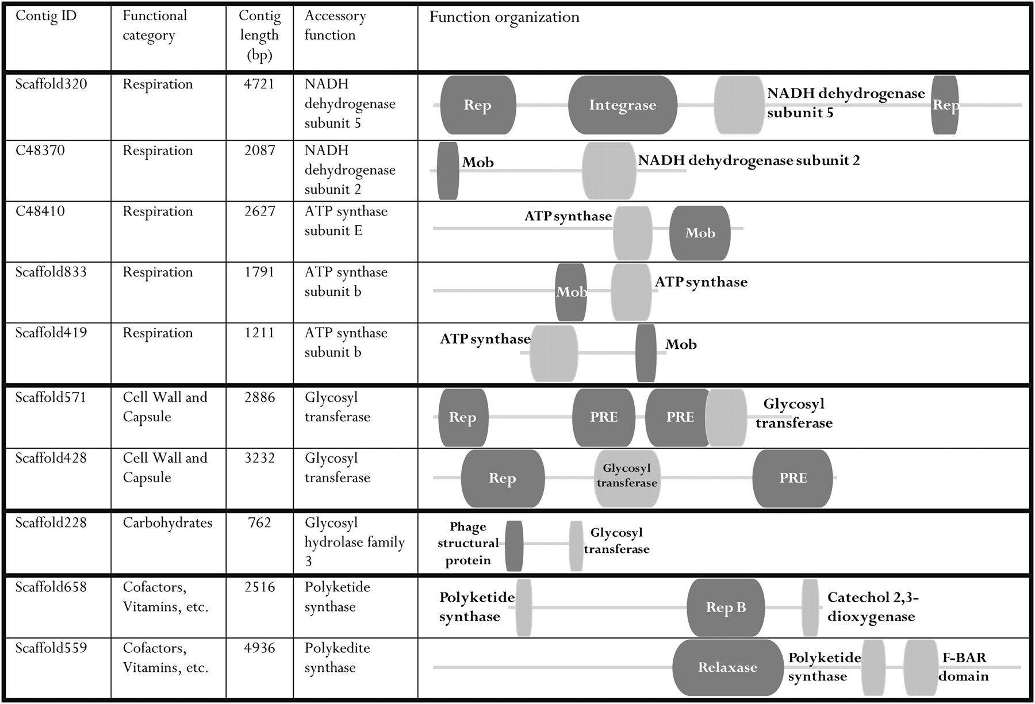
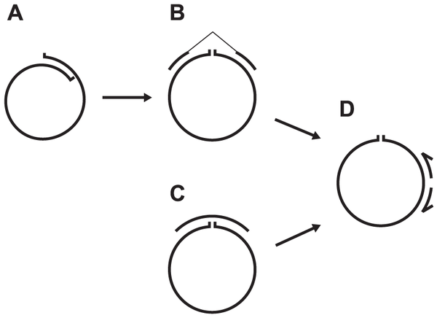
Previous Studies
Jørgensen TS, et al., Hundreds of Circular Novel Plasmids and DNA Elements Identified in a Rat Cecum Metamobilome PLOS ONE (2014)
Kav AB, et al., Inisights into the bovine rumen plasmidome, PNAS (2012)
Notes:
They got ~600 circular elements from large sample (150M paired end reads) of one rat cecum (rat was living in hospital waste – “diverse environment”)
Filtering contigs by 1) demanding ends overlap 2) looking for outwards facing reads at opposite ends (or longer 454 reads) spanning gap
Validated subset by PCR in reverse orientation (primers need to direct replication towards each other – if not circular, no product)
Later paper showed this protocol has bias to plasmids < 10kb

Slide 7
Assessing assembly
Tried two assemblers, Omega (read overlap based, designed for metagenomes) and one de Bruijn graph-based – SPAdes
Switched away from Omega due to coverage contiguity problems
Didn’t use IDBA-UD (used by Danish group) because SPAdes was designed for same purpose and consistently does better on benchmarks, also better supported/maintained

Slide 8
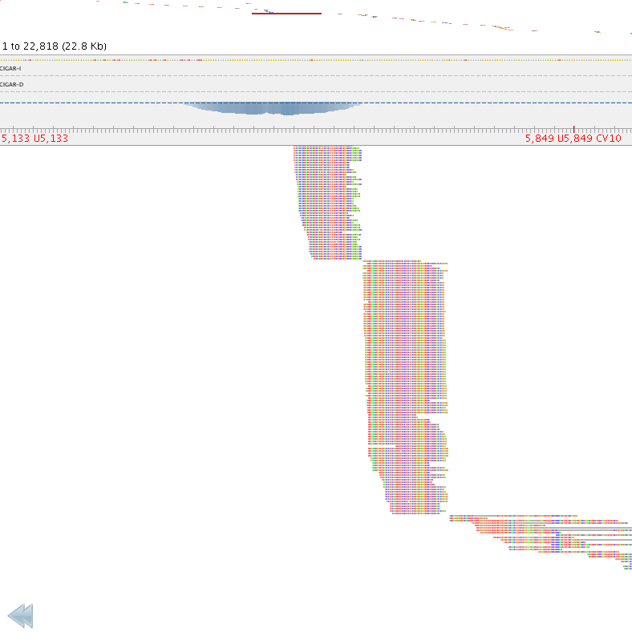
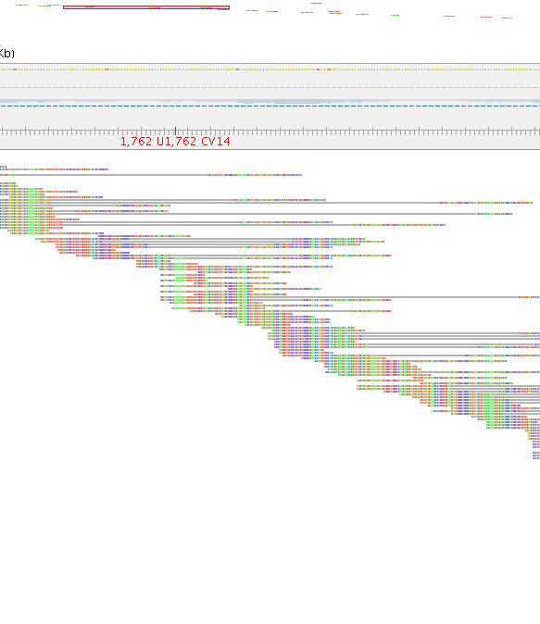
Omega vs. SPAdes – reads mapped to assembled contigs
Notes:
SPAdes uses multiple k-mer sizes, tries to use paired end information early on (not sure how)
More even

Slide 9
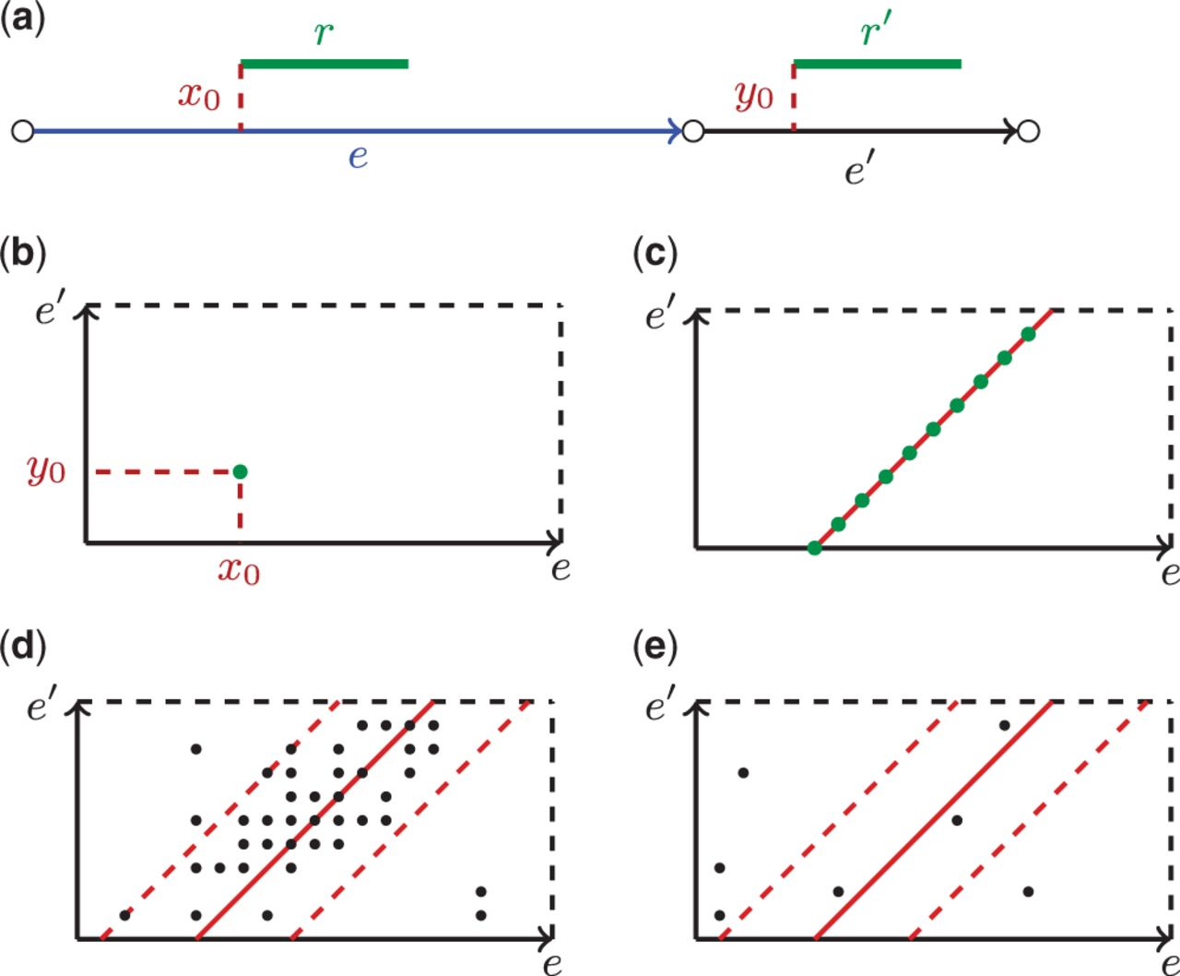
Rectangle graphs: assessing path support with varied insert size
Prjibelski A D et al. Bioinformatics 2014;30:i293-i301
© The Author 2014. Published by Oxford University Press.
Notes:
1) Build graph, map reads to long graph edges, characterize mean & conf. interval of insert size in library
2) Extend edges to paths by testing coverage in confidence interval

Slide 10
ExSPAnder
New repeat resolution extension of SPAdes
combines robustness of SPAdes to high coverage variation & chimeric reads with added information provided by multiple insert size libraries

Slide 11
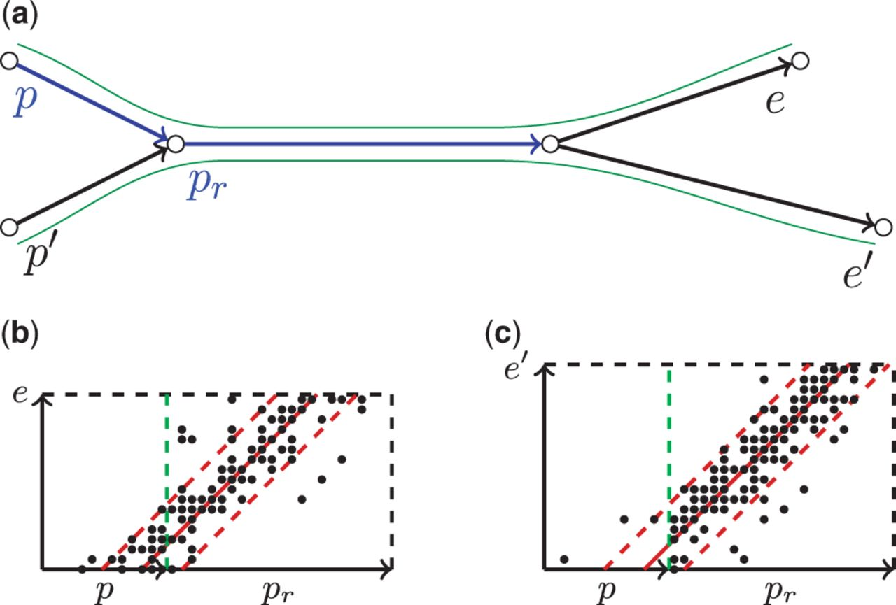
Scoring a path that contains repetitive edges.
Prjibelski A D et al. Bioinformatics 2014;30:i293-i301
© The Author 2014. Published by Oxford University Press.
Notes:
Scoring a path that contains repetitive edges. (a) An example of the assembly graph with a repetitive edge p_{r}. (b) A composite rectangle for the correct extension e of path (p,p_{r}). (c) A composite rectangle for the incorrect extension e′ of the path (p,p_{r})‏

Slide 12
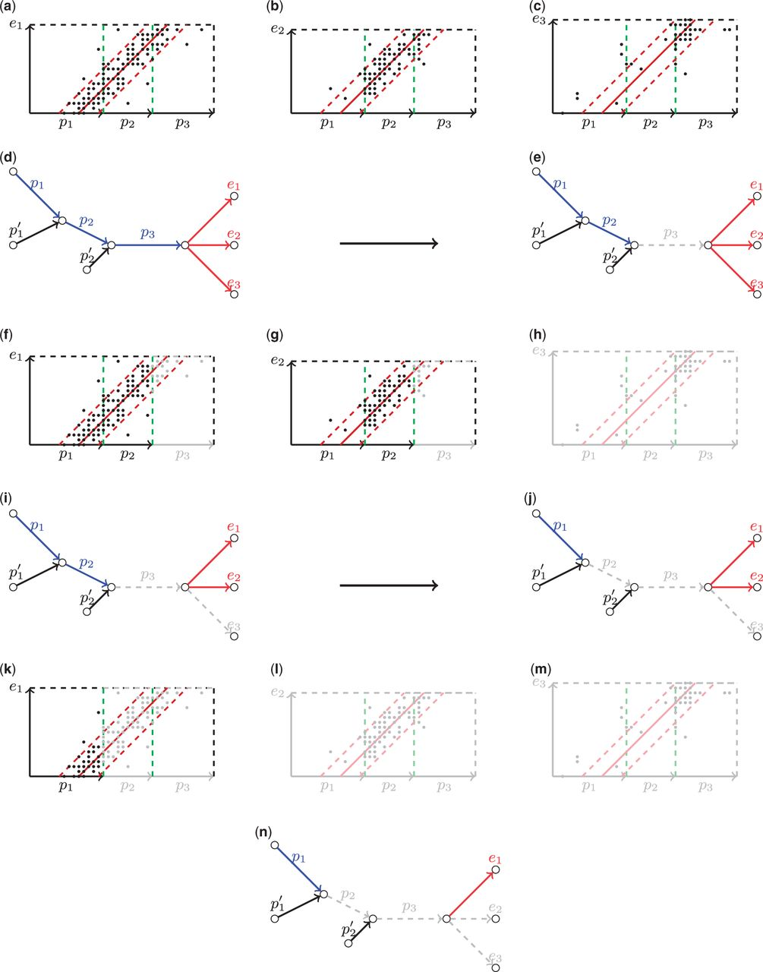
Prjibelski A D et al. Bioinformatics 2014;30:i293-i301

Slide 13
ExSPAnder work-flow
Build graph with SPAdes
For each library, map pairs to long edges of graph and estimate mean & confidence interval of insert size
Examine each library separately in order of insert size. Choose extension based on maximal score passing decision thresholds
Notes:
[need
- slide for decision rule, params
density, support, path score
]

Slide 14
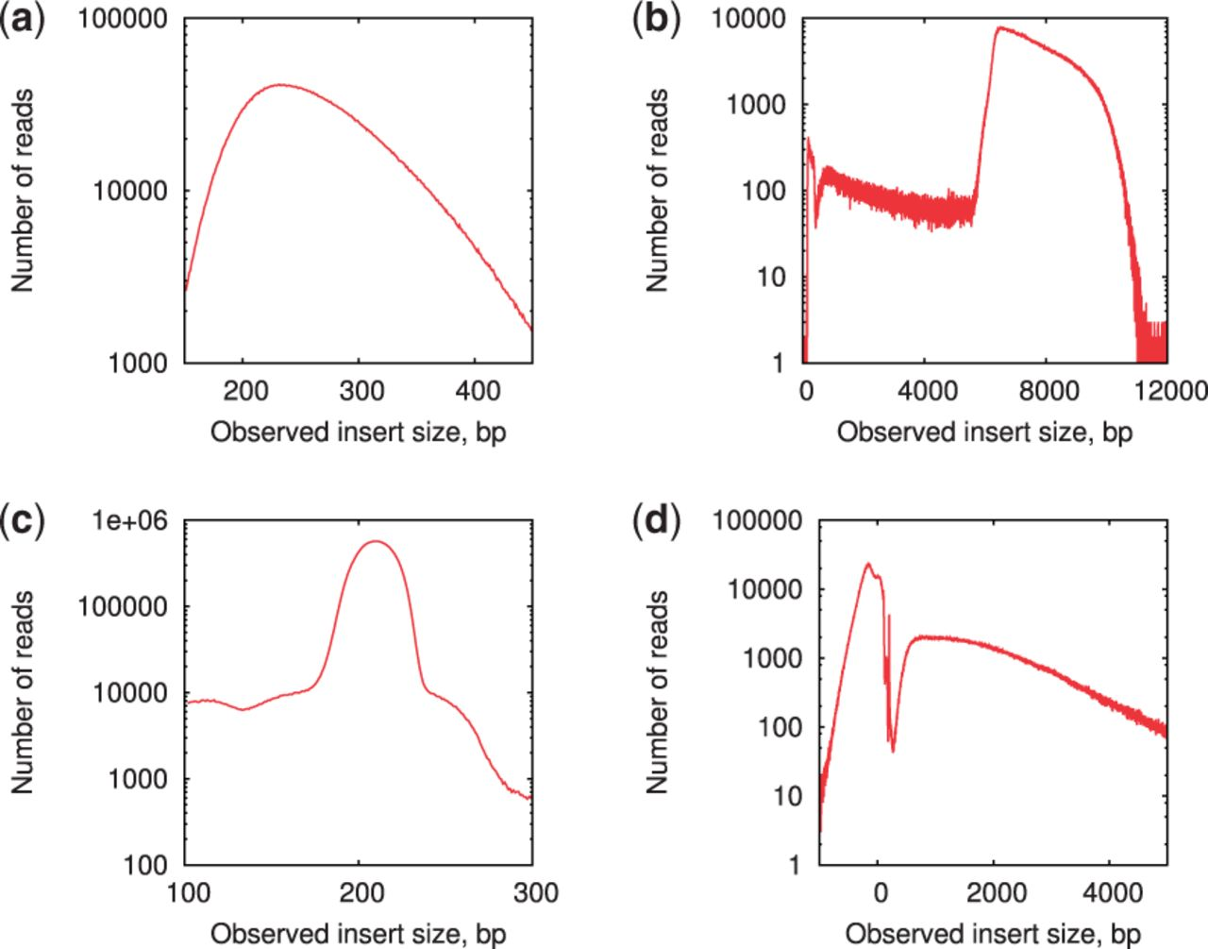
Why increasing insert size order?
Prjibelski A D et al. Bioinformatics 2014;30:i293-i301
Notes:
-note negative sizes, multimodal dists. on jumping libraries (for single genomes)

Slide 15
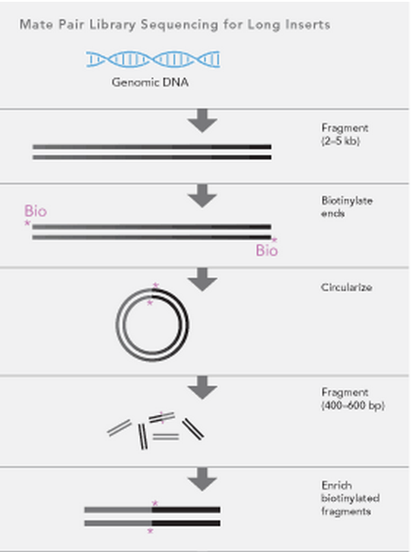
Outies fool insert size estimation, but are indistinguishable from mate pairs
Cycles in assembly graph are broken at arbitrary positions – on alignment, reads at ends
Seen as
Illumina Inc., http://images.illumina.com/technology/mate_pair_sequencing_assay.ilmn
Notes:
-ExSPAnder uses all reads to construct graph, but treats libraries separately to avoid errors due to chimeras, high insert size variation of mate pairs

Slide 16
Idea: 2 iteration assembly using fake mate pair library
Assemble all reads
Map reads to contigs
Separate read pairs by alignment characteristics – inferred insert sizes, orientation – to ‘proper’ and ‘improper’ pairs
Improper pairs either have orientation other than inward facing pair, insert size more than S.D.’s away from empirical mean, or both
Re-assemble, treating ‘improper’ pairs as mate pair library

Slide 17
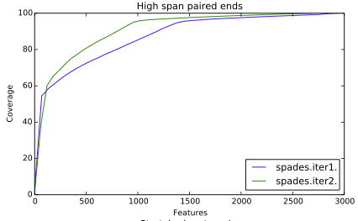
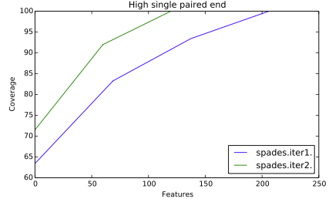
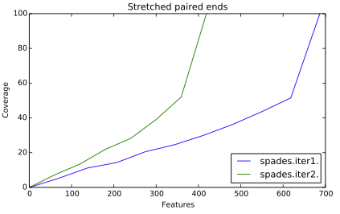
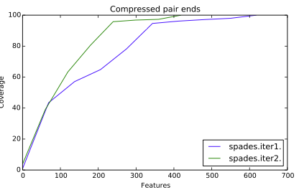
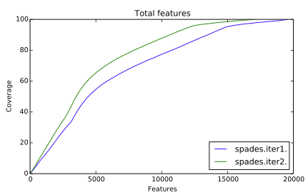
2 iteration comparison
Notes:
High span pe – mate mapped to different contig
Stretch/compressed pe – insert size more than 3 SDs from mean
High single – mate unmapped
Did well in coverage based features as well, only high coverage outie feature increased

Slide 18
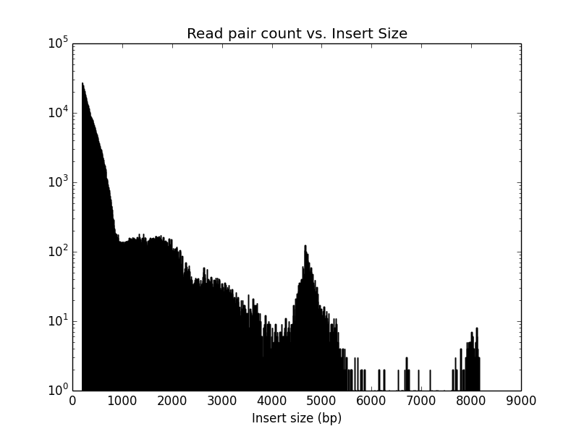
More generally, group by insert size?

Slide 19
Circularity Testing
Current checks
Self overlap (overhanging bases)
Outie reads at ends past a threshold
Problems
ad hoc – no difference between 10 outie reads and 100
Loss of sensitivity – e.g., small gap instead of overhang always rejected
Neglected features – coverage, continuity, degree of end region connectivity

Slide 20
One way to use coverage
Coverage
A
B
Linear contigs have a coverage fall-off at their ends.
If a given contig is circular, coverage should be consistent across the gap between ends (if we glue them together)
Issues: gaps, overhangs
Coverage
B
A

Slide 21
Next steps
Quality control – completed pooled 2 step assembly, filtered for plasmids using existing criteria → ~2400 circular candidates
~4000 plasmids in NCBI database → 2400 is a lot!
Since can’t PCR 2400 candidates, need to screen for artifacts, check consistency by single sample assemblies

Slide 22
Next steps
Open questions:
How to group by insert size
Rigorous way to test circularity
Are observed structural variants real?

