Slide 1
A combinatorial approach for analyzing intra-tumor heterogeneity from high-throughput sequencing data
Iman Hajirasouliha, Ahmad Mahmoody and Benjamin J. Raphael
Ron Zeira
Group meeting 26.11.14

Slide 2
Outline
Motivation and Introduction
Theoretical results
BTP
Max-BTP
ε-BTP
Experimental results
Simulated data
PhyloSub
AML

Slide 3
Cancer evolution
Cancer – complex disease driven by somatic mutations accumulated over time.
Clonal Theory of cancer evolution (Nowell 76) – tumor cells descend from a founder cell.
Advantageous mutations lead to expansion clonal populations.
Ding et al. 2012

Slide 4
Ding et al. 2012

Slide 6
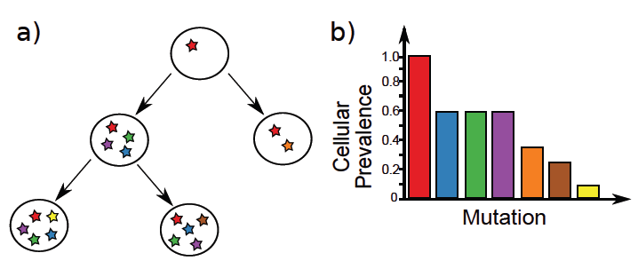
Tumor samples
Sample include multiple cell populations
Exhibit intra-tumor heterogeneity.
Goals: identify subclonal populations, reconstruct cancer phylogeny
Roth et al. 2014

Slide 7
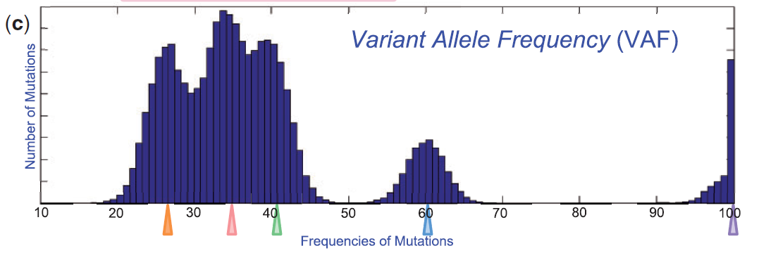
Identifying subpopulations
VAF – variant allele frequency, % of reads with a specific SNV.
Cellular fraction – VAF clusters correspond to tumor subpopulations.

Slide 8
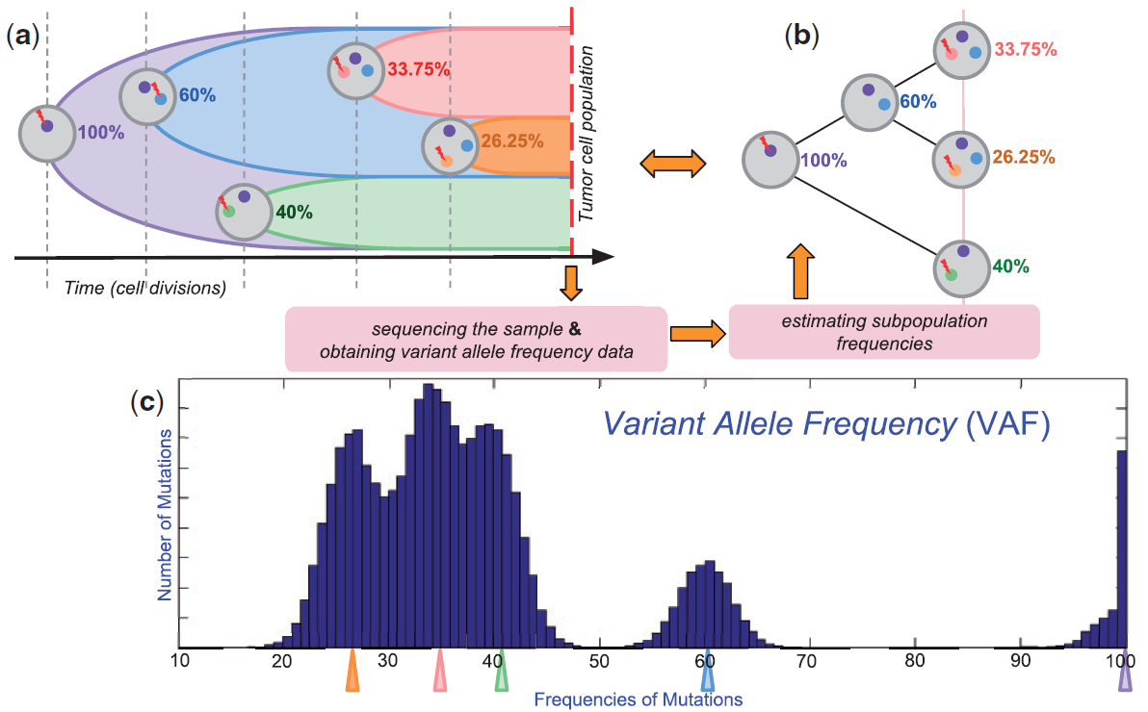
Goal

Slide 9
Assumptions
Any measured mutation results from clonal expansion.
Infinite sites – mutation at a position occurs once.
At most one clonal expansion begin at a given time.
Each clonal expansion splits population into two subpopulations.
Mutation frequencies in each subpopulation satisfy children sum to parent (CSP) condition.

Slide 10
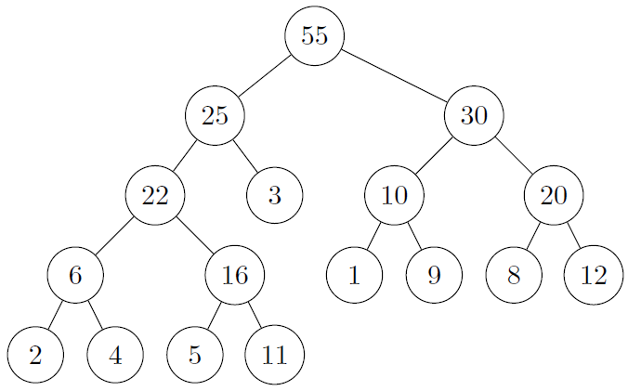
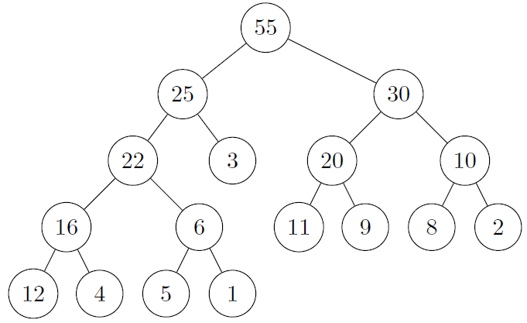
Binary Tree Partition

Slide 11
Triangles
A parent k and its two children i,j form a triangle (k,{i,j}), if they satisfy the CSP condition.
Conflicting triangles either share a parent or a child.
A set of triangles Z is conflict free if no pair of triangles conflict.

Slide 12
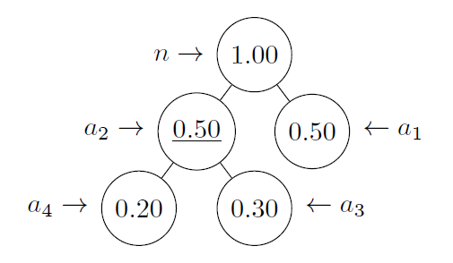
Example

Slide 13
Hardness
THEOERM: The BTP problem is NP-complete.
Reduction from Numerical matching with Target Sums (NMTS).
Furthermore, the non binary TPP is NP-complete by reduction from Subset Sum.

Slide 14
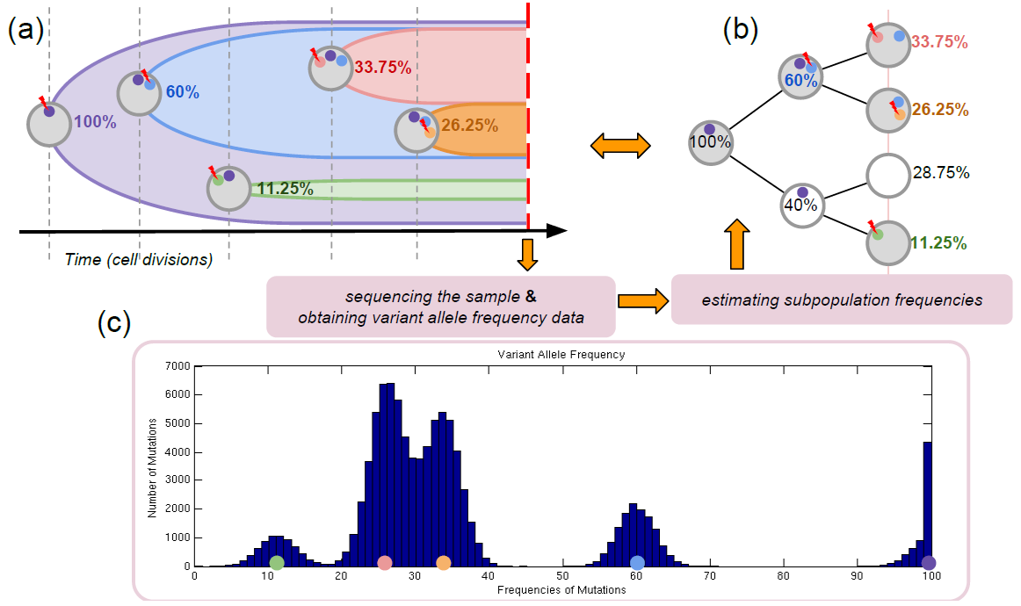
Missing subpopulations

Slide 15
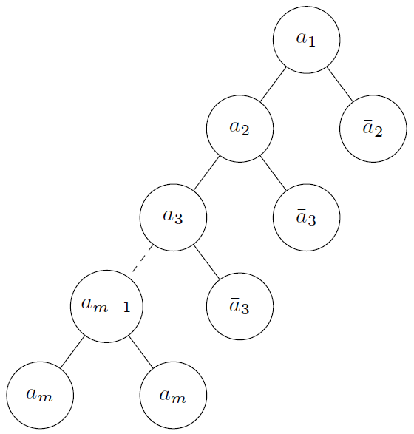
Auxiliary nodes
Proposition: For any given observation 𝓛, there is always a BTP if adding at most m-1 auxiliary nodes is allowed.

Slide 16
Max-BTP
Max-BTP problem: find the maximum sized set of conflict-free triangles.
If Max-BTP has a solution of size 𝛥, a BTP with k=m-1-2𝛥 additional nodes can be found.

Slide 17
Max-BTP approx.
Local search algorithm:
Fix a constant t and start from an empty solution set.
While possible, replace s≤t traingales with s+1 non-conflicting triangles.
Polynomial in t and q.
Approximation is achieved by the packing bound.

Slide 18
ε-BTP
On real data – BTP will not exists.
Subpopulations may be missing.
VAF have errors.

Slide 19
ε-BTP
ε-BTP coincides with BTP for ε=0, k=0
It is always possible to obtain ε-BTP with m-1 auxiliary nodes.

Slide 20
ε-CSP
An ε-CSP tree is acceptable if we can obtain an ε-BTP from it by replacing ã_{i} with with a_{i} s.t. |ã_{i} – a_{i}|≤ ε_{i} .
An ε-CSP tree acceptance condition can be checked with LP. I.e., find a_{i}, e_{i} s.t.
|e_{i} |≤ ε_{i}
(a_{i} + e_{i})=(a_{j} + e_{j})+(a_{k} + e_{k})

Slide 21
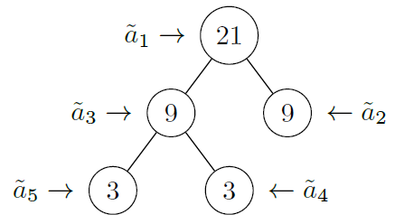
Unacceptable ε-CSP
Not every ε-CSP is acceptable

Slide 22
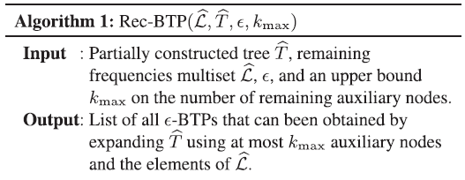
Rec-BTP

Slide 23
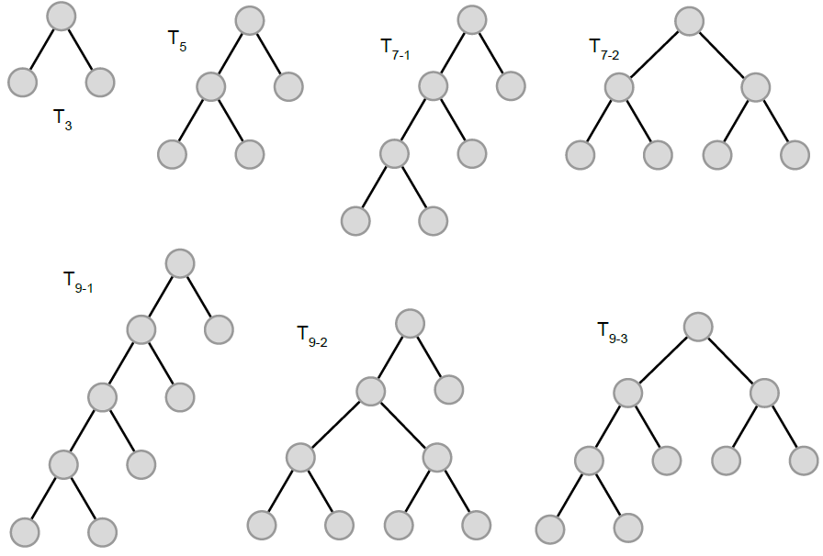
Simulated data
Trees with 3,5,7,9 nodes.
Assign a_{v} uniformly under CSP. (a_{r} =1)
M_{v}~U[50,400] somatic mutations.
X_{v} set of |M_{v}| VAFs from N(a_{v},σ). (σ=1,2,4)
VAF data X=U_{v}X_{v}

Slide 24
Clustering VAF
Cluster VAF with 2 algorithms:
Accelerated Variational Dirichlet Process Gaussian Model (AVDPM, Kurihara et al., 2006).
SciClone (Miller et al., 2014) – variational Bayesian beta mixture model.
For each cluster C_{i}: set ã_{i} = μ_{i},
Run Rec-BTP – find min k ε-BTP.
Break ties with min score

Slide 25
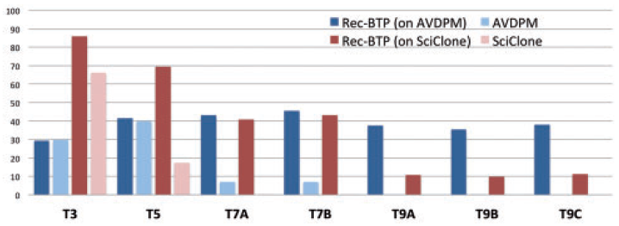
Number of subpopulations
% cases finding correct number
of subpopulations
Trees

Slide 26
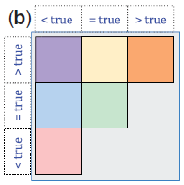
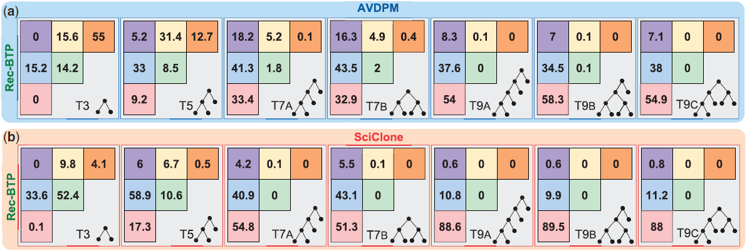
Number of subpopulations

Slide 27
Frequencies accuracy

Slide 28
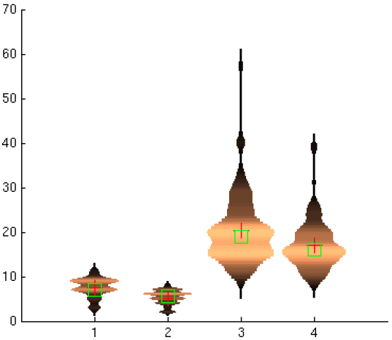
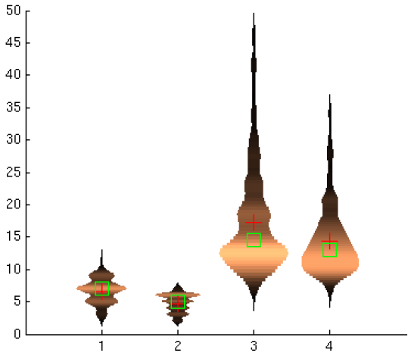
Comparison to PhyloSub
Jiao et al. BMC Bioinformatics 2014.
Uses a Bayesian nonparametric prior over trees.
9 nodes
7 nodes

Slide 29
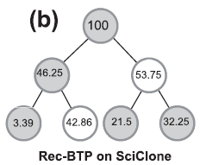
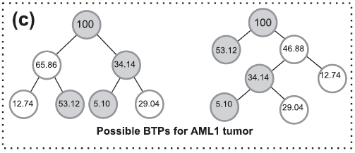
AML data
Ding et al. Nature 2012.
Present a history of {100,53.12,12.74,29,5.1}.
SciClone on VAF – {100,47.1,33.1,22.4,3.6}.

Slide 30
Summary
Rigorous combinatorial problem formulations.
Nice theoretical results.
Shows some improvements over other methods.
Need better comparison to other tree estimating methods – PhyloSub, TrAp (Strino et al. 2013).
There is still room for improvement.

Slide 31
Future directions
Reconstructing mutational history in multiply sampled tumors (Hajirasouliha and Raphael, WABI 2014).
Combine BTP and VAF clustering in a single model.
Combine with a statistical model that better features real data – PyClone (Roth et al. ,2014)
Define different combinatorial problems.

