Slide 1
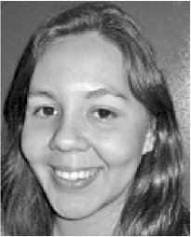
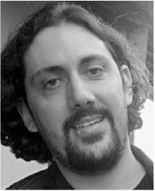
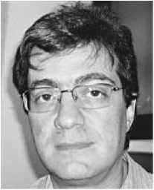
Rearrangement-based phylogeny using the Single-Cut-or-Join operation
Priscila Biller, Pedro Feijão, and João Meidanis
Institute of Computing, University of Campinas, Brazil
Ron Zeira
ACGT 23.7.2014

Slide 2
Outline
Biological motivation
Computational background
Data
Results
Jens Stoye, Bielfeld

Slide 3
Outline
Biological motivation
Phylogeny
Genome rearrangement
Computational background
Data
Results

Slide 4
Computational Genomics
Prof. Ron Shamir & Prof. Roded Sharan
School of Computer Science, Tel Aviv University

Slide 5
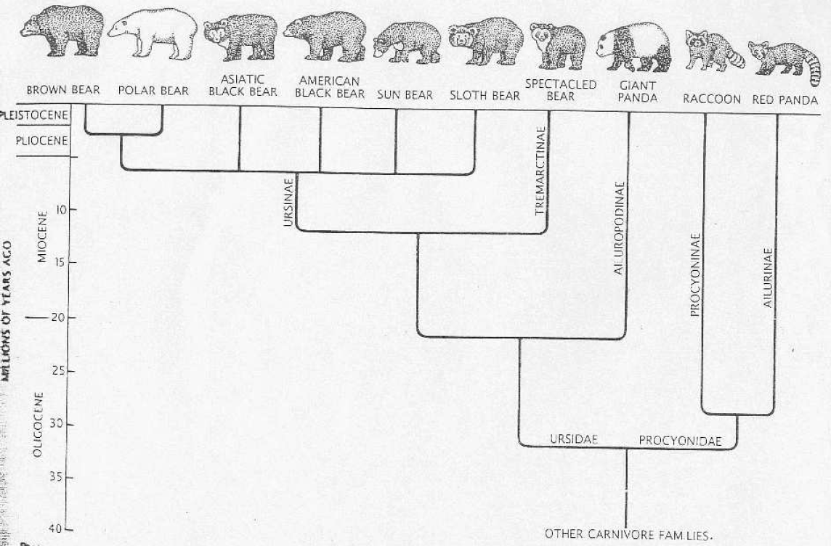
Morphological Vs. molecular
Computational Genomics
Prof. Ron Shamir & Prof. Roded Sharan
School of Computer Science, Tel Aviv University

Slide 6
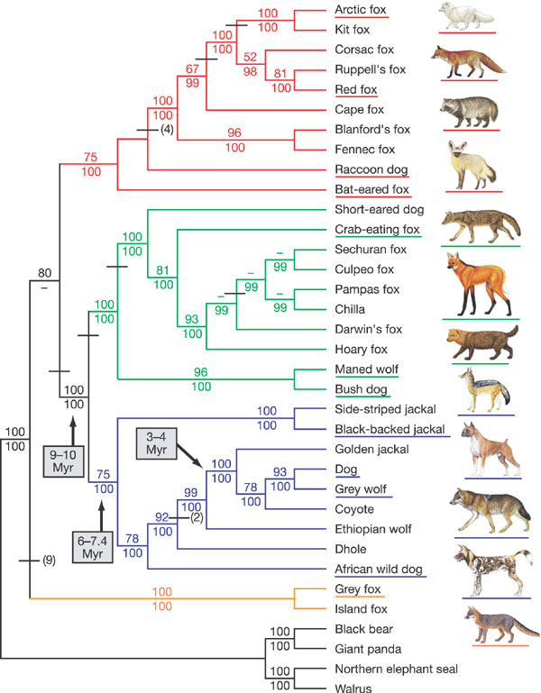
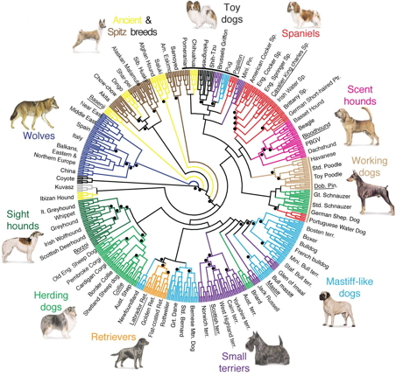
von Holdt et al. 2010
Lindblad-Toh et al. 2005

Slide 7
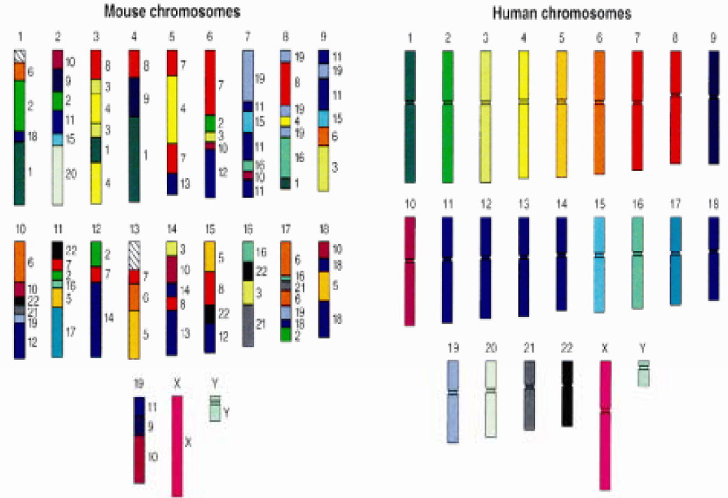
Genome rearrangements
Human genome project

Slide 8
Computational Genomics
Prof. Ron Shamir & Prof. Roded Sharan
School of Computer Science, Tel Aviv University

Slide 9
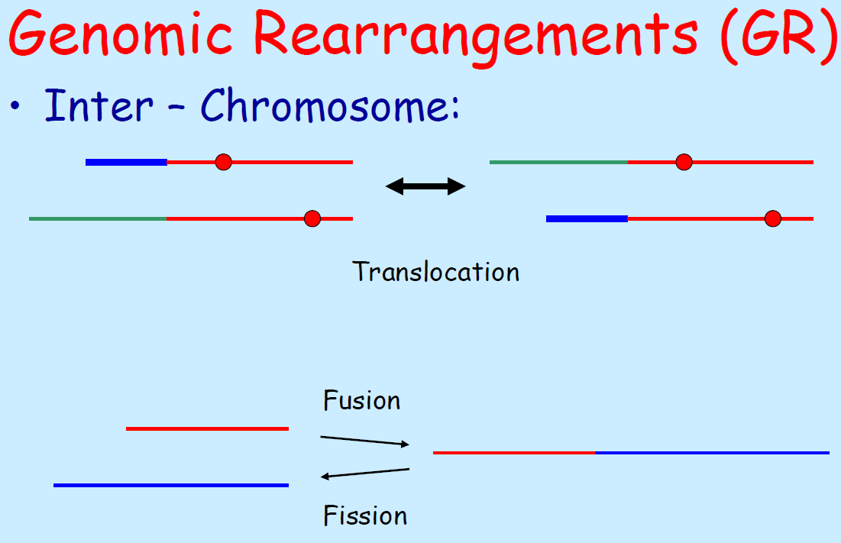
Computational Genomics
Prof. Ron Shamir & Prof. Roded Sharan
School of Computer Science, Tel Aviv University

Slide 10
Computational Genomics
Prof. Ron Shamir & Prof. Roded Sharan
School of Computer Science, Tel Aviv University

Slide 11
Outline
Biological motivation
Computational background
Genome representation and SCJ
Parsimony
Comparison measures
Data
Results

Slide 12
Genome representation
𝒢 – set of genes
Genome Π – set of adjacencies
Oriented gene
Gene head
Gene tail
Adjacency
Telomere
Extremity

Slide 13
Genome characteristics
A chromosome is a series of consecutive genes.
A chromosome is the same as its reverse.
A chromosome with no telomeres is circular, otherwise linear.
A genome with only circular/linear chrom. is called circular/linear respec.; otherwise it is mixed.

Slide 14
SCJ model
Feijão and Meidanis 2011.
SCJ – Single Cut or Join:
Cut an adjacency to 2 telomeres
Join 2 telomeres to an adjacency.
Notes:
a{-b}c,d \underset{cut}{\operatorname{\longrightarrow}} a{-b},c,d \underset{join}{\operatorname{\longrightarrow}} a{-b},d{-c}

Slide 15
SCJ distance problem
Given 2 genomes on the same gene set, find the minimum number of SCJ operations to transform one genome into another.
Feijão and Meidanis 2011:

Slide 16
Example

Slide 17
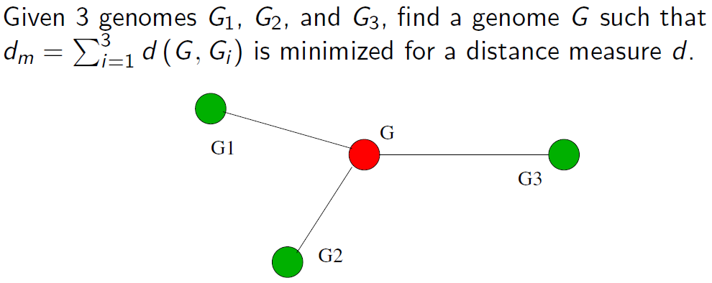
Median problem
Problem is NP-hard for most distances
Ohlebusch et al. 2005

Slide 18
Weighted multichromosomal median
Feijão and Meidanis 2011 – Polynomial solution for mixed, circular and linear genomes under SCJ distance.

Slide 19
Parsimony problems
Parsimony: explain data with min. no. of evolutionary changes.
Small parsimony problem (SPP):
Input: leaf sequences + a leaf-labeled tree T.
Goal: Find ancestral sequences implying minimum no. of changes.
Big parsimony problem (BPP):
Input: leaf sequences.
Goal: Find a most parsimonious tree (topology, leaf labeling and internal seqs.)

Slide 20
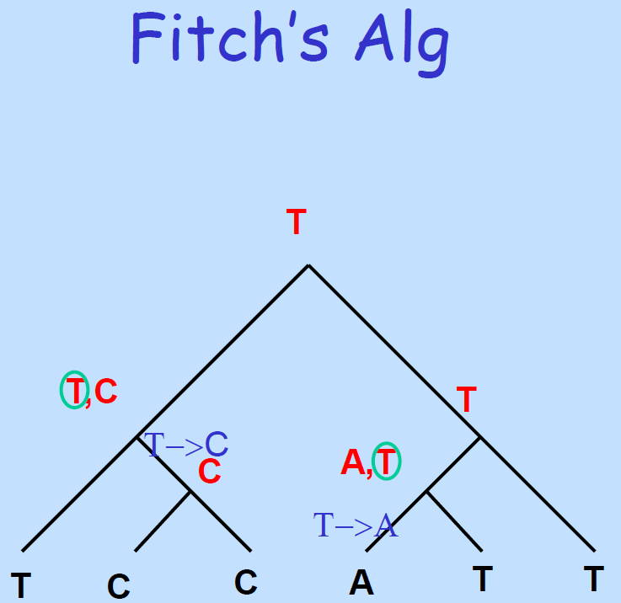
Computational Genomics
Prof. Ron Shamir & Prof. Roded Sharan
School of Computer Science, Tel Aviv University
SPP for sequence diff
Post-order: possible states.
Pre-order: chose state to agree with father.

Slide 21
SCJ SPP
Each adjacency is a binary character (presence/absence).
Run Fitch’s algorithm for each character.
Although adjacencies are not independent, Feijão and Meidanis show that the algorithm’s assignments are consistent and optimal.
SPP under SCJ is polynomial for mixed genomes. NP-hard or open for other dist.

Slide 22
BPP SCJ
BPP SCJ is NP-hard by reduction from Steiner tree problem in {0,1}^{N}.
Use branch & bound, exhaustively searching by solving median problems.
Greedy heuristic:
At each step, add an arbitrary unplaced genome to the tree, by solving a median problem at each edge. The genome is added to the tree in the edge that incurs the minimum branch length.
Solve a SPP on the final tree.

Slide 23
Robinson-Foulds distance
The removal of an edge from a tree partitions the leaves into two disjoint subsets – a split.
The split distance is a normalized count of splits induced by one tree, but not by the other.
Split distance varies from 0 to 1, where 0 represents a “best-case” scenario, when all splits are equal.

Slide 24
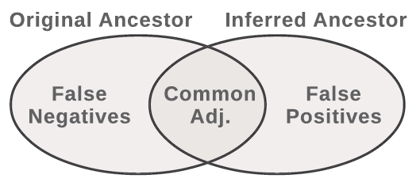
Genome reconstruction measures
The higher the genome is in the tree the more difficult it is to construct.
Percentage of reconstruction – the relative amount of adjacencies between consecutive genes.

Slide 25
Outline
Biological motivation
Computational background
Data
Simulated Data
Campanulaceae Chloroplast DNA
Protostome Mitochondrial DNA
Results

Slide 26
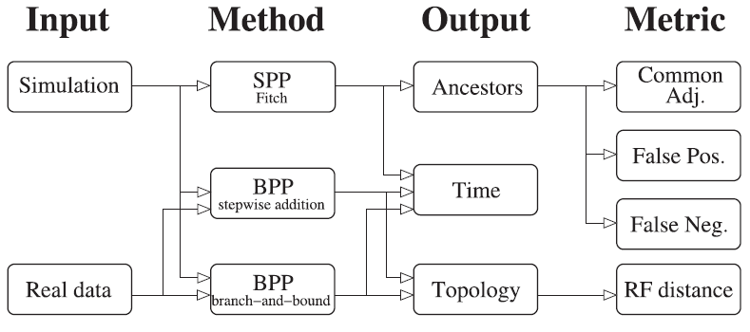
Experimental setup

Slide 27
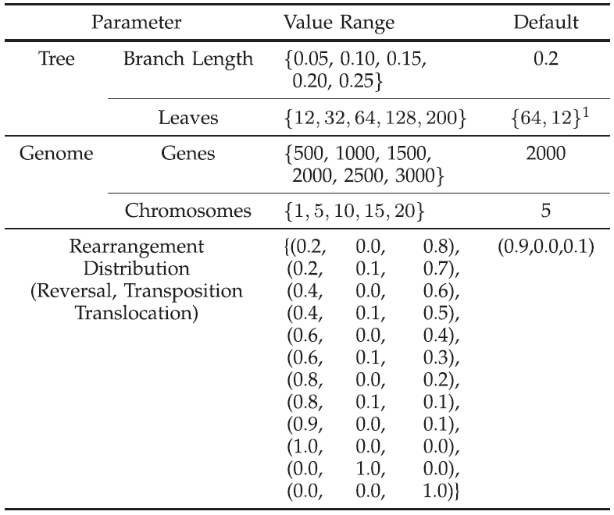
Parameters
Evolutionary events per edge as % of genome
B&B – 12
O.W – 64
Notes:
1 – 12 for B&B, o.w 64

Slide 28
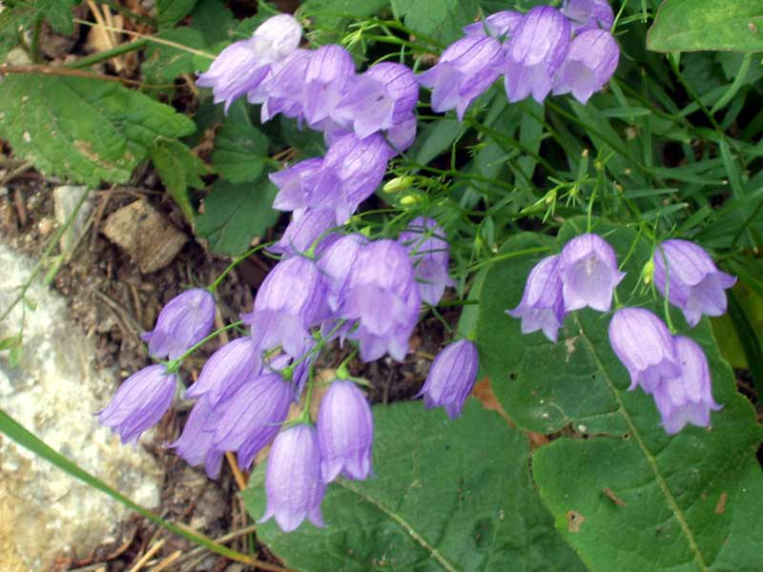
Campanulaceae Chloroplast DNA
Campanulaceae – bellflower family.
Data by Cosner et al.
12 species + outgroup.
One circular chromosome.
105 markers.

Slide 29
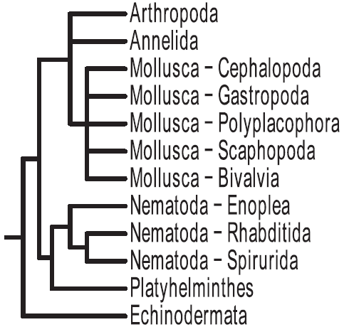
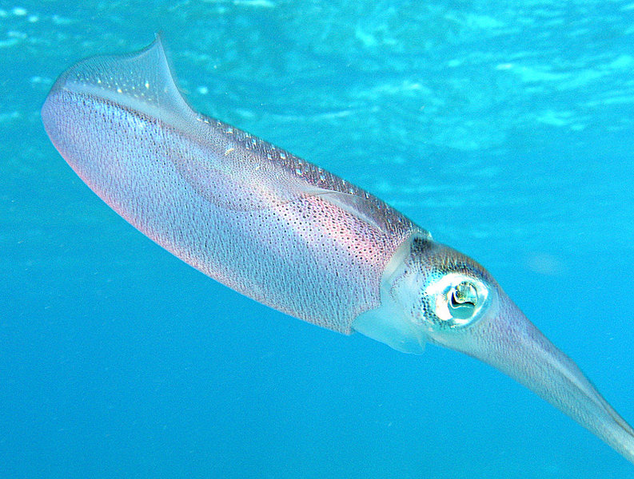
Protostome Mitochondrial DNA
Protostomes are bilaterally symmetrical and triploblastic animals.
Data by Fritzch et al.
112 species, 37 genes.
After preprocessing:
66 species, 36 genes.
NCBI

Slide 30
Outline
Biological motivation
Computational background
Data
Results
Effect of simulation parameters tree quality
Campanulaceae Chloroplast DNA
Protostome Mitochondrial DNA
Ancestral genome accuracy

Slide 31
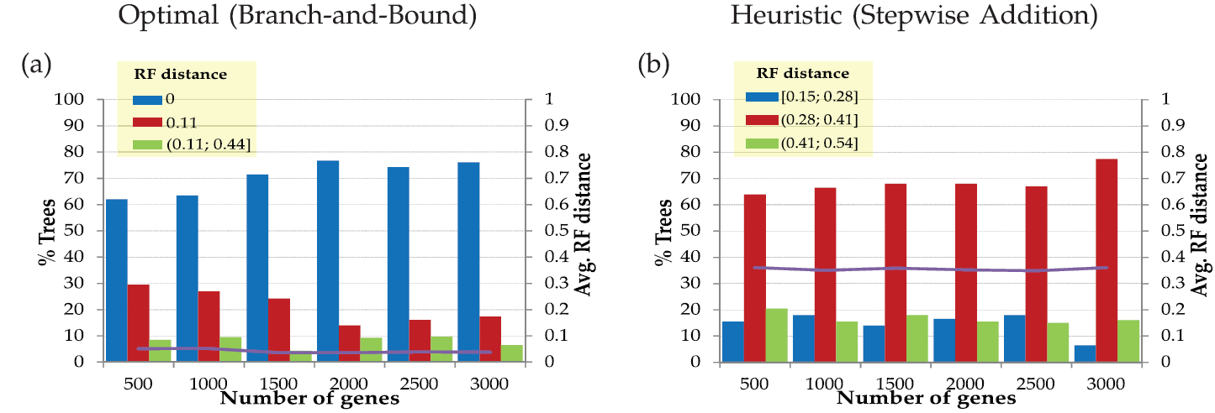
# genes effect
* 12 Vs. 64 species
Notes:
Optimal is better than heuristic.
Quality is independent from the number of genes

Slide 32
Rearrangement distribution effect
Notes:
When the frequency of each event increases or decreases relative to others, the accuracy of the inference is not affected.
Probably this is because the same rearrangement distribution is used in all edges of the tree, being a common term.
the number of events (branch length) matters much more than the type of event.

Slide 33
Branch length effect
Notes:
we see a decrease in accuracy with larger branch lengths

Slide 34
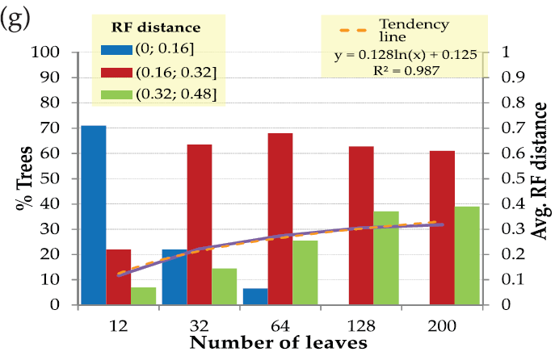
# leaves effect
Notes:
we see a decrease in accuracy with more genomes
logarithmic growth of the RF distance when the number of leaves increases

Slide 35
Topology reconstruction summary
Tree size and branch length impact SCJ inference. Logarithmic growth of the RF distance.
Bernt et al. reported RF distances of [0.05,0.15] with other heuristics and distances on only 50 leaves and 50 genes.
SCJ BPP heuristic method provides less accurate results, but it is able to solve much larger instances.

Slide 36
Campanulaceae Chloroplast DNA
MGR
Based on reversals
MPBE
Based on BP
Cosner et al.
BP+Sequence
GASTS
SPP based on DCJ
SCJ B&B
Notes:
In general, all trees in Fig. 5 are very similar
Should compare their heuristic and not B&B

Slide 37
Protostome Mitochondrial DNA
NCBI
Fritzch et al. alignment-based
SCJ heuristic
SCJ better agrees with NCBI.
Mollusca is problematic because of higher higher frequencies of gene rearrangements.

Slide 38
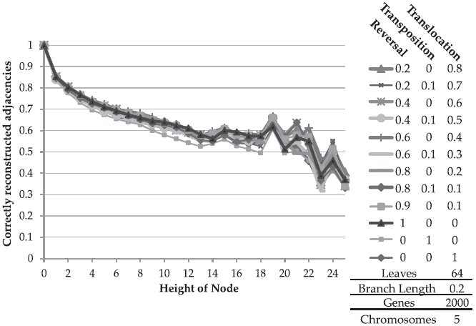
Reconstruction quality
Fix topology and solve SPP.
Compare ancestral genomes reconstruction quality.
Notes:
We can observe a lower percentage of reconstruction in the nodes that have larger height in the tree.
We can see in the graphs that, regardless of the variation in the rearrangement distribution,
the decrease in the percentage of reconstruction is
similar in all lines of the graph, once again showing that the
rearrangement distribution tends to impact negligibly the
accuracy of SCJ methods
In all graphs in this section, the dispersion of the lines is
bigger when the height increases. The dispersion increases
because the number of nodes examined is lower

Slide 39
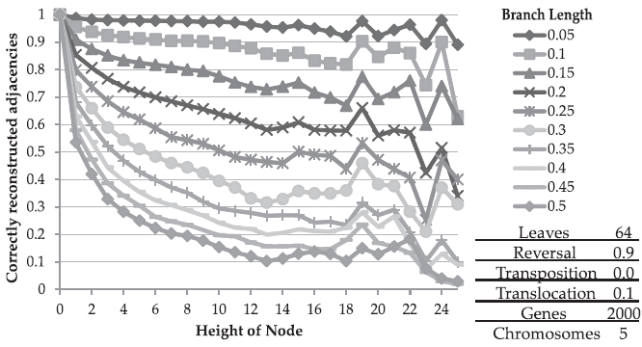
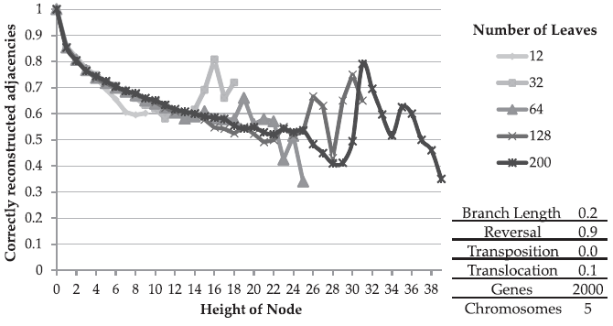
Notes:
As in the analysis of topology, the parameter that affects
the inference more strongly is the number of events on each
edge.
More leaves → higher tree.

Slide 40
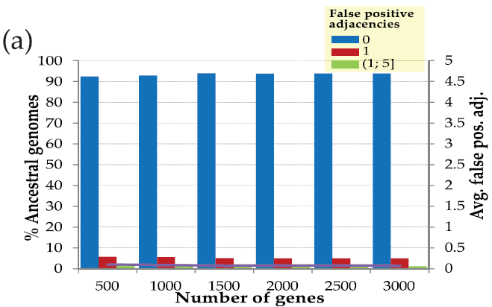
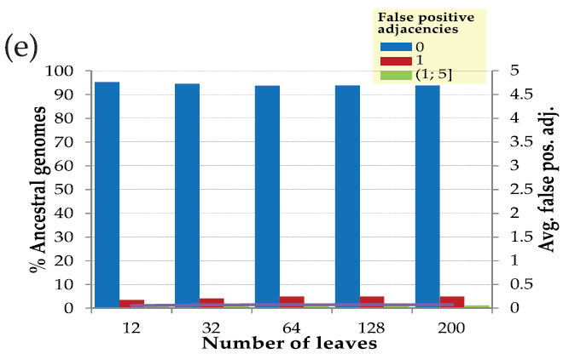
False positive adjacencies (1)
Notes:
Almost no effect
very
few false-positive gene adjacencies in the ancestors, at the
expense of a relatively larger amount of false negatives

Slide 41
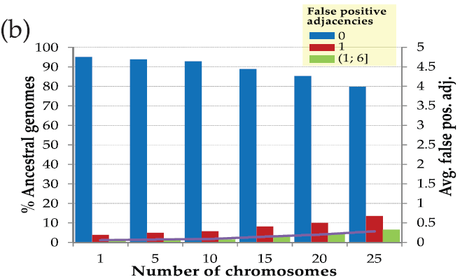
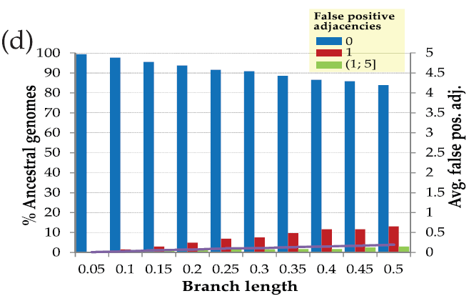
False positive adjacencies (2)
Notes:
Slight degradation
very
few false-positive gene adjacencies in the ancestors, at the
expense of a relatively larger amount of false negatives

Slide 42
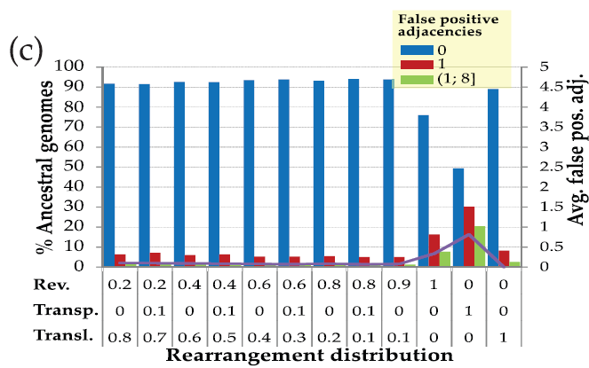
False positive adjacencies (3)
Transposition = 6 SCJ
Reversal = 2-4 SCJ
Translocations = 4 SCJ
Notes:
very
few false-positive gene adjacencies in the ancestors, at the
expense of a relatively larger amount of false negatives

Slide 43
Summary
SCJ has polynomial solutions to otherwise NP-hard problems.
Able to run on large instances (number of genomes and number of genes).
Topology reconstruction is adequate.
Good genome reconstruction on low level nodes.
Conservative – low FP but high FN.

