Slide 1
Multi-step clustering of breast cancer data
Dvir Netanely
Group Meeting Talk
Ron Shamir’s Group, TAU
22.1.2014

Slide 2
TALK Overview
TCGA’s Breast Cancer dataset
  Breast cancer subtypes
  Dataset labels (PAM50, Survival)
Clustering the samples (Standard analysis)
Evaluating the clustering solution using the labels
  Global Jaccard, WSMR, Survival analysis
The Multi-Step Clustering algorithm

Slide 3

Breast Cancer
A Common disease
  1,300,000 cases, 450,000 deaths each year worldwide
Heterogeneous with respect to
  Molecular alterations
    Many different cellular scenarios can lead to cancer
  Cellular composition
    Tumors are composed of several types of cells
  Clinical outcome
    Outcome prediction is challenging

Slide 4

Breast Cancer Clinical Subtypes
Breast cancer tumors are clinically categorized into three basic groups, each with its own therapeutic approach:
  ER+ (Luminal)
  HER2
  Basal-like (Triple-negative: ER-,PR-,Her2-)
Classification of breast cancer tumors into distinct subtypes is critical for planning treatment and for developing new therapies.

Slide 5
Project’s Goal:
Improve Breast Cancer Subtype classification
“Breast cancer is a highly heterogeneous disease due to its diverse morphological features, the variable clinical outcome and the response to different therapeutic options. It is therefore necessary to devise a clinically meaningful classification of the disease, which has to be scientifically sound, clinically useful and widely reproducible. The established histopathological classification has a limited clinical utility, due to insufficient prognostic and predictive power.”
The current state of breast cancer classification , G. Viale 2012
Educational Sessions - Molecular tools for decision making in breast cancers

Slide 6
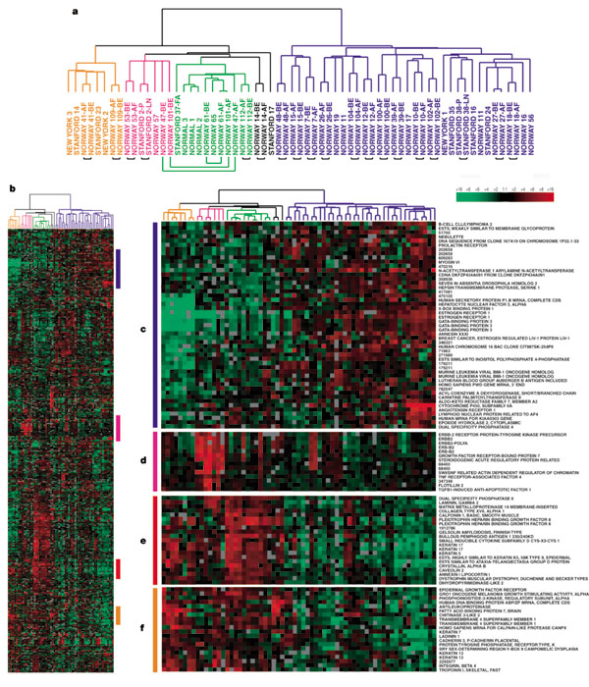
Breast cancer subtype classification based on gene expression - I
In 2000, Botstein et al. identified 4 classes of breast cancer based on gene expression analysis.
65 samples, 496 genes were used for clustering.
Identified 4 molecular sub-types:
  ER+/Luminal-like
  Basal-like (Triple Negative ER-,PR-,Her2-)
  Her2 (Erb-B2+)
  Normal-like
Molecular portraits of human breast tumours
David Botstein et al., Nature 406, 747-752 (17 August 2000)

Slide 7
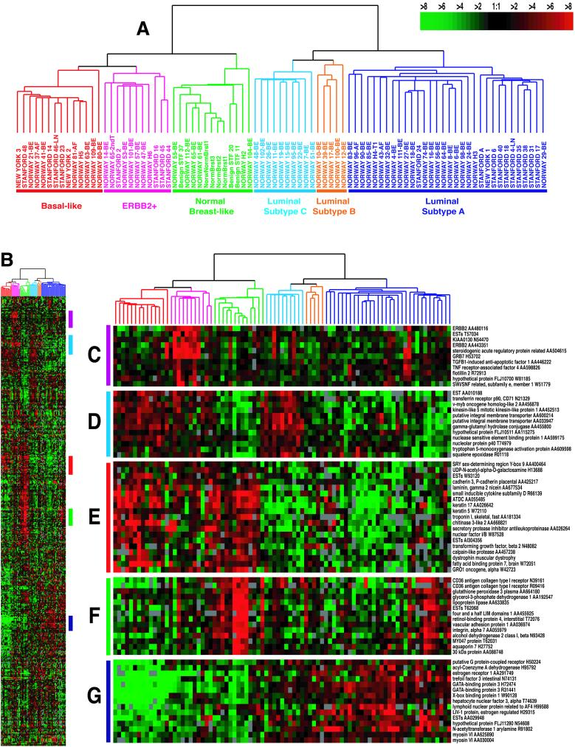
Breast cancer subtype classification based on gene expression - II
“Gene expression patterns of breast carcinomas distinguish tumor subclasses with clinical implications”, Botstein et al. 2001
85 cDNA microarrays, newer chip, same genes as in the previous study.
Identified five robust sub-types:
  Luminal A
  Luminal B
  HER2-enriched
  Basal-like
  Normal-like
Luminal was divided into two subgroups.
Survival analyses on a subcohort of patients showed significantly different outcomes for the patients belonging to the various groups.

Slide 8
The PAM50 Classifier
In 2009, Parker et al. derived a set of 50 genes that robustly classify the five above subtypes of breast cancer.
Analysis based on 189 tumors, 29 normal.
The PAM50 gene set has high agreement in classification with larger “intrinsic” gene sets previously used for subtyping, and is now commonly employed.
Supervised Risk Predictor of Breast Cancer Based on Intrinsic Subtypes, Parker at al. 2009

Slide 9
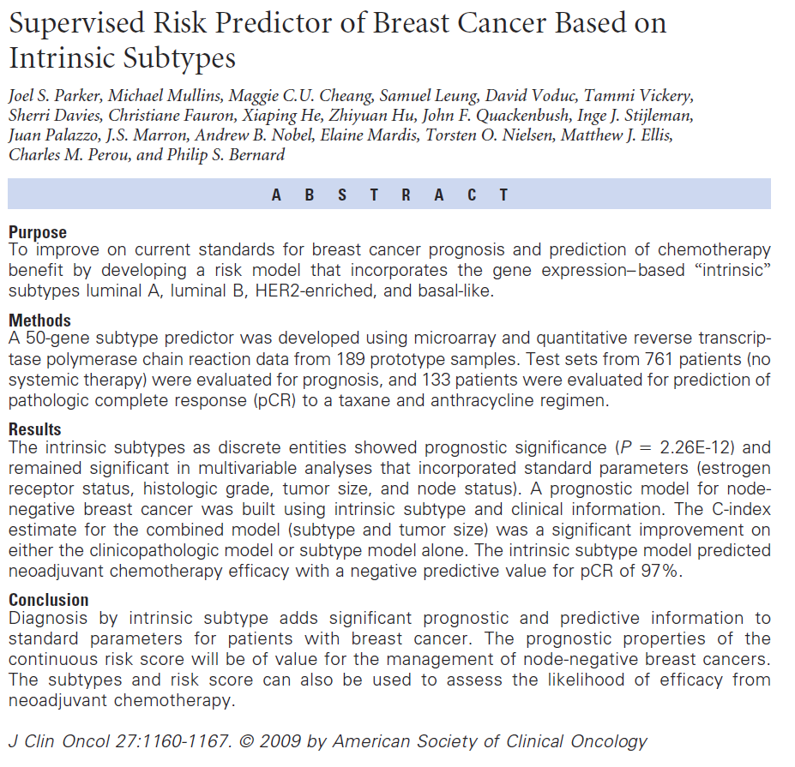
PAM50

Slide 10
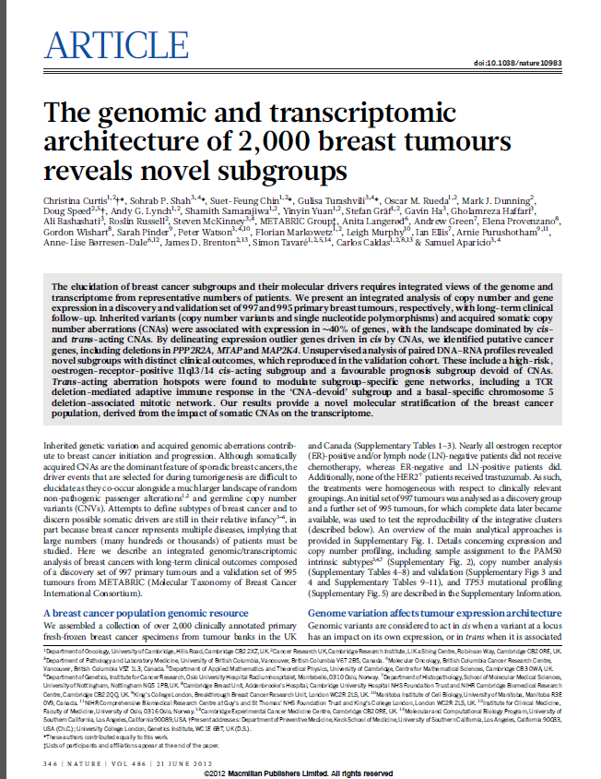
Recent papers suggest there are more than 5 distinct subtypes…
Detected 10 subtypes with distinct outcomes
Two types of data:
Expression:
  HumanHT-12 v3 Expression BeadChip – Illumina
Copy number:
  Affymetrix SNP 6.0 platform
Using as external labels:
PAM50
GENIUS
    http://genomebiology.com/content/11/2/R18
Integrative clustering using iCluster (2009):
Joint latent variable framework for integrative clustering

Slide 11
TCGA’s Breast Cancer data
“Comprehensive molecular portraits of human breast tumours”
The Cancer Genome Atlas Network
Nature Volume: 490, Pages:61–70 October 2012
RNA-Seq data used
  1026 samples x 20531 genes
  Samples include 106 normal, 910 tumor samples
  Gene level expression values, RSEM normalized
Clinical labels available (Integrated from Paper SI + TCGA ongoing updates)
  Age, gender, race…
  Hormone receptor status – ER, PR, Her2
  Pam50 labels based on microarray expression
  Survival data

Slide 12
TCGA’s Breast Cancer data
PAM50 Labels
PAM50 Label | Number of samples
Normal | 106
Basal-like | 97
HER2-enriched | 57
Luminal A | 231
Luminal B | 128
Normal-like | 7
NA | 400 (newer samples)

Slide 13
TCGA’s Breast Cancer data
Survival Labels
Survival data in original paper (published 2012)
DECEASED | 95
LIVING | 713
Survival data 9/2013
DECEASED | 110
LIVING | 793

Slide 14
PCA
Colored by PAM50
Projected samples using the top 2 principle components.
614 samples with PAM50 labels, using the top 2000 variable genes)
54% of the variability is captures in the first PC. Second and onward - less than 2%..

Slide 15
PCA
Colored by ER Status
Projected samples using the top 2 principle components.
614 samples with PAM50 labels, using the top 2000 variable genes)
54% of the variability is captures in the first PC. Second and onward - less than 2%..

Slide 16
PCA
Colored by PR Status
Projected samples using the top 2 principle components.
614 samples with PAM50 labels, using the top 2000 variable genes)
54% of the variability is captures in the first PC. Second and onward - less than 2%..

Slide 17
PCA
Colored by HER2 Status
Projected samples using the top 2 principle components.
614 samples with PAM50 labels, using the top 2000 variable genes)
54% of the variability is captures in the first PC. Second and onward - less than 2%..

Slide 18
Clustering the samples (Standard analysis)
Use the data to group similar samples together (Unsupervised Analysis)
Use the dataset labels to evaluate the obtained clustering solution

Slide 19
Preprocessing is VERY important
Keeping only samples for which PAM50 label is available, removing normal-like (619 samples).
Flooring to 4, ceiling to 12,000, log2.
Applying a variability filter, keeping only top 2000 variable genes.
Normalizing the rows (over all samples)

Slide 20
K-Means Results (K=5)

Slide 21
How to evaluate the obtained clustering solution?
Global Jaccard
WSMR
Differential survival between groups

Slide 22
K-Means Results (K=5)
PCA
PAM50 Labels
Clustering results

Slide 23
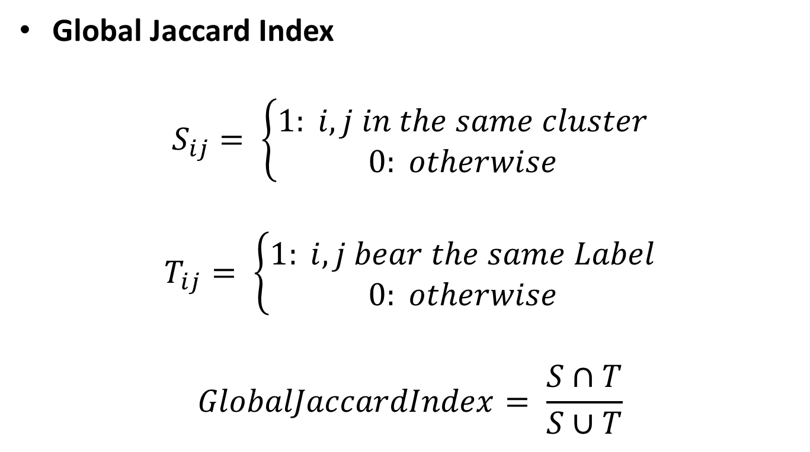
Measures for evaluating clustering solutions
Jaccard Index
Global Jaccard Index
$$S_{ij}= \left\{\begin{aligned}1: i,j in the same cluster \\ 0: otherwise\end{aligned}\right.$$
$$T_{ij}= \left\{\begin{aligned}1: i,j bear the same Label \\ 0: otherwise\end{aligned}\right.$$
$$GlobalJaccardIndex= \frac{S∩T}{S∪T}$$

Slide 24
K-Means Results (K=5)

Slide 25
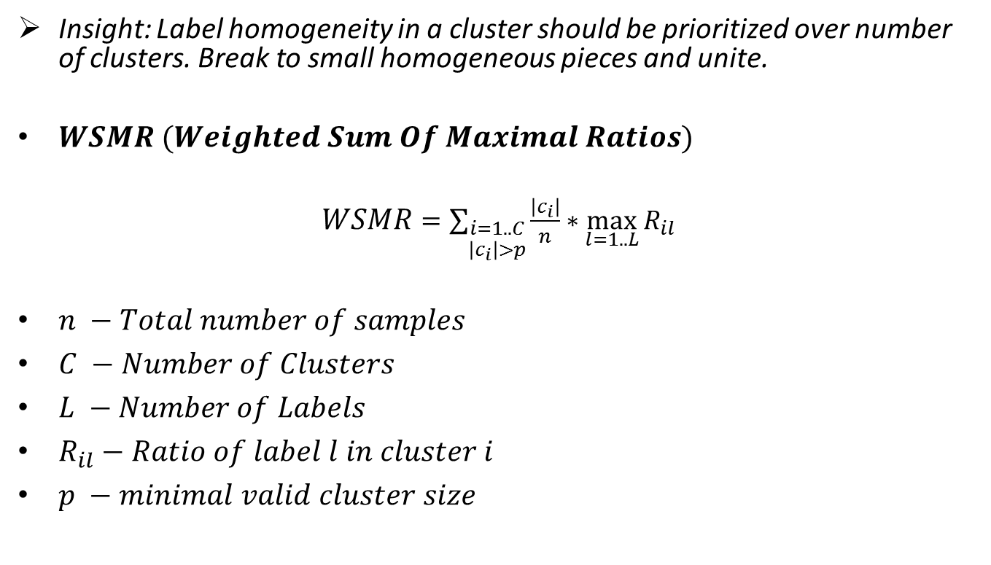
Measures for evaluating clustering solutions
WSMR
Insight: Label homogeneity in a cluster should be prioritized over number of clusters. Break to small homogeneous pieces and unite.
$WSMR (Weighted Sum Of Maximal Ratios)$
$WSMR$ $=\sum_{\begin{aligned}i=1..C \\ \left|c_{i}\right|>p\end{aligned}}{\frac{\left|c_{i}\right|}{n}∗\max_{l=1..L}{R_{il}}}$
$n −Total number of samples$
$C −Number of Clusters$
$L −Number of Labels$
$R_{il}−Ratio of label l in cluster i$
$p −minimal valid cluster size$

Slide 26
K-Means Results (K=5)

Slide 27
Survival analysis

Slide 28
Survival analysis

Slide 29
Unsupervised Analysis
Intermediate thoughts
Tried to group the samples into clusters that make sense in light of the external labels (used various clustering methods).
Preprocessing is important.
The inner structure of the BRCA’s dataset seem to contain some clusters that are easy to identify.
But also a big mixed cluster which is hard to break.
  Maybe only a few genes are differentially expressed?
  Maybe expression data by itself isn’t enough ?
  Maybe the PAM50 LumA,LumB is problematic?
Where to next?
  Break into more clusters?
  Improve the clustering algorithm to produce cleaner clusters?

Slide 30
increasing the number of clusters - the answer?

Slide 31
Kmeans K=10

Slide 32
Kmeans K=10

Slide 33
Survival analysis for Kmeans, K=10

Slide 34
Kmeans K=10

Slide 35
increasing the number of clusters - the answer?
Makes sense if we want to find sub-classes of the 5 PAM50 classes
Improves cluster purity (Higher WSMR -> Useful for building a classifier)
Significant differential survival groups are detected
Over-fitting
Hard to asses the meaning of many small groups

Slide 36
Reminder: Building a clustering based classifier
Find a clustering solution composed of clusters that are highly homogenous with respect to external label.
Assign a single label to each cluster based on calculation of maximal ratio.
Map each new sample to a cluster based on profile correlation.
Assign the new sample with the cluster’s label.

Slide 37
Choosing a clustering solution which maximizes WSMR

Slide 38
Kmeans 15, Correlation distance – Example for high score

Slide 40
Accuracy distribution over 40 executions
Kmeans 15, correlation- Mean: 0.7512, min:0.669, max:0.830

Slide 41
The Multi-Step Clustering Algorithm

Slide 42
Applying hierarchical clustering on different subsets of samples
(All samples)

Slide 43
Applying hierarchical clustering on different subsets of samples
(Tumors only, without Normals)

Slide 44
Applying hierarchical clustering on different subsets of samples
(Luminal A, Luminal B, normal-like)

Slide 45
The Multi-Step Clustering Algorithm
Motivation:
  In certain datasets, a single group of samples may be very different from the other samples.
  Reducing the feature dimension using a variability filter is likely to keep mainly genes whose expression differ between sample in the ‘different’ cluster and other samples. Normalizing gene expression over all the sample would remove differnces between sample that are not in the ‘different’ cluster.
  Finer signals may be lost, making it difficult to distinguish between the secondary clusters.
The Idea:
  In every iteration we extract the most distinct cluster, put it aside and continue with the remaining samples.
  In every iteration we choose the genes that are most variable on the current set of samples, re-normalize and re-culster.

Slide 46
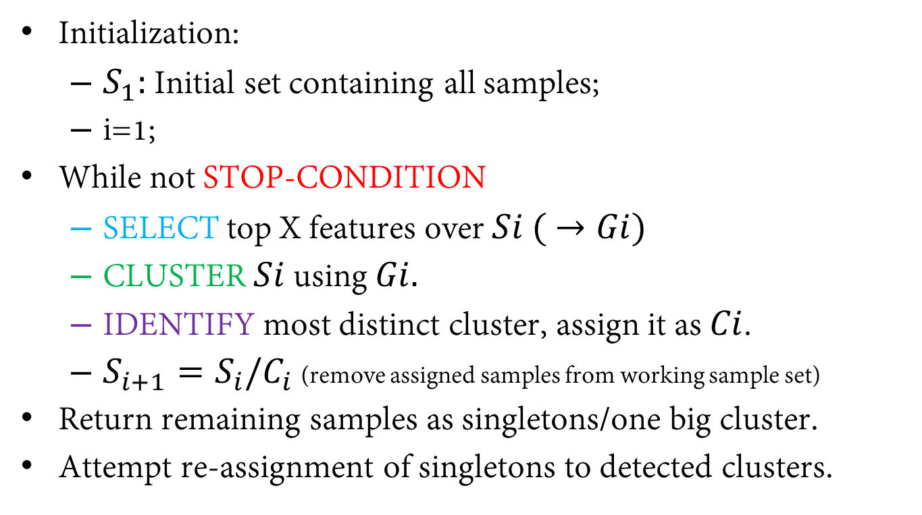
The Multi-Step Clustering Algorithm
Initialization:
  $S_{1}:$Initial set containing all samples;
  i=1;
While not STOP-CONDITION
  SELECT top X features over $Si ( →Gi)$
  CLUSTER $Si$ using $Gi.$
  IDENTIFY most distinct cluster, assign it as $Ci$.
  $S_{i+1}=S_{i}/C_{i}$ (remove assigned samples from working sample set)
Return remaining samples as singletons/one big cluster.
Attempt re-assignment of singletons to detected clusters.

Slide 47
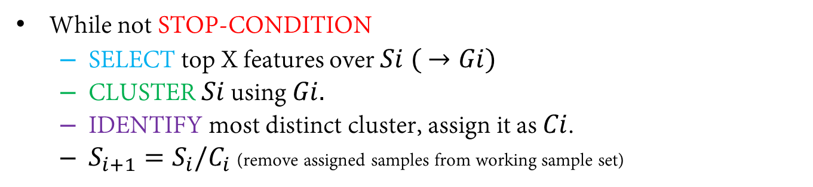
The Multi-Step Clustering Algorithm
While not STOP-CONDITION
  SELECT top X features over $Si ( →Gi)$
  CLUSTER $Si$ using $Gi.$
  IDENTIFY most distinct cluster, assign it as $Ci$.
  $S_{i+1}=S_{i}/C_{i}$ (remove assigned samples from working sample set)
STOP-CONDITION Options:
Stop after predefined number of iterations (given K).
Stop when there are only S samples left.
Stop when the last identified cluster is
  Too small
  Too close to other clusters
  Having low separation/homogeneity

Slide 48
The Multi-Step Clustering Algorithm
While not STOP-CONDITION
  SELECT top X features over $Si ( →Gi)$
  CLUSTER $Si$ using $Gi.$
  IDENTIFY most distinct cluster, assign it as $Ci$.
  $S_{i+1}=S_{i}/C_{i}$ (remove assigned samples from working sample set)
Feature selection options:
Select the top G features having
  Highest variability/range

Slide 49
The Multi-Step Clustering Algorithm
While not STOP-CONDITION
  SELECT top X features over $Si ( →Gi)$
  CLUSTER $Si$ using $Gi.$
  IDENTIFY most distinct cluster, assign it as $Ci$.
  $S_{i+1}=S_{i}/C_{i}$ (remove assigned samples from working sample set)
Clustering options:
Use any clustering algorithm
  K-Means with a certain K.
  Click with a certain H (requires handling singletons)

Slide 50
The Multi-Step Clustering Algorithm
While not STOP-CONDITION
  SELECT top X features over $Si ( →Gi)$
  CLUSTER $Si$ using $Gi.$
  IDENTIFY most distinct cluster, assign it as $Ci$.
  $S_{i+1}=S_{i}/C_{i}$ (remove assigned samples from working sample set)
Identification of most distinct cluster
The cluster whose center is most distant from the all other centers.
A function of Separation + Homogeneity.
The cluster with the largest non-overlapped convex hull polygon on the PCA plot.
Supervised version: cluster with most significant label enrichment/survival score.

Slide 51
Execution example
Iteration 1

Slide 52
Execution example
Iteration 2

Slide 53
Execution example
Iteration 3

Slide 54
Execution example
Iteration 4

Slide 55
Execution example
Iteration 5

Slide 56
Results of Multi-step clustering over Kmeans
K=5, 5 Iterations, 1000 genes per iteration

Slide 57
Results of Multi-step clustering over Kmeans
K=5, 5 Iterations, 1000 genes per iteration

Slide 58
Results of Multi-step clustering over Kmeans
K=5, 5 Iterations, 1000 genes per iteration

Slide 59
PCA
Colored by MSC clusters

Slide 60
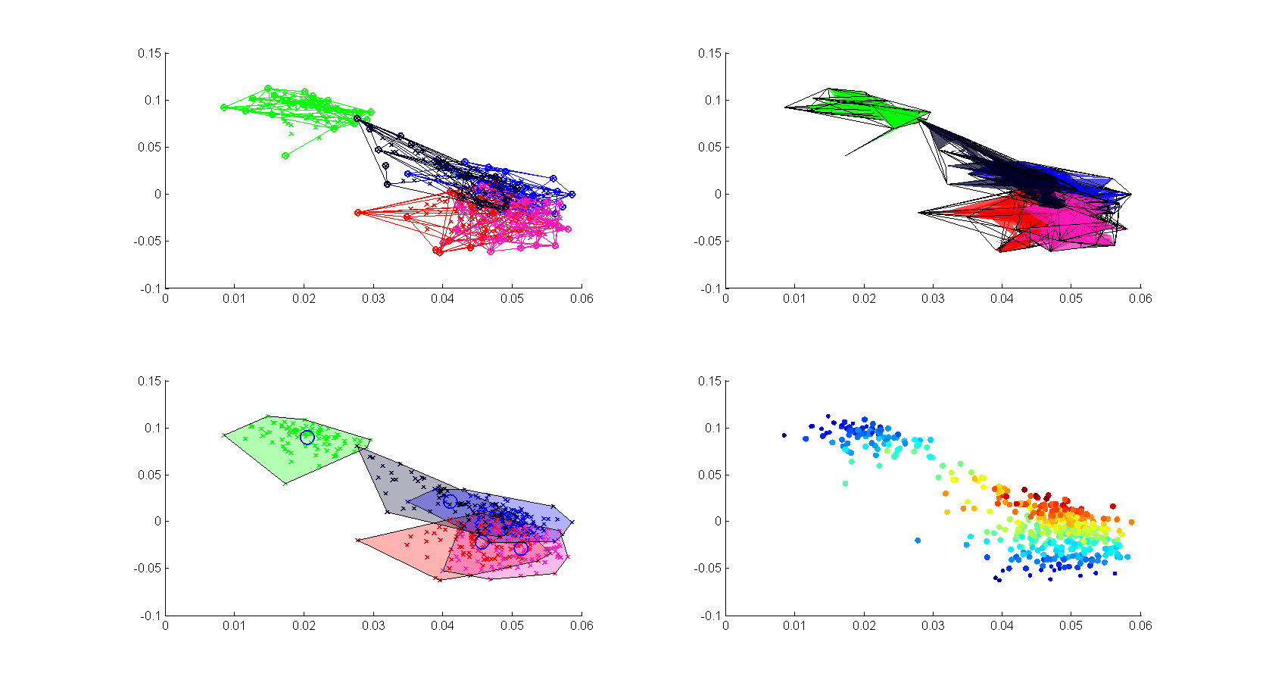
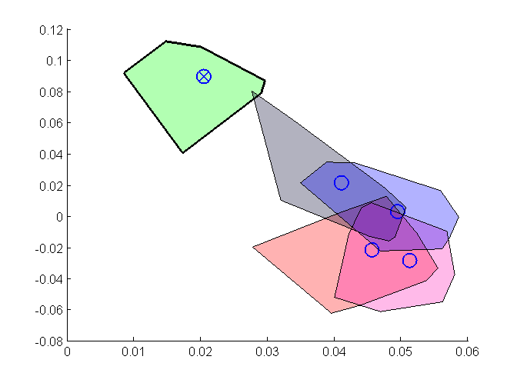
Convex-Hull based approach
NEW !
Computational geometry
Analyzing the polygons defined by the convex-hull of each cluster on the PCA plot (2D/3D - top 2-3 PCs).
Identifying the most distinct cluster in each iteration as the cluster having the largest non-overlapping area (or maximal number of exclusive points).
Stop iterating when overlapping of convex-hulls exceeds a certain value or when the number of exclusive points go below a certain threshold.

Slide 61
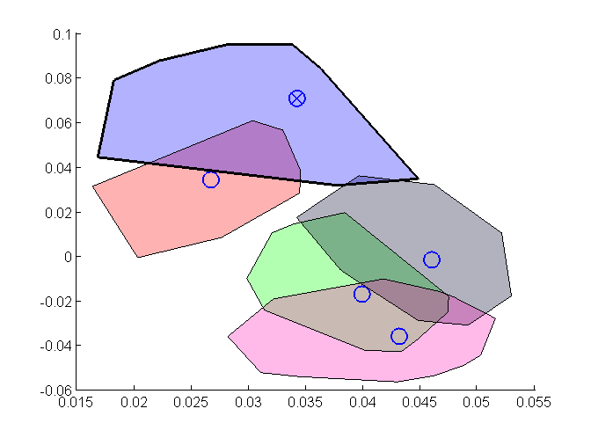
Iteration I

Slide 62
Iteration 2

Slide 63
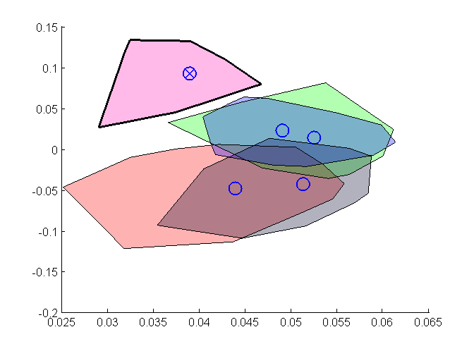
Iteration 3

Slide 64
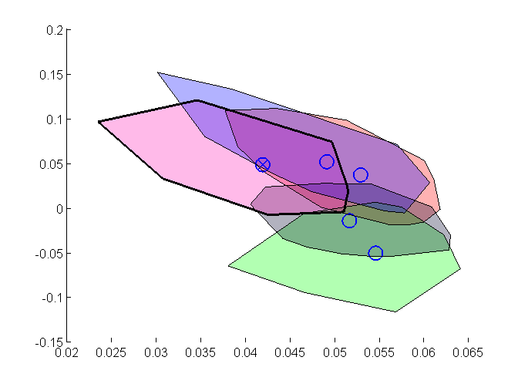
Iteration 4

Slide 65
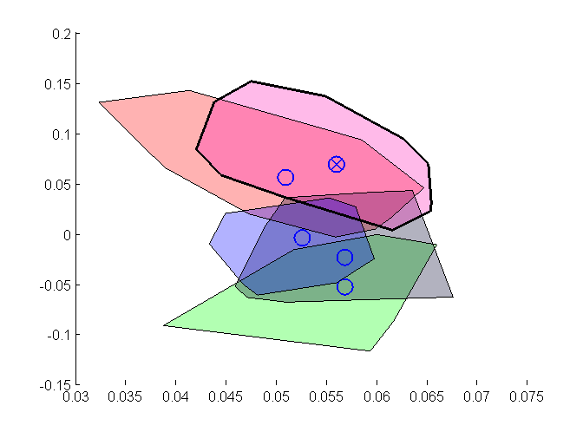
Iteration 5

Slide 66
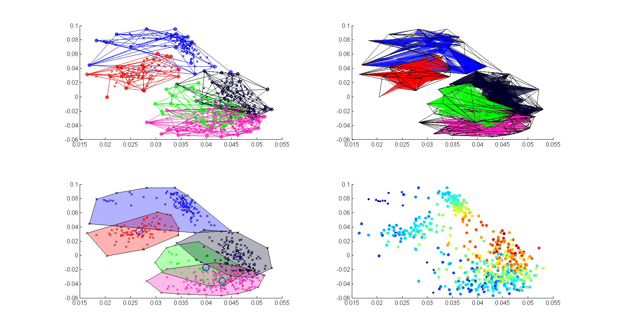
Even scarier plots of the same process..

Slide 68
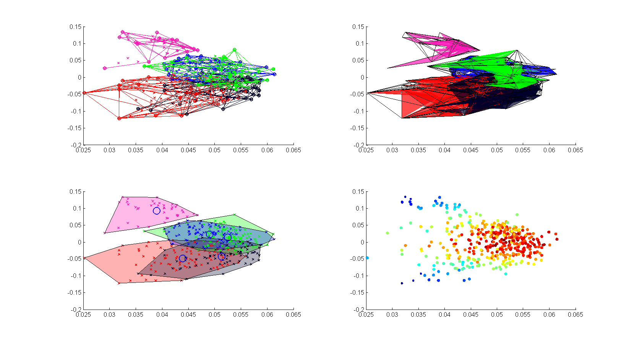

Slide 69
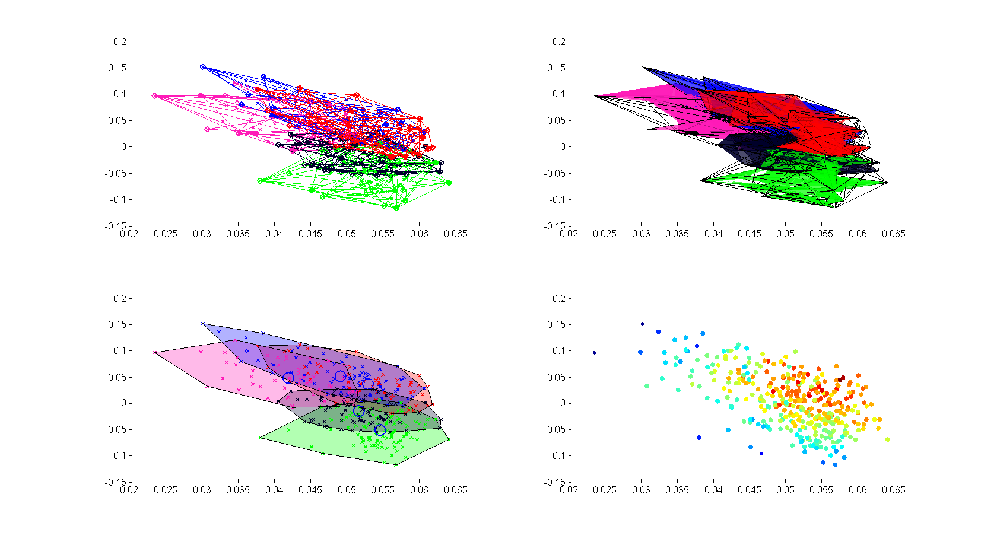

Slide 70
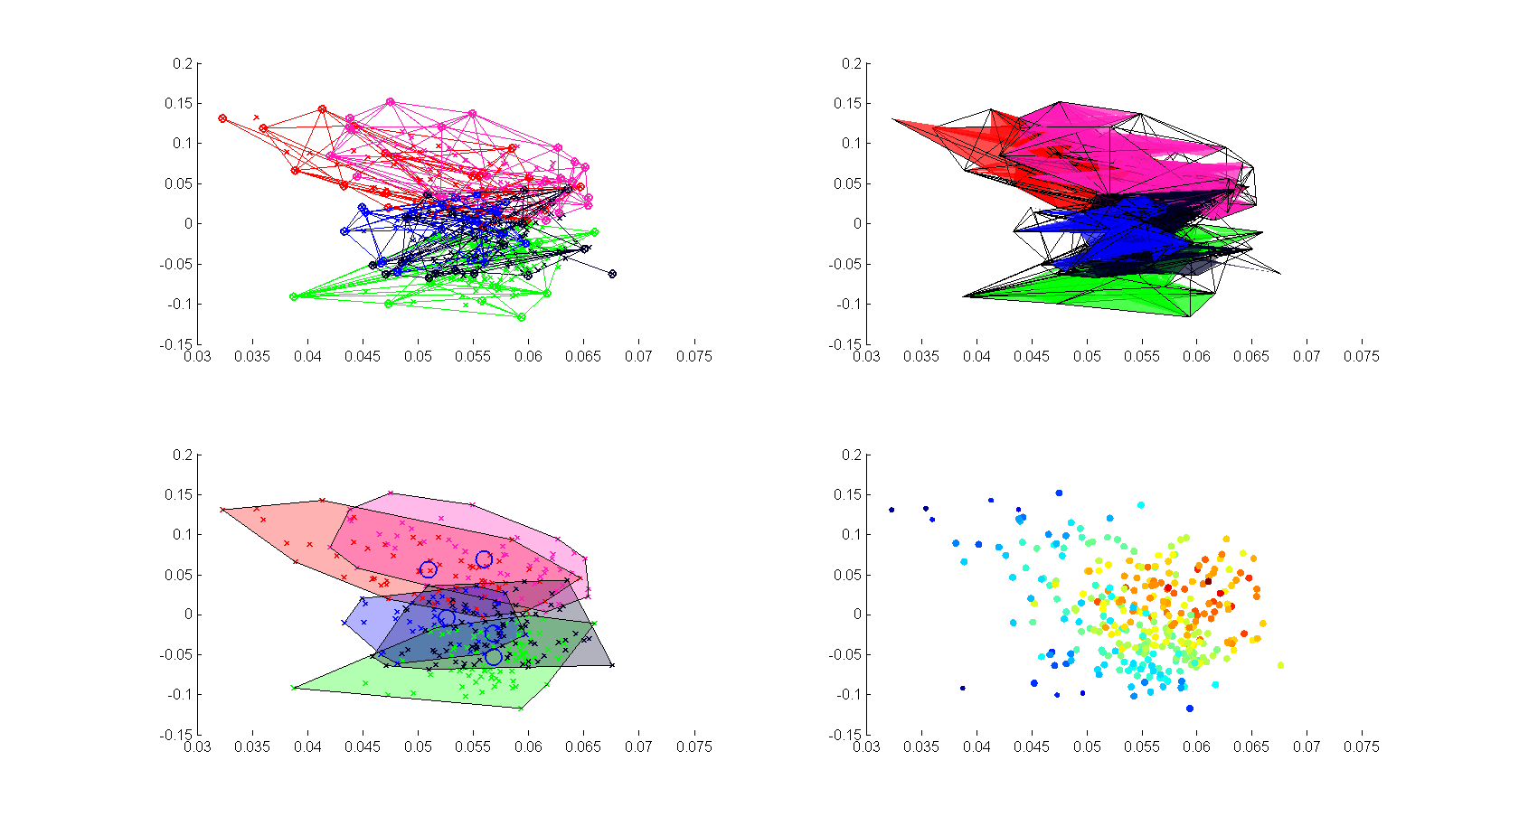

Slide 71
Singleton reallocation
Based on correlation to the centers of identified clusters. Only samples exceeding certain R and pValue are reassigned. Which genes to use ?
  All / Top Var
  Top var between cluster centers
  Union of gene sets used in each iteration

Slide 72
PCA of Her2, Lum A, Lum B samples only
And still, the challenge remains…

Slide 73
Conclusions
Selection of genes based on variability is probably wrong.
Additional data is needed to separate the inner mixed cluster.
PAM50 classes of Luminal A & B may be more fluid than assumed.

