Slide 1
Identification of Breast Cancer Subtypes
Using RNA-SEQ Data
Clinical Data Analysis
Dvir Netanely
Group Meeting Talk
Ron Shamir’s Group, TAU
29.10.2014

Slide 2
TALK Overview
Introduction:
  Breast cancer subtypes
  The TCGA BRCA dataset
  Clustering the TCGA BRCA samples
Evaluating a given clustering solution using the clinical labels
  Survival
  Categorical, Ordinal and Numerical labels
Finding the best clustering method
Introducing the “Genomic Sample Analyzer” platform

Slide 3
Introduction :
Breast cancer subtypes

Slide 4

Breast Cancer Clinical Subtypes
Breast cancer tumors are clinically categorized into three basic groups, each with its own therapeutic approach:
  ER+ (Luminal)
  HER2
  Basal-like (Triple-negative: ER-,PR-,Her2-)
Classification of breast cancer tumors into distinct subtypes is critical for planning treatment and for developing new therapies.

Slide 5
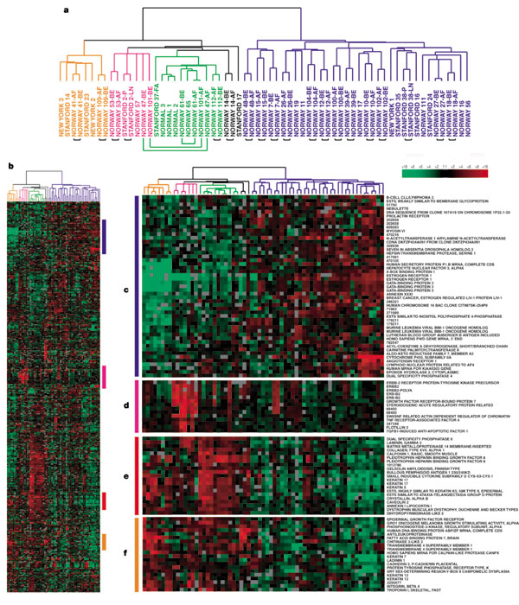
Breast cancer subtype classification based on gene expression - I
In 2000, Botstein et al. identified 4 classes of breast cancer based on gene expression analysis.
65 samples, 496 genes were used for clustering.
Identified 4 molecular sub-types:
  ER+/Luminal-like
  Basal-like (Triple Negative ER-,PR-,Her2-)
  Her2 (Erb-B2+)
  Normal-like
Molecular portraits of human breast tumours
David Botstein et al., Nature 406, 747-752 (17 August 2000)

Slide 6
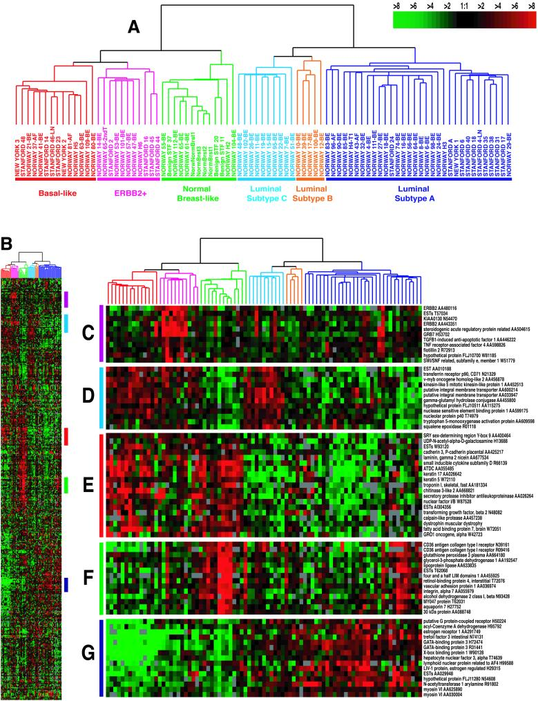
Breast cancer subtype classification based on gene expression - II
“Gene expression patterns of breast carcinomas distinguish tumor subclasses with clinical implications”, Botstein et al. 2001
85 cDNA microarrays, newer chip, same genes as in the previous study.
Identified five robust sub-types:
  Luminal A
  Luminal B
  HER2-enriched
  Basal-like
  Normal-like
Luminal was divided into two subgroups.
Survival analyses on a subcohort of patients showed significantly different outcomes for the patients belonging to the various groups.

Slide 7
The PAM50 Classifier
In 2009, Parker et al. derived a set of 50 genes that robustly classify the five above subtypes of breast cancer.
Analysis based on 189 tumors, 29 normal.
The PAM50 gene set has high agreement in classification with larger “intrinsic” gene sets previously used for subtyping, and is now commonly employed.
Supervised Risk Predictor of Breast Cancer Based on Intrinsic Subtypes, Parker at al. 2009

Slide 8
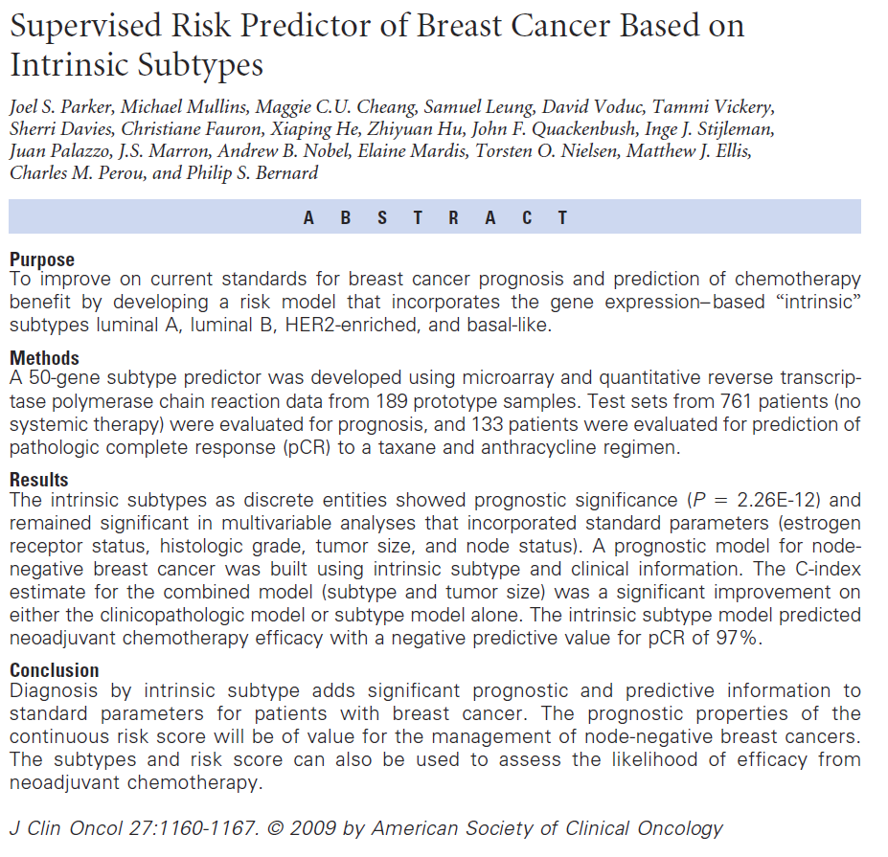
PAM50

Slide 9
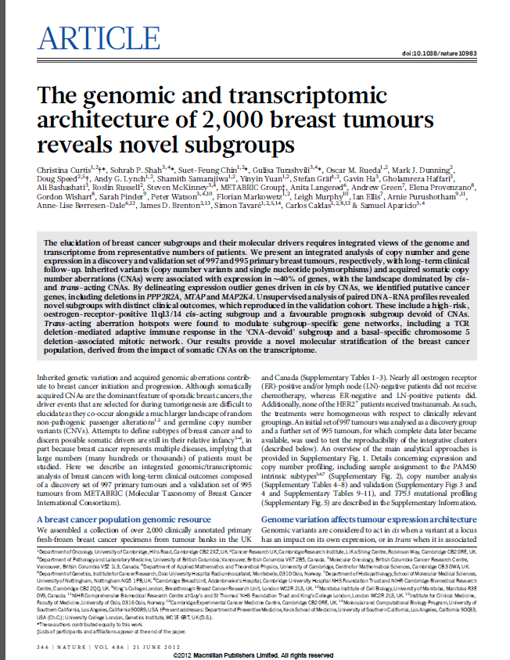
Recent papers suggest there are more than 5 distinct subtypes…
Detected 10 subtypes with distinct outcomes
Two types of data:
Expression:
  HumanHT-12 v3 Expression BeadChip – Illumina
Copy number:
  Affymetrix SNP 6.0 platform
Using as external labels:
PAM50
GENIUS
    http://genomebiology.com/content/11/2/R18
Integrative clustering using iCluster (2009):
Joint latent variable framework for integrative clustering

Slide 10
  The TCGA BRCA dataset

Slide 11
TCGA’s Breast Cancer data
“Comprehensive molecular portraits of human breast tumours”
The Cancer Genome Atlas Network
Nature Volume: 490, Pages:61–70 October 2012
RNA-Seq data used
  1182 samples x 20531 genes
  Samples include 113 normal, 1068 tumor samples
  Gene level expression values, RSEM normalized
180~ Clinical labels available
  Age, gender, race…
  Hormone receptor status – ER, PR, Her2
  Pam50 labels based on microarray/RNA-SEQ expression
  Survival data

Slide 12
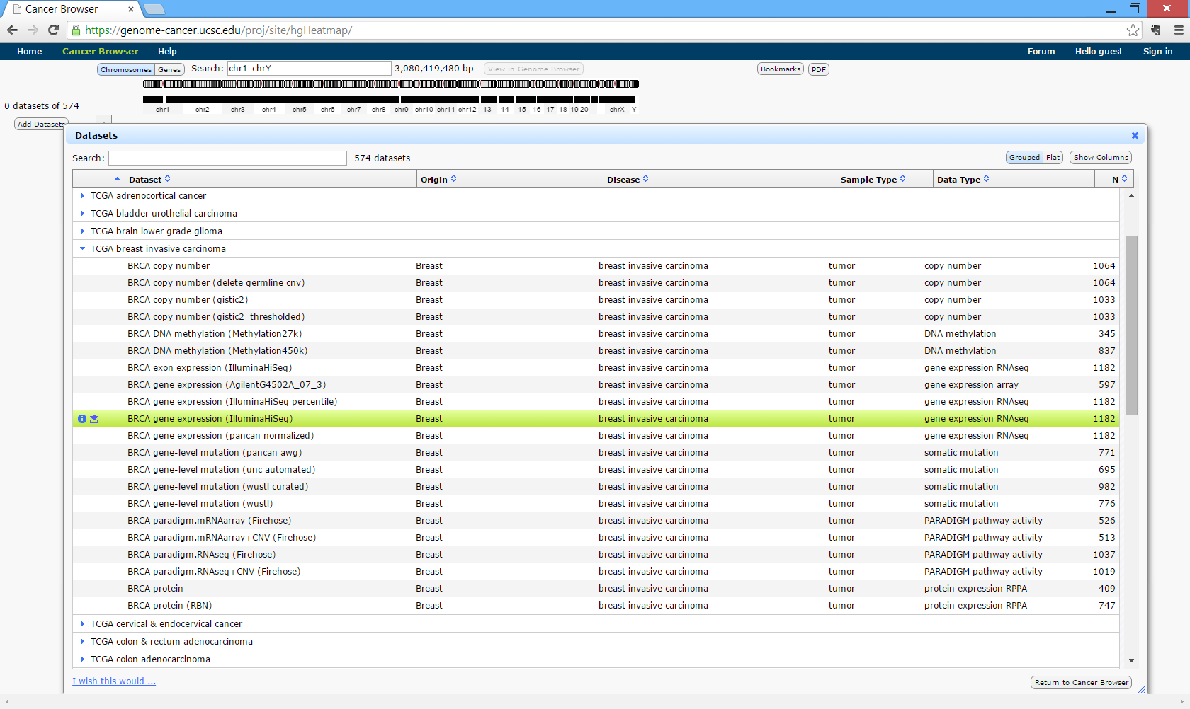
UCSC Cancer Browser

Slide 13
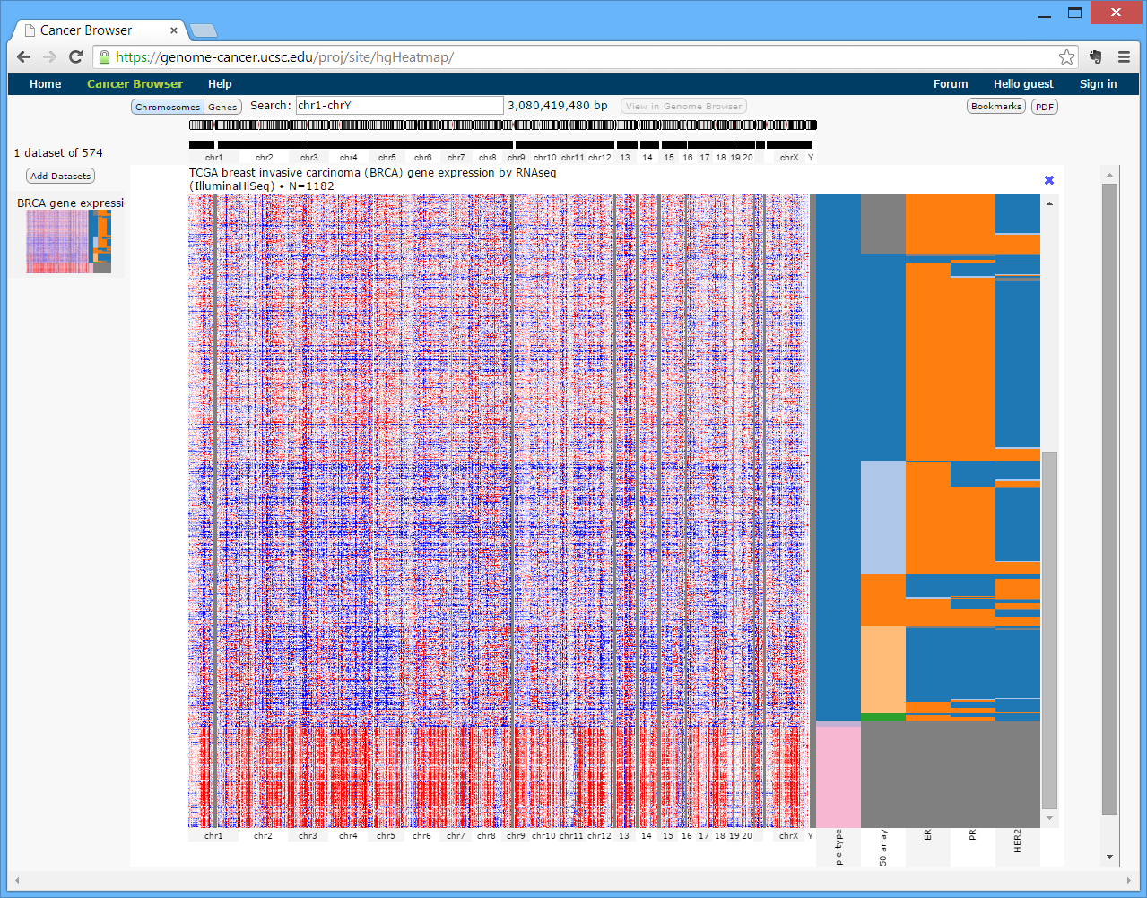
UCSC Cancer Browser – Online analysis

Slide 14
TCGA’s Breast Cancer data
PAM50 Labels
PAM50 Label | Number of samples
Basal | 142
Her2 | 67
LumA | 422
LumB | 194
NA | 220
Normal | 137
Basal | 142

Slide 15
PCA
Colored by PAM50
Projected samples using the top 2 principle components.

Slide 16
PCA
Colored by PR Status
Projected samples using the top 2 principle components.
614 samples with PAM50 labels, using the top 2000 variable genes)
54% of the variability is captures in the first PC. Second and onward - less than 2%..

Slide 17
PCA
Colored by HER2 Status
Projected samples using the top 2 principle components.
614 samples with PAM50 labels, using the top 2000 variable genes)
54% of the variability is captures in the first PC. Second and onward - less than 2%..

Slide 18
Clustering the TCGA BRCA samples

Slide 19
Preprocessing is VERY important
Keeping only samples for which PAM50 label is available, removing normal-like.
Flooring to 4, ceiling to 12,000, log2.
Applying a variability filter, keeping only top 2000 variable genes.
Optional: Normalizing the rows (over all samples), or using Correlation as a distance metric for the clustering

Slide 20
Kmeans K=5 on top 2000 var genes

Slide 21
PAM50 label distribution among the 5 sample clusters

Slide 22
K-Means Results (K=5)
PCA
PAM50 Labels
Clustering results

Slide 23
Research Question

Slide 24
Research Question
Can we Identify and characterize additional clinically relevant BRCA sub-types ?
  Large variance within current subtypes suggests a finer partitioning of the samples may be possible.
HOW ?
  Clustering the samples
  Evaluating the resultant sample partition

Slide 25
  Clustering the samples
Used existing clustering algorithms with various parameters (Kmeans, Hierarchical, Click…)
Worked on an improved clustering method: Dynamic-Feature Clustering
  Iteratively clusters the samples using different sets of genes
Examined ways to improve pre-clustering filtering of the genes
  Bimodality scores may help identify informative genes before clustering

Slide 26
  Evaluating the clustering solution
Calculating homogeneity-Separability scores
  Sum of distances to centroids, Silhouette values

Slide 27
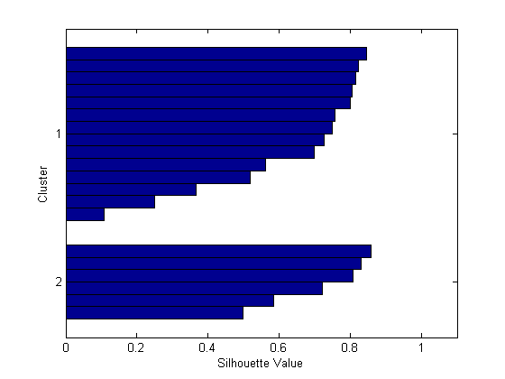

Silhouette
A method of interpretation and validation of clusters of data.
The silhouette value for each point is a measure of how similar that point is to points in its own cluster, when compared to points in other clusters.

Slide 28
Silhouette Value
The silhouette value ranges from -1 to +1.
A high silhouette value indicates that i is well-matched to its own cluster, and poorly-matched to neighboring clusters.
If most points have a high silhouette value, then the clustering solution is appropriate. If many points have a low or negative silhouette value, then the clustering solution may have either too many or too few clusters
The silhouette clustering evaluation criterion can be used with any distance metric.

Slide 29
  Evaluating the clustering solution
Calculating homogeneity-Separability scores
  Sum of distances to centroids, Silhouette values
Comparison to a different partition (like PAM50 labels)
  Jaccard Index, WSMR©

Slide 30
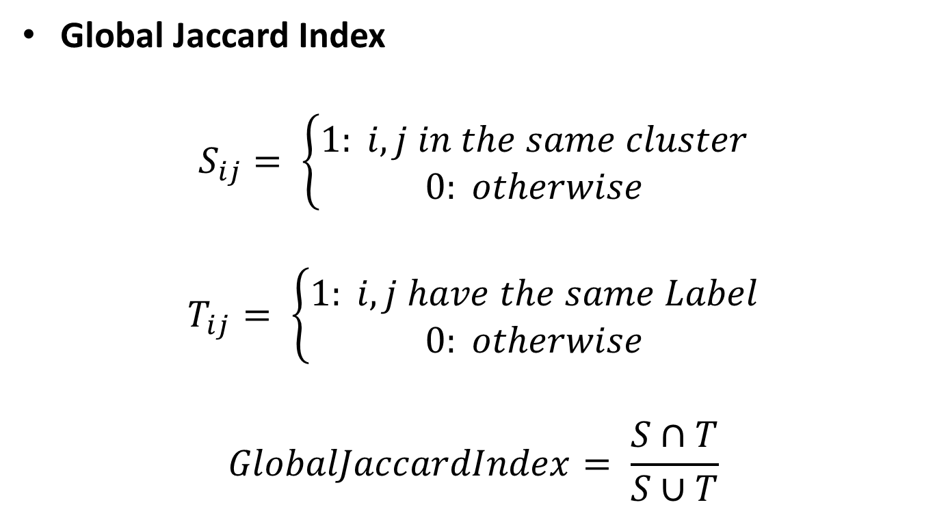
Measures for evaluating clustering solutions
Jaccard Index
Global Jaccard Index
$$S_{ij}= \left\{\begin{aligned}1: i,j in the same cluster \\ 0: otherwise\end{aligned}\right.$$
$$T_{ij}= \left\{\begin{aligned}1: i,j have the same Label \\ 0: otherwise\end{aligned}\right.$$
$$GlobalJaccardIndex= \frac{S∩T}{S∪T}$$

Slide 31
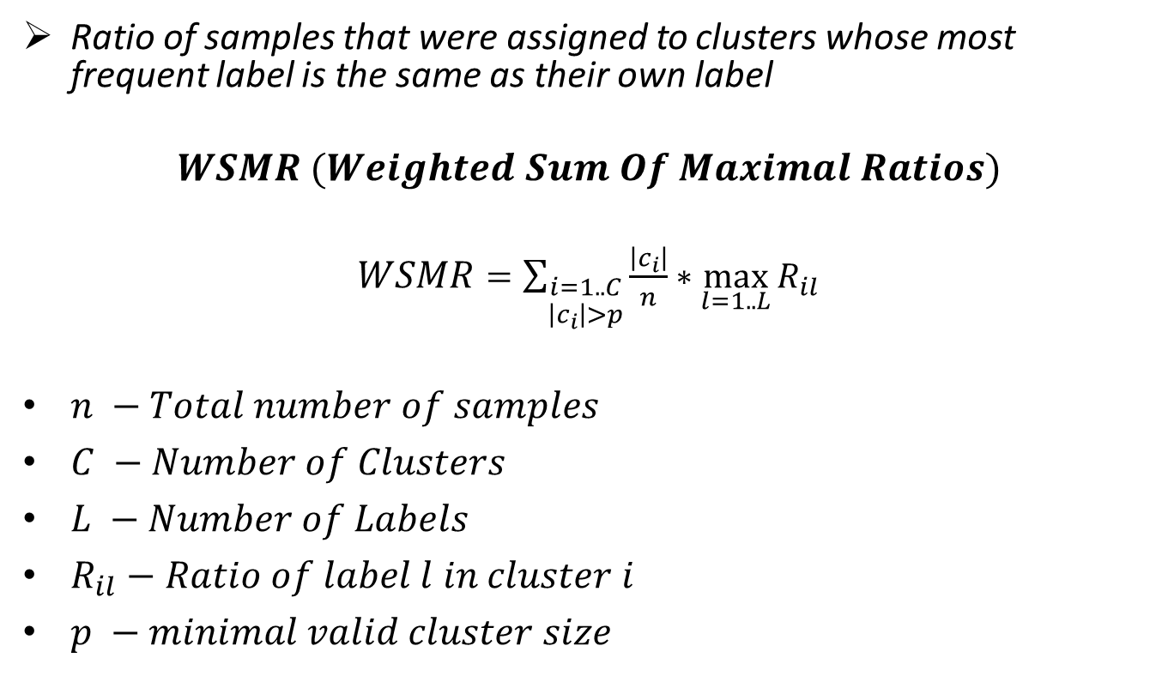
Measures for evaluating clustering solutions
WSMR
Ratio of samples that were assigned to clusters whose most frequent label is the same as their own label
$$WSMR (Weighted Sum Of Maximal Ratios)$$
$WSMR$ $=\sum_{\begin{aligned}i=1..C \\ \left|c_{i}\right|>p\end{aligned}}{\frac{\left|c_{i}\right|}{n}∗\max_{l=1..L}{R_{il}}}$
$n −Total number of samples$
$C −Number of Clusters$
$L −Number of Labels$
$R_{il}−Ratio of label l in cluster i$
$p −minimal valid cluster size$

Slide 32
K-Means Results (K=5)

Slide 33
  Evaluating the clustering solution
Calculating homogeneity-Separability scores
  Sum of distances to centroids, Silhouette values
Comparison to a different partition (like PAM50 labels)
  Jaccard Index, WSMR©
Survival analysis
  Kaplan Meier plots, Log rank test

Slide 34
Survival analysis

Slide 35
Survival analysis

Slide 36
  Evaluating the clustering solution
Calculating homogeneity-Separability scores
  Sum of distances to centroids, Silhouette values
Comparison to a different partition (like PAM50 labels)
  Jaccard Index, WSMR©
Survival analysis
  Kaplan Meier plots, Log rank test
Clinical label analysis

Slide 37
How to evaluate the obtained clustering solution?
Supervised:
Global Jaccard
WSMR
Differential survival between groups
Unsupervised:
Silhouette Index

Slide 38
K-Means Results (K=5)
PCA
PAM50 Labels
Clustering results

Slide 39
Measures for evaluating clustering solutions
Jaccard Index
Global Jaccard Index
$$S_{ij}= \left\{\begin{aligned}1: i,j in the same cluster \\ 0: otherwise\end{aligned}\right.$$
$$T_{ij}= \left\{\begin{aligned}1: i,j have the same Label \\ 0: otherwise\end{aligned}\right.$$
$$GlobalJaccardIndex= \frac{S∩T}{S∪T}$$

Slide 40
Measures for evaluating clustering solutions
WSMR
Ratio of samples that were assigned to clusters whose most frequent label is the same as their own label
$$WSMR (Weighted Sum Of Maximal Ratios)$$
$WSMR$ $=\sum_{\begin{aligned}i=1..C \\ \left|c_{i}\right|>p\end{aligned}}{\frac{\left|c_{i}\right|}{n}∗\max_{l=1..L}{R_{il}}}$
$n −Total number of samples$
$C −Number of Clusters$
$L −Number of Labels$
$R_{il}−Ratio of label l in cluster i$
$p −minimal valid cluster size$

Slide 41
K-Means Results (K=5)

Slide 42
Survival analysis

Slide 43
Survival analysis

Slide 44
Evaluating a given clustering solution using the clinical labels

Slide 45
Kmeans, K=6

Slide 46
Clinical Label Types
Survival | Numerical | Ordinal | Categorical
Survival time Recurrence time | Age Initial weight Tumor weight Year of diagnosis Tumor necrosis percent Tumor nuclei percent Positive nodes number | Metastasis stage Node stage Tumor stage Pathologic stage Menopause status | Gender Sample type Histological type HER2 Status ER_Status PR_Status PAM50 label
Relevant Statistical Tests
Log Rank test Kaplan Meier plots Cox | Rank sum test | Hyper-Geometric Enrichment on binned values Conversion to ranks + rank sum test | Hyper-Geometric Enrichment Chi Square

Slide 47
χ² test
Categorical labels
The chi-square test is used to determine whether there is a significant difference between the expected frequencies and the observed frequencies in one or more categories

Slide 48
Ranked Labels
Categorical labels
χ² test
1 | 0.00E+00 | ER_Status_nature2012 | Indeterminate NA Negative Normal Positive
2 | 0.00E+00 | PAM50Call_RNAseq | Basal Her2 LumA LumB NA Normal
3 | 0.00E+00 | PAM50_mRNA_nature2012 | Basal-like HER2-enriched Luminal A Luminal B NA Normal Normal-like
4 | 0.00E+00 | breast_carcinoma_estrogen_receptor_status | Indeterminate NA Negative Normal Positive
5 | 4.958937e-320 | breast_carcinoma_progesterone_receptor_status | Indeterminate NA Negative Normal Positive
6 | 2.05E-261 | HER2_Final_Status_nature2012 | Equivocal NA Negative Normal Positive
7 | 3.87E-258 | histological_type | Infiltrating Carcinoma NOS Infiltrating Ductal Carcinoma Infiltrating Lobular Carcinoma Medullary Carcinoma Mixed Histology (please specify) Mucinous Carcinoma NA Normal Other specify
8 | 1.27E-253 | er_level_cell_percentage_category | 10-19% 20-29% 30-39% 40-49% 50-59% 60-69% 70-79% 80-89% 90-99% <10% NA Normal
9 | 5.25E-251 | her2_immunohistochemistry_level_result | 0 1+ 2+ 3+ NA Normal
10 | 3.67E-250 | lab_proc_her2_neu_immunohistochemistry_receptor_status | Equivocal Indeterminate NA Negative Normal Positive
11 | 6.75E-243 | breast_cancer_optical_measurement_histologic_type | Infiltrating Ductal Infiltrating Lobular Medullary Mixed Histology Mucinous NA Normal Other
12 | 3.05E-238 | Tumor_T1_Coded_nature2012 | NA Normal T1 T_Other
13 | 2.58E-233 | immunohistochemistry_positive_cell_score | 0 1+ 2+ 3+ 4+ NA Normal
14 | 2.88E-233 | progesterone_receptor_level_cell_percent_category | 10-19% 20-29% 30-39% 40-49% 50-59% 60-69% 70-79% 80-89% 90-99% <10% NA Normal
15 | 3.13E-233 | Node_Coded_nature2012 | NA Negative Normal Positive
16 | 6.44E-232 | OS_event_nature2012 | 0 1 NA Normal
17 | 6.44E-232 | Vital_Status_nature2012 | DECEASED LIVING NA Normal
18 | 1.91E-231 | Survival_Data_Form_nature2012 | NA Normal enrollment followup
19 | 6.35E-231 | Gender_nature2012 | FEMALE MALE NA Normal
20 | 6.96E-231 | Tumor_nature2012 | NA Normal T1 T2 T3 T4 TX
21 | 1.25E-229 | Node_nature2012 | N0 N1 N2 N3 NA Normal
22 | 1.72E-229 | _anatomical_origin | Breast Normal
23 | 1.72E-229 | _primary_disease | Normal breast invasive carcinoma
24 | 1.72E-229 | cohort | Normal TCGA Breast Cancer
25 | 3.04E-229 | Metastasis_nature2012 | M0 M1 NA Normal
26 | 3.04E-229 | Metastasis_Coded_nature2012 | NA Negative Normal Positive

Slide 49
Categorical labels
HG Test for each value of the current label

Slide 50
Categorical labels
HG Test for each value of the current label

Slide 51
Categorical labels
HG Test for each value of the current label

Slide 52
Categorical labels - FDR, Filtering and merging
Filtered
Only rows having pValue<Alpha
Merged
Each Row represent a single label type

Slide 53
Categorical labels – significant label values

Slide 54
Categorical summary table
significant label types

Slide 55
Ordinal labels
Manual ordering of the values
AJCC_Stage_nature2012 | Stage I | Stage IA | Stage IB | Stage II | Stage IIA | Stage IIB | Stage III | Stage IIIA | Stage IIIB | Stage IIIC | Stage IV
Converted_Stage_nature2012 | Stage I | Stage IIA | Stage IIB | Stage IIIA | Stage IIIB | Stage IIIC | Stage IV
pathologic_stage | Stage Tis | Stage I | Stage IA | Stage IB | Stage II | Stage IIA | Stage IIB | Stage III | Stage IIIA | Stage IIIB | Stage IIIC | Stage IV
ajcc_neoplasm_disease_stage | Stage Tis | Stage I | Stage IA | Stage IB | Stage II | Stage IIA | Stage IIB | Stage III | Stage IIIA | Stage IIIB | Stage IIIC | Stage IV
pathologic_N | N0 | N0 (i-) | N0 (i+) | N0 (mol+) | N1mi | N1 | N1a | N1b | N1c | N2 | N2a | N3
ajcc_neoplasm_disease_lymph_node_stage | N0 | N0 (i-) | N0 (i+) | N0 (mol+) | N1mi | N1 | N1a | N1b | N1c | N2 | N2a | N3
Node_nature2012 | N0 | N1 | N2 | N3
pathologic_T | T1 | T1a | T1b | T1c | T2 | T2a | T2b | T3 | T3a | T4 | T4b | T4d
ajcc_tumor_stage_code | T1 | T1a | T1b | T1c | T2 | T2b | T3 | T3a | T4 | T4b | T4d

Slide 56
Ordinal labels
1: HG on binned values
2: Rank sum test

Slide 57
Ordinal labels
1: HG on binned values
2: Rank sum test

Slide 58
Ordinal summary table
significant label types (FDR,Merged)

Slide 59
Numerical summary table
significant label types (FDR,Merged)

Slide 60
Survival labels

Slide 61
Recurrence labels

Slide 62
Final Unified table pValues

Slide 63
Final Unified table
Labels

Slide 64
Final Unified table
Labels

Slide 65
Additional Characterizations?
  GO characterizations for each sample cluster.
  List of differentially expressed genes.
  Other enrichments on gene clusters that are differentially expressed on a single sample cluster.

Slide 66
Applying the entire analysis on several clustering solutions

Slide 67
Feature Dynamic Clustering
Samples:
  Removing Male, Metas, Normal
Genes
  Keeping to 10,000 var genes
FDC params:
clusteringMethodName: Kmeans
param: 5
stopCondition: IterationNumber
geneSelectionMethod: Variance
geneSelectionCutoffMethod: TopNumber
geneSelectionCutoffValue: 1000
distinctClusterIdentificationMethod: CenterDistance
kMeansDistanceMetric: correlation
kInnerRange: 2 3 4 5
clickHomogeneity: 0.7
iterationsNumber: 4

Slide 75
Kmeans solution, k=6 on 10,000 genes

Slide 78
Introducing The
“Genomic Sample Analyzer” platform

Slide 79
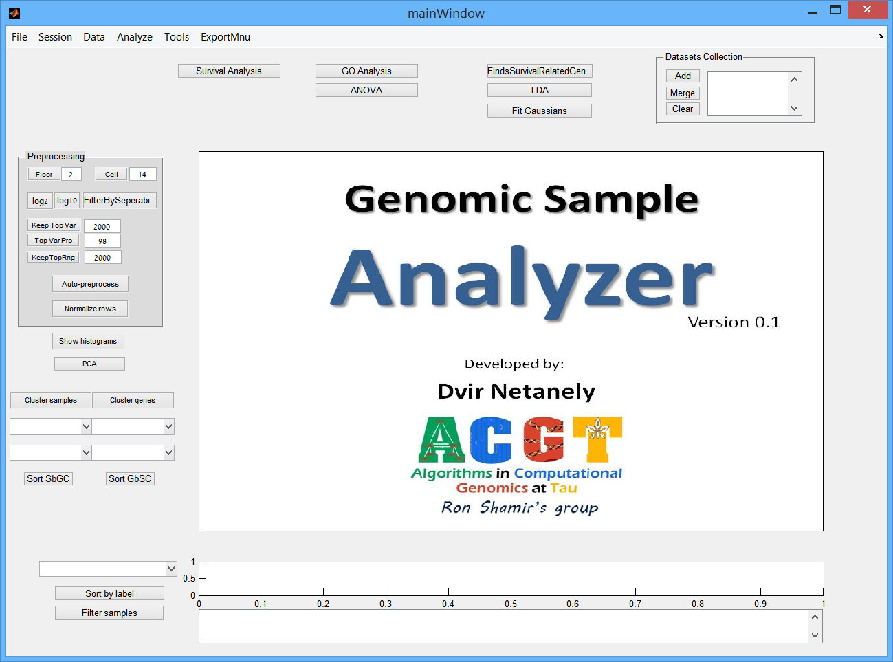

Slide 80
Main Features
Designed to work with large genomic datasets containing thousand of samples/features
Focus on sample analysis
Supports analysis of hundreds of sample labels
Can import datasets (data + labels) from UCSC Cancer Browser (RNA-SEQ, Microarrays, Methylation arrays, miRNA arrays,…)
Can be used as a platform for running algorithm modules.

Slide 81
Data+Clinical label Import from UCSC

Slide 82
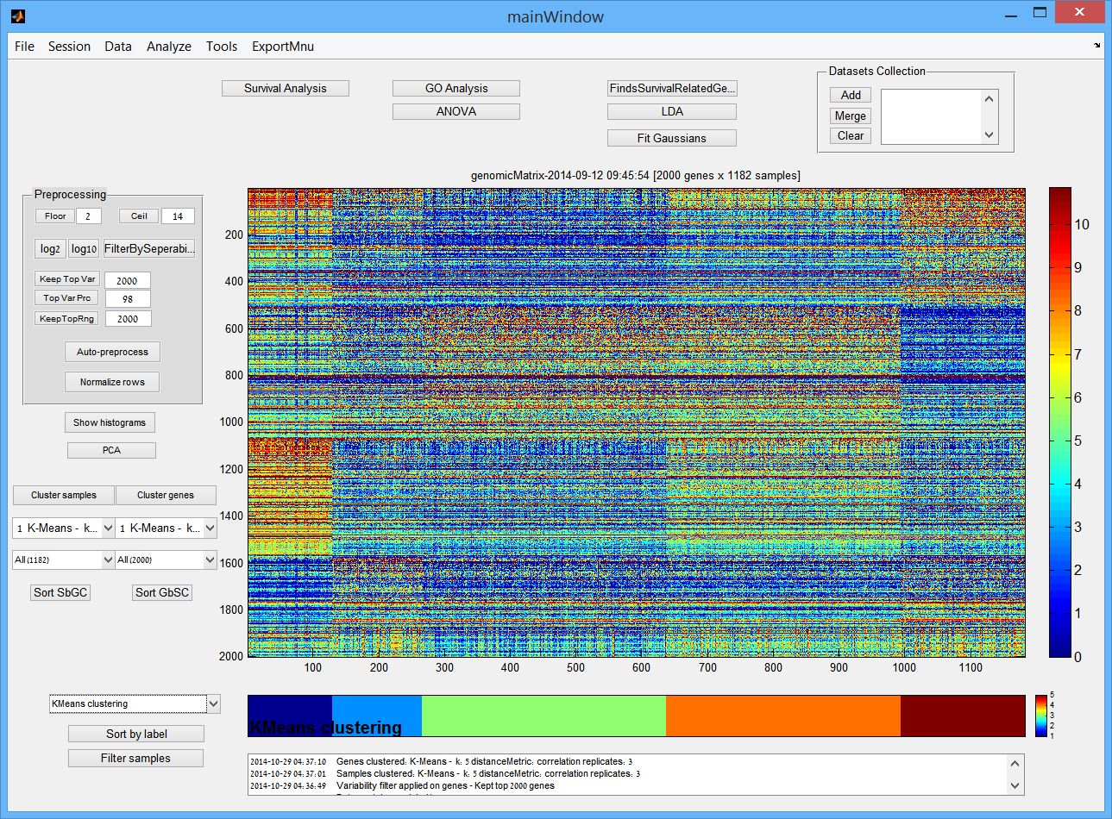

Slide 83
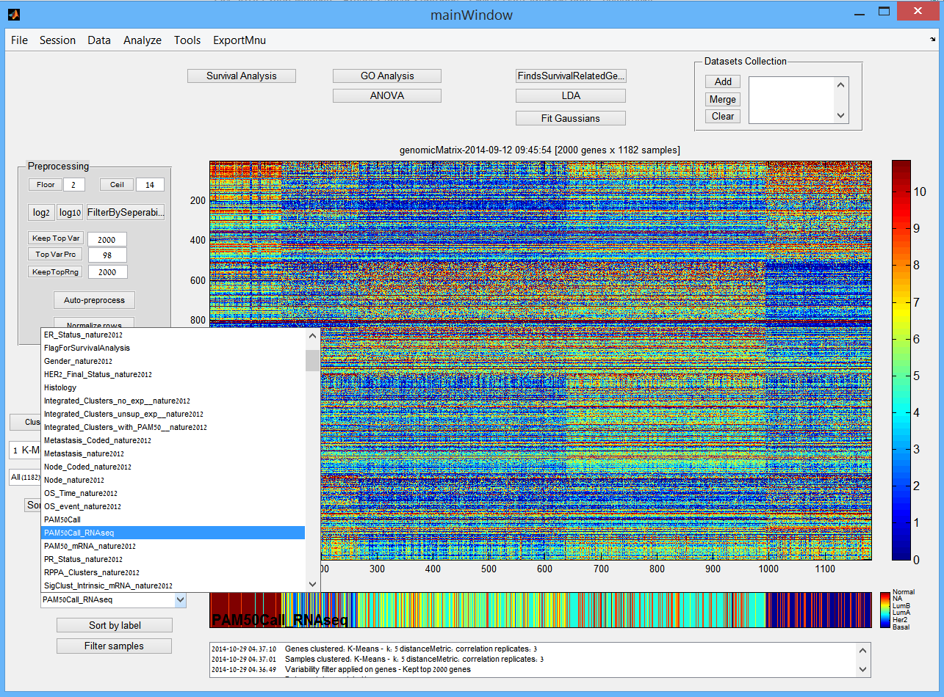

Slide 84
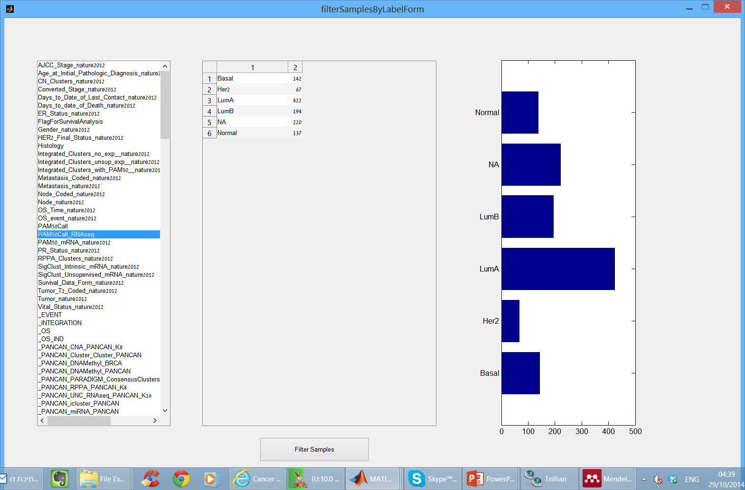
Filter samples by label value

Slide 85
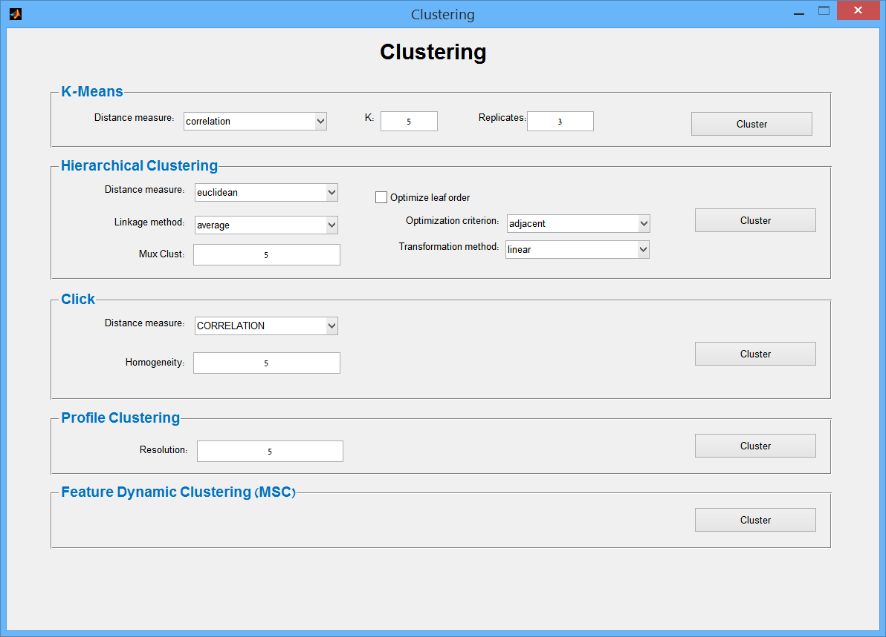
Symmetric clustering on both samples and genes

Slide 86
And more…
  Merge several datasets by sample ID
  GO enrichments on gene clusters
  Bimodality based preprocessing

