Slide 1
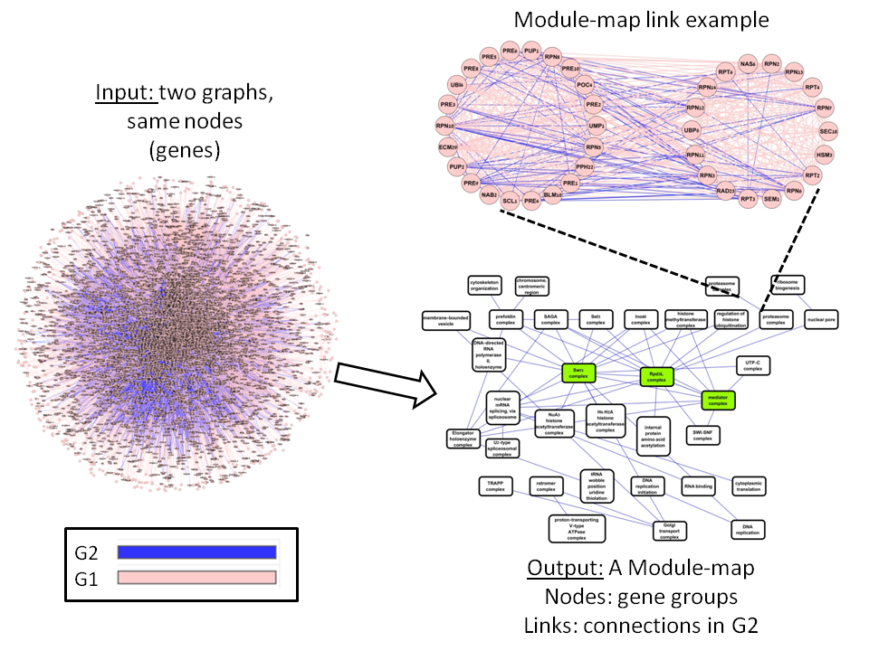
Constructing module maps for integrated analysis of heterogeneous biological networks
Didi Amar
Group meeting
Apr 2014

Slide 2
Introduction

Slide 3
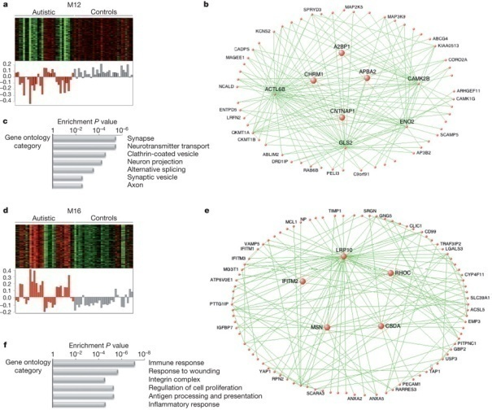
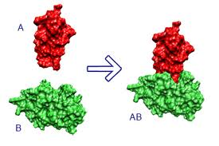
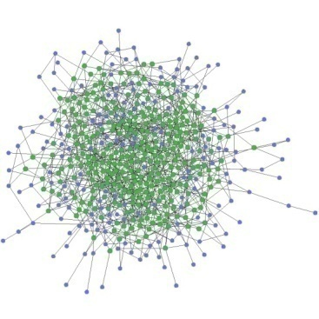
Biological interaction networks
Nodes: genes/proteins or other molecules
Edges based on evidence for interaction
Protein-protein interaction
Gene co-expression
Genetic interaction
Breker and Schuldiner 2009
Voineagu et al. 2011 Nature
Goal: Integrated analysis of two types of interactions

Slide 4
Genetic Interactions (GI)
VAD: Viability After Deleting
Null Hypothesis:
VAD genes 1&2 ~
(VAD gene 1 x
VAD gene 2)
Alternative:
< : Negative GI
> : Positive GI
Srividya I, Tirupataiah S, Mishra K (2012) Yeast Transcription Termination Factor Rtt103 Functions in DNA Damage Response. PLoS ONE 7(2): e31288. doi:10.1371/journal.pone.0031288
http://www.plosone.org/article/info:doi/10.1371/journal.pone.0031288

Slide 5
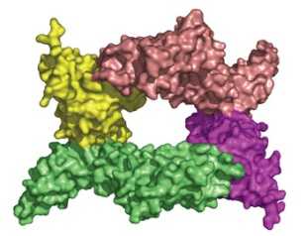
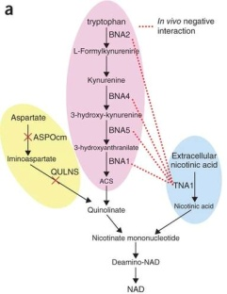
Different interaction types…
“Positive” – expected within families
“Negative” – expected between families
Some networks contain both
Members of a protein complex
Members of parallel pathways

Slide 6
A module map
Input: networks H,G with same vertex set
Goal: summarize the key information in both in a module map
Node – module: gene set highly connected in H
Link – two modules highly interconnected in G

Slide 7
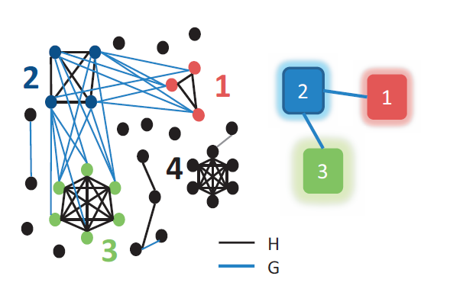
Generalizes clustering and biclustering

Slide 8
Algorithms

Slide 9
Algorithms
Different definitions for the links and the optimization objective function
Problems are NP hard to solve, approximate
Our algorithmic strategy:
Initiators: Find a good initial solution
Improvers: refine by merging/excluding modules
Local vs global improvers
Tested >10 different variants
Next slides: for simplicity assume weighted graphs (edge = 1, non-edge = -1)

Slide 10
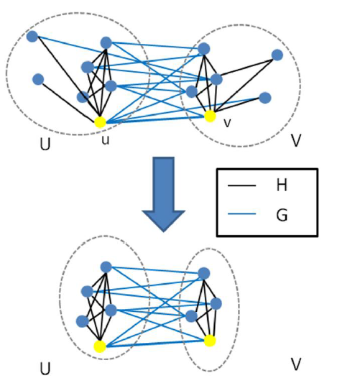
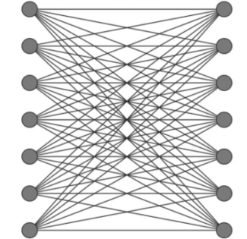
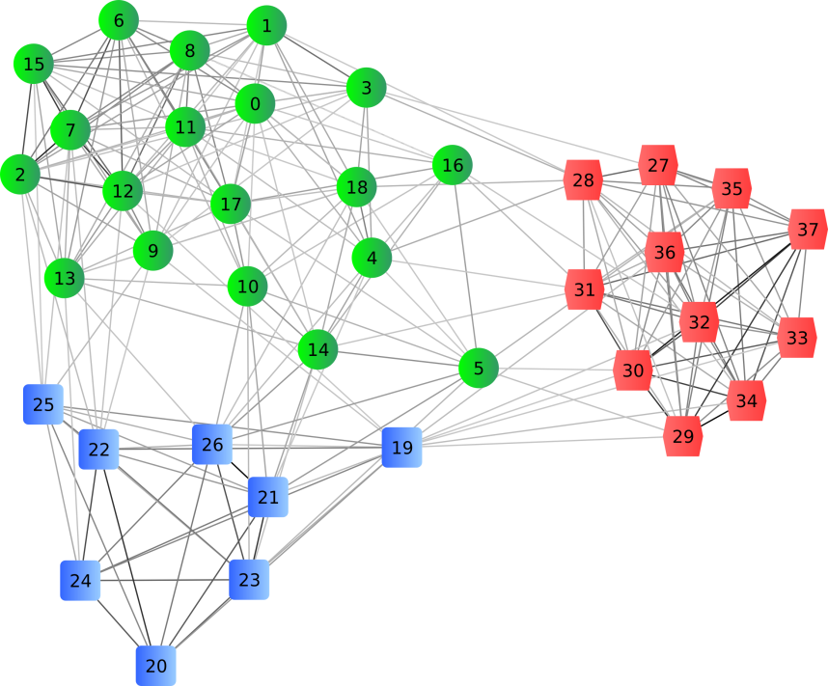
Initiators: overview
Simultaneous analysis
DICER (Amar et al. PLOS-CB 13): use a single G edge as a seed and expand using G,H
Maximum bicliques in G (Li et al. TKDE 07) + DICER expansion
Cluster H (ignore G)
Hierarchical clustering
Greedy node addition in H
…

Slide 11
DICER Initiator
Local search in G and H
Start with an edge (u,v) in G
Define two candidate modules U, V:
The local neighborhood: all nodes connected with edges to u or v
Greedily add/remove bad nodes:
Sum of weights with own side is negative in H
Sum of weights with other side is negative in G

Slide 12
MBC-DICER
MBC-DICER: Find bi-cliques
Define candidate sets U and V that are bicliques in G
Exhaustive solver (FP-MBC Li et al. 2007)
Use a greedy “cleaning procedure”
Technicalities:
If the solver gets “stucked”: stop
Stop if number of bics >50,000

Slide 13
Graph clustering
Cluster H (ignore G)
Two greedy (perform the best step in each iteraction) approaches:
Hierarchical
Iteratively unite two clusters
Node addition
Iteratively add a single node to a cluster

Slide 14
Local Improvement (DICER algorithm, PLoS CB 2013)
Link: sum of G weights between modules is positive
Goal: enlarge links
Greedy approach
Merge module links or add single nodes to link

Slide 15
Global analysis
The score of a set of modules M and a set of links L is:
H: within modules
G: between modules
All links in L must be significant

Slide 16
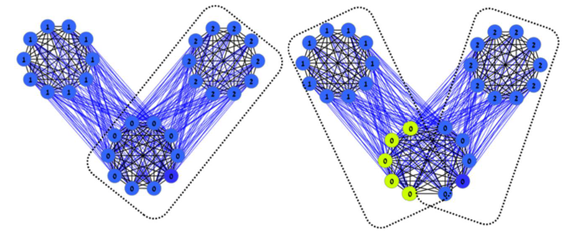
Examples for advantages of Global
Local cannot detect new modules
Local: merge failure example

Slide 17
Global analysis: node vs. module
Null hypothesis: edges between v and M are drawn randomly (n=deg(v))
Hyper-geometric p-value
Options for weighted graphs:
Use Wilcoxon rank-sum test
Set a threshold and use the HG test
M
v
Not M

Slide 18
Global analysis: module vs. module
Calculate a p-value for each node in V and each node in U
Merge p-values using Fisher’s method
Under the null-hypothesis follows a Chi-square distribution (dfs=2*number of p-values)
Other nodes
U
V

Slide 19
Improvement stages
Idea: merge modules if the global score improves
Given a set of modules M₁, …, M_{k} we calculate the gain of all pairwise merges
Expensive: each possible merge requires calculating significance
M1
M’
M_{i}
M4
M2
M_{j}
M3

Slide 20
Improvement stages
Expensive: each possible merge requires calculating significance
Simple idea: if p(M_{i}, M_{l})>b then M’ cannot be linked to M_{l}
M1
M’
M_{i}
M4
M2
M_{j}
M3

Slide 21
Simultaneous merges
Perform many merges at once
If possible links of two improving merges do not overlap then performing them at once is guaranteed to improve the global score
M1
M5
V
U
M_{i}
M4
M_{k}
M6
M2
M_{j}
M_{l}
M3
M7

Slide 22
Experimental Results

Slide 23
(0) Simulations
Graphs with 500 nodes, edge weight 1, non edge -1
Add 2 cliques and 2 bi-cliques
Plant a tree map with 6 modules (module size 10-20)
Weighted: add random Gaussian noise
Unweighted: reverse an edge with probability p

Slide 24
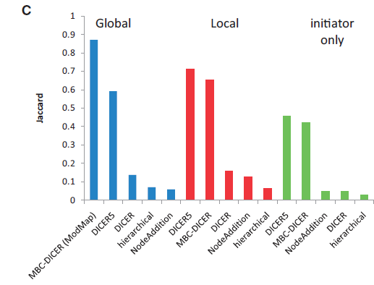
(0) Simulations
Graphs with 1000 nodes, edge weight 1, non edge -1
Add 5 cliques and 5 bi-cliques
Plant a tree map with 10 modules (module size 10-20)
Unweighted: reverse an edge with probability p = 0.15

Slide 25
(0) Simulations: HG vs. Wilcoxon
Unweighted, 2000 nodes
20 modules
Unweighted, p = 0.1
J: HG, WRS = 0.97
Running time: HG < 4 seconds, WRS 397 seconds
Weighted, sd=0.8
J: HG =1, WRS = 0.975
Running times: HG: 3.85 seconds, WRS: 603 seconds

Slide 26
The winning algorithm
Initiator based on enumeration of maximal bicliques in H
Global refinement based on probabilistic score of the whole map

Slide 27
(1) Yeast PPI and GI networks
3979 genes
P: protein-protein interactions (45,456 edges)
N: negative genetic interactions (76,267 edges)
Local improvers: poor results (less than 3 links)
Results for global improver:
Initiator | Modules | Gene coverage | Max module size | Enriched GO terms | Enriched modules (%) | Enriched links (%) | Links
ModMap | 100 | 946 | 49 | 243 | 87 | 80 | 430
DICER | 104 | 837 | 34 | 192 | 67 | 61 | 498
Hierarchical | 123 | 877 | 30 | 186 | 68 | 59 | 394
NodeAddition | 102 | 950 | 49 | 240 | 83 | 79 | 430

Slide 28
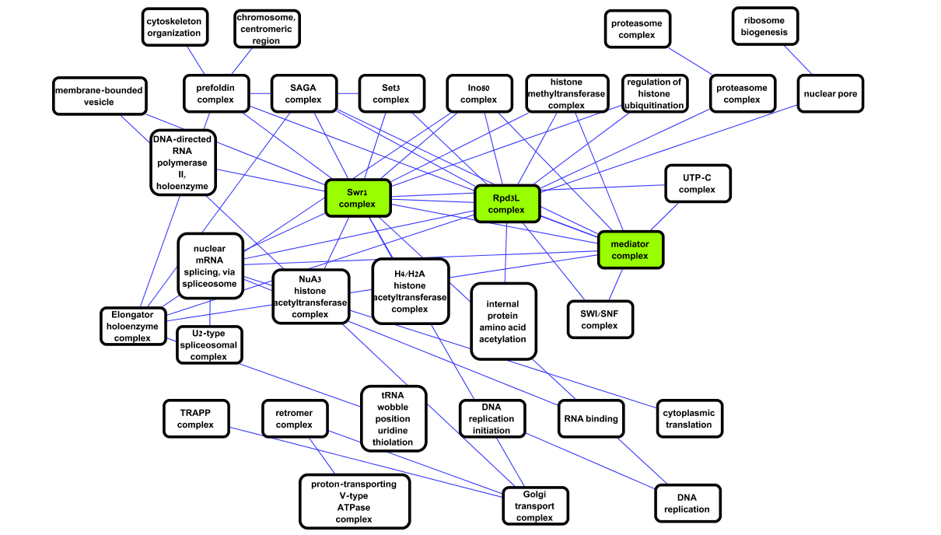
The yeast module map
Chromatin related hubs
Similar to Bandyopadhyay Science 2010, but fully automated discovery, annotation

Slide 29
The top links in the map (p <10⁻⁵⁰)
Between complexes
Between subcomplexes

Slide 30
Comparison to extant methods
Analysis of the Collins et al. 2007 data
Comparing to extant methods that exploit both positive and negative GIs and their weights
Algorithm | Number of modules | Gene coverage | Maximal module size | Number of enriched GO terms | Percent enriched modules | Percent enriched links | Number of links
ModMap | 32 | 238 | 20 | 53 | 84 | 79 | 67
Genecentric (Leiserson et al. 11) | 116 | 1248 | 25 | 39 | 63 | 43 | 58
Kelley and Kingsford 11 | 117 | 355 | 17 | 32 | 17 | 6 | 403

Slide 31
(2) Dynamic GIs
Recent studies tested GIs in cells after DNA damage stress (using MMS)
This allows for detecting GIs that are specific to stress response phenotypes
Our analysis:
Combine two experiments (Bandyopadhyay 2010, Science; Genole 2013, Cell)
H: PPIs
G: MMS-specific positive GIs

Slide 32
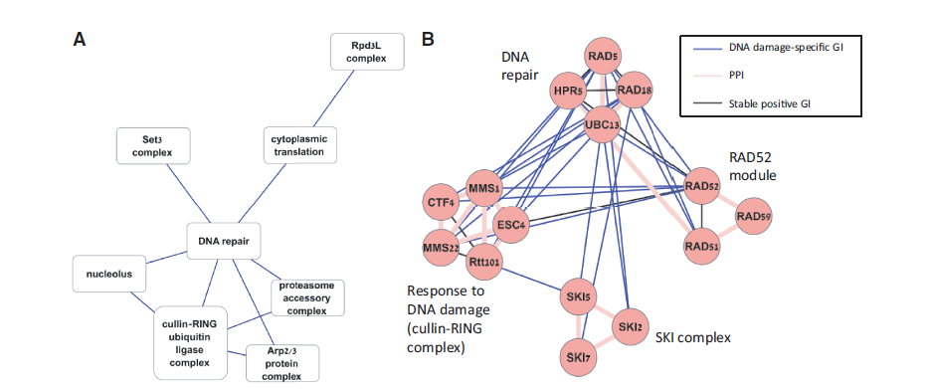
(2) Dynamic GIs
Input: 1078 genes
H: 6771 PPIs
G: 2227 MMS-specific GIs

Slide 33
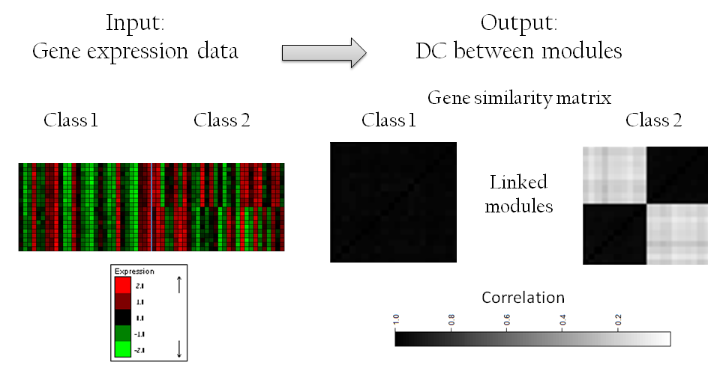
(3) Human case-control profiles
Analyze case-control expression profiles
H: multi-phenotype co-expression network;
G: differential correlation (DC): change in correlation in disease vs. controls

Slide 34
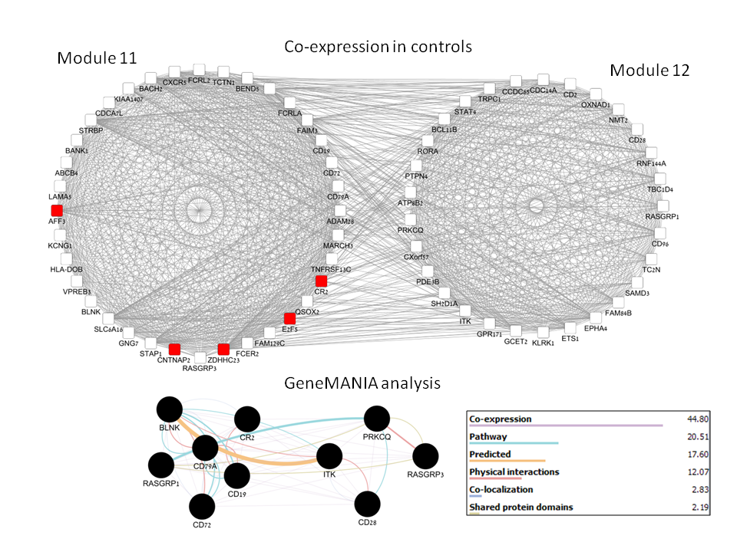
(3) Human case-control profiles
Data: expression profiles of Lung cancer (blood
H: multi-phenotype co-expression network ; G: differential correlation (DC): change in correlation in disease vs. controls
Cross-validation: most links show high DC in the test set
Link example:
Breakage of immune activation in cancer (enrichment q-value<1E-10)
Enrichment for NSLC-specific causal miRNA (mir-34 family, p =0.002)

Slide 35
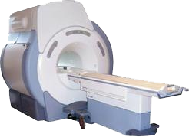
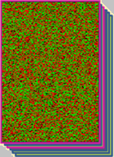
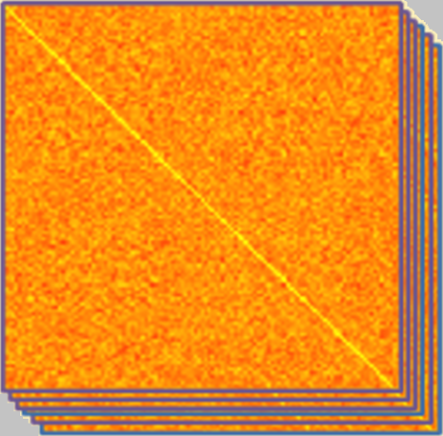
(4) fMRI brain analysis
Time
Average fMRI signal within each parcel
fMRI signals: For each subject: ~100 time point measurements of ~100,000 voxel intensities each
+
parcels
Predefined parcellation
subjects
w_{i}
Use a temporal sliding window Evaluate cross correlations for each subject within each window (w_{i})
parcels
parcels
H: consistent correlation btw parcels
G: correlation focused in time window
parcels
parcels
A. Maron-Katz, N. Singer, T. Hendler
Window
Subject n
Subject 1

Slide 36
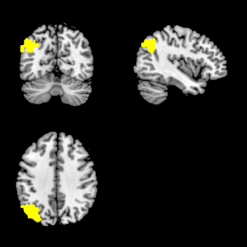
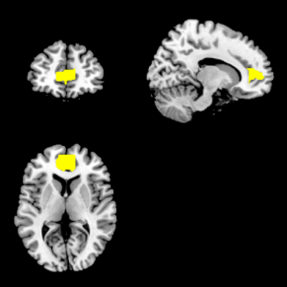
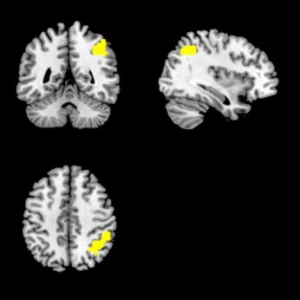
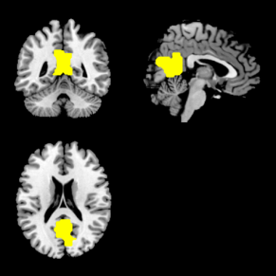
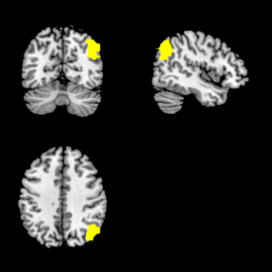
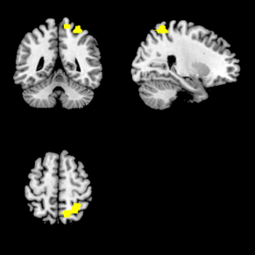
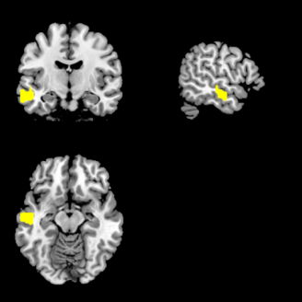
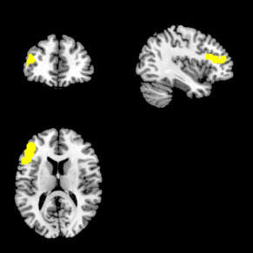
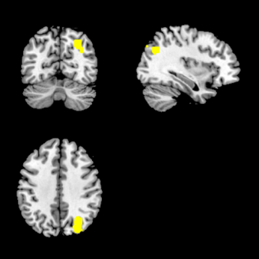
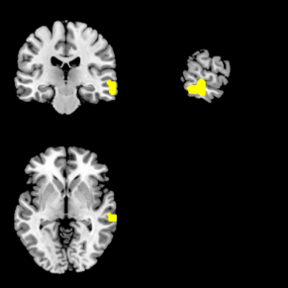
Module map results: 10 dynamically inter-connected modules
Anterior cingulate cortex
Right inferior parietal lobe
Posterior cingulate cortex
5
2
Left angular gyrus
9
1
6
4
Right angular gyrus
Right Parietal lobe
7
3
8
10
Left mid temporal gyrus
Left inferior frontal lobe
Right angular gyrus, right occipital lobe
Right mid temporal lobe
Notes:
Many of these brain regions are known to be involved in off-line processing of events (internally driven and spontaneous thinking)

Slide 37
Summary
Module map: a bird’s eye view summarizing two networks with different interaction types
Developed ModMap algorithm
Performs well in diverse scenarios: PPI+GI; PPI+Stress-specific GIs ;Human disease: correlation and differential correlation.
Future plans:
Visualization (Expander, Cytoscape)
Moving from complexes to pathways
Other application areas, including fMRI

