Slide 1
Evaluation and integration of annotation pipelines for non-model organisms: the potato genome as a test case
David Amar¹, Itziar Frades², Agnieszka Danek³, Tatyana Goldberg⁴, Sanjeev K Sharma⁵, Pete E Hedley⁵, Estelle Proux-Wera^{6,7}, Erik Andreasson², Ron Shamir¹, Oren Tzfadia^{8*}, Erik Alexandersson
¹Blavatnik School of Computer Science, Tel Aviv University, Israel
²Deptartment of Plant Protection Biology, Swedish University of Agricultural Sciences in Alnarp, Sweden
³Institute of Informatics, Silesian University of Technology, Poland ⁴Department for Bioinformatics and Computational Biology, Technical University of Munich, Germany
⁵Cell and Molecular Sciences, The James Hutton Institute, United Kingdom
⁶PlantLink/Department, Swedish University of Agricultural Sciences in Alnarp, Sweden
⁷Current affiliation: SciLifeLab, Stockholm University
⁸ Department of Plant Science, The Weizmann Institute of Science, Israel

Slide 2
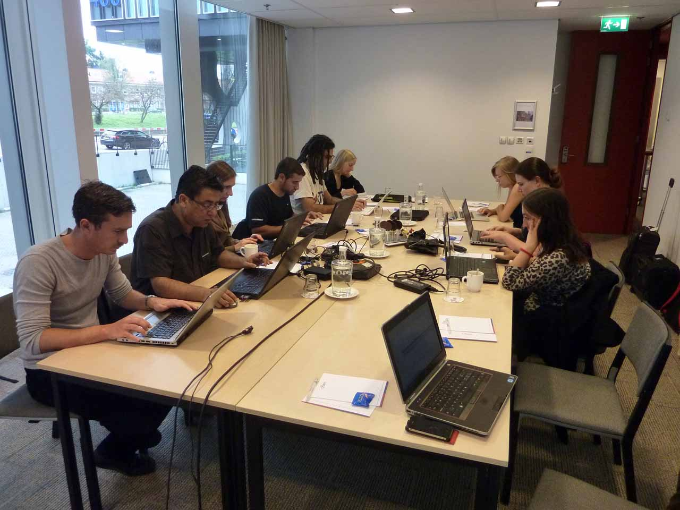
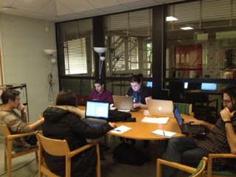
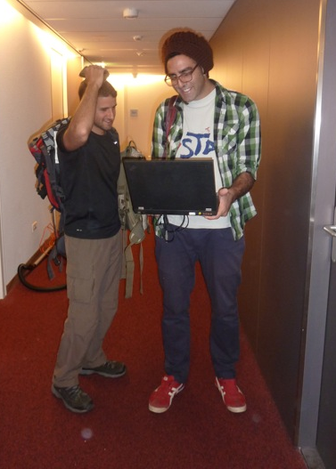
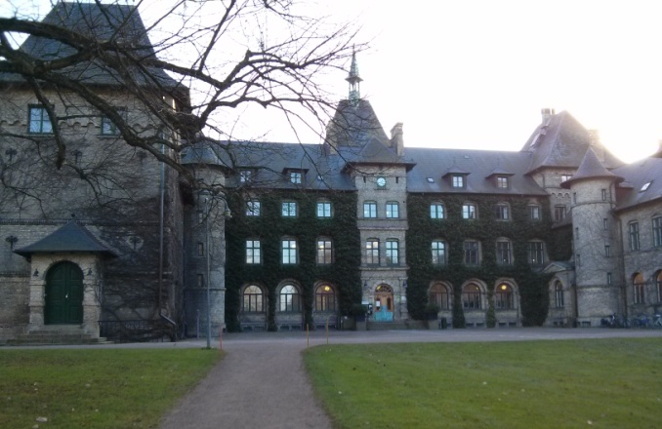
Allbio project
Bioinformatic Hackathon
Collect scientists from different areas (CS, LS, Plant research )
Make them work together on one defined problem
Amsterdam
Malmö
No distractions (!!!)

Slide 3
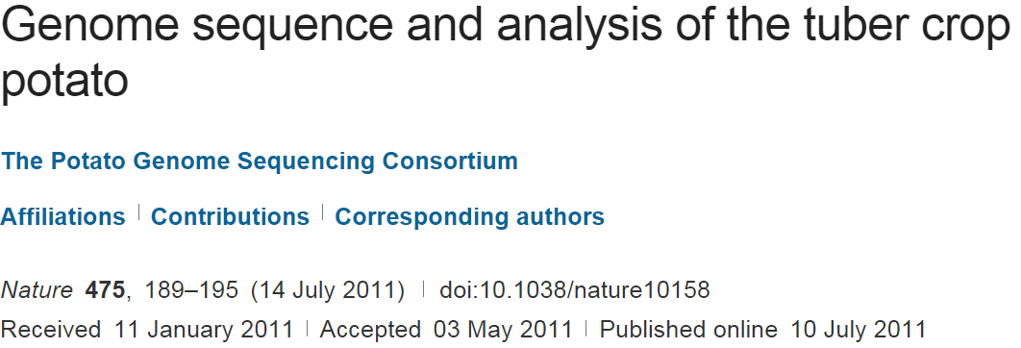
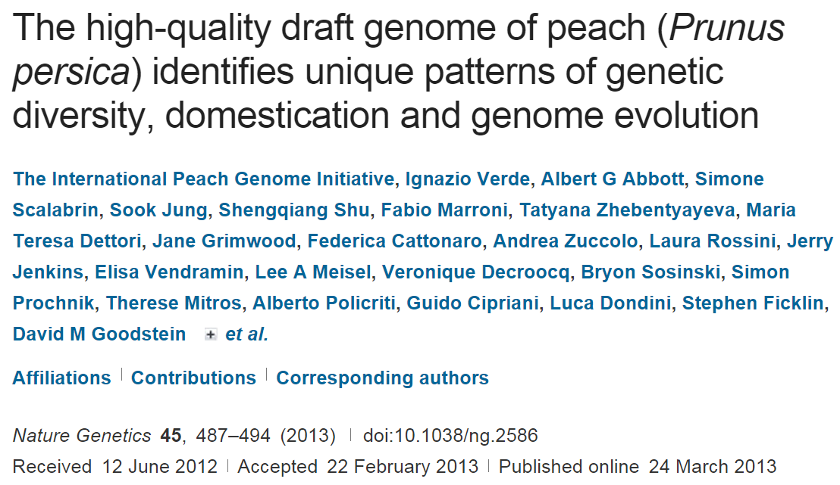
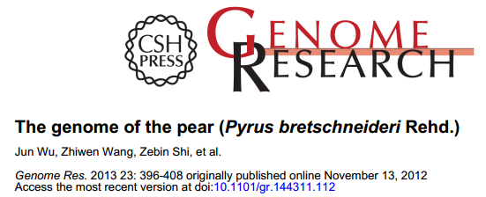
Plant biology: new sequenced plants
Recent 5 years: explosion in newly sequenced plants
>25 species in 2013-2014
Goals: learn evolution, enhance biotechnology

Slide 4
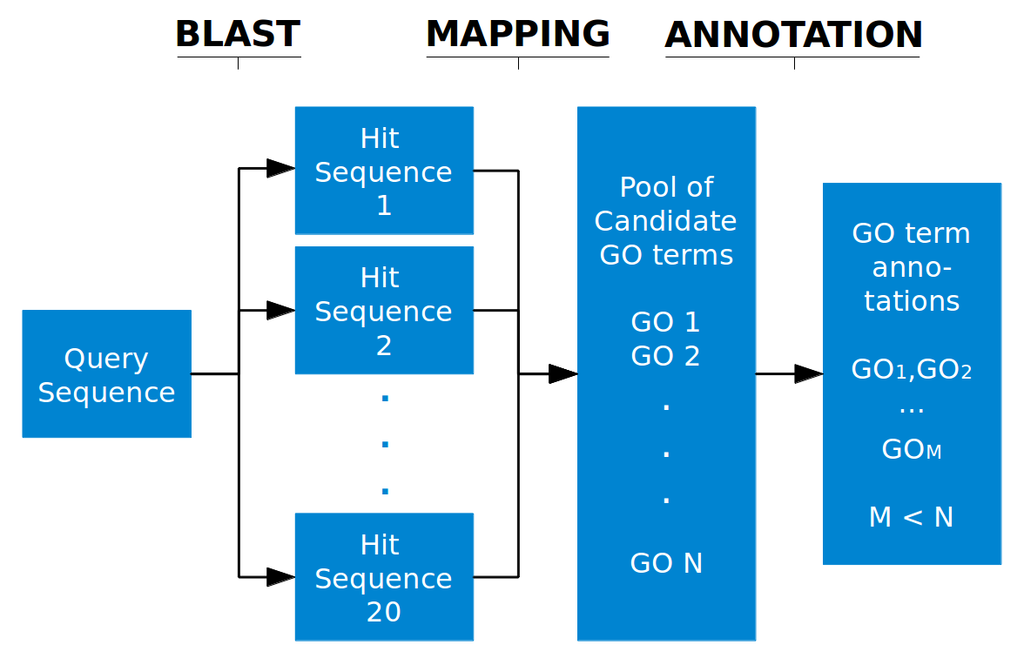
Sequencing a new genome
Sequence
Find genes
Annotate
Example: BLAST2GO overview
Many parameters in each step of the annotation flow
Many available tools
Goal: use the potato genome to compare and integrate

Slide 5
Why potato?
Recently sequenced
3’rd largest food crop human consumption worldwide
Engineering is important due to parasites and drought stress
Well investigated gene models
PGSC, ITAG
Potato experts in our team
Available GE data

Slide 6
Annotation pipelines
Assign genes to GO terms
GO: structured vocabulary of biological entities (details later)
State-of-the-art annotation pipelines
General
BLAST2GO
Trinotate
Contains two sub-pipelines
Plant-specific
OrthoMCL
Biomart (Interpro2GO)
Phytozome
Gene/protein Function

Slide 7
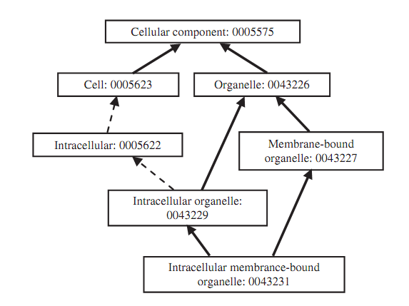
The GO structure

Slide 8
GO Semantic similarity
Measure term similarities using the GO DAG
Use the scores to calculate gene similarity
Many methods were suggested
R packages: GOSim, GOSemSim
A GO term A is represented as DAG(A,T,E) where T is the set of GO terms in A’s DAG (A and all it’s ancestors) and E is the set of edges

Slide 9
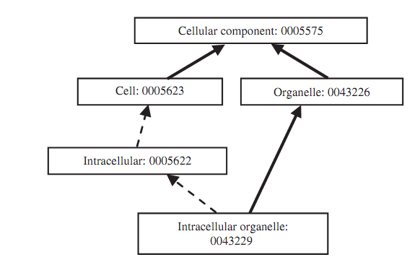
Wang’s score (2007)
w*w
w*w
w
w
1
S-value: the “contribution” t to A:
w is a parameter in the interval (0,1).

Slide 10
Wang’s score (2007)
The semantic value of the term A:
The semantic similarity between two GO terms:
If the trees of A and B do not overlap the value is 0
A measure of the agreed shared similarity

Slide 11
Wang’s score (2007)
Use the running max average to calculate the semantic similarity between two GO term sets
We can now calculate the GO similarity of two genes (use their GO terms as sets)

Slide 12
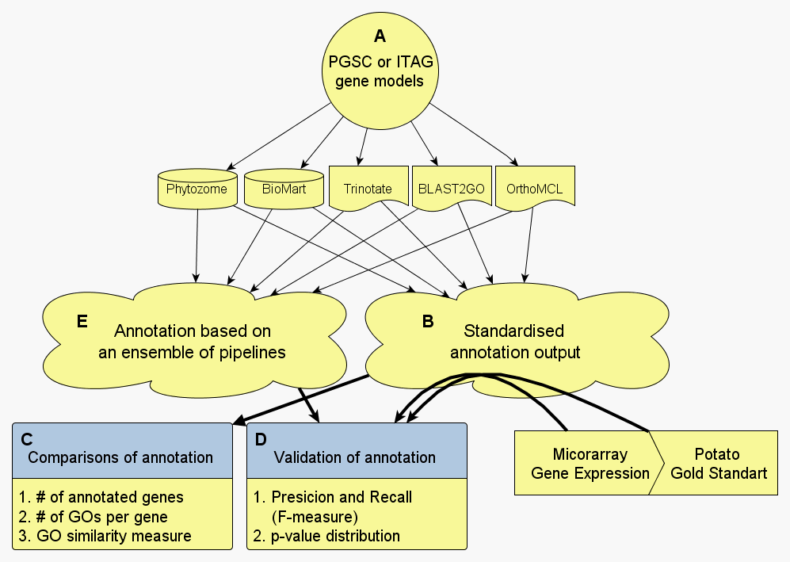
Project overview
PGSC: the genes detected in the original publication. ITAG: found later

Slide 13
Pipeline similarity
To measure similarity of pipelines calculate the similarity of predicted GO terms for each gene and report the mean
Use Wang’s GO semantic similarity
Structure-based similarity
Use standard Jaccard
Structure-free similarity

Slide 14
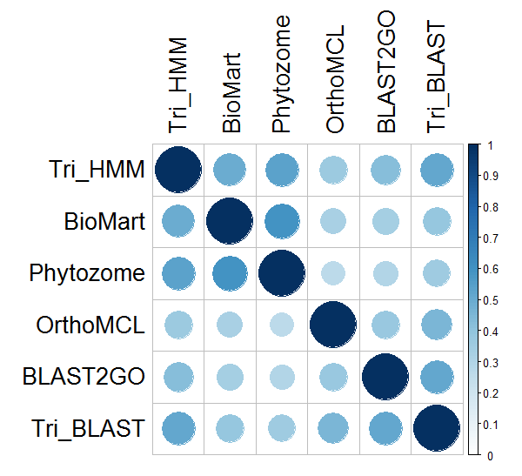
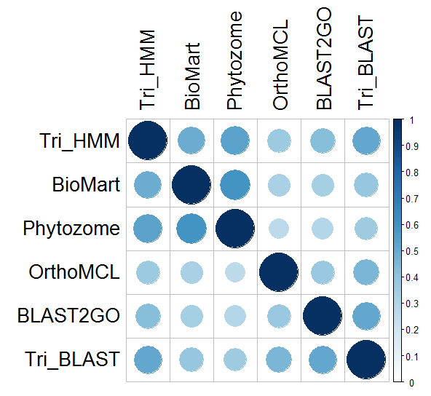
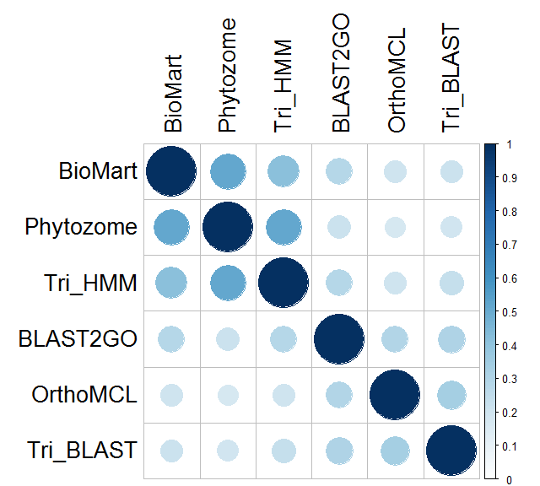
Disparity of pipelines
Structure-free similarity: MF
Pipelines differ in:
Covered genes
Annotations of shared genes
Both GO-free and GO-based
Conclusion: integrate!
Jaccard score
Structure–based similarity: MF
Structure–based similarity: BP
Wang’s score

Slide 15
Pipeline 1
Gene G: profile in pipeline 1
Gene G
Pipeline 2
A | B | C | D
1 | 1 | 0 | 0
A
Gene G: profile in pipeline 2
B
C
A | B | C | D
1 | 0 | 0 | 0
GO structure
Gene G
D
Gene G: combined profile
A | B | C | D
2 | 1 | 0 | 0
Similar ideas were used in Done et al. 2010
K=1
K=2
A | B | C | D
2 | 1 | 0 | 0
A | B | C | D
2 | 1 | 0 | 0
G’s most specific annotation
Conservative: all methods in agreement

Slide 16
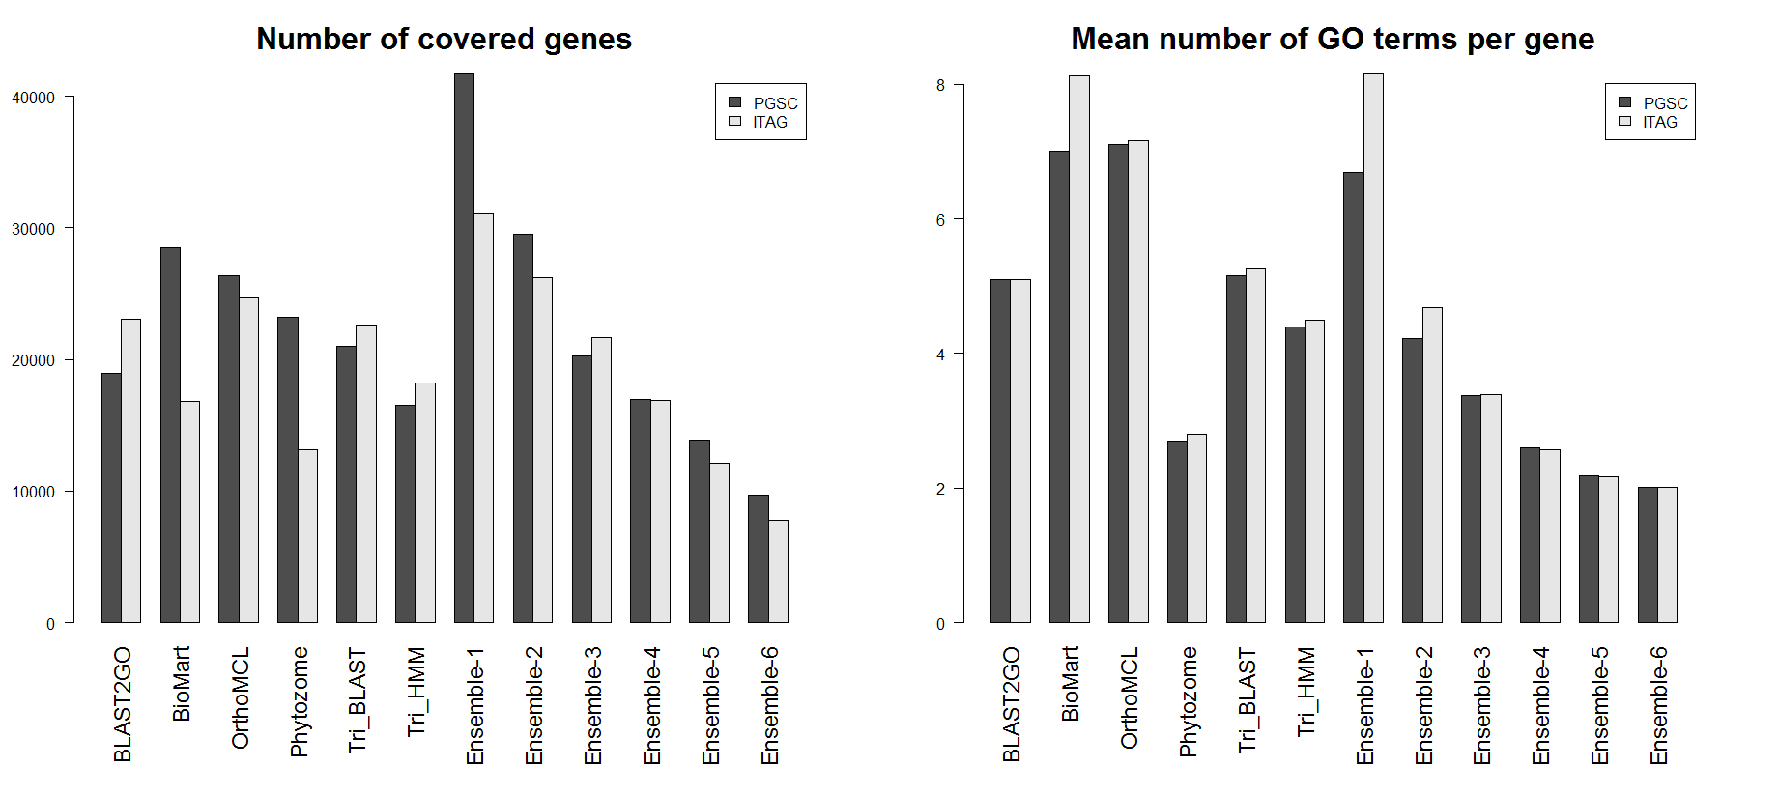
Basic statistics
A)
B)

Slide 17
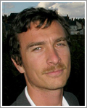
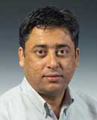
Gold standard
Go over well studied genes
Analyzed >2,000 gene-GO pairs
Composed a “Gold Standard”
~800, gene-GO pairs
Erik Alexandersson
SLU Alnarp
Sanjeev Kumar Sharma, James Hutton

Slide 18
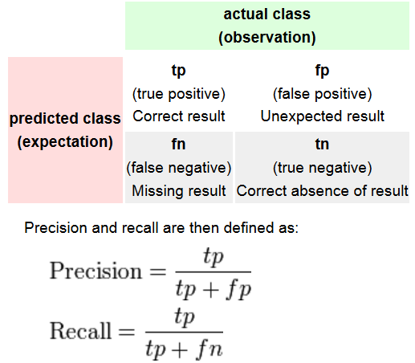
Performance measures
A
B
Summary of precision and recall: F-measure

Slide 19
GO-based gold standard analysis
For each gene: max similarity of gold standard
Real annotations
Pipeline results
Mean of these scores: the precision

Slide 20
GO-based gold standard analysis
For each gene: max similarity of annotations
Real annotations
Pipeline results
Similar ideas were used in Defoin-Platel et al. BMC bioinformatics 2011
Mean of these scores: the recall

Slide 21
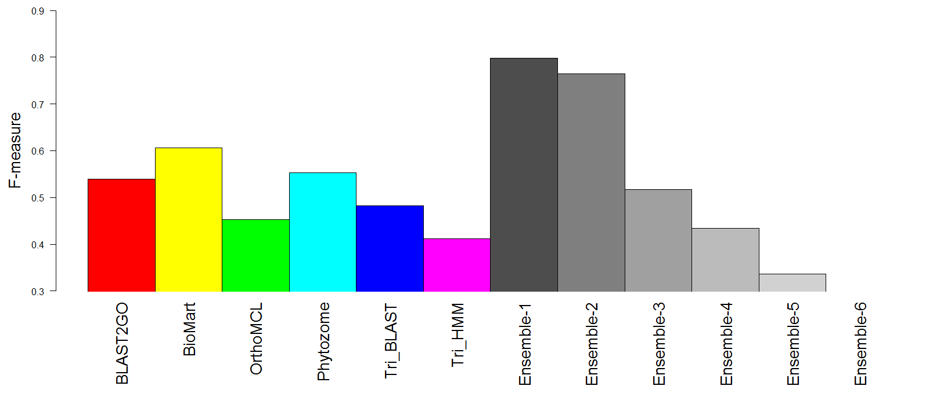
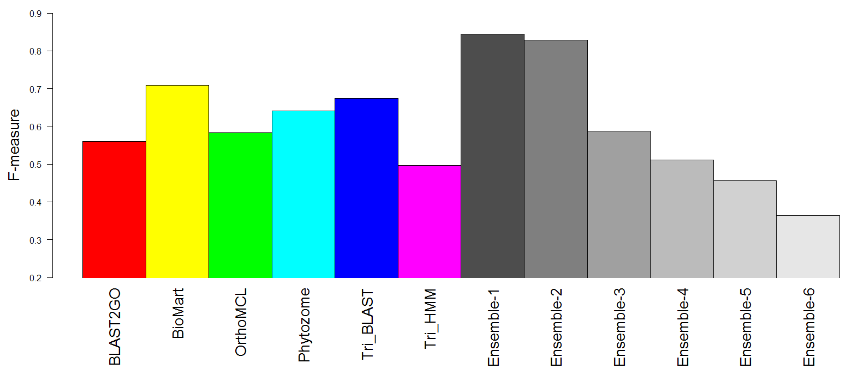
Results
BP
MF

Slide 22
How can we validate using GE?
Genes of small GO BP terms should have higher correlation than expected by chance
For each such GO term get a p-value
By comparing the GO term correlations to random gene pairs
Wilcoxon or KS test
Report: number and percentage of GO terms with p<0.001
Ignore GO terms with > 500 genes

Slide 23
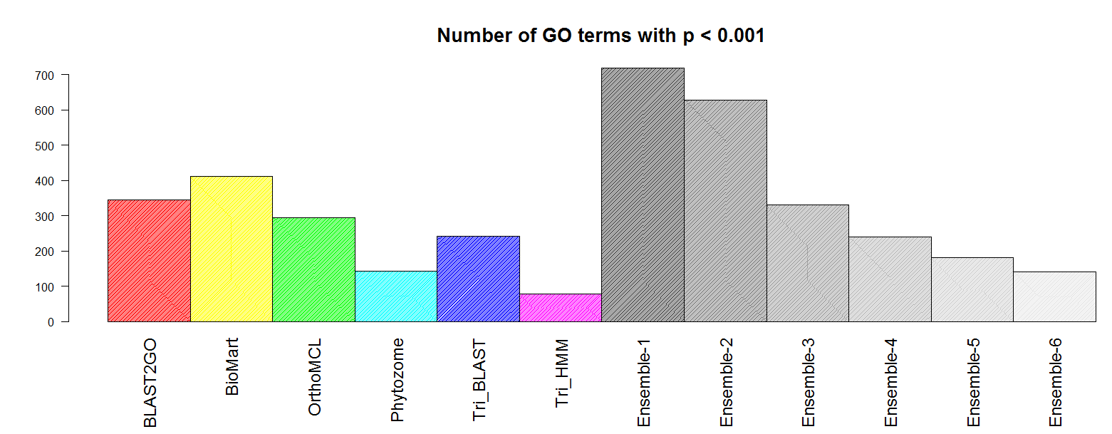
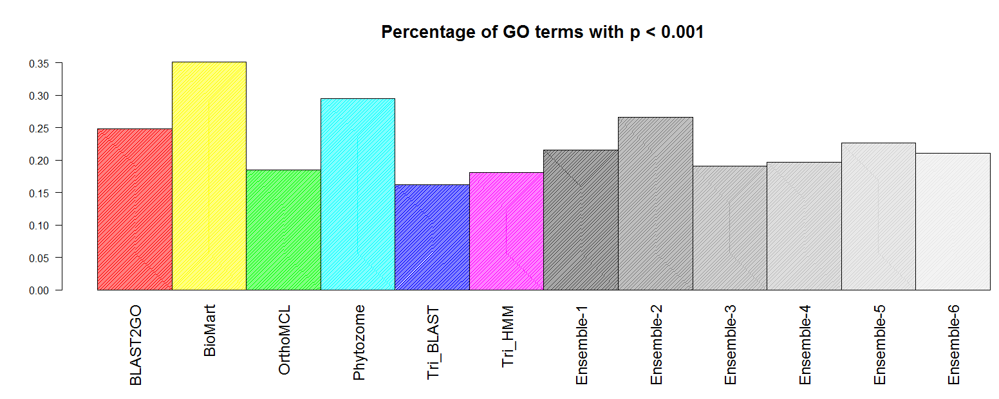
Results

Slide 24
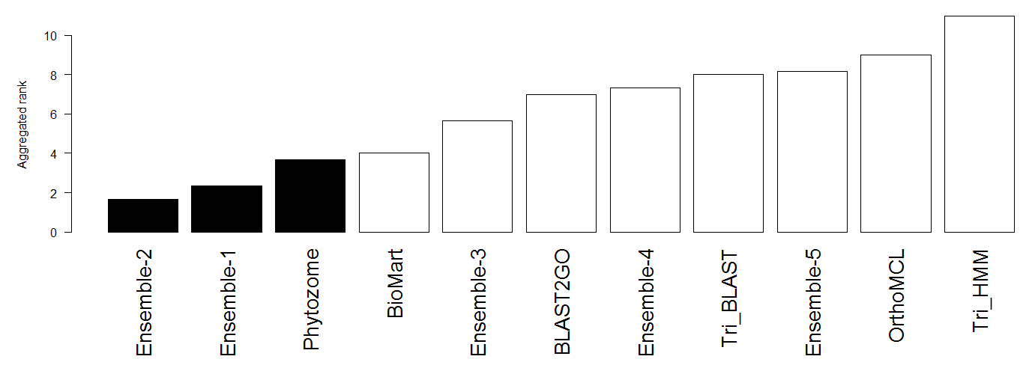
Rank-based consolidated score
PGSC
Rank the methods by the different scores (#genes, NGPG, gold standard validation (2 scores), gene expression validation (2 scores)
Take the average rank as the pipeline score

Slide 25
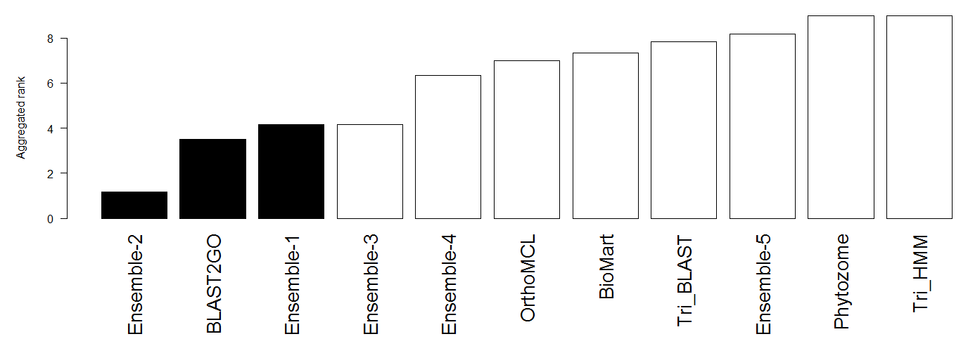
Rank-based consolidated score
ITAG

Slide 26
Conclusions: potato
Genome-wide annotation pipelines might produce very different results
Integration is required
We propose a simple ensemble algorithm
The ensemble performance is high
Compared to a gold standard
In co-expression tests
K=2 was consistently better than single pipelines

Slide 27
Go back to Arabidopsis
Use Arabidopsis predictions made before 2012
Several sources
Validate on new experimental annotation in GO
Added after 2012
BMRF, FALCON: recent multi-label classifiers (AMB 2013)

