Slide 1
Brain Enrichment analysis tool
Application under dev

Slide 2
Background
Often, large sets of positions or connections (pos pairs) within the brain are identified as effected in an fMRI experiment
Functional/anatomic interpretation involves known functional networks/ anatomic atlas
Usually done “by eye”/ by % representation
Even more problematic when it comes to connections

Slide 3
Enrichment analysis in brain findings
Positions: Given s positions (nodes) , of which n are annotated by “a”, what is the chance of getting at least n representatives of “a” in a random set of size |s| sampled from the background?
Connections: Given s position pairs (edges), of which n are annotated by “a-b” or “b-a”, what is the chance of getting at least n representatives of “a-b” or “b-a” in a random edge set of size |s| sampled from the paired background?

Slide 4
Current implementation
Hyper-geometric cumulative distribution function
Given a population of size M, which contains K items with a desired characteristic, HG-CDF computes the probability of observing at least x items with the desired characteristic in a random sample of size N

Slide 5
The tool
Matlab
Input:
1) Position groups/position pair groups
2) Pos background coordinates (non paired)
3) Pos annotations (txt or fMRI img – 3D)
4) Thresh p-value
5) Correction (None/bonferroni/FDR)
6) Min required rep in set

Slide 6
Results display
Text: Set ID; Enriched annot; Correctedpvalue; Inducing positions/connections
Histogram – single for all sets
Upon row click: 3D brain sketch with inducing connections/nodes

Slide 7
Data 1 – a set of decreased functional connections in Mild cognitive impairment
Wang et al. PNA BIOL PSYCHIATRY 2013
Amnestic mild cognitive impairment (aMCI),- the prodromal stage of Alzheimer’s disease
Alzheimer’s disease disrupts the connectome
37 patients with aMCI and 47 HCs
Rest fMRI
Whole brain Craddock 200, Craddock1024
NBS FC analysis :
Suprathreshold connections, CCs, corrected pval for each CC using the null distribution of max CC size (10000 perms - labels)

Slide 8
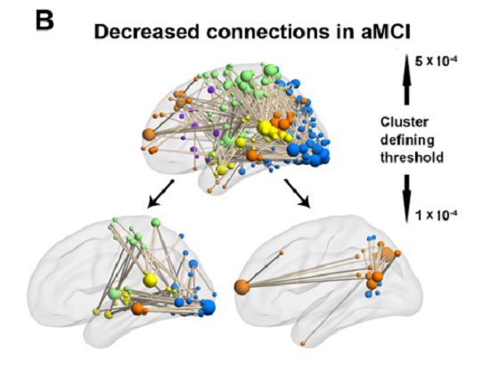
Paper results
Decreased overall FC in aMCI (0.03-0.06Hz);
Increased path length
Decreased nodal strength in DMN nodes
Correlation with mem performance
NBS results (Craddock 1024):
- 1 CC of 363 reduced FCs (p<5*10⁻⁴)
- 2CCs of 65 and 22 connections (p<10⁻⁴)

Slide 9
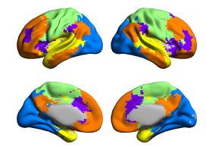
Connection enrichment analysis
Annotations based on 5 modules derived from HCs (modular architecture)
10⁻⁴ thresh (stricter): Larger component - mainly of inter-module connections (46/65, 70.8%)- SMN,VN,AN, smaller: 68.2% within DMN
Visual
Senso-motor
DMN
VAN
Auditory

Slide 10
Tool operation

Slide 11
Results

Slide 12
Upon clicking on a node

Slide 13
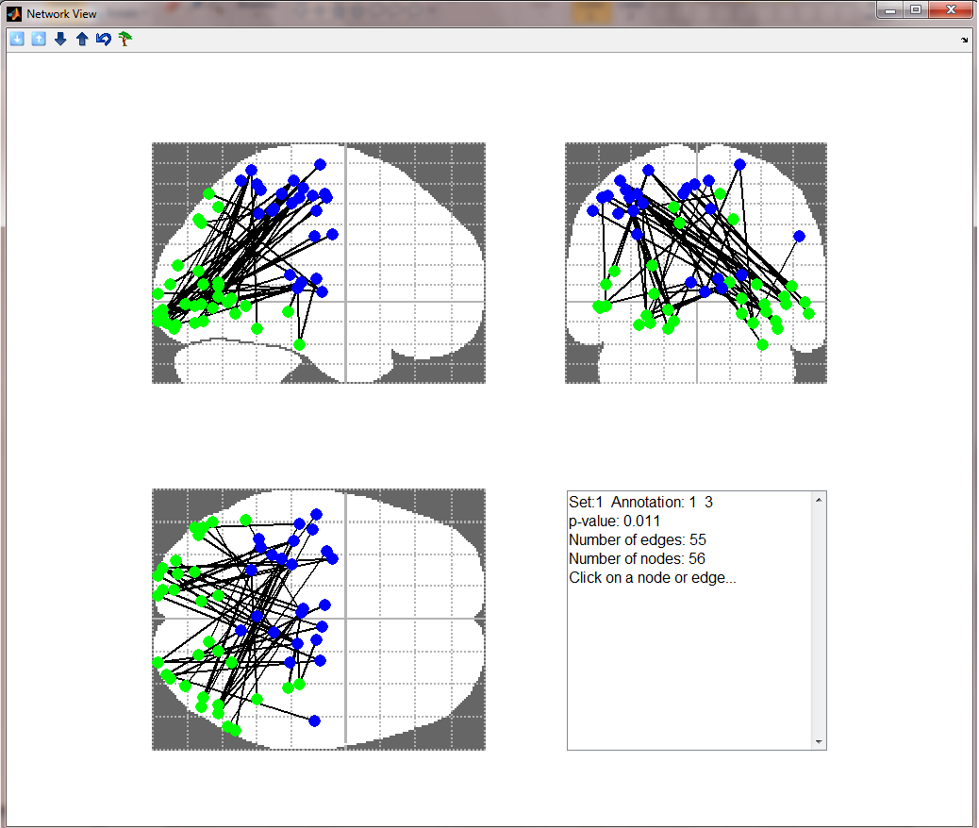
Network view of results: Sensomotor-Visual

Slide 14
Network view of results: Sensomoter-Audisoty

Slide 15
Network view of results: Within Default Mode (DMN)

Slide 16
Network view of results: Within VN

Slide 17
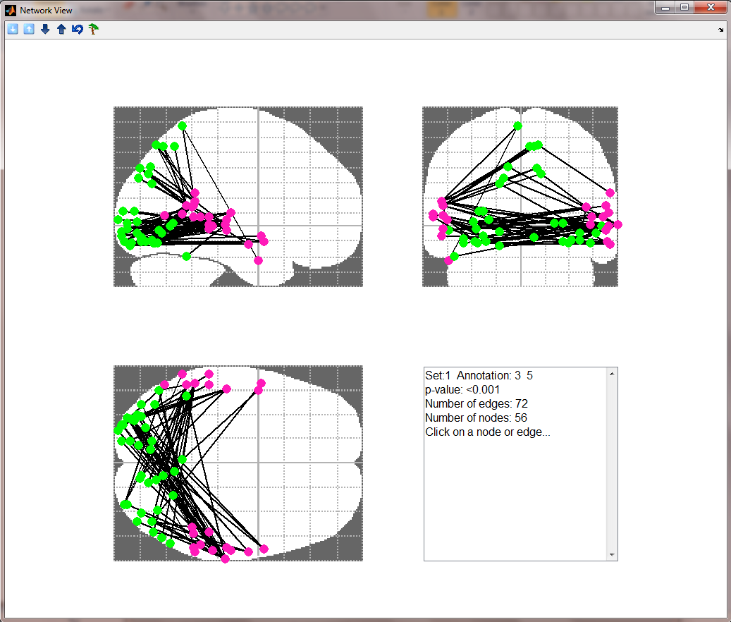
Network view of results: Visual-Auditory

Slide 18
Summary
Study used a stricter threshold to facilitate interpretation (did not interpret large component)
We provide result annotations with significance
They reported results only for strict threshold, according to representation
Our additions: Statistical significance, decreased FC within VN
Limitation: they identified CCs – we did not put this as a constraint

Slide 19
Data 2: Inter subject correlation (ISC) identified while watching emotion inducing film clips Nummenmaa et al. PNAS 2012
Notes:
Experimental design for fMRI (Upper) and subjective emotional ratings (Lower).
Participants watched short movie clips depicting pleasant, un-pleasant, and neutral events. The movies were preceded by a 5-s presentation of a fixation cross and were followed by a 15-s presentation of text that described the general context of the upcoming movie without revealing details of its actual events. After fMRI the participants watched the movies again and rated their moment-to-moment experiences of valence (pleasantness–unpleasantness) and arousal.

Slide 20
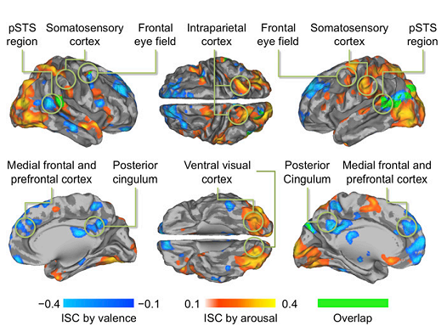
ISC analysis – seek regions synchronized across subjects
Valence and arousal time series used in the general linear model (GLM) to predict moment-to-moment ISC of brain activity during movie viewing
Notes:
Cerebral regions where ISC was statistically significantly correlated
with self-reported valence (blue to turquoise) and arousal (orange to yellow)
scores during viewing of film clips (P<0.05, FDR corrected).
TODO: check supp if there was any spatial constraint

Slide 21
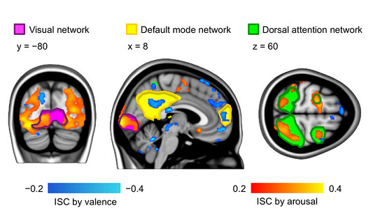
Network comparison within paper
Valence modulates ISC in the DMN (yellow) and Arousal in VN (pink) and DAN (green).
Notes:
They obtained the networks using seed based FC analysis (seeds taken from literature)

Slide 22
VN Enrichment within arousal ISC

Slide 23
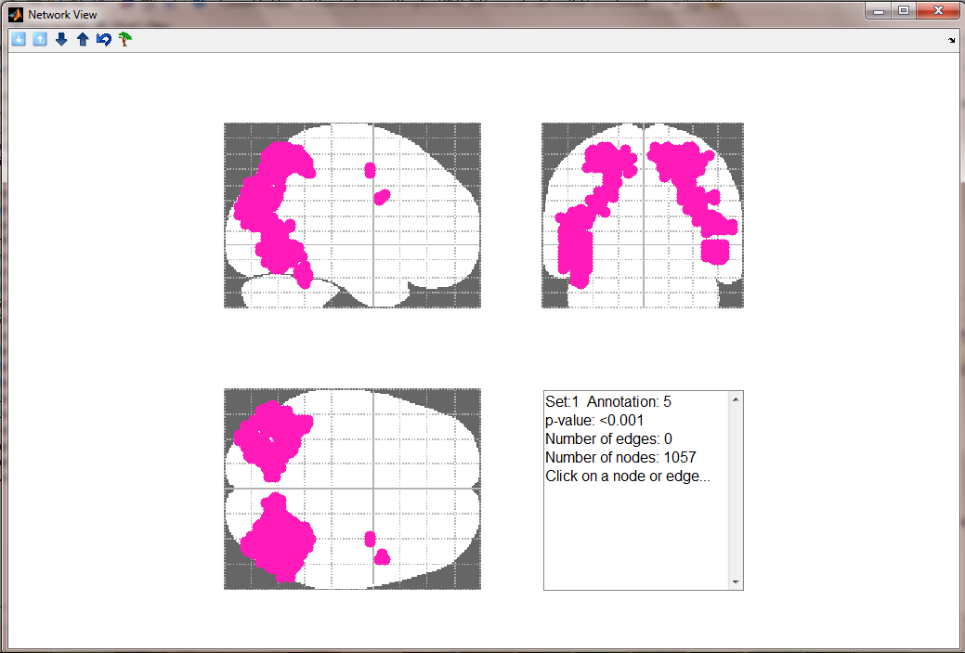
DAN enrichment within arousal ISC
Notes:
DAN - is composed of bilateral intraparietal sulcus (IPS) and the junction of the precentral and superior frontal sulcus; and is known to be involved in top-down orienting of attention

Slide 24
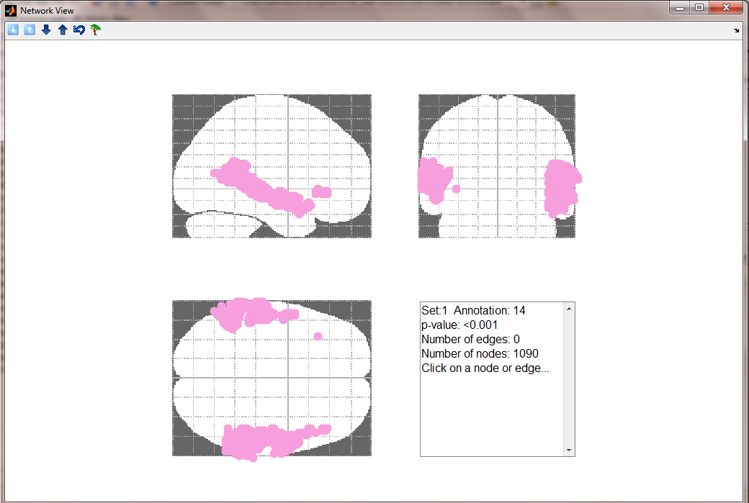
AUN enrichment within arousal ISC

Slide 25
Data 3: Functional connections effected by social stress
57 male subjects
Predefined GM parcellation (~500 parcels)
Univariate analysis of all parcel pairs (paired t-test), FDR corrected (>100000 tests)

Slide 26
FC analysis results
490 differential connections a) 301 weakened (blue)
b) 189 strengthened (red)

Slide 27
Lobe based enrichment analysis

Slide 28
Discussion
Weakening of cross-hemispheral prietal-temporal connections (DMN and dorsal attention)
Strengthening of thalamo-cortical connection - Thalamus – relays sensory signals to the cortex, regulates of consciousness, sleep, and alertness
– Thalamus connectivity ~ arousal -- Thalamo-frontal connectivity ~cognitive functions
No association with stress measures (subjective ratings, cortisol level)

Slide 29
Network based enrichment analysis
Set | Annot | P-value | FR
Weakened | 2(MN)-2(MN) | 4.8133e-010 | 19.15
Weakened | 2(MN)-3(DAN) | 1.9365e-006 | 3.52
Weakened | 2(MN)-7(DMN) | 5.7627e-010 | 3.45
Weakened | 3(DAN)-7(DMN) | 5.7627e-010 | 3.45

Slide 30
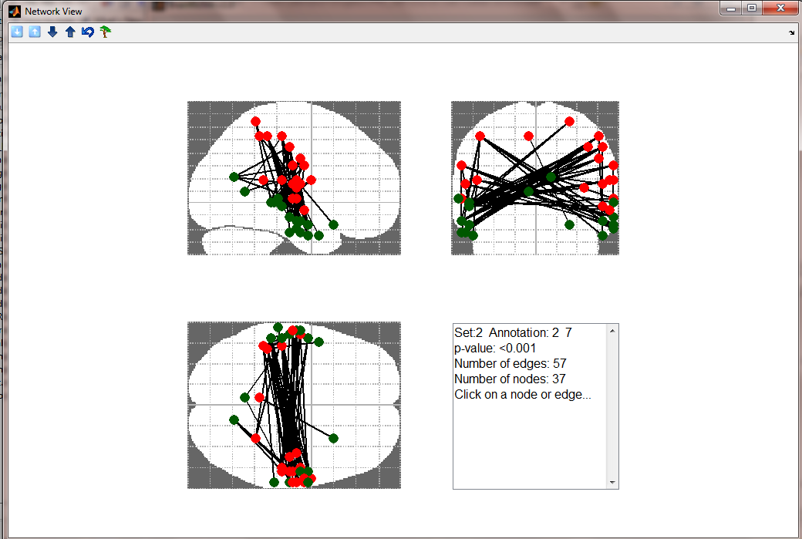
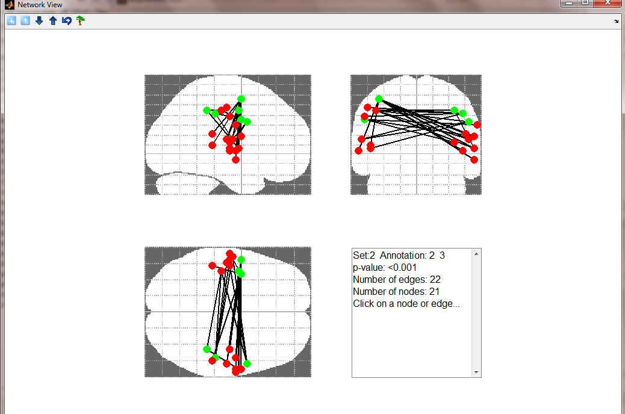
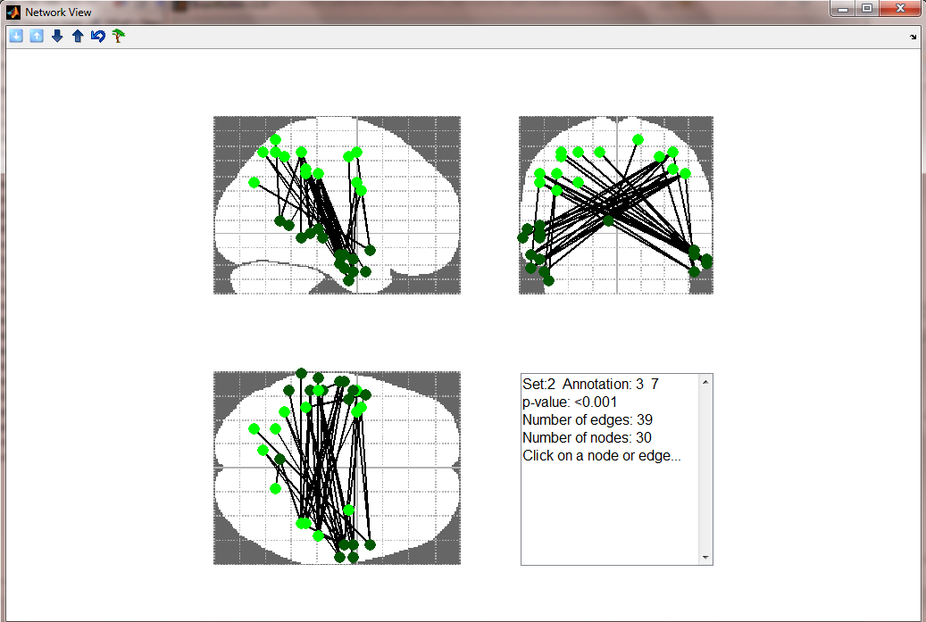
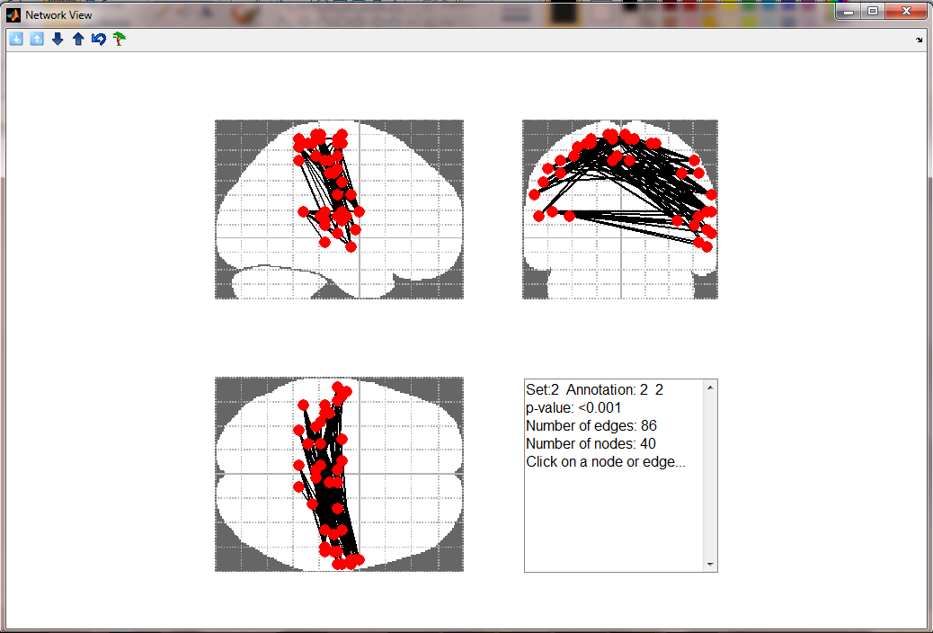
MN

Slide 31
Open issues
GUI improvements: e.g. better error handling
Technical issues: e.g. network view with many nodes - time issues
Incorporating spatial information/restrictions according to the way sets were identified (e.g. random sampling of similar sub-graphs)

