Slide 1
Annual meeting of the Organization for Human Brain Mapping (OHBM) Hamburg June 2014

Slide 2
General impression
Over 3000 participants
Neuroimaging
Impressive keynote lecture by Yaniv Assaf from TAU (structural MRI and plasticity – mice and man)
Emphasis:
- Multimodality (e.g. fMRI+EEG)
- High resolution fMRI (spatial and temporal)
Dynamics in resting state functional connectivity
Brain parcellation
Data sharing and collaborations
Man-machine interface (E.g. Neurofeedback, Robotic limbs)
Emotion and motivation
Psychiatric disorders (Mostly Schyzophrenia, PTSD, Depression)
Neurologic disorders (e.g. Neurodegenerative)

Slide 3
The dynamic human brain
1. Emerging approaches
2. Functional and predictive implications across task types, cognitive states and developmental and clinical groups
3. Various definitional and computational constraints in examining brain dynamics

Slide 4
Decomposing dynamic functional connectivity: states or building blocks?
Dimitri Van De Ville, UniGE/EPFL, Lausanne, Switzerland
The cosinal nature of the signal -> artificial changes in correlation in small time windows
Trade off between band filter and window length
Large number of tests -> prefer MVA over UVA
Interesting to test for wFC≠FC
Mixture of states (Leonardi’s talk) – eigenconnectivities
Notes:
We use 15 TRs win (30 secs)

Slide 5
Vince Calhoun, The Mind Research Network and UNM, Albuquerque, NM, USA Allen et. Al. Cerebral cortex 2012
N= 400 subjects (200 females)
C=100 components->50 ICNs/RSNs
22 TRs 126 wins
Notes:
The inverse of a square matrix , sometimes called a reciprocal matrix, is a matrix such that A*A⁻¹=1

Slide 6
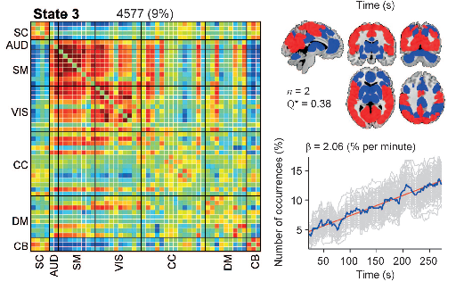
Allen et. Al. Cerebral cortex 2012
Window sub-sampling to local maxima in FC variance -> 7.5±1.5 windows per subject
K=7 (7 states)
Number and % of state occurrences in time
Notes:
Light gray lines show occurrence proﬁles for 100 bootstrap resamples (of what? Windows?)
Distrance measure = Manhatten distance
(1,2) (3,4)=(3-1)+(4-2)

Slide 7
Allen et. Al. Cerebral cortex 2012

Slide 8
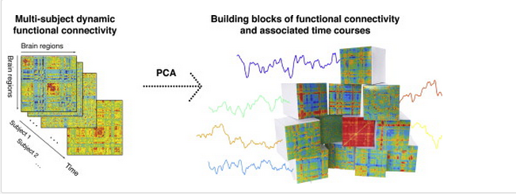
“Dynamic functional connectivity: Better characterized by separated states or a mixture of patterns?”
Nora Leonardi, Ecole Polytechnique, Lausanne, Switzerland
IEEE 2013
An approach based on PCA
Regionally-averaged (AAL) BOLD activity
Sliding time windows -> wFC –aFC matrices
PCA->FC patterns (“eigenconnectivities”)
Contributions of eigenconnectivities assessed for each time point
Phase randomization to assess weight sig
Notes:
Here, we propose a data-driven approach based on principal component analysis (PCA) to reveal
hidden patterns of coherent FC dynamics across multiple subjects. We demonstrate the feasibility and relevance
of this new approach by examining the differences in dynamic FC between 13 healthy control subjects and 15
minimally disabled relapse-remitting multiple sclerosis patients. We estimated whole-brain dynamic FC of
regionally-averaged BOLD activity using sliding time windows. We then used PCA to identify FC patterns, termed
“eigenconnectivities”, that reflect meaningful patterns in FC fluctuations. We then assessed the contributions of
these patterns to the dynamic FC at any given time point and identified a network of connections centered on the
default-mode network with altered contribution in patients. Our results complement traditional stationary anal-yses, and reveal novel insights into brain connectivity dynamics and their modulation in a neurodegenerative
disease.
© 2013 Elsevier Inc. All rights reserved
Phase randomizations preserve the mean, variance and autocorrelation properties of the time courses, while randomizing their precise timing. Fluctuations in FC estimated from phase randomized brain activity are thus due to random activity timing. Randomized connectivity destroys its precise timing, while preserving inter-subject variability in the mean and variance of connectivity (i.e., we can disentangle effects of inter-subject variability in mean FC values from FC fluctuations).
We also assessed the significance of each eigenconnectivity by comparing its eigenvalue to a null distribution obtained using the phase randomized data.

Slide 9
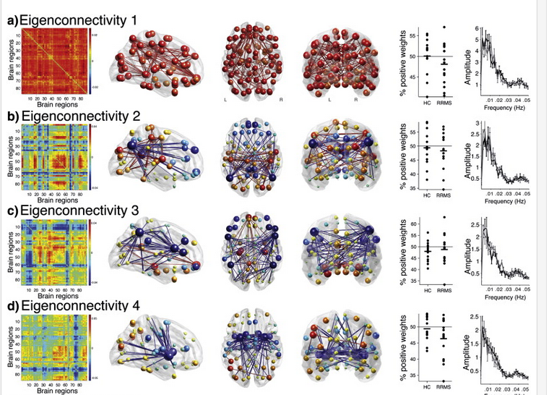
13 HCs, 15 MS patients
Notes:
Eigenconnectivity 1 identifies an all-positive pattern and reflects overall FC strength (“excursions” around the mean where whole-brain dynamic FC is globally increased or decreased); * Indeed global signal was not removed
Brain regions are shown as spheres where their size represents their degree and the color represents their sign (red for positive and blue for negative degrees). Connections use the same color convention (red = positive, blue = negative).

Slide 10
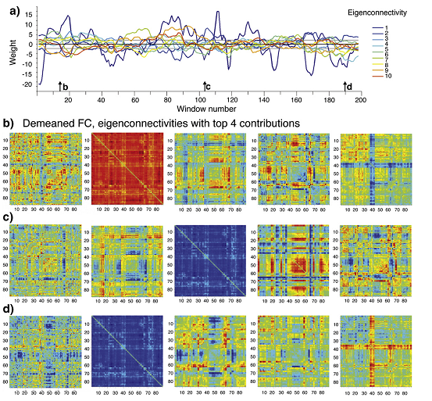
Notes:
Time-dependent weights of the 10 first eigenconnectivities for the same example subject as in Fig. 2. Straight lines represent the 5th and 95th percentiles of phase-randomized weights across all subjects and eigenconnectivities.
(b–d) Example FC networks of Fig. 2b after row-wise demeaning (first column) and the eigenconnectivities with the four largest weights (2nd to 5th columns). We flipped the sign of eigenconnectivities with negative weights (e.g. in (c) eigenconnectivity 1 had a negative weight and thus appears as “blue”).
(b), (c) and (d) correspond to the windows marked with arrows in (a).

Slide 11
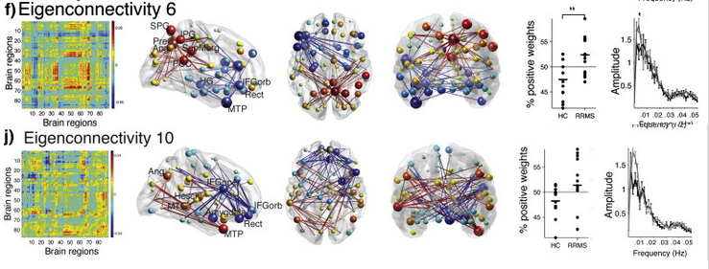
“Dynamic functional connectivity: Better characterized by separated states or a mixture of patterns?”
13 HCs, 15 MS patients
Inter group comparison: Hotelling's T²test on % positive weights (first 10 eigenconnectivities) -> 6&10
Identified a network of connections centered on the DMN with altered contribution in MS patients (disappeared in |w|>30 TRs = 60secs)

Slide 12
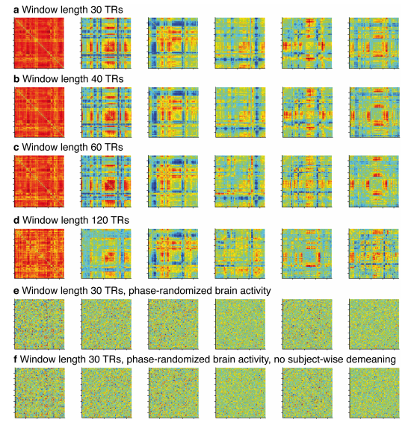
Effects of window length
Tested several options ranged: 30s to 2 min (2-8 TRs)
first eigenconnectivities roughly resemble each other
Estimated connectivity patterns are not the same
Hotelling's T²test did not reveal significant inter-group diff for |w|>30trs
Notes:
Given the similarities between estimated eigenconnectivities at different window lengths, it seems unlikely that it is random variability that drove FC patterns at short window lengths. Exploratory work using different band pass cut-off frequencies also suggested that the large-scale structure of the eigenconnectivities was largely preserved across broad frequency ranges. In our main analysis we chose a cut-off of 0.15 Hz as sliding window correlations are estimated from a small number of samples and a lower cut-off helps to remove noise. The chosen cut-off is similar to what has been used in other studies on dynamic FC (Allen et al., in press, Bassett et al., 2011, Handwerker et al., 2012, Kang et al., 2011 and Li et al., in press), but it would be interesting to further investigate the effects of different frequency cut-offs on dynamic FC when physiological data is available to reduce noise in resting-state activity time courses. Together, these results suggest that patterns of covarying connections were largely similar across varying window lengths, frequency cut-offs and with or without scrubbing.

Slide 13
“Time-resolved functional connectomics: dynamics of human brain connectivity at rest”
Andrew Zalesky, Melbourne Neuropsychiatry Centre, The University of Melbourne
High resolution fMRI data for 10 healthy subjects (Connectome)
15 min RS (TR=0.75 seconds )
Sliding window of 60 seconds
AAL based nodes (Validation with several parcellation schemes)
100 most dynamic FCs per subject (criterion?) – seem to be synchronized in time of increase, average correlation~=0
Graph efficiency measure seem to be synchronized in time of increase
High efficiency connections are spatially longer by average
PNAS in press
Notes:
Time synch within subject – we see it too in music listening (interesting to test in rest)
Avg Cor~0 = we see it too

Slide 14
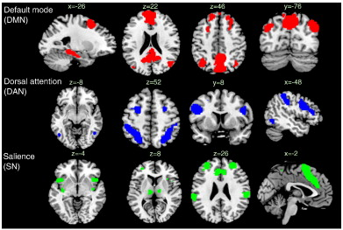
EEG and physiological correlates of resting-state fMRi connectivity dynamics
Catie Chang, NINDS/NIH, Advanced MRI section, Laboratory of Functional and Molecular Imaging, Bethesda, USA
Variability in rsFC over time (also under anesthesia) is it informative?
Use physiological measures as reference (EEG HRV)
EEG correlates of time-varying BOLD functional connectivity
Chang et al. Neuorimage 2013.
A sliding window analysis of EEG+fMRI data (40s win – 26TRs, 50% overlap)
Mental state assessed from amplitude of alpha and theta oscillations
Three predefined functional networks (DMN,DAN,SN)
A significant inverse relationship bet alpha power and DMN-DAN FC
* known association bet alpha and deep breath

Slide 15
EEG and physiological correlates of resting-state fMRi connectivity dynamics
Association between heart rate variability and fluctuations in
resting-state functional connectivity Chang et. al Neuroimage 2013
- 35 healthy volunteers
Seed based rsFC (amygdala and dorsal anterior cingulate cortex; dACC)
Sliding window (45s, 50% overlap, TR=1.25sec)
Identified a set of regions that became more strongly coupled with the dACC and amygdala during states of elevated HRV
Notes:
. Effects differed between high and low frequency components of HRV, suggesting specific contributions of parasympathetic and sympathetic tone on individual connections. Furthermore, dynamics of functional connectivity could be separated from those primarily related to BOLD signal fluctuations.
connectivity dynamics
Regions for which temporal fluctuation in functional connectivity (RMSSD) with the dACC (top row) and amygdala (bottom row) during resting state had significant positive correlation with fluctuations in HRV. Clusters are significant at<0.05 corrected.
Heart rate variability was calculated as the root mean square devia-tions (RMSSD) of theheart rate time series,which is anestablishedmetric
of HRV (Task Force, 1996). The RMSSD metric primarily reflects the HF
(parasympathetic) component of HRV, and has been verified to relate
closely to frequency-domain measures of high-frequency HRV

Slide 16
Notes:
Regions for which temporal fluctuation in functional connectivity with the dACC (top row) and amygdala (middle row) during resting state had significant positive correlation with fluctuations in Fourier-based LF (blue) and HF (red) measures of HRV. Bottom row: regions for which BOLD activity was correlated with the time series of LF- and HF-HRV. All maps are cluster thresholded at<0.05 (corrected), with a height threshold of<0.0001 uncorrected (t>4.17) for the connectivity maps and<0.001 (t>3.34) for the activation
maps.

Slide 17
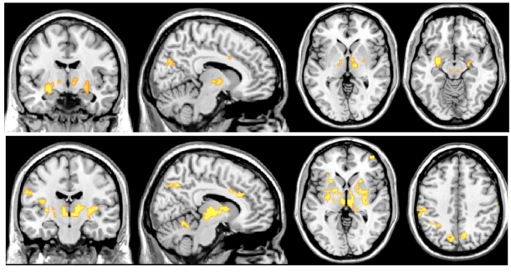
Merge across subjects
Notes:
Fig. 8.Areas for which the inter-subject analysis of mean functional connectivity and mean HRV survived a threshold of<0.05uncorrected, masked with clusters significant at <0.05 (corrected) in the analysis of the temporal relationship between functional connectivity and HRV.

Slide 18
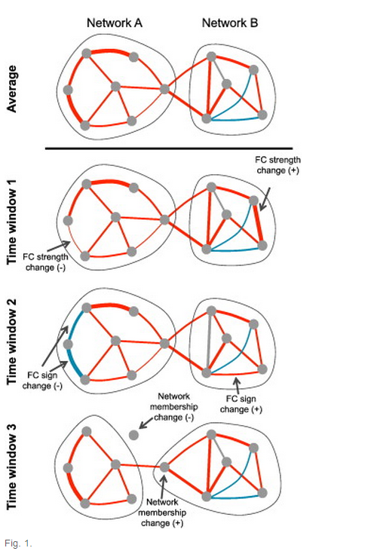
“Multivariate methods for characterizing variability in spatial and temporal connectivity among intrinsic brain networks”
Vince Calhoun, The Mind Research Network and UNM, Albuquerque, NM, USA
Notes:
Time-varying changes in functional connectivity (FC). The schematic graph representation illustrates possible changes in connectivity properties (row 1). The FC strength between two nodes can change in magnitude (row 2), sign (row 3), or be lost/gained as the strength changes above or below a threshold, such that the node membership changes (row 3). Red edges, positive connections; blue edges, negative connections.

Slide 19
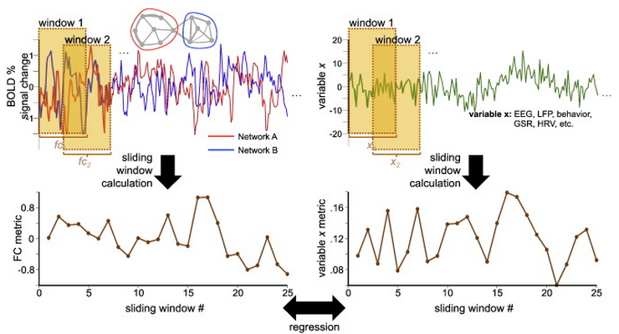
Notes:
Evaluating the relationship between sliding-window functional connectivity (FC) and a concurrently measured variable. A sliding-window FC analysis is performed on pairs of BOLD signal time series, here derived from two networks “A” and “B” (upper left), producing a sequence of sliding-window FC values (lower left). Similarly, measurements of a neural, physiological, or behavioral variable “x” (upper right) can be computed in identical sliding windows (lower right). The two sliding window time series can then be compared using methods such as linear regression, as one way of determining whether the observed BOLD FC dynamics may be associated with variable “x”. EEG, electroencephalography; GSR, galvanic skin response; HRV, heart rate variability, LFP, local field potentials.

Slide 20
Dynamic changes of spatial functional network connectivity in healthy individuals and schizophrenia patients using independent vector analysis (Neuroimage 2014)
Most dynamic studies are based on second-order statistics between fMRI courses
Examine higher-order statistical dependence between pairs of spatial components and its change across time
extract time-varying components from healthy controls and patients with schizophrenia using independent vector analysis (IVA)
Based on mutual information among IVA components, perform statistical analysis and Markov modeling to quantify changes in spatial connectivity
Results: more fluctuations in patient group , primarily between the frontoparietal, cerebellar and temporal lobe regions.
Notes:
IVA = an extension of ICA to multiple data sets and enables one to
In contrast to group ICA, IVA also maximizes the dependence between associated components from different data sets. These associated components are conceptually regrouped into so-called source component vectors (SCVs), which cannot be achieved by separate ICA of each data set during blind source separation. IVA has shown, in most cases, superior performance in capturing variability in spatial components across individuals and groups (Dea et al., 2011, Ma et al., 2013 and Michael et al., 2013). We also noted that as group variability increases, the estimation of the IVA component shows less interference from other components than that estimated by the group ICA method (Ma et al., 2013). capture spatial variations.

Slide 21
Summary
Sliding window rules (need long enough windows)
Parcellation/building blocks based
Mixed states approach
Usage of other physiological measures as reference

