Slide 1
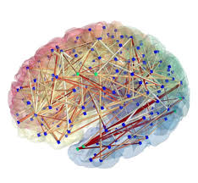
Connectivity differences in brain networks
Andrew Zalesky, Luca Cocchi, Alex Fornito, Micah M. Murray, Ed Bullmore, Neuroimage, April 2012

Slide 2
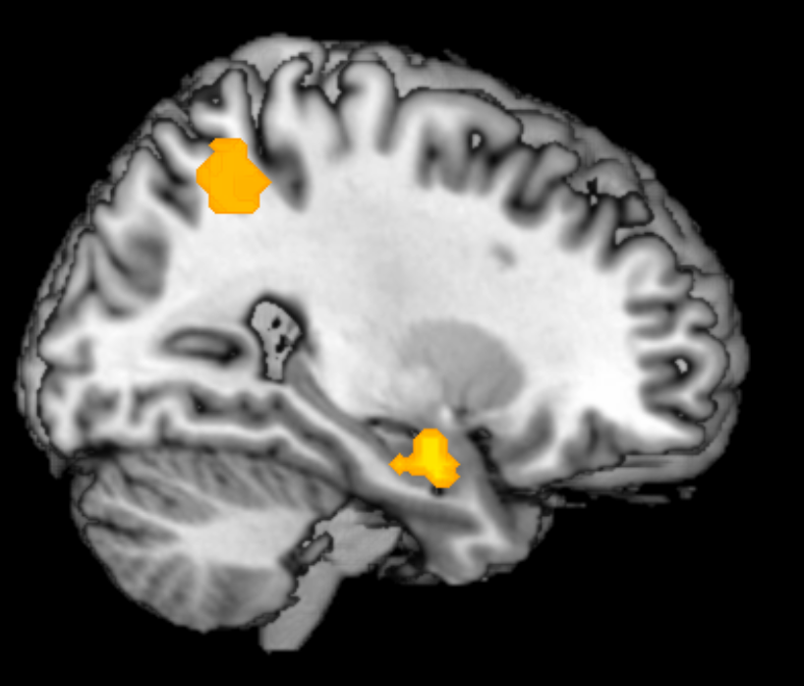
Background
Brain network:
node=brain region
edge=a connection formed between two nodes (physical/functional)
Nontrivial topological features (small-world organization, modular structure, highly connected hubs)
Notes:
A small world network is characterized by dense local clustering or cliquishness of connections between neighboring nodes yet a short path length between any (distant) pair of nodes due to the existence of relatively few long-range connections.
can support both segregated/specialized and distributed/integrated information processing. Moreover, small-world networks are economical, tending to minimize wiring costs while supporting high dynamical complexity.
A pair of anatomically discrete regions are said to be
functionally connected if they exhibit a high degree of
temporal correlation in their activity time series acquired
during functional MRI

Slide 3
Background
Topological properties vary over developmental stages, clinical conditions, cognitive states
May represent simple differences in connectivity
Differences in connectivity strength more straight forward to interpret
High dimensionality
High levels of dependency in data

Slide 4
Example to studies that compare connectivity strength
Vaisvaser et. al. 2013

Slide 5
Goal
Assessing evidence of an experimental effect at each connection comprising a brain network
E.g. association between connectivity strength and diagnostic status
Control family-wise errors (i.e. the likelihood of committing one or more type I errors among all connections)

Slide 6
The process
Given a set of pairwise connectivity measures i.e. edge weights (can be anatomic or functional) compute a test statistic for each connection
Extract supra-threshold connections
Control family-wise errors based on spatial structures identified between connection NBS = network based statistic SCP = spatial pairwise clustering

Slide 7
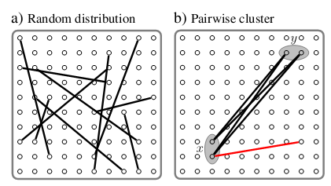
Spatial pairwise clustering - SCP
Nodes i and j are neighbors iff dist(p_{i},p_{j})<d
Edges i and j are neighbors iff dist(p1_{i},p1_{j})<d and dist(p2_{i},p2_{j})<d
Pairwise clusters provide evidence of an experimental effect
Seek such clusters within a set of supra threshold connections

Slide 8
SCP – procedure
n nodes
m= n*(n-1)/2 connections
A= a binary matrix of size m*m
A(i, j)=A(j, i)=1 iff ei and ej are neighbors and ei,ej є {supra-threshold connections}
Identify connected components in A (use BFS) – i.e. edge clusters
1 |  |  | 1 |  | 1
 | 1 | 1 | 1
 | 1 | 1 |  |  | 1 |  | 1
1 | 1 |  | 1
 |  |  |  | 1
1 |  | 1 |  |  | 1
 |  |  |  |  |  | 1
 |  | 1 |  |  |  |  | 1
A
Identify size (#edges) of largest cluster
Estimate significance by permuting data k times and recording larges cluster size on each permutation

Slide 9
Network Based Statistic - NBS
Different clustering definition
ei and ej are neighbors iff dist(p1_{i},p1_{j})<d or dist(p2_{i},p2_{j})<d
A is now an n*n (n=#nodes) matrix A(i,j)=1 iff dist(i,j)<d and ei,ejϵ {supra-threshold connections}
Identify connected components in A (use BFS) – i.e. edge clusters
Permutation based significance estimation recording largest cluster size on each permutation
Notes:
Not sure about d

Slide 10
Case 1: NBS will identify a single network of three nodes but will include red edge
SCP will identify two clusters (significance will be estimated separately)
Case 2: Both will identify two separate clusters but NBS will include red edges
Case 3: NBS will identify the black network while SCP will not
A mult interconnected regions effect->NBS
A two regions effect -> SCP

Slide 11
Application
Electroencephalographic (EEG) activity recorded from 160 scalp channels from 11 healthy volunteers
Visual task under three levels of working memory load
Source estimation -> N=280 discrete nodes uniformly distributed across cortical surface
Pairwise correlation -> 10,861 connections (min distance= 40 mm)

Slide 12
Visual task under WM load
Notes:
Experimental design. VSWM stimuli consisted of black disks (6 for imposing high VSWM loads and 3 for inducing low VSWM loads) presented on a grey background.
Subjects were asked to encode the location of each disk. VSWM stimuli were presented for 1500 ms and subjects had to maintain online the disk location for 4500 ms before
recognition. On 50% of the trials (in each VSWM condition), 3 disks were displaced in a random direction from their original location during the encoding phase. A grid
composed by black squares was presented in 50% of the VSWM trials (25% in the high VSWM load condition and 25% in the low VSWM load condition), subjects had to
indicate if the squares were organized in column (see the low VSWM load condition) or row (see the baseline and high VSWM condition). Two VSWM baseline conditions
(i.e., without grid presentation during the delay period; not presented in the ﬁgure) were also presented to balance the design.

Slide 13
Application
F-statistic computed for pairwise correlations across load levels
Lowest p-value was 0.00026 (Non significant when using Bonferroni/FDR with α=0.05)
NBS applied with F thresholds of 6.5,7,8
SPC applied with F thresholds of 6.5,7,8 and d=7mm (average of 5.8 neighbors per node)
5000 permutations (condition randomization) were used to estimate sig

Slide 14
Results
The connections comprising each distinct cluster are colored uniquely. n.s. indicates the cluster is not significant (p>0.05).

Slide 15
Results

Slide 16
Approach advantages
Exploratory (does not test a single hypothesis)
Non-parametric – does not require assumption re. data distribution. Any measure of variation can be used
Can be easily interpreted

Slide 17
Disadvantages
Threshold choice – arbitrary (wrong choice can damage sensitivity but not specificity)
d is also arbitrary

Slide 18
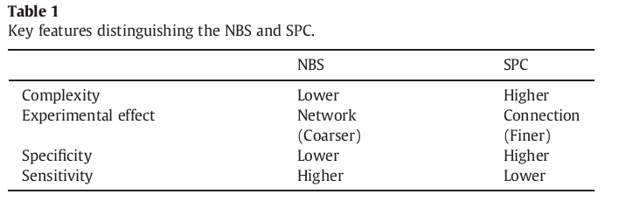
SPC Vs. NBS
NBS– more suitable for coarse parcellations

Slide 19
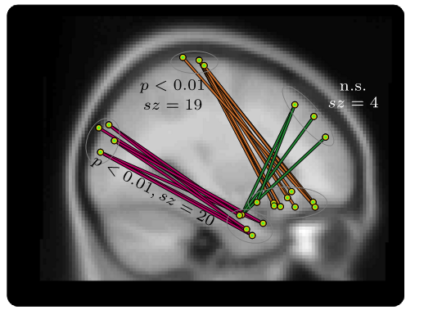
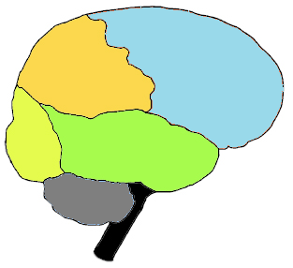
Cognitive interpretation
Three distinct connections were modulated by visuo-spatial WM load:
occipital–temporal frontal–temporal dorsofrontal–orbito-frontal
In line with previous findings (frontal lobe involvement in dual tasks)
In line with theoretical models
Should be tested with a signed variance measure
Notes:
Concurrent execution of two unrelatedtasks has been found to result in either enhanced or decreased overall
performance compared to the case of serial execution
Our findings support the hypothesis that neural networks
encompassing frontal, temporal and occipitoparietal regions are central
in managing dual-task demands. Specifically, our current results are in
line with previous studies suggesting that frontal regions play a central
role in linking sensory-perceptual and motor operations in dual task
contexts
Our findings are also in line with theoretical models implicating frontal/
prefrontal regions in cognitive control mechanisms integrating sensory
and motor processes

Slide 20
SPC application on Schizophrenia data
12 chronic schizophrenia patients and 15 healthy controls (age, gender, education matched)
17 min resting state fMRI scan (eyes closed)
Standard preprocessing
GM mask + quality mask
Data dim 13,668 voxels X 512 time points

