Slide 1
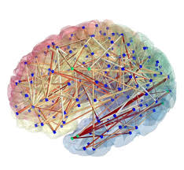
Detecting enrichment within neural connections
Project talk
Adi Maron-Katz
David Amar

Slide 2
Background
Neural connection = structural (i.e white fibers) or functional (i.e. correlation in neural activity)
Many connections identified experimentally (e.g. large scale change following a task)
Requires interpretation
Less relevant for anatomically defined nodes
Use known spatial node annotations. E.g. functional networks/ anatomic atlas
What are we looking for? change between two or within one annotation (e.g. functional network)
Usually done “by eye” or by % representation

Slide 3
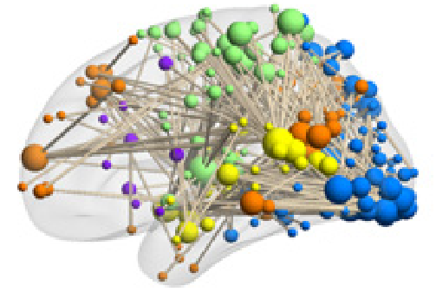
Example – how can one interpret this? Reduced FC in aMCI
Visual
363 functional weakened connections in Amnestic Mild Cognitive Impairment (aMCI) - 37 patients vs. 47 healthy controls
Senso-motor
DMN
VAN
Auditory
Wang et al. BIOL PSYCHIATRY 2013
Notes:
Amnestic Miled Reduced cognitive functions that may be a prodromal stage of Alzheimer’s desease

Slide 4
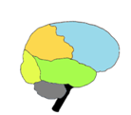
Example 2 – how can one interpret this?
490 functional connections (FCs) changed following acute stress exposure:
301 weakened (blue)
189 strengthened (red)

Slide 5
The paired enrichment problem
7 edges
10
1
4
1 edge
2
5
1 edges
3
6
8
Tot: 11 edges
7
9
For each pair of colors, how surprising is the number of observations (i.e. edges) that connect it?
Notes:
For simplicity – assume that each node is assigned with one color

Slide 6
Hyper geometric (HG) score
how surprising is the number of yellow balls in my sample?
OR
What is the probability of getting at least 3 yellow balls in a sample of 7?
M balls in the pool
K “special” balls (e.g. yelow)
If I sample N of them – what are the odds of having at least x “special” balls in my sample (p-value)?
Notes:
Under the assumption that each ball is sampled independently, HG-CDF

Slide 7
“Paired” version of HG test

Slide 8
Independency assumption
10
1
4
2
5
3
6
8
7
9
Implicit assumption - balls are sampled independently
Is this indeed the case for edge sampling?
Is this the case for neural connections?

Slide 9
HG vs. Random Edge sampling Frequency comparison in 50000 samples
|V|=100 ; |E| = 100 ; |V(green)|=10 ; |V(red)|=10
Random graphs
HG
x
x
Notes:
Frquency = for HG : pVal*50000 , for Samples: #of graphs with x special balls

Slide 10
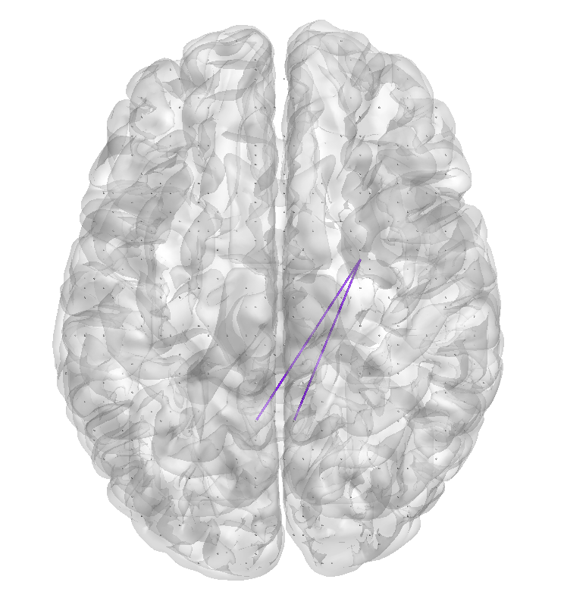
Biological independency?
Hypothetical structural connectivity
Activity change -> functional connectivity change
Special restrictions (e.g. CCs)
How can we account for such an effect ?
Sample the space of possible graphs to generate a null distribution that better fits such cases

Slide 11
Suggested solution 1 – “graph structure preservation”
10
1
4
2
5
3
6
8
7
9
Randomly assign colors (i.e. annotations) to nodes
Preserve annotation sizes

Slide 12
Suggested solution 2 – “annotation degree preservation”
10
1
4
2
5
3
6
8
Deg(red)=9
Deg(green)=9
Deg(Blue)=2
7
9
Randomly select x edges
Preserve degree of each color

Slide 13
Current implementation
8
6
10
5
3
2
1
2
9
1
5
3
4
5
4
6
1
1
9
2
6
4
1
1
2
1
3
3
1
2
2
4
5
4
6
5
5
6
6
4
9
9
10
8
10
1
4
10
4
2
5
1
5
3
6
8
2
3
6
8
7
9
7
9
Deg(red)=9
Deg(green)=9
Deg(blue)=2
Deg(no color)=2

Slide 14
Suggested solution 3 – “Node degree preservation”
10
1
4
10
1
4
2
5
2
5
3
6
8
3
6
8
7
9
7
9
Randomly select x edges while preserving the degree of each node
Used for PPI enrichment analysis to handle non-uniform deg distribution of proteins in networks (e.g. Franceschini et. al. Nuc Acid Res. 2013 – “STRING V9.1…”)
Keeps all other nodes “out of the game” – is this reasonable?

Slide 15
Current implementation
2
4
10
1
3
1
9
2
7
8
5
3
4
5
6
6
1
2
5
2
5
4
1
1
1
2
2
2
2
3
3
4
4
4
5
5
5
5
6
6
7
8
9
10
10
1
4
10
1
4
2
5
2
5
3
6
8
3
6
8
7
9
7
9

Slide 16
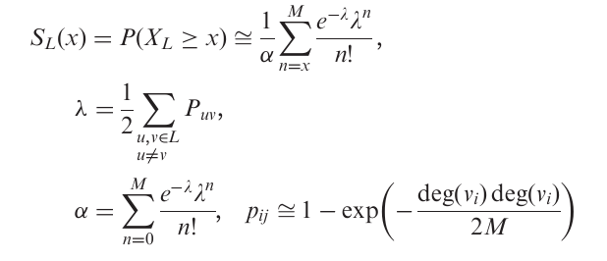
Solutions from PPI analysis
Degree preserving randomization
For large L=|V| - Poisson distribution approximation holds:
M= tot # interactions within L ->I.e. |E| (?)
What is a large L?
Franceschini et. al. Nuc Acid Res. 2013 (“STRING V9.1…”)
Notes:
The random variable XL is a sum of Bernoulli variables
with distinct parameters, and hence a Poisson–Binomial
variable. If L is large, XL can thus be approximated by a
Poisson random variable, whose cumulative probability
function is:

Slide 17
Case 1
Case 2
10
8
10
1
4
1
4
2
5
5
2
3
6
8
6
3
7
9
7
9
Case 3
Case 4
10
8
1
4
1
4
2
5
2
5
3
6
3
6
7
9
7
9

Slide 18
Methods comparison – toy example
This trivial case would be missed by the two rank preserving methods…
10
1
4
2
5
3
6
8
Annotation | HG | Label perms | Annotation deg pres perms | Deg pres perms | FR
Red-Red | 1 | 1 | 1 | 1 | 0
Red-Green | 0.00021 | 0.0004 | 0.0174 | 0.0221 | 3.18
Red-Blue | 0.83 | 0.84 | 0.7366 | 0.7033 | 0.68
Green-Green | 1 | 1 | 1 | 1 | 0
Green-Blue | 0.83 | 0.84 | 0.7387 | 0.7017 | 0.68
Blue-Blue | 1 | 1 | 1 | 1 | 0
7
9
Notes:
In the literature I found quasi bicliques

Slide 19
Methods comparison – toy example 2
10
8
1
4
2
5
3
6
7
9
Annotation | HG | Label perms | Annot deg pres perms | Deg pres perms | FR
Red-Red | 0.6440 | 0.6674 | 0.9697 | 0.9929 | 1.1538
Red-Green | 0.2391 | 0.3280 | 0.9249 | 0.9917 | 1.1538
Red-Blue | 0.4006 | 0.4798 | 0.1721 | 0.2238 | 1.1538
Green-Green | 0.6440 | 0.6626 | 0.9691 | 0.9930 | 1.1538
Green-Blue | 0.4006 | 0.4764 | 0.1709 | 0.2221 | 1.1538
Blue-Blue | 1 | 1 | 1 | 1 | 0
Notes:
In the literature I found quasi bicliques

Slide 20
Methods comparison – toy example 3
10
8
Hub sensitivity?
1
4
2
5
3
6
7
9
Annotation | HG | Label perms | Annot deg pres perms | Deg pres perms | FR
Red-Red | 0.2541 | 0.3385 | 0.9859 | 0.9895 | 2
Red-Green | 0.1192 | 0.1419 | 0.4021 | 0.3842 | 1.6667
Red-Blue | 0.6647 | 0.6277 | 0.6874 | 0.7114 | 1
Green-Green | 1 | 1 | 1 | 1 | 0
Green-Blue | 0.9271 | 0.8605 | 0.5541 | 0.5241 | 0.5000
Blue-Blue | 1 | 1 | 1 | 1 | 0
Notes:
In the literature I found quasi bicliques

Slide 21
Methods comparison – toy example 4
1
4
2
5
3
6
Who is right here?
7
9
Annotation | HG | Label perms | Annot deg pres perms | Deg pres perms | FR
Red-Red | 0.0466 | 0.0952 | 0.9996 | 0.9999 | 2.7536
Red-Green | 7.72e-05 | 0.0029 | 0.9971 | 0.9999 | 2.7536
Red-Blue | 0.0020 | 0.0182 | 0.1873 | 0.2409 | 2.7536
Green-Green | 0.0466 | 0.0978 | 0.9840 | 0.9931 | 2.7536
Green-Blue | 0.0020 | 0.0172 | 0.0630 | 0.0892 | 2.7536
Blue-Blue | 1 | 1 | 1 | 1 | 0
v
v
v
v
v
v

Slide 22
Real cases– Wang 1024
Annotation | HG | Label perms | Annot deg pres perms | Deg pres perm | FR
VN-AN* | 0 | <0.0001 | 0.0038 | 0.0043 | 2.8
SMN-AN* | 1.31e-08 | 0.0002 | 0.0002 | <0.0001 | 2.29
VN-VN | 4.21e-05 | 0.017 | 0.4592 | 0.41 | 1.95
DMN-DMN* | 0.0012 | 0.0489 | <0.0001 | <0.0001 | 1.57
AN-AN | 0.092 | 0.17 | 0.9892 | 0.986 | 1.55
SMN-VN* | 0.0055 | 0.0555 | 0.247 | 0.256 | 1.41
SMN-SMN | 0.609 | 0.5373 | 0.4038 | 0.353 | 0.96
VAN-AN | 0.89 | 0.8 | 0.0152 | 0.016 | 0.68
DMN-VN | 0.999 | 0.968 | 0.9998 | 0.9997 | 0.64
DMN-AN | 1 | 0.998 | 1 | 1 | 0.35
SMN-VAN | 1 | 0.999 | 0.5268 | 0.542 | 0.14
DMN-VAN | 1 | 0.9999 | 0.5313 | 0.517 | 0.14
SMN-DMN | 1 | 1 | 1 | 1 | 0.13
VN-VAN | 1 | 1 | 1 | 1 | 0
VAN-VAN | 1 | 1 | 1 | 1 | 0
* Was reported in paper
Notes:
Perms 2 annotation degrees:
152 SMN
151 DMN
242 VN
13 VAN
168 AN
Tot Degs = 726
# connections = 363

Slide 23
Real cases– Wang 1024 – FDR corrected
Annotation | HG | Label perms | Annot deg pres perms | Deg pres per FDR correctedm | FR
VN-AN* | 0 | <0.0015 | 0.019 | 0.02 | 2.8
SMN-AN* | 9.83E-08 | 0.0015 | 0.0015 | <0.00075 | 2.29
VN-VN | 0.000211 | 0.085 | 0.8855 | 0.878571 | 1.95
DMN-DMN* | 0.0045 | 0.1665 | <0.0015 | <0.00075 | 1.57
AN-AN | 0.23 | 0.425 | 1 | 1 | 1.55
SMN-VN* | 0.0165 | 0.1665 | 0.741 | 0.768 | 1.41
SMN-SMN | 1 | 1 | 0.8855 | 0.878571 | 0.96
VAN-AN | 1 | 1 | 0.057 | 0.06 | 0.68
DMN-VN | 1 | 1 | 1 | 1 | 0.64
DMN-AN | 1 | 1 | 1 | 1 | 0.35
SMN-VAN | 1 | 1 | 0.8855 | 0.903333 | 0.14
DMN-VAN | 1 | 1 | 0.8855 | 0.903333 | 0.14
SMN-DMN | 1 | 1 | 1 | 1 | 0.13
VN-VAN | 1 | 1 | 1 | 1 | 0
VAN-VAN | 1 | 1 | 1 | 1 | 0
* Was reported in paper
Notes:
Perms 2 annotation degrees:
152 SMN
151 DMN
242 VN
13 VAN
168 AN
Tot Degs = 726
# connections = 363

Slide 24
Annotation info

Slide 25
Real cases– Acute stress – strengthened
Annotation | HG | Label perms | Annot deg pres perms | Deg pres perm | FR
Temp_L-SL_M | 3.30E-11 | 0 | <0.0001 | <0.0001 | 60.1257
SL_M-Par_R * | 0 | 0 | 0.1032 | 0.0765 | 47.1574
Front_R-SL_M | 0 | 0 | 0.0027 | 0.0005 | 28.2944
Temp_R-SL_M | 7.20E-08 | 5.00E-04 | 0.405 | 0.4315 | 20.2103
SL_M-Par_L | 7.74E-04 | 0.0053 | 0.9088 | 0.926 | 16.9767
SL_L-SL_M | 8.67E-04 | 0.007 | 0.9678 | 0.9797 | 16.3237
Limbic_M-SL_M | 9.67E-04 | 0.0076 | 0.7461 | 0.779 | 15.7191
SL_R-SL_M | 0.009 | 0.0183 | 0.9911 | 0.995 | 14.1472
Front_L-SL_M | 5.84E-05 | 0.0041 | 0.1238 | 0.138 | 12.4098
SL_R-SL_R | 0.0048 | 0.0187 | 0.1134 | 0.0642 | 8.9351
Limbic_L-Limbic_L | 0.1102 | 0.0952 | 0.0507 | 0.0275 | 8.5741
SL_M-OCC_L | 0.1381 | 0.1219 | 0.9731 | 1 | 6.7368
Limbic_M-Par_R | 1.09E-04 | 0.0022 | 3.00E-04 | 0.0003 | 5.589
Par_L-Par_M | 0.0606 | 0.081 | 0.015 | 0.0142 | 5.0301
SL_R-Par_L | 0.0123 | 0.0349 | 0.1753 | 0.1924 | 4.5271
* Found association with stress

Slide 26
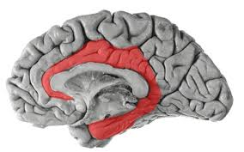
Annotation info
Notes:
Temp_L: deg=82 ,#nodes=40
Temp_R: deg= ,#nodes=
SL_M : deg= ,#nodes=
Par_L: deg= ,#nodes=
Par_R : deg= ,#nodes=
Limbic_M: deg=, #nodes=

Slide 27
Conclusions so far
Often, HG res resemble label permutation res, while deg pres res resemble annot deg pres
HG and label perm are more associated with FR
HG usually produces the “best” pValue
Deg preserving permutation missed a trivial case
Deg preserving permutation missed the only case in real data that was associated with stress
Your insights?

Slide 28
Thank you

