Slide 1
Paper presentation: Genomic Regions Flanking E-Box Binding Sites Influence DNA Binding Specificity of bHLH Transcription Factors through DNA Shape Cell Reports, March, 2013
Raluca Gordân¹, Ning Shen², Iris Dror³, John Horton², Remo Rohs³ and Martha L. Bulyk¹
¹Harvard, ²Duke University, ³USC
Yaron Orenstein
ACGT “after the holidays” group meeting
2nd October, 2013

Slide 2
Gene expression regulation
Transcription is regulated mainly by transcription factors (TFs) - proteins that bind to DNA subsequences, called binding sites (BSs).
TFBSs are located mainly in the gene’s promoter – the DNA sequence upstream the gene’s transcription start site (TSS).
TFs can promote or repress transcription.

Slide 3
TFBS models
The most popular presentation of TFBS is a position weight matrix (PWM). Each position has weights for the 4 possible letters (A,C,G,T).
For example:
Logo format:
6 | 5 | 4 | 3 | 2 | 1
0 | 0.2 | 0.7 | 0 | 0.8 | 0.1 | A
0.6 | 0.4 | 0.1 | 0.5 | 0.1 | 0 | C
0.1 | 0.4 | 0.1 | 0.5 | 0 | 0 | G
0.3 | 0 | 0.1 | 0 | 0.1 | 0.9 | T

Slide 4
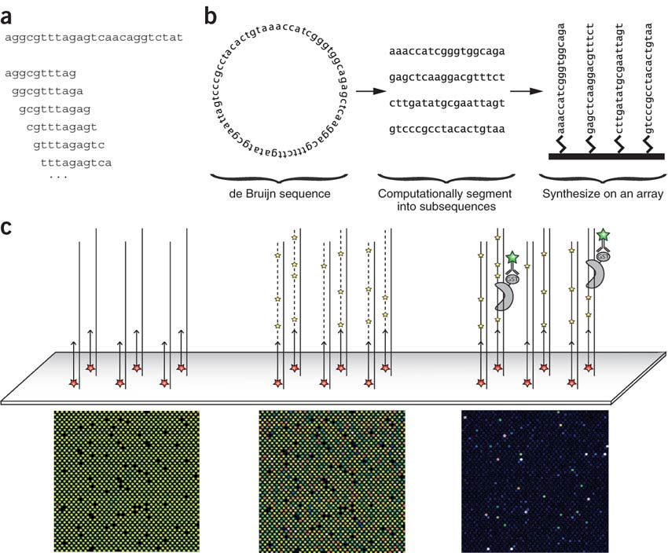
Protein binding microarrays

Slide 5
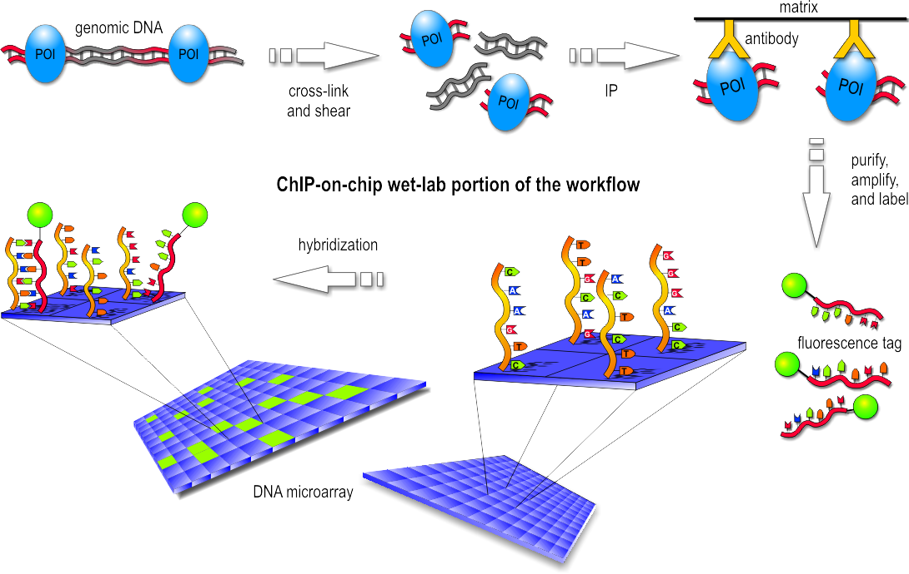
ChIP-chip

Slide 6
Paralogous TFs
Paralogous TFs have similar DNA binding preference.
Still they bind to different genomic target in vivo.
Co-factors and local chromatin environment partially explain some of the difference.

Slide 7
The question
How do TFs from the same family bind to different targets in vivo?
Is there a specific sequence preference?

Slide 8
The case study
Yeast bHLH TFs Cbf1 and Tye7.
ChIP-chip data collected from the same culture conditions (YPD) (Harbison et al., 2004).
Universal PBM data available (Zhu et al., 2009).

Slide 9
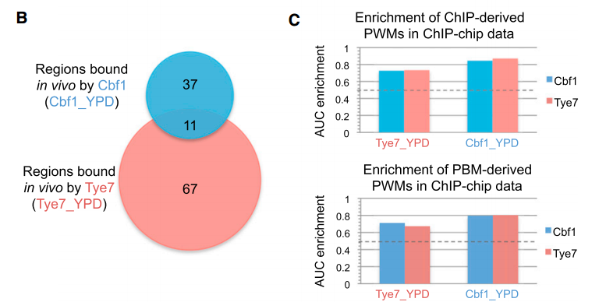
In vivo targets
Difference in PBM- and ChIP- derived PWMs fail to explain specific enrichment.

Slide 10
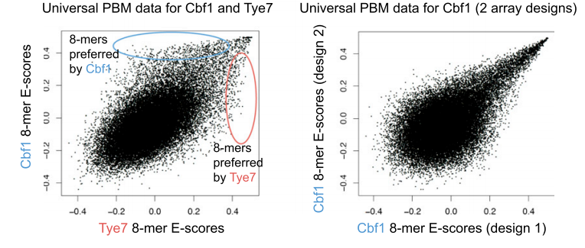
In vitro targets
E-score = Enrichment score.
Hints that specificity may be partially achieved by sequence preference.

Slide 11
New data: genomic context PBM
Regions bound in vivo (p-value < 0.005).
Regions not bound in vivo (p-value > 0.5).
Putative sites: two consecutive overlapping 8-mers with E-scores > 0.35.
gcPBM contaions: 30bp regions centered at these sites (bound and unbound).

Slide 12
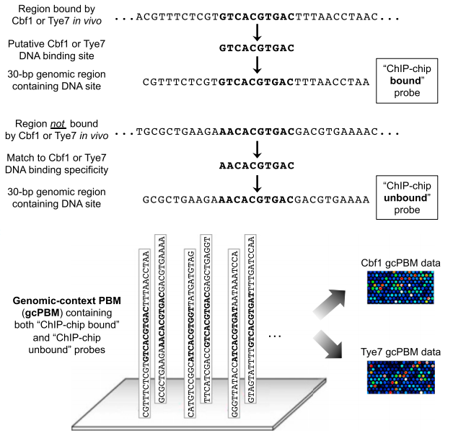

Slide 13
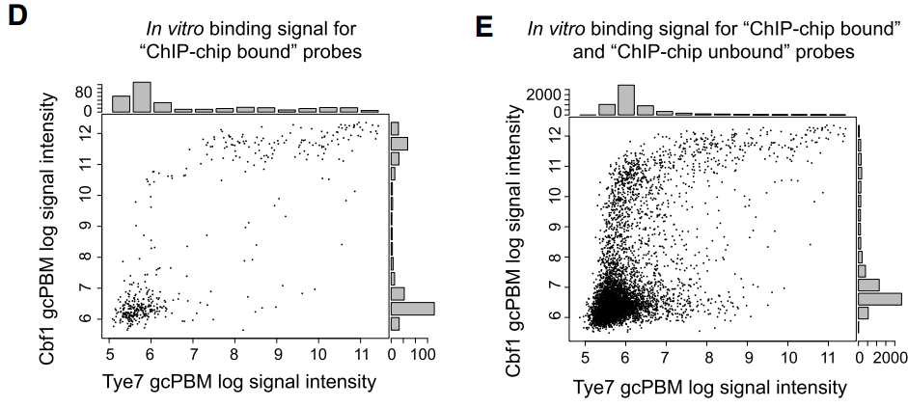
Comparing in vitro binding

Slide 14
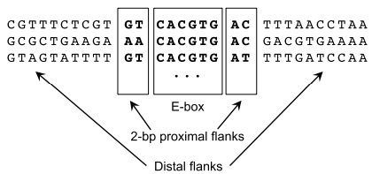
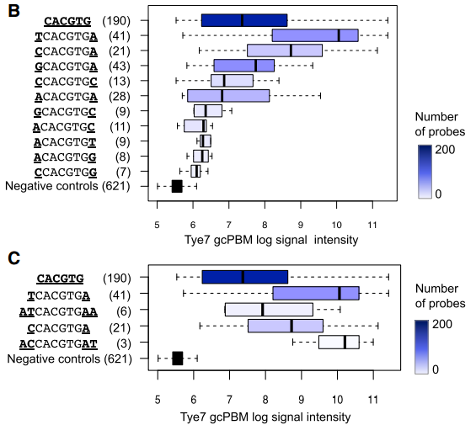
Flanking base pairs contribute to specificity in vitro
Proximal and distal flanks affect binding: variability in binding from high to low specificity

Slide 15
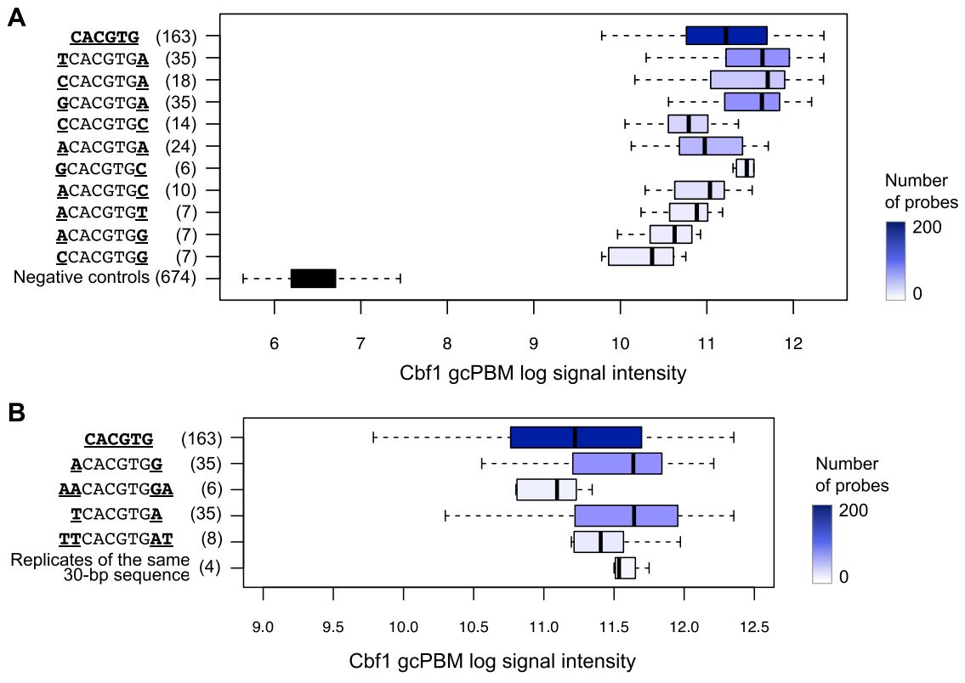
Another example from the supplementary

Slide 16
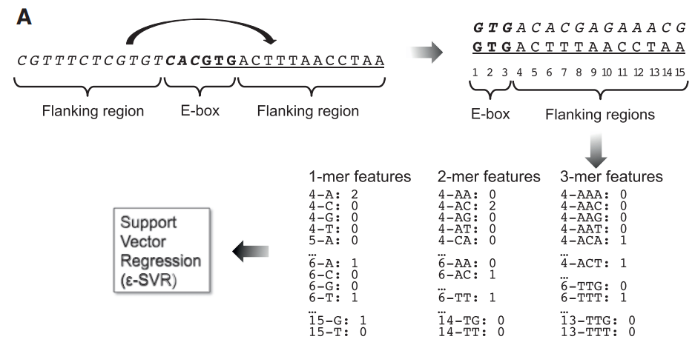
Regression analysis
Sequence features based on complement flanks:

Slide 17
Regression details
Selected probes for which the maximum PBM 8-mer score in the flanks was < 0.3:
280 for Cbf1 312 for Tye7
Target: log(fluorescence intensities).
ε-SVR
grid search using 10-fold and leave-one-out cross-validation to determine best parameters for ε and C.

Slide 18
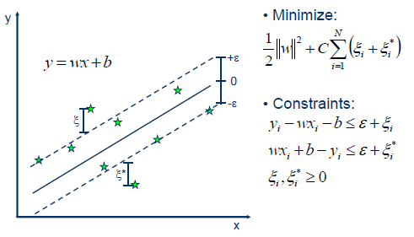
Epsilon Support Vector Regression
Errors within the epsilon range are ignored.
C = weight of penalty.

Slide 19
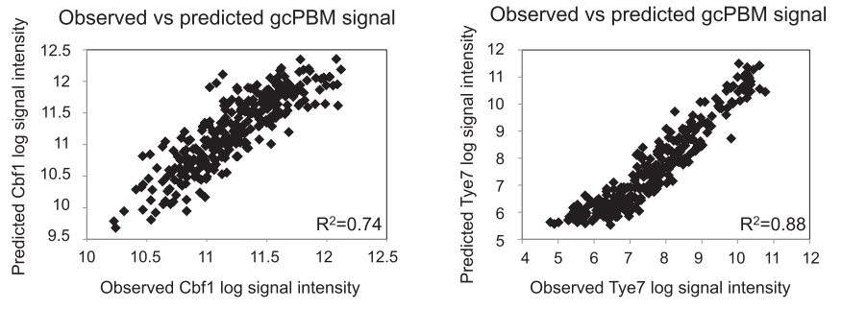
Prediction results
Leave-one-out cross-validation for prediction.

Slide 20
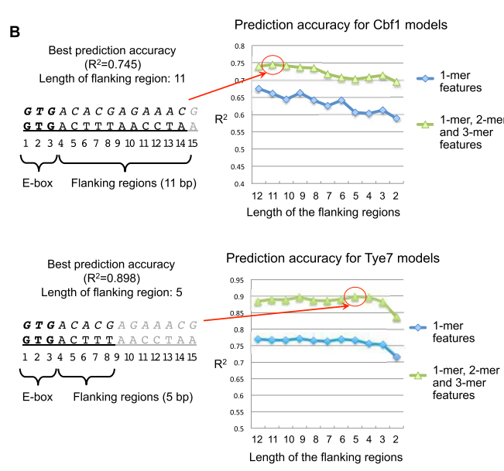
Feature sets
1-mer, 2-mer and 3-mers performed the best.
The addition of 4-mers did not improve (due to high number of parameters).

Slide 21
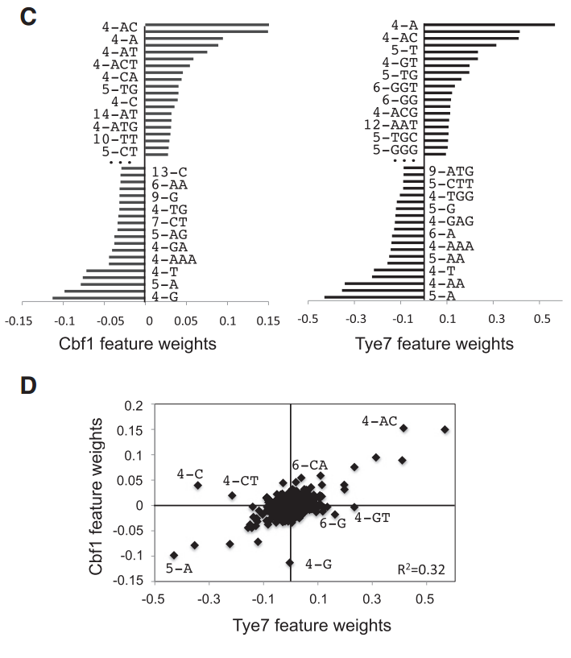
Feature weights

Slide 22
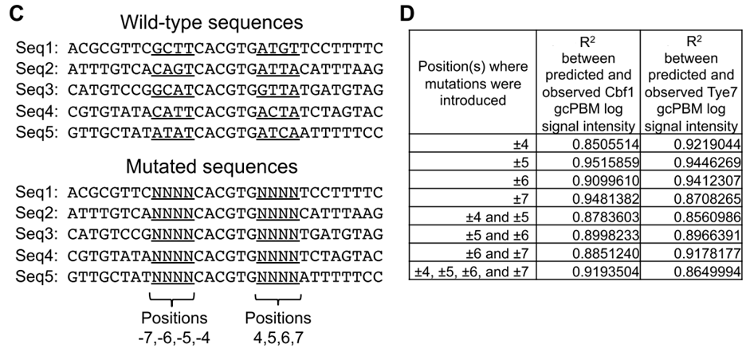
Validation
gcPBM with mutations in the flanking regions.
Overall: Cbf1 R²=0.84 Tye7 R²=0.75

Slide 23
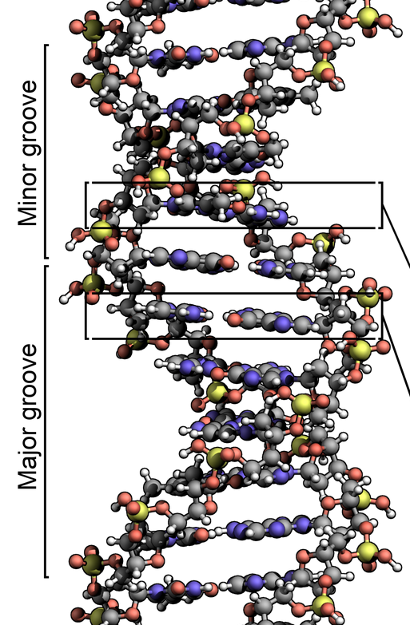
Grooves
Spaces between the strands.
May provide a binding site.
22 and 12 Å wide.
The narrowness of the minor groove means that the edges of the bases are more accessible in the major groove.
TFs usually make contact to the sides of the bases exposed in the major groove.

Slide 24
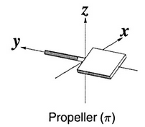
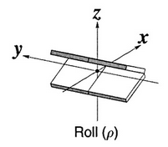
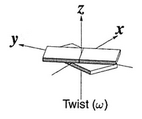
Helical parameters
The location and orientation in space of every base pair relative to its predecessor along the axis of the helix.
Rise and twist determine the handedness and pitch of the helix.
Roll and tilt make successive base pairs less parallel, and are typically small.

Slide 25
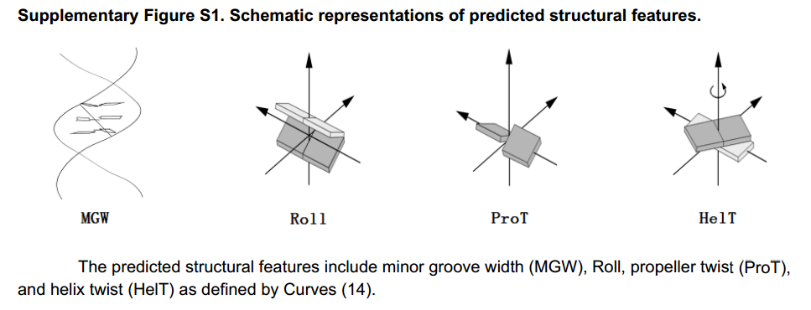
DNA shape features
High-throughput DNA shape prediction derives structural features of DNA (Rohs lab):
(Zhou et al. 2013)

Slide 26
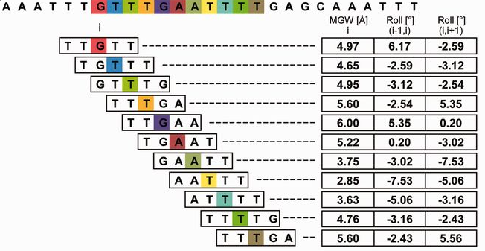
Predicting DNA shape features
Using pentamers (512 possible configurations)
(Zhou et al. 2013)

Slide 27
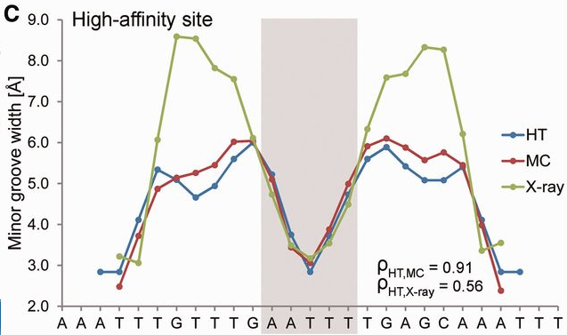
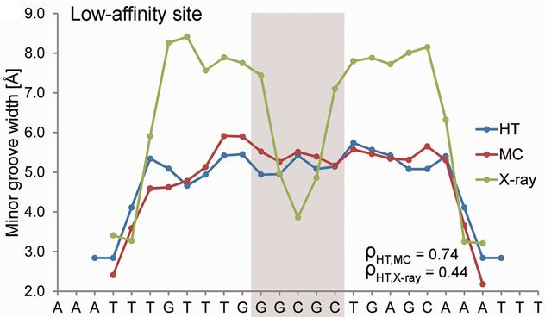
Validating the predictions
(Zhou et al. 2013)

Slide 28
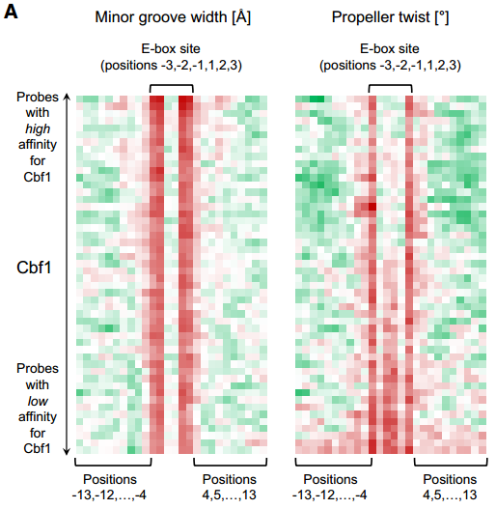
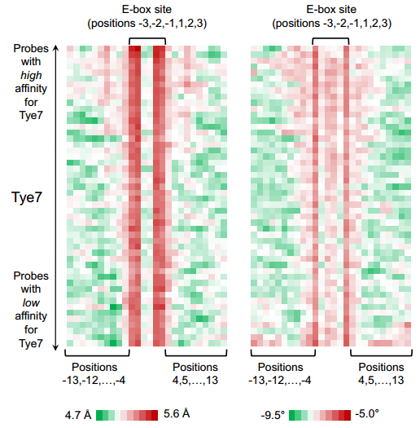
Shape parameters in binding sites
Sites grouped to 50 bins.
Shape parameters averaged.

Slide 29
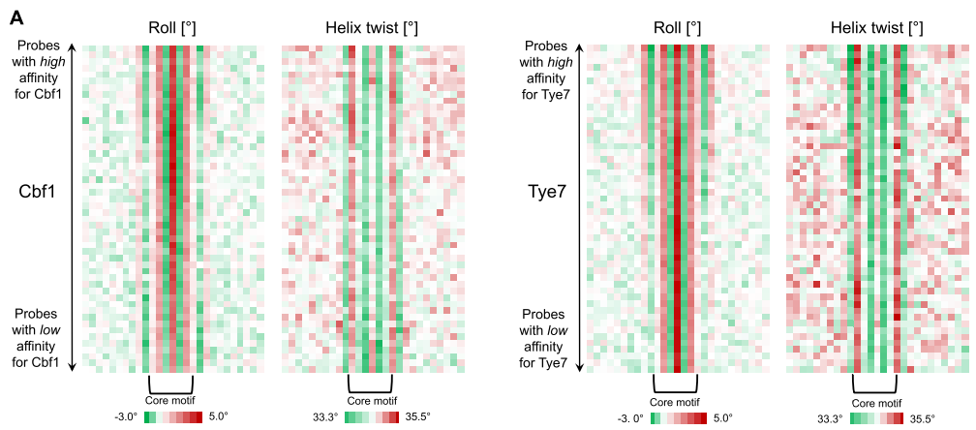
Shape parameters in binding sites

Slide 30
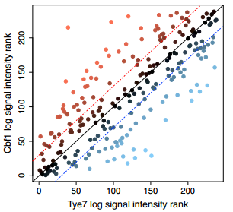
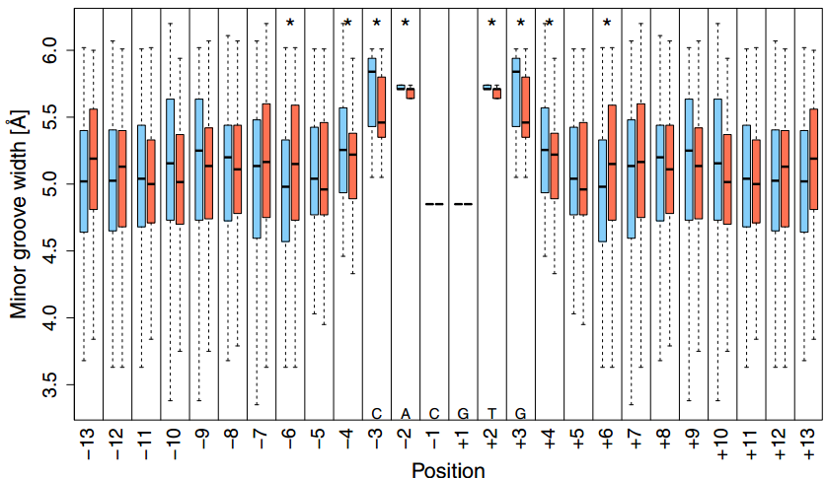
Differentiation using shape parameters

Slide 31
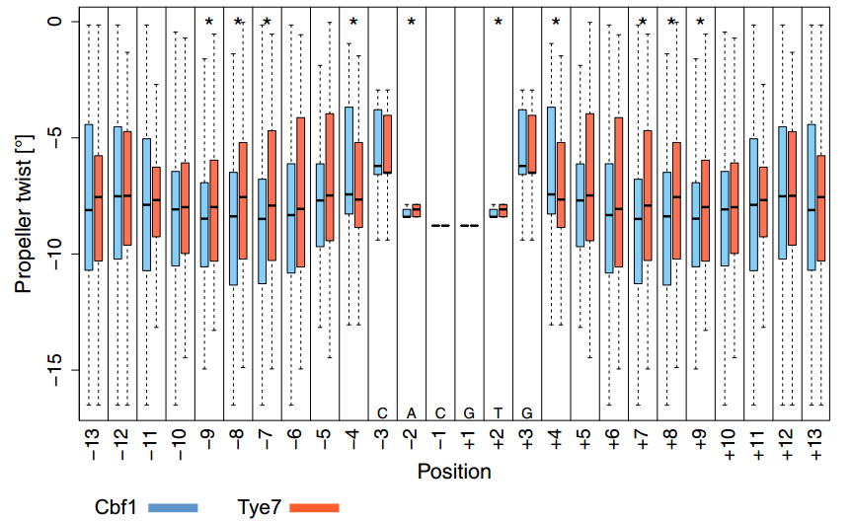
Differeitation using propeller twist

Slide 32
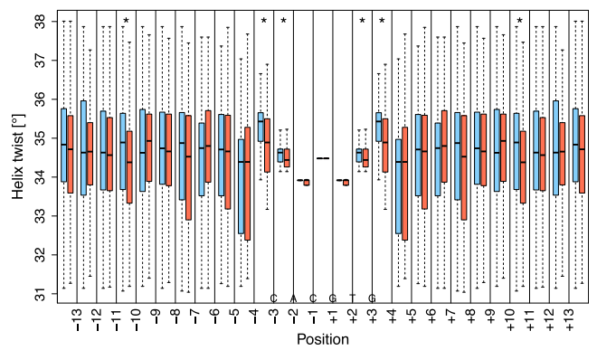
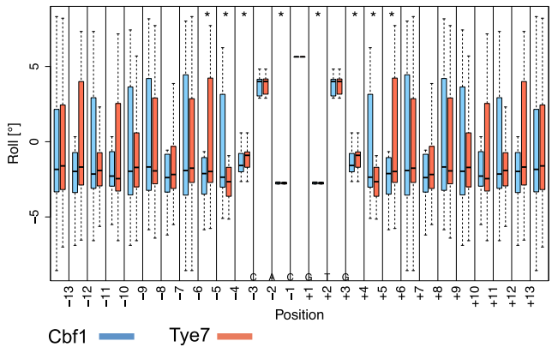
Differentiation using helix twist and roll

Slide 33
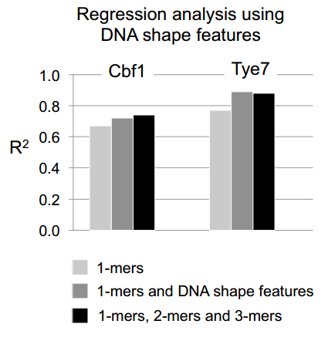
Predicting using shape features
Linear SVR.
Leave-one-out cross validation.
R²=0.72, 0.89 compared to R²=0.74 and 0.88.
Number of features reduced from hundreds to tens.

Slide 34
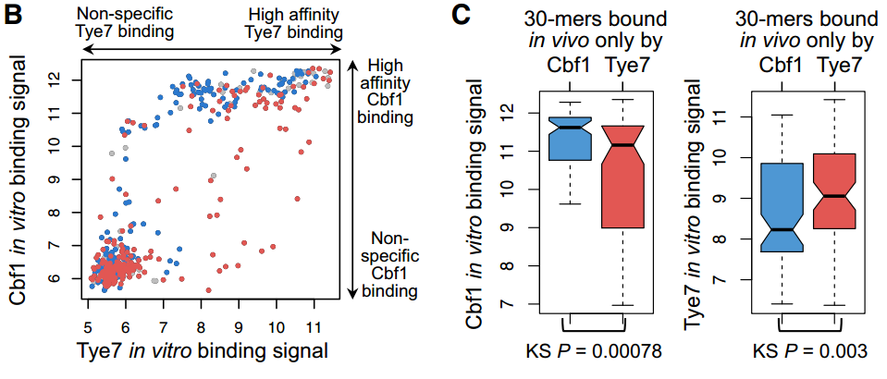
Going back to in vivo binding
Blue = Cbf1, Red = Tye7, Grey = both.

Slide 35
Conclusions
Sequences flanking the core cause subtle differences in binding of paralogous TFs.
DNA shape features may be widely used signals in cis-regulatory sequences.
bHLH factors recognize the E-box (CACGTG), and bind distinctly by local shape features.

Slide 36
Future plans
Are shape features significant in other TF families?
We are cooperating with Rohs lab using the new HT-SELEX data:
We pre-process that data to k-mer counts.
They use it to predict binding using shape features compared to 2-mers and 3-mers.

Slide 37
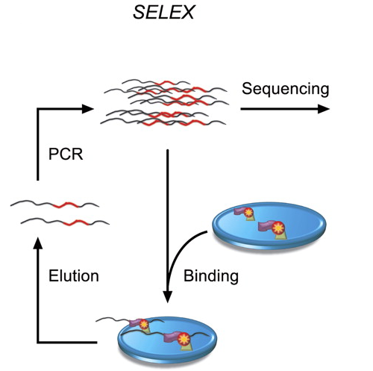
HT-SELEX

Slide 38
Initial results

