Slide 1
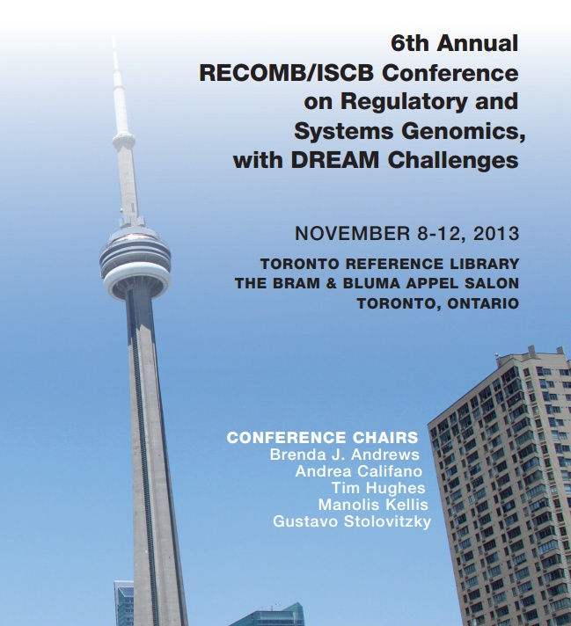
Yaron Orenstein
ACGT group meeting 20.11.13

Slide 2
Conference information
Annual RECOMB satellite conference.
Iterates between East coast, West coast and Europe.
Organizers: Gustavo Stolovitzky, Andrea Califano, Manolis Kellis, Brenda J. Andrews, Tim Hughes.

Slide 3
General impression
Getting less computational and more biological throughout the years.
Mixed quality of talks; many using large amounts of new data.
Many speakers and delegates from Toronto and Boston.
Talks never on time; breaks too short; almost no time for poster session.

Slide 4
DREAM challenges
Three challenges this year:
HPN-DREAM Breast Cancer Network Inference Challenge.
NIEHS-NCATS0UNC DREAM Toxicogenetics Challenge.
DREAM Whole Cell Parameter Estimation Challenge.

Slide 5
INTRODUCTION Protein-DNA binding

Slide 6
Gene expression regulation
Transcription is regulated mainly by transcription factors (TFs) - proteins that bind to DNA subsequences, called binding sites (BSs).
TFBSs are located mainly in the gene’s promoter – the DNA sequence upstream the gene’s transcription start site (TSS).
TFs can promote or repress transcription.
RNA binding proteins regulate post-transcriptionally.

Slide 7
TFBS models
We represent the binding site as a position weight matrix (PWM). Each position has weights for the 4 possible letters (A, C, G, T).
For example:
Logo format:
6 | 5 | 4 | 3 | 2 | 1
0 | 0.2 | 0.7 | 0 | 0.8 | 0.1 | A
0.6 | 0.4 | 0.1 | 0.5 | 0.1 | 0 | C
0.1 | 0.4 | 0.1 | 0.5 | 0 | 0 | G
0.3 | 0 | 0.1 | 0 | 0.1 | 0.9 | T

Slide 8
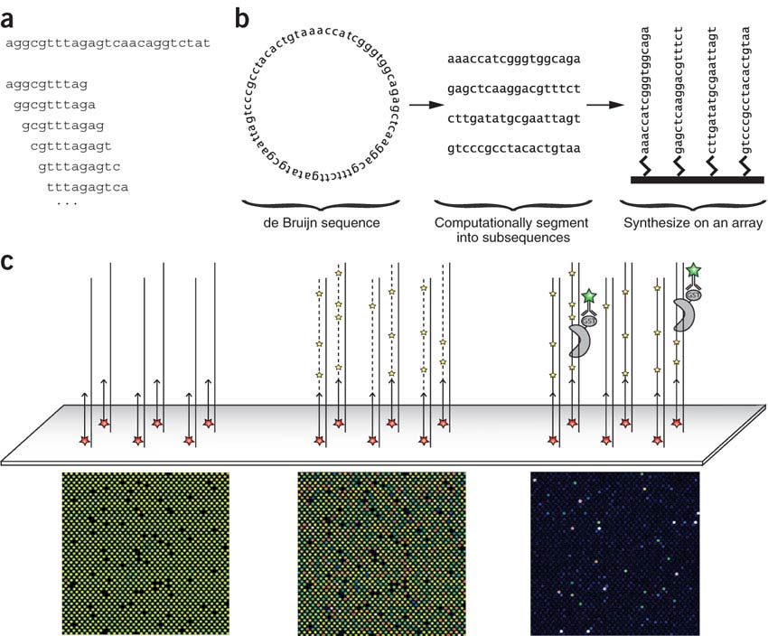
Protein binding microarray
(Berger et al., Nature Biotechnolgy 06)

Slide 9
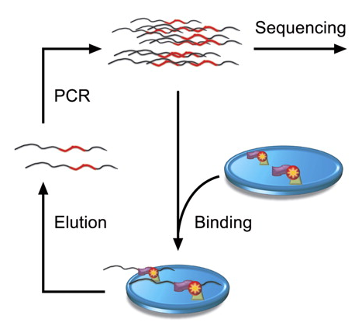
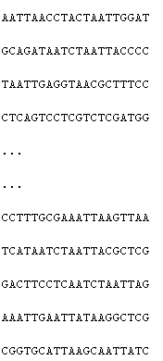
High-throughput SELEX
cycles 0-3
(Jolma et al., Genome Research 10)

Slide 10
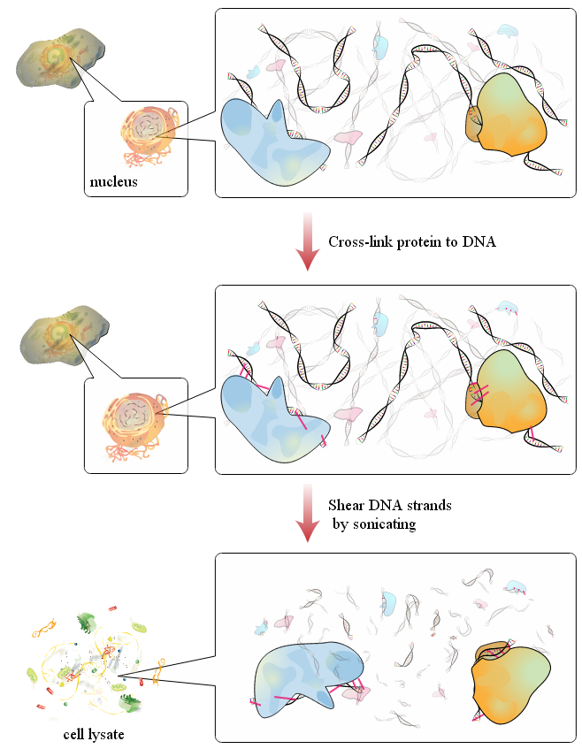
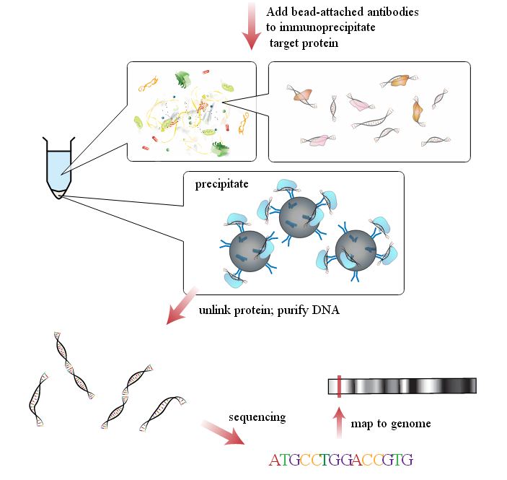
ChIP-seq
(Wikipedia, ChIP-seq value, 2013)

Slide 11
ANACDOTES Talks and posters All video talks available at: http://www.iscb.org/recomb-mm/media-recombrsg2013

Slide 12
CIS-BP database
Matt Weirauch (Cincinnati Children’s Hospital) introduced the new database CIS-BP.
Performed PBM experiments on 1,033 TFs from 131 eukaryotes covering 54 TF families.
Inferred 38% of 166,851 predicted TFs by amino-acid sequence similarity.

Slide 13
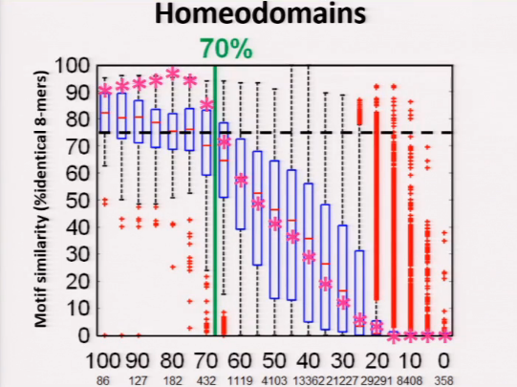
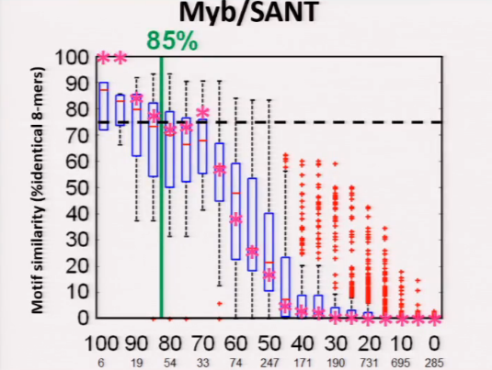
The “65% rule”

Slide 14
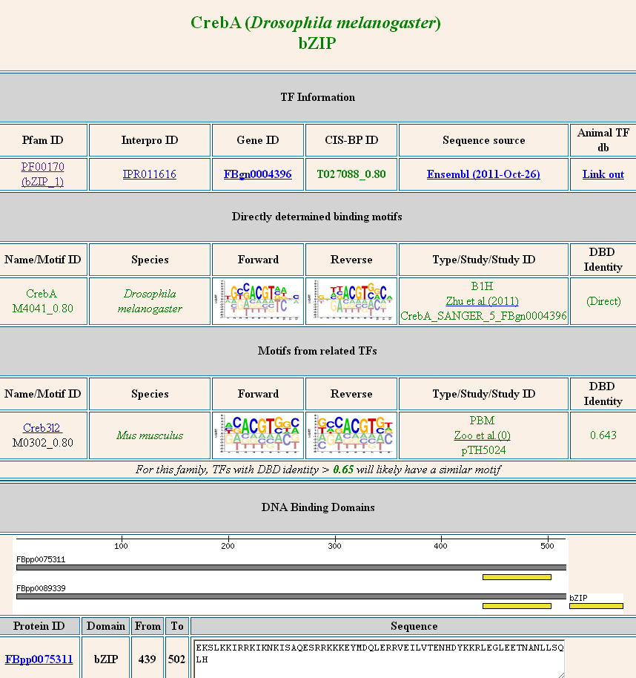

Slide 15
DNA-shape features for binding predictions
Iris Dror (Technion, Remo Rohs and Yael Mandel-Gutfreund): analysis of HT-SELEX data to infer DNA shape features for 105 TFs.
Oligos (that include the seed) are unbound at cycle 0, and bound at the last cycle.
Validated on open chromatin ChIP-seq peaks.
No comparison to 1/2/3-mer features.

Slide 16
TF flexible model
Anothony Mathelier (University of British Columbia): a more complex model for TF-DNA binding, which allows various lengths and dependencies.
Based on 1st-order Markov model.
Suggest new visualization and showed an advantage on ChIP-seq data (compared to PWM and dinucleotide PWM).

Slide 17
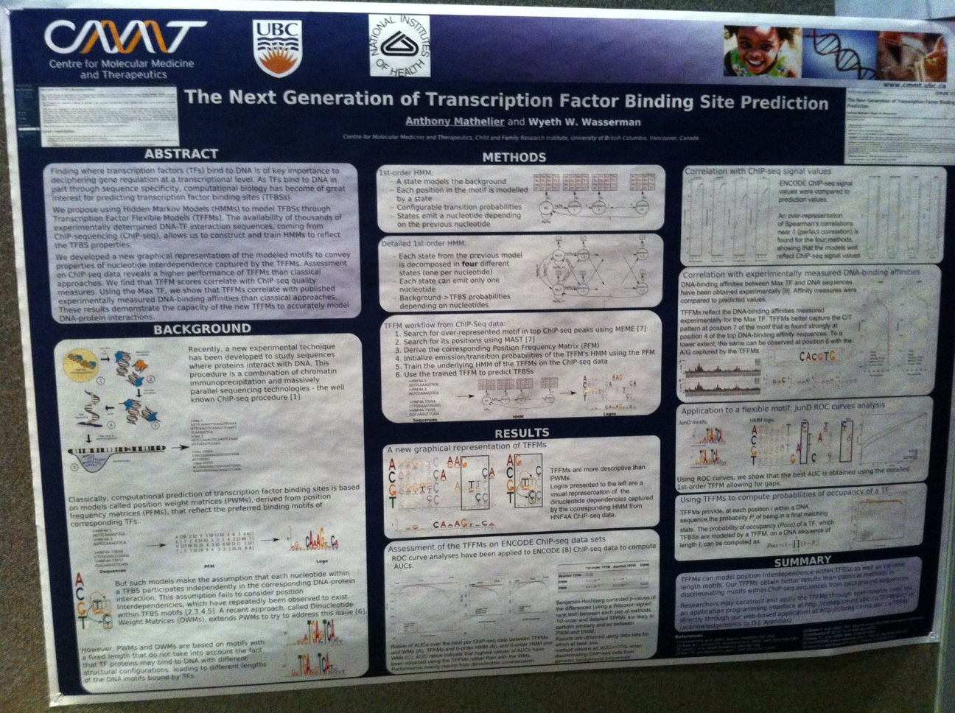

Slide 18
C. Elegans proteins
Sam Lambert (Tim Hughes lab): producing PBM experiments for C. elegans proteins.
Using these, identify promoter regions and sub-regions in it.
Validation of functionality by inserting yeast genomic segments into C. elegans’ genome.

Slide 20
Context-Genomic PBMs
Raluca Gordan (Duke university): finding binding preference that differentiate between proteins from the same TF family.
bHLH proteins: c-Myc and Mxi1 (CACGTG).
Example: c-Myc binds CCCACGTG, CACATG, AACGTG and CATGCG; Mxi1 binds GGCACGTG.

Slide 22
KEYNOTE

Slide 23
RNAcompete: new platform to measure RNA-binding proteins
Introduced: Nature Biotechnology, 2009.
~240,000 short RNA oligos (31-40bp); each 9-mer appears 16 times.
Bound oligos measured using a microarray.
Tested 207 proteins (recently, Nature, 2013).

Slide 24
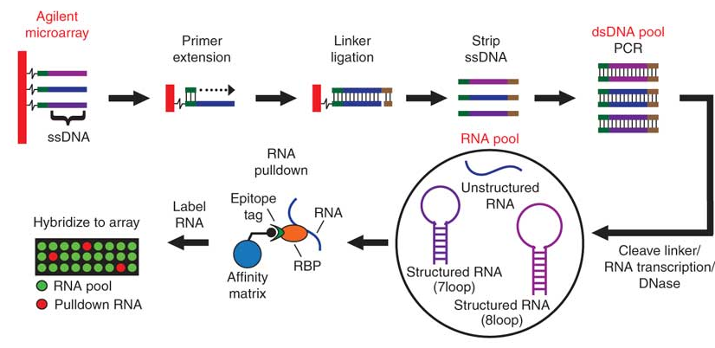
RNAcomepte overview

Slide 25
Array design
De Bruijn sequence to cover all 11-mers, split to 35bp long oligos = 167,773 probes.
RNAShape predicts free energies: 130,936 are strongly structured, and 36,837 are weakly.
Heuristically assured that each 9-mer appears at least 8 times in weakly structured probes (by swapping probe segments).

Slide 26
Array design – cont’d
Removed RNA probes that might interact with each other or cross-hybridize on the array.
Used MegaBLAST to identify matches and fixed by mutating positions (heuristically).
Set A and Set B each contained at least 8 copies of each 9-mer, 33 copies of each 8-mer and 155 copies of each 7-mer (~120K oligos).

Slide 27
Computational analysis
Computed Z- and E-scores for each 7-mer.
Enrichment score (modification of WMW):
B (F) = # oligos (not) containing the 8-mer
ρ_{B} = sum of their ranks

Slide 28
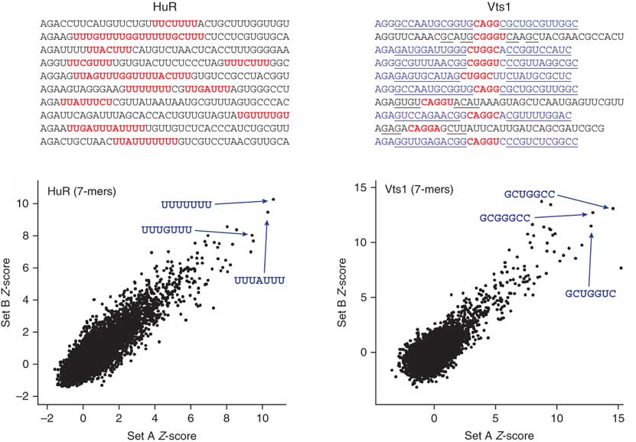
Example of two proteins

Slide 29
Motif inference
Used different tools: RANcontent, MALARKY, MEME, MatrixREDUCE, BEEML-PBM, Top 10 (motifs) 7-mer procedure.
Top 7-mer procedure:
Clustering the high-scoring 7-mers using affinity propagation.
Aligning the 7-mers in each group to produce a probability matrix.

Slide 30
Benchmarked on
Benchmark on:
Cross-validation between set A and set B.
Reproducibility between biological experiments.
Similarity to literature and same-amino motifs.
In vivo binding prediction (RIP-seq and CLIP-seq).
Top 10 7-mer procedure performed best.
Most proteins bind sequence; a few bind with preference to secondary structure.

Slide 31
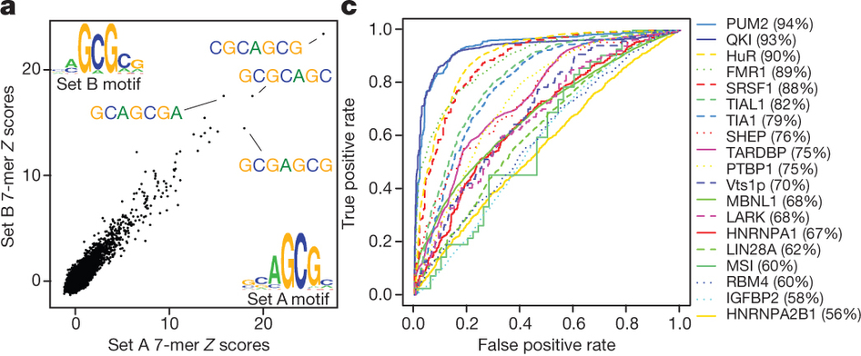
Representative data
(a) 7-mer Z scores and motifs for the two probe sets for ZC3H10.
(c) ROC curves showing discrimination of bound and unbound RNAs by the corresponding protein in vivo.

Slide 32
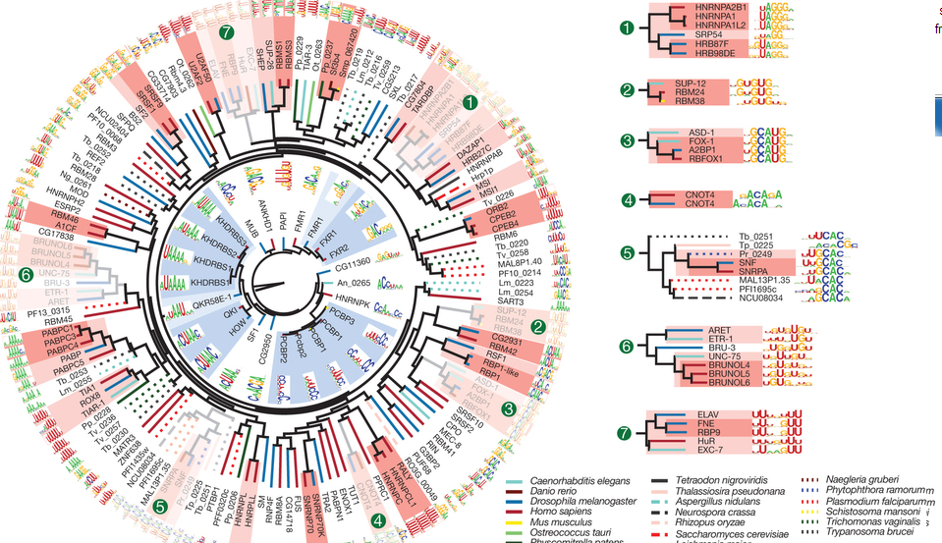
Clustering by amino acid similarity
Inner/outer cycles: KH, RRM (RNA binding domains).
Shading =
similarity
dark, 70%
light, 50%

Slide 33
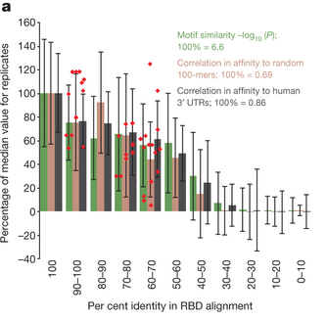
Motif similarity versus % amino acid sequence identity
All pairs.
Column = average
Error bars = standard deviation
Red points = for validation

Slide 34
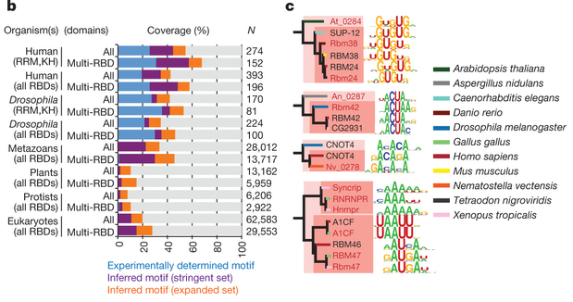
Protein coverage
(c) red text = validation motifs

Slide 35
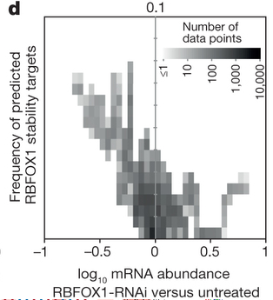
Functional analysis
Look for genes that hold:
(sequence) 3’ UTR contains RBP motif.
(expression) RBP is (anti-)correlated with target.
RBFOX1 positively regulates mRNA stability (validated by knockdown experiment – targets are collectively reduced).

Slide 36
RBFOX relation to autism
Reduced levels of RBFOX1 in the brains of individuals with autism have been associated with widespread changes in alternative splicing of exons associated with proximal RBFOX1 binding sites.
Genes encoding transcripts with predicted 3′ UTR binding sites for RBFOX1 that show decreases in mRNA levels in autism are significantly enriched for voltage-gated ion channels
Reduction of the stability of RBFOX1 targets may affect nervous-system-specific processes.

Slide 37
HT-SELEX for RNA binding proteins
Kate Cook (Tim Hughes lab): a single in vitro selection step using a random sequence pool, followed by deep sequencing.
Learn sequence and secondary structural features of RNA-binding proteins.
Identifies known false oligos; a more uniform nucleotide distribution than HT-SELEX.

Slide 39
Conclusions
Most advancements are at producing new data using high-throughput technologies.
The amounts of high-quality data are unprecedented.
The analysis is still behind, and there are a lot of questions that can now be answered.

