Slide 1
Space-efficient and exact de Bruijn graph representation based on a Bloom Filter
Roye Rozov
Shamir group meeting 3/7/13

Slide 2
Introduction
De novo assembly of large genomes is a memory intensive process – often requires >= 100 GB using standard tools (e.g., Velvet, SOAPdenovo)
Newer methods have been able to reduce this to about half (e.g. SGA requires ~50GB per human genome assembly), but this is still out of reach if a powerful server is not available
Minia, a new Bloom filter based assembler introduced here, reduces memory use by one more order of magnitude

Slide 3
R. Chikhi, 2013 “de novo assembly” presentation,
http://evomicsorg.wpengine.netdna-cdn.com/wp-content/uploads/2013/01/2013-evomics-assembly.pdf
Notes:
Biological events – viral/mitochondrial DNA, etc.

Slide 4
De Bruijn graph assembly
Nodes are kmer substrings, edges (k+1)mers formed by k-1 overlaps between nodes
Assembly attempts to find traversal covering all edges – often not unique due to cycles and ambiguous branch order
R. Chikhi, 2013 “de novo assembly” presentation,
http://evomicsorg.wpengine.netdna-cdn.com/wp-content/uploads/2013/01/2013-evomics-assembly.pdf

Slide 5
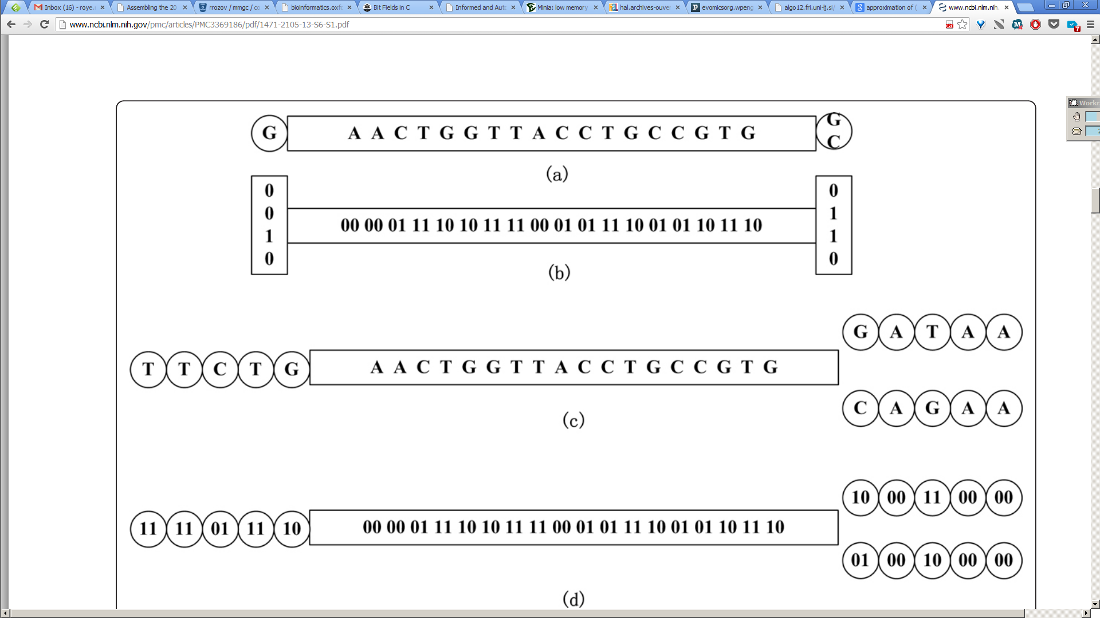
Memory efficient dBG methods – 1.Sparse Assembler
C. Ye et al, BMC Bioinformatics 2012
Notes:
draw overlap, write original cost, explain size calculation
Remember it’s 2g because in most cases only one extension on each side

Slide 6
2. Conway and Bromage 2011
R. Chikhi, WABI 2012 presentation
Sparse bitmap representation designed to store minimal information about each node
Designed to be close to self-information limit and efficiently queriable
Notes:
***If you list all combinations and then number the list to be able to identify contents, this is the cost of a number identifying a group***

Slide 7
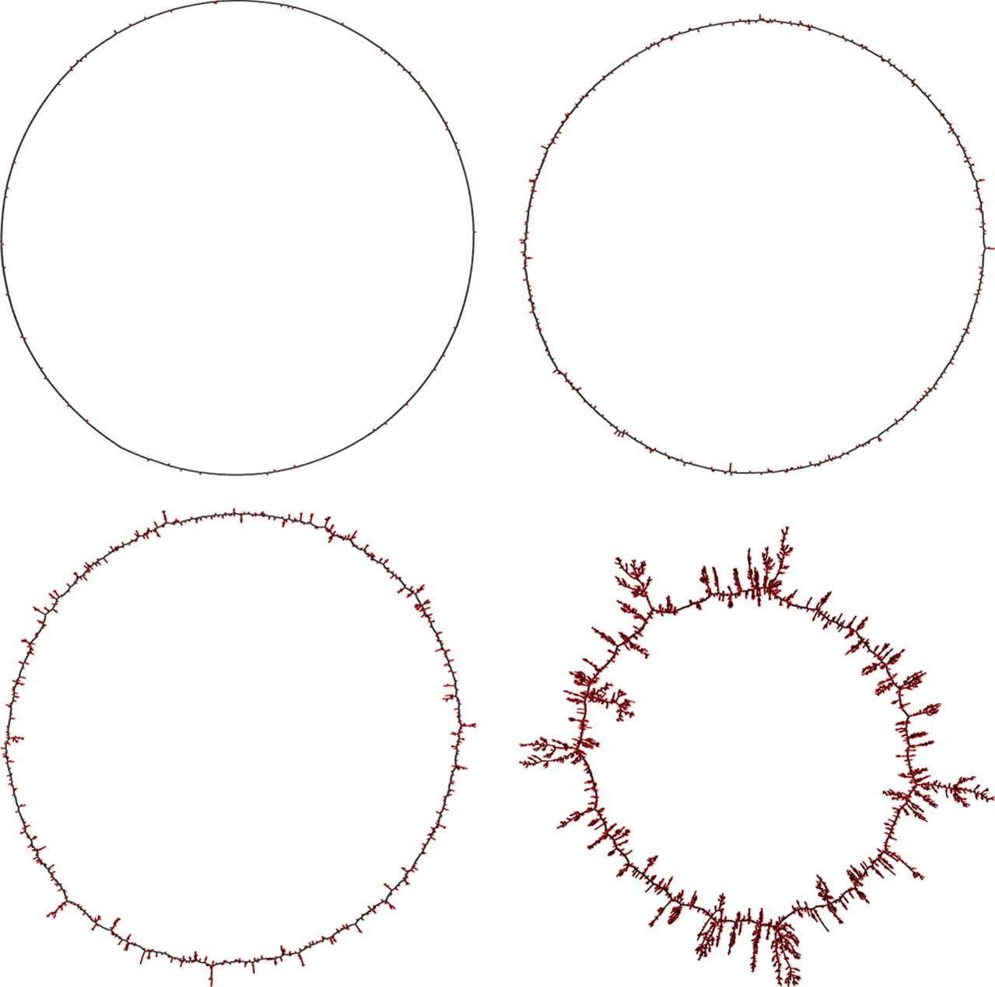
3. Pell et al.
Stored kmers in Bloom filter
Showed that global structure is maintained up to FP limit (~18%)
Used kmer traversal to partition kmers and then assemble components separately using conventional assembler (Abyss) with little RAM
Wikimedia Commons: “Bloom filter”
Notes:
Did not use Bloom filter for assembly – used to partition reads into smaller sets, which are then assembled using classical assembler

Slide 8
Minia - Main ideas
1) for any node, enumerate its neighbors using Bloom filter
2) sequentially enumerate all nodes using list on disk, use to construct cFP
3) limit memory use in assembly by using Bloom filter + cFP set to allow traversal,
4) mark visited complex nodes during traversal

Slide 9
Store only nodes
Hashed kmer nodes
Reads
Implied edges
ACG
CGT
GTT
ACA
CAT
ATA
CCG
GTA
.
.
.
ACGTT
k=3
query hash
ACATA
A
C
G
T
CCGTA
A|CG?
.
.
.
.

Slide 10
Allow enumeration of real neighbors
Bloom filter allows querying for neighbors
Maintain list of critical false positives to avoid false branching
List of all kmers stored on disk allows identifying cFP set

Slide 11
Traversal
Marking visited nodes needed for DFS/BFS traveral
Cannot mark anything on Bloom filter
Use additional hash to mark these, but only mark complex nodes – branch-points or tips
2k+8 cost per node, luckily there are few – 0.06 of all kmers stored in human genome assembly performed
C. Ye et al, BMC Bioinformatics 2012

Slide 12
cFP construction
S = set of true positive nodes (stored on disk)
E = set of all extensions of S
P (C E) = the set of all yes answers to extension queries on Bloom filter
Create P by querying all of S, writing to disk
Generate cFP by loading partitions of S to hash, removing elements of partition from P iteratively

Slide 13
Bloom filter parameters
h = number of hash functions applied
F = false positive rate
m = size of array
n = number of elements inserted
F ≈ (1 – e^{-h/r})^{h} , r = m/n (number of bits per element)
For the optimal number of hash functions, m ≈ 1.44log₂ (1/F)n
Notes:
F from prob bit set to one is 1 – (prob not set to one)^{kn}
Prob not set to one = 1 – 1/m (since each position equally likely)
F is prob of getting a “yes” by chance – k positions set to one =[ 1 – (prob not set to one)^{kn} ]^{k}
^{K} is same as h

Slide 14
cFP vs. Bloom filter size
More false positives with a smaller Bloom filter (in terms of bits per element)
E[|cFP|] = 8nF
BF + cFP total: 1.44n(log2(1/F) +16Fnk)
Minimum based on optimal number of hashes: n(1.44 log₂ (16k/2.08) + 2.08)

Slide 15
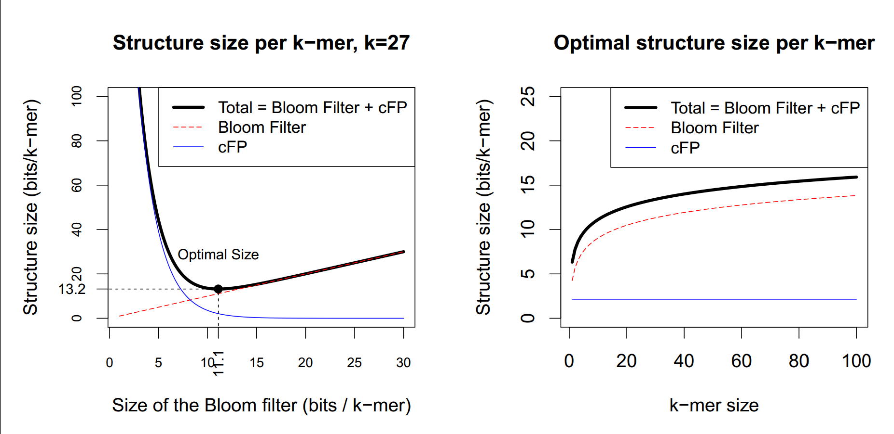
cFP vs. BF size

Slide 16
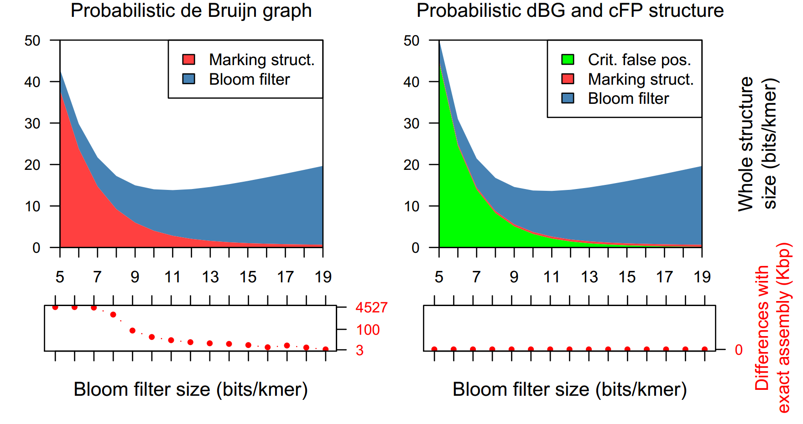
Results – with vs. without cFP
Notes:
Small e.coli data set 20 M reads, assemblies compared with reference
13.8 with cFP vs 13.6 without
Basically trade marking structure for cFP because many more nodes become complex without cFP, and each node is expensive
Benefit is much better agreement with reference assembly (after mapping contigs with MUMmer)

Slide 17
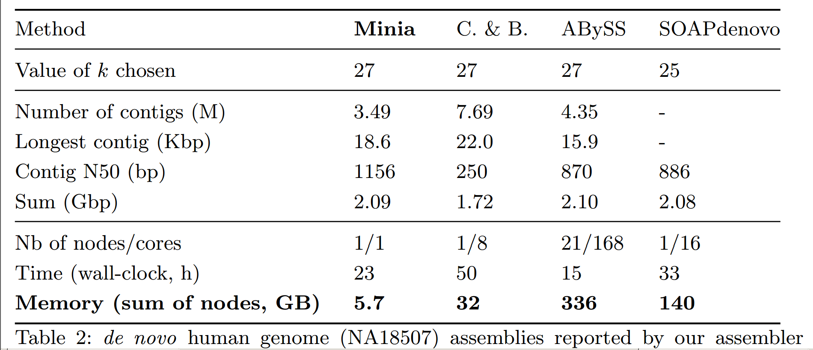
Human de novo assembly
Notes:
Aligned contigs after assembly, found high accuracy
Compared with sparseAssembler – much lower memory use, similar N50, time

Slide 18
Bounded depth bounded breadth localized traversal
R. Chikhi, 2013 “de novo assembly” presentation,
http://evomicsorg.wpengine.netdna-cdn.com/wp-content/uploads/2013/01/2013-evomics-assembly.pdf

