Slide 1
Multi – metagenome compression (MMGC*)
De Bruijn graph based reference free compression
Shamir group meeting, 6/3
*Tentative name – open to suggestions ☺

Slide 2
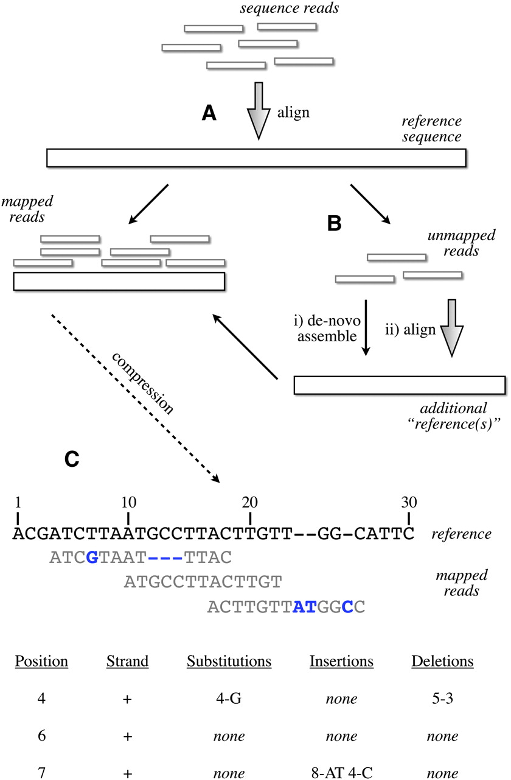
Schematic of the compression technique.
Hsi-Yang Fritz M et al. Genome Res. 2011;21:734-740
Copyright © 2011 by Cold Spring Harbor Laboratory Press
Notes:
Schematic of the compression technique. (A) Reads are first aligned to an established reference. (B) Unaligned reads are then pooled to create a specific “compression framework” for this data set. (C) The base pair information is then stored using specific offsets of reads on the reference, with substitutions, insertions, or deletions encoded in separate data structures.
-instead of storing l (~50-90) characters per read, we store one int for position and a few more chars to signify differences when they are present

Slide 3
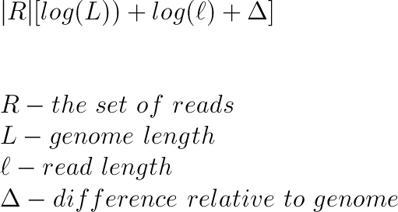
Reference-based compression (rbc) benchmark
Notes:
http://www.codecogs.com/latex/eqneditor.php
\\
|R|[ log (L)) + log(\ell) + \Delta]\\
\\
\\
R - the\ set\ of\ reads\\
L - genome\ length \\
\ell - read\ length \\
\Delta - difference\ relative\ to\ genome
Assume read length 100 – 8 bits/char
Go from R* 800 to R*[30 + 7 +2] =~ R*40 → 20* compression
Improvement with relative encoding of positions, different coding schemes of errors and positions

Slide 4
What are the options for lossless compression without a reference?
Use reference of related species
High error content due to differences may negate savings
Not always clear which reference to use
No guarantee close reference will be available
Sample may contain multiple species, as in metagenomics
Assemble reference genome
High time/memory demands currently
Once assembled, need to store reference as well

Slide 5
State of the art, quip
Jones, D. et al: Nucleic Acids Research 2012
Notes:
[not sure if this adds anything besides giving their result, maybe show a picture of assembly? Have one on the right side of first slide]
Performs rough assembly when no reference available
‘rough’ to keep memory use and CPU time low
Quotes 0.20 compression ratio (including names and quality scores); in our test, about 0.25 (for sequence alone) – equivalent to converting chars to bit encoding
Talk about SCALCE and BEETL as well

Slide 6
De Bruijn graph read compression - strategy
read kmers are nodes, k-1 overlaps between nodes are edges (k is a chosen parameter)
Try to keep graph small
Keep k low (~20)
Allow a single base error in building the graph (e.g., if one substitution in a read creates a read already added, don’t add its kmers)
Encode reads as paths on the graph
Encoding = start, end, & anchor points needed to specify unique path of given length

Slide 7
de Bruijn graph representation
Hashed kmer nodes
Reads
Implied edges
ACG
CGT
GTT
ACA
CAT
ATA
CCG
GTA
.
.
.
ACGTT
k=3
query hash
ACATA
A
C
G
T
CCGTA
A|CG?
.
.
.
.

Slide 8
Build-graph(R,k) // builds the de Bruijn graph from the read set G= Null For each read r in R if !(check-kmers(r,k,G)) add kmers of r to G return(G)
check-kmers(r,k,G) // boolean function; checks if all kmers of r up to one error are in G Xmin = 1; Xmax = L; // L is the length of the read for each kmer km of r check if km in G // (query hash of kmers) -O(1)
if km isn’t in G
let [y,y+k-1] be the indices spanned by km.
Xmin = max(Xmin,y);
Xmax = min (Xmax,y+k-1);
if Xmax < Xmin return(false); // okay if Xmax == Xmin for each position p in [Xmin,Xmax] do: for z in {A,G,C,T} do: (*) r_{zp} = replace position p of r with the value z.
for j=p-k+1 to j = p do: if the kmer on positions [j,j+k-1] of r_{zp} is not in G,
break // return to (*);
return (true); // if we got here that means that r_{zp} is good!!!
Notes:
O(Rk^2)

Slide 9
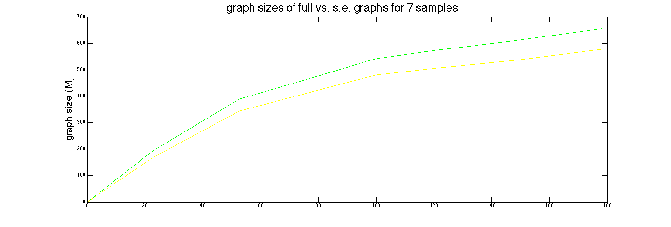
Single Error savings
Size trend, k = 15 on 7 samples
Varying k, proportion seems constant at 100M reads (4 samples)
 | Full graph size(M) | s.e. graph Size(M) | proportion
K=17 | 965 | 835 | 0.87
K=25 | 1195 | 1018 | 0.85
K=31 | 1245 | 1061 | 0.85
Notes:
Hard to run more samples on larger k – large memory requirements
-seg to diff hash issues

Slide 10
Hashing implementation tradeoffs
Open hash
Closed hash
Array of pointers to linked lists of key/value pairs
Collisions lead to additions at end of lists
High load factor leads to extra memory cost in list pointers
Array of pointers to key/value pairs
Collisions lead to iterated double hashing h(key) = h1(key) + i(h2(key)) mod (hash size)
Memory overhead to maintain empty slots for double hashing, time overhead for rehash of all elements

Slide 11
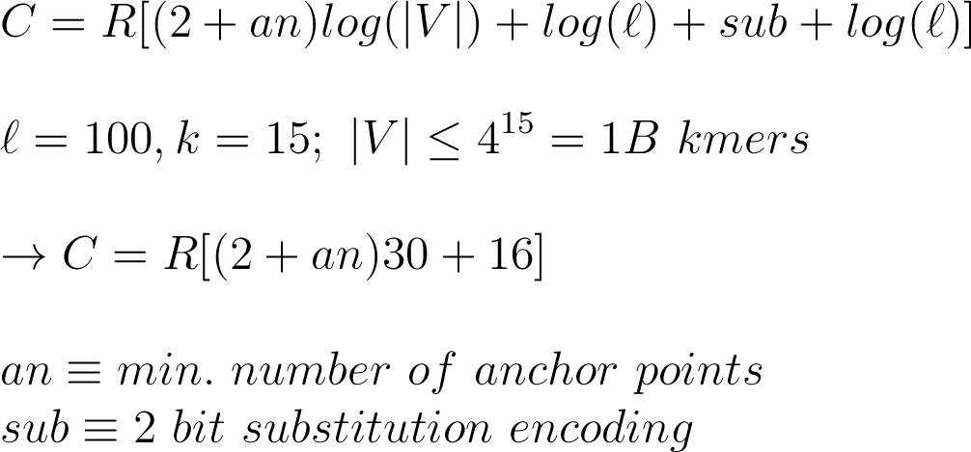
Encoding reads – start, end + anchors
Notes:
\\
C = R[(2+an)log(|V|) + log(\ell) + sub + log(\ell)]\\
\\
\ell = 100, k = 15;\ |V| \leq 4^{15} = 1B\ kmers \\
\\
\rightarrow C = R[(2+an)30+ 16 ]\\
\\
an \equiv min.\ number\ of\ anchor\ points\\
sub \equiv 2\ bit\ substitution\ encoding \\

Slide 12
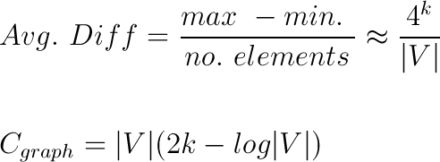
Encoding cost - graph
Naïve approach – 2k(|V|)
Better: sort kmers lexicographically, encode as integer differences
Notes:
\\
Avg.\ Diff = \frac{max\ - min.\ }{no.\ elements} \approx \frac{4^k}{|V|} \\
\\
\\
C_{graph} = |V|(2k - log|V|)
K = 15, |V| close to 4^k after a few samples → 2 or 3 bits to encode diffs b.c. log becomes irrelevent – need to consider smallest symbol sizes in Huffman or
Whatever encoding used → 10^9 *3/8 → few hundred MB
→ Larger k implies more expensive encoding

Slide 13
To determine anchors
we want the shortest unique path of length l
Search by BFS from start to end kmers, identify which of the read’s kmers are uniquely reachable from start at the correct distance [need picture here]
re-cast problem as shortest path on graph of all uniquely reachable nodes
Use dynamic programming to find minimum number of anchors [this needs to be explained better – draw small example?]

Slide 14
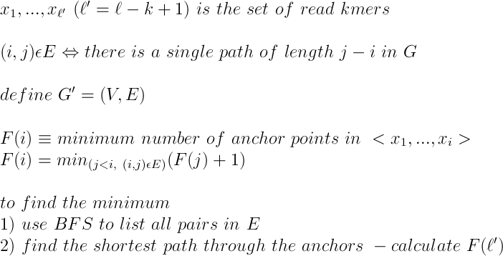
Notes:
\\
x_1, ..., x_{\ell'}\ (\ell' = \ell -k +1)\ is\ the\ set\ of\ read\ kmers\\
\\
(i,j)\epsilon E\Leftrightarrow there\ is\ a\ single\ path\ of\ length\ j-i\ in\ G \\
\\
define\ G' = (V,E)\\
\\
F(i) \equiv minimum\ number\ of\ anchor\ points\ in\ <x_1, ..., x_i> \\
F(i) = min_{(j < i,\ (i,j)\epsilon E) }(F(j)+1)\\
\\
to\ find\ the\ minimum\\
1)\ use\ BFS\ to\ list\ all\ pairs\ in\ E\\
2)\ find\ the\ shortest\ path\ through\ the\ anchors\ - calculate\ F(\ell')\\

Slide 15
Letting next BFS level max be 1M
 | Full graph an. | s.e. graph a.n.
K=17 | 2.09 | 1.96
K=25 | 0.53 | 0.31
Letting next BFS level max be 10k
 | Full graph an. | s.e. graph a.n.
K=17 | 2.79 | 2.60
K=25 | 0.77 | 0.46
K=31 | 0.25 | 0.14

Slide 16
Issues
Building graph is slow
Finding ‘an’ is slow
BFS search often encounters large connected components – need to lay anchors when size of next level > 10,000
Bigger problem: Need to find anchors to encode all reads
Large amount of memory needed during run

Slide 17
The ‘sweet spot’
Want to use lowest k possible to keep memory use and graph encoding cost low, and running time reasonable
If k is too low, many false positive edges (e.g., kmer extensions in graph not present in reads)
Simple case, imagine graph with all 4^k nodes – every possible extension is in graph, BFS will always be very slow
Not adding s.e. read kmers effectively reduces F.P. rate

Slide 18
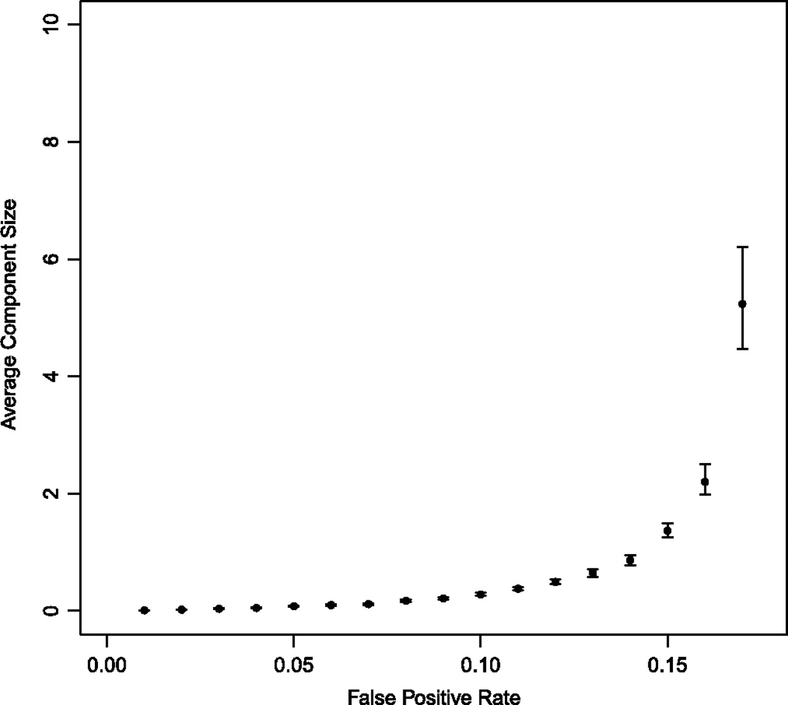
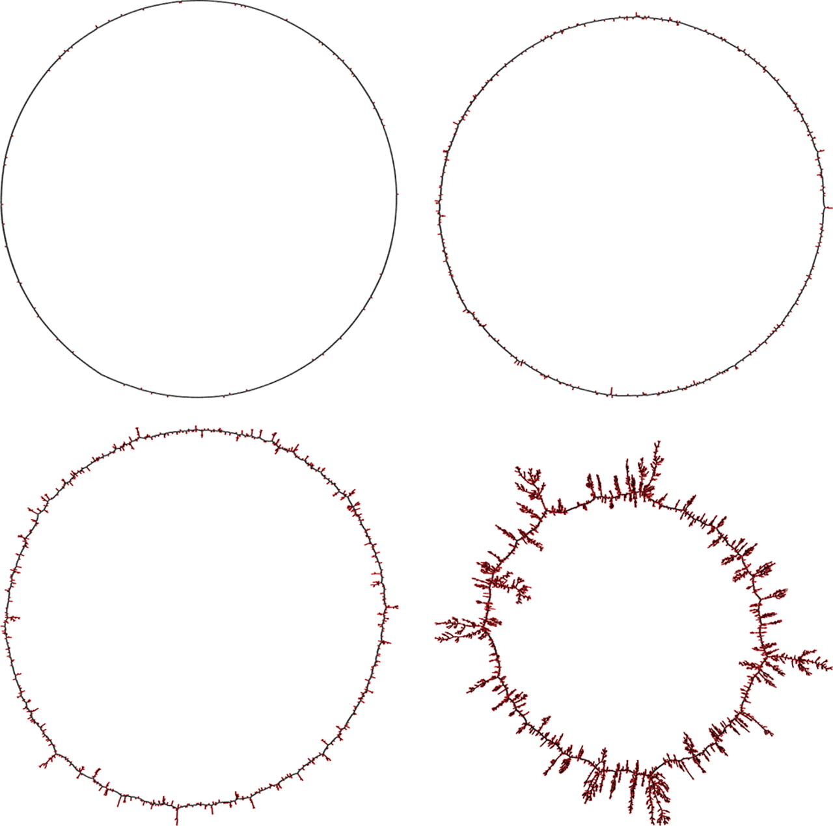
The ‘sweet spot’
Pell J et al. PNAS 2012;109:13272-13277
Notes:
Graph visualizations demonstrating the decreasing fidelity of graph structure with increasing false positive rate. Erroneous k-mers are colored red and k-mers corresponding to the original generated sequence (1,000 31-mers generated by a 1,031 bp circular chromosome) are black. From top left to bottom right, the false positive rates are 0.01, 0.05, 0.10, and 0.15. Shortcuts “across” the graph are not created.
Average component size versus false positive rate. The average component size sharply increases as the false positive rate approaches the percolation threshold.
*** explain what a bloom filter is, and how it leads to false positive nodes
*** they show independence of k for small k, but they use a very small genome
***the FP threshhold for which they say this happens is 0.18
Our graph size tends to 1-2B, if we want FP < 0.18, need 4^k > 10B → k > 17

Slide 19
Next steps
Encode/decode
Check accuracy, time, space on small number of reads, scale up
Estimate genome complexity of a given data set (without building full graph) to know sweet spot in advance

