Slide 1
Integrating human omics data to prioritize candidate genes
Yong Chen^{1, 2,3}, Xuebing Wu⁴, Fengzhu Sun^{1, 5}, Rui Jiang^{1,*}
1 MOE Key Laboratory of Bioinformatics and Bioinformatics Division, TNLIST/Department of Automation, Tsinghua University, Beijing, China
2 School of Sciences, University of Jinan, Jinan, Shandong, China
3 Institute of Biophysics, Chinese Academy of Sciences, Beijing, China
4 Computational and Systems Biology Program, Massachusetts Institute of Technology, USA
5 Molecular and Computational Biology Program, University of Southern California, USA

Slide 2
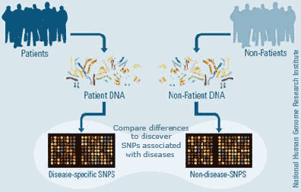
Introduction
Find association between gene and disease
Most phenotypes, even Mendelian cases, are not monogenetic
GWAS help in finding loci candidates for diseases

Slide 3
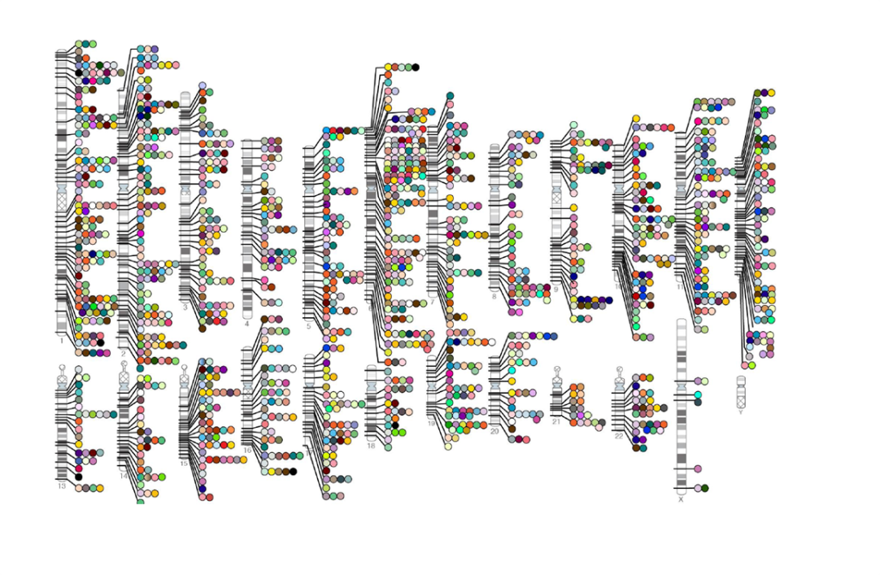
Introduction
However, GWAS are limited
Get the actual genes
Understanding molecular and functional causes
Example: ~1100 diseases in OMIM have some loci, but marked as “unknown molecular basis”
The solution: use other data!

Slide 4
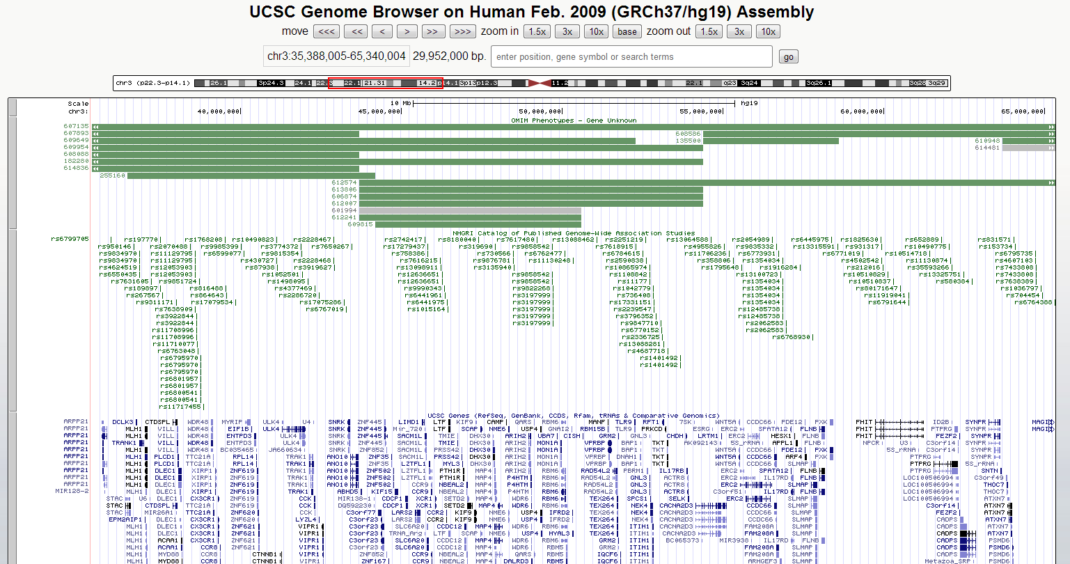
Example

Slide 5
Computational method types
Classification of methods (Piro and Di Cunto 2012):
Disease-centered: disease-specific. Starting point can be a set of known genes or pathways.
Undifferentiated approaches: scoring genes by their overall involvement in any disease phenotype
Disease-class-specific: designed to deal with a specific class of diseases. For example, metabolic disorders.
Generic methods

Slide 6
Paper Overview
Introduce a novel generic method
Algorithm overview:
Use known disease similarity scores
Use multiple data sources to calculate similarity of genes
For each gene estimate the association between disease similarity and gene similarity
Rank genes by the association scores

Slide 7
Method overview

Slide 8
Data
Disease similarity: previous method by van Driel 2006
Uses text mining of papers, MeSH, UMLS.
Gene similarity
Gene functional annotations (GO, KEGG)
Sequence features
PPI
Gene expression

Slide 9
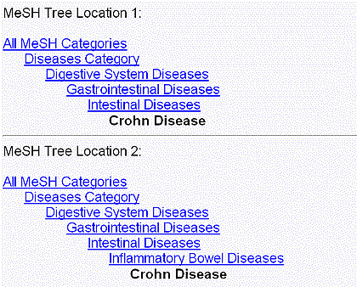
Disease similarity
Used the text analysis of van Driel 2006
5080 disease terms extracted from OMIM
Use NCBI MeSH anatomical and disease trees of concepts

Slide 10
OMIM-Mesh data
MeSH terms
#MeSH term appears in OMIM descriptions
OMIM disease
x
Calculate similarity
y

Slide 11
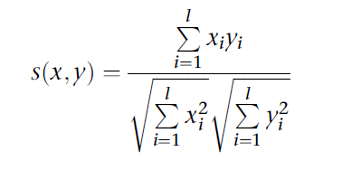
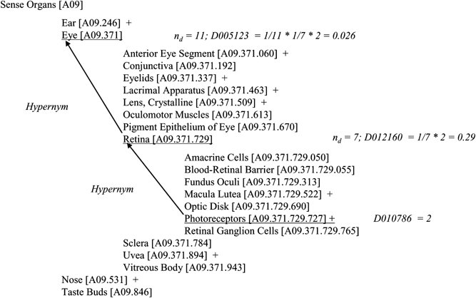
Disease similarity – van Driel 2006
Based on cosine similarity
Additional normalizations
The tree structure: the score of a term is its count + the average count of its direct descendants (recursion)
The frequency of OMIM terms

Slide 12
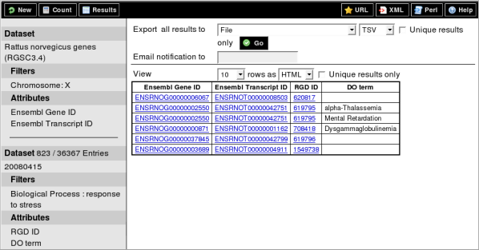
Known gene-disease associations
Used BioMart
1428 associations
1126 diseases
938 genes

Slide 13
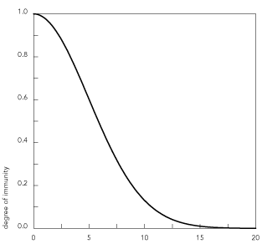
PPI similarity
Used HPRD (34,364 PPIs, 8919 proteins).
Calculate the shortest path of each gene pair p and p’ – Lpp’.
Use Gaussian kernel:
Sim(p,p’) = exp(-Lpp’)

Slide 14
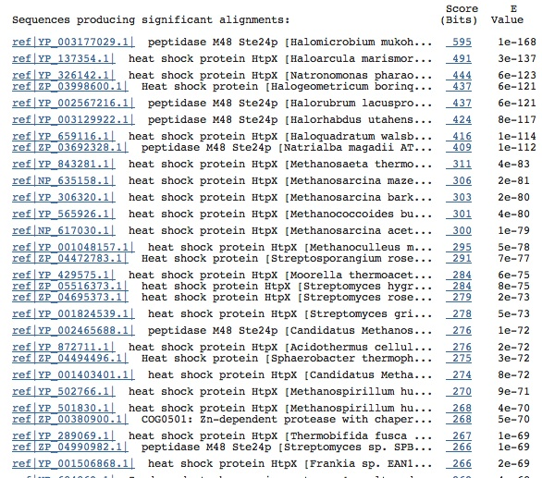
Sequence similarity
Run BlastP for each pair of genes (proteins).
Get the -log E-value: Epp’
Normalize the score to be between 0 and 1
Divide by the maximal score
If the E-value is zero, set the Sim(p,p’) to be 1.

Slide 15
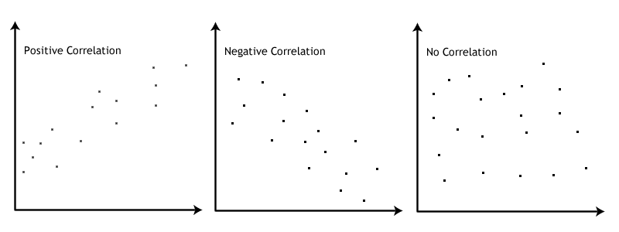
Gene expression similarity
Data of Su et al. (2004)
159 healthy profiles
Covering 79 tissues
Were samples merged?
Similarity score of genes: Pearson correlation of the profiles.

Slide 16
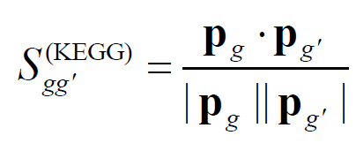
KEGG Pathway gene similarity
For each gene:
Create a binary vector of all pathways
Put 1 if the gene is related to the j’th pathway and 0 otherwise
Measure cosine similarity

Slide 17
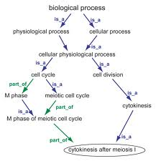
GO term association
Step 1: calculate GO terms associations
For a GO term t, define its “null” probability:

Slide 18
GO term association
Define the association of two terms:
Intuition: low level common ancestor -> low p -> high association

Slide 19
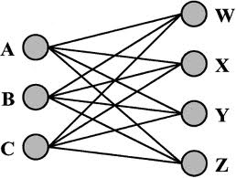
GO gene similarity
To get the similarity of two genes, average the similarity between their GO terms
Running max average

Slide 20
Paper Overview
Introduce a novel generic method
Algorithm overview:
Use known disease similarity scores
Use multiple data sources to calculate similarity of genes
For each gene estimate the association between disease similarity and gene similarity
Rank genes by the association scores

Slide 21
BRIDGE
We are interested in candidate genes for a disease d
We can measure similarity of d and another disease d’
Use this simple ability to score a candidate gene g’’

Slide 22
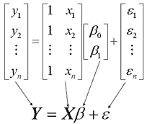
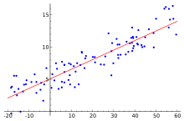
BRIDGE
Define a regression problem
Y = similarity of d and d’
Feature = one of the similarity scores. Measure similarity of g and the known disease genes G(d)
Use goodness-of-fit to score the gene

Slide 23
Regression formulation
Learn the contribution of the different gene datasets to the similarities of a query disease d
The ‘y’ labels: the known similarity of the query d and another disease d’
Intercept, need to estimate
G(d) = the known genes of disease d
(i) = one of the datasets of gene similarity – PPI, Sequence, GO , KEGG, expression

Slide 24
Regression formulation
To summarize:
Y – the similarity of d with other diseases
5 features
Each one measures the sum of similarities of the genes of d and d’

Slide 25
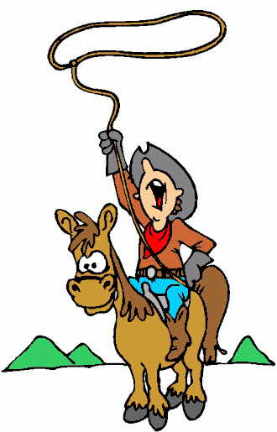
LASSO
Use LASSO for feature selection = add L1 regularization
Estimation of Lambda is done using a known method called GCV.

Slide 26
Where is the candidate gene?
From the text it is not clear where is the candidate gene g’’
Two options (in our opinion)
Add the candidate gene to G(d)
Set G(d) ={g’’}

Slide 27
Scoring a single gene
The following is given:
For each regression calculate the goodness-of-fit score
Where
R should be explained as a function of the candidate gene!

Slide 28
Validation methods
Use LOOCV – remove one known disease-gene association.
Rank the test set.
Three options for background:
Linkage analysis: all neighbor genes within 10MB of the tested gene
99 random controls
The whole genome

Slide 29
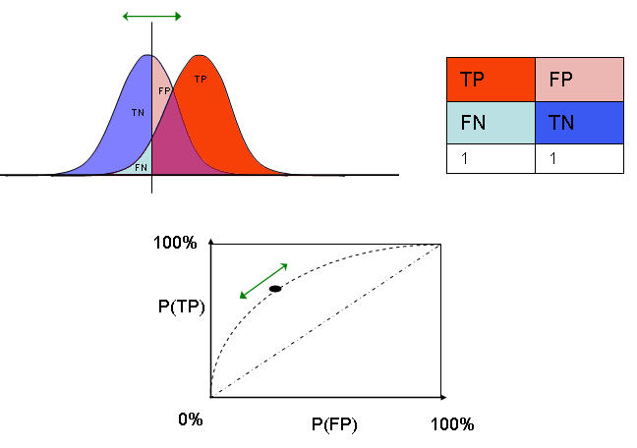
Performance measures 1
% of the tests that were ranked #1
Given a rank threshold calculate:
TPR – Sensitivity
% rank was better than the threshold
FPR – Specificity
% rank was worse than the threshold
Calculate ROC score

Slide 30
Performance measures 2
Define a threshold for R
Consider all scores above the threshold - U
Calculate precision and recall
Precision: % (detected real positives)
Recall: % (detected real positives in U)

Slide 31
Performance measures 3
Fold enrichment (Wu et al 2008)
“for a method that was able to rank test genes among the top m% against control genes in n% validation runs, the fold enrichment was n/m on average”
Well defined?
20 random samples from U(1,100):
m | n | %n/%m
1 | 0 | 0
20 | 5 | 1.25
40 | 11 | 1.375
60 | 13 | 1.083333

Slide 32
“ab initio” Performance measure
Predict associations of diseases ignoring G(d)
In the LOOCV when testing a gene-disease pair ignore all known associations with the disease
Use the same three background sets
Check if the known pair is among the top k genes

Slide 33
Remarks
No “negatives” in LOOCV
Probably hard to define
Background definitions are questionable but were used previously
Regarding the candidate gene problem it seems that the “ab initio” test is done by setting G(d) = {g’’}

Slide 34
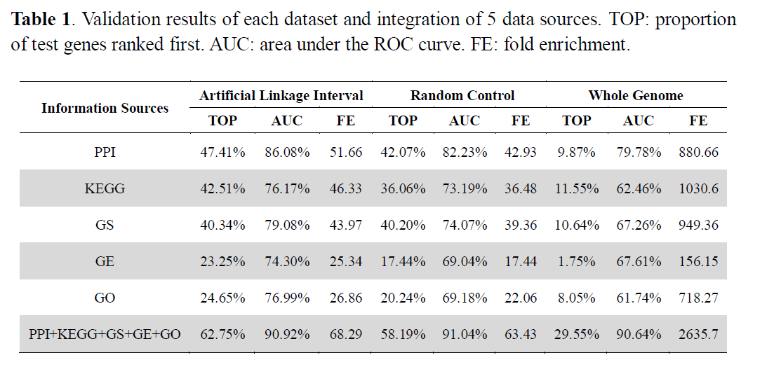
Results

Slide 35
Results: whole genome == all PPI genes
Use all 8919 PPI genes as BG
Standard LOOCV
29.55% of the tests were ranked #1
90.64% ROC
Ab initio:
28.22%
89.17% ROC

Slide 36
Comparison to CIPHER
Previous method of the same authors
Ratio between scores:
1.27
2.6
2.6

Slide 37
Comparison to Lage et al. 2008
Not fully explained.
Were the methods executed on the same datasets and tests ?
Is this linkage interval analysis?
Why did the authors use a threshold of 0.1 similar to that of Lage et al.?

Slide 38
Comparison to ENDEAVOR
EDEAVOR is an ensemble method that uses 12 data types.
It requires a relatively large set of known genes.
Comparison on 12 “complex diseases” that have at least 6 known genes:
ENDEAVOR: 61.8% precision
BRIDGE: 69.19%
Recall is not reported

Slide 39
“Biological” analysis

Slide 40
Clustering
Calculate all disease-gene scores
Ab initio
Apply 2-way hierarchical clustering
Analysis of the results
Disease clusters – manual
Gene clusters – GO enrichment (DAVID)

Slide 41
Cluster analysis

Slide 42
Test case 1 : obesity
Inspect the top 100 genes in the ab initio whole genome prediction.
8 out of 13 known genes are discovered and ranked in the top 50
28 genes are related according to DAVID and GeneCards
GO: fatty acid metabolic process, lipid metabolic process, cell communication
Genes related to many diseases and cancer types

Slide 43
Test case 2: Type 2 diabetes
13 out of 20 known genes are discovered
33 genes are related according to DAVID and GeneCards
DAVID enrichment analysis: insulin receptor signaling, carbohydrate metabolism.
The top ranked gene – RNF128 is annotated as related to type 1 diabetes (KEGG)
Is this a weakness?

Slide 44
Diabetes and Obesity
Studies show relation between the diseases.
In the top 100 obesity genes, 15 are related to diabetes.
In the top 100 diabetes genes, 9 are related to obesity.
The source of annotation and significance of the overlap is not given.

Slide 45
Transcriptional networks
Take the top 100 genes
Obesity and diabetes
Create a map linking TFs to predicted targets.
No TFs filtering
192 TFs for obesity, 182 TFs for diabetes
Gives an average of 7 TFs per gene
Is this biologically sound?

Slide 46
Diabetes example

Slide 48
Pros
Important problem
Integrative analysis, multiple data-sources
Feature selection
Relatively large number of genes
Bridge shows some improvement over extant methods

Slide 49
Cons
Poorly written
KEGG database introduces bias?
LASSO Lambda estimation?
Does BRIDGE promotes well studied genes?
Why only PPI genes?
Comparison of methods is not full
Clustering analysis seems forced

