Slide 1
A novel approach to combine expression data and protein-protein interaction networks and its application on Arabidopsis thaliana
REVIEW
Daniele Santoni¹, Aleksandra Swiercz^{2,3}, Agnieszka Żmieńko², Marta Kasprzak^{2,3}, Marek Blazewicz^{3,4}, Paola Bertolazzi¹ , and Giovanni Felici¹
1 Institute for Systems Analysis and Computer Science “Antonio Ruberti”, National Research Council of Italy, Viale Manzoni 30, 00185, Rome, Italy 2 Institute of Bioorganic Chemistry, Polish Academy of Sciences, ul. Noskowskiego 12/14, 61704 Poznan, Poland. 3 Institute of Computing Science, Poznan University of Technology, ul. Piotrowo 2, 60965 Poznan, Poland. 4 Poznan Supercomputing and Networking Center, ul. Noskowskiego 10, 61704 Poznan, Poland

Slide 2
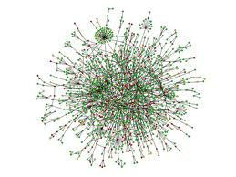
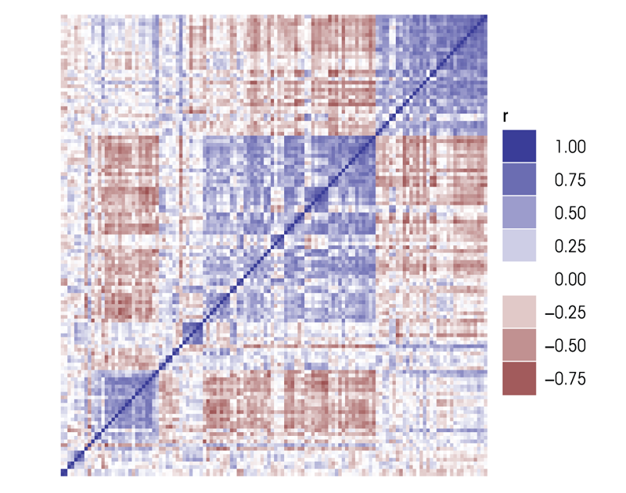
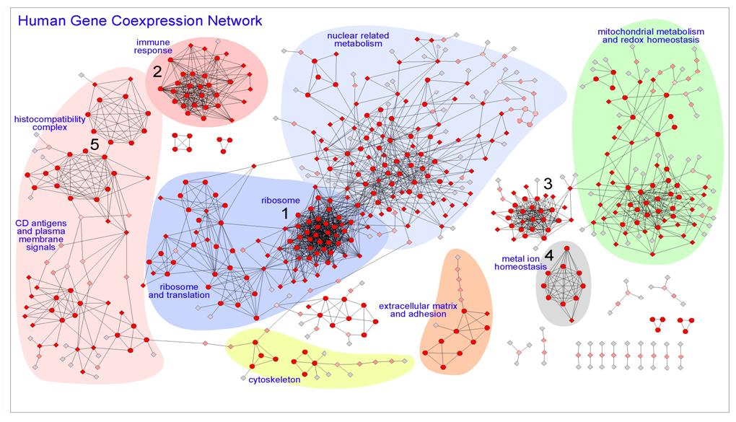
Joint analysis of PPI and expression
Graph 1: PPI
Graph 2: co-expression of genes

Slide 3
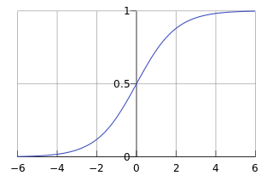
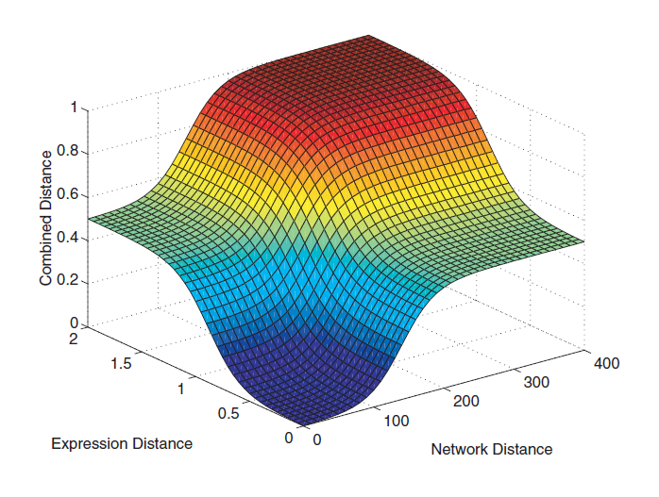
Co-clustering (Hanisch et al. 2002)
Step 1: calculate distances
Expression: 1-correlation
PPI: shortest paths
Step 2: integrate
Use sum of the sigmoidals
Smoothes “low” and “high” distances
Gives proper normalization
Equal contribution
Step 3: cluster

Slide 4
Co-clustering
Distance of two genes o_{i} and o_{j}:
control the shape and slope:
Set the slope to 0.5
Set the shape heuristically to get similar plots for each distance

Slide 5
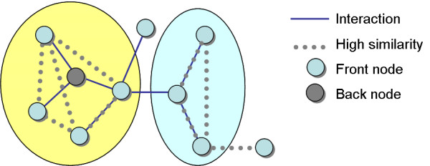
Mattise (Ulitsky and Shamir 2007)
Expression: high similarity
PPI: connectivity constraint
Beta parameter: the expected proportion of high correlations within clusters

Slide 6
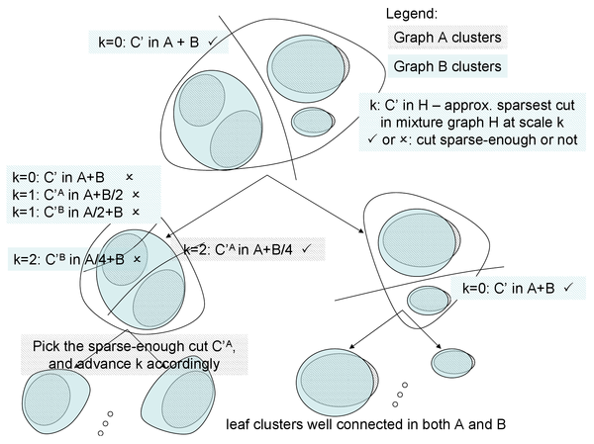
Joint cluster (Narayanan et al. 2010)
Repeatedly, Search for the best sparse cut

Slide 7
Joint cluster (Narayanan et al. 2010)
Use spectral theory to find cuts in each graph (approximation)
In graph mixtures (faster, heuristic)
Select the cut that is sparse enough in all graphs
Repeat until clusters are good enough

Slide 8
CLAIM: idea
Calculate distance matrix for each data
Cluster each data: multiple solutions
For each solution pair: consistency graph
V=genes, E=if genes are clustered together
Analyze consistency graphs
Create the consensus graphs
Level l
V=genes, E= edge appear in all consistency graphs except (l-1)
Find cliques

Slide 9
CLAIM: toy example
Cluster each data
Consistency graphs
Consensus graphs and cliques

Slide 10
Gene pair distance measures
Expression data
1-pearson correlation
PPI
Shortest path
Analyzed genes that are represented in both

Slide 11
Clustering
Integrate the distance matrices:
Run Kmeans on each distance matrix
K from 5 to 30 (increment of 5)
50 different seed start
Not specified how the best clustering is selected
M_{k} - the results on PCM only for a specific k
S_{k} - the results on SPM only for a specific k
Correlation only
PPI only

Slide 12
Clustering
Integrate the distance matrices:
This integration is meaningless without proper normalization of the scores
SPM is between 0 and 13
PCM is between 0 and 2
Distributions of the scores?
Correlation only
PPI only

Slide 13
Integrative analysis
Use M_{i} and S_{j} to construct a consensus graph G_{i,j}
Nodes: the genes
Edges: gene pairs that are clustered together in both solutions
Exclude the pairs (5,5),(5,10),(10,5)
They claim that when the number of clusters is large the co-clustering is more significant

Slide 14
CLAIM
We now have 33 consistency graphs
Define a graph H_{p} whose nodes are the genes
Add an edge if it appears in at least p of the G_{i,j} graphs
In each graph H_{p} look for the maximal cliques
Using the R package igraph
“Computing time of the clique algorithm is bounded by 2 hours on a PC desktop i5 dual core CPU with 8GB RAM running Linux Ubuntu 11.10”
Define the level of a clique as 34-p

Slide 15
Mattise analysis
Mattise looks for connectivity in the PPI
Clusters can be large and induce a sparse matrix of the PPI
Multiple runs
Maximal size between 3 and 34 (32 runs)
Matisse score was normalized by the number of edges

Slide 16
Enrichment analysis
Enrichment analysis
KEGG
Hyper geometric test
Significance: p<0.05 (no correction)
Cluster enrichment: the most significant enrichment

Slide 17
Function prediction
Score of a protein-pathway pair
A protein p is assigned to the pathway for which the score is above a threshold (ROC score)
Cliques that contain the protein p
The level of a clique
Cluster i
1 if p is in PT and 0 otherwise (LOOCV test)

Slide 18
Gene expression data
Arabidopsis time-series data
Salinity stress
0, 0.5h, 1h, 4h, 16h, 32h
Gene values normalized by time 0
Differential genes estimated using F-test
0.05 significance (no FDR?)
3,943 gene remain

Slide 19
PPI data
Arabidopsis Interactome map:
In the paper: 4,866 genes
11374 interactions (un-weighted)
“Paths of infinite lengths were removed by considering only the first connected component, whose resulting diameter was equal to 13”

Slide 20
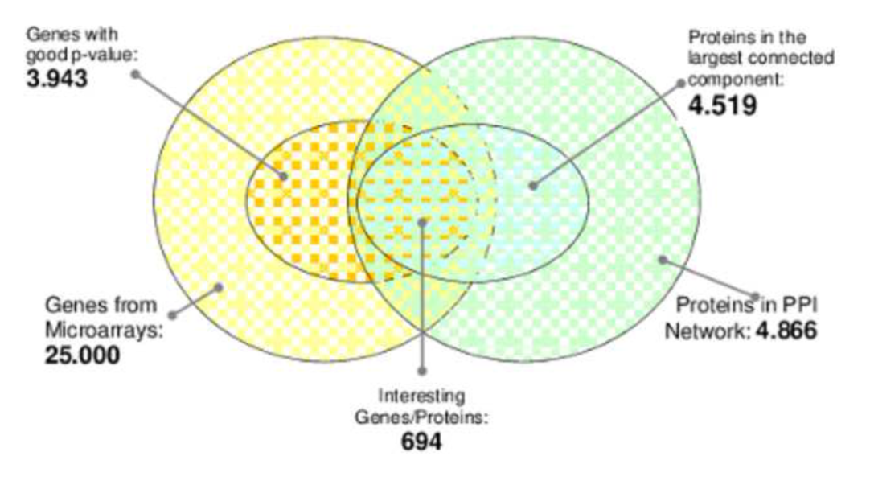
The analyzed data
Analyzed genes
Circles are not proportional to the real set size
The intersection is not necessarily more “interesting”

Slide 21
CLAIM cliques
A total of 4,563 cliques
2,372 contain at least one annotated gene
Where used in the enrichment test
564 cliques of level < 30
Min\Max size
Min - 3 (according to the results)
Max - 30

Slide 22
CLAIM on weighted graphs
In the text:
“These new distances were then used to extract alternative clusters sets using the same algorithm (k-means) as for CLAIM”
Used the CLAIM procedure on clustering of single weighted graph.
According to the results: CLAIM

Slide 23
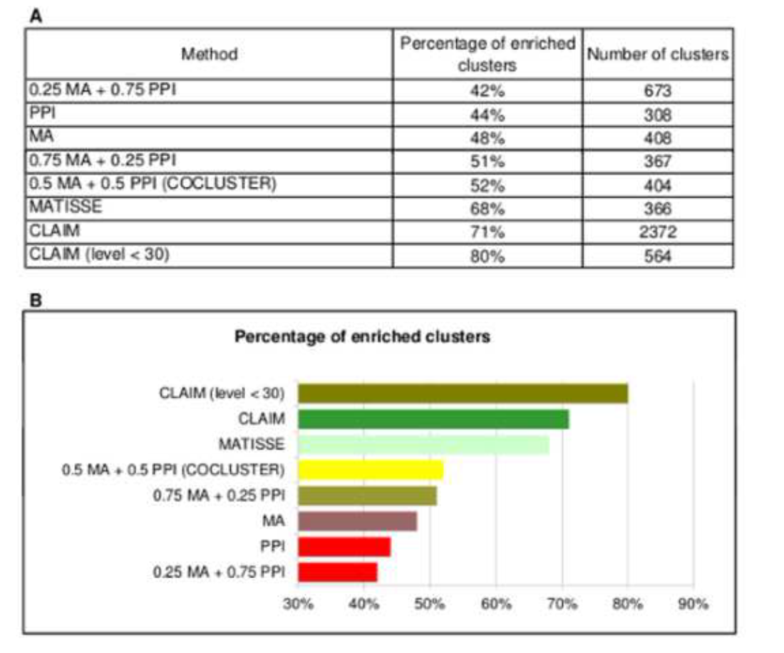
Enrichment results

Slide 24
Pathway prediction results
Mattise:
instead of 1/l_{i} use the normalized weight of the cluster.
Consider only clusters of size 3:30 (similar for CLAIM’s clusters)
They claim their Mattise variant is better than the original algorithm

Slide 25
Pathway prediction results

Slide 26
Major comments
Statistical tests must be corrected
Compare to more similar methods
Especially co-clustering
To assess the novelty and contribution:
Need more case tests. Preferably, with more genes
Or at least show the added value over similar methods when the number of genes is low

Slide 27
Minor comments
Interpretation: currently CLAIM outputs thousands of clusters
The “blind test” is not equivalent to LOOCV
A pathway protein p always affects its cluster
We expect a small difference
The graph integration process does not normalize the distances

Slide 28
Minor comments
Mattise should use the “large” PPI and not the one induced by the selected 700 genes
Not mentioned in the text
The authors should show a comparison to the default Mattise
How many connected components are 700 genes induce?

Slide 29
Minor comments
Excluding small Ks within CLAIM is not justified
There are only 700 genes
Separation\homogeneity of the solutions is not shown

