Slide 1
The Bi-Module problem: new algorithms and applications
Group meeting
January
2013
David Amar

Slide 2
Motivation: biological networks, regulation
Helps organize and understand the data
Can help in a variety of machine learning problems
Patient classification
Gene regulation
We have many networks, each can help understand a specific “concept”
Integrate networks

Slide 3
Example: differential coexpression
Differential correlation: the difference in co-expression of a gene pair between two classes.
In complex diseases, different regulatory factors may change the level of activity of group of genes.
Here we analyze co-expression networks
Node for a gene
Edge weight – correlation, DC
Undirected
Can be large
gene1
Control
Case
gene2

Slide 4
Recent advances
Single gene analysis (Lai et al. 2004)
CoXpress (Watson 2006)
find co-expression modules using one of the conditions (classes) in the data and then test if these modules show a different co-expression pattern in other classes.
GSCA
gene set co-expression analysis (Choi et al. 2009)
DiffCoEx (Tesson et al. 2010):
detection of gene modules that manifest a marked change in the correlation and module-to-module changes.

Slide 5
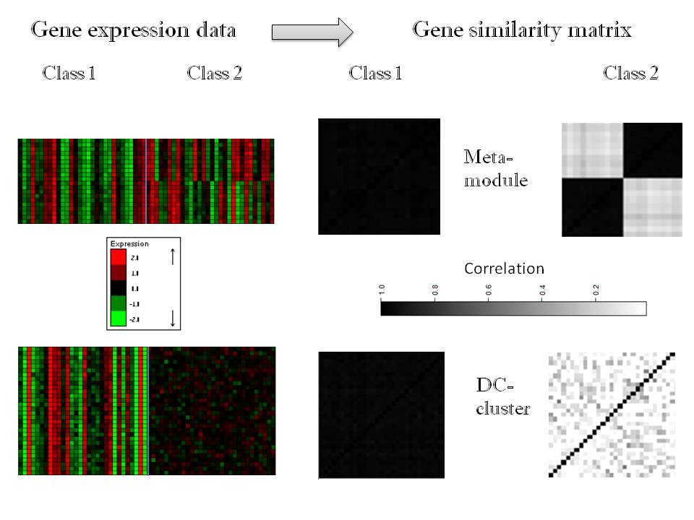
DC “global” patterns
Bi-Module
DC-cluster

Slide 6
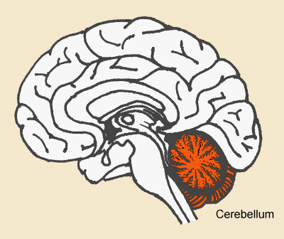
Cerebellum activity, 80 genes, p=3.7E-10
Un-annotated
Spliceosome (8.4E-3), miRNA preprocessing

Slide 7
DICER analysis flow
Main

Slide 8
DICER input graphs
We developed a statistical model to measure significance of DC.
The output of the statistical process three graphs on the same node set (genes)
Positive score: pair is significant
Up-DC
Down-DC
CG
“DC” graph

Slide 9
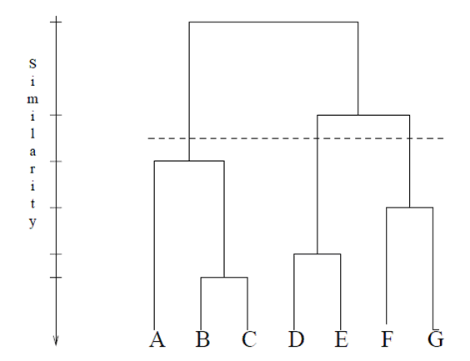
Searching for clusters
Cluster the DC graphs.
We used simple average linkage hierarchical clustering.

Slide 10
Simulated data
150 genes and 60 conditions divided into two classes of 30 conditions each.
In these data we planted a DC cluster of 30 genes and a 20-gene meta-module consisting of two 10-gene modules.
We added noise to the data

Slide 11
Simulated data

Slide 12
DICER results
Bi-module recovery was perfect.
DICER detected the planted cluster, but reported additional clusters:
The meta-module itself (with three additional genes)
Some other small clusters

Slide 13
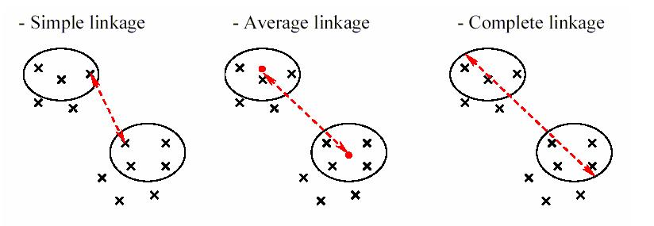
Improvement
Use complete hierarchical linkage instead of average linkage
In real data, as compared to average linkage:
Promoted homogeneity (“cliques”)
Clusters tend to be small
Results are now perfect

Slide 14
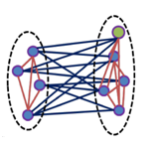
Bi-modules
A pair of gene modules
In each module: genes are correlated across all phenotypes
Genes that belong to different modules are differentially correlated.

Slide 15
Formal Definition
We are given two edge-weighted graphs G=(V,E) and G'=(V,E') with the same vertex set V.
A bi-module is two disjoint vertex sets S, T in V such that:
Sum of edge weights of S and T in G is positive.
Sum of weights between S and T is positive in G'.
Constraints
Find a bi-module of maximum cardinality .

Slide 16
DICER’s heuristic approach
Input: consistency correlations graph (CG) and DC graph.
Start with an edge (u,v) in the DC graph and define its neighborhood: all nodes connected with edges to u or v.
Discard nodes connected to u and v.
Remove “bad” genes, until the bi-module is “legal”:
Negative sum of DC scores with the other side
Negative sum of CG scores with the other side
Accept if the bi-module is “interesting”
C1 or C2 are not too small
Ratio between sizes is at least 1/4
C1
C2

Slide 17
A heuristic approach

Slide 18
Simple testing framework
We shall simulate the data
Discrete graphs
Add complete bi-modules
Add noise to graphs
“flip” edges randomly
Additional “noise”: add cliques and bicliques to both graphs.

Slide 19
Random graph discrete model
Let n be the size of the graph
Let p be the noise parameter
Let n1,n2 be the size range for module
Let mm be the number of bi-modules
Let m be the size of random cliques or bicliques
Edge weights: 1 or -1

Slide 20
Random graph discrete model
Let n be the size of the graph
1000
Let p be the noise parameter
0 to 0.2
Let n1,n2 be the size range for module
10-20
Let mm be the number of meta-modules
1 or 10
Let m be the size of random cliques or bicliques
15
Edge weights: 1 or -1

Slide 21
Scoring a pair
Agreement between a “real” bi-module (U1,V1) and (U2,V2)
U vs. U : 0.5(J(U1,U2) + J(V1,V2)))
U vs. V : 0.5(J(U1,V2) + J(V1,U2)))
Agreement score: Max(UvsU,UvsV)
Score is between 0 and 1
U1
V1
U1
V1
OR
U2
V2
U2
V2

Slide 22
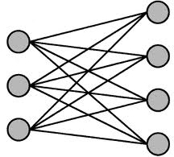
Scoring a solution
Y1
S1
Y2
S2
Y3
S3
Running max average Jaccard
Set1: S1,…,Sn
Set2:Y1,…,Ym
For each Si calculate the best score vs. Set2
For each Yi calculate the best score vs. Set1
Report the average
Y4

Slide 23
Performance?
1 MM
No random cliques and bicliques

Slide 24
How can we improve DICER?

Slide 25
DICER variant 1 – DICER*
Consider a simple variant of DICER:
While looking for seeds ignore small seeds
Module size at least 5

Slide 26
DICER variant 2: MBC-DICER
Look for complete bicliques in the DC graph
Use these as seed pairs for initial search
Start with small bicliques of the DC graph and unite\expand them

Slide 27
Technical details
We used the FP-MBC solver (Li et al. 2005, exhaustive search)
Outputs all maximal induced bicliques of minimal size >= k1,k2
Maximal induced biclique
A complete biclique
Cannot be extended

Slide 28
Technical details
Fast for sparse graphs
On PPI (>6000,>17000) – less than three minutes
Not efficient for noisy or non sparse graphs
Time
Memory

Slide 29
Use the solver
The solver can be very slow
We only need “good” start points
Solve (minSize,maxBics)
Set minimal size to (minSize,minSize)
kill if the number of bicliques exceeds maxBics
Return the bics

Slide 30
MBC-DICER: find seeds
findSeeds(G1,G2,minSize,maxNum)
Seeds= []
While new bics are discovered
Bics<-solve(size,maxNum)
For bic in sorted(Bics)
Remove all edges within the bic in G2
Bic<-Greedy remove nodes(bic)
Add bic to Seeds

Slide 31
DICER variant 3
We formalize the discrete complete bi-module problem as a MILP problem.
Assume the input graphs are undirected
Edge weights are 1 or zero
Output is one bi-module

Slide 32
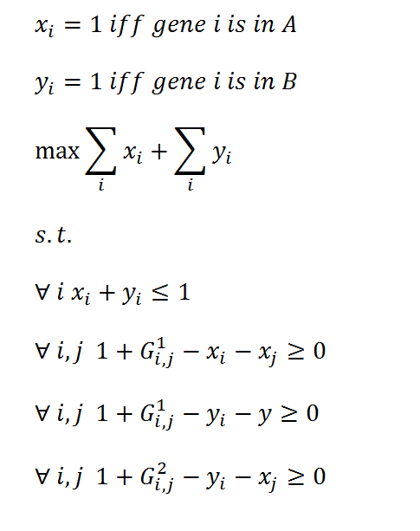
DICER variant 3
We formalize the discrete complete bi-module problem as a MILP problem.
Binary variables
Max cardinality
Gene i can get 1 for at most one set
If (A=1) and (B=1) => C=1

Slide 33
DICER variant 3
Too slow…

Slide 34
DICER variant 3
Other DICER variants needed less than 10 seconds on the same data.
We can also formalize the continuous problem as a MIP problem with quadratic constraints.
The constraints are not convex and cplex fails.

Slide 35
Discrete graph model
1 Bi-module
Average J

Slide 36
Discrete graph model
1 Bi-module
Running time

Slide 37
Discrete graph model
10 MMs
Add a clique and a biclique to each graph (i.e., non-meta-module patterns)

Slide 38
Running time example
10 MMs with non-MM cliques and bicliques
P=0.1

Slide 39
Lung cancer data
Healthy (n=97) vs. sick (n=90)
Top 3000 genes
DICER*, MBC-DICER: minimal size is 5
Accept all modules
Compare total coverage, miRNA enrichments

Slide 40
Lung cancer data
 | DICER | DICER* | MBC-DICER
Number of modules | 30 | 58 | 64
Maximal MM size | 152 | 146 | 155

Slide 41
Lung cancer data

Slide 42
Plans - outline
Understand how the start point affects the results.
Test on new random models
Use several larger datasets (increase n to 10000).
Other related biological questions
Genetic networks
MDN+PPI
Other related computational questions
The module-map problem

Slide 43
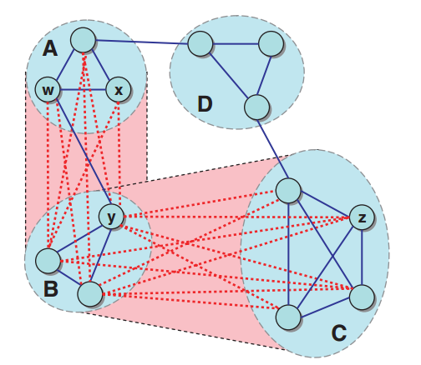
The module map detection problem
Instead of looking for specific bi-modules look for the best module map.
A module map contains:
A set of modules M1,…,Mn
A set of un-assigned singletons X
A set of module pairs – E1,…,Em
The goal is to maximize:
Sum of edges within modules in G1 plus
Sum of edges between module pairs in G2

Slide 44
PPI and genetic interactions data
GI: information of a double KO mutants
Bad pair: lower fitness
Neutral
Good pair: healthier than expected
Goal (Ulitsky et al. 2008)
Find a set of modules: bad mutations within, good between modules
Add PPI connectivity constraints.

Slide 45
Ulitsky et al. 2008
Greedy heuristic
Try to improve the solution by:
Add single nodes to modules
Merge modules
After merge\addition update the module-pairs list
Algorithm convergence depends on the start point
Use step 1 (no pairs) first and then run the algorithm

Slide 46
Global vs. local
DICER can be viewed as an algorithm for module-map detection
“Local” greedy approach – focus on local improvements of module-pairs
More constraints

Slide 47
Algorithms
Compare “local” hill climber and “global” hill climber
Starting point: single nodes, DICER seeds (different variants)
Compare on differential co-expression data
Compare on GI data

