Slide 2
Single Sample Expression-Anchored Mechanisms Predict Survival in Head and Neck Cancer Yang et al. 2012 Presented by Yves A. Lussier MD PhD The University of Chicago

Slide 3
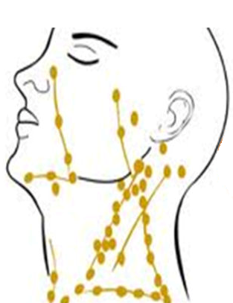
Head and Neck Squamous Cell cancer
A group of similar cancers
Spread to lymph nodes
Strongly related to environmental risk factors
Alcohol, smoking, UV lights, viruses
~40,000 new cases in the US per year
Hard to predict recurrence
Early detection is crucial

Slide 4
Computational goals
Use gene expression data for patient classification and recurrence survival
Improve interpretability of the classifiers by integrating pathway information
Keep classification performance high
Standardize across multi datasets

Slide 5
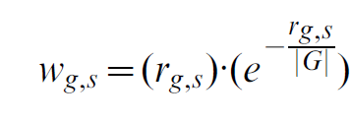
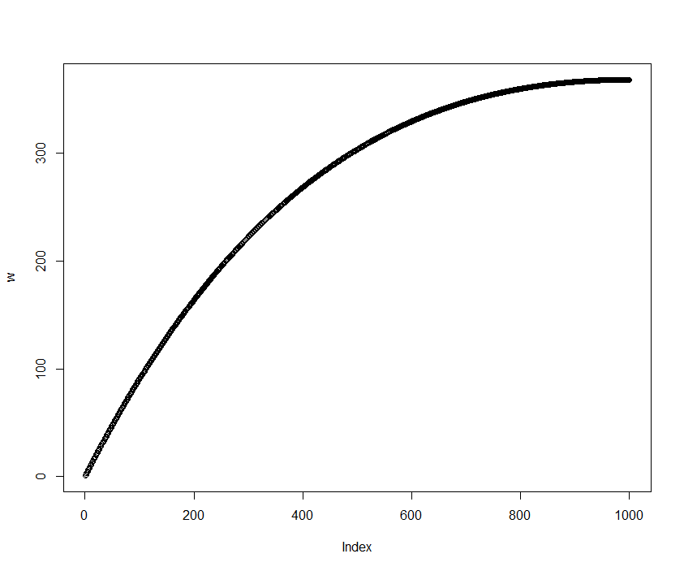
Sample analysis
Input: an expression profile of a sample
A vector of real values for each patient
Step 1: rank the genes
Step 2: calculate a score for each gene
Rank of gene g in sample s
Total number of ranked genes

Slide 6
Gene set features
Gene sets: GO terms or KEGG pathways
Define the normalized centroid (NC) of a gene set to be the average weights of the genes
Calculate the NC score for each gene set and its complement

Slide 7
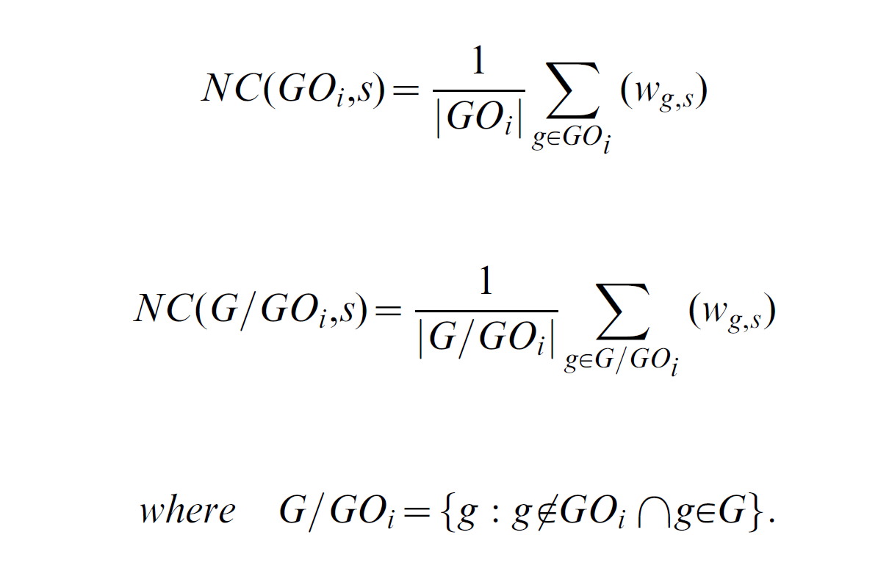
Gene set features
Calculate the NC score for each gene set and its complement

Slide 8
Gene set features
The score of a gene set is the difference between the two
Which results in the FAIME profile for each sample

Slide 9
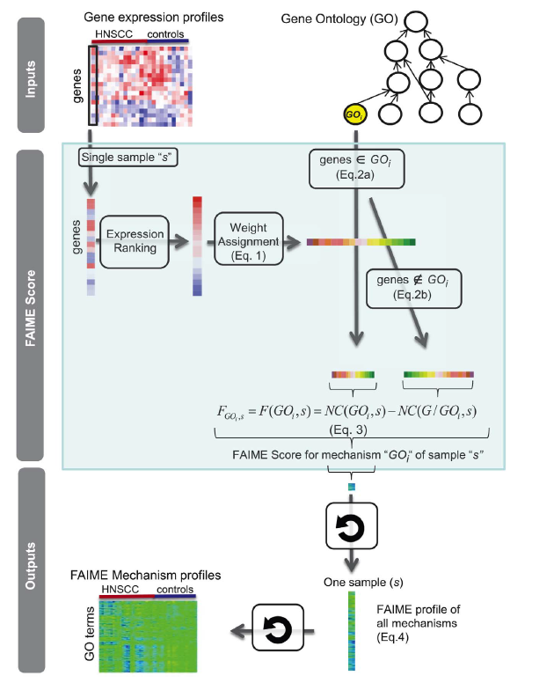
FAIME summary

Slide 10
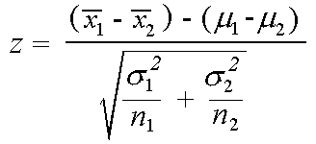
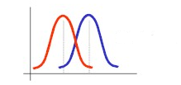
Differential pathways
Differential analysis for each pathway\GO feature
Healthy FAIME scores
Sick FAIME scores
Get empirical p-values by shuffling the labels (1000 repeats)

Slide 11
Analysis overview 1

Slide 12
Data used
8 GE HNSCC datasets
3 for training
5 for validation
Controls can be
Samples from an independent healthy individuals
Paired samples – sample from distant uninvolved site
Paired samples – samples from the margins of the tumor

Slide 13
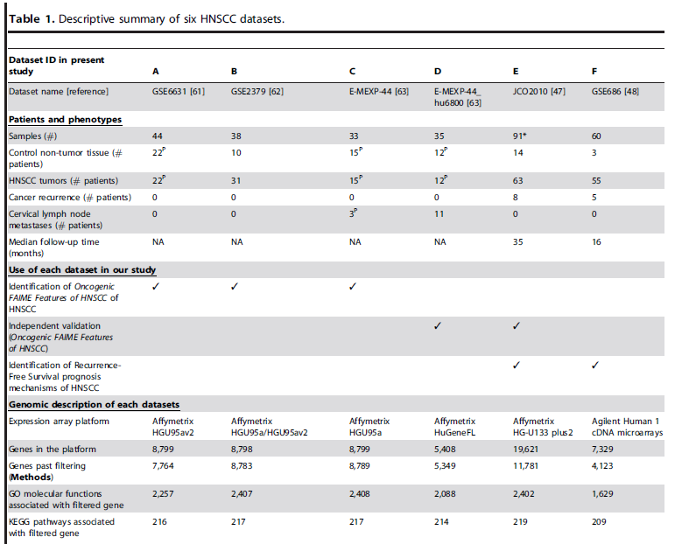
Data used

Slide 14
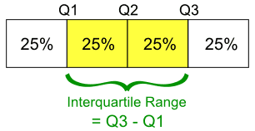
Preprocessing
Download raw data (cel files) from ArrayExpress
Use MAS5 to get the expression matrix
Probe -> genes
Keep the probe with the largest inter-quantile range
Remove genes with negative average expression across samples
Affy’s MAS5 implementation should produce non negative values
Comment: preprocessing is not sample based!

Slide 15
Data used

Slide 16
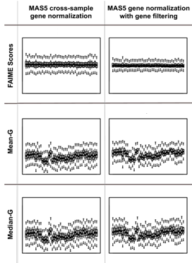
Stability of FAIME scores
Dataset A
22 HNSCC
22 independent controls
Boxplot for each sample
Values are pathway scores

Slide 17
Reproducibility tests
Compared methods
FAIME
Pathway p-value calculated using Z-scores
Hypergeometric enrichment analysis
Differential genes (from the original papers)
GSEA (actually, they used GSA)
CORG (Lee et al. 2008; Ideker lab)
Test the overlap after running the methods on datasets A-C

Slide 18
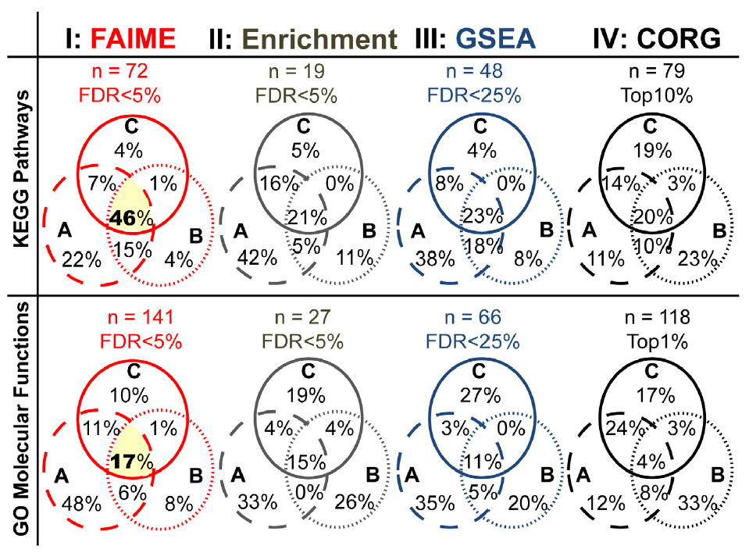
Reproducibility tests

Slide 19
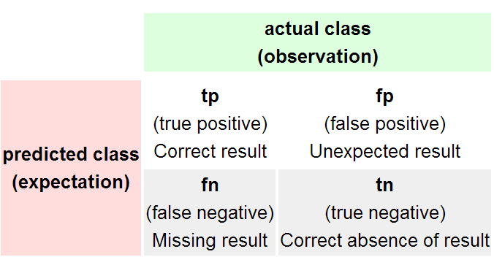
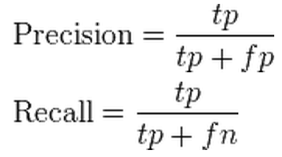
Reproducibility across methods
Goal: test if FAIME’s significant pathways cover the standard analysis
Idea: use the standard analysis (GSEA, or HG) as gold standard
Given FAIME’s pathways calculate precision-recall curves based on pathway sizes
For a threshold k calculate precision and recall considering pathways with > k genes

Slide 20
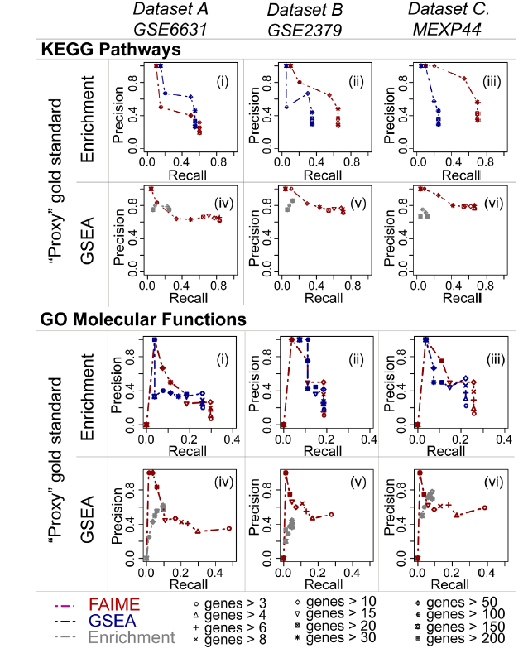
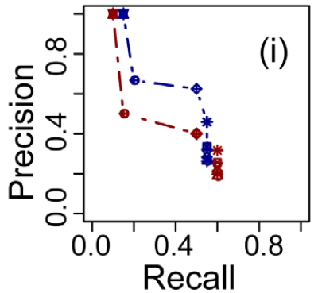
Reproducibility across methods

Slide 21
Validation on independent datasets
Use the pathways and GO terms that were stable in datasets A-C
57 features
Test their ability to classify new datasets
D: n=35; E:n=91
Classification: just cluster the samples to two groups (next slides)
Average linkage hierarchical clustering

Slide 22
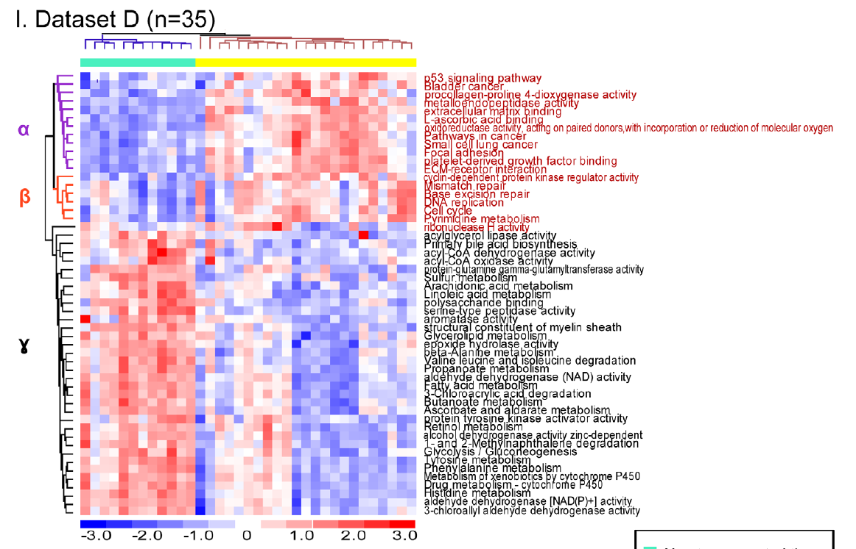
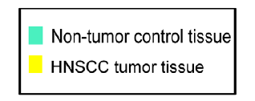
Validation on independent datasets
Extra-cellular events
Nuclear events, cell cycle
No Errors
Metabolism

Slide 23
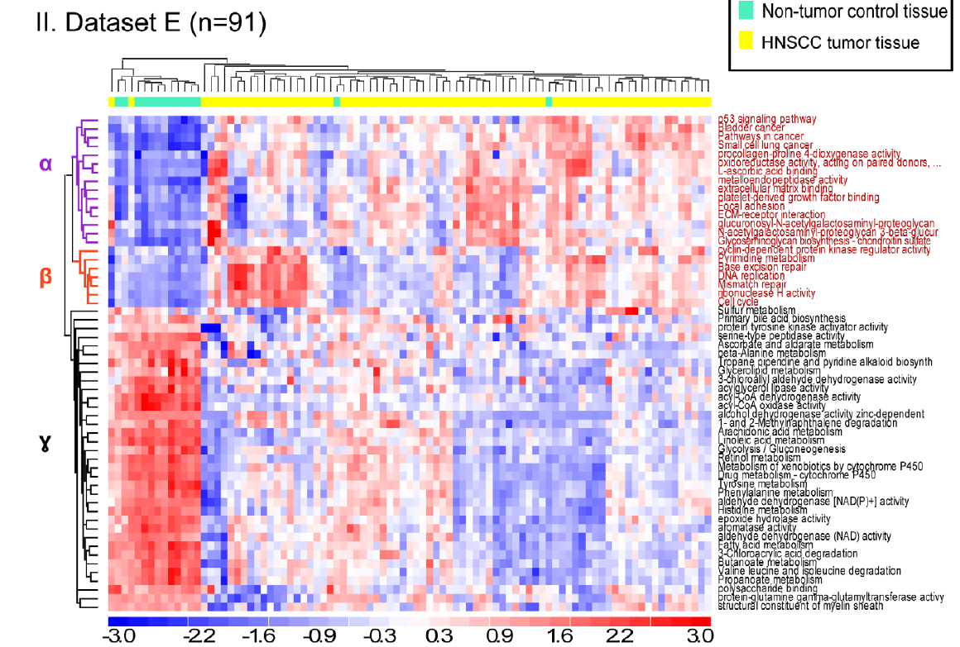
Validation on independent datasets
3 Errors

Slide 24
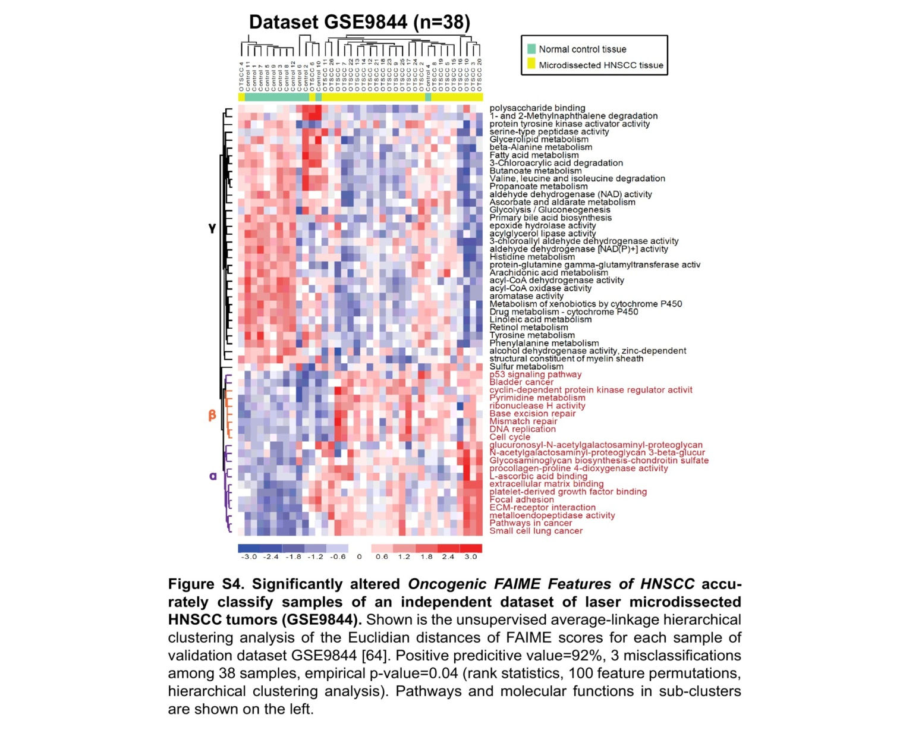
Additional dataset (supplement)
4 Errors

Slide 25
Survival analysis
For datasets E and F a follow-up study is given for the cancer patients
Cluster the HNSCC samples to two groups
Used the CLARA algorithm
Compare the sample clusters based on the survival data (recurrence free survival)

Slide 26
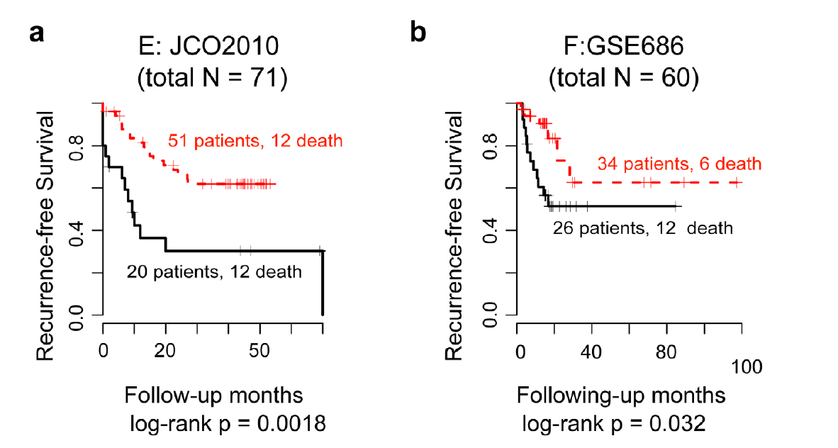
Survival analysis

Slide 27
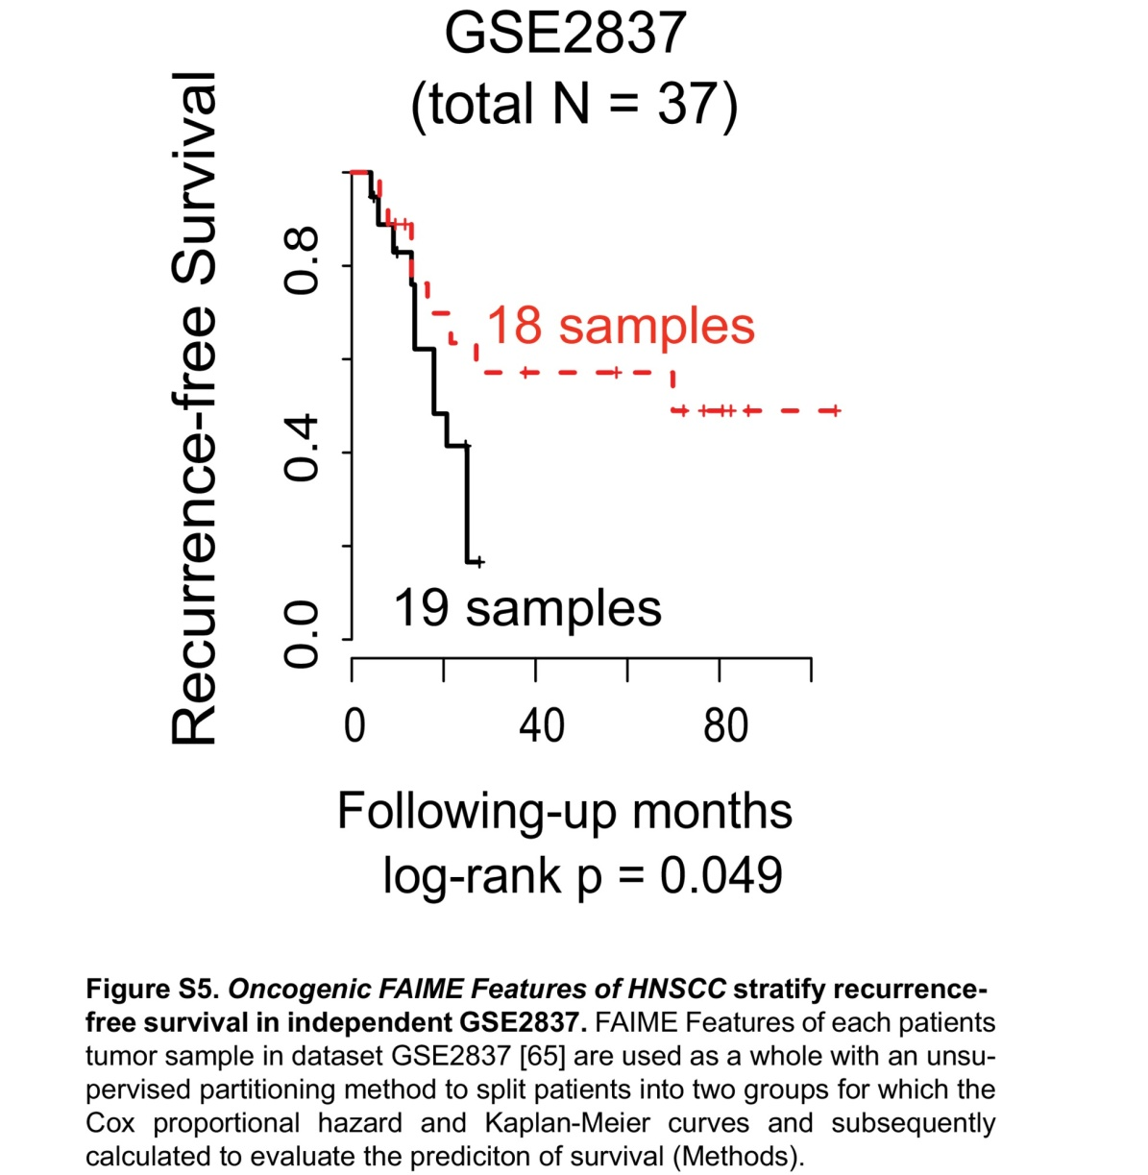
Additional dataset (supplement)

Slide 28
Survival analysis: comments
The same flow with GSEA or Mean-G: survival plots are not significant (p>0.07)
In the publication of dataset E another HNSCC specific clinical test (called HPV) did not produce significant separation.

Slide 29
Prostate cancer (Chen et al. 2013, BMC Medical Genomics)
Analyzed three case-control datasets
Validation: survival analysis on an independent dataset

Slide 30
FAIME scores
Re-scale FAIME scores (not justified):

Slide 31
Tested gene sets
Gene ontology
~4000 terms
Cancer modules (Segal et al. 2004)
~2000 samples covering 22 tumor types
Cluster to 454 modules

Slide 32
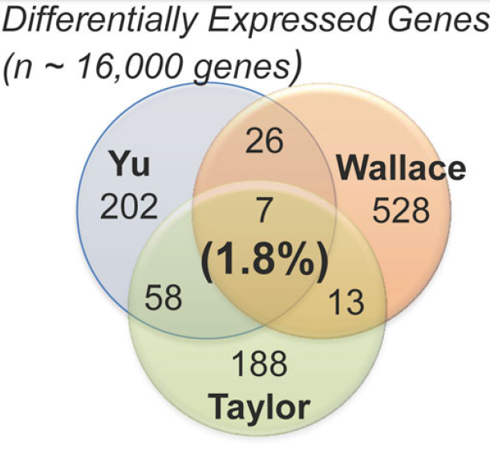
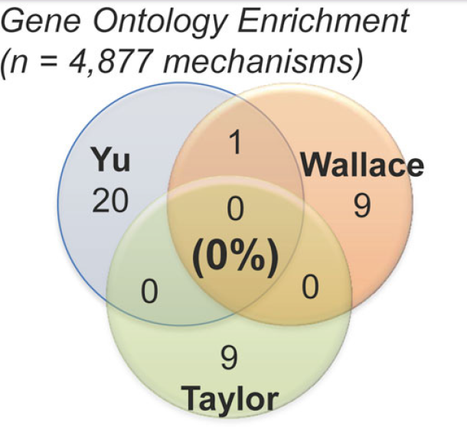
Reproducibility
GO
CM
FAIME

Slide 33
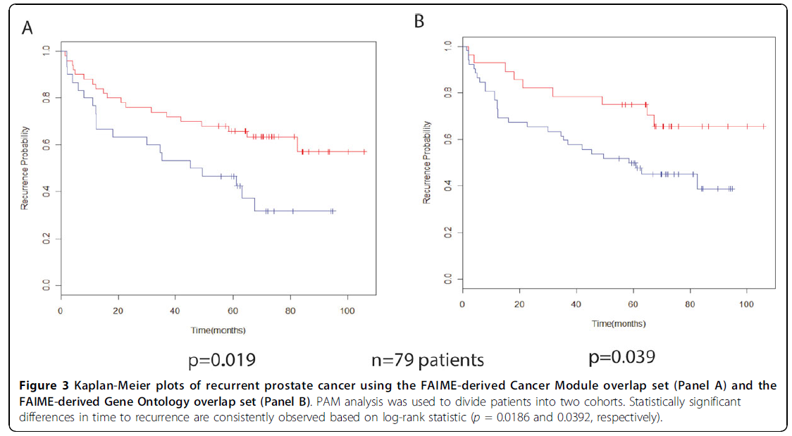
Survival analysis
Recurrence: if PSA (prostate cancer blood biomarker) is present – suggesting bad prognosis

Slide 34
Relevant to us?
Ranking based analysis can help in integration of different datasets
Pathway level scores provide standardized set of features across datasets
The FAIME score can be improved
The idea of using case control studies for survival analysis on independent data is a strong validation scheme

