Slide 1
Integrating expression and pathway databases for revealing disease biomarkers
Didi Amar and Tom Hait
Group meeting
October 2013

Slide 2
Motivation
Study expression profiles of many diseases and healthy controls
Unlike standard case-control studies we have many negative controls
Use thousands of expression profiles
Requires integration of many technologies
Utilize pathway information
Better interpretability
Better classification (?)

Slide 3
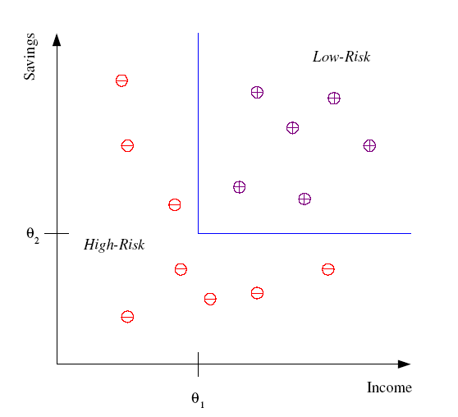
Background – classification
Example: Credit scoring
Differentiating between low-risk and high-risk customers from their income and savings
Output: class assignment or probabilities
Discriminant: IF income > θ₁ AND savings > θ₂
THEN low-risk ELSE high-risk

Slide 4
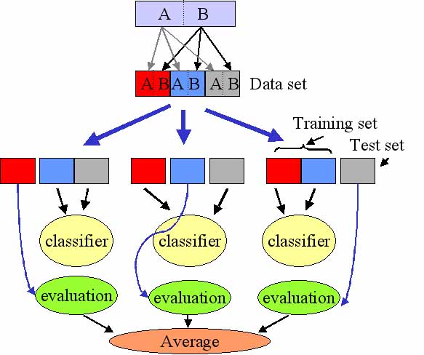
Performance measures
Use cross-validation
Measure performance:
Accuracy
ROC score
Precision
Recall
F-measure
AUPR
…

Slide 5
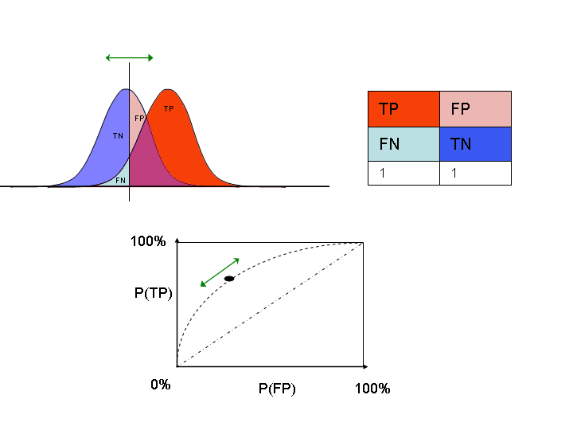
Weighted and non-symmetric
ROC score idea:
Given two classes A and B
Rank all samples according to predicted probability for assignment to class A
Ask if the samples of A tend to get high ranks
P(A)
Multiclass: calculate the ROC of each class and report the weighted average

Slide 6
Huang et al. PNAS 2010
Analyzed 110 datasets
Each dataset was automatically assigned to a disease term
For each dataset a profile was calculated
Used two affymetrix platforms:133A, 133A Plus 2
~8500 shared genes
Each sample was analyzed vs. the controls of the dataset
Log of rank ratio of each gene
Nice classification performance: 82% precision at 0.2 recall

Slide 7
Huang et al. PNAS 2010
Pitfalls:
Only two platforms
No single sample analysis
Several datasets were removed from GEO
Probably due to statistical problems in the data
No “healthy” class
Interpretability

Slide 8
Single sample pathway analysis (Yang et al. 2012,2013)
Limited integration of datasets
Used gene expression data for patient classification and recurrence survival
Improve interpretability of the classifiers by integrating pathway information
Keep classification performance high
Standardize across multi datasets

Slide 9
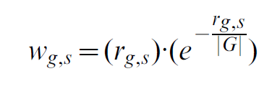
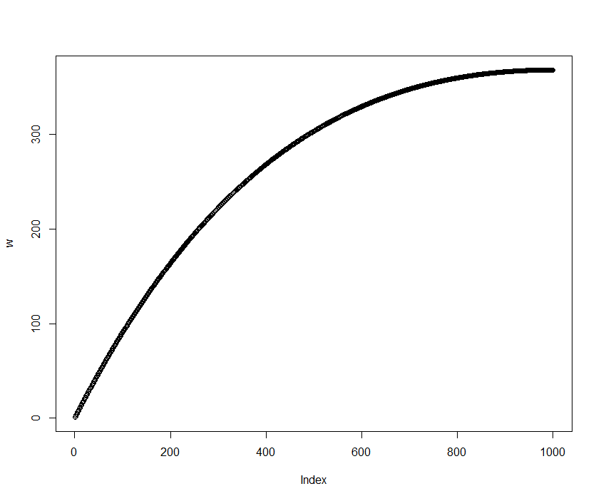
Sample analysis
Input: an expression profile of a sample
A vector of real values for each patient
Step 1: rank the genes
Step 2: calculate a score for each gene
Rank of gene g in sample s
Total number of ranked genes

Slide 10
Gene set features
Gene sets: GO terms or KEGG pathways
Define the normalized centroid (NC) of a gene set to be the average weights of the genes
Calculate the NC score for each gene set and its complement

Slide 11
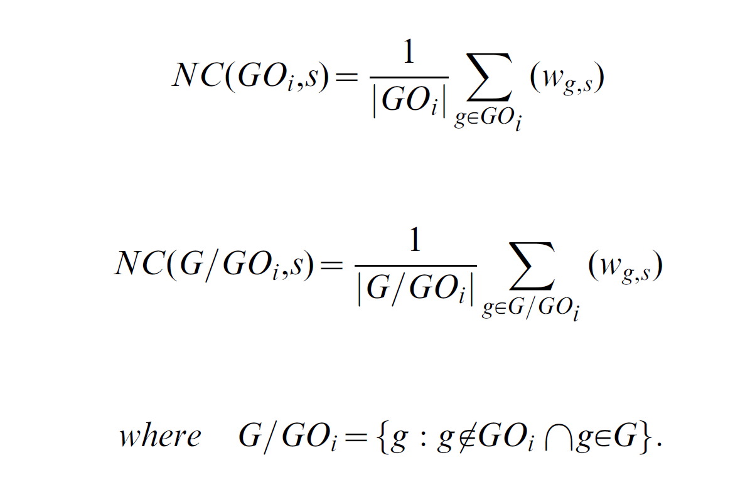
Gene set features
Calculate the NC score for each gene set and its complement

Slide 12
Gene set features
The score of a gene set is the difference between the two
Which results in the FAIME profile for each sample

Slide 13
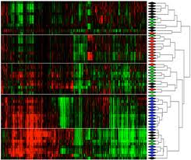
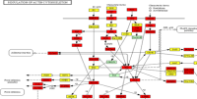
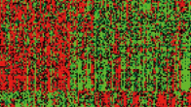
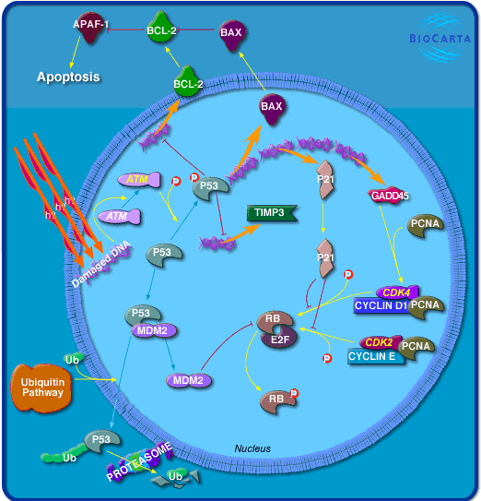
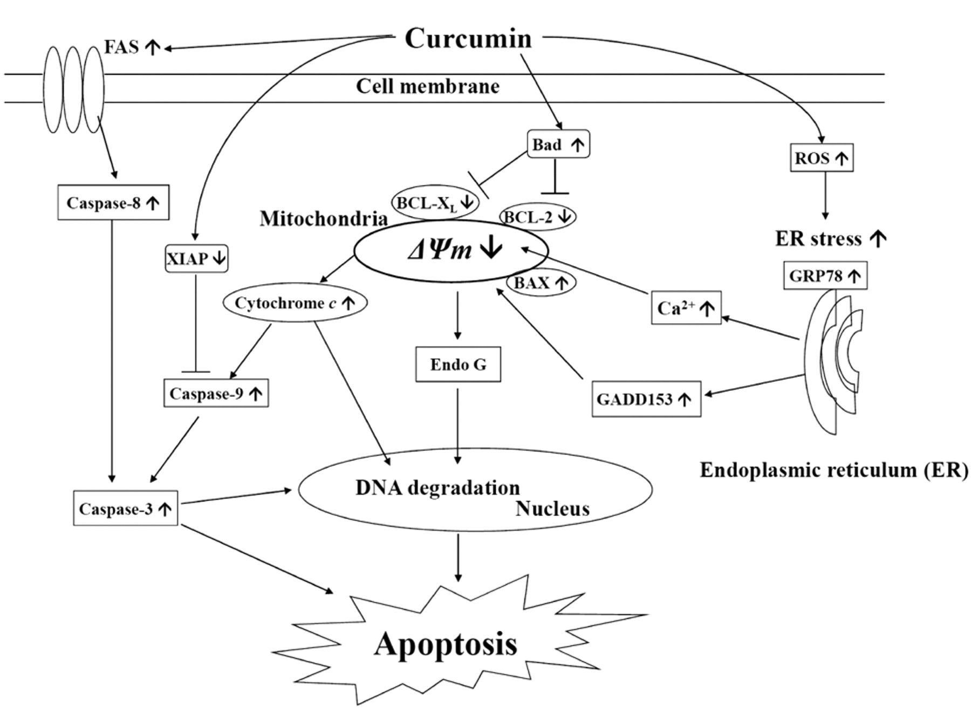
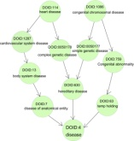
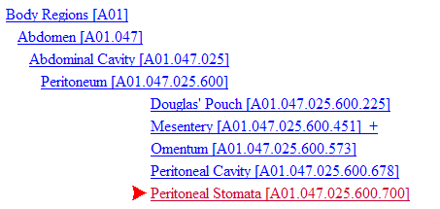
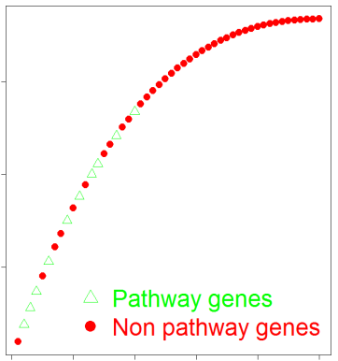
Analysis design (goal)
GSE
Expression profiles
Pathways
Platform data
KEGG
Reactome
GDS
Single sample analysis
TCGA
Ranked genes\
transcipts
Sample i
g₁, g₂ ,g₃, … , g_{k}
Biocarta
NCI
Dataset\sample description
g₁, g₂ ,g₃, … , g_{k}
Weighted ranks
w₁, w₂ ,w₃, … , w_{k}
Sample labels
Single sample - single pathway analysis
low
expression
Disease
Tissue
Standardized profile
high
expression
For each pathway:
Mean
SD
KS test
Skewness
Transcript features
Pathway features
Y
X_{T}
X_{P}
Samples

Slide 14
Analysis design (goal)
GSE
Expression profiles
Pathways
Platform data
KEGG
Reactome
GDS
Single sample analysis
TCGA
Ranked genes\
transcipts
Sample i
g₁, g₂ ,g₃, … , g_{k}
Biocarta
NCI
Dataset\sample description
g₁, g₂ ,g₃, … , g_{k}
Weighted ranks
w₁, w₂ ,w₃, … , w_{k}
Sample labels
Single sample - single pathway analysis
low
expression
Disease
Tissue
Standardized profile
high
expression
For each pathway:
Mean
SD
KS test
Skewness
Transcript features
Pathway features
Y
X_{T}
X_{P}
Samples

Slide 15
Analysis design (current)
GSE
Expression profiles
Pathways
Platform data
KEGG
Reactome
GDS
Single sample analysis
Ranked genes\
transcipts
Sample i
g₁, g₂ ,g₃, … , g_{k}
Biocarta
NCI
Dataset\sample description
g₁, g₂ ,g₃, … , g_{k}
Weighted ranks
w₁, w₂ ,w₃, … , w_{k}
Sample labels
Cancer
Healthy
Other disease
Single sample - single pathway analysis
low
expression
Standardized profile
high
expression
For each pathway:
Mean
SD
KS test
Skewness
Transcript features
Pathway features
Y
X_{T}
X_{P}
Samples

Slide 16
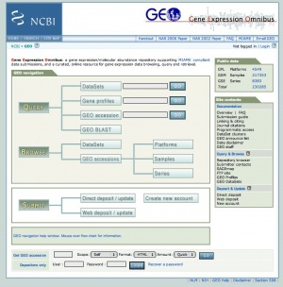
Expression data
GSE
Expression profiles
GDS
TCGA
Use the manually curated GEO datasets
“GDS” objects
250 human microarray datasets with “disease state” attribute
13114 samples; 59 platforms
Manually go over large GEO datasets that have no GDS
40 datasets
13118 samples; 14 platforms

Slide 17
Platform analysis
GSE
Expression profiles
GDS
TCGA
Use platforms with > 20000 probes
Consider only platforms of Affymetrix, Illumina or Agilent
Ignore GPL97 (U133B) – low gene intersection with other platforms
20 platforms
GDS: 178 datasets; 9684 samples
GSE: 34 datasets; 11900 samples

Slide 18
Removed platform-comment
GPL97 – Affy U133B
In many cases the same patients also have GPL96 arrays
Example: GDS1975 and GDS1976 contain 86 samples each, both are from the same patients
Excluding this platform reduces the number of shared refseqs to 2194
Excluding this platform reduces the number of shared entrez genes to 3407

Slide 19
Probes to entrez, refseq
GSE
Expression profiles
GDS
TCGA
For each platform get the probe to refseq and probe to entrez mapping
Analyze the data of the platform GEO object
Sometimes external mapping is needed
Missing refseq column: usually, can be found in the genbank column
Map refseq to entrez when only refseq information appears
No cases of Entrez+ and Refseq-

Slide 20
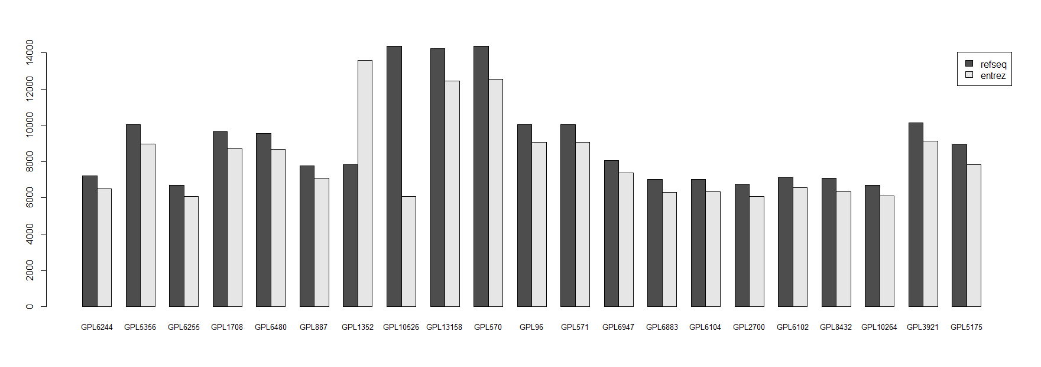
Platform gene intersection
Refseq: 6686
Entrez: 6067
How many probes are covered by the intersection?

Slide 21
Enrichment analysis of the intersection (entrez)
More than 300 GO terms at 0.05 FDR (!)
Top enrichments:
GO term | # genes | p-value
small molecule metabolic process - GO:0044281 | 1034 | 2.00E-58
response to stress - GO:0006950 | 1149 | 6.42E-58
response to organic substance - GO:0010033 | 819 | 1.10E-57
negative regulation of biological process - GO:0048519 | 1195 | 2.57E-46
regulation of biological quality - GO:0065008 | 964 | 2.37E-42

Slide 22
Pathways
Use the R graphite package
Available pathway databases:
KEGG
Reactome
Biocarta
NCI
1723 pathways in total
Covering 7842 genes
Pathways
KEGG
Reactome
Biocarta
NCI

Slide 23
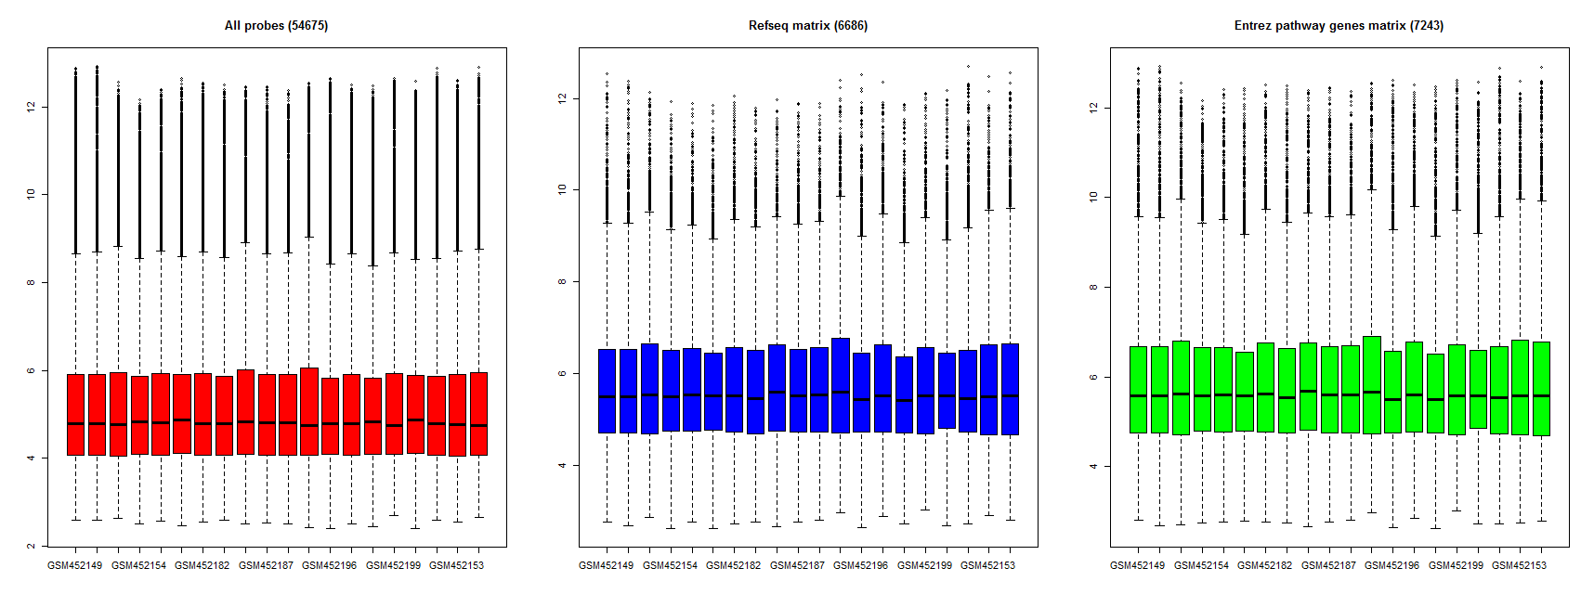
All probes vs. refseq gene set vs. Pathway entrez genes
GDS4513

Slide 24
Transform data to weighted ranks

Slide 25
Pathway analysis
The background – all pathway genes
The FAIME statistic is similar to using the mean ranks

Slide 26
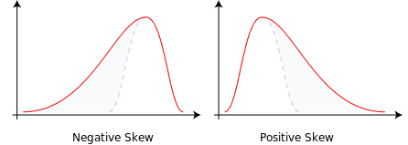
Pathway analysis
Additional statistics:
The standard deviation of the pathway scores
The skewness of the pathway score

Slide 27
Pathway analysis
Additional statistics:
Test if the distribution of pathway gene scores is different than the non-pathway scores
We use a non parametric test
Kolmogorov-Smirnov
Test both up- and down- representation

Slide 28
Pathway features

Slide 29
Mapping samples to labels
Huang et al. used the MetaMap tool for (automatically) mapping native language descriptions to MeSH terms
MetaMap is not good enough, example:
GDS4358
“Analysis of diagnostic lymph-node biopsies from classic Hodgkins lymphoma HIV- patients before ABVD chemotherapy”
MetaMap top score: “HIV infections”
In most cases, no tissue was found

Slide 30
Manual analysis
For each dataset analyze the description of:
The GDS object
The GSE object
Classes names
Tissues
Missing data? Go to the paper!

Slide 31
Manual analysis
For each dataset analyze the description of:
The GDS object
The GSE object
Classes names
Tissues
Missing data? Go to the paper!

Slide 32
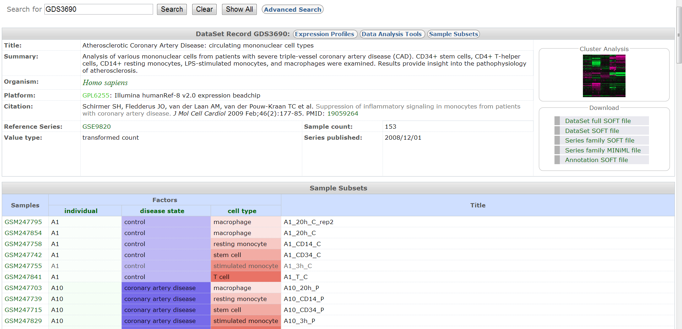
GDS data example

Slide 33
GSE data example – series matrix

Slide 34
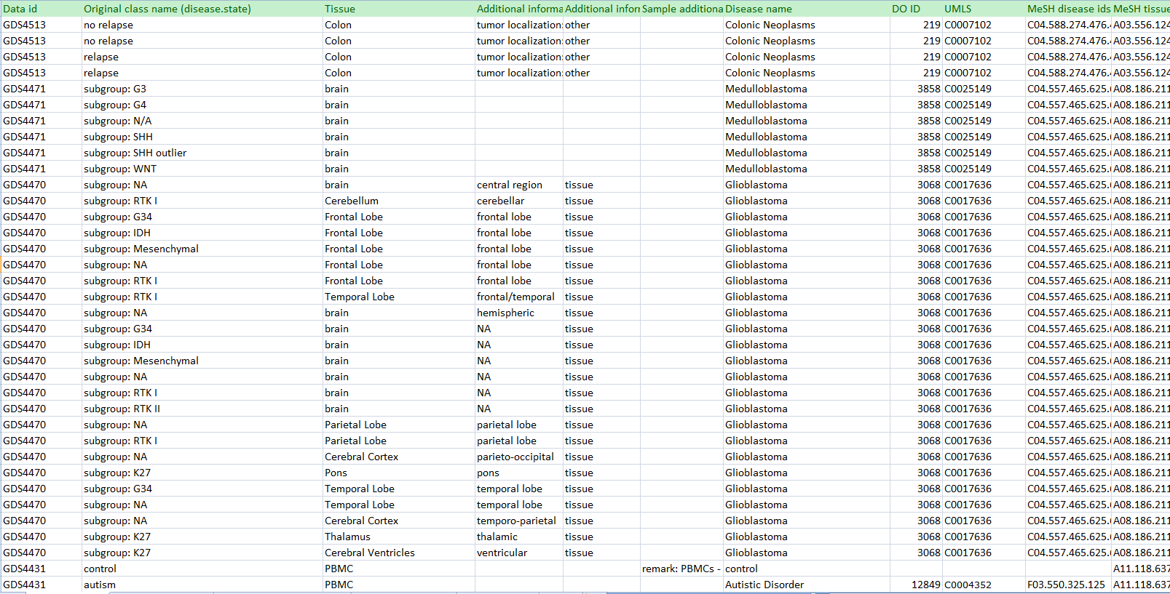
So, where are we?
Finished going over the GDS objects
~600 records
8168 samples
>180 disease names
~110 tissues

Slide 35
So, where are we?
In progress:
Analyze GSE objects
Found an error in GEO
GDS4471 data does not fit the platform: use the GSE data
Get cancer profiles from TCGA

Slide 36
Cancer vs. healthy vs. others
Define simple classes: cancer (MeSH id starts with C04), control, other disease
Round1: 105 GDS datasets
81 datasets had at least two classes
5661 samples
Classifier: SVM
Feature selection: t-test, top 500

Slide 37
Test 1: LOOCV within datasets
For each datasets that has at least two classes
LOOCV using the raw data matrix
LOOCV using the refseq genes matrix
Goal: make sure that the refseq matrix produces similar results

Slide 38
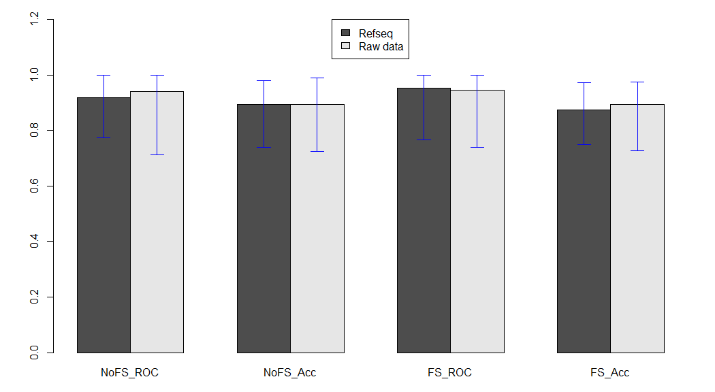
Results

Slide 39
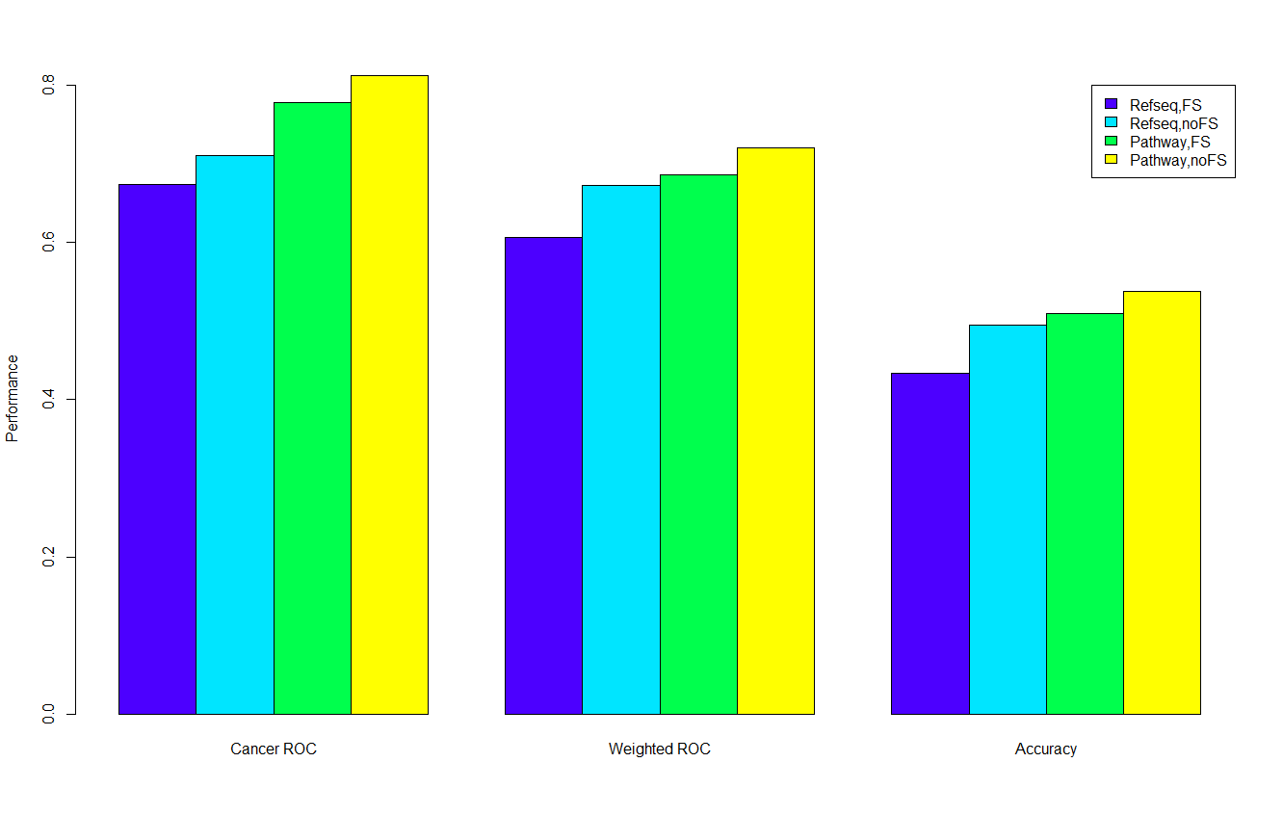
Test 2: Leave dataset out
Use all datasets
Compare the refseq matrix and the pathway matrix

Slide 40
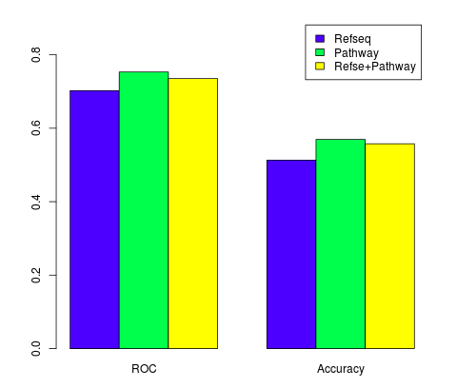
Round2: 145 datasets
Leave 10 datasets out
7883 samples
Cancer: 3285, Control: 2098, Other: 2500

Slide 41
Random forest vs. SVM

Slide 42
Future work
Add GSE and TCGA samples
RNAseq analysis
Test other labels:
Disease: use the UMLS or disease ontology structures
Tissues\Anatomy: use MeSH trees

Slide 43
Multitask vs. multilclass learning
Use DO structure 1: assign datasets to ancestors
Multiple datasets per class
Multiclass: each sample is mapped to a single class, number of classes > 2
Multitask: samples can be mapped to more than one class

Slide 44
Multitask computational approaches
Learn all classification models using a global loss function
Generalized SVMs (iLSVM, Zhu et al. 2012)
Classification chains (Groves et al. 2012)
Learn a classifier for each task
Create a new matrix M: sample VS. class probabilities
Learn a new model for each class:
Data: M and the original features

Slide 45
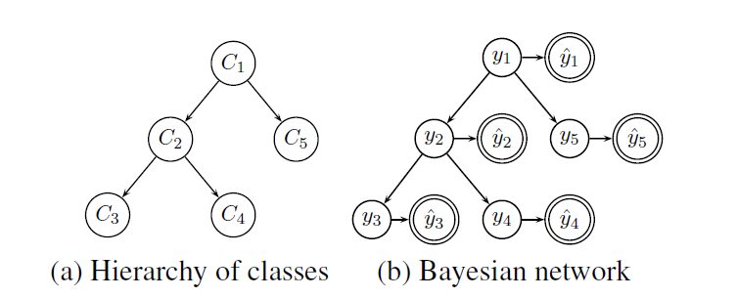
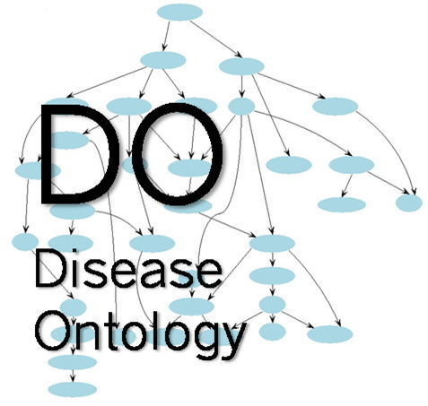
Bayesian correction for hierarchies (DeCoro et al. 2012)
Learn a classifier for each task
For each sample and a task we have the correct classification y and the prediction y’
According to Bayes theorem we want to maximize:

Slide 46
Bayesian correction for hierarchies (DeCoro et al. 2012)
Enforcing the Bayesian network:
Using the original base classifications
Technicalities: use internal CV, learn the global distribution

Slide 47
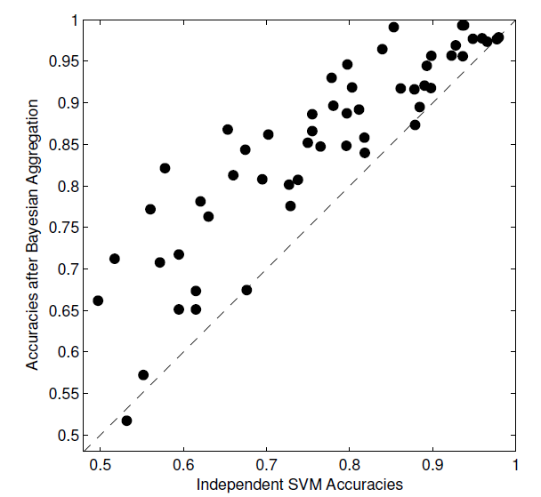
Bayesian correction for hierarchies (DeCoro et al. 2012)

