Slide 1
Gaining biological specificity in gene set analysis by correcting for multifunctionality
Jesse Gillis¹ and Paul Pavlidis²
1. Department of Psychiatry and Centre for High-Throughput Biology
University of British Columbia, Vancouver, BC Canada
2. Cold Spring Harbor Laboratory

Slide 2
Introduction to enrichment analysis

Slide 3
Simple enrichment analysis
A clustering solution: C1,…,Ck
Known gene sets
Null hypothesis: Ci is selected at random from a background BG
Therefore the size of the intersection of Ci and Sj follows a hyper-geometric distribution
Calculate all pairwise p-values
Correct for multiple testing

Slide 4
Scored genes analysis
We have predefined sets (the pathways):
From the GE data we calculate a statistic z for each gene
For each gene set S, we calculate a statistic
that is a function of the z-scores.
Significance is usually estimated
Accurately if we know the null distribution of T
Permutation tests.

Slide 5
GSEA (Subramanian et al. 2005)
Rank order N genes in BG to form L={g1, ..., gN }
for example, using correlation r of g with a phenotype of interest
Given a set of interest S (“the pathway”) and a rank i
evaluate the fraction of genes in S (“hits”) weighted by their correlation score up to a given position i in the ranking
Do the same considering genes not in S – i.e., evaluate the miss probability

Slide 6
GSEA (Subramanian et al. 2005)
1
2
3
4
Calculate the same score for the “miss” – ranked genes not in S
The enrichment score of S is s the maximum deviation from zero:
5
6
7
8
i
i+1
i+2
i+3

Slide 7
GSEA (Subramanian et al. 2005)
If p is 0, the score is the KS statistic for comparing two distributions (the maximal difference between two CDFs)
Q-value: compare ES(S) to the same score calculated after permuting the sample labels
GSA (Tibshirani and Efron) improves upon GSEA
T-test based statistic
Permutations of the labels and the genes

Slide 8
Gene multifunctionality

Slide 9
Gene multifunctionality: is it noise?
Some genes are hubs – related to many terms or pathways.
Not clear if genes are multifunctional because
They are highly investigated
This is a real biological phenomenon
It is a side-effect of the way we interpret biological systems

Slide 10
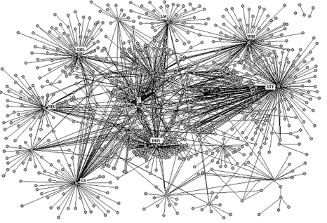
Gene multifunctionality: is it noise?
From a systems point of view, some components are expected to be critical in that they are “important junctions”
Structure of biological networks supports this in part (hubs)

Slide 11
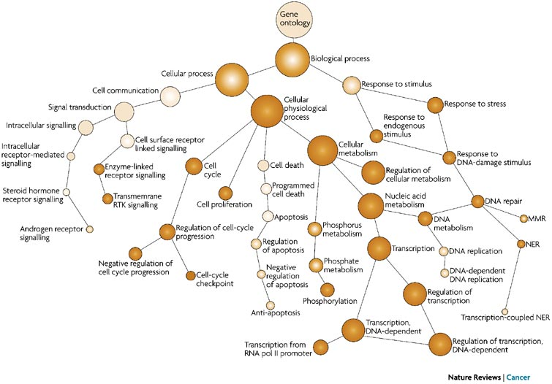
Solution 1: preprocessing
Use small GO terms, or cut the GO DAG at a specific level (Alterovitz et al. 2007)

Slide 12
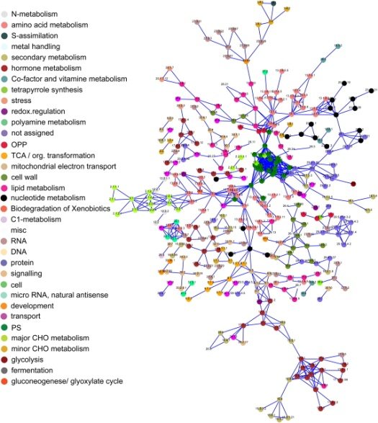
Solution 2: better annotations
Biologically specific ontologies
MapMan for plants
Immune GO (Geifman et al. 2010)

Slide 13
Solution 3: structured analyses
Postprocessing analysis of the results: given enriched terms remove their enriched parents (Jantzen et al. 2011)
Simultaneous analysis of all GO terms together
Example: Bauer et al. 2010 NAR
O – gene is differential or not (1 or 0)
P – prior that a GO term is differential
T – term is differential or not
H – the annotated genes (one to one with O)
Alpha, Beta – FP and TN freqs
MCMC for estimation

Slide 14
Solution 4: Down-weighting multifunctional genes
Tarca et al. 2012 BMC bioinfo
Use GSA-like procedure
Add weights for each gene
A gene score will be its t-test score multiplied by its multifunctionality weight
The score is designed such that specific genes get weight of 2 and non specific are weighted 1
Let f(g) be the number of sets in which g appears

Slide 15
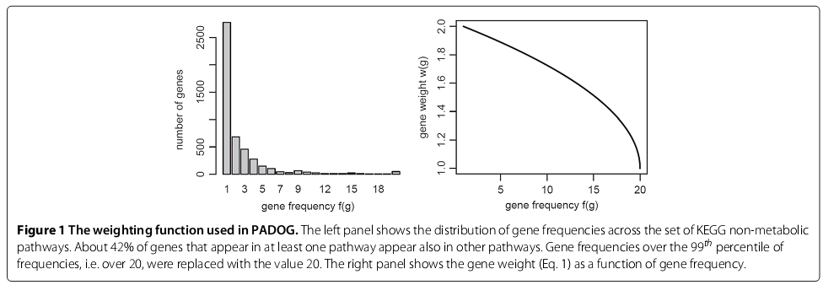
Dealing with multifunctionality - examples
The weight of a gene

Slide 16
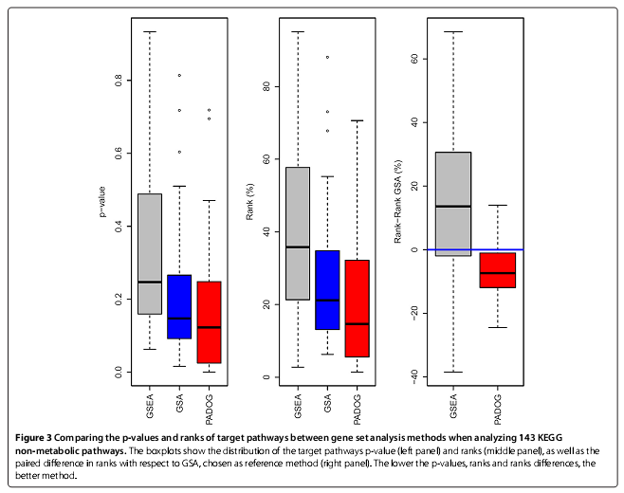
Results example
Analyzed 24 case-control GE datasets for which a KEGG pathway of the cases exists
Show better specificity of the results

Slide 17
Gaining biological specificity in gene set analysis by correcting for multifunctionality
Jesse Gillis¹ and Paul Pavlidis²
1. Department of Psychiatry and Centre for High-Throughput Biology
University of British Columbia, Vancouver, BC Canada
2. Cold Spring Harbor Laboratory

Slide 18
The approach here
Try to remove multifunctional genes to make the results more specific
MOFO algorithm for hit list analysis
The focus of the paper
Regression based algorithm for ranked list analysis
Briefly explained, no results in the main script

Slide 19
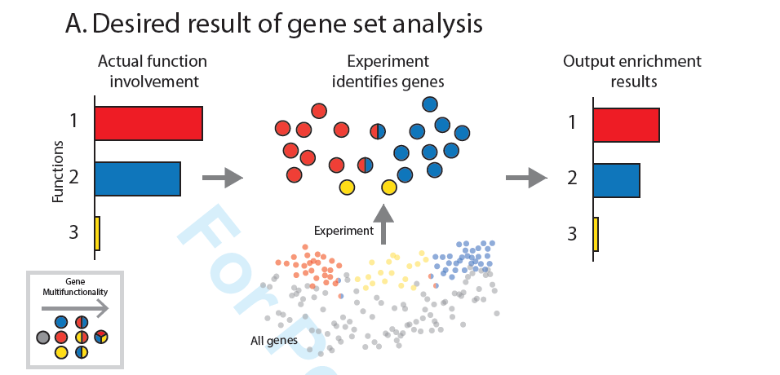
Expected

Slide 20
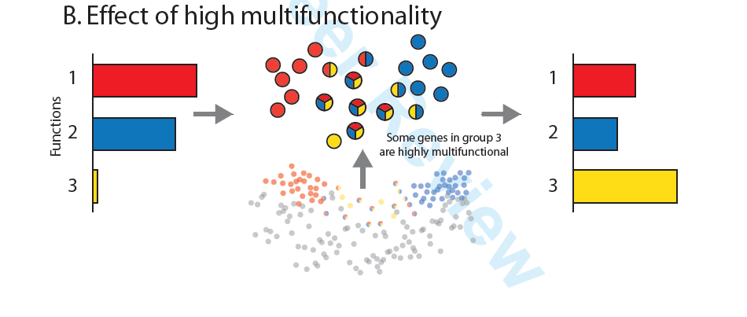
Observed

Slide 21
Calculating multifunctionality
Of a gene
The number of GO terms
Of a GO term (Gillis and Pavlidis 2011)
Rank all genes by their multifunctionality score
Use this ranking to calculate ROC score
Labels are 1 if the gene is in the GO term and 0 otherwise
Use non-parametric test to get a p-value. For example Mann-Whitney test

Slide 22
Enrichment vs. multifunctionality
Each dot is a gene
X: the number of GO terms
Y: number of containing MsigDB hit lists

Slide 23
Enrichment vs. multifunctionality
Each dot is a GO term
X: multifunctionality of the GO term
Y: fraction of times the GO term was detected in a hit list (0.05 FDR)

Slide 24
Enrichment vs. multifunctionality
Change in the top 10 GO terms after removing the most multifunctional gene in each hit list
Mean shift is 8

Slide 25
MOFO algorithm
Iterations for a hit list H
If the H is not multifunctional or no enrichment was detected, terminate
Record the initial enrichments
Rank the GO terms. Keep the top N (10) - K
Repeatedly try to remove the most multifunctional gene from the hit list
In each iteration check if the ranking of K changed
Stop if the shift is large enough

Slide 26
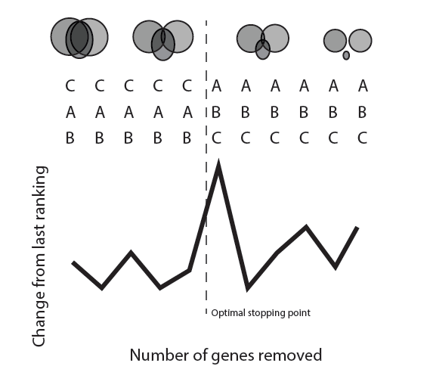
MOFO algorithm

Slide 27
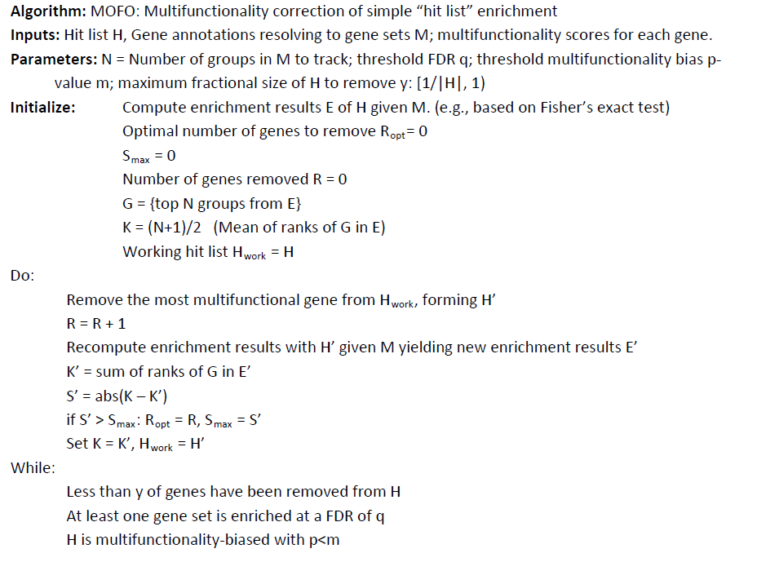
MOFO algorithm

Slide 28
Simulations 1
Create a hit list of 100 genes
10 are from a target GO term
90 are assumed to be noise (0.9 FDR!?)
The rank of the GO term as a function of the multifunctionality of the background

Slide 29
Simulations 2
Randomly select 10 GO terms
These GO terms are expected to be at the top
Mean rank 5.5
The mean rank over 1000 repeats was 20.7
The mean rank as a function of the multifunctionality of a single gene that is removed
The removed gene is actually TP(!)

Slide 30
MOFO on MolSigDB signatures 1
8% of the genes are removed on average
52% of the enrichments are removed
Correlation between multifunctionality and enrichment p-value decreases from -0.66 to -0.51

Slide 31
MOFO on MolSigDB signatures 2
Analyzed all signatures that are divided to up- and down-regulated (1134 signatures)
NOT CLEAR!
From the paper: for each hit list
Measure correlation with other hit lists
Measure the relative rank of the opposite set

Slide 32
Additional validation
Map the hit lists to the tested disease
Use disease-gene annotations (Neurocarta)
Perform disease enrichment instead of GO
Test the ranking of the correct target gene

Slide 33
Additional validation

Slide 34
Additional remarks
Multifunctionality definition is fitted to pathways and not to GO terms
Gene annotated deep in the GO DAG has many GO terms
Some of the observed biases could be due to GO term size which should correlate with GO multifunctionality

Slide 35
Comments

Slide 36
Remarks
Multiple testing correction is not addressed properly
No thorough comparisons with extant methods
The background gene set is ignored
Too verbose
Most results are based on ranking GO terms
Only small percentage is expected to be significant and relevant
Need to add similar comparisons considering only significant GO terms or comparing the actual p-values

Slide 37
Example
Why is the rank interesting?
The main question should be if the GO term is accepted after correction or not

Slide 38
Additional remarks – other reviewers
The authors should discuss the relationship between the “multifunctional genes” and the GO dependencies.
The paired analysis is not always biologically justified
For example in a process we can have an up-regulated gene A which causes down-regulation of gene B

Slide 39
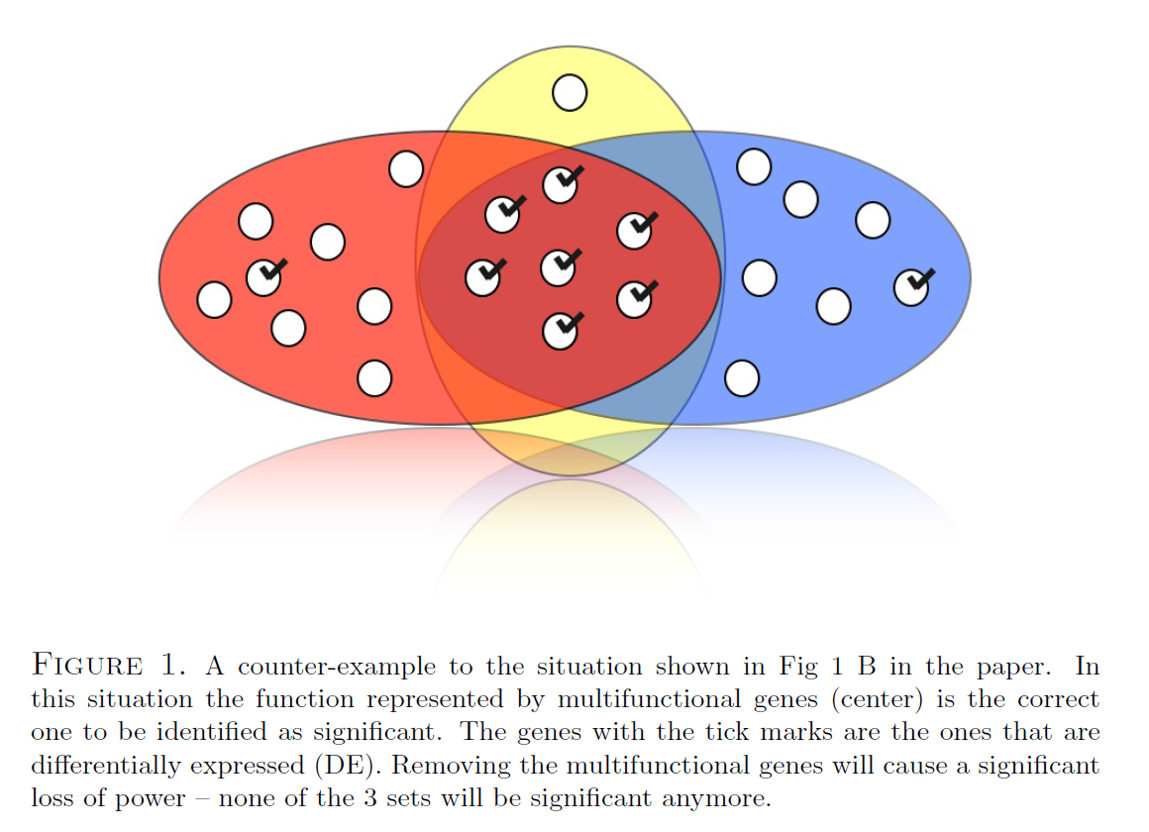
Additional remarks – other reviewers

