Slide 1
Disrupted Functional Brain Connectome in Individuals at Risk for Alzheimer’s Disease
Wang J, Zuo X, Dai Z, Xia M, Zhao Z, Zhao X, Jia J, Han Y, He Y.
Source
State Key Laboratory of Cognitive Neuroscience and Learning, Beijing Normal University, Beijing, China
Biological Psychiatry, March 13

Slide 2
Background
Alzheimer’s disease (AD) - a progressive, neurodegenerative disease
Characterized by decline in cognitive and memory functions
Likely caused by aberrant neuronal circuitry
Amnesic mild cognitive impairment (aMCI) - a transition state between normal aging and AD (high risk for AD)
Currently, the clinical diagnosis of aMCI has limited specificity
Numerous studies have reported aMCI patients to have impaired structural integrity and functional connectivity
Topological organization of whole-brain networks in aMCI still largely unexplored

Slide 3
This study
Resting-state fMRI to investigate topological changes in aMCI patients’ functional connectome
Association to individual clinical or behavioral variables
Check diagnostic power of topological properties

Slide 4
Data
37 aMCI patients (17 men and 20 women)
47 age and education matched healthy controls ( 17 men, 27 women)
8 min fMRI scans (478 seconds =239 time points)
Standard preprocessing steps (slice timing correction, head motion correction, normalization to MNI space, high pass filter and regression of nuisance signals head-motion profiles)
standardized clinical evaluation protocol
Notes:
Each participant was assessed using a standardized clinical evaluation protocol that included the Mini-Mental State Examination (MMSE) (30), the Clock Drawing Test (CDT), the Auditory Verbal Learning Test (AVLT) (31), and the Clinical Dementia Rating Scale (32).

Slide 5
Network Construction
Brain was divided into 1024 regions of interest (ROIs) according to a high-resolution, randomly generated brain atlas (H-1024)
Pearson correlation was calculated between any pair of ROIs using maximal overlap discrete wavelet transform method in four wavelet scales (scale 1, .125–.250 Hz; scale 2, .063–.125 Hz; scale 3, .031–.063 Hz; and scale 4, .016–.031 Hz) -> 4 frequency-specific correlation matrices for each participant
Only significant correlations (p<=.05 Bonferroni-corrected) retained (de-noising)
Notes:
The idea of omitting the downsampling in the discrete wavelet transform is sufficiently intuitive that this variant was invented several times with different names. Including MODWT
Denoising-if corr is nonsignificant for all subjects

Slide 6
Discrete wavelet transform (DWT) – (from wikipedia)
Any wavelet transform for which the wavelets are discretely sampled
As with other wavelet transforms, a key advantage it has over Fourier transforms is temporal resolution: it captures both frequency and location information (location in time)

Slide 7
Network Analysis
A small-world network - originally proposed by Watts and Strogatz (1998), a graph in which most nodes are not neighbors of one another, but can be reached from every other node by a small number of steps
enables high efficiency of both specialized and integrated processing
In a small-world network typical inter-nodal distance is proportional to the log(number of nodes)
Small-worldness: can be quantified using measures of a clustering coefficient and a characteristic path length
Notes:
small-worldness enables high efficiency of both specialized and
integrated processing (41,55),

Slide 8
Graph metrics elaboration
Clustering coefficient
Ki – the degree of node I
Wij – the wavelet Pearson correlation between node i and node j
scaled by the sum of all existing edge weights and Gi is the subgraph that is composed of the nodes directly linking to node i.
Notes:
Local – number of triangles divided by number of triplets
Global – average over all nodes

Slide 9
Graph metrics elaboration
The characteristic path length L^{w} of a weighted network G with N nodes is defined as the harmonic mean of the shortest path length across all possible pair of nodes
d_{ij} = the weighted shortest path length between node i and node j
The length of an edge was designated as the reciprocal of the edge weight
Notes:
Check this…

Slide 10
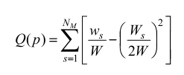
Graph metrics elaboration
Modularity is a central organizational principle for brain networks
Modularity index Q(p) for a partition p of a weighted network is defined as:
N_{M} = number of modules
W = the total network weight
w_{s} = sum of weights between all nodes in s
W_{s} = sum of the nodal strength of nodes in s (i.e. weighted degree centrality)
Notes:
The nodal strength for a given node i in a network is defined as the sum of all of the edge weights between this node and all of the other nodes in the network. Regions with a high nodal strength indicate high interconnectivity with other regions and can be categorized as hubs.
Modularity quantifies the difference between the weight of intra-module links of the actual network and that of random networks in which connections are weighted randomly (16). The aim of the module identification process is to find a specific partition p that yields the largest network modularity, max ~Q . Here, we detected modular structure using a spectral optimization algorithm (17) that was implemented
using the Brain Connectivity Toolbox (BCT, http://www.indiana.edu/~cortex/connectivity.html).

Slide 11
Null Model of random networks
Normalized metrics calculated by dividing real values by corresponding mean derived from 100 random networks with preserved properties
Typically, for small world networks >1, ≈1,
A modular network has a >1
Notes:
same number of nodes, edges and degree distributions (weight of each edge were retained during rewiring)

Slide 12
Statistical analysis- between group differences
Between-group differences in topological attributes were inferred by nonparametric permutation tests
Randomly reallocating all values into two groups and recomputing mean differences between the two randomized groups (10,000 permutations)
Network-based statistic (NBS) approach used to localize the specific pairs of regions in which the functional connectivity was altered in aMCI patients
Notes:
NBS:
We first performed two-sample one-tailed t-tests (after controlling for the effects of age, gender, the age-gender interaction and
education) in an element-by-element manner on those connections that were significantly non-zero (p < 0.05, Bonferroni-corrected) in at least one participant.
Then, a primary threshold (p<5*10- 4 and 1*10 -4 in this study, respectively) was applied to define a set of supra threshold links within which any connected components and their size (defined as the number of links included in these components) were determined. To estimate the significance for each component, null distribution of connected component size was derived empirically using a nonparametric permutation approach (10,000 permutations). (???)
For each permutation, all subjects were reallocated randomly into two groups, and two-sample one-tailed t-tests were conducted for the same set of connections mentioned above. The same primary threshold was then used to generate suprathreshold links within which the maximal connected component size was recorded
Finally, for a connected component of size M found in the right grouping of controls and patients, the corrected p-value was determined by calculating the proportion of the 10,000 permutations for which the maximal connected component was larger than M

Slide 13
NBS
For each connection that passed sig thresh in at least one subject (h0= is not weaker in aMCI, h1= is weaker in aMCI)
Primary thresh (p<5*10- 4 and 1*10 -4) -> set of supra threshold links ->CCs and CC size were determined
Significance of each CC (c) was evaluated by repeating the analysis for 10000 random groupings and recording the maximal connected component size for each permutation (p=proportion of perms in which max CC was larger than |c|)
Notes:
We first performed two-sample one-tailed t-tests (after controlling for the effects of age, gender, the age-gender interaction and education) in an element-by-element manner on those connections that were significantly non-zero (p < 0.05, Bonferroni-corrected) in at least one participant
Then, a primary threshold (p<5*10- 4 and 1*10 -4) *[– looks like a replacement for MTC] was applied to define a set of supra threshold links within which any connected components and their size (defined as the number of links included in these components) were determined. To estimate the significance for each component, null distribution of connected component size was derived empirically using a nonparametric permutation approach (10,000 permutations). (???)
For each permutation, all subjects were reallocated randomly into two groups, and two-sample one-tailed t-tests were conducted for the same set of connections mentioned above. The same primary threshold was then used to generate suprathreshold links within which the maximal connected component size was recorded
Finally, for a connected component of size M found in the right grouping of controls and patients, the corrected p-value was determined by calculating the proportion of the 10,000 permutations for which the maximal connected component was larger than M

Slide 14
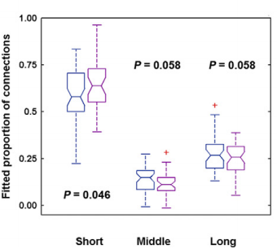
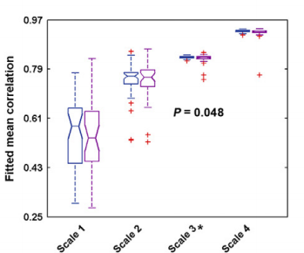
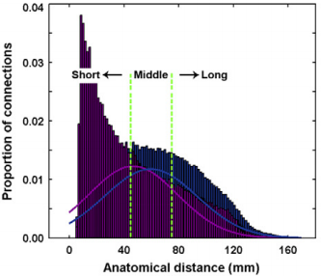
Results – frequency specific alterations
The aMCI networks had a significantly lower mean wavelet correlation (p.048) and contained a higher proportion of short-range (anatomical distance <45 mm) connections (p.046) only in wavelet scale 3 (.031–.063 Hz)
No significant between-group differences were detected in other frequency bands (all p>.05)
Thus, the subsequent network topological analyses focused only on wavelet scale 3
Notes:
(A) Between-group differences in the number of connections (left), mean correlation (middle), and mean anatomical distance (right) of the
functional networks anddistribution of wavelet correlationswith respect tobins of anatomical distance(B). In the specific wavelet scale 3 (.031–.063Hz), the aMCI patients exhibited fewer connections, lower mean correlation, and shorter mean anatomical distance. Further analysis revealed that aMCI targeted more middle- and long-distance connections (B).*p<.05;#.05<=p<=.10. HC, healthy control subjects

Slide 15
Results - Global Topological Organization
Whole-brain connectome of both aMCI and HC groups exhibited typical features of small-world topology and modular structure
Significantly increased characteristic path lengths in the aMCI group (HC: 7.950±5.236; aMCI: 14.506±22.250;p=.047)
Borderline results: increased normalized path length and decreased modularity
Notes:
Compared with matched random networks, the functional brain networks of both groups had larger clustering coefficients, almost
identical shortest path lengths, and larger modularit
Additionally, the aMCI group showed trends toward increased normalized characteristic path lengths (HC: 1.673±.412; aMCI: 1.928 ±.694; p=.055) and decreased modularity (HC: 3.129±1.015; aMCI: 2.696±.632; p.084) compared with the HC group

Slide 16
Results - Relationship Between Network Metrics and Behavioral Performance
Within the aMCI group, the whole-brain topology (L^{W}, , and ) and nodal strength of several structures correlated significantly (p<.05)with the AVLT-recognition and immediate recall ability of patients
Notes:
(angular gyrus, MTG, inferior temporal
gyrus, and middle frontal gyrus)

Slide 17
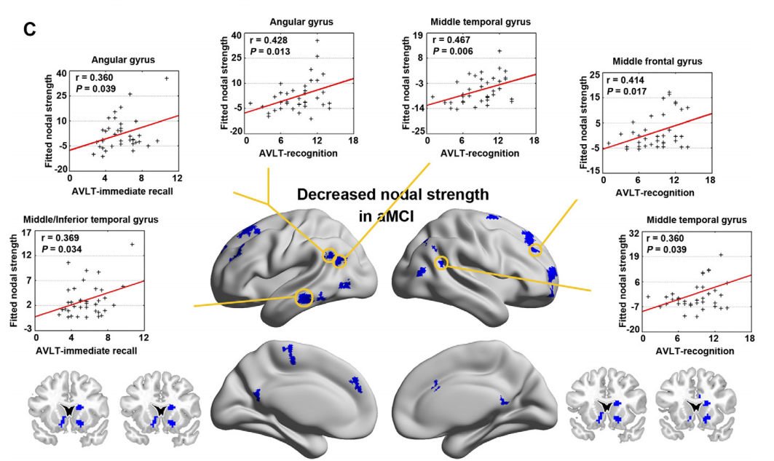
Results - Regional Topological Organization
Between-group comparisons of nodal strength revealed that 27 brain structures were targeted (p<.01, uncorrected) by the disease
Notes:
Auditory Verbal Learning Test = AVLT
They do not say why this is not corrected only that it should be considered exploratory

Slide 18
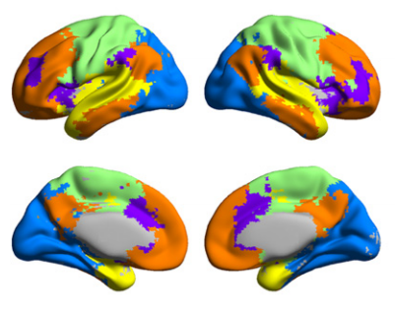
Module distribution of “targeted” structures
Modular architecture was derived from the HC group
Five modules were found (Qmax=.536) corresponding to familiar networks:
Sensori-motor Default mode Ventral attention Visual processing Auditory

Slide 19
Module distribution of “targeted” structures
Targeted ROIs in aMCI belonged mainly to Default network (19/27, 70.4%)
Followed by attention (4/27, 14.8%), motor (2/27, 7.4%),and visual (2/27, 7.4%) modules
Decline of nodal strength in the DMN is consistent with previous studies that demonstrate involvement of these regions in episodic memory and a breakdown (?) in the DMN spontaneous activity in MCI
Notes:
Beyond the default network, the subcortical caudate and putamen also showed decreased nodal strength in patients (also supports previous findings) – This is not mentioned in the above numbers

Slide 20
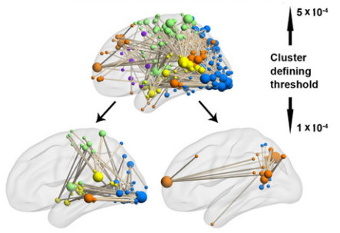
Results - Disrupted Functional Network Connectivity in aMCI
Under p<5*10⁻⁴ a single network of 363 connections linking widely distributed structures showed decreased FC in the aMCI group (p=.006, corrected).
Under p<10⁻⁴ the network split into two CCs: one of 65 connections (p=.004, corrected) and the other of22 connections (p=.011, corrected).
The larger component comprised mainly of inter- module connections (46/65, 70.8%)
The smaller component comprised mainly of intra- module connections
Notes:
It seems that the largest de-connectivity is within DMN

Slide 21
Discussion – inter group differences
Increased path length may reflect disrupted neuronal integration between distant regions (consistent with previous AD studies)
Large disconnected network - comparable with previous reports of selected reductions of network-related activity
Overall, results provide empirical evidence for disrupted network organization in aMCI at three (global, nodal, and connectional) levels
Notes:
What do they mean by: “Moreover, these connections were related directly to whole-brain network topology, suggesting their contribution to the observed global topological abnormalities.”
The caudate and putamen are key nodes in the neostriatum; they receive numerous inputs from the cortex, send the connections to
the basal ganglia nuclei, and thenproject back to the cortex via the thalamus (70,71).
striatum is a subcortical part of the forebrain. It is the major input station of the basal ganglia system.

Slide 22
Network classification
For each metric different thresholds were used to classify each sample into either aMCI or control
Under each threshold, the fraction of correctly identified aMCI patients (sensitivity) and the fraction of correctly identified controls (specificity) were calculated
A cut-off point that simultaneously optimized the sensitivity and specificity was determined

Slide 23
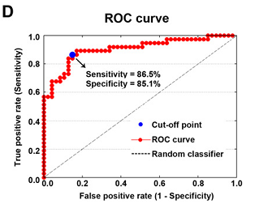
Results – network measures prediction power
Mean functional connectivity strength of the NBS-based connected network (cluster-defining threshold = 10⁻⁴) showed highest prediction power (AUC=0.904,p<10⁻⁶)
Sensitivity = 86.5%
Specificity = 85.1%
Accuracy= 85.7%
All other network metrics studied exhibited poor discriminative power
Notes:
I assume that “Mean functional connectivity strength” is the mean Pearson correlation between all connections in the NBS based CC, however this is not explicitly defined in the paper nor in the supp

Slide 24
Discussion – diagnostic power
Previous studies searched for aMCI-related biomarkers using structural properties
More recent studies used dysfunctional interregional connectivity for distinguishing aMCI from healthy controls
Here NBS-based connectivity network differentiated aMCI patients from healthy individuals with high sensitivity and specificity.
aMCI diagnosis could be further improved by combining both structural and functional connectivity information from multimodality imaging data
Notes:
No comparison in quality to previous studies (missing) did prev studies obtain better/not as good results?

Slide 25
Reproducibility and Test-Retest Reliability
Repeating analysis after regressing out WM and CSF
Repeating analyses for three other commonly
employed low-resolution atlases, the Anatomical Automatic Labeling atlas (AAL, n = 90) , the Harvard-Oxford atlas (HOA, n = 112) and the Craddock et al.’s functional atlas
(Crad, n = 200)
Notes:
ICC???
Repeating analyses for binary networks
Intraclass correlation (ICC) was used to quantify the test-retest reliability of the network metrics on another public RS dataset

Slide 26
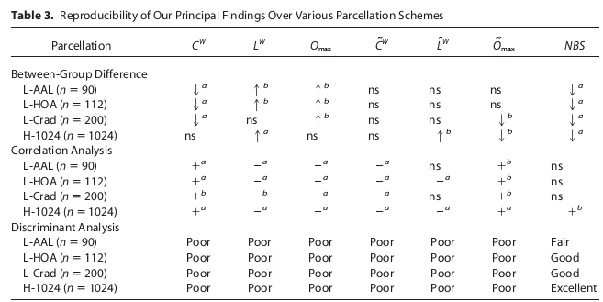
Results - Reproducibility of the Findings
Most reported findings were reproducible across different parcellation schemes
Notes:
AUC>=90%=Excelent
80<=AUC<90 – good
70<=AUC<80 – fair
AUC<70 - poor
Again the term Correlation analysis appears here and does not appear elsewhere. What are they referring to??

Slide 27
Results – reproducibility
high-resolution parcellation outperformed low-resolution parcellation in discriminating patients with aMCI from HCs
In the wavelet scale 3, most global network metrics exhibited fair to excellent (0.4<intraclass correlation<0.9) test-retest reliability
Nodal strength reliability distributed unequally across the brain
most metrics and brain structures that showed between-group differences exhibited moderate to high reliability
High reproducibility also for preprocessing strategies and network types (data not shown)

Slide 28
Summary
Abnormal organization of the aMCI connectome from .031 Hz to .063 Hz including
increased characteristic path length;
Decreased clustering coefficient
Decreased DMN nodal strength
Impaired FC between different functional modules
Abnormal metrics correlated with some of the patients’ cognitive performance
One such metric distinguished patients from healthy controls with high sensitivity and specificity
“Small worldness” and modularity were found in both groups
Notes:
small-worldness enables high efficiency of both specialized and integrated processing (41,55), andmodularity enables faster ad-aptation by changing the functionality of one module without losing functionality in other modules (56).
The fact the differences were found in only one band range is Consistent with accumulating evidence for frequency-dependent functional changes in the brain

Slide 29
What can we learn from this?
Use group label random permutations to detect characteristics that are unique to a specific group of subjects
Try use mean FC strength to distinguish between groups
Statistical “flexibility” (?)
How to talk about results that contain a set of connections (a few dozens)

