Slide 1
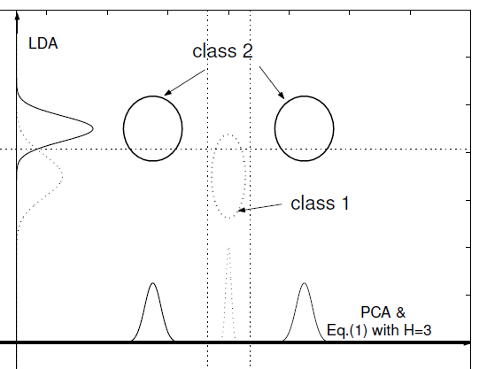
A review on subclass discovery
Didi Amar
Group meeting July 2012

Slide 2
Motivation for subclass discovery
Latent subclasses – different phenotypes.
Non-linear patterns.
Outlier detection.
Better biological interpretation:
Biomarker selection.
Differences between sub-disease and control.

Slide 3
Supervised data
We have a set of samples ( ), where x denotes a vector of p features and y denotes the label of x (classification) or a real score (regression).
Examples of a feature space
Gene expression of a patient.
Copy number variations of a tumor.
SNP information (binary features)
Image processing
The pixels of the image
A set of explanatory features.

Slide 4
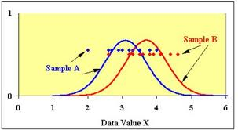
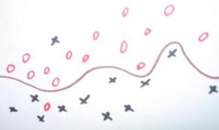
Supervised data analysis
Classifications algorithms usually give a confident score for classifying a sample $x$ to a class $C$.
Differential expression methods give a high score to a gene if its expression differs between classes
Differential expression
Classification

Slide 5
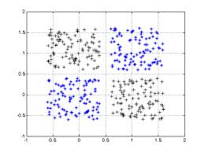
Supervised vs. Unsupervised class discovery
Two options:
Check for subclasses in a supervised data.
Detect significant classes in an unsupervised data.
In most disease datasets today we have control samples so the data is supervised.
Our main focus will be on subclass discovery and not general class discovery.

Slide 6
Automatic subclasses detection in leukemia
Molecular Classification of Cancer: Class Discovery and Class Prediction by Gene Expression. Golub et al. 1999
http://www.broadinstitute.org/cgi-bin/cancer/publications/pub_paper.cgi?mode=view&paper_id=43

Slide 7
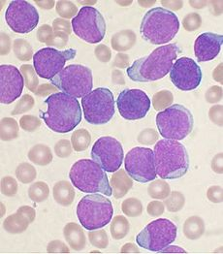
Leukemia
Cancer of the blood or bone marrow.
Abnormal increase of white blood cells.
Types
Acute: extreme rapid progression, most common type of children leukemia.
Chronic: slow progression, allows monitoring to decide the best treatment.
Myeloid: cancer affects cells that are supposed to be red blood counts.
Lymphocytic: cancer affects cells that are supposed to be white blood cells related to inflammation.

Slide 8
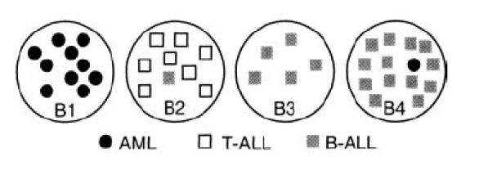
Leukemia subclasses
Golub et al. (1999) used SOM to cluster gene expression profiles of 38 leukemia patients.
All genes were used.
Using k=2, the clustering differentiates between AML (24/25) and ALL (10/13).
Using K=4, another subclasses were detected.

Slide 9
Validation paradigms
Molecular Classification of Cancer: Class Discovery and Class Prediction by Gene Expression. Golub et al. 1999
http://www.broadinstitute.org/cgi-bin/cancer/publications/pub_paper.cgi?mode=view&paper_id=43
Class discovery in gene expression data (Amir Ben Dor, Nir Friedman, Zohar Yakhini 2001)
http://www.cs.huji.ac.il/~nir/Abstracts/BenDorFriedmanRECOMB2001.html
Simultaneous Class Discovery and Classification of Microarray Data Using Spectral Analysis (QIU, JCB 2009)
http://www.ncbi.nlm.nih.gov/pmc/articles/PMC3148134/?tool=pubmed
Optimal Subclass Discovery for Discriminant Analysis (Zhu and Martinez 2004)
http://ieeexplore.ieee.org/xpl/articleDetails.jsp?reload=true&arnumber=1384891&contentType=Conference+Publications

Slide 10
How to validate a new class assignment
The most obvious method: use additional information of the samples:
Known phenotype based subclasses.
Known genotypes, CNVs etc.
Survival analysis.

Slide 11
How to validate a new class assignment
Statistical approaches: if the class assignment is significant then (Golub et al. 1999, Ben Dor et al. 2001):
We shall have significant differential genes or at least the distribution of the gene scores should be higher than expected.
Distribution of classification confidence scores of a test set should be non-uniform, and similar to the training data.
We can construct a significant classifier.
These can be used as objectives for methods that search for new class assignment.

Slide 12
How to validate a new class assignment
Another practical validation\application:
check if partitioning to subclasses improves classification of the original classes.
We have a new class partition of the samples.
The probability that a sample belongs to a class $C$ is the sum of probabilities over $C^{′}s$ subclasses
We shall see an example from image processing.

Slide 13
Subclasses detection in neuroblastoma
A 6-gene signature identifies four molecular subgroups of neuroblastoma (Abel et al. 2011)
http://www.cancerci.com/content/11/1/9/

Slide 14
Introduction: PCA
Summarization of data with many (p) variables by a smaller set of (k) derived (synthetic, composite) variables.
p
k
A
X
n
n

Slide 15
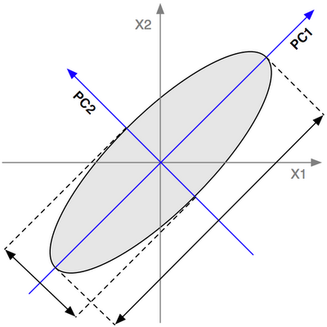
Introduction: PCA
Summarization of data with many (p) variables by a smaller set of (k) derived (synthetic, composite) variables.

Slide 16
Introduction: PCA
Input: a matrix X in which each row is a sample (n) and each column is a feature (p).
PCA steps:
Standardize the features, this is a linear transformation A.
Calculate the covariance matrix of the features.
Decompose the matrix to eigenvectors.
Keep the top K eigenvectors, forming the transformation matrix C (PXK).
The final data is Y=CAX.

Slide 17
Neuroblastoma
NB is a childhood tumor, the most common in infants.
Children diagnosed before 18 months with a localized tumor have favorable outcome.
Older children with metastatic cancer show poor prognosis and have low survival rate.
MYCN amplification is known to be associated with fast progression rate and poor progression despite age and stage.
However, most metastatic tumors do not show MNA.

Slide 18
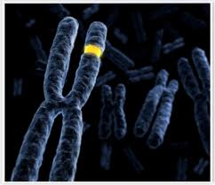
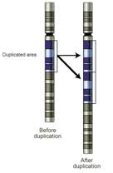
Subclass detection in NB
Copy number variation studies (Brodeur 2003, Michels et al. 2007) detected three subclasses:
Type 1: low risk tumors with numeric alterations and high expression of nerve growth factor TrkA.
Type 2A: intermediate risk with 11q deletion, 17q gain and no MNA.
Type 2B: high risk with MNA, 17q gain and 1p deletion.
There are many intermediate tumors that cannot be assigned to one of these clusters.

Slide 19
Subclass detection in NB (Abel et al. 2011, Cancer Cell)
The analysis flow:
Filter low variation genes.
Use PCA (K=3)
In the new space add an edge between a sample and its nearest neighbor. The connected components are the final clusters.
The variation filter: remove low variation genes until the separation between 1, 2A, 2B is good.

Slide 20
Datasets used
De peter dataset: 23 NB tumors, U133A arrays (Affymetrix).
McArdle and Wilzen: 30 NB tumors, 133A arrays.
Wang data: 101 NB tumors and one brain sample, HGU95Av2 (Affymetrix).
Datasets 1 and 2 were analyzed. Dataset 3 was used for validation.

Slide 21
Results
Four clusters were detected in dataset 1 and 2

Slide 22
Results
Six known NB genes were analyzed using ANOVA. All genes were significant in both datasets.
Gene | P1 | P2 | P3 | P4
ALK | Down | Up | Up | Down
BIRC5 | Down | Up | Up | Down
MYCN |  |  | Up | Down
NTRK1 | Up |  | Down | Down
PHOX2B |  |  |  | Down
CCND1 |  |  |  | Down

Slide 23
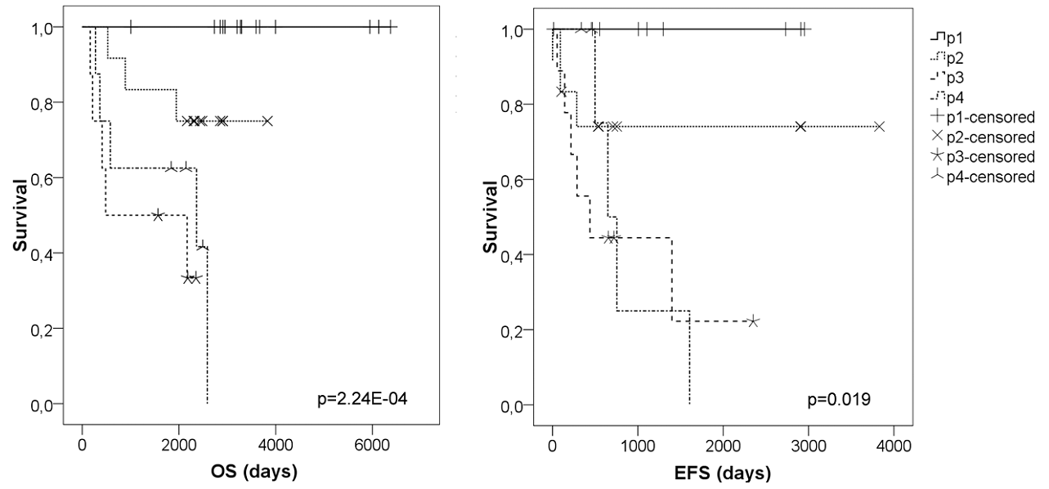
Survival analysis
Survival analysis confirmed the subclasses detection

Slide 24
Subclasses refinement
The p1-p4 sample assignment were manually refined such that the differentiation of the six NB genes improve. New groups are called r1-r4.
Differential analysis of r1-r4 detected 98 genes of which 74 were also in dataset 3.
Dataset 3 was clustered based on these genes (hierarchical clustering).

Slide 25
Wang data
Dataset 3 cluster | Genetic marks | Prognosis | Datasets 1 and 2 fitting clusters
H1 |  | Good | P1
H2 | Del11q, no MNA, 17q gain | Bad, Stage 3-4 | P2
H3 | MNA, del1p, 17q gain | Worst, stage 4 | P3
H4 | Del11q, no MNA, 17q gain | Bad, Stage 3-4 | P4

Slide 26
Wang data

Slide 27
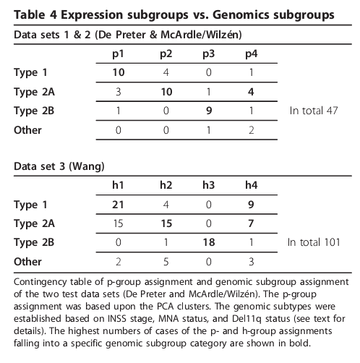
Gene expression subclasses vs. CNV subclasses

Slide 28
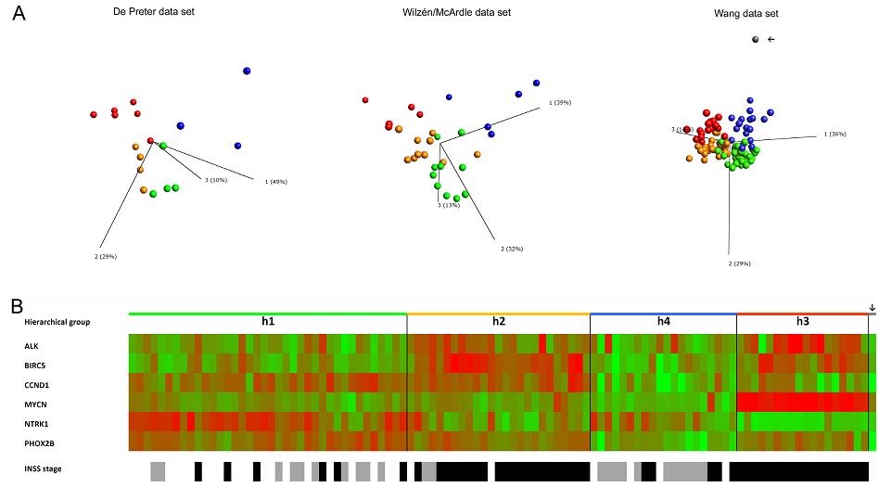
Analysis based on known NB genes

Slide 29
Automatic subclasses detection in septic shock
Identification of pediatric septic shock subclasses based on genome-wide expression profiling (Wong et al. 2009 BMC Medicine)
http://www.biomedcentral.com/1741-7015/7/34/

Slide 30
Pediatric Septic shock
A result of a severe infection.
Can cause multiple organ failure and death.
Subclass detection is important to adjust patient specific immune therapy.
For example, Wong et al. (2008) identified a group of patients with increased survival rate after IL8 admission.

Slide 31
Subclass detection in Septic shock (Wong et al. 2009, BMC medicine)
Whole blood gene expression profiles.
98 cases and 32 controls.
Preprocessing:
Find genes that have at least a 2-fold change in 25-50% of the patients as compared to the median of the controls.
6099 probes were found.

Slide 32
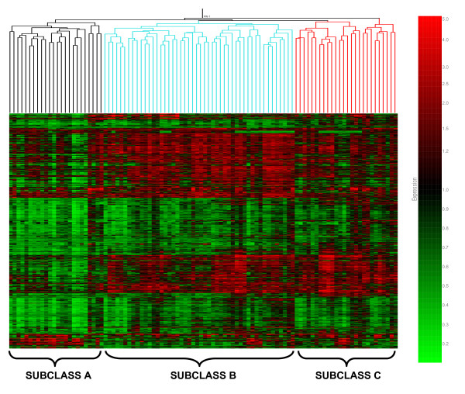
Subclass detection in Septic shock
Higher mortality rate and organ failure. Younger than B. More Gram+ bacteria than C.
Received higher levels of hydrocortisone for cardiovascular shock as compared to C

Slide 33
Subclass detection in Septic shock
ANOVA analysis based on these groups detects 6,934 probes (Bonferroni 0.05).
Kmeans with k=10 of the genes and pathway analysis (No p-value correction).
Many septic shock related pathways.
Taking the genes of the top 5 pathways in each cluster they ran LOOCV with SVM and got 91%
Do you see the problem?

Slide 34
SPACC: A semi-supervised method
Simultaneous Class Discovery and Classification of Microarray Data Using Spectral Analysis (QIU, JCB 2009)
http://www.ncbi.nlm.nih.gov/pmc/articles/PMC3148134/?tool=pubmed

Slide 35
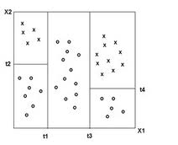
SPACC (Qiu and Plevritis 2009 JCB)
Proposed method:
Use an unsupervised clustering algorithm that partitions the samples to two (they used Spectral clustering).
Don’t split a group if above x% of the samples are from the same group.
We now have a binary tree that splits the feature space to domains. Each domain corresponds to a (sub)class.

Slide 36
SPACC (Qiu and Plevritis 2009 JCB)
Validation
Ran on two leukemia datasets (Golub 99- 38 samples 2 classes, Alizadeh 2000- 81 samples 5 classes).
When “hiding” some of the classes in the Alizadeh data, SPACC finds them.
Compare classification with kNN. They show a 10% improvement upon kNN.

Slide 37
SPACC remarks
Validation is very partial
No comparison with other clustering methods.
The validation datasets are easy.
In the original paper, the classifier of Golub et al. had >90% accuracy as SPACC (91%).
No comparison with decision trees:
These are supervised methods that build a tree that partition the feature space to domains.
Unlike SPACC these methods use the class labels while splitting the feature space.

Slide 38
Improving linear classification using subclass detection
Subclass analysis in LDA:
Optimal Subclass Discovery for Discriminant Analysis (Zhu and Martinez 2004)
http://ieeexplore.ieee.org/xpl/articleDetails.jsp?reload=true&arnumber=1384891&contentType=Conference+Publications
Subclass Discriminant Analysis (Zhu and Martinez 2006)
http://www2.ece.ohio-state.edu/~aleix/pami06.pdf
Background on LDA
Book: The elements of statistical learning (Friedman, Hastie, and Tibshirani)
Where are linear feature extraction methods applicable? (Martinez and Zhu 2005)
http://www2.ece.ohio-state.edu/~aleix/pami05.pdf
A direct LDA algorithm for High-Dimensional Data – with applications to face recognition (Yu and Yang, 2004)
http://www.citeulike.org/group/11724/article/5907405

Slide 39
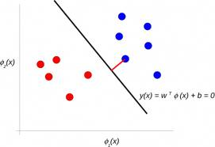
Why linear classification?
Linear classification: partition the feature space using linear hyperplanes.
When the linearity assumption holds, even few samples are enough for classification.
Most problems can be formulated in terms of generalized eigen-decomposition problems, for which many solvers are available.

Slide 40
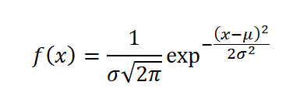
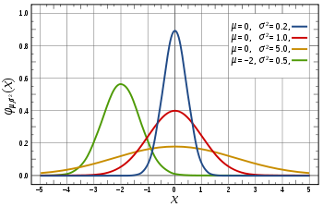
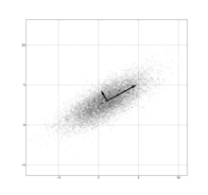
Introduction: Gaussian distributions
Univariate normal distribution
Multivariate normal distribution
The determinant of the covariance matrix is a generalization of the variance of the points
This is called the Mahalanobis distance of x

Slide 41
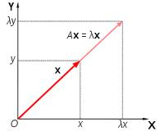
Multivariate normal distribution intuition
Mahalanobis distance measures the distance of a vector from the distribution’s center of mass.
If the covariance matrix is I we get the Euclidean distance.
Along “short” axis we pay a large price for being far.
If $λ$is an eigenvalue of $Σ$ then Mahalanobis distances give it a weight of $\frac{1}{λ}$ (we use the inverse of the covariance matrix)

Slide 42
Multivariate normal distribution intuition
If we have only one feature we get the univariate normal distribution.
All marginal distributions are normal.
A linear transformation Mx also distributes normally
The new mean is:
The covariance matrix is
Practically:
We can transform the data to orthogonal basis.
We can reduce the dimension of the data to simpler Gaussians.

Slide 43
Multivariate normal distribution intuition
The determinant gives us a single measurement of the variance of the distribution.
The covariance matrix is non-negative.
The largest eigenvector corresponds to the axis with the largest variance, this holds for the second, the third and so on.

Slide 44
Linear Discriminant Analysis
We want to learn P(Class| Data).
$$P\left(Class=k | X=x\right)=\frac{f_{k}\left(x\right)π_{k}}{\sum_{l=1}^{K}{f_{l}\left(x\right)π_{l}}}$$
In LDA we assume that $f_{k}$ is a multivariate normal distribution and that the covariance matrices of different classes are equal.
When we compare two classes:
$\log{\frac{P\left(G=k | X=x\right)}{P\left(G=l | X=x\right)}}=\log\left(\frac{f_{k\left(x\right)}}{f_{l}\left(x\right)}\right)+\log\left(\frac{π_{k}}{π_{l}}\right)$
$$= \log\left(\frac{π_{k}}{π_{l}}\right)−\frac{1}{2}{\left(μ_{k}+μ_{l}\right)}^{T}Σ^{−1}\left(μ_{k}−μ_{l}\right)+ x^{T}Σ^{−1}\left(μ_{k}−μ_{l}\right)$$
Decision boundaries are linear.

Slide 45
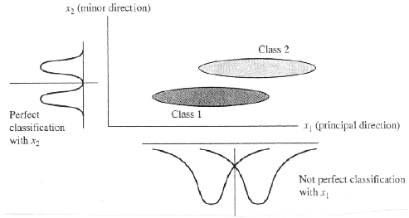
LDA
Another option is to look at the Mahalanobis distance of x from the centers of the distribution, but we won’t get a linear classifier.
PCA vs. LDA objective:

Slide 46
Fisher criterion
Fisher defined a simple and intuitive criterion for linear separation: we are looking for a linear transformation of the data V such that:
$\max_{V}{\frac{|V^{T}S_{b}V|}{|V^{T}S_{w}V|}}=\max{\frac{\left|{\tilde{S}}_{b}\right|}{\left|{\tilde{S}}_{w}\right|}}$ (V usage: Y=VX)
Where $S_{b}$ is the covariance between the means of the classes:
$S_{B}= \sum_{c}{\left(μ_{c}−μ\right){\left(μ_{c}−μ\right)}^{T}}$
$S_{W}$ is the covariance within the classes:
$$S_{W}=\sum_{c}{\sum_{i∈c}{\left(x_{i}−μ_{c}\right){\left(x_{i}−μ_{c}\right)}^{T}}}$$

Slide 47
Fisher criterion- theoretical results
Solving the Fisher problem is equivalent to solving a generalized eigen-decomposition problem:
$$S_{B}V=S_{W}VΛ$$
$Λ$ is a diagonal matrix (the eigenvalues).
From the above we get
$V^{T}S_{B}V=V^{T}S_{W}VΛ ⟹\left|V^{T}S_{B}V\right|=\left|V^{T}S_{W}VΛ\right|= |V^{T}S_{W}V||Λ|$
Hence: $\frac{\left|V^{T}S_{B}V\right|}{|V^{T}S_{W}V|}=\prod_{i=1}^{n}{λ_{i}}$
To maximize the formula, we shall keep the top eigenvalues (covariance matrices are nonnegative).
The dimension of V can be at most C-1 to get only positive eigenvalues (hint: the rank of $S_{B}$ is at most C-1).

Slide 48
Theoretical results- interpretation
Generalized eigen-decomposition problems have many solvers.
Fisher criterion is easy to manipulate by defining different covariance matrices e.g., non-parametric approaches.
LDA can be used for classification and dimension reduction.

Slide 49
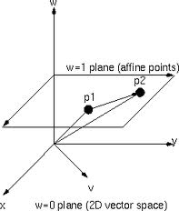
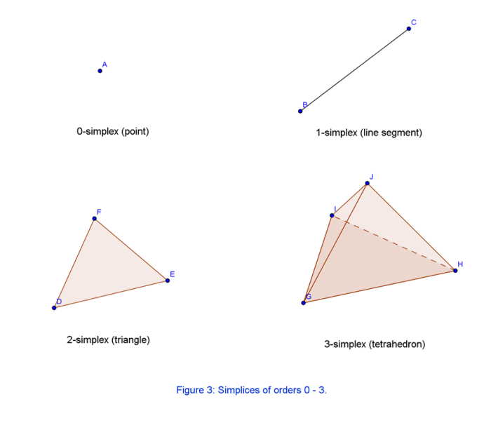
LDA geometric intuition
Assume priors are equal
Standard LDA can be seen as measuring the distances from the classes means, in the space defined by the shared covariance matrix.
Since the number of means is at most C, we could build an affine subspace of dimension C-1 such that the classification is dependent only in this space. Thus, Fisher-LDA with the maximal dimension is equivalent to standard LDA.

Slide 50
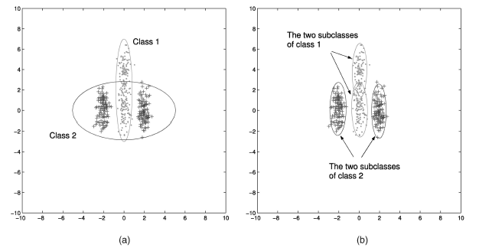
SDA (Zhu and Martinez, 2006)
We can approximate one Gaussian using two Gaussians, but the opposite is not correct.
We can therefore split classes and use linear bounds. Also, the LDA space can be larger now.

Slide 51
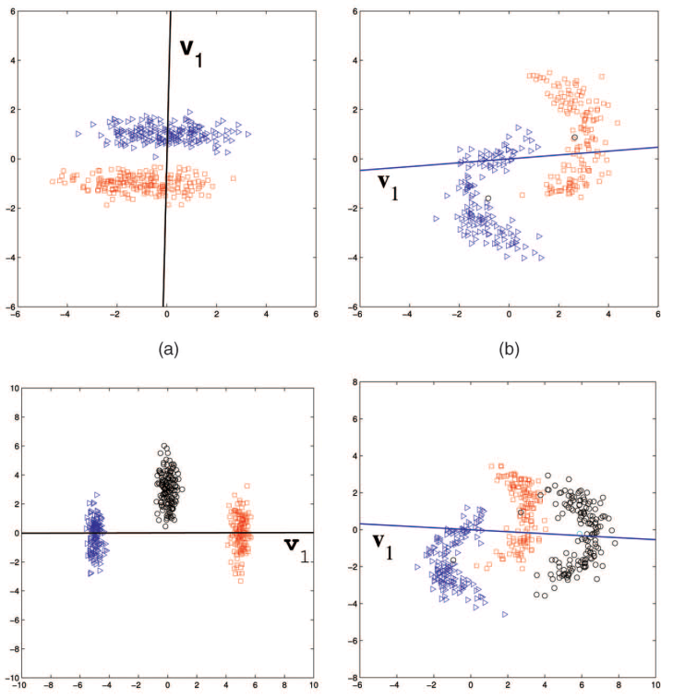
SDA (Zhu and Martinez, 2006)
We can approximate one Gaussian using two Gaussians, but the opposite is not correct.
We can therefore split classes and use linear bounds. Also, the LDA space can be larger now.

Slide 52
The clustering method
Learning mixture of Gaussians is usually done using EM methods or Kmeans.
Here they suggest a simple and fast algorithm that they call NN-clustering:
We start by sorting the sample vectors of class $i$: $x_{i1},…,x_{in}$.
First, $x_{i1}$ and $x_{in}$ are the two farthest vectors.
Then $x_{ij}$is the $j^{th}$ closest vector to $x_{i1}$ and $x_{i\left(ni−j\right)}$ is the $j^{th}$ closest to $x_{in}$.
The ordered set is then partitioned to $h$ clusters.
In this process assume that each class is equally represented.

Slide 53
SDA first criterion
Use a clustering algorithm to partition each class to t subclasses.
For each t, evaluate the classification accuracy using LOOCV:
Leave one sample out of the data
Partition each class to t clusters
Evaluate the test using LDA
Choose the best t and build the LDA model according to partitioning to t classes.

Slide 54
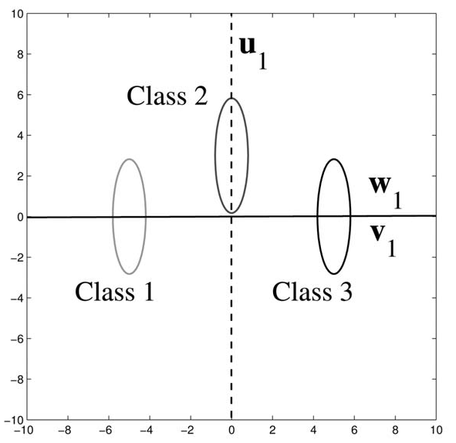
SDA second criterion
Define a conflict between $S_{B}$ and $S_{W}$ as the cases in which the angle between the eigenvector $u$ of $S_{W}$ and $w$ of $S_{B}$ is low.
If the eigenvectors are orthogonal we are in agreement:

Slide 55
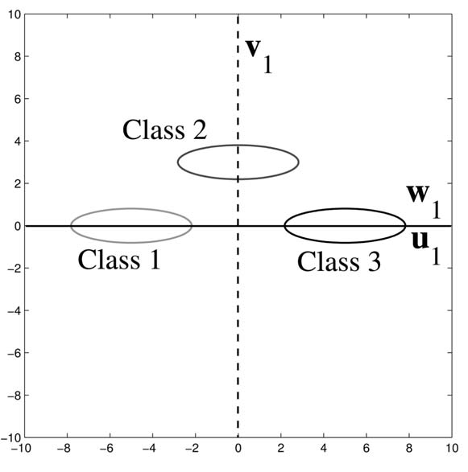
SDA second criterion
If the angle is zero, LDA might fail as a dimension reduction method even if all assumptions hold (!):
V is selected instead of u
W and u are the same, the eigenvalue of w is larger.

Slide 56
SDA second criterion
Suppose we divide the data to $n_{B}$ clusters. For each eigenvector $u_{i}$ of the new $S_{B}$ measure its angle with the first i vectors of $S_{W}$. Assume all eigenvectors have a norm 1:
Normalize by the number of sub classes, the problem is:
$$K=\sum_{i=1}^{n_{B}}{\sum_{j=1}^{i}{{\cos\left(u_{i},w_{j}\right)}^{2}=}}\sum_{i=1}^{n_{B}}{\sum_{j=1}^{i}{{\left(u_{i}^{T}w_{j}\right)}^{2}}}$$

Slide 57
SDA- NN clustering method
For preventing overfitting, we adjust the between classes covariance to:
This measurement promotes separation between subclasses of different classes.
If we have too much classes, the priors are very small and this shrinks the values of the matrix.

Slide 58
Results 1
Validation: ETH-80 dataset:
Images of: apples, pears, cars, cows, horses, dogs, tomatoes, and cups (8).
Each class has 10 objects (80 samples).
Each object has images of 41 orientations (410 images in each class).
Two options to use this dataset:
Feature extraction: use 300 features that measure the distance of a point from the silhouette of the object.
Use the pixels as features (750 features).

Slide 59
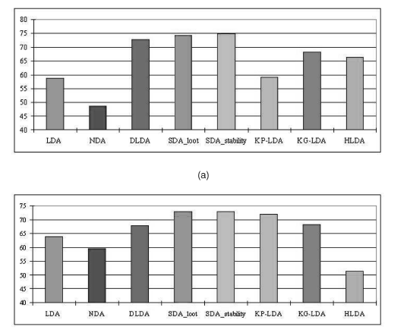
Results 1

Slide 60
Results 2
Face recognition
Over100 persons
Each person has 26 different images.
Use pixels as features.
2-cv process

Slide 61
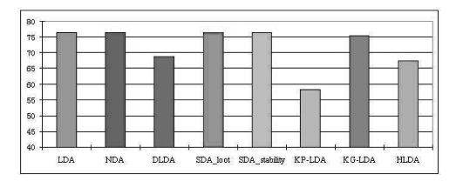
Results 2

Slide 62
Summary
Clustering based methods
Preprocessing: usually use the controls to select differential genes.
In most cases the number of clusters is selected manually.
Classification based methods
When we have a control class.
Use tree classifier that dissect the space. Infer the subclasses from the tree structure.
How to validate new (sub)classes?
Clinical\genetic information.
Prediction scores distribution is not random.
Classification based on the new classes.
Classification improvement.

