Slide 1
Prima
Updating Human Promoters

Slide 2
What is the problem?
For each protein coding gene there is a 5UTR promoter.
For each 5UTR promoter we have a start location – Transcript Start Site (TSS) and an End site before the coding sequence (CDS)
TSS

Slide 3
In Human genome – for each 5UTR promoter there might be a couple of TSS’s with a different start locations
Which one should we choose?
Expander choose randomly 1 TSS
What happens if the Promoter that was chosen by Expander is a promoter of a transcript from the brain while the Dataset is from the Liver?

Slide 4
Promoters building process
Download 5UTR + 3000 upstream and Transcript flank + 3000 upstream protein coding fasta sequences from ensembl biomart
Running scripts on the sequences in order to get the promoters:
fasta_filter.py – filter the known chromosomes of the organism
Preprocesspromoters.pl – compares the 5UTR promoters to Transcript flank file.

Slide 5
3) fetchSeqsFromFasta.pl – gets a file in Expander format
4) addLLids.pl – adds LLids to the promoters
5)Prepare a list of BG gene list file
6) Save non masked version – e.g Hs_Proms_v50.protein_mirna.19329.txt“
7) Prepare masked version using RepeatMasker
8) Updating TF fingerprints using checkProfiles_5.3.pl

Slide 6
There are 2 versions of promoters:
The old – V53
The new – v68
With v68 we have the problem
We also checked refseq genes

Slide 7
Checking the promoters
Chaim and Rani instructed me to check the new promoters using Amadeus and Expander.
Ron and Rani requested to know what is the distribution of TSS’s per gene.
Rani also wanted me to check the Refseq genes compare to Ensembl.

Slide 8
Distribution of TSS’s per gene

Slide 9
Distribution of TSS’s per gene

Slide 10
Amadeus Output
Ensembl_V53 – With HCC.txt dataset
Found a total of 2 motifs.
MOTIF #1: PwmMotif(116): <Consensus=ATTTGAAATG; Threshold=0.001800847>
Total p-value: 1.1E-36
MOTIF #2: PwmMotif(96): <Consensus=GGGCAATCGG; Threshold=0.002489652>
Total p-value: 2.6E-21

Slide 11
Ensembl_V68 – With HCC.txt dataset
Found a total of 3 motifs.
MOTIF #1: PwmMotif(113): <Consensus=AATTCGAATC; Threshold=0.003465992>
Total p-value: 3.9E-21
MOTIF #2: PwmMotif(99): <Consensus=AGCCAATAGG; Threshold=0.001575591>
Total p-value: 5.4E-18
MOTIF #3: PwmMotif(70): <Consensus=ACGAATCACC; Threshold=0.002440623>
Total p-value: 8.5E-16

Slide 12
Refseq_genes – With HCC.txt dataset
Found a total of 3 motifs.
MOTIF #1: PwmMotif(103): <Consensus=AGTTCGAAAC; Threshold=0.003017029>
Total p-value: 1.3E-23
MOTIF #2: PwmMotif(120): <Consensus=GGCCAATCGG; Threshold=0.001822137>
Total p-value: 1.1E-15
MOTIF #3: PwmMotif(25): <Consensus=GAGAAAACAA; Threshold=0.010772911>
Total p-value: 1.7E-13

Slide 13
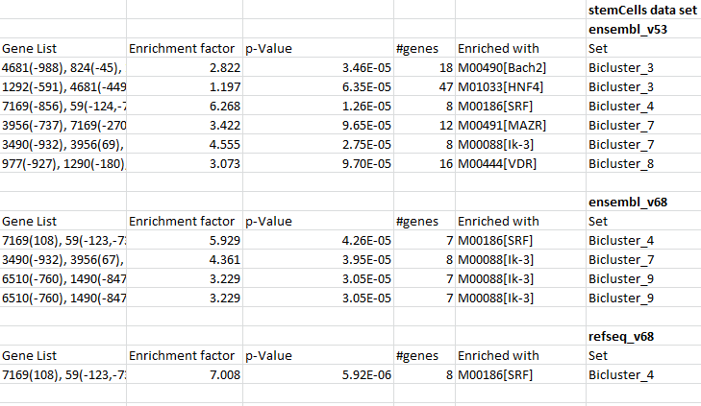
Expander output

Slide 14
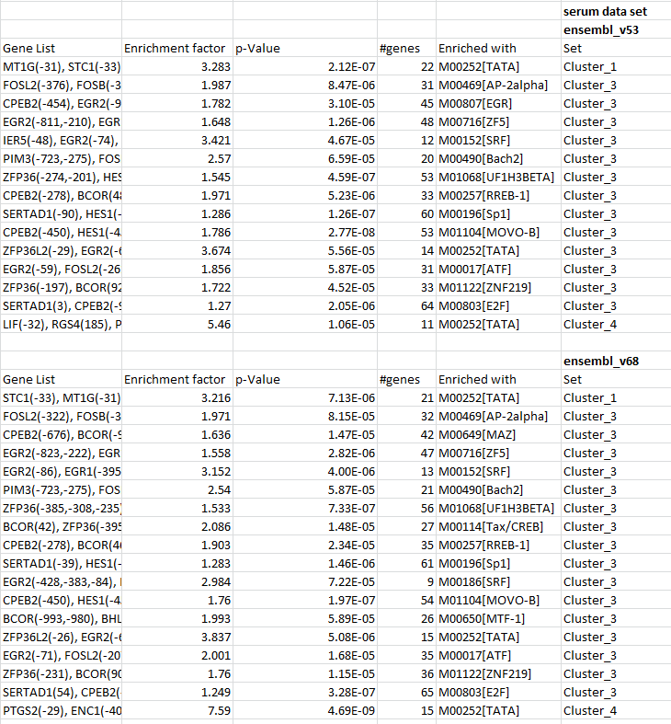

Slide 15
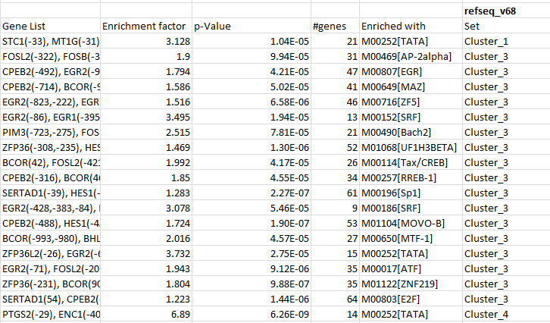

Slide 16
Additional Problem
In some organisms the number of promoters in V68 was reduced in almost a half from the older v53/56, for example:
Rat – v56:22934, v68:10376
C.elegans – v56:20151, v68:12450
Chicken – v56:16730, v68:8533

