Slide 1
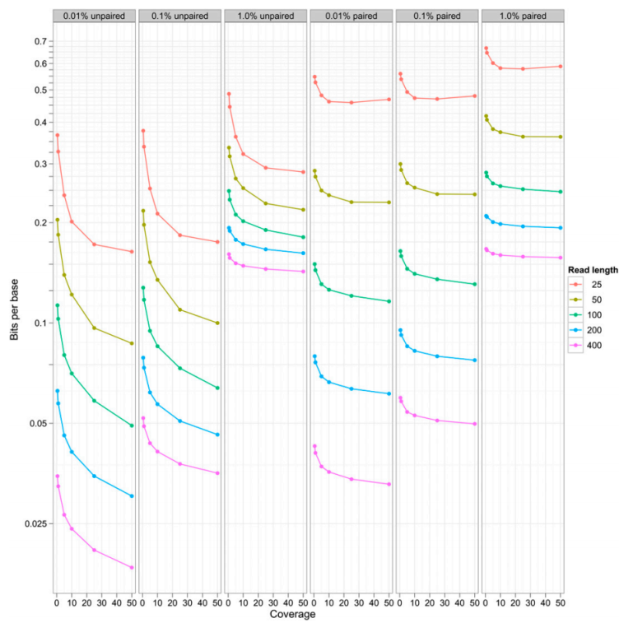
Compression by Reference
Shamir lab meeting 15/8/12

Slide 2
Why is DNA compression needed?
Foreseeable that each person will have genome sequenced in the future
Sequencing price dropping, output growing
Output growth outpaces storage growth rate
In some cases storing is more expensive than sequencing sample again
Want to reduce amount stored for cost and (transfer) time savings

Slide 3
DNA compression background
Can compress on trace (images), reads, or assembled sequence
Sequence assembly challenging in itself, focus on compression of reads
General compression methods can be applied, but want to do better by using reference, and fact that sequence of reads are largely identical to reference sequence at defined locations
Want to handle differences/errors efficiently

Slide 4
SlimGene Compression

Slide 5
REFINEMENT
Fragments ordered by genomic position
Fragments corresponding to same position appear consecutively with error information
Errors indicated with relative offset
OpCode describes type of error

Slide 6
Huffman OpCode

Slide 7
Huffman code
Prefix code: there is no codeword that is a valid prefix of any other codeword
Intuition: given alphabet of symbols and their frequencies code symbols such that most commonly used symbols get shortest encoding
SlimGene close to theoretical limit calculated with by entropy
Notes:
Go to example Huffman encoding here
Mention going left is 0, right is 1

Slide 8
Compact offset encoding
Store error position vector with length of genome
Store offset to correct error (‘1’ on error vector) – “bits to skip”
Store offset relative to end, as most errors tend to be at end of read
Per nucleotide requirement:
Notes:
Show quick example – consider removing formula

Slide 9
Results on simulated data
Notes:
Simulation – p0 is prob of zero errors in each case, p1-p10 were tallied on real data, p0 is varied and rest are shifted to sum to one
Fragments of length 100 from chrom 20

Slide 10
Golomb Code
Geometric distribution, or occurrence of small values in the input stream is significantly more likely than large values
Tunable parameter M divides input into quotient q and remainder r
Quotient coded as unary (n 1s followed by 0 or vice versa) and remainder in truncated binary encoding, each of these parts is also a prefix code

Slide 11
mzip
1. We store the lookup position of each read on the reference sequence as the integer position on this compression framework. The lengths of reads are compressed using Huffman coding (Huffman 1952). For constant read length across a file, we store the length once.
2. We assume that read order does not have any meaning for any given data set and reorder the reads with respect to the integer position determined in (1), allowing efficient relative encoding of the positions by storing the differences between successive values instead of the absolute values. Given coverage and read length, a Golomb code is chosen that is parameterized on the expected distance between reads.
3. Any variation from the reference is stored as an offset relative to the integer position from (1), along with the base identities (for substitutions and insertions) or the length (for deletions). Offset values, again, are assigned a Golomb code parameterized on the distance between successive variation positions.
4. The read pair information is stored as an unsigned rank offset from the positionally lower read to the positionally higher read, with three bits present to indicate relative orientation of reads and the strands from which they were sequenced. Again, Golomb encoding, parameterized on expected rank offsets, is
used.
Notes:
Mix of coding tricks, not too many details given

Slide 12
mzip

Slide 13
Parameter dependencies
Notes:
Columns are different error rates, paired or unpaired reads

Slide 14
Quality values: are they needed?
Different attitudes towards them
Needed for individual SNP calling on individual
SNPs also inferred, necessity should be based on how they impact results
Errors on SNPs mitigated by looking at population
Two papers present different lossy approaches – limit possible values of quality, versus only store subset of values

Slide 15
SlimGene Quality values
Notes:
Develop probabilistic model for lossless, see too much space still used

Slide 16
SlimGene results

Slide 17
mzip results

