Slide 1
An iterative network partition algorithm for accurate identification of dense network modules
Siqi Sun, Xinran Dong, Yao Fu and Weidong Tian
State Key Laboratory of Genetic Engineering,
Institute of Biostatistics,
School of Life Sciences,
Fudan University,
Shanghai
Nucleic Acids Research, 2012
Ron Zeira
AGCT 30.5.12

Slide 2
Motivation
Biological network provides a convenient platform for modeling, displaying and visualizing the complex relationships.
For example: protein–protein interaction, gene co-expression network, etc…
It is often necessary to partition a network into modules to generate biologically meaningful hypothesis.

Slide 3
Modularity
Given an undirected graph G=(V,E) and a partition of the vertices C. We define modularity:
Where m=|E|, E(C) is the edges in cluster C and deg(v) is the (global) degree of node v.
-1/2≤q(C)≤1
Max modularity is NP-hard, even for fixed k.
On Finding Graph Clusterings with Maximum Modularity – Brandes et al.
Notes:
Modularity is a benefit function that quantifies how well
a network is divided into modules
which reveals an inherent trade-off: to maximize the first term, many edges should be contained in clusters,
whereas the minimization of the second term is achieved by splitting the graph into many clusters with small
total degrees. Note that the first term |E(C)|/m is also known as coverage [

Slide 4
Max modularity facts
Isolated nodes have no impact on modularity.
A clustering with maximum modularity has no cluster that consists of a single node with degree 1.
There is always a clustering with maximum modularity, in which each cluster consists of a connected subgraph.
A clustering of maximum modularity does not include disconnected clusters.
On Finding Graph Clusterings with Maximum Modularity – Brandes et al.

Slide 5
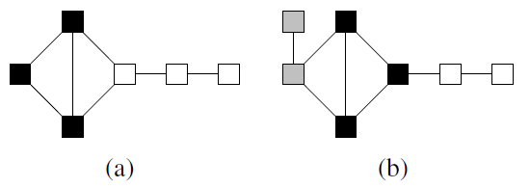
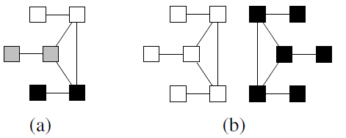
Modularity impairments
Counterintuitive Behavior:
Non-Locality
Sensitivity to Satellites
Scaling Behavior
Algorithm resolution limit
n clique
n vertices
On Finding Graph Clusterings with Maximum Modularity – Brandes et al.
Notes:
there is an
inherent resolution limit in the modularity function,
making it difficult to detect smaller communities by
maximizing modularity.

Slide 6
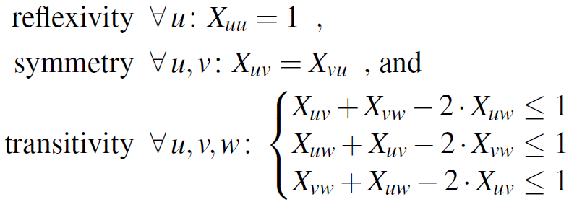
ILP formulation
Define decision variables X_{uv} in {0,1}.
Let E_{uv} = 1 for a (u,v) edge and 0 o.w.
We want to maximize:
To form a clustering, X_{uv} should be an equivalence relation:
On Finding Graph Clusterings with Maximum Modularity – Brandes et al.

Slide 7
Max modularity heuristics
Multi-Step Greedy (MSG) – merge 2 communities maximizing modularity.
Spectral clustering (SC) – mapping similarity matrix to different dimension and use k-means.
Qcut – uses modularity to determine partioning and combines spectral and local search methods.
Other: simulated annealing…
Notes:
MSG is a greedy method. Compared with traditional
greedy methods that iteratively merge two communities
contributing the most to modularity maximization,
MSG optimizes modularity by merging multiple pairs
of communities at each step of iteration. In addition,
a Vertex Mover algorithm is implemented after the convergence
of modularity maximization to adjust the
‘misplaced’ vertices to neighboring communities in order
to further improve the modularity. MSG is highly computationally
efficient, with a complexity of approximately
O (Nlog2N) for sparse networks, where N is the number
of nodes in the network.
SC is a spectral approach-based clustering method.
It involves mapping of the similarity matrix in a highdimensional
space to a low-dimensional space, clustering
the nodes by k-means, and selecting the best ‘k’ that gives
the maximum modularity value (24). It is currently one of
the most popular network partition algorithms.
Qcut is a graph partitioning algorithm. Compared with
other graph partitioning algorithms, Qcut uses modularity
to automatically determine the optimal partitioning
and the number of partitions, and is parameter free. In
addition, Qcut also combines spectral graph partitioning
with local search to optimize modularity, making it an
efficient heuristic algorithm

Slide 8
The iNP algorithm
Input: G – graph, A – clustering algorithm
Apply A to partition G.
Apply A on each module to discover smaller modules.
Determine whether to stop or continue partitioning on a pre-partitioned module according to the modularity compared to random.

Slide 9
Stop criteria
Simulate random graphs with similar degree distribution.
Partition each graphs with MSG and obtain modularity of random graphs.
Start with 10 graphs:
S>=1 → continue
S<=0.2 → stop
Else → 50 more graphs, Z-score of M-values
If Z>=2 continue else stop

Slide 10
Validation on simulated networks
6*4*3*9=648 networks with 1000 nodes
6 mean community sizes 25 to 150
4 community size variances 10% to 40%
The in-out-degree; number of links node has in the module to that in the network.
in-out-degree ratio mean: 0.5,0.6,0.8 and variance 0.2.
9 networks each.
Notes:
Complicated model
Modules about the same size
Sparse networks

Slide 11
Jaccard accuracy
Given partitioned modules G_{i} and an originally defined moduls A_{j}.

Slide 12
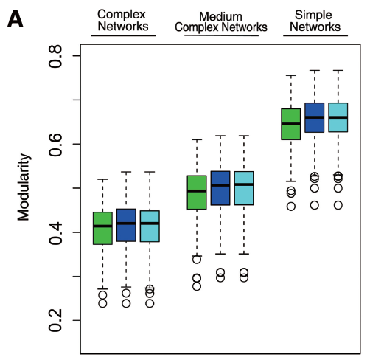
Why iNP?
Similar modularity in all methods.
MSG is 20 times quicker than SC and Qcut.
Notes:
Despite the resolution limitation, modularity preserves the
primary network structure of undetected dense modules

Slide 13
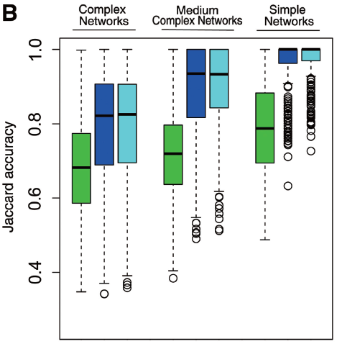
But…
MSG has significantly worse Jaccard coefficients.

Slide 14
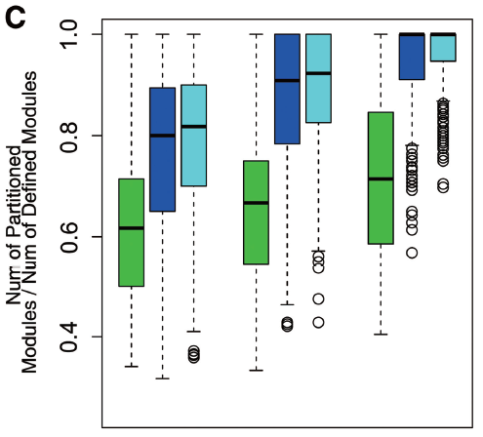
Over-aggressive/over-conservative?
Methods discover less modules.

Slide 15
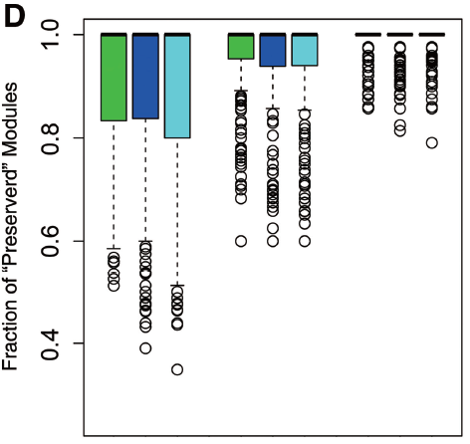
Over-aggressive/over-conservative?
A defined module is considered preserved if 80% of its nodes are kept in the same module after a network partition.
Tendency to merge dense modules into large ones.

Slide 16
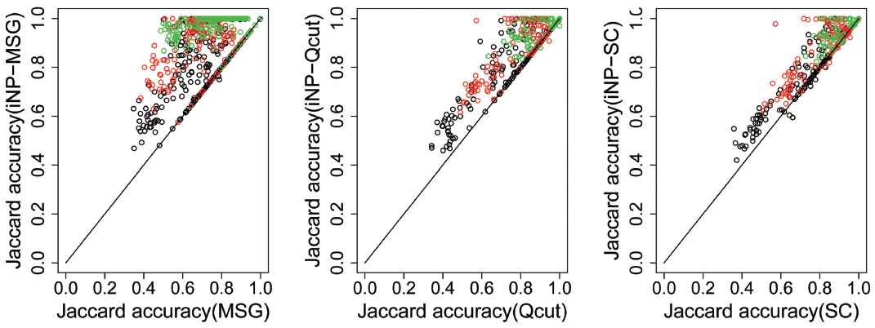
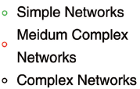
iNP improves?

Slide 17
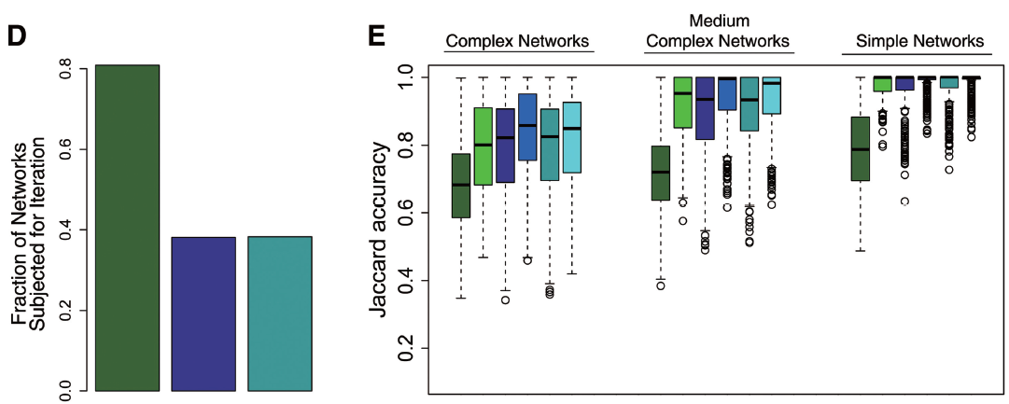
iNP improves?
iNP-MSG is comparable with other methods while still very efficient.

Slide 18
Biological data
Protein complex interaction network from Yu et al 08; 1622 genes, 9070 interactions (average degree ~11, 0.7% of possible edges)
Breast cancer expression data from GEO.
Normalized data
Followed Zhang et al’s method of construction.
Ended with 9112 genes and 244928 edges (average degree of ~54, 0.6% of possible edges)

Slide 19
Co-expression graph construction
185 (143,43?) samples. 21561 genes.
Filter lowest 30% probes.
Calculate log2 of gene expression’s median.
Impute missing values with KNN.
Quantile normalization in each sample.
Remove correlated samples > 0.99.
Select the top X% correlated gene pairs s.t:
Linear regression coefficient between the log10 transformed degree k and the frequency of k gives the best correlation. (scale free property)
Notes:
Such network is considered to
have the scale free property. Based on this measure,
we chose the network constructed from the top 0.1

Slide 20
Gene co-expression modules
Given a group of genes (module);
Compute gene expression median.
Plot ROC curve to classify samples using median expression.
If AUC > 0.8 → up-regulated gene module.
If AUC < 0.2 → down-regulated gene module.

Slide 21
Functional linkage enrichment (FLE)
The more functionally related genes are in a module, the more biologically meaningful it is.
Use funsim score of Schlicker et al. funsim considers all associated GO terms of 2 genes, as well as their specificity.
Given a partition G_{i};
Notes:
where i
refers to the ith partitioned module, N is the total
number of partitioned module, funsimavg,i is the
averaged funsim scores of all gene pairs in the i-th partitioned
module, and funsimrand is the random funsim score
of a pair of genes in the genome

Slide 22
However…
FLE may be biased to networks with more number of modules.
This may be especially a problem for iterative partitioning.
Functional cohesiveness score (FCS); Suppose a module m was partitioned into N modules:

Slide 23
FCS/FDS
Functional distinctiveness score (FDS)
For random module partitioning FCS=FDS=1
If further partitioning is more bioligically relevant both scores >1
If, however, partition destroys the structure <1

Slide 24
PPI
FLE
FCS
FDS
FLE → biologically meaningful
FCS,FDS>1 → all partitioning provided meaningful results.
Modularity is about the same.

Slide 25
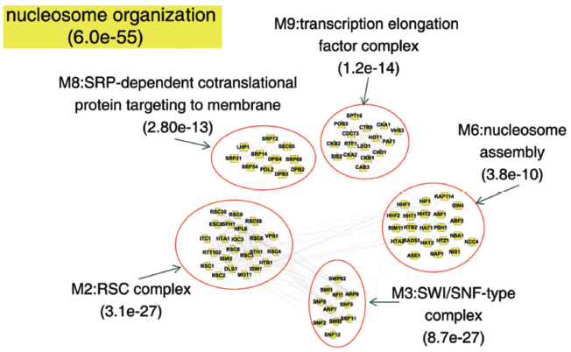
PPI
MSG merged all genes together while iNP-MSG partitioned complexes apart.

Slide 26
Breast cancer GE
FLE → biologically meaningful
FCS,FDS>1 → all partitioning provided meaningful results.
Top four largest modules consist of a large portion of the network.

Slide 27
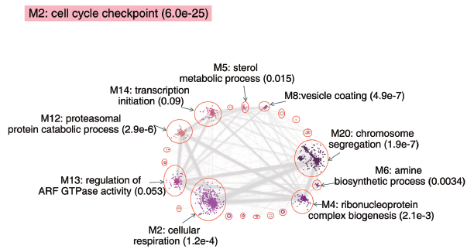
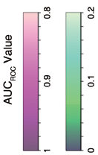
MSG up-regulated module AUC=0.91.
iNP-MSG divided to 65 modules, 21 with AUC >0.8.
Most significantly up-regulated has AUC=0.98.
The most significant GO tern is ‘chromosome segregation’.
This module also include notorious genes such as BRCA1.

Slide 28
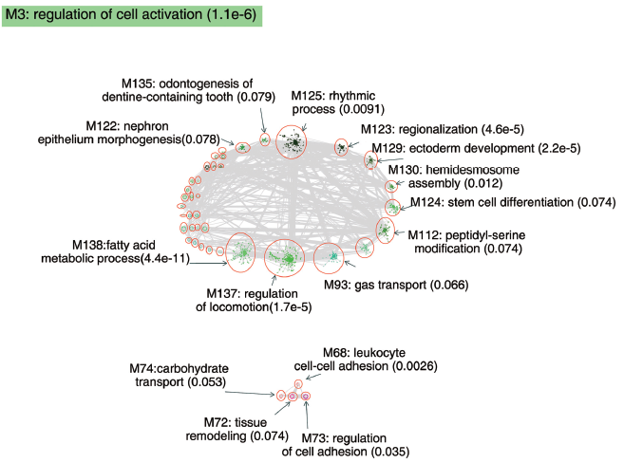
Further partition revealed up-regulated modules inside the larger down-regulated one.

Slide 29
(My) Conclusions
Ups:
Fast (< 2 minutes on breast cancer).
Accurate.
Adaptable.
Introduce new scores.
Downs:
Modularity function is disappointing.
Non standard scores.
*Works on sparse networks.
*Too heuristic.

