Slide 1



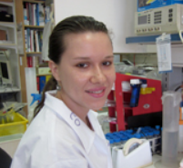

Comprehensive Multi-layer Exploration of the Transcriptional Responses to ionizing radiation (IR) Using Deep-sequencing Technologies
TRIREME Project; WP3
TAU: Yossi, Ron
MPI-Berlin: ML Yaspo
Sharon
Rashi
Yuliya
Karzov
Ana
Kupershtein
Marie-Laure
Yaspo
Hans-Jörg
Warnatz

Slide 2

DNA
turnover
Endogenous
agents
Exogenous
agents
Double strand breaks
Sensors
ATM
Effectors
Survival
pathways
Cell death pathways
Cell cycle
arrest
Stress
responses
Apoptosis and others
DNA
repair

Slide 3
Multi-layer Exploration of the Transcriptional Response to IR Using NGS Technologies
mRNA Response
(RNA-seq)
microRNA Response
(miR-seq)
TF DNA-binding Profile
(ChIP-seq)
Chromatin Modulation
(ChIP-seq)

Slide 4
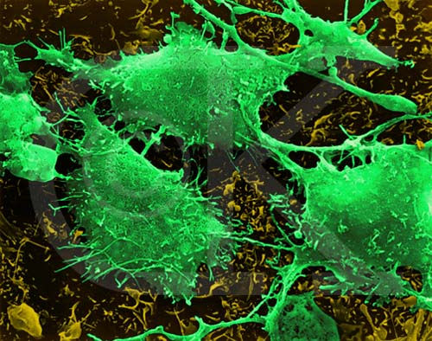
Choice of Model Cell Line
CAL51 - metastatic breast cancer
  Highly malignant in nude mice
  Normal diploid Karyotype
  Presence of key DDR players (e.g., functional p53)
  Proper activation of the DDR (e.g, cell-cycle checkpoints)

Slide 5
Comprehensive Exploration of the Transcriptional Response to IR (CAL51)
mRNA Response
(RNA-seq)
microRNA Response
(miR-seq)
TF DNA-binding Profile
(ChIP-seq)
Chromatin Modulation
(ChIP-seq)

Slide 6
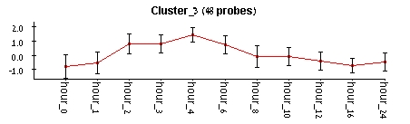
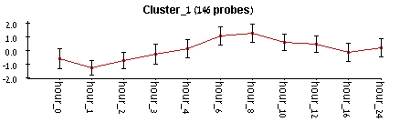
Preliminary experiment using arrays
Goal: determine time-points for RNA-seq
Early-up
Late-up

Slide 7
RNA-Seq experiment
Five samples:
  C0, C4, IR4, C8, IR8
  Dose: 5 Gy
Platform:
  Illumina GAII
Protocol
  Paired-end
  Reads length=50 bases
  Protocol preserves transcript’s strand

Slide 8
RNA-Seq Data Analysis
Initial steps:
Alignment of the reads to the human genome (TopHat)
Counting the number of reads which map to each gene in each sample (HTSeq; annotations: Ensembl)
Normalization of the counts to derive estimates of expression levels (quantile)
Number of Uniquely Mapped Reads | Sample
61.4 M | C.0h
82.3 M | C.4h
77.4 M | IR.4h
87.2 M | C.8h
67.0 M | IR.8h

Slide 9
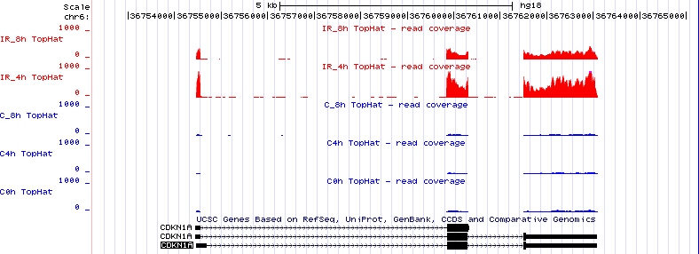
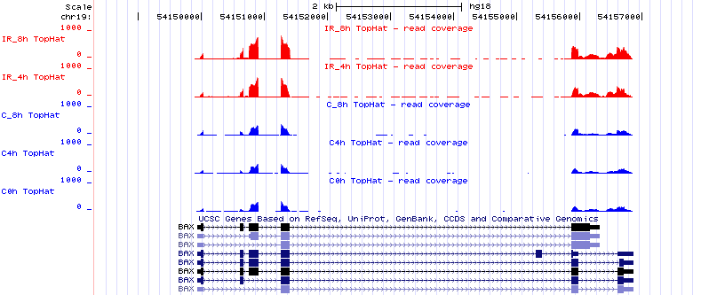
Irradiated samples
>50x
Control samples
p21
Exons
>2x
BAX

Slide 10
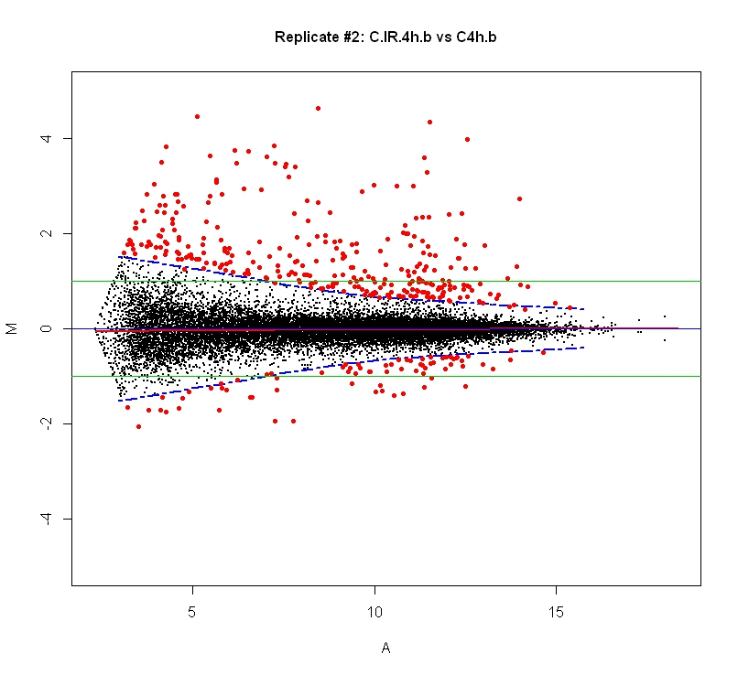
IR-Responsive Genes
Irradiated vs. untreated sample (4h)
Fold-change (log2)
FC-threshold: 2.5*SD
Fold-change threshold is adjusted to noise (expression level)
Expression level (log2)

Slide 11
Number of responding genes
Repressed | Induced
74 | 299 | 4 hrs
32 | 382 | 8 hrs
103 | 484 | Total (unique)
FC-threshold: 2.5*SD

Slide 12
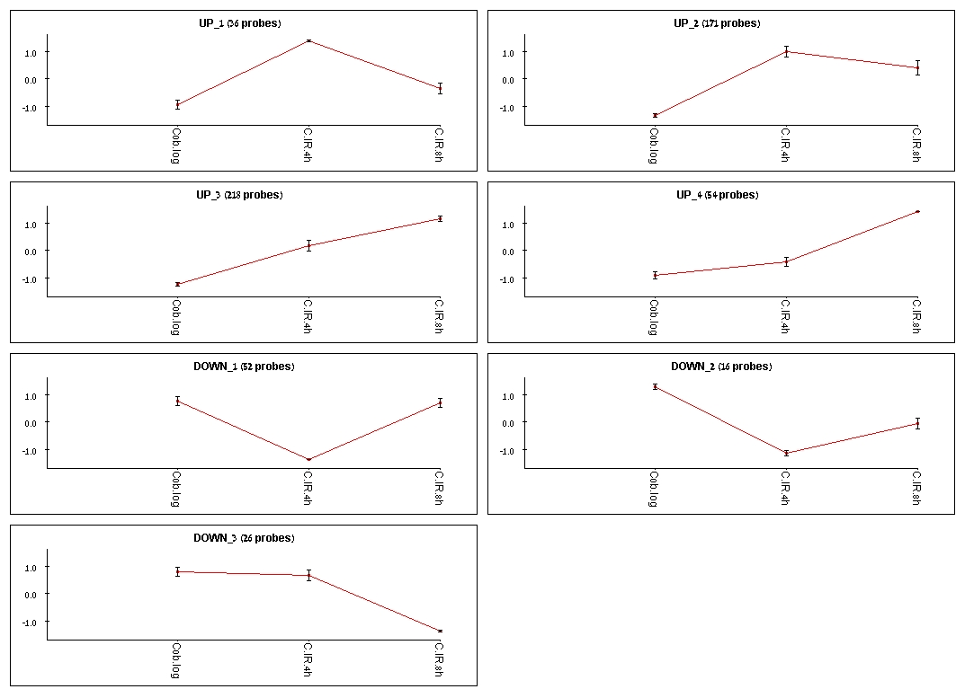
Kinetics of the Response - Induction

Slide 13
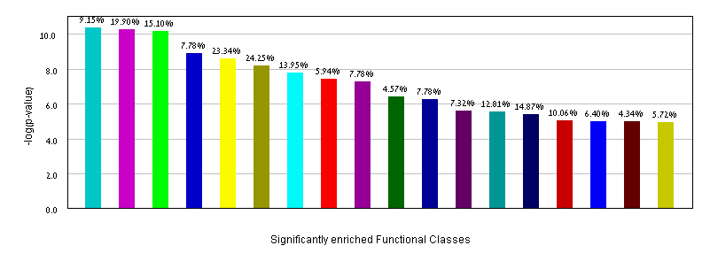
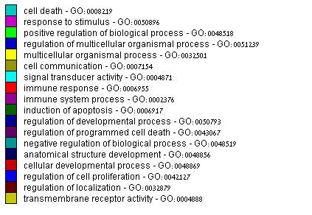
GO Functional Enrichment – Induced Genes

Slide 14


Apoptosis
Regulation of
cellular proliferation

Slide 15
Kinetics of the Response - Repression

Slide 16
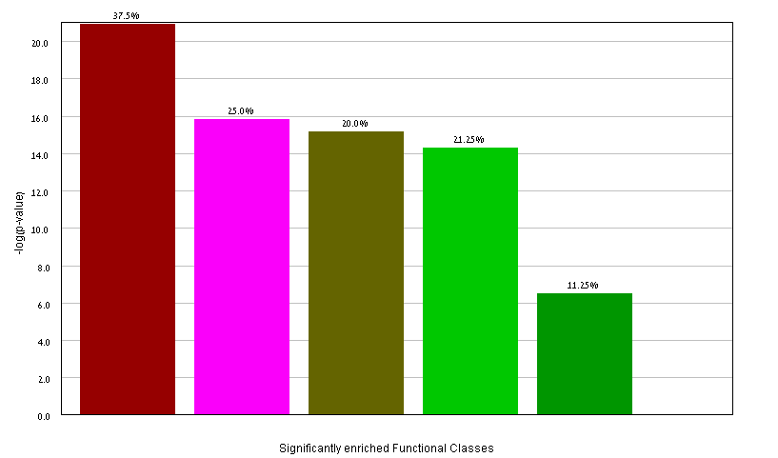


GO Functional Enrichment – Repressed Genes

Slide 17
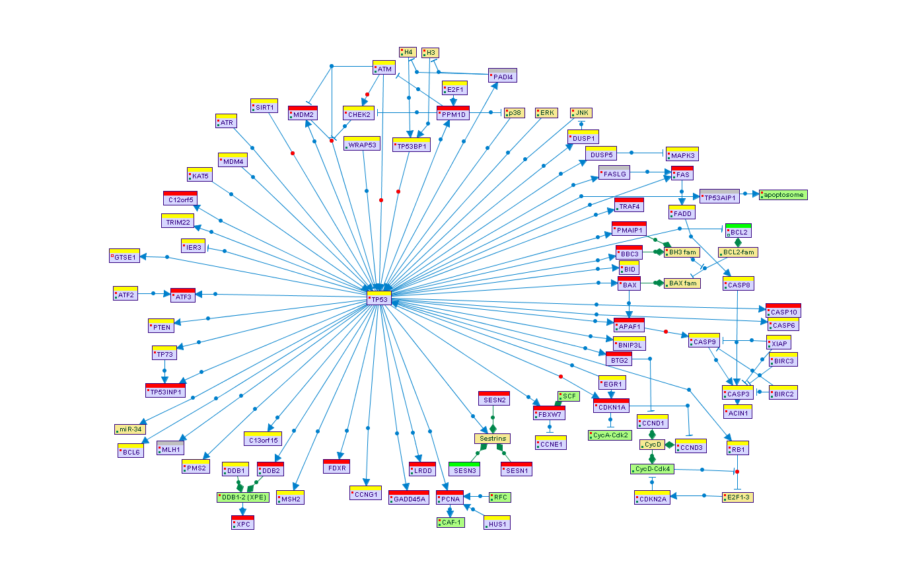
Enriched Signaling Pathways (SPIKE)
p = 5.8E-13

Slide 18
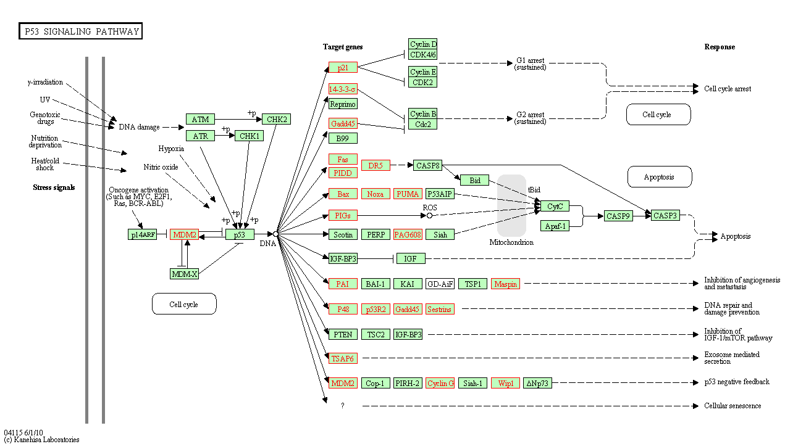
KEGG

Slide 19
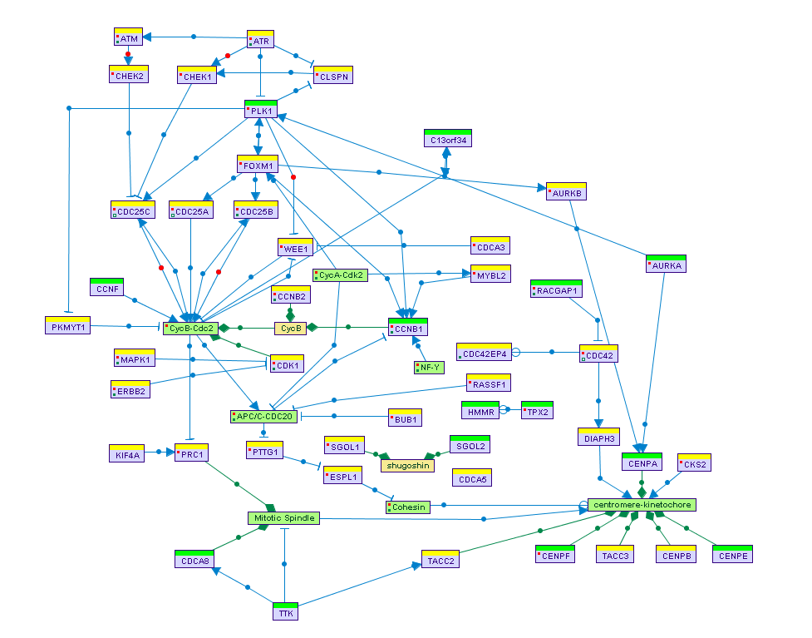
G2-M phase
p = 1.56E-14

Slide 20

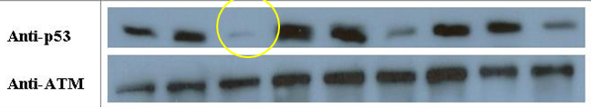
Dissection of the p53-dependent transcriptional response
We applied RNA-seq to samples knocked-down for p53 (same dose (5 Gy) and time-points (0, 4 hr and 8 hr))
  Efficient repression of p53 expression: p53-kd resulted in >10-fold decrease in p53 transcript level
TP53 mRNA
“WT” samples
p53kd samples

Slide 21
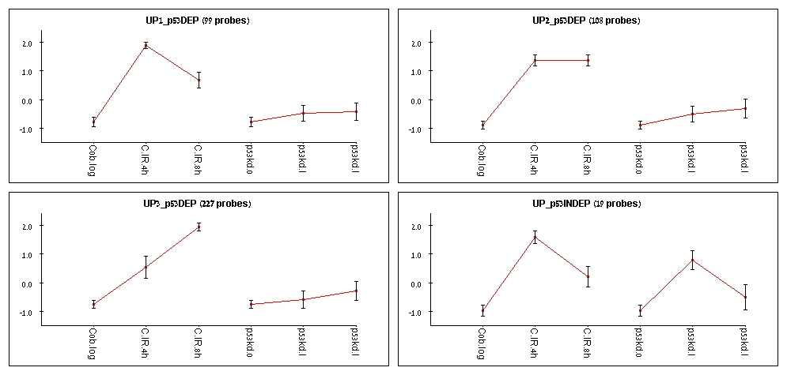
p53-kd effect on gene induction in response to IR
> 90% of the response is p53-dependent

Slide 22
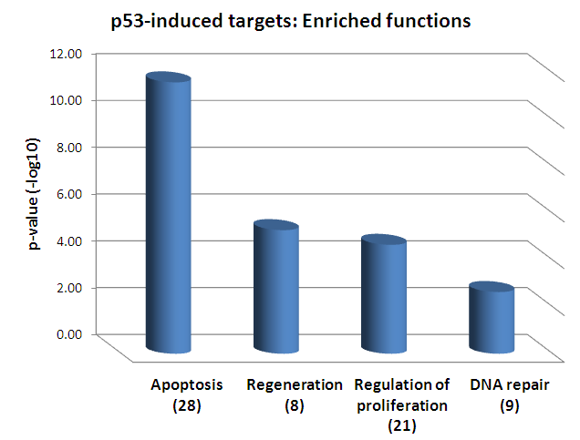
Functional Annotation of p53-Dependent Genes

Slide 23

p53-independent gene induction in response to IR
p53-independent response

Slide 24
ATM-dependent Transcriptional Activation
Gene expression profiles were recorded under the same conditions (5 Gy, 0, 4 and 8 hrs) using expression arrays (Illumina bead-chips, 48K probes)
Samples: Control, p53kd, ATMi and siGFP
Triplicates
112 genes were significantly induced (p<0.05) in the Control cells at 4 hr

Slide 25
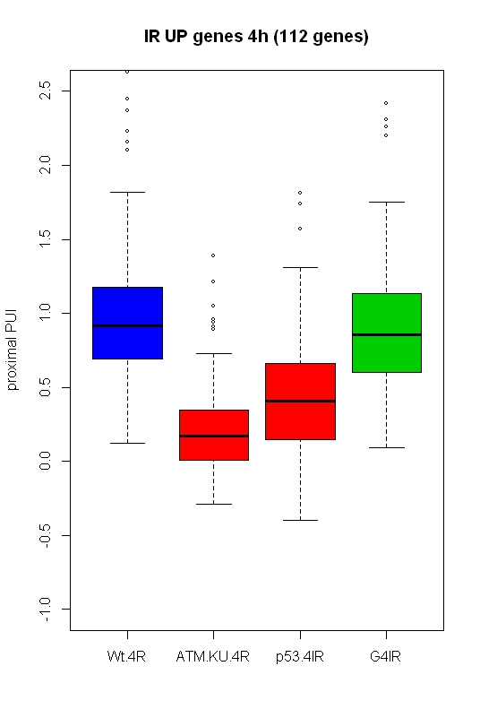
ATM inhibition effect (Array data)
p=E-20
p=E-29
Fold-change (log2)

Slide 26
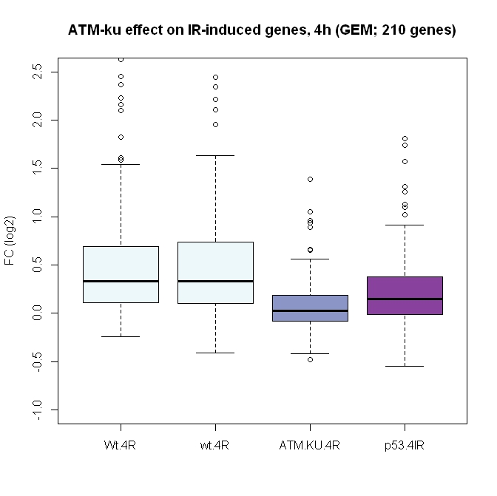
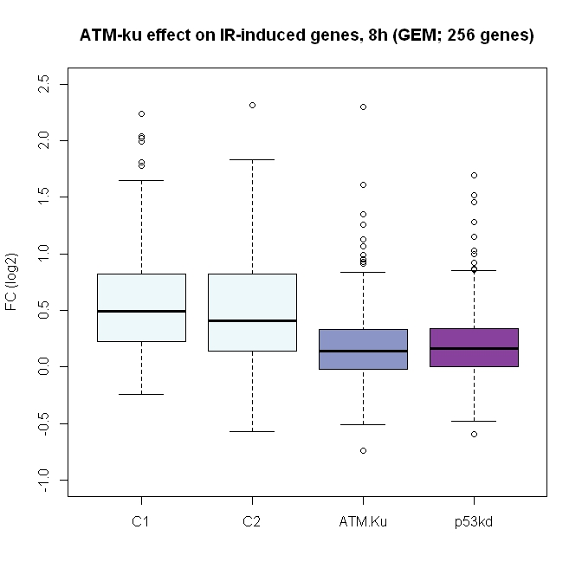

Slide 27
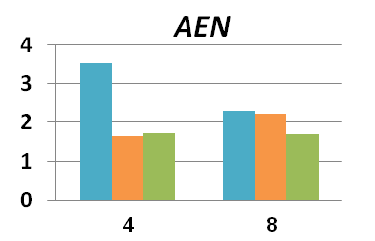
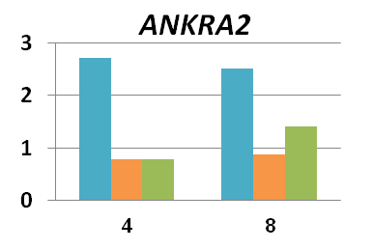
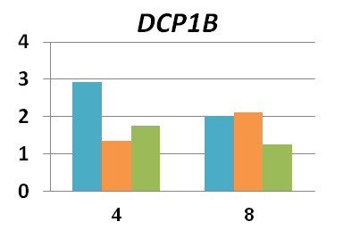
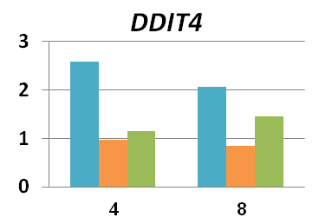

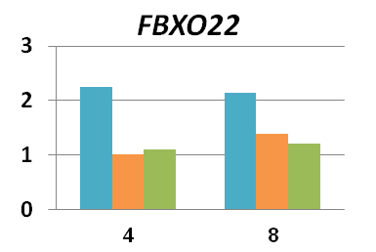
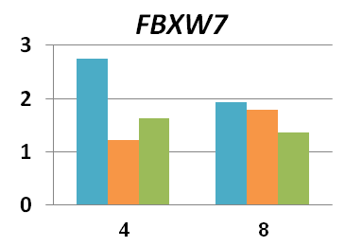
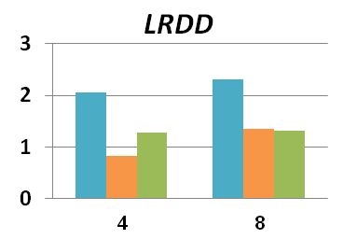
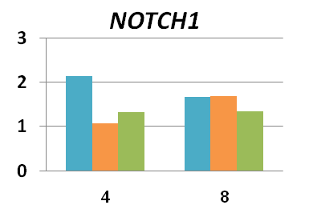
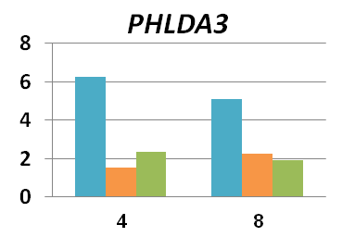
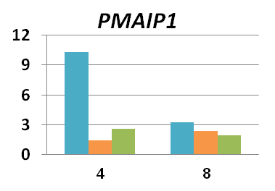
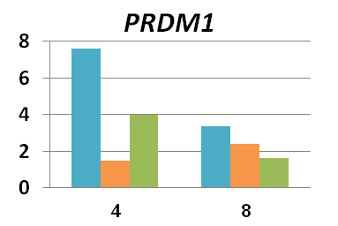
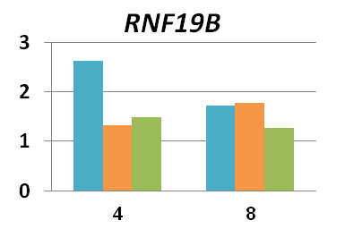
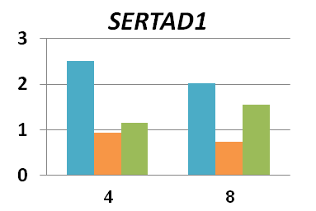
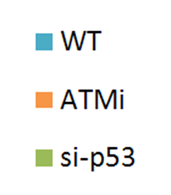

Validations (RT-PCR)
WT

Slide 28
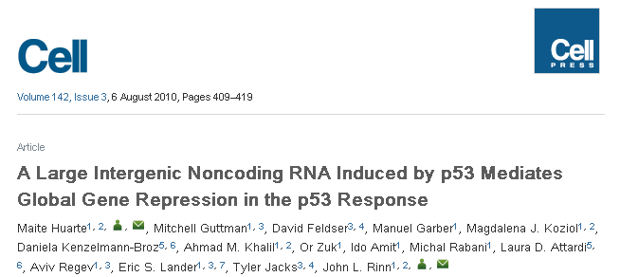
IR-induced long-nc RNAs (RNA-Seq)
Long intergenic non-coding RNAs (linc RNAs) is a novel family of transcripts
RNA-seq significantly enhances their detection (typically, very lowly expressed)
Current number in the human genome ~ 7K linc-RNA genes.
Only ~100 linc-RNAs have been functionally annotated to date; documented roles in:
  Transcriptional regulation
  Epigenetic regulation
  Splicing
  Stem cells and differentiation
So far, one linc-RNA was functionally linked to the DNA damage response (linc-p21)

Slide 29
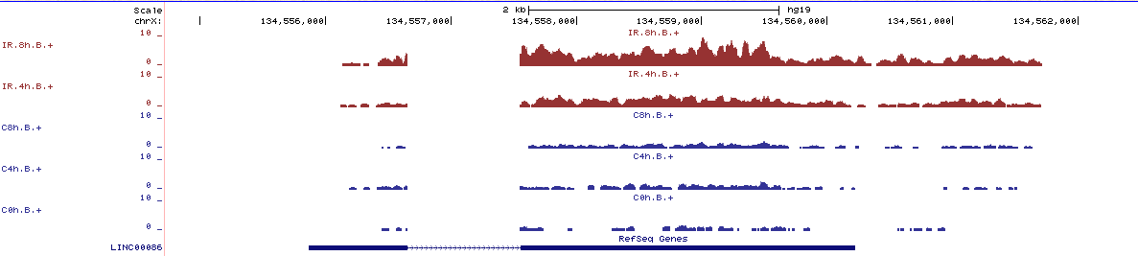
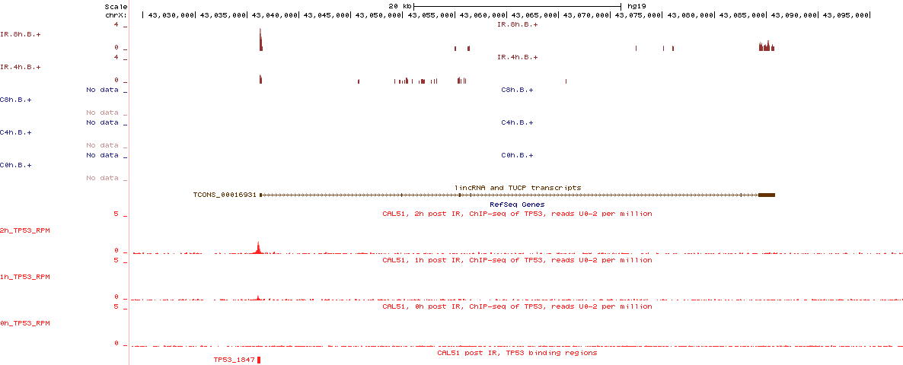
IR-induced long-nc RNAs (RNA-Seq)
We identified 8 linc-RNAs that were significantly induced in response to IR (all are very lowly expressed)
Their induction was p53-dependent (Their induction was significantly attenuated in the p53kd samples)

Slide 30
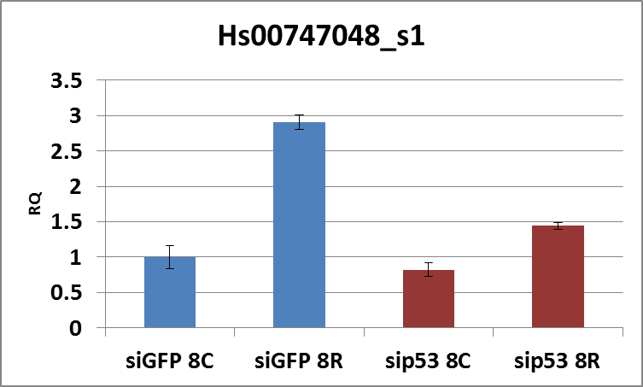
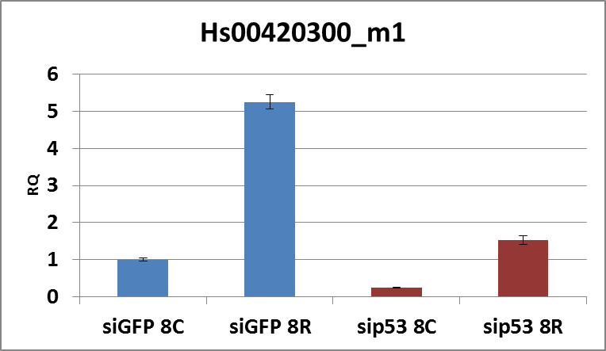
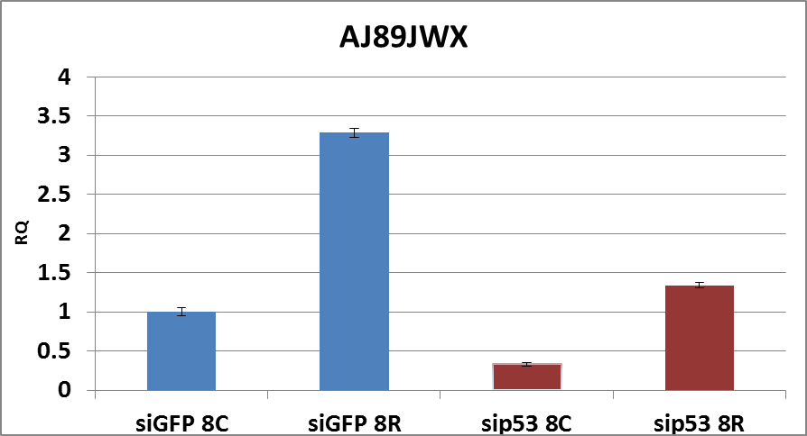
IR-induced linc-RNAs - Validations

Slide 31
> 90% of the response is p53-dependent
This p53-dependent response contains both direct and secondary p53 target genes → we applied ChIP-seq to identify p53 direct targets

Slide 32
p53 ChIP-Seq
p53 binding profiles were recorded at 0, 1h and 2h after IR (5 Gy)
Results:
  1,830 genomic sites showed significantly induced p53 binding following IR (CisGenome; FDR=5%; 2h)
  These sites are associated with 1,080 genes (from 15 kb upstream of gene start down to gene end)

Slide 33
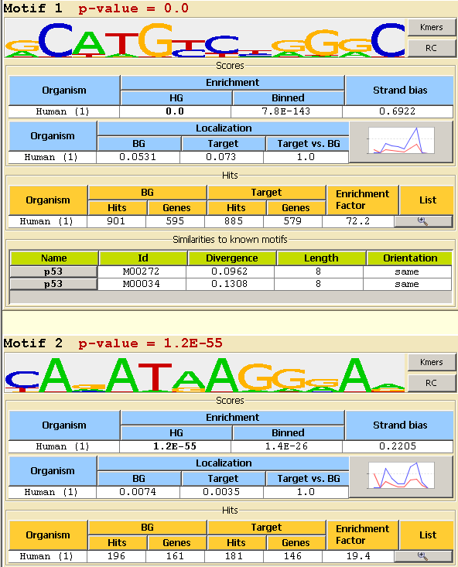

peak
~ 250 – 300 bp

Slide 34
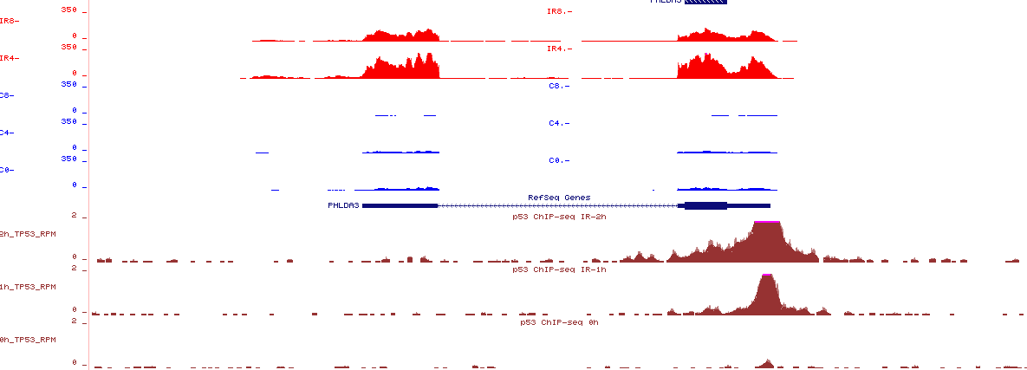
Integrated analysis of RNA-seq and ChIP-seq datasets
RNA-seq
>10x
ChIP-seq

Slide 35
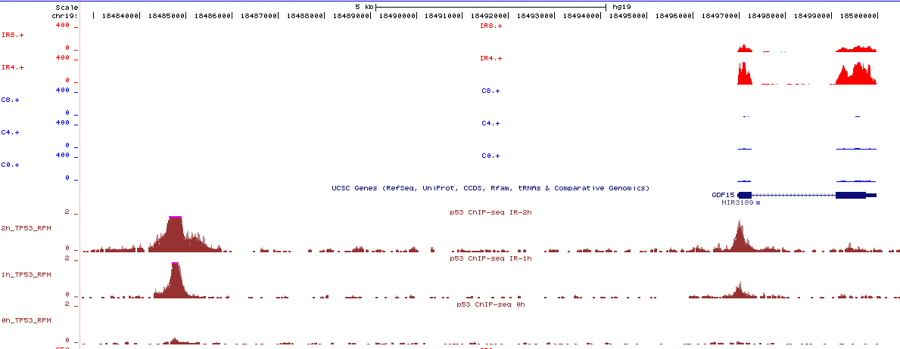
Integrated analysis of RNA-seq and ChIP-seq datasets

Slide 36
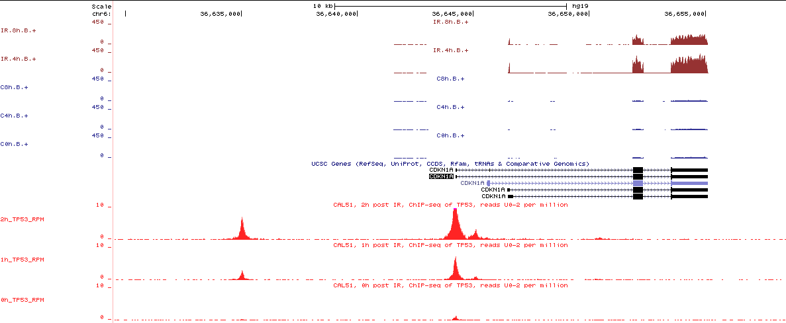

Slide 37
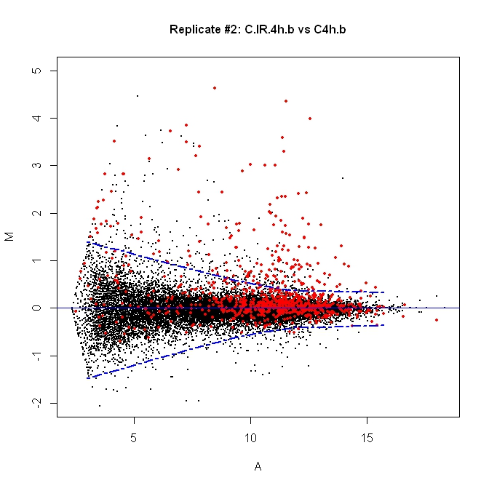
p53 target genes; IR 4h
* Total number of expressed genes = ~18K
* Total number of p53 target genes (among expressed ones) = 807 (4.7%)
* Number of induced genes (4h) = 299
* Number of p53 targets among the induced genes = 138 (46%)
(p-val < E-99)
Induced genes
Fold-change (log2)
Expression level (log2)

Slide 38
p53 target genes; IR 4h
The IR-induced genes are strikingly enriched for p53 direct targets
Yet, many (most) of the p53 targets identified by ChIP-Seq do not respond to IR
Which factors determine the response of p53 targets?
Fold-change (log2)
Expression level (log2)

Slide 39
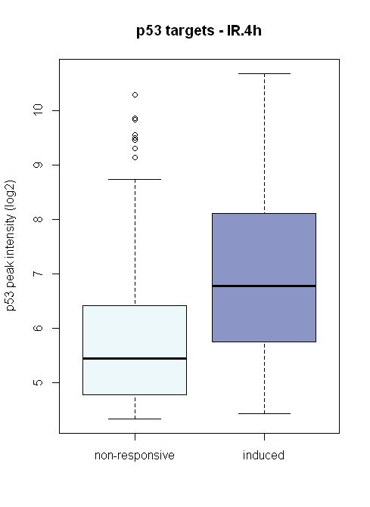

Effect of the strength of p53 binding sites on the responsiveness of the target genes
p=3.4E-20
p=1.2E-20

Slide 40
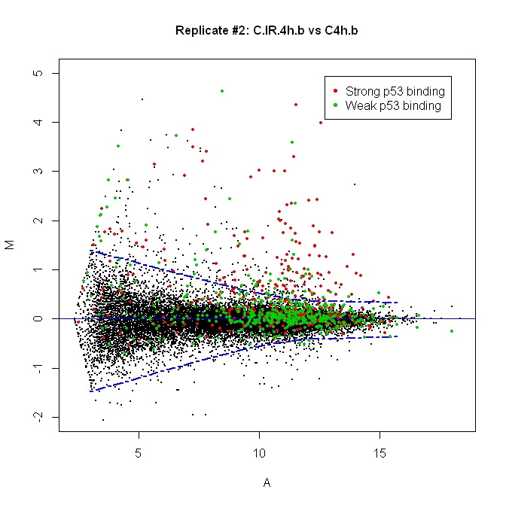
The strength of the binding site has a great impact
It’s not the only factor
Location of the binding site (peak) relative to TSS?
Fold-change (log2)
Expression level (log2)

Slide 41
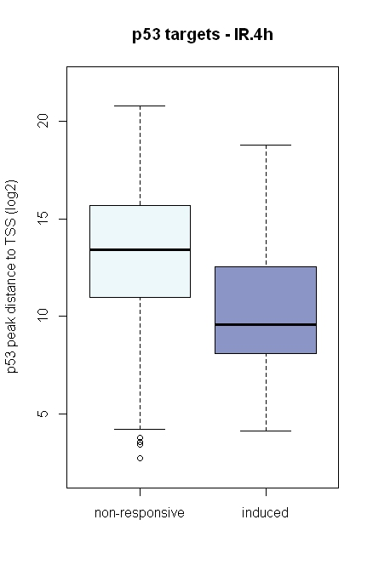
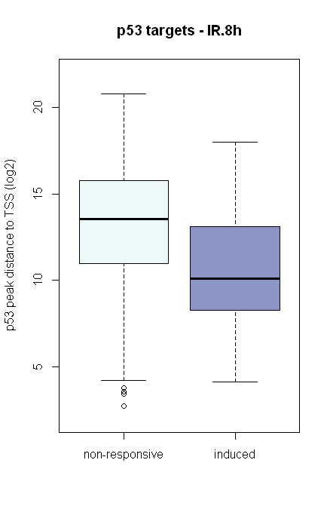
Effect of the location of p53 binding sites on the responsiveness of the target genes
p=9.3E-18
p=1.0E-17

Slide 42
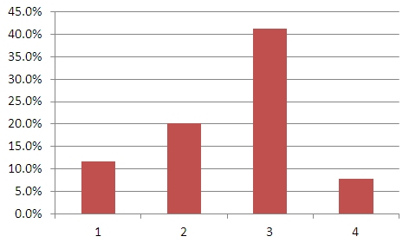
Effect of the location of p53 binding sites (peaks) on the responsiveness of the target genes
Dis = Distance of p53 peak to TSS
-15k<Dis < -2.5k
-2.5k<Dis < 0
0<Dis < 2.5k
2.5k<Dis < Gene End
Region #1
(111 peaks)
Region #2
(119 peaks)
Region #3
(170 peaks)
Region #4
(397 peaks)
Exon 1
TSS
% of responsive p53 targets
p53 peak region

Slide 43
Identification of secondary TFs which mediate the p53-dependent response
p53 target genes; IR 4h
Fold-change (log2)
Expression level (log2)

Slide 44
Secondary TFs induced by IR in
p53-dependent manner: FOSL1 and E2F7
mRNA levels
Fosl1
Fosl1
Protein levels
FOSL1

Slide 45
p53-independent Response
p53-independent response

Slide 46
NFkB ChIP-Seq
Rel-A NFkB subunit binding profiles were recorded at 0, 1h and 2h after IR (5 Gy)
Results:
  1,088 genomic sites showed significantly enhanced Rel-A binding following IR (FDR=5%)
  These sites are associated with 906 genes (from 15 kb upstream of gene start down to gene end)

Slide 47


Motif found on Rel-A peaks

Slide 48

Rel-A targets (IR4h)
p53 targets (IR4h)
Fold-change (log2)
Fold-change (log2)
Expression level (log2)
Expression level (log2)
Rel-A targets
Expressed genes: ~ 18k
Among them Rel-A targets: 807 (4.5%)
Induced genes (IR, 4h): 299
Among them Rel-A targets: 37 (12.4%)
p-value=2.25E-8
p53 targets
Expressed genes: ~ 18k
Among them p53 targets: 807 (4.5%)
Induced genes (IR, 4h): 299
Among them p53 targets: 138 (46%)
p-value < E-99

Slide 49

NFkB Targets’ Response
p53-independent response

Slide 50


Slide 51



Slide 52




Which factor(s) mediate the rapid attenuation of the expression of NFkB targets?
TF Binding to IL6 promoter
IL6
This study identified a cluster of rapidly induced and repressed genes in response to LPS
They demonstrated that activation is mediated by NFkB and repression is mediated by ATF3.
TF binding (ChIP):
RelA - dotted purple
ATF3 - dashed purple
IL6 mRNA level:
Rt-PCR - blue solid
Rt-PCR in Atf3-KO cells - red solid
Mathematical model prediction - green solid

Slide 53

ATF3 Induction in Response to IR
ATF3 Induction (RNA-seq)
2.0
1.5
1.0
NFkB
IR
Target genes
ATF3

Slide 54

IR-induced p53 target linc-RNAS

Slide 55


Slide 56
Comprehensive Exploration of the Transcriptional Response to IR (CAL51)
mRNA Response
(RNA-seq)
microRNA Response
(miR-seq)
TF DNA-binding Profile
(ChIP-seq)
Chromatin Modulation
(ChIP-seq)

Slide 57
Modulation of chromatin in response to IR
IR-induced modulation of two Histone markers was examined:
  H3K4me3: a marker of active promoters
  H3K4me1: a marker of active enhancers

Slide 58

H3K4me3 level correlates with promoters transcriptional activity

Slide 59

H3K4me3 level in promoter
Expression level
Supplementary Fig 6

Slide 60


H3K4me3 level is induced in an ATM-dependent manner at IR-induced promoters

Slide 61


Slide 62


H3K4me1 level is modulated in an ATM-dependent manner at IR-induced p53 binding sites

Slide 63
Comprehensive Exploration of the Transcriptional Response to IR (CAL51)
mRNA Response
(RNA-seq)
microRNA Response
(miR-seq)
TF DNA-binding Profile
(ChIP-seq)
Chromatin Modulation
(ChIP-seq)

Slide 64
Global Exploration of IR-Responsive microRNAs (miRs)
Standard RNA-Seq protocols measure only long transcripts (longer than ~ 150-200 nt)
A different protocol (“miR-Seq”) is used to measure small RNAs such miRs (mature length is ~ 22 nt)
Interestingly, our RNA-Seq data detected pre-miR transcripts (from which the mature miRs are processed)

Slide 65



RNA-Seq Detection of pre-miRs
miR-34a primary transcript
mature miR-34a
IR-induced linc-RNA
>5x

Slide 66
IR-Responsive microRNA
miR-seq was applied to the same samples subjected to RNA-Seq
  Control and p53kd samples
  IR: 5 Gy; timepoints: 0, 4h and 8h.

Slide 67

IR4h
Fold-change (log2)
Expression level (log2)

Slide 68


miR-seq
RNA-seq
Another indication for noisy measurements: The overlap between miRs responding at 4h and 8h was minimal …

Slide 69

miR-486
One of top scoring miRs was miR-486
It was induced by IR by more than 2-fold in both 4h and 8h
It is encoded within an intron of an hosting gene - ANK1
ANK1 itself is one of the IR-induced mRNAs

Slide 70

IR-induced p53 target microRNAs
miR-34a
p53 ChIP-seq

Slide 71

RNA-seq
miR-486
p53 ChIP-seq

Slide 72
IR modulation of Alternative splicing (?)

Slide 73
Comprehensive Multi-layer Exploration of the Transcriptional Responses to ionizing radiation (IR) Using Deep-sequencing Technologies
TRIREME Project; WP3
TAU: Yossi, Ron
MPI-Berlin: ML Yaspo
Sharon
Rashi
Yuliya
Karzov
Ana
Kupershtein
Marie-Laure
Yaspo
Hans-Jörg
Warnatz

