Slide 1
ISOBM conference report
Didi Amar
Group meeting
Nov 2012

Slide 2
Plan
What is ISOBM
The war on cancer
Biomarkers for prostate cancer

Slide 3
2012 – in Ramada Hotel, Jerusalem
~200 participants
33 countries
Most participants were clinical doctors
Academia, hospitals, HMOs, companies
Some molecular biologists
Some surgeons
One computational participant (not even a doctor…)
Considered small but high quality conference

Slide 4
General comments
Cancer and biomarkers
No non-cancer biomarker studies
Most experiments used low-throughput platforms
Some of the studies had impressive sample size (thousands…)
Non-invasive sources for biomarkers:
Blood
Urine
Breath

Slide 5
General comments
No computational\statistical talks
But a few methods discussed new technologies (e.g., protein arrays)
Very basic analysis
Biomarker size < 5 features
In most cases did not use classification algorithms (logistic regression, neural networks)
Hierarchical clustering, survival analysis

Slide 6
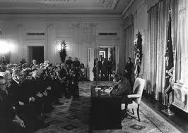
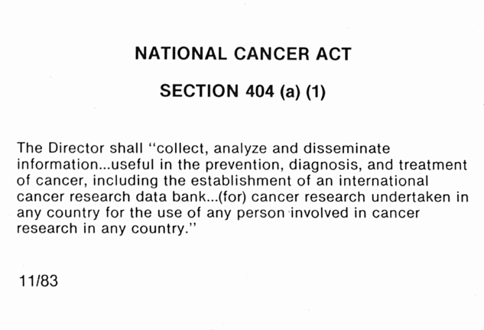
The war on cancer
In 1971 President Nixon signed the National Cancer Act

Slide 7
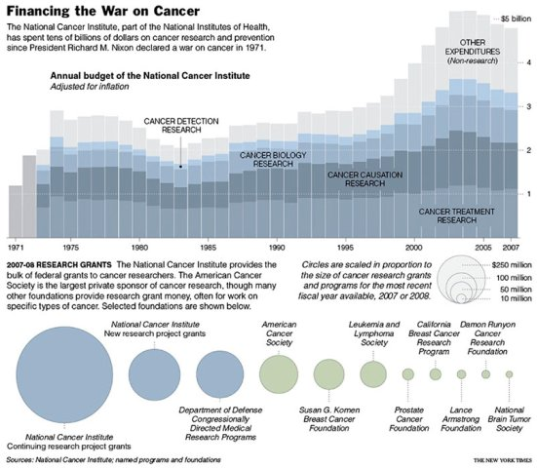
The war on cancer

Slide 8
The President’s Cancer Panel
A three-person panel that reports to the President of the United States on the development and execution of the National Cancer Program.
Members serve 3-year terms, and at least two of the three panel members must be distinguished scientists or physicians.

Slide 9
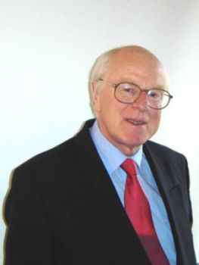
The war on cancer: ISOBM talks
Prof. Joe Duffy
University College Dublin and St Vincent's University Hospital
An expert in molecular mechanisms of cancer metastasis, and breast cancer.
Annual Abbott award to investigators who have made an outstanding contribution in the field of basic or clinical oncology.
Prof. Margaret Kripke
The University of Texas M. D. Anderson Cancer Center.
Considered a founder and an expert in the field of photoimmunology (the study of how ultraviolet light can alter the function of the immune system)
Two terms on the President’s Cancer Panel (report submitted a month ago).

Slide 10
The war on cancer: ISOBM talks
The war on cancer: Are we winning?
Accelerating Progress in Cancer research: What is needed?

Slide 11
The bad news
1990-2005: 980 drugs on trials, 32 accepted.
Current drugs have short term effect.
1 in 2 men will have cancer
1 in 3 women
Death rates from pancreas and liver cancer increase.
Increase in child cancer: mortality and cases
In the US, African American have higher tendency than all other groups.

Slide 12
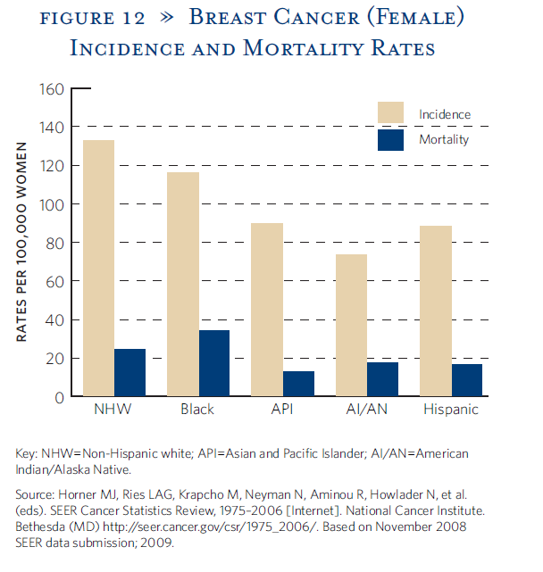
Disparity of cancer

Slide 13
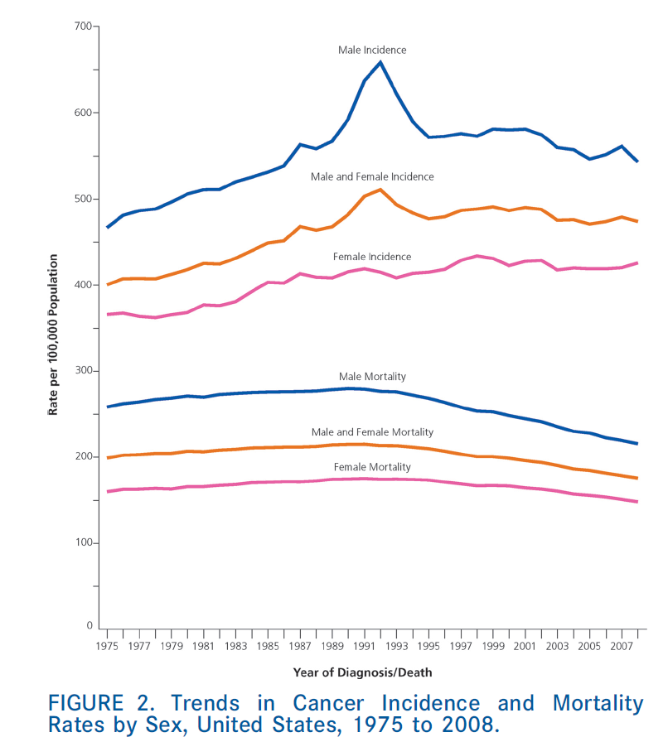
Bad news vs. good news

Slide 14
Some Specific good news
CML: Imatinib, dasatinib etc.
Survival rate > 95%
Breast cancer, her2 mutant patients
Her2 – growth factor
Mutation in cancer cells only (not genetic)
~20% of breast cancers
Tend to be more aggressive
Several her2 drugs (Herceptin, Tykerb)
Survival increase by 1-2 years, recurrence decreases.

Slide 15
Some Specific good news
Lung cancer – Tyrosine kinase inhibitors (TKI)
Kinases are important in signaling and proliferation.
By “accident” the drug helped non mutation subjects
VEGF inhibitors: renal cell carcinoma, colorectal cancer
Crizotinib for EML4-ALK positive lung cancer (special DNA abnormal configuration)
Drug approved after 4 years (!)
Melanoma: 5 different drugs, each targets a different gene
In most cases: increase survival by > 2-fold and can reduce recurrence probability after surgery

Slide 16
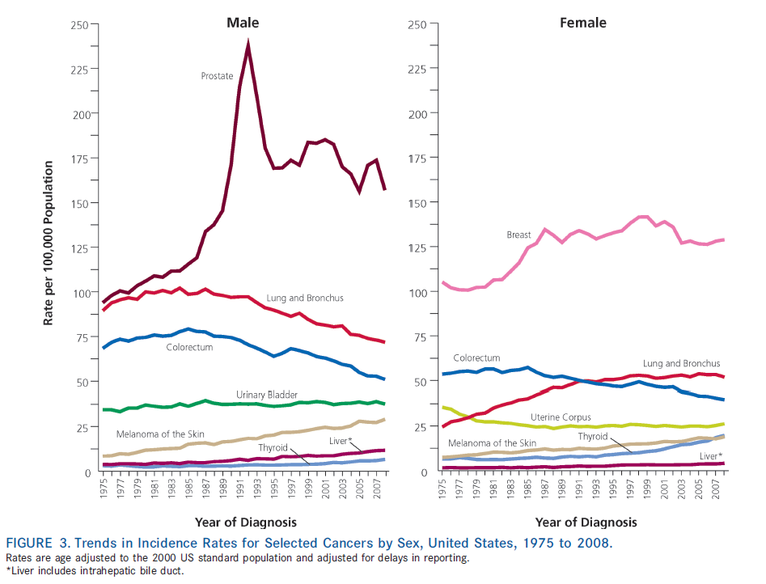
Disparity of cancer

Slide 17
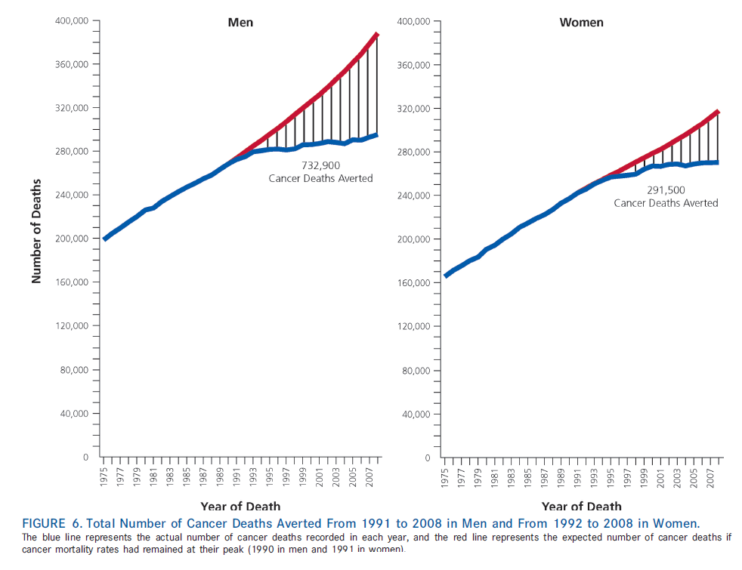
The “good” news

Slide 18
Slow progression in cancer research
Why do we progress so slowly?
Opinion of the talkers (mainly Prof. Kripke)
Based on overall statistics (looking at global patterns)
The 2012 report is not available yet
Most suggest a possible improvement

Slide 19
Cancer research: reasons for Slow progression
This is a complex disease
>120 different diseases
Funding priorities
Research focus on advanced cancer and treatment\prognosis and not prevention.
Good words on the ISOBM community
In melanoma: detection before the disease enters the body = life or death
Very little funding for environmental cause studies
%20 of the cases (!)

Slide 20
Cancer research: reasons for slow progression
Grant review system
Prefers basic science over impact
Favors established researchers
Prefer “safe” projects that will give some results
USA federal funding
Too much time to get a grant (1-2 years)
Instability in NIH budget
Hard to manage long term research

Slide 21
Cancer research: reasons for slow progression
Clinical trials (FDA)
Inefficient
Hard to test combined therapies
The future of cancer treatment
Focus on advance stages

Slide 22
Cancer research: reasons for slow progression
Lack of data sharing!
Cancer research is slow not due to a lack of technology, but due to lack of knowledge
No intense data mining like in other science areas
Medical records
Tissue repositories
Not enough collaborations (within and with other communities)

Slide 23
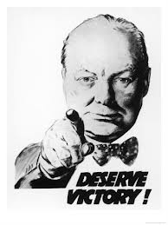
So, where are we?
We did not lose
We did not win
“Now this is not the end. It is not even the beginning of the end. But it is, perhaps, the end of the beginning. ” Winston Churchill (after the second battle of El Alamein, 1942)

Slide 24
Biomarkers - background
According to NIH a biomarker is:
A characteristic that is objectively measured
Indicator of
Normal biological processes
Pathogenic processes
Pharmaceutical response to treatment
Cancer biomarkers can be produced by healthy cells or tumor cells

Slide 25
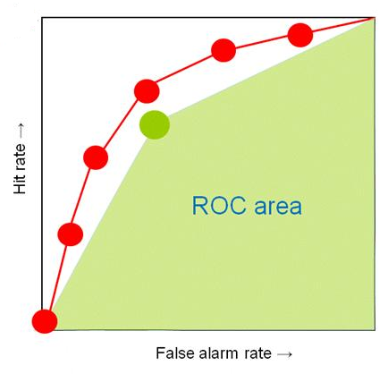
Biomarkers development
Assay 1
f:a1…ak -> b
Usually a linear combination (e.g., logistic regression)
Assay 2
Biomarker
Assay n
One or more experiments, usually less than 5 features in total. In most cases one feature.
Between 0 and 1, 0.5 is a random classifier, 1 is perfect
In many cases estimated on the training data

Slide 26
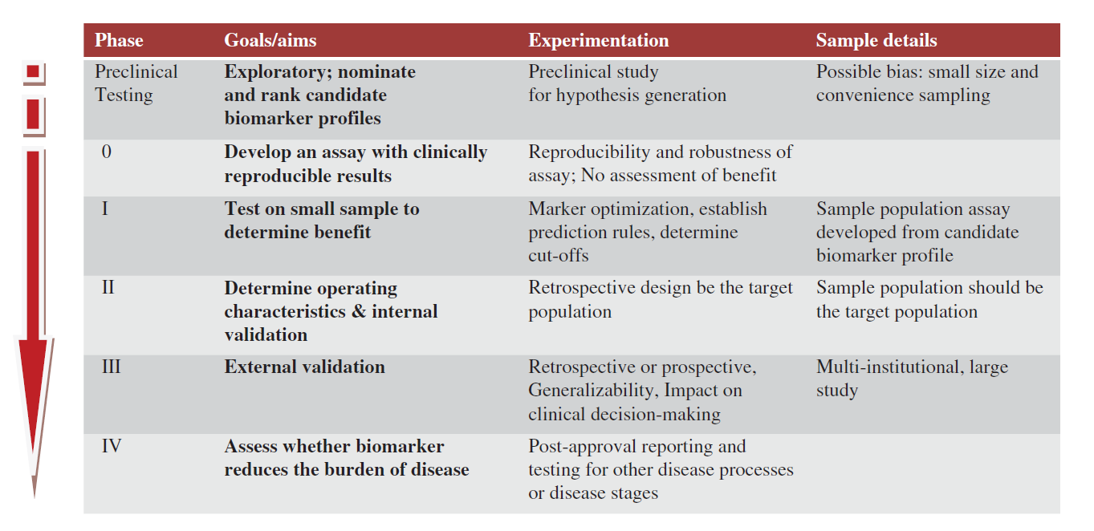
Biomarkers: a standardized approach for development and detection
In 2002 the NCI developed a five stage approach to standardize biomarker detection

Slide 27
Biomarkers of prostate cancer
Focus on the field, not on specific talks
Based mainly on reviews and papers by Semjonow J, and Roobol M.J. that participated in ISOBM
Focus on blood biomarkers
Recent “new” biomarkers

Slide 28
Prostate cancer
The second leading cause of cancer death in men
Today at the clinic, two tests for prostate cancer
Physical rectal examination (DRE)
Blood based PSA markers
Tests are important
Early detection - survival
Preventing biopsies (1000-2000$ vs. 100-200$)
Disease monitoring

Slide 29
Background
First biomarkers were discovered in the 1970s
Using biomarkers revolutionized the field
Early detection
Decrease in PCa metastasis and death (this is questionable)
Disease state monitoring
Risk factors

Slide 30
PSA
Prostate specific antigen (PSA)
Glycoprotein and enzyme (serine protease) secreted by the epithelial cells of the prostate
Other name: kallikrein 3 (KLK3)
15 kallikrein genes, clustered on Chromosome 19
Cleavage of extracellular proteins
Appears in the prostate and in the blood

Slide 31
PSA - controversy
“PSA–based screening results in small or no reduction in prostate cancer–specific mortality and is associated with harms related to subsequent evaluation and treatments, some of which may be unnecessary“
United States Preventive Services Task Force (USPSTF) recommendation 2011.

Slide 32
Blood based diagnosis
Thousands of papers on prostate cancer blood biomarkers (>3000).
Many try to improve the total PSA test.
New markers are not widely used.
Some are used in private clinics
The field is shifting towards combining several biomarkers and clinical features.

Slide 33
Correlation between total PSA and disease
Overall, when PSA increase so does PCa risk.
A rule of thumb: use threshold 4 ng/ml
Hard to determine a specific threshold.
~15% of subjects have normal DRE and a total PSA less than 4.0 ng/ml
No total PSA threshold at age 62 – 91
No evidence that lowering the total PSA threshold below 4 ng/ml improves the long-term survival in men with PCa.

Slide 34
Total PSA limitations
Some aggressive PCa’s do not produce PSA.
PSA levels have high variance
Technical (assays)
Biological (age, metabolism rate, medication use)
Hard to compare results of different assays (sometimes two experiments contradict).
Biomarker calculation may depend on the assay type.

Slide 35
PSA as a risk factor
PSA might be associated with risk years before cancer appears (several studies).
Loeb et al. (2006):
1178 samples in their 40s with some risk.
13-years follow-up.
PSA < 0.7 vs. PSA>0.7 -> 14.6-fold increase in PCa risk.
Lilja et al. (2007, 2008):
Data over 25 years
1,684 samples – 462 had PCa within a median of 18 years.
Odds ratio for disease (patients aged 44-50 when PSA was measured) -> up to 4 fold increase when PSA > 2

Slide 36
PSAV
PSAV: total PSA over time
Months or years
Can help in early detection
Example: exponential increase ~5 years before cancer appears (in some patients, but specific).
Overall not significantly improved diagnosis over total PSA in non long –range experiments (Roobol et al. 2003, Pinsky et al. 2007).

Slide 37
PSAV for risk and survival analysis
Ballentine et al. 2006
n =~100
1. Died of PCa
2. PCa patients, alive or died of another cause.
3. Controls

Slide 38
Problems with PSAV
Follow-up time may be too long to get beneficial estimates.
Many time-points are needed.
Fast increase is common in men with high PSA levels to begin with.
The proportion of these men is expected to be low in large cohorts.

Slide 39
PSAV - conclusion
Total PSA levels do not increase sharply before PCa diagnosis.
It rises gradually and slowly over many years, also in many men who later present with advanced cancer.

Slide 40
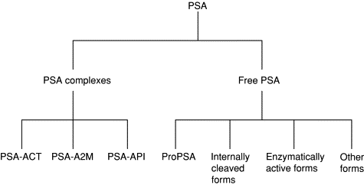
PSA subtypes: possible new markers

Slide 41
Free PSA
Approved by FDA as an additional test for subjects with total PSA between 4 and 10.
High fPSA% -> lower probability for finding PCa
Probably because benign prostate hyperplasia.
Catalona et al. (1998) using fPSA% improved ROC to 0.74 as compared to 0.53 by using total PSA.
Inconclusive results regarding treatment outcome prediction.
High PSA
Low fPSA%: PCa
High fPSA%: no cancer

Slide 42
Free PSA subtypes
[-7, -5 or -2 ] proPSA

Slide 43
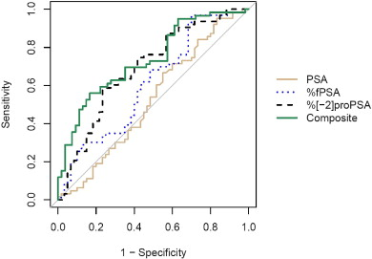
Classification improvement using fPSA isoforms
Sokoll et al. 2008
123 samples
63 PCa
Logistic regression

Slide 44
Survival analysis marker
Isharwal et al. 2011
71 PCa subjects
Survival analysis

Slide 45
Extending the standard biomarkers
Nam et al. (2007) used PSA and general features:
Ethnicity, age, urine tests, total PSA, free PSA, DRE.
3108 samples
1304 prostate adenocarcinoma
1804 controls
Diagnosis based on biopsies
Logistic regression
No cross-validation
AUC, accuracy and confidence intervals
ROC ~0.74
PSA based classifier had 0.62 ROC

Slide 46
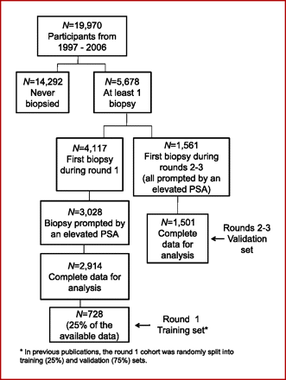
Extending biomarkers example 2
Veickers et al. 2010
Data from the European Randomized Study of Screening for Prostate Cancer, Rotterdam.
Subjects that had relatively high PSA
Subjects that had at least one biopsy
Markers measured before biopsy
Test set
Biopsy detected 388 PCa’s

Slide 47
Using several features
It is not clear from the text how several features were combined.
An expert system?
Linear combination of all features except for total PSA.
Manually?
For men with extremely high PSA decide: cancer
No threshold mentioned

Slide 48
Results
 | AUC (95% CI) | Incremental enhancement
Laboratory models
Full: age, tPSA, fPSA, iPSA, hK2 | 0.713 (0.682, 0.743) | —
Without fPSA | 0.576 (0.542, 0.610) | 0.137
Without iPSA | 0.669 (0.637, 0.701) | 0.044
Without hK2 | 0.701 (0.671, 0.732) | 0.012
Clinical models
Full: DRE, age, tPSA, fPSA, iPSA, hK2 | 0.711 (0.681, 0.741) | —
Without fPSA | 0.606 (0.573, 0.640) | 0.105
Without iPSA | 0.679 (0.648, 0.710) | 0.032
Without hK2 | 0.700 (0.670, 0.731) | 0.011

Slide 49
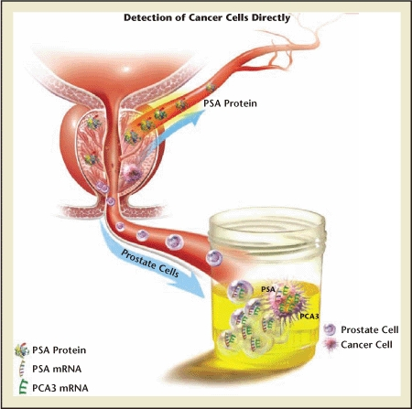
Urine biomarkers
After DRE, prostate cells appear in urine.
PCA3: non-coding RNA gene.
PCA3 is highly expressed in PCa cells.
Several studies reported improved ROC over PSA (e.g., Roobol et al. 2010, 0.64 vs. 0.58)

Slide 50
Urine biomarker example: Tomlins et al. 2012
Chromosomal rearrangements in prostate cancer
In ~50% of PSA screened cancers the TMPRSS2 gene is fused with ERG or ETV1.
The protein product TMPRSS2:ERG is not likely to be secreted
No antibody test as in PSA
Alternative approach: use RT-PCR to measure this fusion transcript levels.

Slide 51
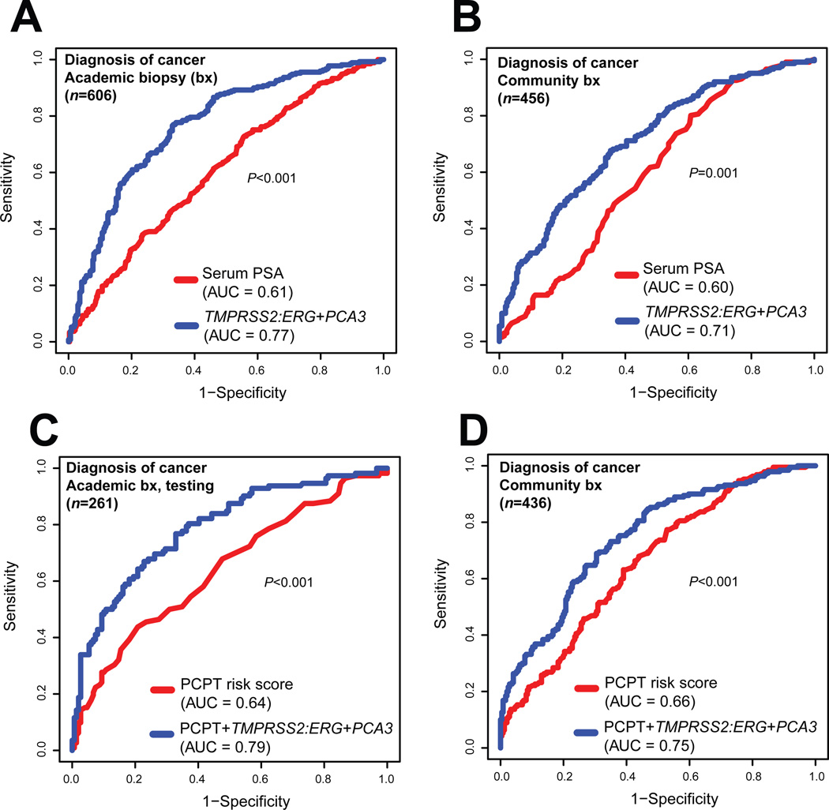
Results (Tomlins et al. 2012)
Logistic regression
10-fold CV
Academic: 606 men collected by 3 universities, 269 had PCa.
Community cohort: 463 men, 204 PCa’s
All patients had relatively high PSA levels.
PCPT: a score that uses DRE, PSA and other clinical features (not available for all samples).

Slide 52
What about high throughput?
Progress is very slow
Search in GEO: prostate cancer + blood + at least 100 samples
10 datasets
Only two are relevant (no general studies, no cell-lines, human samples > 100)
Olmos et al. 2012: data on prognosis: whole blood, 31 good vs. 63 advanced stage. Unsupervised analysis + survival analysis.
Cortese et al. 2012: PC (n=19) vs. BPH (n=20) vs. control (n=20). Methylation profiles: discovered a signature of 32 features. ROC 0.79 on training, 0.56 on test.

Slide 53
Summary
Active research
ROC scores are not impressive
Even without CV
Most studies are low-throughput based
Small improvements over time
Reproducing results is hard
Technical issues
Experiment design
High heterogeneity of individuals

