Slide 1
Synchronized Feature selection for multiple data sets
Didi Amar
Group meeting 29/2/2012

Slide 2
Motivation
Parallel analysis of multiple data sets, from different technologies and diseases:
One disease, different technologies, same lab.
One disease, different technologies, different labs.
Multiple diseases, technologies, labs, possible? helpful?
Use the dependencies among data sets to select gene signatures.

Slide 3
FS Nomenclature
The selected features are called the “gene signature” in bioinformatics.
Univariate method: considers one variable (feature) at a time (ttest, InfoGain etc…).
Multivariate method: considers subsets of variables (features) together (SVM-RFE, wrappers).
Filter method: ranks features or feature subsets independently of the predictor (classifier).
Wrapper method: uses a classifier to assess features or feature subsets.
Embedded method: FS is embedded in model learning (Lasso, Logistic regression trees).

Slide 4
Signatures Stability
There are cases in which many genes contribute a little, the result is relatively large signatures (Guyon 2010).
It seems that many different signatures show similar accuracy (Ein-Dor 2005, Michiels 2005).
Some papers showed that the lack of stability in terms of genes did not prevent sharing of functional interpretation (Shen 2008, Reyel 2008).

Slide 5
The GO structure
The GO project provides an ontology of defined terms representing gene properties, covering three domains: cellular component, molecular function and biological process.
The GO ontology is structured as a DAG, edges represent relationship (e.g. is-a) between GO classes.

Slide 6
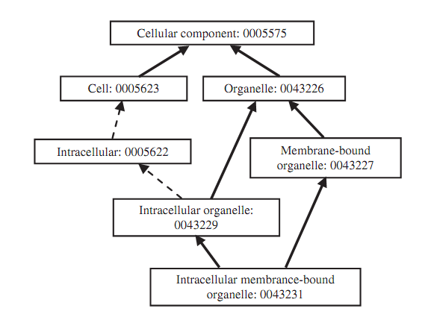
The GO structure

Slide 7
GO Semantic similarity
Measure gene\term similarities according to their GO annotations.
Can be used to score similarity between two gene sets.
Many methods were suggested.
Easy to use R packages: GOSim, GOSemSim (better for large scale analysis).

Slide 8
Wang’s score (2007)
A Method for scoring the similarity between groups of GO terms, that takes into account the GO DAG structure.
A GO term A is represented as DAG(A,T,E) where T is the set of GO terms in A’s DAG (A and all it’s ancestors) and E is the set of edges.

Slide 9
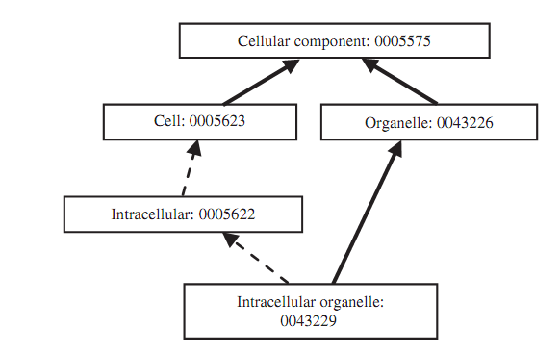
Wang’s score (2007)
w*w
w*w
w
w
1
S-value: the contribution of go term t to GO A by:
w is a parameter in the interval (0,1).

Slide 10
Wang’s score (2007)
We also define the semantic value of the term A:
The semantic similarity of two go terms:
The functional similarity between a go term and a list of GO terms:
The functional similarity between two lists of GO terms:

Slide 11
Sets similarity
We will consider two options to measure similarity between two sets:
Average similarity:
Running max:

Slide 12
Introduction summary
Many FS methods out there, most of them can be used to rank features.
The selected features are called the gene signature.
Semantic similarity methods use a DAG of terms to calculate similarities of
Terms (nodes in the DAG)
Term sets (Each gene has a set of terms)
We can use semantic similarity to calculate similarities of gene sets.

Slide 13
Problem formulation
For simplicity, we analyze two data sets
We want to select J genes in every data set.
In each data set, genes are ranked in ascending order (e.g. using ttest, top rank has lowest p-value): is the rank of gene j in data i.
E is the expected similarity of the diseases

Slide 14
Problem formulation
General regularized problem should look like:
Our loss should penalize large differences between the expected similarity and observed similarity of diseases (data sets)
This part keeps the model simple, in our case a simple model is one that keep the gene ranks high

Slide 15
Problem formulation
Generally:
The simple case - if the data sets are from the same disease then:

Slide 16
For one disease, we have two objectives
rmax
avg

Slide 17
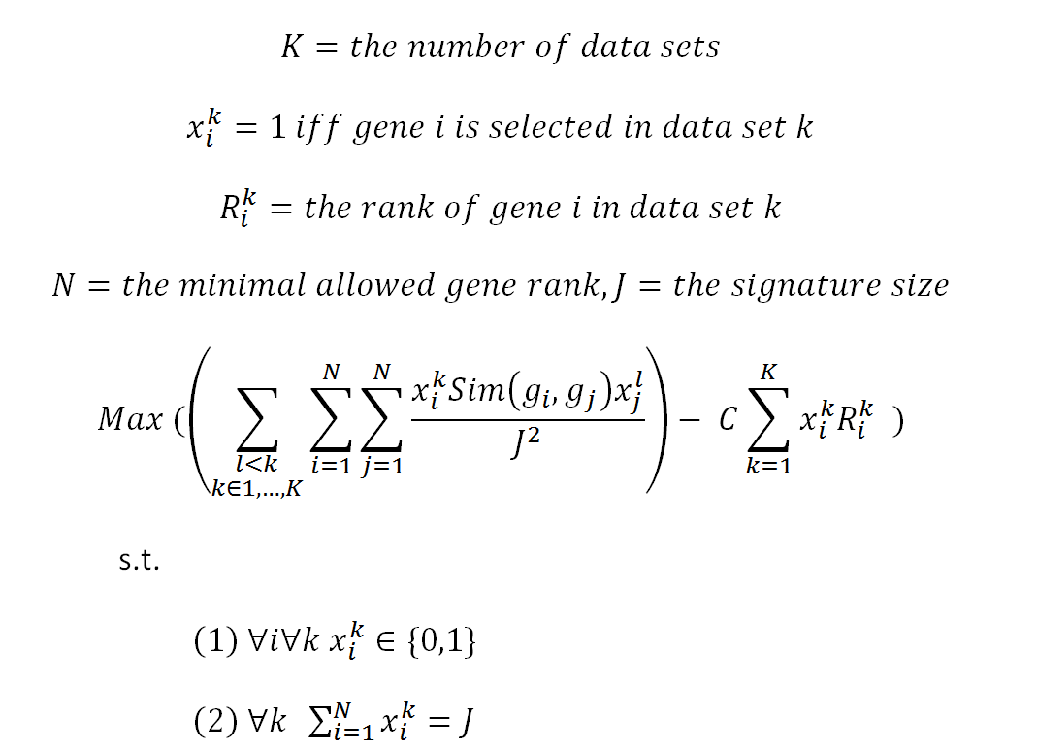
Avg MIQP formulation

Slide 18
MIQP - notes
MIQP can be solved using the Cplex software.
Cplex tries to solve MIP using heuristics and branch&bound.
With hundreds of integer variables the process can go forever…
Cplex can be used in Matlab, C++, C#, and Java (import /usr/local/lib/cplex121/lib/cplex.jar). API is very convenient (see http://home.eng.iastate.edu/~JDM/ee458_2011/CplexLargeUsersManual.pdf)
Cplex also supports quadratic constraints – a MIQCP problem. Will be relevant to the general problem formulation.

Slide 19
For the rmax: a simple hill climber
A simple solver:
Start with the best ranks.
Iteratively choose the best swap (across all data sets) between a gene in the signature and a gene that is not in the signature.
Stop if reached a local maxima.
We can also try to start with random signatures.

Slide 20
Tests parameters (for now)
Signature size (J):100
Maximal rank allowed (N) = 500
C=0 or C=1.
Important technical note: we normalize all ranks by N (the best rank now is 1/500 and not 500).
Ranking algorithm: Information gain (Univariate method, similar to ranking by -entropy).

Slide 21
Accuracy tests
Use SVM classifier for accuracy measurements.
Cross validation (CV):
SimFS: in each fold split all data sets to train and test. Learn on the training of all data sets to select features in each data set and test the classifier learned in each data set.
For regular FS this is the same as usual CV.
Measure average ROC score for each data set
5CV , 50 repeats

Slide 22
Stability tests
Here only 2CV works.
Do 100 times:
Split all data sets to two.
Perform FS on each split
For each data set measure the agreement between the two runs using the semantic similarity between the selected sets.

Slide 23
Test1: same disease, same technology
Breast cancer
Four gene expression data sets of bad vs. good prognosis:
Vant Veer (46,51)
Van Der Vijver (78,217)
Wang (93,193)
Pawitan (34,125)

Slide 24
Hill climber (rmax objective)
MF GO annotations
Convergence after 100-120 iterations
 | Wang | VantVeer | Vijver | Pawitan
Wang | 1.000 | 0.652 | 0.690 | 0.624
VantVeer | 0.652 | 1.000 | 0.773 | 0.692
Vijver | 0.690 | 0.773 | 1.000 | 0.713
Pawitan | 0.624 | 0.692 | 0.713 | 1.000
 | Wang | VantVeer | Vijver | Pawitan
Wang | 1.000 | 0.947 | 0.943 | 0.954
VantVeer | 0.947 | 1.000 | 0.953 | 0.951
Vijver | 0.943 | 0.953 | 1.000 | 0.943
Pawitan | 0.954 | 0.951 | 0.943 | 1.000

Slide 25
Hill climber (rmax objective)
BP GO annotations
Convergence after ~180 iterations
 | Wang | VantVeer | Vijver | Pawitan
Wang | 1.000 | 0.541 | 0.596 | 0.493
VantVeer | 0.541 | 1.000 | 0.658 | 0.544
Vijver | 0.596 | 0.658 | 1.000 | 0.618
Pawitan | 0.493 | 0.544 | 0.618 | 1.000
 | Wang | VantVeer | Vijver | Pawitan
Wang | 1.000 | 0.898 | 0.883 | 0.885
VantVeer | 0.898 | 1.000 | 0.879 | 0.891
Vijver | 0.883 | 0.879 | 1.000 | 0.899
Pawitan | 0.885 | 0.891 | 0.899 | 1.000

Slide 26
Hill climber (rmax objective)
BP GO annotations
Convergence after ~180 iterations
 | Wang | VantVeer | Vijver | Pawitan
Wang | 1.000 | 0.115 | 0.144 | 0.105
VantVeer | 0.115 | 1.000 | 0.155 | 0.115
Vijver | 0.144 | 0.155 | 1.000 | 0.150
Pawitan | 0.105 | 0.115 | 0.150 | 1.000
Avg improvement
 | Wang | VantVeer | Vijver | Pawitan
Wang | 1.000 | 0.261 | 0.265 | 0.262
VantVeer | 0.261 | 1.000 | 0.247 | 0.244
Vijver | 0.265 | 0.247 | 1.000 | 0.252
Pawitan | 0.262 | 0.244 | 0.252 | 1.000

Slide 27
Hill climber – enrichments (Kegg)

Slide 28
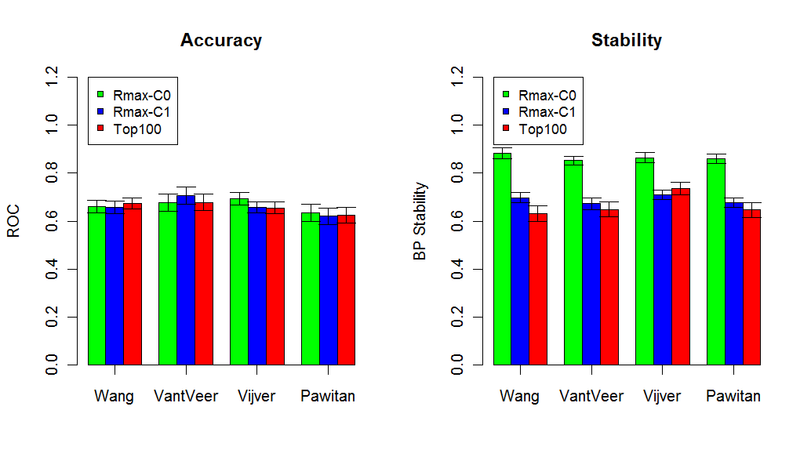
Hill climber CV results

Slide 29
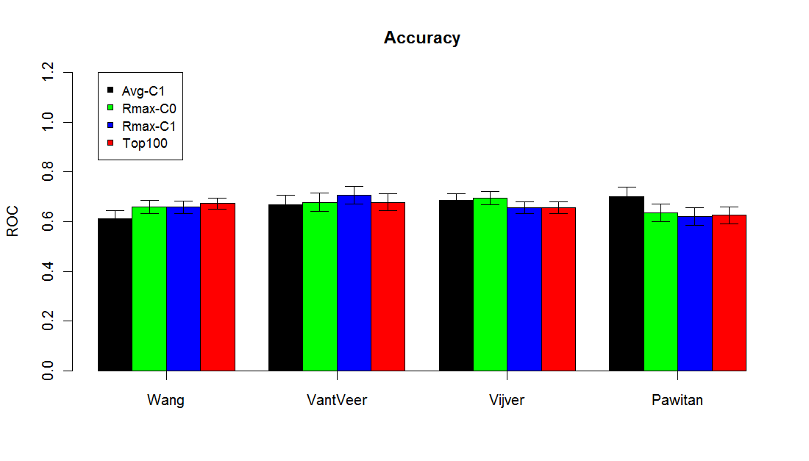
MIQP accuracy (C=1)

Slide 30
Test2: Same disease, different technologies
Lung cancer data.
Methylation profiles of 768 genes (285 samples)
Gene expression profiles (10000 genes, 187 samples).

Slide 31
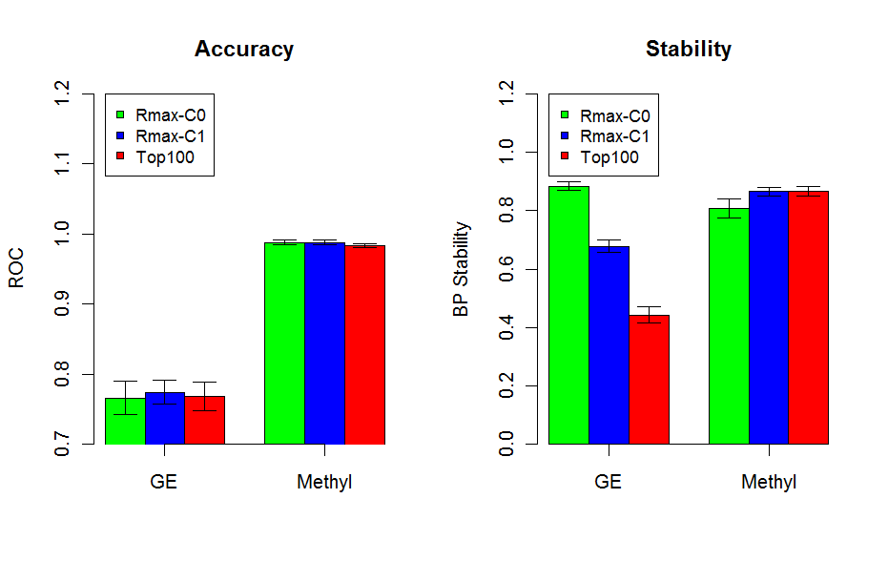
Rmax - CV
P=E-10
P=0.04

Slide 32
Disease similarity
One option is to use genes to disease associations.
The OMIM database keeps a list of genes that were discovered to cause\affect diseases.
These signatures can be used to calculate the disease similarities.

Slide 33
Disease similarity
Another option: use the disease ontology DAG and calculate disease similarities directly (without going through genes).
The Human Disease Ontology project aims to provide an open source ontology for the integration of biomedical data that is associated with human disease.
The R package DOSim calculates disease similarities.

Slide 34
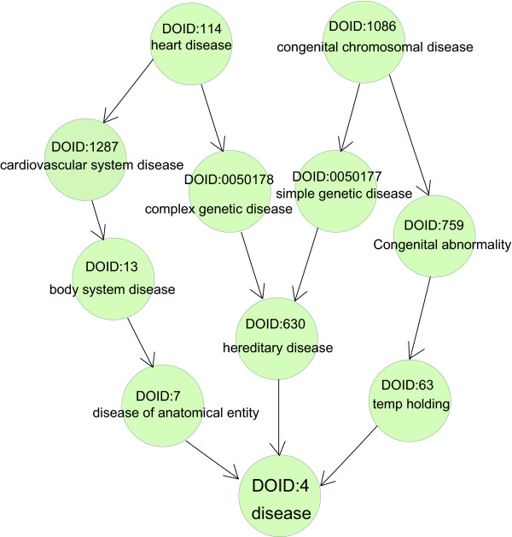
Disease Ontology
The DO project also provides gene to term mapping.
This can be used for gene enrichment analysis, can be done in the DOSim package (we can also use TANGO)

Slide 35
Pandora’s box: measuring disease similarities

Slide 36
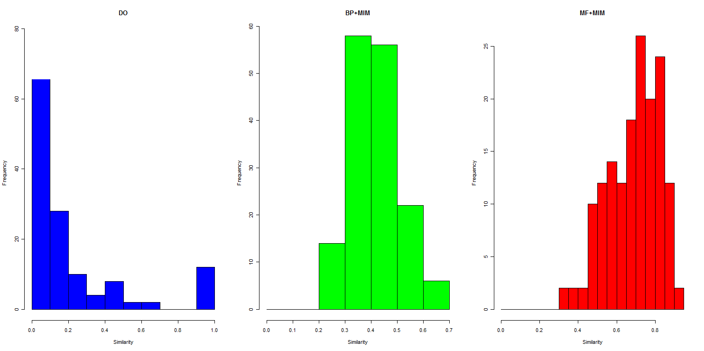
Distribution differences

Slide 37
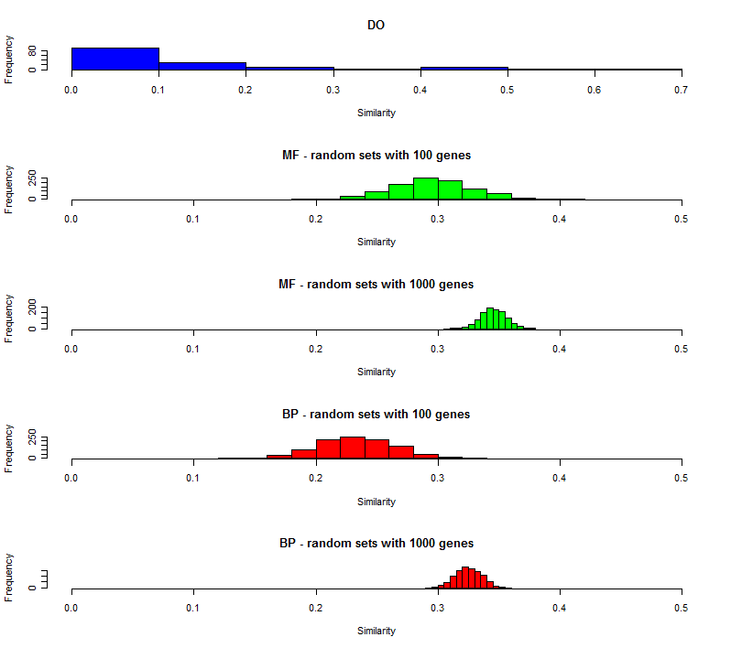
Sets sizes differences (rmax)

Slide 38
Tools summary
Go semantic similarities: R package GOSemSim.
Powerful solvers : Cplex package (Java API).
Learning algorithms implementations: WEKA (Java API).
Disease similarities:
GOSemSim + OMIM DB
R package DOsim.

