Slide 1
Subject/data classification using resting state functional connectivity
Joint work with Didi Amar

Slide 2
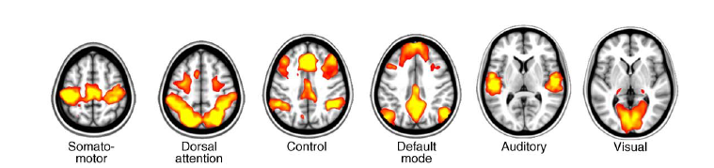
Background
fMRI data = Blood oxygen levels of ~40000 Gray matter volumes (i.e. voxels)
Functional connectivity analysis is often used to study the network organization of the brain
Work in the last decade has revealed slow correlated activity within functional networks in the resting state (i.e. RSNs)
Biswal 95\2008,, Raichle 2001, Greicius and Menon 2003, Beckmann 2005, Fox 2007, Vincent 2007, Martuzzi 2010, Buckner 2008
Notes:
לדבר על כך שיש חיווט פונק' שרואים אותו גם ברסט בלי קשר לתפקוד
רשת הדיפולט – לציין ולהגיד שפועלת בעודף בזמן מנוחה – קשורה לתפישת עצמי, חשיבה ספונטנית

Slide 3
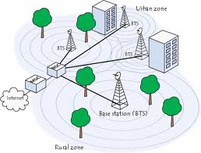
Resting state functional connectivity
The cellular network model: “Keep alive” signals are sent on a regular basis to maintain connectivity and facilitate fast communication when needed
Altered resting state (RS) functional connectivity (FC) - associated with a vadriety of cognitive impairments a psychiatric disorders Menon 2011, Rabinak et. Al. 2011, Kim et. Al. 2011, Assaf et. Al. 2010, Hawellek et. Al. 2011

Slide 4
Classification based on FC – Example I
Decoding Subject-Driven Cognitive States with Whole-Brain Connectivity Patterns
W. R. Shirer , S. Ryali 2, E. Rykhlevskaia , V. Menon and M. D. Greicius. Cerebral Cortex May 2011
27 healthy right-handed subjects
2 cohorts of 15 (training) and 12 (test) subjects separated by 5-6 months
1st cohort: 4x10 min scans in which mental tasks were performed with eyes closed
Rest
Music
Subtraction
Memory
1st
Shuffled
Notes:
W. R. Shirer1 , S. Ryali 2 , E. Rykhlevskaia 2, V. Menon2,3 and M. D. Greicius 1,3 1 Functional Imaging in Neuropsychiatric Disorders (FIND) Lab, Department of Neurology and Neurological Sciences, 2 Stanford Cognitive and Systems Neuroscience Lab (SCSNL), Department of Psychiatry and Behavioral Sciences and, 3 Program in Neuroscience, Stanford School of Medicine, Stanford, CA 94305, USA

Slide 5
2nd cohort: 5x10 min scans in which mental tasks were performed with eyes closed
Preprocessing: head movement correction, MNI (standard brain) normalization, smoothing*, high pass filter (>0.008Hz), HR &respiration regressed out.
ROI extraction: group ICA on first cohort => 14 networks=> spatial partition =>90 functionally defined ROIs (available)
For each ROI time series global mean+ confounding effects of CSF and WM were regressed out
Rest
Music
Subtraction
Memory
Spat navigation
1st
Shuffled
Notes:
Images were corrected for movement using least square minimization and normalized (Friston et al. 1995) to the Montreal Neurological Institute template. Images were then resampled every 2 mm using sinc interpolation and smoothed with a 6-mm Gaussian kernel. Resampling and *smoothing were done in 3 dimensions yielding a 2-mm 3resolution and effective spatial smoothness (full-width at half-maximum) of 7.237.138.4 mm.
A low pass filter is often used in resting-state analyses but was excluded here to retain potentially useful information in the higher frequency bands, particularly during the cognitive tasks. To confirmour hypothesis that high-frequency data might be useful in classifying, we included an analysis using a band-pass filter which resulted in significantly reduced classification accuracy (see Supplementary Text and Supplementary Fig. S1).
It is worth noting that cardiac and respiratory signals are known to cause noise in high-frequency bands. To correct for this, we measured the subjects’ heart rate and respiration rate while they were being scanned. These data were used to regress the participants’ physiological noise from their fMRI data
These 90 ROIs are available for download from the corresponding author’s website

Slide 6
Pearson correlation coefficient between all ROI pairs + Fisher transformation => 3960 cell matrix of FC for each of the 4 cognitive states in every subject
Feature selection: For each cognitive state, a one-sample t-test was used to identify significant cells across all subjects (FDR corrected p-val ≤ 0.01)
Any cells that were significant for more than one cognitive states were excluded=> state-specific and unique cells with strong positive or negative correlations (187 rest, 147 memory,114 music, 275 subtraction)
Notes:
Images were corrected for movement using least square minimization and normalized (Friston et al. 1995) to the Montreal Neurological Institute template. Images were then resampled every 2 mm using sinc interpolation and smoothed with a 6-mm Gaussian kernel. Resampling and smoothing were done in 3 dimensions yielding a 2-mm 3resolution and effective spatial smoothness (full-width at half-maximum) of 7.237.138.4 mm.
A low pass filter is often used in resting-state analyses but was excluded here to retain potentially useful information in the higher frequency bands, particularly during the cognitive tasks. To confirmour hypothesis that high-frequency data might be useful in classifying, we included an analysis using a band-pass filter which resulted in significantly reduced classification accuracy (see Supplementary Text and Supplementary Fig. S1).
It is worth noting that cardiac and respiratory signals are known to cause noise in high-frequency bands. To correct for this, we measured the subjects’ heart rate and respiration rate while they were being scanned. These data were used to regress the participants’ physiological noise from their fMRI data
These 90 ROIs are available for download from the corresponding author’s website

Slide 7
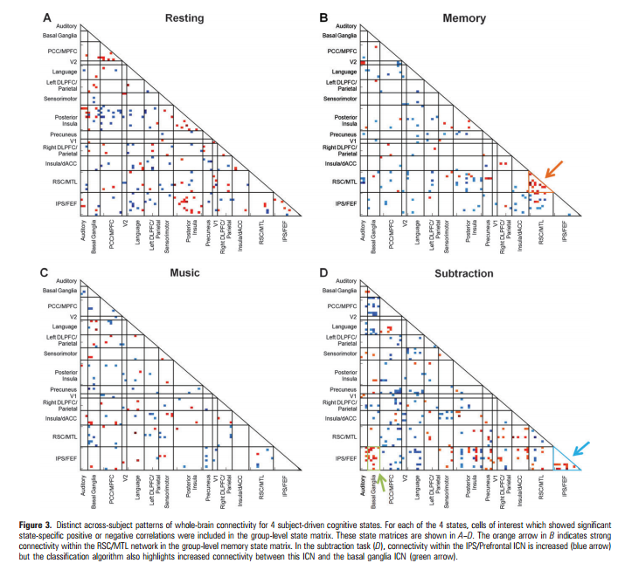
Notes:
IPS = intraparietal sulcus
MTL = medial temporal lobe
RSC = retrosplenial cortex
FEF = frontal eye fields
Red=positive corr
Blue = negative corr
Color intensity = corr abs val

Slide 8
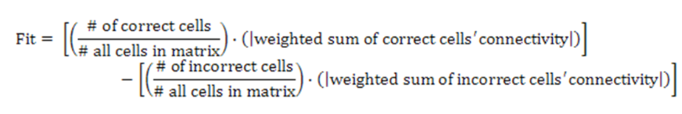
Classification method
Each of an individual’s 4 scan matrices was assigned to the group-level state matrix that best matched it based on a spatial correlation fit score
5th assignment classification: the scan that least fit any of the group-level state matrices was classified as the spatial navigation scan (“Winner takes all”)

Slide 9
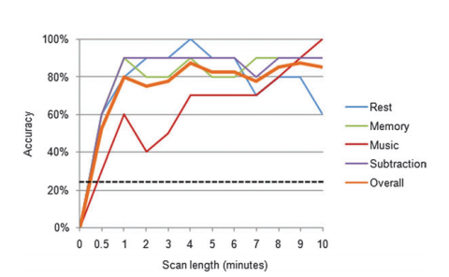
Results
Subject driven tasks drive significant connectivity differences. This was demonstrated across the 90x90 matrix both within and between ICNs
84% accuracy in the LOOCV analysis (P<0.001)
85% accuracy in the test set ( P<0.001)
80% accuracy using only the first minute of data

Slide 10
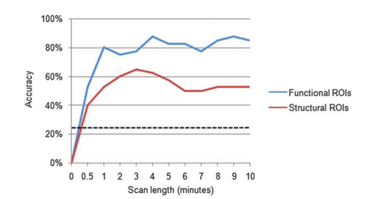
Results
92% accuracy (P<0.001), 46 of 50 scans , when adding the fifth task (“winner takes all” approach)
Classification accuracy with the structural (112 AAL) ROIs reached <=65% (P < 0.001) (26 of 40 states correctly classified)
Notes:
classification because we used a winner-take-all approach.
When applied to the 4-way classification, the winner-take-all
approach results in 100% accuracy for both the LOOCV and the
independent cohort classification analyses

Slide 11
Classification based on FC – Example II
Classification of ADHD children through multimodal magnetic resonance imaging. (Dai et. Al. ADHD 200, Frontiers in systems neuroscience)
ADHD = Attention deficit hyperactivity disorder
The most commonly diagnosed behavioral disorder of childhood
Affects about 3 - 5% of school aged children
Diagnosed much more often in boys than in girls.
ADHD may run in families, but it is not clear exactly what causes it
Set in motion as the brain is developing
Notes:
DaiDai 1, Jieqiong Wang1, Jing Hua2 and Huiguang He1* 1 NeuralImagingComputationandAnalysisGroup,StateKeyLaboratoryofManagementandControlforComplexSystems,InstituteofAutomation,Chinese AcademyofSciences,Beijing,China 2 GraphicsandImagingLaboratory,DepartmentofComputerScience,WayneStateUniversity,Detroit,MI,USA

Slide 12
Classification based on FC – Example II
ADHD 200 Global competition
Compared several features based on both sMRI and rs-fMRI (separately and combined)
Selected RS FC as the feature to train a support vector machine (SVM) since cross validation (CV) accuracy was achieved when using this feature
Ranked 6th of 21 groups and 1st in terms of sensitivity and J-statistic
Notes:
J-statistic = a single statistic that captures the performance of a diagnostic test. The use of such a single index is "not generally to be recommended".^{[1]} Y = Sensitivity + Specificity − 1
In statistics, the F₁ score (also F-score or F-measure) is a measure of a test's accuracy. It considers both the precision p and the recall r of the test to compute the score: p is the number of correct results divided by the number of all returned results and r is the number of correct results divided by the number of results that should have been returned. The F₁ score can be interpreted as a weighted average of the precision and recall, where an F₁ score reaches its best value at 1 and worst score at 0.
The traditional F-measure or balanced F-score (F₁ score) is the harmonic mean of precision and recall:
F=2*precision*recall/(precision+recall)

Slide 13
Data
Structural and rs-fMRI of 776 labeled (285 – cases, 491 – controls) and 195 unlabeled
Samples were collected from eight sites, using different scanners and scanning parameters
Not all the subjects in ADHD-200 datasets are available or suitable for the studies
152 of 776 subjects were excluded due to low quality images or ADHD-HI (hyperactivity) type
Notes:
Check reason of exclusion

Slide 14

Analysis
Basic fMRI preprocessing is not discussed
CC400 atlas Craddock et al. (2012) => 351 ROIs
FC maps: Pearson correlation + pruning with 0.05 threshold (to reduce noise)
BSS/WSS: used to filter non discriminative features (most)
Further selection
is done using a wrapper-based method which utilizes SVM based on recursive feature elimination which is named SVM-RFE (Guyon et al., 2002)
Notes:
No fisher transformation is reported
WSS = within-class sum of squares – a sum over classes of how variable are the values of the ith feature in the class
BSS = between-class sum of squares – a sum over classes and features of how different is the average in the class from the average overall for feature i
f_{ij} is the value of the i-th feature of the j-th sample and c is the group label
WSS/BSS filter method computes the ranking scores independently for each feature (does not take into account the relationship – e.g. redundant or complementary) between features. This filter reduces noise and increases performance
Features with weak discriminative power may contribute to the performance of classification if they are complementary to others, while those with strong power may affects the performance if they are redundant.
SVM is trained iteratively using selected feature subset. In each iteration, the ranking score for each feature in the selected feature subset is calculated during the SVM training process (e.g.,for linear SVM we cans simply consider the ranking score of features as the w that satisfies y = w · x + b, however, the SVM-RFE algorithm uses the radial basis function kernel, which is slightly complicated for estimation of the score).
A portion of features with small score are eliminated in each iteration of SVM training until the classification accuracy is over a set threshold, or the number of remaining features in the selected subset is smaller than a set value
I( yj = c ) equals 1 if the j-th subject belongs to group c and equals 0 otherwise (belonging function).

Slide 15

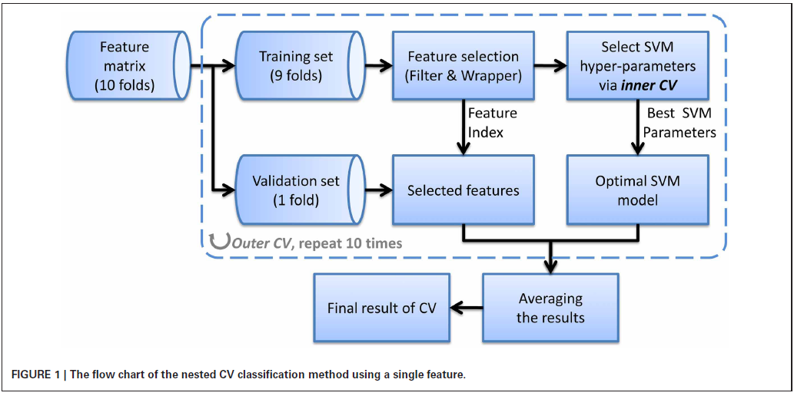
SVM with radial basis function (RBF) kernel is used for classification
Let x1, x2 be the feature vectors, RBF kernel is defined as:
σ = the width of the kernel, should be carefully tuned for SVM model optimization – done using grid search with CV
Notes:
A 10-fold outer CV was used: in each fold of outer CV, one tenth samples from each class are kept out for validation and the remainder are used for selecting features and training classifier (including select- ing hyper-parameters). Then the held-out samples are validated using the selected features and parameters which are obtained in the training process.
TODO: go over this slide and better understand it!
we also attempt to apply multi-kernel learning (MKL) to integrate multi-modal features (Sonnenburg et al., 2006; Hinrichs et al., 2011). Although MKL is theoretically better, it has more parameters to be tuned. Thus, the training process will be much more time-consuming, and sub-optimal model tends be obtained which might affect the effectiveness of MKL.
X1=feature values of cases
X2 = feature values of controls
K(x1,x2) =
In the context of machine learning, grid search refers to exhaustive searching through a subset of the hyperparameter space of a learning algorithm to solve problem of model selection/hyperparameter optimization. A grid search algorithm must be guided by some performance metric, measured by cross validation on a training set.^{[1]}
Since the parameter space of a machine learner may include real-valued or unbounded value spaces for certain parameters, manually set bounds and discretization may be necessary before applying grid search.
exp(-euc(x1,x2)²/2sigma²)

Slide 16
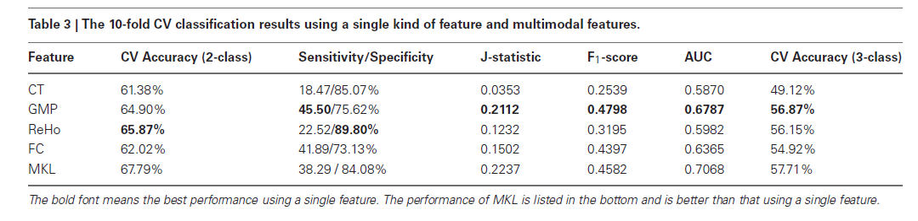
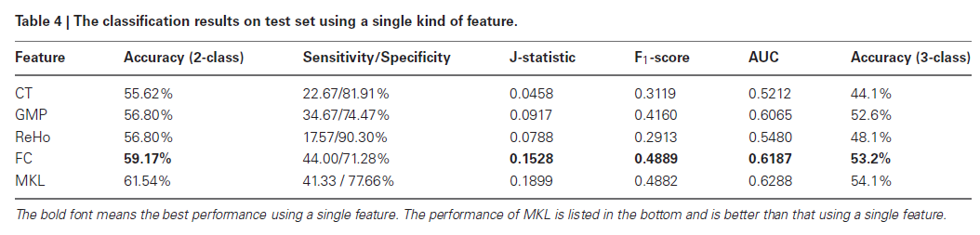
Results
Notes:
A hierarchical 2-class classifier is used, which first classifies subjects into ADHD group and TDC group, and then into ADHD subtype.
TDC = typical developed children
J-statistic = a single statistic that captures the performance of a diagnostic test. The use of such a single index is "not generally to be recommended".^{[1]} Y = Sensitivity + Specificity − 1
F₁ score (also F-score or F-measure) is a measure of a test's accuracy. It considers both the precision p and the recall r of the test to compute the score: p is the number of correct results divided by the number of all returned results and r is the number of correct results divided by the number of results that should have been returned. The F₁ score can be interpreted as a weighted average of the precision and recall, where an F₁ score reaches its best value at 1 and worst score at 0.
The traditional F-measure or balanced F-score (F₁ score) is the harmonic mean of precision and recall:
F=2*precision*recall/(precision+recall)
ROC= a receiver operating characteristic (ROC), or simply ROC curve, is a graphical plot which illustrates the performance of a binary classifier system as its discrimination threshold is varied. It is created by plotting the fraction of true positives out of the positives (TPR = true positive rate) vs. the fraction of false positives out of the negatives (FPR = false positive rate), at various threshold settings. TPR is also known as sensitivity, and FPR is one minus the specificity or true negative rate.
AUC = Area under the ROC curve The area under curve (AUC), when using normalized units, is equal to the probability that a classifier will rank a randomly chosen positive instance higher than a randomly chosen negative one (assuming 'positive' ranks higher than 'negative').^{[8]} It can be shown that the area under the ROC curve is closely related to the Mann–Whitney U,^{[9][10]} which tests whether positives are ranked higher than negatives. It is also equivalent to the Wilcoxon test of ranks.^{[10]} The AUC is related to the Gini coefficient
ROC score = AUC of the ROC

Slide 17
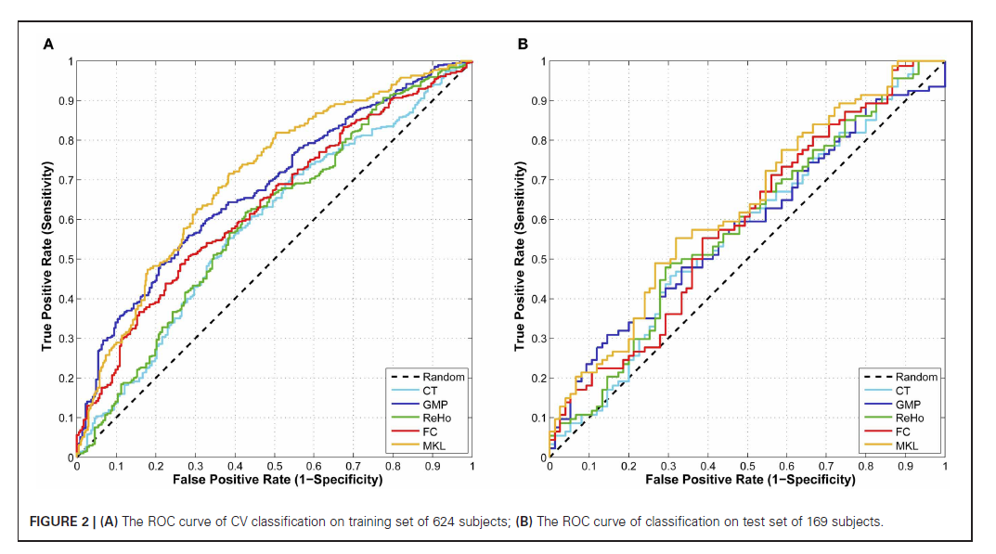

Slide 18
Classification based on FC – Example III
Robust Feature Selection in Resting-State fMRI Connectivity Based on Population Studies
Computer Vision and Pattern Recognition Workshops (CVPRW) conference 2010, Venkataraman et. Al
Schizophrenia: a mental disorder characterized by a breakdown of thought processes and by poor emotional responsiveness
Common symptoms include auditory hallucinations, paranoid or bizarre delusions, or disorganized speech and thinking, significant social or occupational dysfunction.
Onset of symptoms typically occurs in young adulthood
Diagnosis is based on observed behavior and the patient's reported experiences.
Impairments reﬂect abnormalities in widely-distributed functional and anatomical networks
Despite considerable interest in recent years, the origins and expression of the disease are still poorly understood
Notes:
Archana Venkataraman,Marek Kubicki, Carl-Fredrik Westin, Polina Golland
MIT Computer Science and Artiﬁcial Intelligence Laboratory, Cambridge, MA 02139
Psychiatry Neuroimaging Laboratory, Harvard Medical School, Boston, MA 02215
Laboratory for Mathematical Imaging, Harvard Medical School, Boston, MA 02215
Abnormalities in RS FC have been reported

Slide 19
Data
18 cases 18 controls (all males)
Anatomical scans and RS fMRI scans
Preprocessing: first 5 TRs removal, head motion correction, slice timing correction (FSL), spatial smoothing
Low pass filter (freq<0.08Hz)
WM, CSF and whole brain signal removal (regression)
Anatomical images were segmented into 77 regions (FreeSurfer )
Notes:
We extract fMRI connectivity between two anatomical regions by computing the Pearson correlation coeﬃcient between every pair of voxels
in these regions, applying a Fisher-r-to-z transform to each correlation (to enforce normality), and averaging these values. Since our regions are large, the correlation between the mean time courses of the two regions shows poor correspondence with the distribution of voxel-wise
correlations between them. Therefore, we believe our measure is more appropriate for assessing fMRI connectivity across subjects.
Additional Motion correction via linear regression (*) – should clarify for myself in the future…

Slide 20
Feature extraction
Mean signal extraction for each anatomical region and subject
Cross correlations matrix calculated for each subject
Fisher z transformation on correlation matrices
Above matrices averaged over subjects to be used as features
An additional analysis using only 16 expert-defined regions
Notes:
We extract fMRI connectivity between two anatomical regions by computing the Pearson correlation coeﬃcient between every pair of voxels
in these regions, applying a Fisher-r-to-z transform to each correlation (to enforce normality), and averaging these values. Since our regions are large, the correlation between the mean time courses of the two regions shows poor correspondence with the distribution of voxel-wise
correlations between them. Therefore, we believe our measure is more appropriate for assessing fMRI connectivity across subjects.
Our feature selection method is based on a procedure that searches across subsets of the data to isolate a set of robust, predictive functional connections. The metric, known as the Gini Importance, also summarizes multivariate patterns of interaction, which cannot be captured by univariate techniques.

Slide 21
Classification
Use Gini Importance metric for feature selection (multivariate) –compared against 2-sample t-test
A Random Forest classiﬁer and a Radial Basis Function (RBF) SVM were trained
Assumption: when ranking features according to GI value or t-score signiﬁcant diﬀerences between cases and controls are contained in the ﬁrst K features (several K values are tested)
Notes:
* The Gini coefficient measures the inequality among values of a frequency distribution (for example levels of income). A Gini coefficient of zero expresses perfect equality where all values are the same (for example, where everyone has an exactly equal income). A Gini coefficient of one (100 on the percentile scale) expresses maximal inequality among values (for example where only one person has all the income).^{[3][4]}
Random forest (or random forests) is an ensemble classifier that consists of many decision trees and outputs the class that is the mode of the classes output by individual trees. At each decision node, the algorithm selects a feature and threshold that maximize the separation between classes
During testing, we rank the functional correlations
either by GI value or by t-score magnitude. Our assumption is that the signiﬁcant diﬀerences between the
control and clinical populations are contained in the
ﬁrst K features. We assess this hypothesis by training both a Random Forest classiﬁer and a Radial Basis Function Support Vector Machine (RBF-SVM) [5] using just these K functional correlations, and evaluating the classiﬁcation accuracy on the held-out group.
Utilizing multiple classiﬁers ensures a fair comparison
between GI and univariate tests.

Slide 22


Classification - Elaboration
The Gini Impurity G(ν) estimates the probability that two random observations, drawn from the same class distribution as the initial n_{ν} samples, will have diﬀerent labels:
Given a feature f and a threshold η, we construct the two child nodes ν1 and ν2 of ν by partitioning the dataset along f according to η=> n_{ν1}(f, η) samples are assigned to child ν1, and n_{ν2} (f, η) samples are assigned to node ν2. The change in Gini Impurity between the node ν and its children is:
(1)
(2)
Notes:
TODO: elaborate here
Random forest: At each decision node, the algorithm selects a feature and threshold that maximize the separation between classes
During testing, we rank the functional correlations
either by GI value or by t-score magnitude. Our assumption is that the signiﬁcant diﬀerences between the
control and clinical populations are contained in the
ﬁrst K features. We assess this hypothesis by training both a Random Forest classiﬁer and a Radial Basis Function Support Vector Machine (RBF-SVM) [5] using just these K functional correlations, and evaluating the classiﬁcation accuracy on the held-out group.
Utilizing multiple classiﬁers ensures a fair comparison
between GI and univariate tests.

Slide 23

Classification - Elaboration
During training, Random Forest selects feature f∗(ν) and the threshold η∗(ν) that together maximize Equation (2) at node ν
This process is continued recursively for all child nodes until each leaf of the tree deﬁnes a unique class
Final classiﬁcation obtained by majority vote among all random trees
Gini Importance (GI) of feature f is found by integrating the reduction in Gini Impurity throughout the entire forest
Notes:
As I understand f here is a group of features (?)
Random forest: At each decision node, the algorithm selects a feature and threshold that maximize the separation between classes
During testing, we rank the functional correlations
either by GI value or by t-score magnitude. Our assumption is that the signiﬁcant diﬀerences between the
control and clinical populations are contained in the
ﬁrst K features. We assess this hypothesis by training both a Random Forest classiﬁer and a Radial Basis Function Support Vector Machine (RBF-SVM) [5] using just these K functional correlations, and evaluating the classiﬁcation accuracy on the held-out group.
Utilizing multiple classiﬁers ensures a fair comparison
between GI and univariate tests.

Slide 24
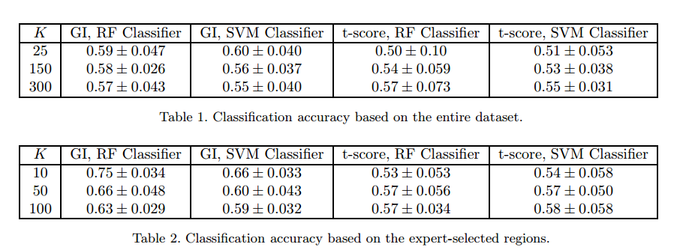
Results
Notes:
Tables 1 and 2 report the classiﬁcation accuracy (do not mention AUC) for each feature selection/classiﬁer pair based on the entire
dataset and on the expert-selected ROIs, respectively.
K=number of features
The three values of K roughly correspond to thresholding the mean p-value of the Kth feature to 0.01, 0.05 and 0.10, respectively. We observe that the Random Forest classiﬁer consistently outperforms RBF-SVM

Slide 25

Meditation
A set of mental training routines that originated from ancient eastern traditions
“promotes an objective manner of interpreting thoughts, events and emotions, without elaborating or ‘ruminating’ on their potential implications for the self” (Bishop, 2004)
Believed to improve interaction with reality by gradual modification of our conscious experience
Notes:
Can be devided according to what one is doing – E.g. OM-open monitoring, FA – focused attention…
Several schools, most common ones: Mindfulness , Zen
Based on research findings mindfulness based therapy (MBT) programs have been developed for stress reduction, depression relapse reduction and chronic pain treatment.
MBT has been shown to:
1) Reduce levels of self reported anxiety (Goldin & Gross, Emotion 2010)
2) significantly reduce recurrence rates in depressed patients (Teasdale et. Al. 2000, Williams et. Al. 2000) ***

Slide 26
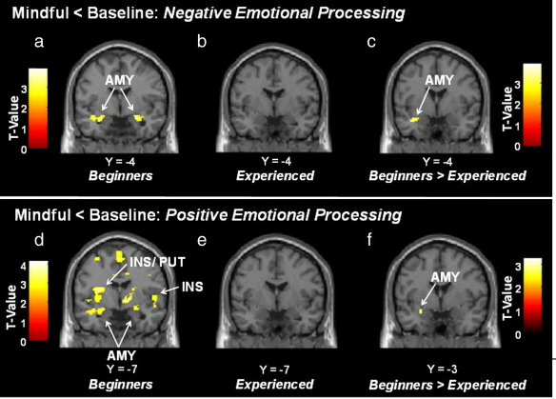
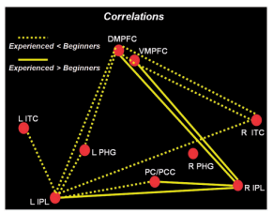
Meditation related neural changes
Changed neural response to emotion inducing photos Taylor et. Al. 2011 and association with attenuated subjective experience of pain Zedian et. Al. 2011, Grant et. Al. 2011
DMN connectivity differences between experienced and beginner meditators
Taylor et. Al. SCANS 2012
Notes:
Studies in recent years indicate association with:
- Structural and functional changes a number of brain areas
- Structural and functional connectivity changes ***
Statistical activation maps for the mindfulness-induced deactivations. Mindfulness led to decreased activation in the left amygdala for beginners relative to experienced meditators (c) during negative emotional processing (by subtracting neutral from negative pictures) (f) and during positive emotional processing (by subtracting neutral from positive pictures). Activation maps for mindfulness-induced deactivations during negative and positive emotional processing are shown for each group separately (a–b and d–e). Contrast estimates (and 90% confidence interval) are shown for the indicated brain regions and peak voxels of activation. Activation maps are displayed on a single-subject T1-weighted template image included in the SPM8 software package. AMY, amygdala; PUT, putamen; INS, insula.
View high quality image (326K)

Slide 27
Can we tell experienced meditators from others using RS fMRI ?
Can RS FC be used as features in this case?
Can we detect differences using a predefined set of regions that “make sense”? Or are we better off using the whole brain?
Which connections best discriminate between the two classes?
What is the best choice for preprocessing steps and ROI definitions?
Notes:
Possible neuro-feedback application

Slide 28
Our data
Subjects:
  ~30 healthy adults aged 18-70
  15 experienced meditation practitioners (>800 hs)
fMRI-EEG data (HRV will be extracted from EEG)
Behavioral data: Emotion regulation questionnaire (ERQ), self reported trait anxiety (STAI-t), self reported negative and positive affect (PANAS)
Rest 5 min
Cognitive task 4 min
Rest/meditation 15 min
Notes:
Why cognitive task? How do I justify this?
Should I mansion the ER-IAT?

Slide 29
Preprocessing & ROI definition
Head movement correction, MNI (standard brain) normalization, spatial smoothing
Band pass filter, WM+CSF signal removal (possibly add whole brain signal removal)
ROI definition: currently grid based (testing several options) – example quality res one sub
Grid cell dim | # surviving cells | Average homogeneity | Min Homogeneity | Average separation
3x3x3 | 2333 | 0.903 | 0.469 | 0.351
4x4x4 | 1195 | 0.864 | 0.432 | 0.386
5x5x5 | 764 | 0.83 | 0.383 | 0.421
IClust400 | 321 | 0.825 | 0.337 | 0.434
Notes:
I got 691 5x5x5 regions – changed it to 764 to fit Didi’s report – need to check this!

Slide 30
Feature Extraction
Pearson CC between all ROI pairs
With & without Fisher z transformation
Either use a predefine set or regions/ connections or start with the set of all features

Slide 31
Neurophysiology of ER: EEG
Electroencephalographic (EEG) spectrum power analysis
Theta-Band oscillatory activity differences have been associated with emotional experience and psychopathology . Mulert et. al. 2007, Gregory et. al. 2009
Slow/fast ratio wave measures have been reported as related to various psychological states and traits (e.g. fear modulated response inhibition and anxiety levels)
Gennady et. Al 2005, Gennady et. Al. 2006
Frequency range | Usually appears in
Delta (<4 Hz) | sleep stages, especially “deep sleep”
Theta (4-7 Hz) | Sleep stages, deep relaxation
Alpha (8-13 Hz) | Rest
Beta (14-20 Hz) | Activity, cognitive task
Gamma ( >20Hz) | Cognitive demanding task
Notes:
הבדלים בתטא מACC – חוויה רגשית ופסיכופתולוגיה
תדר איטי מול מהיר – קשור למגוון סטייט וטרייט פסיכולוגים

Slide 32
Heart Rate Variability (HRV) as a measure of ER
Heart rate variability (HRV) is an established measure of regulated emotional responding (Appelhans et. al. 2006, Thaye et. Al. 2012)
High-frequency (0.15 to 0.4 Hz) component of the power spectrum of HRV is considered to represent an autonomic parasympathetic vagal influence on the sino-atrial node of the heart (Malik et. al. 1996)
Notes:
HRV = מדד מבוסס לתגובה רגשית
הרכיב בתדר גבוה נחשב כמייצג את ההשפעה של עצב הוואגוס (מערכת העצבים האוטונומית)
למה פארה סימפטתי?

Slide 33
Questionnaires
ER questionnaire (ERQ) - used to assess the individual tendency to use the modes of suppression and reappraisal emotion regulation
Emotion Regulation Implicit Association Test (ER-IAT) - designed to assess participants’ implicit evaluations of emotion control versus emotion expression according to word association (computational, time measure)
Positive and Negative Affect Scale (PANAS) a 20-item questionnaire which traces modifications in emotional state. Items are partitioned into a positive-emotion factor and a negative-emotion factor.
STAI trait the trait section of the Gaudry & Spielberger State-Trait Anxiety Inventory (STAI).

Slide 34
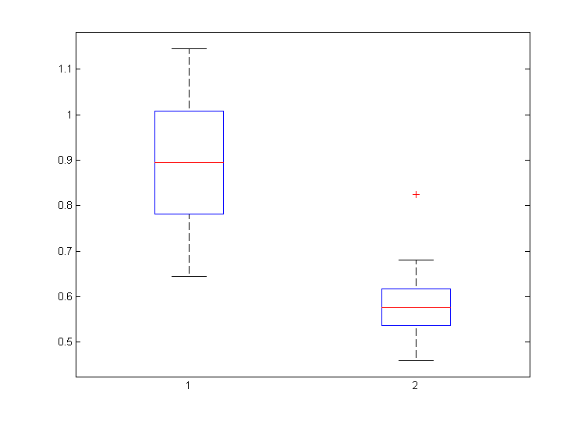
Detected physiological differences
Frontal Theta/Alpha ratio measure (t-test pval = 0.00338)
MD
Controls

Slide 35
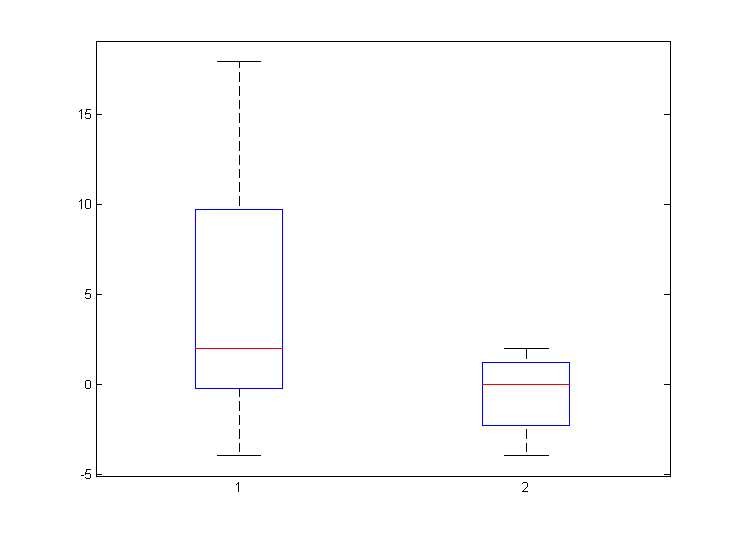
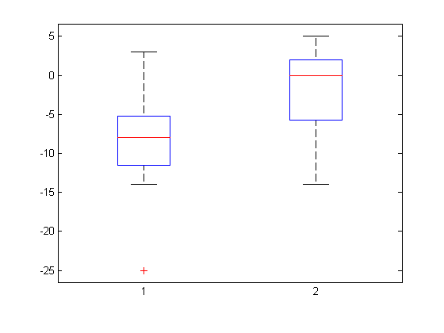
Detected behavioral differences
Negative mood change (t-test pval = 0.02)
Positive mood change (t-test pval = 0.007)
MD
Controls
Controls
MD
Notes:
Check this

Slide 36
Preliminary tests & results
30 samples
15 individuals that meditate regularly
15 controls
For example: grid 5X5X5 data
  764 regions/cells (I got 691)
  290703 pairwise correlations (features)
  None passes (0.05 or 0.1) FDR correction

Slide 37
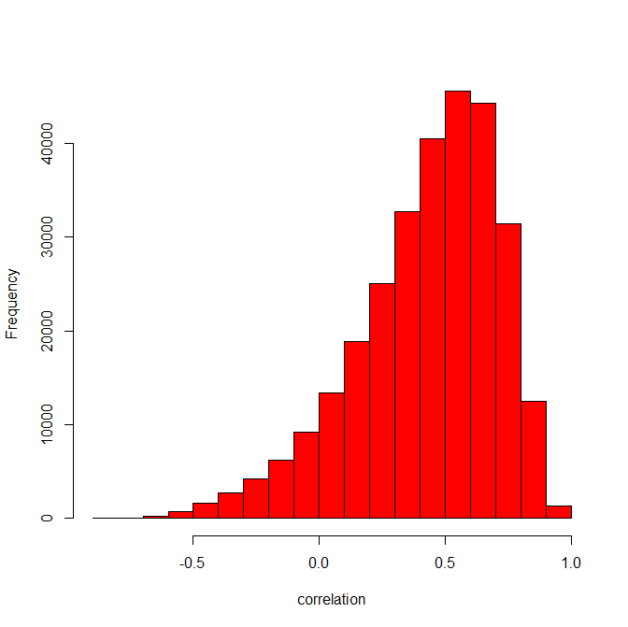
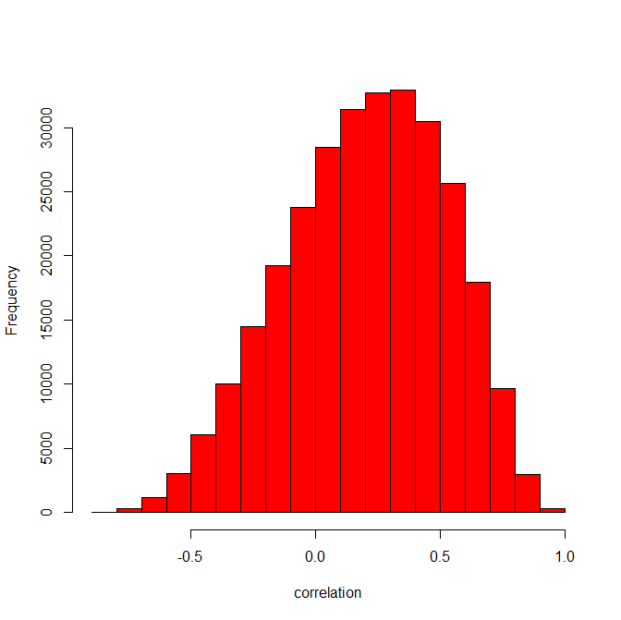
Disparity of samples
Example, two control subjects

Slide 38
Classification results
Linear SVM
LOOCV
Use t-test as feature selection method
  Choose the top k (e.g., 1000)
Measure ROC score and p-value for separation of probability scores (Wilcoxon rank-sum test)
Preprocessing methods
  None
  Fisher (make each sample normally distributed)
  Fisher+Standardization (make all distributions similar)

Slide 39
5X5X5 data results
Top 1000 features

Slide 40
Other parameters
Choosing 500 or 2000 features reduced performance:
  2000: ROC 0.85 (vs. 0.86), accuracy 70% (vs. 73.3%)
  500: ROC 0.84, accuracy 73.3%
Trying 4X4X4 (~1000 areas, >590,000 features)
  ROC 0.81
  Accuracy 60%

Slide 41
Summary
Separation is significant (ROC>0.85, p<0.001).
Standard preprocessing steps (Fisher, standardization) => decrease in performance
Top 1000 features is enough (~0.33% of the data).
Future:
  Try large areas (e.g., 6X6X6)
  Cluster the graph induced by the selected features
  Test other datasets

Slide 42
My questions
What determines the score of a feature after using an SVM for classification (i.e. how do we eliminate features in a wrapper-based method)?
In the radial based kernel formula – what does it mean that x1 and x2 are feature vectors? Why are there 2 feature vectors?
What is grid search?
What is K(x1,x2)?
Did he use the file that is with WM_CSF_RO and BF as I think he did?
In the third paper is f a group of features? (in the Gini importance calc)
How can one rank features according to GI if it is a multivariate measure?
What does the ± in slide 24 mean?
GI and random forest…
What does Didi mean by standard preprocessing decrease performance?

