Slide 1
Project presentation
Presenting initial work done by:
Yaron Orenstein
Using position-specific prior for motif discovery
ACGT group meeting 07/09/11

Slide 2
Talk layout
Introduction
What is position-specific prior and how is it related to gene regulation?
Previous work
Types of priors: uniform, simple and discriminative
Three methods: Gibbs sampling, expectation maximization, and a greedy post-processing
Initial work
Comparing Amadeus to the competing methods
Ideas how to modify Amadeus to use this data

Slide 3
Gene expression regulation
Transcription is regulated mainly by transcription factors (TFs) - proteins that bind to DNA subsequences, called binding sites (BSs)
TFBSs are located mainly in the gene’s promoter – the DNA sequence upstream the gene’s transcription start site (TSS)
TFs can promote or repress transcription
Other regulators: micro-RNAs (miRNAs)

Slide 4
TFBS models
We represent the binding site as a position weight matrix (PWM). Each position has weights for the 4 possible letters (A, C, G, T)
For example:
6 | 5 | 4 | 3 | 2 | 1
0 | 0.2 | 0.7 | 0 | 0.8 | 0.1 | A
0.6 | 0.4 | 0.1 | 0.5 | 0.1 | 0 | C
0.1 | 0.4 | 0.1 | 0.5 | 0 | 0 | G
0.3 | 0 | 0.1 | 0 | 0.1 | 0.9 | T

Slide 5
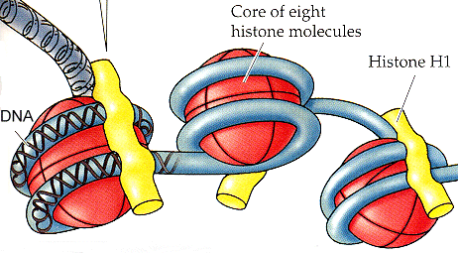
Nucleosome positioning
The genome DNA sequence is very long (3 Giga base pairs)
Inside the cell, the DNA is wrapped around protein complexes called nucleosomes
These occupy 147 base pairs, which are unaccessable to TFs

Slide 6
Nucleosome positioning – cont.
A lot of work was done in Segal lab to discover nucleosome positioning
The method is: use an enzyme to cut the DNA between nucleosomes, remove the nucleosome and sequence the depleted sequences
The problem is that the nucleosome configuration is dynamic

Slide 7
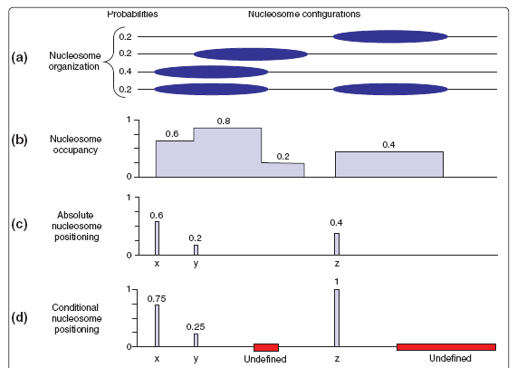
Nucleosome position definitions

Slide 8
Other examples of prior information sources
Conservation based prior, e.g. k-mer counts in orthologs or alignment based
DNA duplex stability information: use the helix destabilization profiles since TF binding sites occur preferentially in regions with high DNA duplex stability

Slide 9
Problem definition
Input:
DNA sequences, each containing a binding site of a specific TF
For each position in the DNA: prior probability that a BS starts at the position
Output:
Binding site of the TF in PWM format

Slide 10
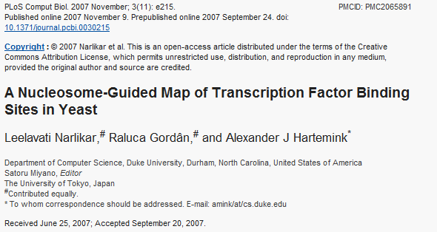
First paper in the field

Slide 11
Types of priors
The basic prior, which was in the underlying assumption of many works, is the uniform prior
Each position has the same probability for a TF binding site to start
So, how do we use the nucleosome positioning information to construct a prior?

Slide 12
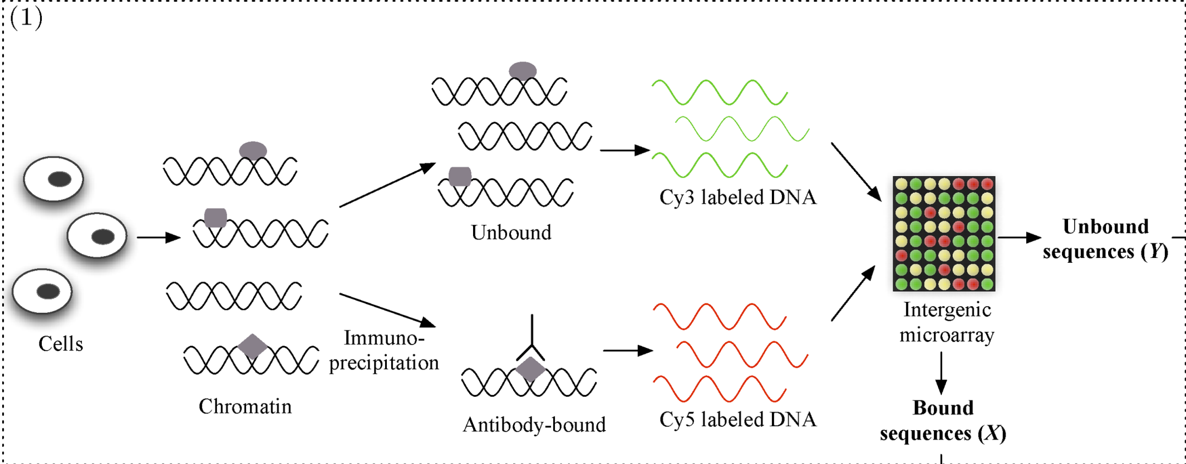
TF ChIP-chip data
Obtain the sets of bound and unbound sequences ({X₁,X₂,…,X_{n}) and {Y₁,Y₂,…,Y_{m}}, respectively) from a ChIP-chip experiment for a particular TF (indicated by a diamond)

Slide 13
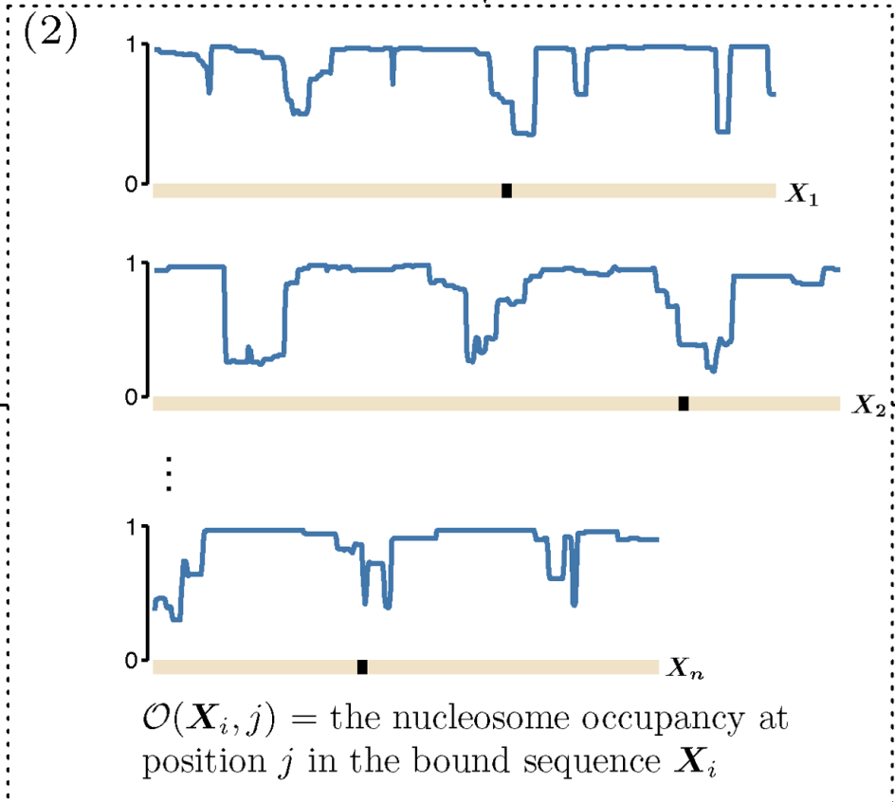
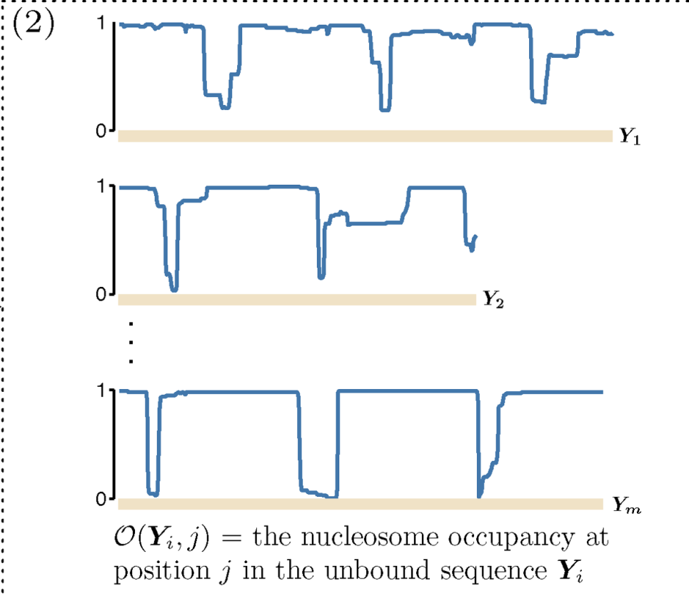
Bound Unbound
Determine the nucleosome occupancy O for all the bound and the unbound sequences

Slide 14
Simple prior
The simple prior suggested in (Narliklar et al. 07)
O(S, j) = the probability of the j-th position in sequence S being occupied by a nucleosome
Simple nucleosome score for each W-mer starting at position j in the bound sequence X_{i}:
S_{N}(X_{i}, j) is the probability that the W-mer at location j in X_{i} is a binding site of the profiled TF

Slide 15
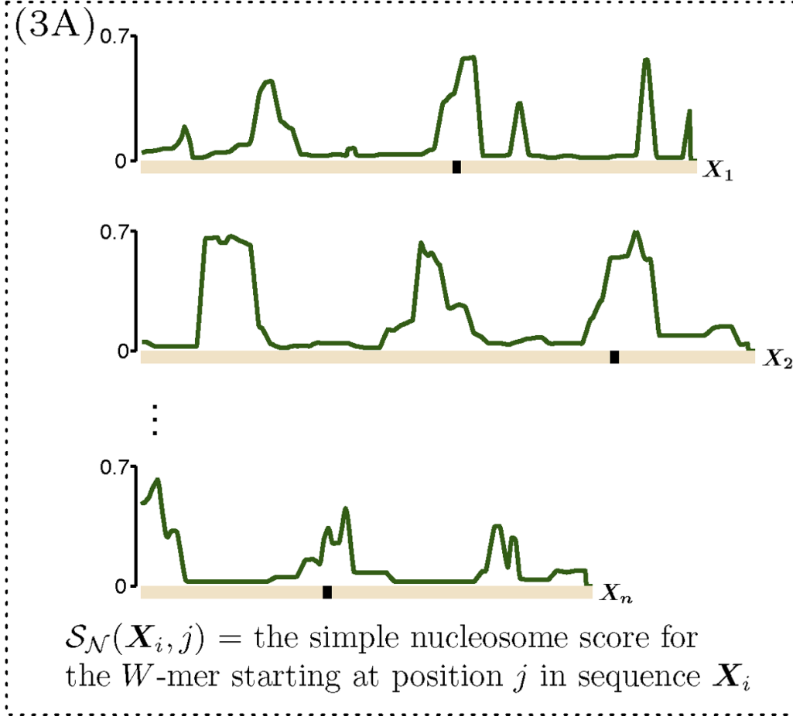
Compute the simple nucleosome score S_{N}(X_{i}, j) for each W-mer starting at position j in the bound sequence X_{i} by averaging the accessibility (1 − O) over all positions in the W-mer

Slide 16
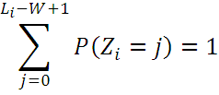
Each X_{i} contains at most one binding site
Z_{i} = the location of BS in X_{i} (0 = no BS)
L_{i} is the length of X_{i}
And for every 1 ≤ j ≤ L_{i}-W+1:
And normalization, for every 1 ≤ i ≤ n :

Slide 17
Discriminative prior
Y₁.. Y_{m} as m sequences not bound by the TF
S_{DN}(X_{i}, j) = discriminative score for nucleosome occupancy. This is the relative count of accesible W-mers in bound sequences.
is the W-mer starting at location j in X_{i}
The transition to probabilities is as before

Slide 18
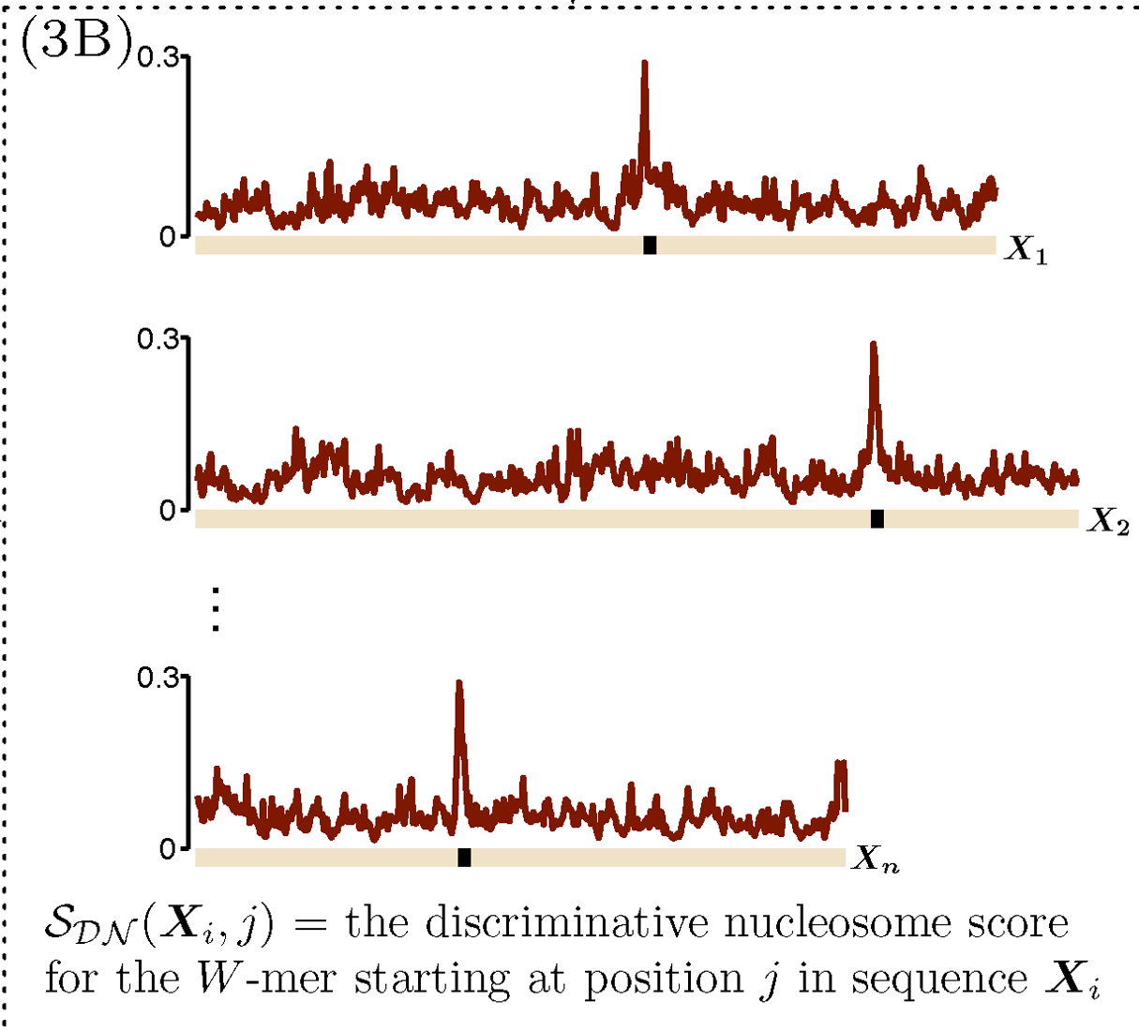
Compute the discriminative nucleosome score S_{DN}(X_{i}, j) for each W-mer starting at position j in sequence X_{i}, using the accessibility (1 − O) over all occurrences of this W-mer in both the bound and the unbound sequences

Slide 19
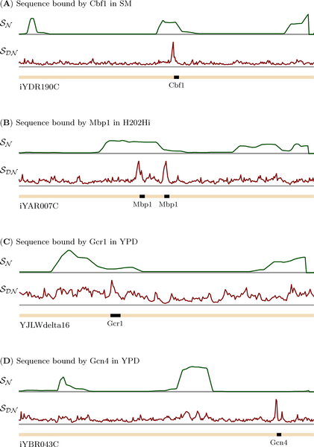
Nucleosome occupancy and the values of S_{DN} over four intergenic sequences
(A) iYDR190C in Cbf1_SM
(B) iYAR007C in Mbp1_H2O2Hi
(C) YJLWdelta16 in Gcr1_YPD
(D) iYBR043C in Gcn4_YPD
The boxes indicate binding sites annotated by Harbison et al.

Slide 20
S_{DN} over a single sequence belonging to multiple sequence-sets
The intergenic region iYMR280C belongs to four sequence-sets: Ume6_H2O2Hi, Ume6_YPD, Reb1_H2O2Lo, and Reb1_YPD. The boxes indicate binding sites annotated by Harbison et al.. S_{DN} for each sequence-set is different although S_{N} does not change

Slide 21
Gibbs sampling
Z = vector of length n, denoting the starting location of the binding site in each sequence
TF motif modeled as a PWM of length W =
Rest of the sequence follows background
Wish to find and Z that maximize the joint posterior distribution of all the unknowns given the data

Slide 22
Gibbs sampling – cont.
Assuming two priors and over and Z, respectively, the objective function is:
Gibbs sampling sample repeatedly from the posterior over and Z till apparent convergence, and output the highest scoring PWM

Slide 23
Evaluation
They used 2 sources of occupancy data on 156 yeast sequence sets (Harbison et al. 04):
The computational model learned by Segal et al. over the whole yeast genome
Low-resolution whole-genome ChIP-chip results for Myc-tagged H4 and H3 published by Lee et al.
Uniform | Simple | Discriminative computational | Discriminative in vivo | AlignAce | Meme | Mdscan | Meme_c (conservation) | Converge (conservation) | Kellis (conservation)
46 | 51 | 70 | 60 | 16 | 35 | 54 | 49 | 56 | 50

Slide 24
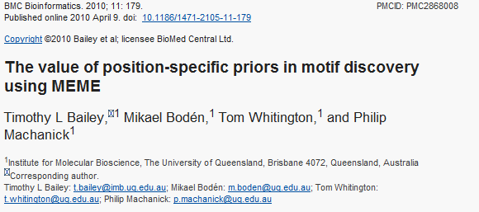
MEME-PSP
Bailey et al. modified their popular MEME algorithm to use position-specific prior

Slide 25
Phase I: Finding Starting Points
For each sequence, the site with maximum probability Pr(site|θ_{M}), given the PWM θ_{M ,} was determined in original MEME
Sites are now sorted by a value proportional to their posterior probabilities, Pr(site|θ_{M})Pr(θ_{M}), where Pr(θ_{M}) is the prior probability
Meme computes weights where P_{i}* is the maximum value of P_{i,j} in sequence X_{i}

Slide 26
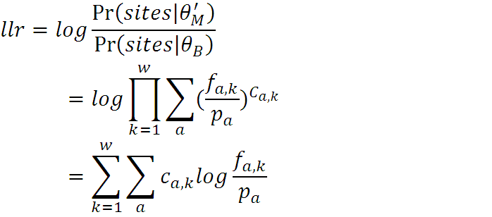
Modified log likelihood ratio
These weights are used to build a weighted PWM
The LLR is then:
c_{a,k} = weighted counts
p_{a} = nucleotide frequency
f_{a,k} = weighted frequency
This score is used to find the most likely starting positions

Slide 27
Phase II: Expectation Maximization
MEME uses EM to maximize the expectation of the joint likelihood of the sequence model given the sequences X and the missing information variables Z
EM proceeds by iterating an E-step followed by an M-step
The only change in MEME's existing EM implementation is the replacement of uniform assumption of site positions with the position-specific prior in the E-step

Slide 28
E-step
The next Z values:
P_{i,j} = the probability of a site in seq. i position j
m is the length of one sequence
Here Z variables are indicator variables, so the next Z value (specific calculation):

Slide 29
M-step
The M-step of the EM algorithm in MEME is unchanged. It re-estimates ϕ by solving:

Slide 30
Phase III: Scoring the Motifs
The scoring phase of the MEME algorithm assigns scores to the motifs discovered by EM
The criterion is based on the statistical significance of the log-likelihood ratio
Unlike the starting point phase (Phase I), the scoring phase of MEME computes the unweighted LLR, even when using non-uniform positional priors
Tests showed that the weighted LLR performed no better, so this part of the MEME algorithm was kept unchanged

Slide 31
Evaluation
The yeast data is from 156 ChIP-chip experiments each measuring the binding of a single TF (Harbison et al. 04)
This conservation-based prior is based on intergenic regions from S. cerevisiae that have a ChIP-chip fluorescence p-value ≤ 0.001 and the orthologous regions from six related organisms
The negative sequences are all S. cerevisiae intergenic regions with a p-value ≥ 0.5 and their orthologs

Slide 32
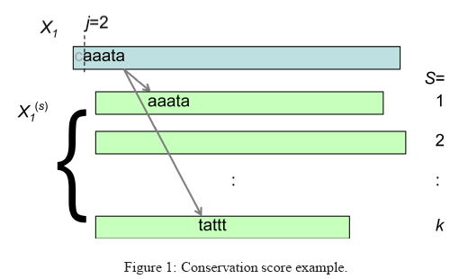
Conservation score
The prior is based on alignment-free conservation score:
I[] is an indicator function, denotes the W-mer at position j in sequence X_{i} , is ortholog sequence (s)
This score is used to calculate the simple and discriminative prior probability as in Gordan et al.

Slide 33
Euclidean distance
The metric compares the single motif reported by a motif discovery algorithm to a known motif for the TF by computing the scaled Euclidean distance between the PWMs for the motifs
Threshold of 0.25 defines a binary success

Slide 34
Performance of motif discovery algorithms
Proportion of Successes | Successes | Description | Algorithm
12% | 19 | local alignment of conserved regions | PhyloCon
13% | 21 | alignment-based; uses EM | PhyME
31% | 49 | MEME run with non-conserved bases masked | MEME_c
35% | 54 | similar to PhyME but uses Gibbs sampling | PhyloGibbs
36% | 56 | alignment-based | Kellis et al.
42% | 66 | alignment-based; uses EM | Converge
44% | 69 | Gibbs sampler with conservation-based priors | PRIORITY- C
49% | 76 | Gibbs sampler with discriminative conservation-based priors | PRIORITY- DC
23% | 36 | MEME with OOPS model | MEME: OOPS
25% | 39 | MEME with ZOOPS model | MEME: ZOOPS
47% | 73 | MEME with OOPS model and priors | MEME: OOPS-DC
52% | 81 | MEME with ZOOPS model and priors | MEME: ZOOPS- DC
41% | 65 |  | AMADEUS

Slide 35
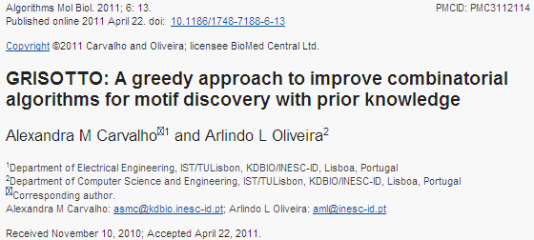
GRISOTTO
A pre-processing phase to improve a discovered motif according to prior info

Slide 36
Algorithm 1: GRISOTTO
Input = DNA sequences f , list of priors S = S₁, ..., S_{l}
1. run RISOTTO(k,z_{min},z_{max});
2. let r = ε and C be the list of the first z motifs returned in Step 1;
3. for each motif m in C
4. let m = GGP(m, f, S);
5. if (BIS(r,f ,S)<BIS(m,f ,S))
6. let r = m;
7. return r;

Slide 37
Algorithm 2: GGP
Input = motif m, DNA sequences f, list of priors S = S₁,...,S_{l}
1. let t = 0 and i = 0;
2. while (t < k)
3. let changed = false;
4. for each α in Σ (IUPAC alphabet)
5. if (BIS(m<i, α>, f ,S)>BIS(m, f ,S))
6. let m = m<i, α>, t = 0 and changed = true;
7. if (not changed)
8. let t = t + 1;
9. let i = (i + 1) mod k;
10. return m;

Slide 38
Self-information of PWM
A motif m of size k written in IUPAC can be translated into a PWM with dimension 4 × k
For each sequence f_{i} the respective position j_{i} where m occurs with maximum probability (P_{m}) is annotated
Assuming that m occurs independently in each sequence of f, the self-information that m occurs in all sequences of f in the annotated positions is

Slide 39
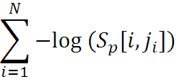
Self-information of a prior
The prior information is computed from the annotated sequences
The self-information given by the prior S_{p} of observing the annotated positions j_{i}, for all 1 ≤ i ≤ N, is:
where S_{p}[i, j] is the prior probability stored at the j-th position of the i-th sequence in S_{p}

Slide 40
Combining information from several priors
To combine prior information is to multiply the contribution of each prior by a constant α_{p} that measures the belief in the quality/relevance of each prior S_{p} and consider a balanced sum of all self-informations:

Slide 41
Combining PWM information and prior information
Balance with a constant the self-information given by the occurrence of the motif with the self-information of the priors
This is the balanced information score

Slide 42
Evaluation: source of priors
3 different priors were compared by:
DC = Evolutionary conservation-based prior
DE = Destabilization energy-based prior
DN = Nucleosome occupancy-based prior
In addition, a combination of the 3 was used in GRISOTTO-CDP.

Slide 43
Results on Harbison et al. 04
% | Successes | Description | Algorithm
12% | 19 | Local alignment of conserved regions | PhyloCon
13% | 21 | Alignment-based with EM | PhyME
23% | 36 | MEME with OOPS model | MEME:OOPS
25% | 39 | MEME with ZOOPS model | MEME:ZOOPS
31% | 49 | MEME without conserved bases masked | MEME-c
35% | 54 | Alignment-based with Gibbs Sampling | PhyloGibbs
36% | 56 | Alignment-based | Kellis et al.
41% | 64 | Alignment-based with Gibbs sampling | CompareProspector
44% | 68 | Alignment-based with EM | Converge
47% | 73 | MEME with OOPS model and DC priors | MEME:OOPS-DC
49% | 77 | Gibbs sampler with DC priors | PRIORITY-DC
52% | 81 | MEME with ZOOPS model and DC priors | MEME:ZOOP-DC
53% | 83 | GRISOTTO with DC priors | GRISOTTO-DC
45% | 70 | Gibbs sampler with DE priors | PRIORITY-DE
51% | 80 | GRISOTTO with DE priors | GRISOTTO-DE
45% | 70 | Gibbs sampler with DN priors | PRIORITY-DN
49% | 77 | GRISOTTO with DN priors | GRISOTTO-DN
60% | 93 | GRISOTTO with combined priors | GRISOTTO-CDP

Slide 44
Summary 1
Three different studies tackled the problem of utilizing position specific prior for the task of motif discovery:
Gibbs sampling approach, first study by Gordan et al. 07, including priors definitions
Expectation Maximization approach by Bailey et al. 10
Greedy preprocessing algorithm by Carvalho et al. 11

Slide 45
Amadeus algorithm
Pipeline of refinement phases of increased complexity
Key: sensitive, efficiently computed scores to filter motifs
Phases:
Preprocess
Mismatch
Merge
PWM
Optimization
EM
Cutoff = 0.005
Motif Model:
k-mer
List of k-mers
PWM

Slide 46
Amadeus in words
Generally, the first phases use simple motif models and enumerate a very large number of candidates, whereas the final phases evaluate a smaller number of more complex motifs, namely PWMs.
Motifs in each phase are evaluated using one or more score functions: enrichment, localization, strand bias, and chromosomal preference, which are combined into a single P-value.
The phases of Amadeus, in their running order, are preprocess, mismatch, merge, greedy, postprocess, and pairs analysis.

Slide 47
Summary 2
Suggestion for modifications in Amadeus:
Position weight matrix built in a weighted fashion, i.e. taking into account prior probability as a weight of each site
Replacing the hypergeometric score to take into account prior information, e.g. BIS score or a hypergeomtric score with multiple categories
Modifying the last EM phase as in MEME

