Slide 1
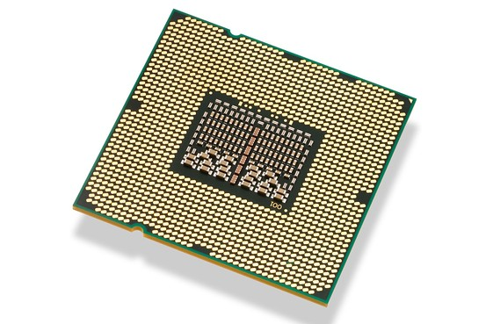
Post Silicon Test Optimization
Ron Zeira
13.7.11

Slide 2
Background
Post-Si validation is the validation of the real chip on the board.
It takes many resources, both machine and human.
Therefore it is important to keep less tests in the suite, but these tests must be efficient.
Notes:
Post-Si validation is the validation of the real chip on the board.
Concentrates on more complex system scenarios and protocols.
It has a huge capacity, but the internal observability is very poor.
Shooting in the dark – try to generate all possible scenarios randomly.
Post-Si validation takes many resources, both machine and human.
Many test failures are not real (e.g., environment problems), but they require many hours of debugging.
Many tests are inefficient or obsolete, but the validation engineers fear to drop them.
Therefore it is important to keep less tests in the suite, but these tests must be efficient.
Finding a subsets of the tests that ‘cover’ events while still giving high confidence to the validation engineer.
Clustering tests together based on coverage:
Identify and visualize similar tests.
Find representative tests.
Tune test configuration parameters to improve the coverage (TBD).

Slide 3
DB
Events
s1
0 |  |  | 9 |  |  | 9 |  |  |  |  | 3 |  |  |  |  | 5 |  |  | 7
 |  |  | 5 |  |  |  |  |  |  |  |  | 6 |  |  | 8 |  |  |  | 6
0 |  |  |  |  |  | 6 |  |  |  |  | 4 |  |  |  | 5 | 3
 |  |  | 8 |  |  | 7 |  |  |  |  | 4 |  |  |  |  | 4 |  |  | 5
 |  |  |  |  |  | 7 |  |  |  |  |  | 6 |  |  | 8 |  |  |  | 5
1 |  |  | 7 |  |  |  |  |  |  |  | 3 |  |  |  |  | 5 |  |  | 7
 | 4 |  |  | 8 |  |  | 8 |  | 7 |  |  |  | 6 |  |  |  | 5 | 3
 | 6 | 7 |  | 6 |  |  | 5 | 6 |  |  |  | 7 | 6 |  |  |  |  | 6 | 7
 |  | 4 |  | 4 |  |  |  | 3 | 5 |  |  |  | 5 |  |  |  | 6 | 5
 |  | 8 |  |  |  |  | 4 | 5 | 5 |  |  | 5 |  |  |  |  |  |  | 6
 |  |  |  | 6 |  |  | 5 |  |  |  |  |  |  | 8 |  |  |  |  | 8
 | 8 | 6 |  |  |  |  |  | 5 |  |  |  | 8 | 8 | 7 |  |  | 6 |  | 4
9 |  |  |  |  | 3 |  |  |  |  | 6
5 |  |  |  |  | 7 |  |  |  |  | 5
s2
Test 1
s3
s4
s5
s6
s1
Tests
s2
Test 2
s3
s4
s5
s6
Test 3
s1
s2
Notes:
A Test comprises of a series of
system elements (for example CPU+memory+USB+…).
configurations and modifications. Configures the system parameters. The parameters inside could be probabilistic – for example 80% memory reads and 20% multiplications.
Since tests are not deterministic each test may be run with several seeds.
An Event could be any internal signal that is visible and has a coverage meaning:
For example cache misses or division by 0 in a CPU.
Event occurrences are counted in each test.
Each event has a threshold and an operator (>). We say that an event was covered if the counter exceeds its threshold.
The DB contains triplets mapping
(test,seed,event) → hit counter
Notice that not all the data is taken in each run.
The absolute hit values may be misleading since each test ran a different amount of time. It would be preferable to use the hit ratio (data currently not available).
Some numbers:
874 tests, 302 events and 7M counter reads.
Only 22% of the matrix is non-zero.
Looking only on covered events:
Taking maximum over seeds gives 722 testlines, 108 events and 9059 counter values (11.8%).
Taking average over seeds gives 718 testlines, 105 events and 8930 counter values (11.6%).

Slide 4
DB
Take the maximum hit over seeds.
Filter results below threshold.
Results in a 722X108 testXevent matrix 11.8% full.
A test has 3 sets with the system elements, configurations and modifications it ran with.

Slide 5
Event Covering techniques
Single event covering:
Set cover.
Dominating set.
Event pairs covering:
Pair set cover.
Pair dominating set.
Undominated tests.
Notes:
Given a universe U and a family S of subsets of U, a cover is a subfamily C⊆S of sets whose union is U.
In the set covering optimization problem, the input is a pair (U,S), and the task is to find a set covering which uses the fewest sets.
A greedy algorithm can achieve an approximation ration of H(s-max).
Each test is a set of event that it covers (hits). The goal is to find a subset of the tests that covers all events.
A greedy approach gave a subset of 18 tests that cover all events.
We say that test A dominates test B on event E if the event’s counter value in test A is at least as good as B's.
The goal is to find a minimum subset S of the tests, such that for each event in any test there is a test in S that dominates it.
A greedy approach gave a subset of 45 tests.
When using a binary matrix the problem is the same as set cover.
The graph edges have a set of colors; each test has a different color, and the set of colors of an edge corresponds to the tests that cover both its end events.
The goal is to find a subset of the tests (colors) so that all the edges in the graph are covered.
Notice that this problem is identical to set cover of event pairs.
A greedy approach gives a cover of 77 tests that covers all 3559 event pairs.
Notice that not all pairs are possible:
Find a test set dominating all event pairs. In other words, we seek a subset of the tests such that each event pair will be dominated together by a test in the subset.
A greedy approach found a set of 240 tests that dominates all event pairs.
Taking the minimum hit count for each event in each event pair. Then find a dominating set on a matrix where the rows are tests and the columns are event pairs.
A generalization covering objective is to cover all possible event combination (exponential number).
We say that a test A dominates tests B if for every event that B hits k times, A hits the same event at least k times.
If a test is dominated it cannot contribute to any type of cover.
When looking on a binary matrix domination becomes containment (⊆).
Removing tests that are dominated by another test on all events.
There is a subset of 473 tests that are not dominated by any other test on the counters matrix.
There is a subset of 291 tests that are not dominated by any other test on the binary matrix.

Slide 6
Test X Event matrix
Events
 |  | 2 |  |  |  |  |  |  |  |  | 3 |  |  |  |  | 7
 |  | 5 |  |  |  |  |  |  |  |  | 4 |  |  |  |  | 5
 |  |  |  |  |  |  |  | 7 |  |  |  |  |  |  |  | 4
 |  | 5 |  |  |  |  |  |  |  |  | 1
 |  |  |  |  | 4 |  |  | 3
 |  |  |  |  | 5 |  |  | 8 |  |  |  |  |  |  |  | 8
 |  |  |  |  | 4 |  |  |  |  |  |  |  |  |  |  | 5
Tests

Slide 7
Test clustering
The goal is to find groups of similar tests.
First attempts with expander.
Similarity measure.
Binary K-Means.
Other binary methods clustering.

Slide 8
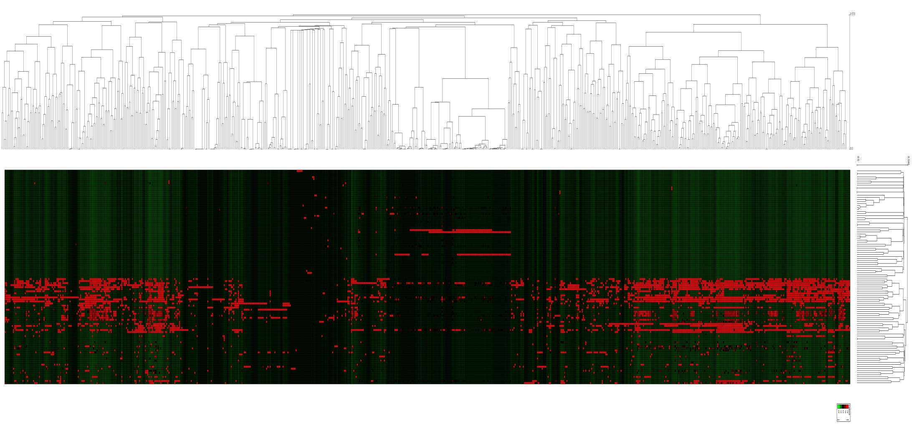
Clustering with expander
Tests
Events
Notes:
Loading the hit count matrix to expander

Slide 9
Hit count drawbacks
Pearson correlation\Euclidian distance consider sparse vectors similar.
Hit counts are deceiving.
Normaliztion.
Notes:
Since most of the matrix is 0s, sparse test vectors will be considered similar when using the Pearson similarity measure.
The hit counts in the matrix doesn't necessarily represent a real event ‘expression’ since each test ran a different amount of time.
Expander normalizes each row.
The hit counts depend on the time each test ran. In order to do a reliable comparison between the hit counts of different tests we should have used the rate of events and not the hit count. The very high variance in the hit count between the test and between events may also suggest that the actual numbers are misleading.
Clustering is also dependent on the data normalization methods. In our study, several normalization methods were tried: normalizing each test or event to mean 0 and variance 1, quantizing hit numbers or even binarizing them. All these methods change the relative difference between tests or events.
Another problem is the sparseness of the matrix. Similarity measures like Pearson correlation (used in Click) or Euclidian distance (used in k-means) will consider sparse test vectors to be very similar. Using Euclidian distance for example, a test that hit an event a thousand times would be considered more similar to a test that doesn't hit the event than to one that hits it a million times. A better similarity measure would score high tests that hit common events.
Clustering (using Click, SOM or K-Means) usually gives 1 big cluster containing hundreds of tests with low event coverage and some 2-4 small clusters (dozens of tests) that have higher coverage.

Slide 10
Binary similarity measure
Consider tests as binary vectors or sets.
Hamming distance – doesn’t differ between 0-0 and 1-1
Jaccard coefficient:
Pro - Prefers 1’s over 0’s.
Con – usually underestimates similarity.
Notes:
Look at tests as binary vectors where t[i]=1 if it covers event i
Another way is to look at tests as sets of events (features).

Slide 11
Binary similarity measure
Geometric mean/dot product/cosine/Ochiai:
Arithmetic mean:
Geometric mean ≤ arithmetic mean

Slide 12
Binary similarity measure
Arithmetic | Geometric | Jaccard
α | α | α/(2-α) | Undervalued overlap |v1|=|v2|=k |v1 ∩ v2| = αk
(1+α)/2 | Sqrt(α) | α | Undervalued part v1 ⊆ v2 |v1 ∩ v2| =|v1|= α|v2|
Similarities:
Jaccard ≤(?) Geometric mean ≤ arithmetic mean

Slide 13
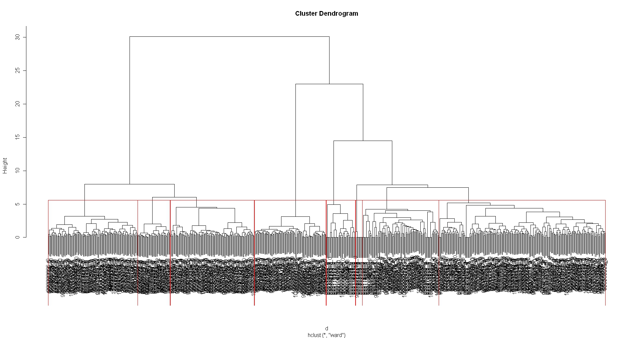
Test Clustering (Jaccard similarity)
Hierarchical cluster divided to 8 clusters.
Done with R
Notes:
Such a dendrogram can also be used to produce clusters by cutting the tree at a given height or branch length. Another approach could be looking on deep branches that may be singled out as highly similar tests.

Slide 14
Binary K-means
Choose initial solution.
While not converge
Move a test to the cluster it is most similar to
How to calculate the dissimilarity between a cluster to a single set using the binary dissimilarity measures?

Slide 15
Binary K-means
Test 2 cluster similarity:
Calculate binary centroid. Then check similarity.
Use the average similarity to the cluster.
Use the minimum/maximum similarity to the cluster.
Notes:
Calculate the binary cluster centroid. This is a set/vector that holds events that appear in the majority of cluster members. Similarity of two clusters is then defined is their centroids’ similarity. This method is used in the binary matrix decomposition algorithm [3], a version of a binary K-means.
Calculate the average similarity between pair of sets, one from each cluster.

Slide 16
Binary K-means
Choose initial k representatives:
Choose disjoint tests as representatives.
Choose tests with some overlaps.

Slide 17
Evaluating clustering
High homogeneity and low separation (function of the similarity).
Average Silhouette: how similar each test to its own cluster than to the “closest” cluster.
Cluster distribution.

Slide 18
Notes:
Figure 6 shows the average homogeneity and separation for all clusters with two similarity measures. Notice that different similarity values are a function of the similarity measure. When splitting the data to more clusters we get more homogeneous clusters, as expected. On the other hand, more clusters decrease the separation between them. There is a tradeoff between homogeneity and separation when choosing the initial solution – taking orthogonal cluster representatives gives better separation but worse homogeneity. The difference is noticeable in Jaccard.
Jaccard.
Figure 6: Performance of different variants of k-means as a function of the value k. The graphs show different similarity measures and different choices of the initial solution. Left: homogeneity and separation using Jaccard similarity. Right: homogeneity and separation using geometric mean similarity

Slide 19
Notes:
Figure 7 shows the average silhouette. The silhouette index takes into consideration both homogeneity and separation. Finding a maximum point for the silhouette can be used to choose the number of clusters to use. Unfortunately, there is no clear maximum indicating a "correct" number of clusters. We can see that for large number of clusters, starting with orthogonal representatives has a clear advantage.
Figure 7: The average silhouette of solutions obtained using different variants of k-means, as a function of the value k. Variants differ by the similarity measure and the choice of the initial solution.
Where a(v) is average dissimilarity of v to all other sets in the same cluster; b(v) is the minimum of average dissimilarity of v to all sets in the closest cluster. The clustering solution is better when the silhouette is close to 1. The silhouette of a clustering solution is the average silhouette of all sets.

Slide 20
Notes:
Figure 5 shows the distribution of the cluster sizes as a function of the number of clusters. The graphs plot the maximal size cluster and the cluster sizes standard deviation. It was noticed that in all clustering solutions there is always one big cluster consisting of at least 50% of the data. It can be seen that the choice of the initial solution has a greater effect on the distribution than the similarity measure. When the initial solution for k-means has tests with overlapping events, the final clustering tends towards smaller distributed clusters in both similarity measures. It also shows the distribution difference when using correlation base similarity, as in Expander, and the binary measures. K-means with Euclidian distance tends to divide clusters more uniformly than binary measures.
Figure 5: Performance of different variants of k-means as a function of the value k. Left: maximum cluster size. Right: cluster size standard deviation. k-means ran with two similarities measure: Jaccard and geometric mean. Different choices of the initial solution were tested: tests that have coverage overlap and those that do not. For comparison, Expander's k-means solution with Euclidian distance is presented too.

Slide 21
Click
CLICK is a graph-based algorithm for clustering.
Gets a homogeneity threshold.
Run click with dot product similarity.
Allows outliers – reflect a unique behavior.
Notes:
CLICK (CLuster Identification via Connectivity Kernels) [5] is a graph-based algorithm for clustering. The input for CLICK is the gene expression matrix. The CLICK algorithm attempts to find a partitioning of the set of elements into clusters, so that two criteria are satisfied: homogeneity - pairs of elements from the same cluster are highly similar to each other; and separation - pairs of elements from different clusters have low similarity to each other. Unlike K-means, CLICK allows some elements to remain un-clustered. Un-clustered elements, referred as singletons, should be dissimilar to any of the clusters found.

Slide 22
Notes:
Figure 8 displays how clusters are distributed when using Click. As in k-means, the solutions always contain one big cluster. As the threshold for high homogeneity increases, the algorithm tends to divide the data and keep more tests un-clustered (singletons). High homogeneity causes smaller clusters on the one hand, but on the other hand more tests remain un-clustered. When setting the threshold too high, click doesn't produce any clusters.
Figure 8: Characteristics of a clustering solution produced by Click as a function of the homogeneity threshold. The graph plots the number of unclustered tests and the size of the maximal cluster for each homogeneity threshold. It also shows the number of clusters multiplied by hundred to fit the sacle.
Figure 9 shows the homogeneity and separation for each threshold. There is no clear number that achieves both high homogeneity and low separation. There are some results better than others. In comparison with K-means with the same similarity measure (geometric mean/dot product), click has better homogeneity values but slightly worse separation. CLICK has slightly better silhouette values than its k-means counterparts. Click has the advantage over k-means by not clustering all the data.
Beside the average homogeneity, individual cluster homogeneity is also important. Highly homogenous clusters indicate similar tests groups that can be reduced.
Figure 9: Characteristics of a clustering solution produced by Click. Left: the homogeneity and separation of Click’s solution as a function of threshold. Right: the minimal, maximal and average cluster homogeneity in every solution. Usually the most homogenous cluster is small making the average homogeneity closer to the minimum homogeneity belonging to a bigger cluster.

Slide 23
Cluster common features
Similar tests (outputs) should have similar configurations (inputs)?
Find dominant configs/elements in each cluster using hyper-geometric p-val.
Look on configuration “homogeneity”.
Notes:
Features = system elements, configs, mods
Hypergeometric score has a tendency towards big groups
TODO:
Check event and feature similarity matrixes.

Slide 24
Cluster common features
Random partition hom | Random partition # | Config homogeneity | P-val & >50% | #Configs p-val > 1e-4
0.4034 | 0 | 0.4269 | 14 | 19 | Cluster1 (141)
0.3938 | 0 | 0.4301 | 8 | 8 | Cluster 2 (136)
0.3776 | 0 | 0.4334 | 1 | 1 | Cluster 3 (54)
0.3561 | 0 | 0.3743 | 1 | 8 | Cluster 4 (51)
0.3919 | 0 | 0.3552 | 2 | 2 | Cluster 5 (38)
0.4028 | 0 | 0.4728 | 1 | 1 | Cluster 6 (33)
0.3889 | 0 | 0.3918 | 14 | 32 | Singletons (269)
Notes:
Click homogeneity threshold 0.7
260 configs overall

Slide 25
Common features – open issues
Compare similarities matrixes according to event and features.
Compare cluster solutions according to the features.
Given a clustering solution analyze the feature’s role.
Notes:
The Mantel Test to compare similarity matrices

Slide 26
Choose the “best” tests to run
Do until size is met:
Select the “best” test to add or the “worst” test to remove.
Good/Bad test?
Similarity.
Coverage.
Cluster.
Notes:
Choose a subset of N (out of 722) tests to run
general scheme.

Slide 27
Evaluate a test subset
Number of event multi-covered.
Minimal event multi-covered.
Minimal homogeneity.
Feature based.
Notes:
Minimal number of configurations

Slide 28
“Farthest” first generalization
Start with arbitrary or known subset (cover).
At each iteration add the most dissimilar (remove most similar) test to the current selection.
Dis/Similar?
Average test to subset dissimilarity.
Minimal test to subset dissimilarity.
Notes:
Given a space of n points and an integer k, choose k cluster centroids that minimize:
Max j Max x in cj D(x,cj)
A 2 approximation:
Start with arbitrary point.
At each stage add the farthest point from the current set.
Actually select one of the most k dissimilar to avoid the same solution every time.

Slide 29
Coverage based
Start with arbitrary or known subset (cover).
At each iteration find the event least covered and add a test that cover it.
Similar to set multi-cover.

Slide 30
Cluster based
Add singletons to cover.
Choose arbitrary cluster according to size, then choose a test from it.
Choose the cluster according to the centroid.

Slide 31
Choose 400 tests with no initial cover
Min event cover | Average event cover | Homogeneity | Undominated left | Event pair cover percentage | Event cover percentage
0 | 30.13 | 0.0662 | 320 | 0.9336 | 0.9814 | Add farthest first
0 | 40.66 | 0.1091 | 214 | 0.9682 | 0.9907
0 | 30.18 | 0.0662 | 320 | 0.9353 | 0.9814 | Remove closest first
0 | 40.91 | 0.1085 | 231 | 0.9676 | 0.9907
54 | 60.67 | 0.1756 | 58 | 0.9994 | 1 | Add min event
0 | 44.58 | 0.1432 | 161 | 0.8951 | 0.9351 | Cluster based
1 | 63.75 | 0.245 | 70 | 0.9839 | 1
0 | 46.61 | 0.1496 | 152 | 0.8949 | 0.9166 | random
Notes:
All with Jaccard
Upper → average dissimilarity, lower → min dissimilarity
Cluster: upper→size, lower → coverage

Slide 32
Choose 400 tests with initial 291 un-dominated
Config homogeneity | Config in use | SE homogeneity | SE in use | Min event cover | Average event cover | Homogeneity
0.37 | 100% | 0.4564 | 94.63% | 5 | 52.97 | 0.1364 | Add farthest first
0.3823 | 98.44% | 0.457 | 94.26% | 8 | 55.69 | 0.1601
0.3695 | 100% | 0.4563 | 93.81% | 5 | 52.96 | 0.1364 | Remove closest first
0.3898 | 97.67% | 0.4643 | 92.85% | 1 | 60.2 | 0.1877
0.3734 | 96.89% | 0.4498 | 92.96% | 49 | 62.94 | 0.1928 | Add min event
0.3888 | 98.06% | 0.4689 | 91.99% | 1 | 59.34 | 0.1908 | random
Notes:
All with Jaccard
Upper → average dissimilarity, lower → min dissimilarity

