Slide 1
DREAM6/FlowCAP2 Molecular Classification of Acute Myeloid Leukaemia Challenge
AGCT meeting, August 2011
David Amar, Yaron Orenstein & Ron Zeira
Ron Shamir’s group
http://www.the-dream-project.org/challanges/dream6flowcap2-molecular-classification-acute-myeloid-leukaemia-challenge

Slide 2
AML
Acute myelogenous leukemia (AML) is a malignancy that arises in either granulocytes or monocytes which are white blood cells that battle infectious agents throughout the body.
AML is the most common type of leukemia.
There are several (7-9) subtypes of AML are classified based on the stage of development myeloblasts have reached at the time of diagnosis.

Slide 3
Flow cytometry
Flow cytometry is a technique used to measure the physical and chemical properties of cells or cellular components.
Cells are measured individually, but in large numbers.
http://www.usuhs.mil/bic/
http://www.abdserotec.com/

Slide 4
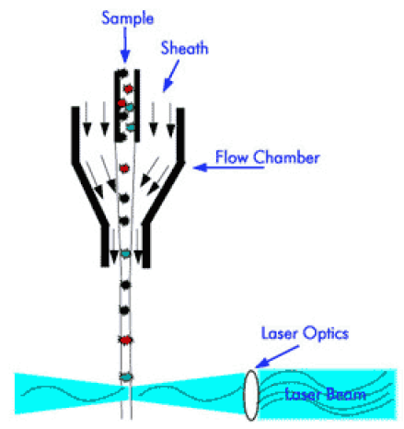
Flow cytometry
The cell sample is injected into a stream of sheath fluid.
The cells in the sample are accelerated and individually pass through a laser beam for interrogation.

Slide 5
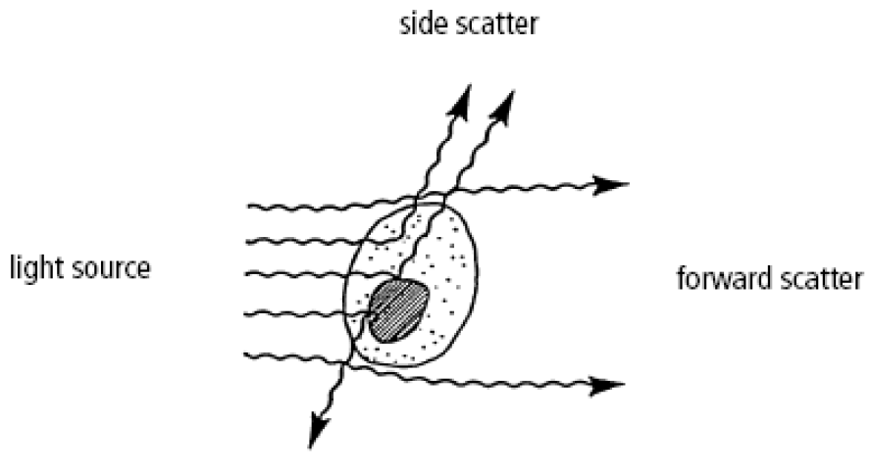
Flow cytometry
When a cell passes through the laser beam, it deflects incident light.
Forward-scattered light (FSC) is proportional to the surface area or size of a cell.
• Side-scattered light
(SSC) is proportional to the granularity or internal complexity of a cell.

Slide 6
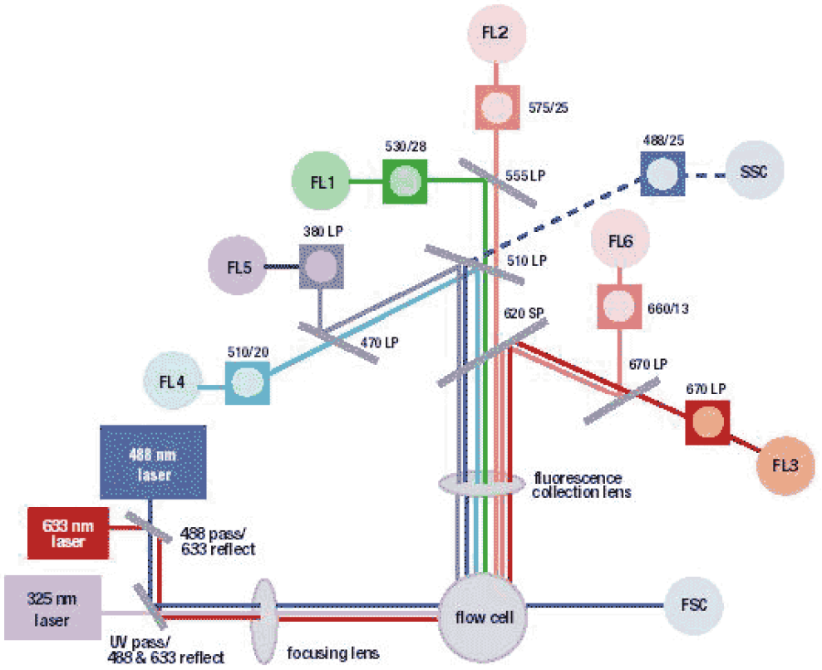
Flow cytometry
Light emitted from the interaction between the cell particle and the laser beam is collected by a lens.
The light moves through a system of optical mirrors and filters.
Specified wavelengths are then routed to optical detectors.

Slide 7
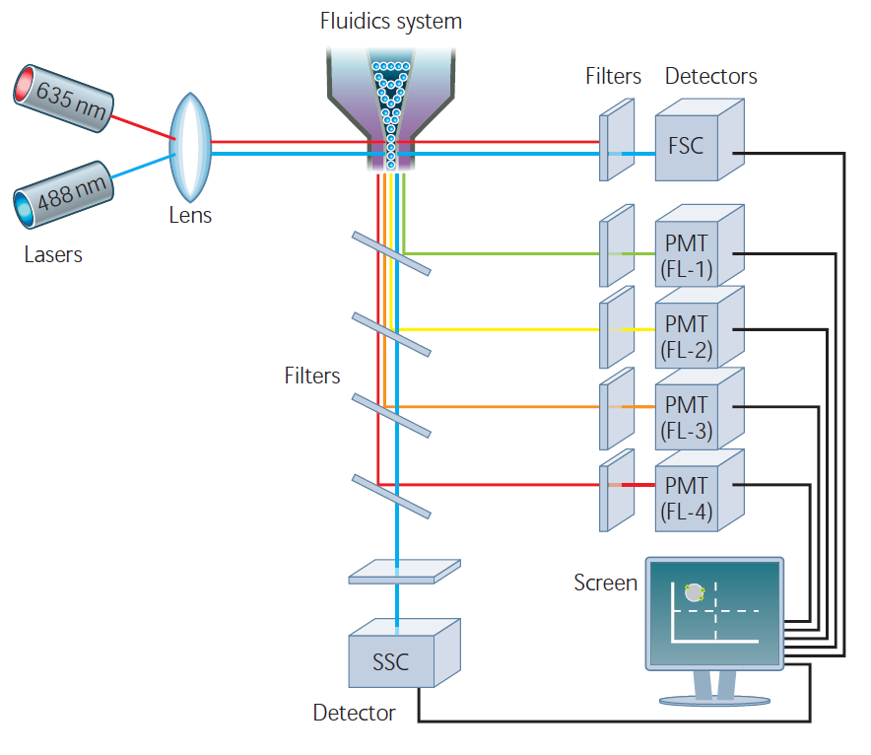
Flow cytometry

Slide 8
Flow cytometry
In this way, not only can cells be measured based on their size and internal complexity, but they can also be measured based on their fluorescent (color) signal intensity.
Fluorescence is typically “bestowed” upon a cell through the use of fluorescent dyes called fluorochromes.

Slide 9
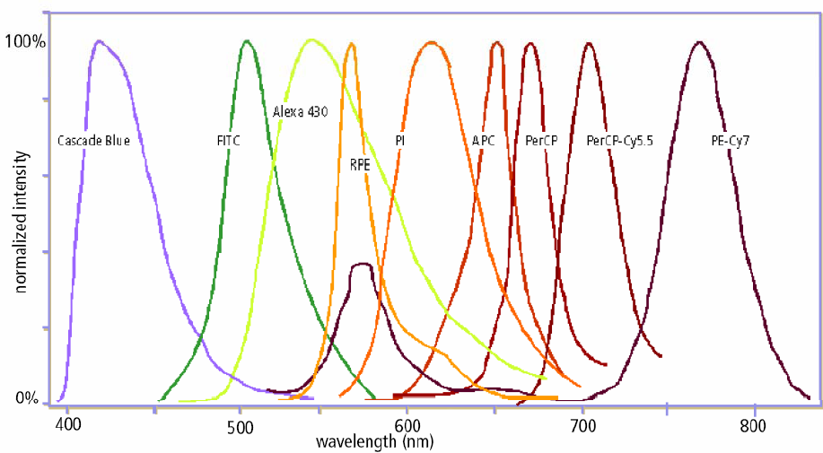
Compensation
Fluorochromes possess overlapping emission wavelengths.
fluorescence interference can be corrected for by adjusting the measurement parameters of the flow cytometer.

Slide 10
Basic Immunology
Antibodies (immunoglobulins) are proteins used by the immune system to neutralize foreign invaders.
They recognize, through specific binding, molecules called antigens.
Antibodies are covalently bound to fluorochromes as a means of and reliably specifically labeling cells.

Slide 11
Immunophenotyping
Monoclonal antibodies are used to recognize specific antigens on the surface of cells.
These cell-surface markers characterize different cell types.
Fluorochrome-tagged monoclonal antibodies brightly label cells for detection by the flow cytometer.

Slide 12
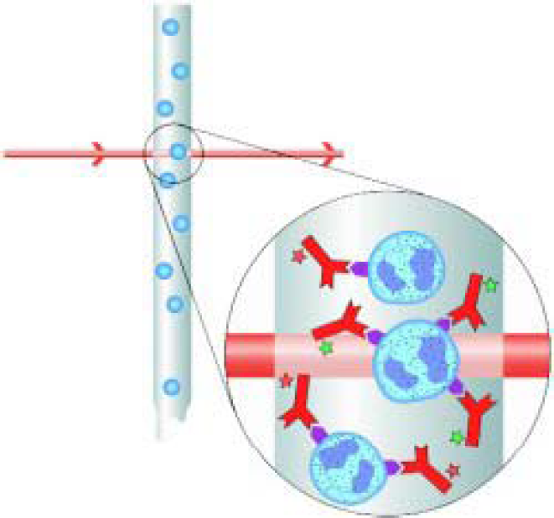
Immunophenotyping
Many cell surface features (as well as some internal characteristics) can be simultaneously assessed by employing different combinations of fluorochromes.

Slide 13
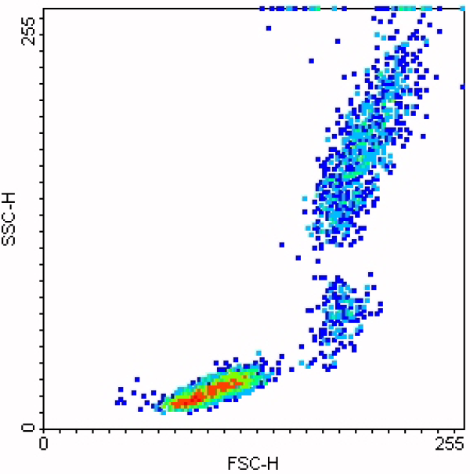
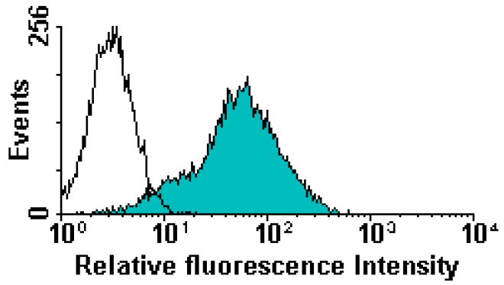
FACS data analysis
Data comes in 10 bit reads from the FS, SS and color detectors for each event.
Flow cytometry computer software can generate data in the form of density plots and contour plots.

Slide 14
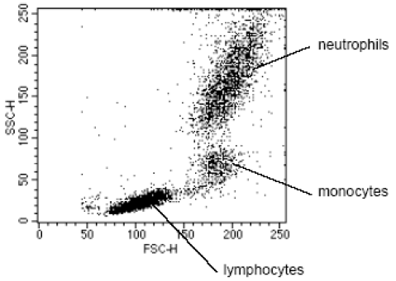
Gating
Distinguish cell types and debris.

Slide 15
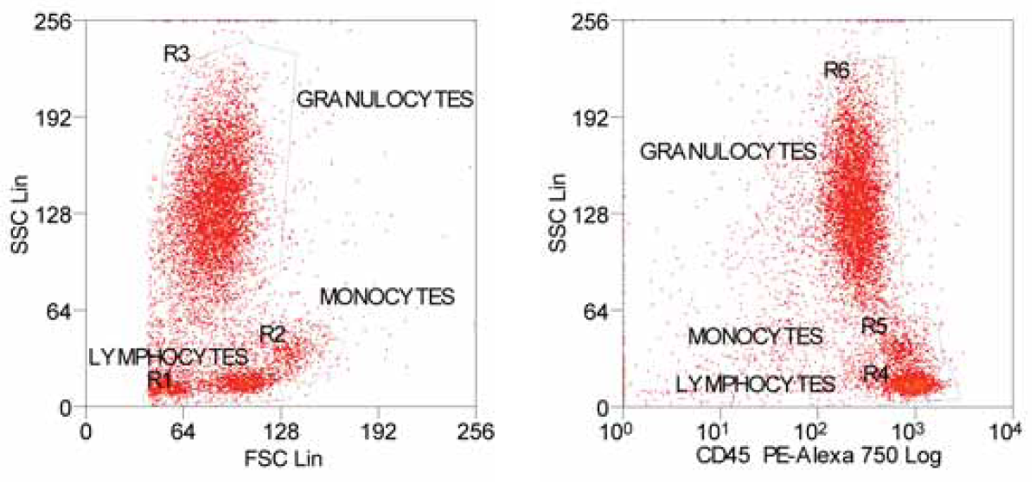
Gating
Lysed whole blood analysis using scatter and fluorescence
Notes:
Above on the left is a FSC/SSC plot for human lysed whole blood using
smaller numbers of cells than in Figure 9. The lymphocytes, monocytes and
granulocytes have been gated as region 1 (R1), region 2 (R2) and region
3 (R3), respectively. ‘Region’ simply refers to an area drawn on a plot
displaying flow cytometry data.
On the right the same cells are now plotted as SSC on the y-axis versus CD45
fluorescence on the x-axis. CD45 is a marker expressed on all white blood
cells at varying intensities but is absent on red blood cells. In relative terms,
lymphocytes have a low SSC and high CD45 count (R4), granulocytes have a
high SSC and low CD45 count (R6), while monocytes are somewhere in
between the other two (R5). The major difference between the lymphocytes
gated in R1 and those gated in R4 is the absence of red blood cells in the
latter, making it a much purer preparation. This highlights the usefulness of
gating strategies that combine a scatter parameter with a fluorescence
parameter.

Slide 16
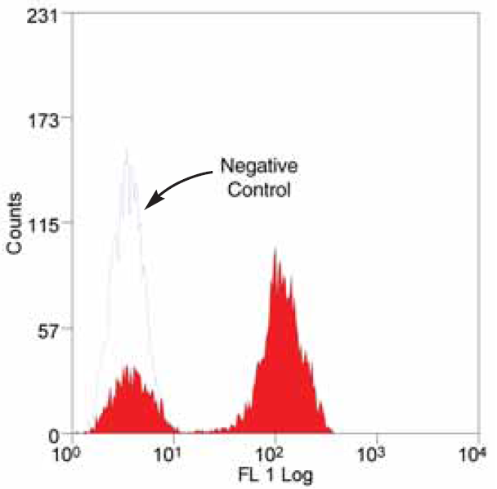
Single-parameter histograms
Ideally, flow cytometry will produce a single distinct peak that can be interpreted as the positive dataset.
However, in many situations, low analysis is performed on a mixed population of cells resulting in several peaks on the histogram

Slide 17
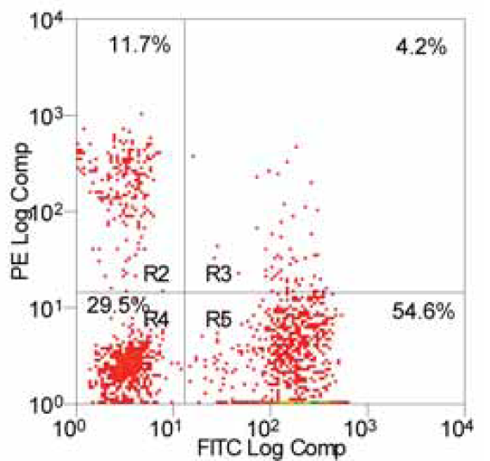
Two-parameter plots
Lymphocytes were stained with anti-CD3 (x-axis) and anti-HLA-DR (y-axis). CD3 and HLA-DR are markers for T cells and B cells, respectively.
Notes:
In Figure 14, R2 encompasses the PE-labeled B cells – note their positive shift
along the PE axis. R5 contains the FITC-labeled T cells (positively shifted
along the FITC axis). The top right quadrant contains a few ‘activated T cells’
(about 4% in this sample) that possess some HLA-DR expression also.
As these stain with both antibody markers they are grouped in their own
region (R3). R4 contains cells negative for both FITC and PE (no shift).

Slide 18
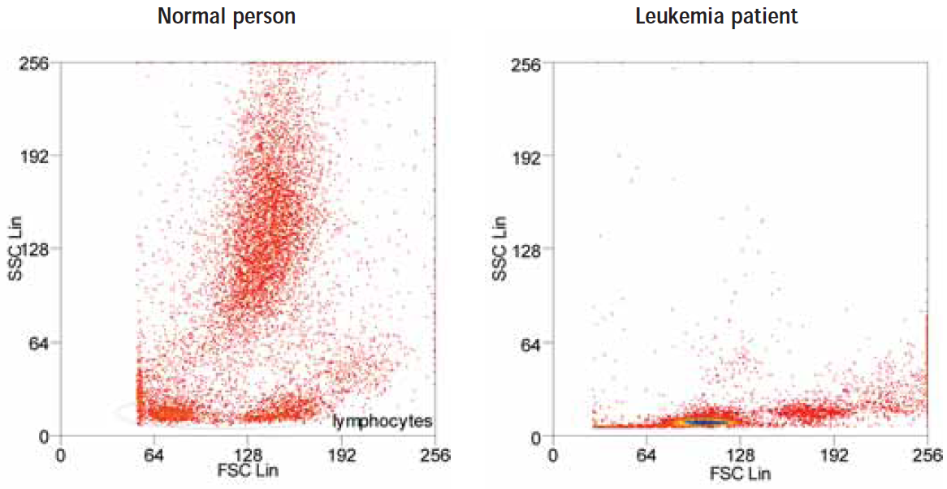
Immunophenotyping
Abnormal growth may interfere with the natural expression of markers resulting in overexpression of some and under-representation of others.
Notes:
The differences between the blood profiles of a healthy individual and one
suffering from leukemia, for instance, are very dramatic. This can be seen
from the FSC v SSC plots in Figure 16. In the healthy person the cell types are
clearly defined, whereas blood from a leukemia patient is abnormal and does
not follow the classic profile.

Slide 19
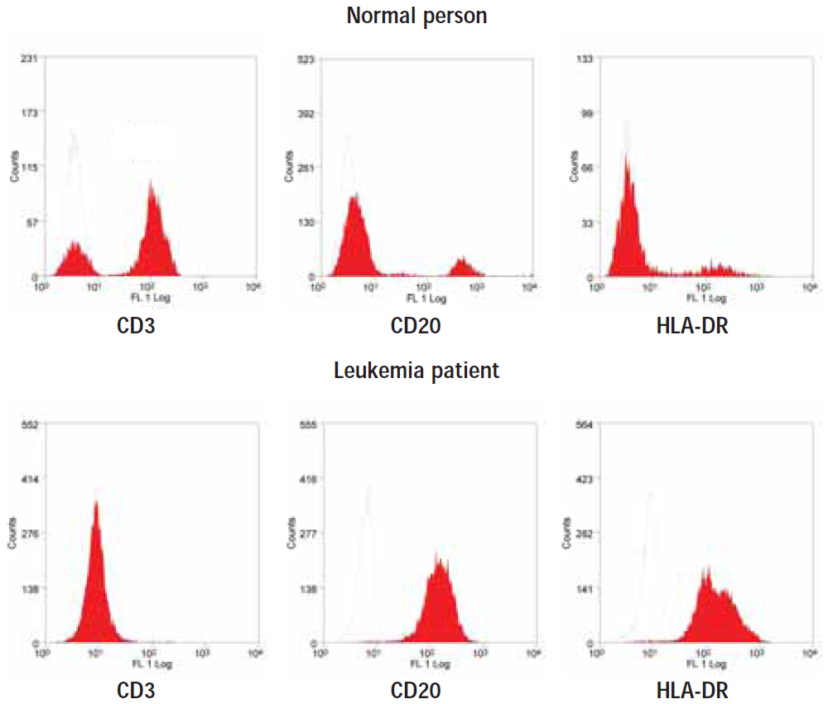
Immunophenotyping
Notes:
CD3
A normal person has a significant proportion of CD3-positive lymphocytes.
In the patient with leukemia, staining for CD3 is absent.
CD20
In the leukemia patient there are a large number of cells staining positive for
CD20. In the healthy person only a few stain positive.
HLA-DR
The leukemia patient is HLA-DR-positive. In the normal person only a small
number of cells stain positive.
Being CD3-negative, CD20-positive and HLA-DR-positive, a clinician could
diagnose with certainty that this patient is suffering from a B cell lineage
leukemia or lymphoma. The precise classification of disease may be
determined using further antibodies.

Slide 20
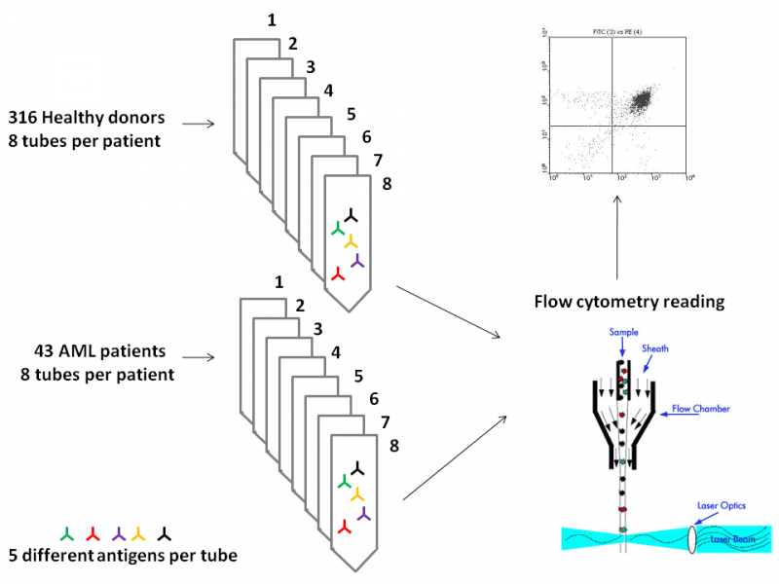
The challenge

Slide 21
The challenge
The samples consist of 43 AML positive patients and 316 healthy donors.
Samples from peripheral blood or bone marrow aspirate were collected over a one year period.
The samples were subsequently studied with flow cytometry to quantitate the expression of different protein markers.

Slide 22
The challenge
Each patient’s sample was subdivided in 8 aliquots (“tubes”) and analyzed with different marker combinations, 5 markers per tube.
Information for about half of the donors on whether they are healthy or AML positive is provided as training set.
The challenge is to determine the state of health of the other half, based only on the provided flow cytometry data.

Slide 23
The challenge
 | FL1 | FL2 | FL3 | FL4 | FL5
Tube 1 | IgG1-FITC | IgG1-PE | CD45-ECD | IgG1-PC5 | IgG1-PC7
Tube 2 | Kappa-FIT | Lambda-PE | CD45-ECD | CD19-PC5 | CD20-PC7
Tube 3 | CD7-FITC | CD4-PE | CD45-ECD | CD8-PC5 | CD2-PC7
Tube 4 | CD15-FITC | CD13-PE | CD45-ECD | CD16-PC5 | CD56-PC7
Tube 5 | CD14-FITC | CD11c-PE | CD45-ECD | CD64-PC5 | CD33-PC7
Tube 6 | HLA-DR-FITC | CD117-PE | CD45-ECD | CD34-PC5 | CD38-PC7
Tube 7 | CD5-FITC | CD19-PE | CD45-ECD | CD3-PC5 | CD10-PC7
Tube 8 | Non Specific | Non Specific | Non Specific | Non Specific | Non Specific
Notes:
antigen would be assigned a cluster designation, or CD number, meaning that a known cluster of antibodies were binding to this known antigen

Slide 24
The challenge
Expression of the CD45 molecule correlates with the stage of differentiation of the cells studied and is weak in the case of acute myeloid leukaemia thus enabling malignant cells to be distinguished from normal ones.
The 8th tube is an isotype control tube, with non-specific-binding antibodies (i.e., mouse antibodies).

Slide 25
The challenge
Submit a list of the test subjects ranked according to the confidence you assign to the subject to be affected with AML. A confidence score for each patient should also be provided.
Results will be scored using the area under the precision versus recall (PR) curve.
Other metrics such as the area under the receiver operating characteristic (ROC) curve will also be evaluated.
Notes:
Results will be scored using the area under the precision versus recall (PR) curve. Precision is defined as the fraction of correct positive set predictions, and recall is the proportion of correct positive set predictions out of all patients in the positive set. Other metrics such as the area under the receiver operating characteristic (ROC) curve will also be evaluated. Teams will be ranked according to their overall performance based on the area under the PR and ROC curves. We will evaluate these predictions as discussed in [6]

Slide 26
Data
Raw data in Flow Cytometry Standard (FCS) .
Preprocessed data (transformed/compensated) in CSV format.
Each subsequent row is an event (a cell) detected by the flow cytometer
"FS Lin","SS Log","FL1 Log","FL2 Log","FL3 Log","FL4 Log","FL5 Log"
273,0.545,0.219,0.210,0.181,0.163,0.144
......
793,0.649,0.457,0.377,0.344,0.1889,0.149

Slide 27
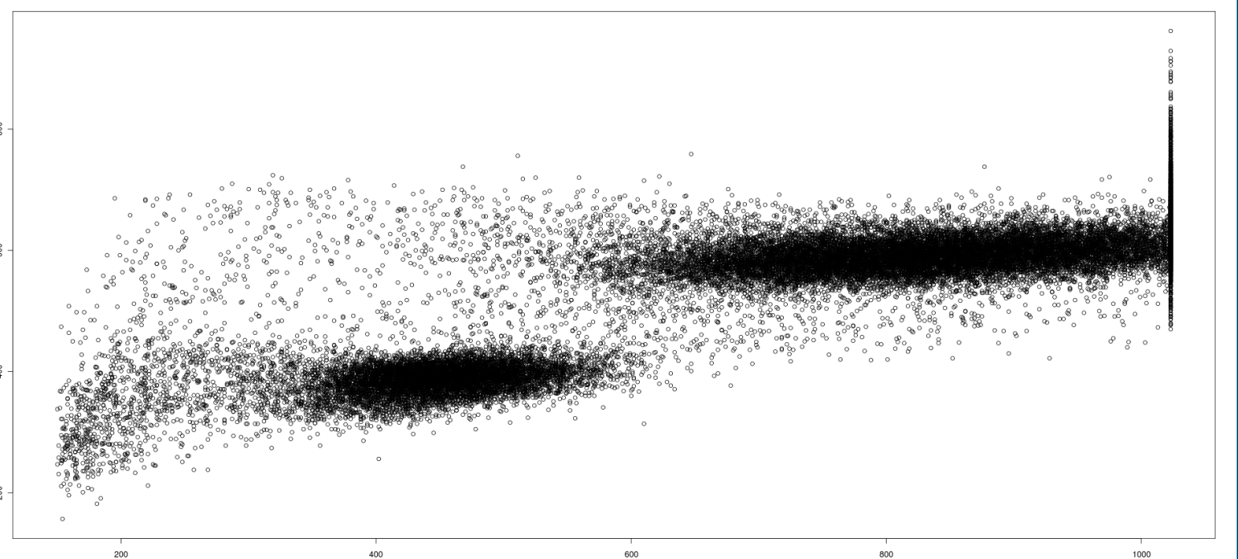
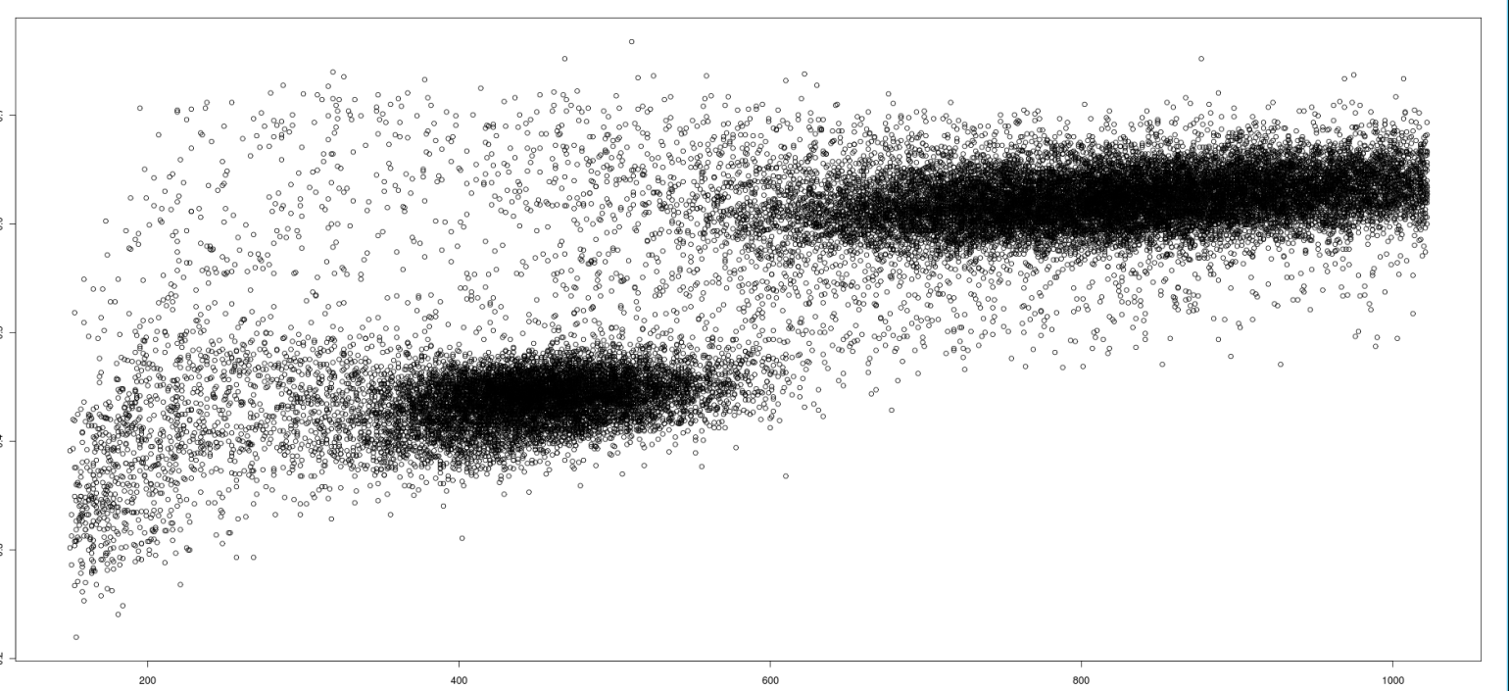
Raw Vs. preprocessed
Raw
SSC
FSC
Preprocessed (compensated/transformed)

Slide 28
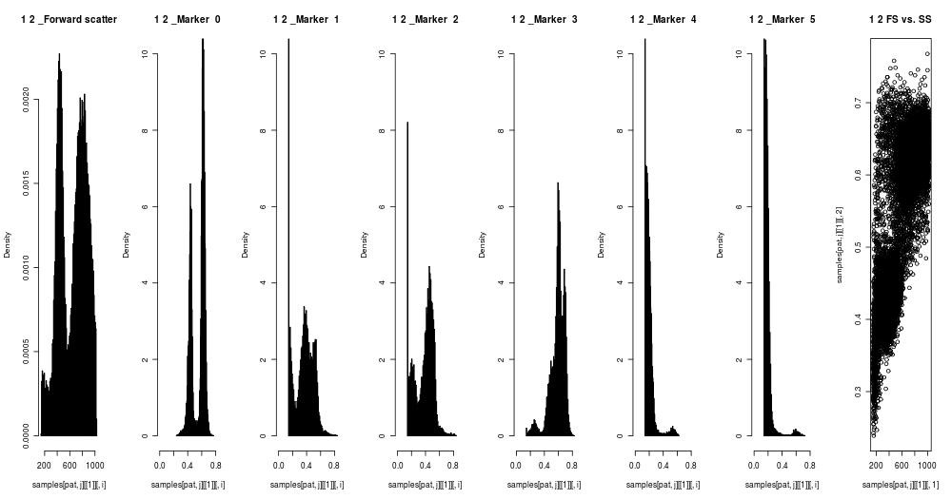
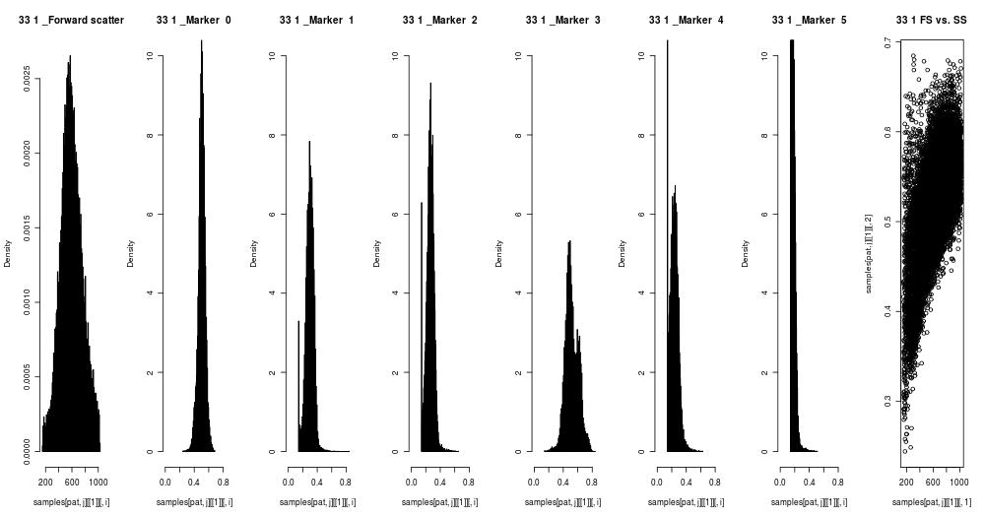
Tube 2
Healthy
FSC
SSC
Kappa
Lambda
CD45
CD19
CD20
FSC-SSC
AML

Slide 29
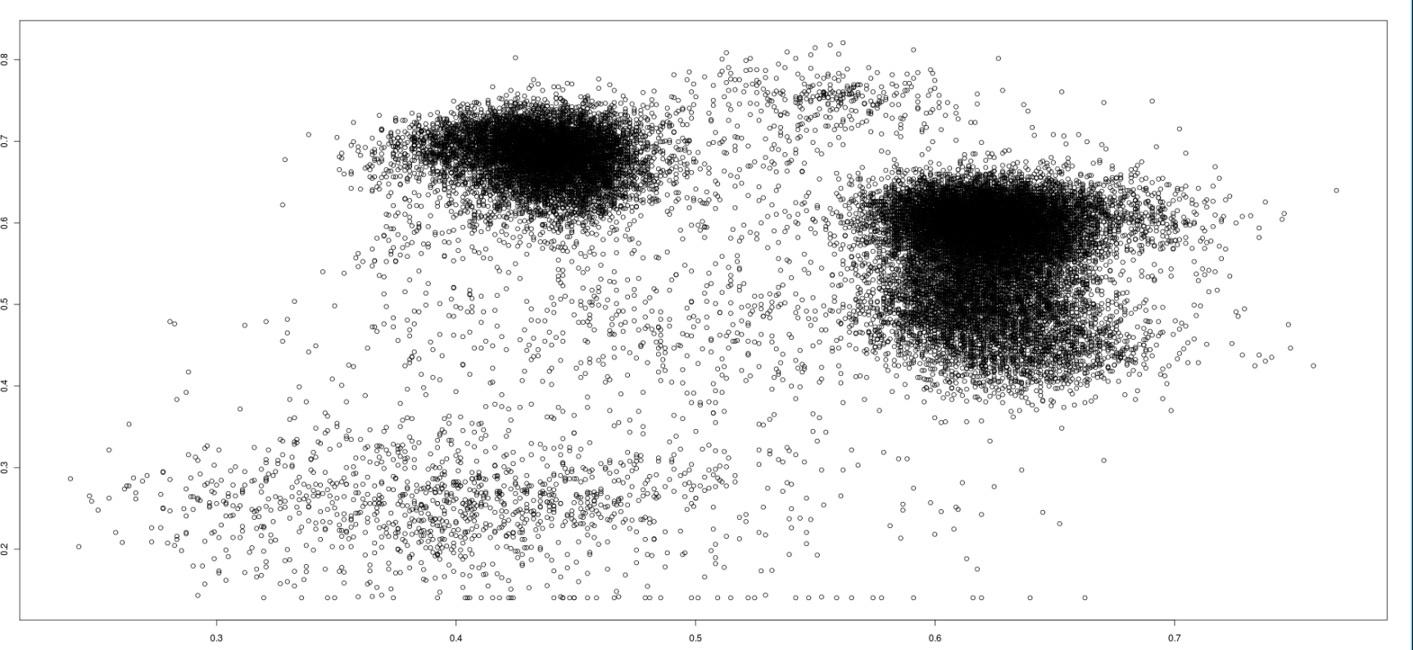
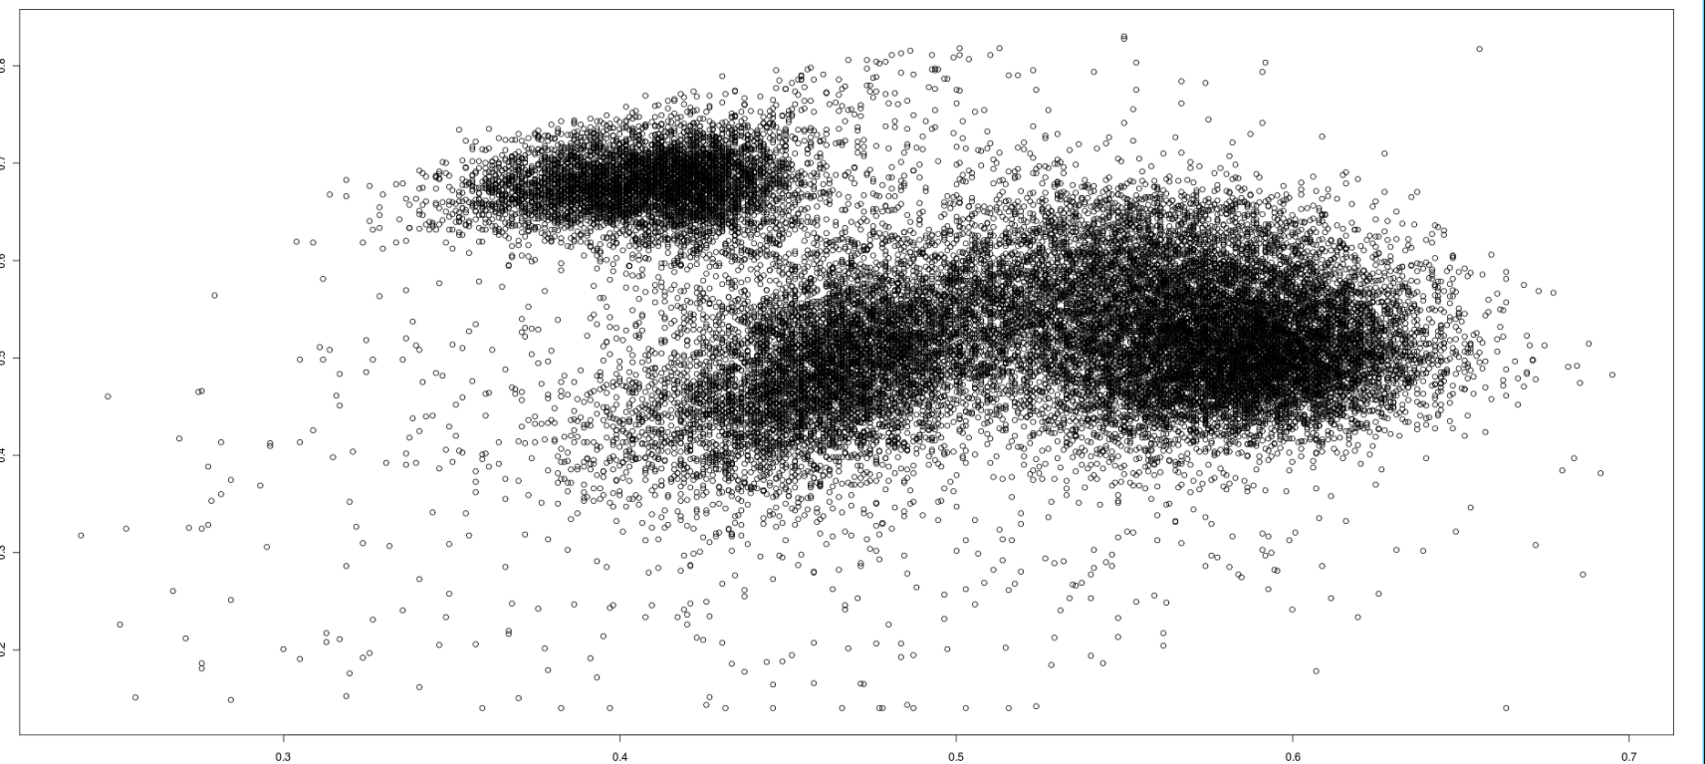
Healthy
CD45
SSC
AML

Slide 30
Basic approach
For each tube column (FSC, SSC and 5 markers) calculate statistics – mean, standard-deviation, 3rd and 4th moments.
Train a learning algorithm with these features.
Out of the available 23 AML and 156 healthy subjects, 5 AML and 20 healthy have been left aside for validation purposes.
Perform leave one out cross validation.

Slide 31
Version 1.0
Features: mean and standard deviation of every column: 98 features overall.
Classifier | AUPR | ROC | Accuracy
SVM-linear (estimate Probs) | 0.7535 | 0.953 | 95.45%
SVM-linear | 0.877 | 0.940 | 98.05%
RBF-network | 0.865 | 0.952 | 98.7%
RF | 0.918 | 0.951 | 98.05%
MLP | 0.931 | 0.957 | 97.4%
Classification via SVM regression | 0.961 | 0.986 | 98.7%

Slide 32
Version 1.10
Features: moments 3 and 4 (skew and kurtosis): 98 features
Classifier | AUPR | ROC | Accuracy
SVM-linear (estimate Probs) | 0.82 | 0.94 | 96.75%
SVM-linear
RBF-network | 0.74 | 0.937 | 94.16%
RF | 0.894 | 0.955 | 97.4%
Classification via SVM regression | 0.938 | 0.978 | 96.75%

Slide 33
Version 1.15
Features: moments 1, 2, 3 and 4 : 196 features
Classifier | AUPR | ROC | Accuracy
SVM-linear (estimate Probs) | 0.92 | 0.968 | 98.7%
Classification via SVM regression | 0.978 | 0.996 | 98.05%
Vote: averaging SVM and Classification via SVM regression | 0.981 | 0.997 | 98.7%

Slide 34
Version 2.0
Removing the lower 10% events of each marker. Use 4 moments.
Classifier | AUPR | ROC | Accuracy
SVM-linear (estimate Probs) | 0.819 | 0.96 | 97.4%
RBF-network | 0.848 | 0.95 | 98.05%
RF | 0.909 | 0.96 | 98.05%
Classification via SVM regression | 0.962 | 0.985 | 98.7%
Vote: averaging SVM and Classification via SVM regression | 0.963 | 0.985 | 98.05%

Slide 35
Version 2.1
Removing low score events outside the threshold of mean+stdv in the noisy tube. Use 4 moments.
Classifier | AUPR | ROC | Accuracy
SVM-linear (estimate Probs) | 0.878 | 0.991 | 96.75%
RBF-network | 0.886 | 0.945 | 96.1%
RF
Classification via SVM regression | 0.917 | 0.973 | 94.8%

Slide 36
Version 3.0
Moments 1-4 on raw data.
Classifier | AUPR | ROC | Accuracy
SVM-linear (estimate Probs) | 0.917 | 0.968 | 98.05%
Classification via SVM regression | 0.992 | 0.999 | 98.7%
Vote: averaging SVM and Classification via SVM regression | 0.988 | 0.998 | 98.05%

Slide 37
Version 4.0
Take events in the to quartile for each color. For each color calculate moments of FS,SS and intensity.
Classifier | AUPR | ROC | Accuracy
SVM-linear (estimate Probs) | 0.915 | 0.941 | 97.4%
RF | 0.921 | 0.971 | 98.05%
Classification via SVM regression | 0.896 | 0.914 | 96.75%
Naïve Bayes
Feature Selection: 200 information gain+SVM | 0.82 | 0.936 | 97.4%
Feature Selection: 200 information gain+SVMReg | 0.93 | 0.951 | 98.7%
Feature Selection: 200 RFE+SVMReg | 0.909 | 0.933 | 98.05%
Vote: 1,2 and 6 | 0.931 | 0.963 | 98.05%

Slide 38
Version 5.0
Correct using control tube: divide each tube’s distribution by the noisy tube’s distribution.
Classifier | AUPR | ROC | Accuracy
SVM-linear (estimate Probs) | 0.88 | 0.955 | 96.75%
RF | 0.864 | 0.897 | 95.45%
Classification via SVM regression | 0.895 | 0.948 | 96.1%
Vote: 1,2 and 3 | 0.895 | 0.937 | 98.1%

Slide 39
Other trials
Event counts.
Marker cross correlation.
Only FS and SS.

Slide 40
Results summary
Preprocess | Best classifier | AUPR | ROC | Accuracy
Mean + stdv | Classification SVM reg | 0.961 | 0.986 | 98.7%
Moments 3-4 | Classification SVM reg | 0.938 | 0.978 | 96.75%
Moments 1-4 | Vote: SVM + SVM reg | 0.981 | 0.997 | 98.7%
Remove lower markers (10%) | Vote: SVM + SVM reg | 0.963 | 0.985 | 98.05%
Remove lower markers using noise | Classification SVM reg | 0.917 | 0.973 | 94.8%
Raw data: moments 1-4 | Classification SVM reg | 0.992 | 0.999 | 98.7%
Upper quartile events | voting | 0.931 | 0.963 | 98.05%
Divide distribution by noise | Classification SVM reg | 0.895 | 0.948 | 96.1%
On the validation set the AUC is 1.

Slide 41
Important features
Weight | Moment | Marker | Marker designation
0.5032 | 2 | CD34 | stem cell marker, adhesion, found on hematopoietic precursors, capillary endothelium, and embryonic fibroblasts
0.3475 | 1 | CD7 | found on thymocytes, some T cells, monocytes, natural killer cells, and hemopoietic stem cells
0.3374 | 4 | CD33 | a marker of unknown function found on immature myeloid cells
0.3301 | 4 | CD13 | found naturally on myelomonocytic cells
0.3159 | 3 | CD13
0.3001 | 1 | CD20 | found on B cells that forms a calcium channel in the cell membrane
0.2675 | 3 | CD117 | c-kit, the receptor for Stem Cell Factor, a glycoprotein that regulates cellular differentiation, particularly inhematopoiesis
0.2586 | 1 | CD19 | B-lymphocyte surface antigen B4
0.2176 | 2 | CD64
0.2174 | 3 | CD2 | found on thymocytes, T cells, and some natural killer cells that acts as a ligand for CD58 and CD59 and is involved in signal transduction and cell adhesion
0.2149 | 2 | CD117
0.2114 | 4 | CD14 | a membrane protein found on macrophages which binds to bacterial lipopolysaccharide.
0.2018 | 1 | CD45 | leucocyte common antigen, a type I transmembrane protein present on all hemopoietic cells except erythrocytes that assists in cell activation

Slide 42
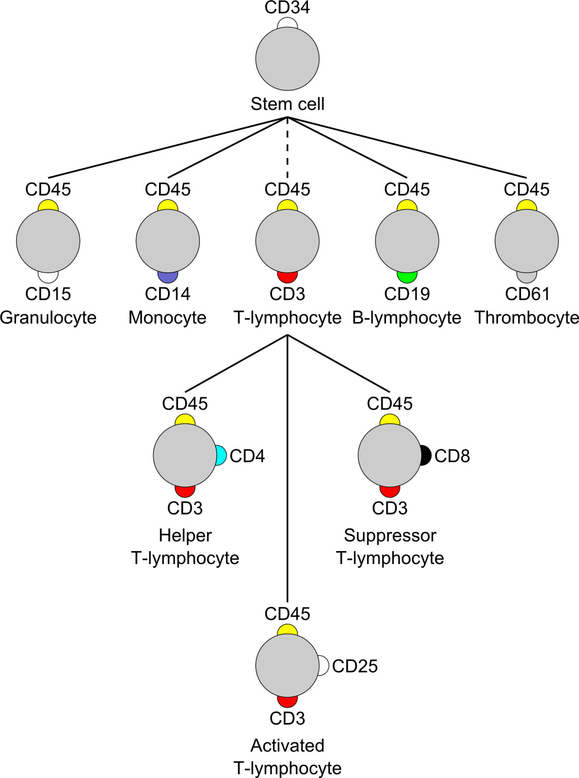
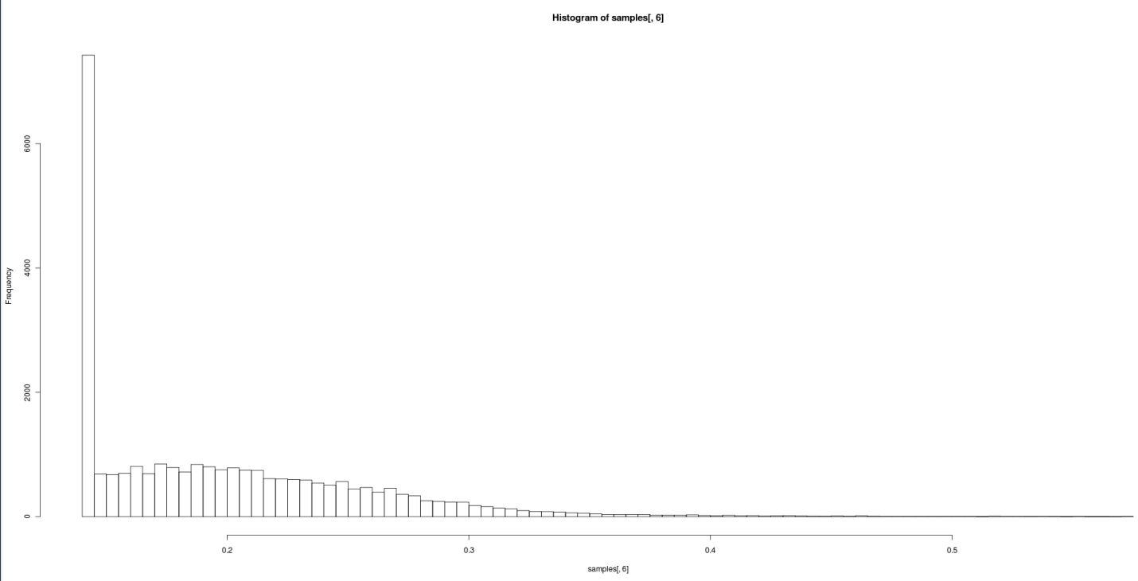
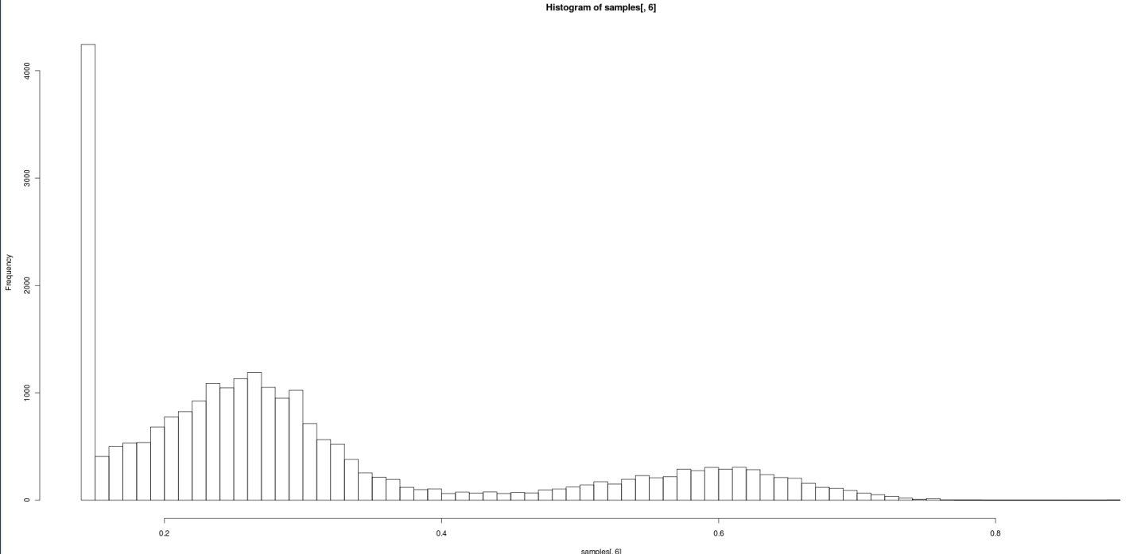
Role of CD34
Healthy
AML

Slide 43
Future work
Try to use flow cytometry analysis software (FlowJO).
Validate on the test data.
Classify the unknown data.

