Slide 1
Haifa Verification Conference 2011 – Report
December 5-8, 2011
Ron Zeira

Slide 2
HVC
Annual conferences dedicated to advancing the state-of the-art and state-of-the-practice in verification and testing of hardware and software.
Simulation-based verification
Formal verification methods
High-level stimuli generation
Equivalence checking
SAT-based verification algorithms
Classification of hardware bugs
Static analysis
Design for verifiability
Hardware/software co-verification
Debugging
Emulation and acceleration
Formal modeling and specification
Post-silicon validation
CSP-based functional verification
Formal specification languages
Model checking
Quality assurance
Testing methodologies
Defect prevention
Test-driven development
Hybrid verification methods
Model-based testing
Verification coverage
Developer testing
Review and inspection
Semi-formal verification
Test automation and automated test generation
Coverage analysis and test minimization
Test planning
Testing and analysis of concurrent software
Domain specific testing and analysis
Functional and performance testing

Slide 3
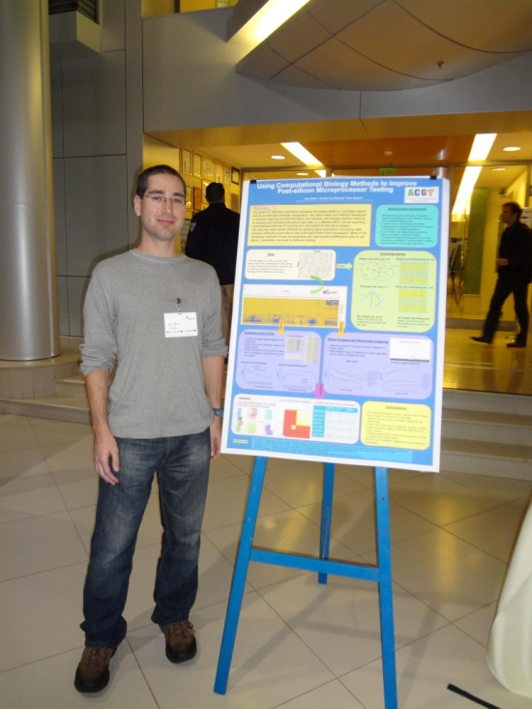
General impressions
Relatively small conference.
Mostly formal verification. Smaller sessions on testing, SW and tools.
~18 papers – mostly from abroad.
Some papers seemed mediocre.
Only 4 posters.

Slide 4
SAT
Preprocessing and Inprocessing Techniques in SAT
Prof. Armin Bier
Institute for Formal Models and Veriﬁcation Johannes Kepler University, Linz, Austria

Slide 5
Dress Code as Satisﬁability Problem
propositional logic:
variables: tie , shirt
negation : ¬ (not)
disjunction V disjunction (or)
conjunction Λ conjunction (and)
three conditions / clauses:
clearly one should not wear a tie without a shirt
not wearing a tie nor a shirt is impolite
wearing a tie and a shirt is overkill
is the formula satisﬁable?
¬ tie V shirt
tie V shirt
¬ (tie Λ shirt)= ¬tie V ¬shirt
(¬ tie V shirt) Λ(tie V shirt) Λ(¬tie V ¬shirt)

Slide 6
The SAT problem
Given a propositional formula in CNF, check whether it is satisfiable (and optionally: output one solution, if it is satisfiable )
(¬ tie V shirt) Λ(tie V shirt) Λ(¬tieΛ¬shirt)
clause
variable
literal

Slide 7
The SAT problem
SAT is a central problem in Computer Science, with both theoretical and practical interests.
SAT was the 1st NP-complete problem.
SAT received a lot of attention [1960-now].
SAT has very efficient implementations.
SAT has become the “assembly language” of hard-problems
SAT is logic

Slide 8
Motivation – software verification
Prove/refute code
y←N-1
if (x>N)
y←x
else
y←N
assert(y>=N)

Slide 9
Solving SAT
[Davis & Putnam, 1960; Davis, Longemann & Loveland,1962] The DPLL Algorithm, a complete SAT Solver
SAT competitions since 2002: http://www.satcompetition.org/
Aggregation of several techniques to SAT, such as learning, unlearning, backjumping, watched literal, special heuristics.

Slide 10
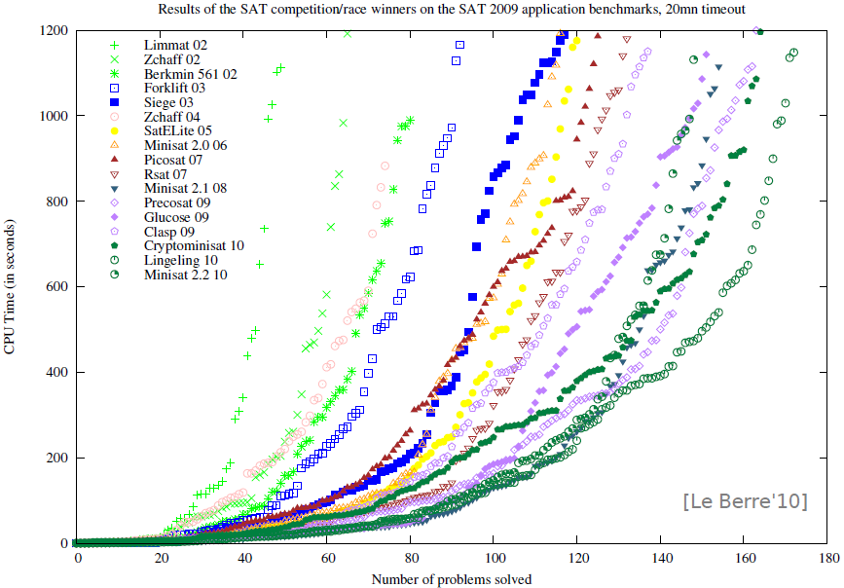

Slide 11
Satisability of Clause Sets
$A⊨N$ if and only if $A⊨C$for all clauses C in N.
$A⊨C$if and only if $A⊨L$for some literal L $∈$C.

Slide 12
Partial Valuations
Since we will construct satisfying valuations incrementally, we consider partial valuations (that is, partial mappings $A:⊓→\{0,1\}$).
We start with an empty valuation and try to extend it step by step to all variables occurring in N.

Slide 13
Partial Valuations
If A is a partial valuation, then literals and clauses can be true, false, or undefined under A.
A clause is true under A if one of its literals is true; it is false (or “conflicting”) if all its literals are false; otherwise it is undefined (or “unresolved”).

Slide 14
Unit Clauses
Let A be a partial valuation. If the set N contains a clause C, such that all literals but one in C are false under A, then the following properties are equivalent:
there is a valuation that is a model of N and extends A.
there is a valuation that is a model of N and extends A and makes the remaining literal L of C true.
C is called a unit clause; L is called a unit literal.

Slide 15
Pure Literals
Let A be a partial valuation and P a variable that is undefined under A. If P occurs only positively (or only negatively) in the unresolved clauses in N, then the following properties are equivalent:
there is a valuation that is a model of N and extends A.
there is a valuation that is a model of N and extends A and assigns true (false) to P.
P is called a pure literal.

Slide 16
DPLL
boolean DPLL(clause set N, partial valuation A) {
if (all clauses in N are true under A) return true;
elsif (some clause in N is false under A) return false;
elsif (N contains unit clause P) return DPLL(N, $A∪\{P⟼1\}$);
elsif (N contains unit clause ¬P) return DPLL(N, $A∪\{P⟼0\}$);
elsif (N contains pure literal P) return DPLL(N, $A∪\{P⟼1\}$);
elsif (N contains pure literal ¬P) return DPLL(N, $A∪\{P⟼0\}$);
else {
let P be some undefined variable in N;
if (DPLL(N, $A∪\{P⟼0\}$) return true;
else return DPLL(N, $A∪\{P⟼1\}$);
}
}
Notes:
Initially, DPLL is called with the clause set N and with an empty partial valuation A.

Slide 17
DPLL
In practice, there are several changes to the procedure:
The pure literal check is often omitted (it is too expensive).
The branching variable is not chosen randomly.
The algorithm is implemented iteratively; the backtrack stack is managed explicitly (it may be possible and useful to backtrack more than one level).

Slide 18
DPLL
Backjumping:
If a conflict is independent of some earlier branch, try to skip that over that backtrack level.
Restart:
Runtimes of DPLL-style procedures depend extremely on the choice of branching variables.
If no solution is found within a certain time limit, it can be useful to restart from scratch with another choice of branchings (but learned clauses may be kept).

Slide 19
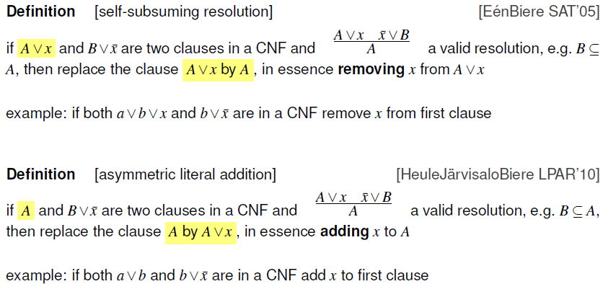
SSR and ALA
Notes:
apply asymmetric literal addition to a clause w.r.t. to fixed CNF as long as possible, if the result is a tautological / blocked then remove clause (otherwise keep original)

Slide 20
Motivation for unhiding
SAT solvers applied to huge formulas:
Millions of variables
Fastest solvers use pre/inprocessing
Need cheep and effective inprocessing technique for millions of variables
Unhiding redundancy in large formulas
Using binary implication graph
Fast enough to be applied to learned clauses

Slide 21
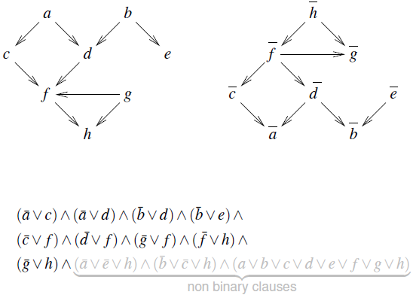
Binary implication graph (BIG)
Notes:
Build implication graph from binary clauses
Counter-positive graph
Non-2sat is polynomial
BIG must be acyclic otherwise a literal implies its negation, which leads to a contradiction

Slide 22
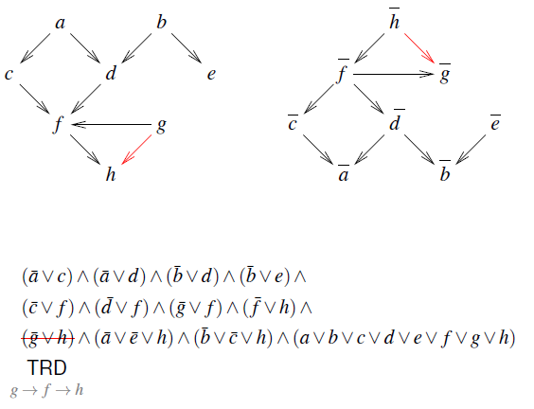
Transitive reduction (TRD)

Slide 23
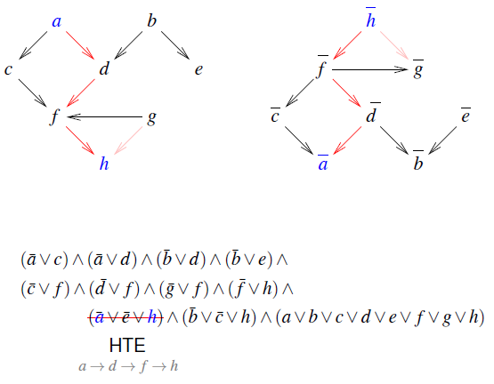
Hidden tautology elimination (HTE)

Slide 24
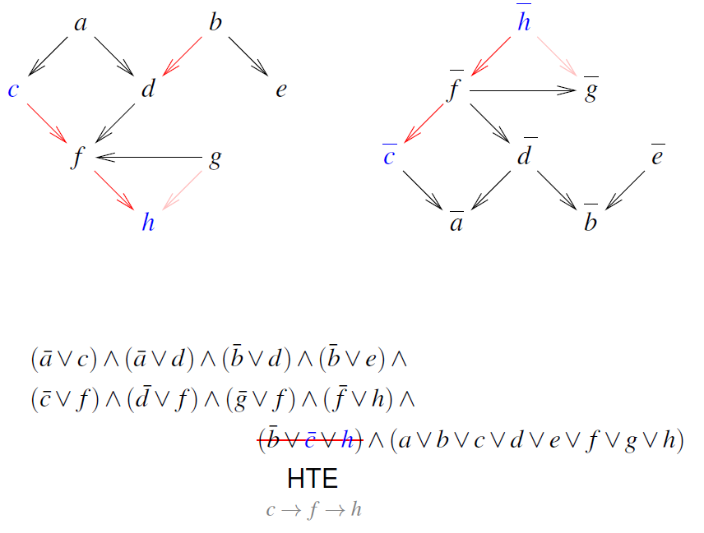
Hidden tautology elimination (HTE)

Slide 25
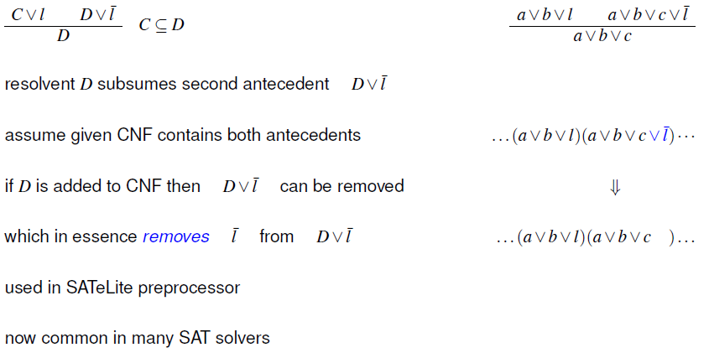
SSR

Slide 26
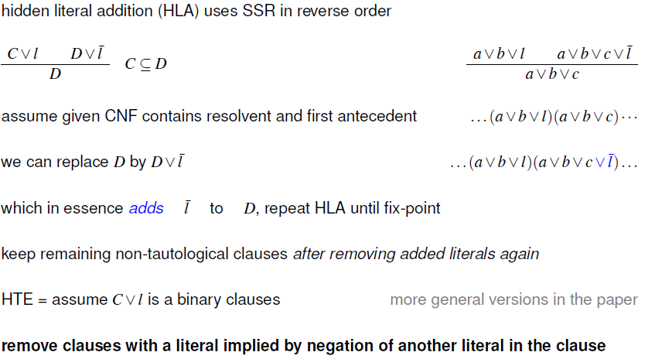
THE=reverse SSR+tautology elimination

Slide 27
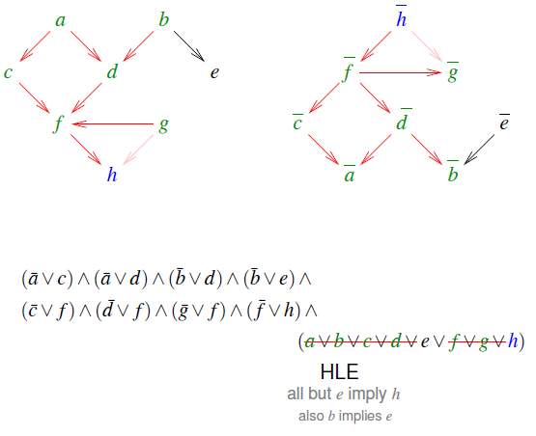
Hidden literal elimination

Slide 28
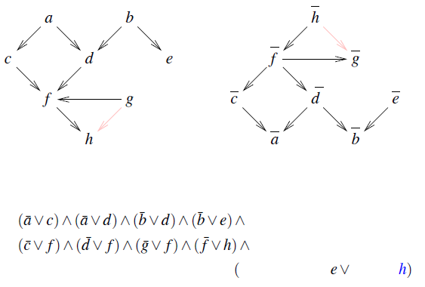
Hidden literal elimination

Slide 29
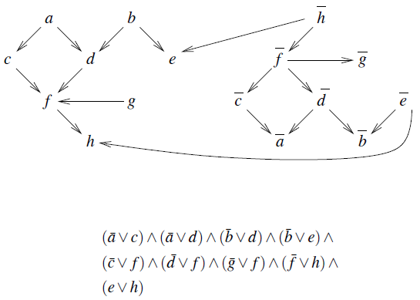
TRD + HTE + HLE

Slide 30
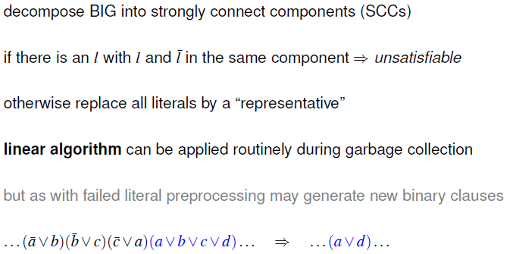
Equivalent Literal Substitution ELS

Slide 31
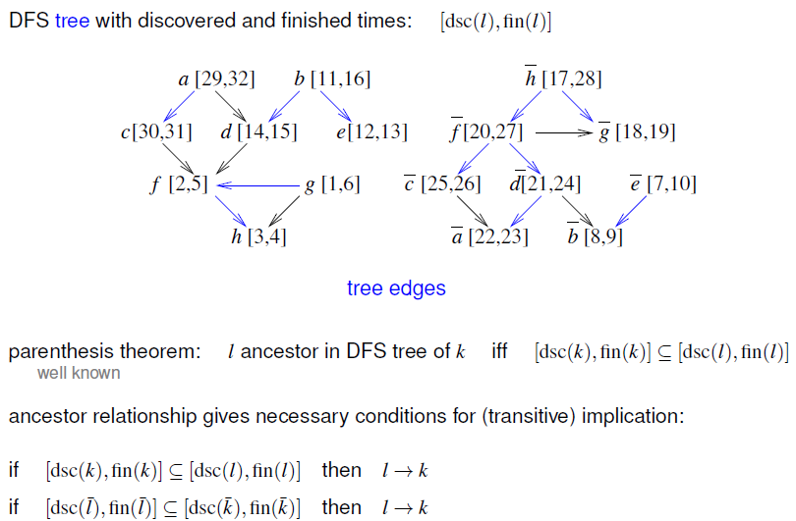
Time stamping
Notes:
time stamping in previous example does not cover b→h
“coverage” heavily depends on DFS order
if BIG is a tree one time stamping covers everything

Slide 32
Some conclusions
SAT is a practical problem
preprocessing is important for SAT solvers
inprocessing provides additional benefits
new class of clause elimination procedures
even quadratic algorithms are most of the time too expensive

Slide 33
Combinatorial Test Design
Rachel Tzoref-Brill
IBM Haifa research

Slide 34
Motivation
The challenge:
We have too many combinations to deal with
We would like to use our time efficiently
We would like to control the risks we are taking
We would like to know what we tested
Minimize omissions

Slide 35
Motivation
A solution: Combinatorial Test Design (CTD):
Systematic planning of tests
Maximizes the value of each tested scenario
Significant reduction in the number of tests
Controlled risk
Easy to review

Slide 36
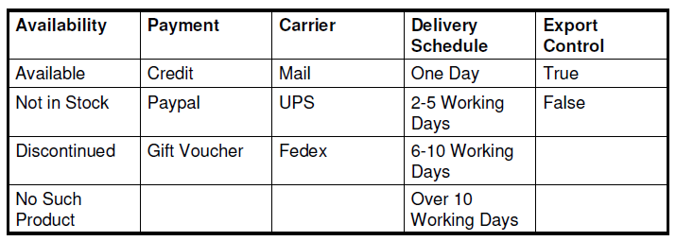
Toy Example – Online Shopping System
4 x 3 x 3 x 4 x 2 = 288 combinations
Do we really need to test all combinations?

Slide 37
Levels of interaction
Suppose there is a bug, and Credit does not work well with One Day delivery
Any combination that includes Credit and a One Day delivery will expose that bug
There are 24 such combinations
This is the case of a level two interaction. Level 3 interaction with 3 variable etc.

Slide 38
Test all combinations?
The root cause analysis of many bugs shows they depend on a value of one variable (20%-68%)
Most defects can be discovered in tests of the interactions between the values of two variables (65-97%)

Slide 39
Combinatorial Test Design (CTD)
To balance cost and risk, we select a subset of tests that covers all the interactions of variables at some level of interaction (pairs, three-way, etc.)
A combinatorial test design (CTD) algorithm finds a small test plan that covers 100% of a given interaction level

Slide 40
Restrictions
Impossible or irrelevant combinations, for example:
Mail Carrier with One Day Delivery Schedule
Fedex Carrier with Over 10 Working Days Delivery Schedule
Naturally we cannot create and run actual tests that contain impossible combinations, so we need to state in advance what should be excluded

Slide 41
Generating a combinatorial solution
3 main approaches:
Mathematical construction (covering arrays)
Efficient, usually optimal
Not applicable to the general case (restrictions)
Greedy algorithms
Heuristic-based incremental construction
Sub-optimal
Meta-heuristic search
Search based algorithms: genetic algorithms etc.
Converge to near optimal
Notes:
Orthogonal arrays
A covering array, CA(N, t, k, v), is an N × k array on v symbols with the property that every N × t sub array contains all ordered subsets of size t from the v symbols at least once.

Slide 42
BDD approach for CTD
View CTD as a subset selection problem
To enable representation of all valid tests use Binary Decision Diagram (BDD)
BDDs are a compact data structure for representing Boolean functions (and sets)
Sets operations are performed efficiently, directly on the compressed representation

Slide 43
BDD-based CTD algorithm
A greedy algorithm
At every step, choose a test out of all valid tests that covers as many new combinations (tuples) as possible, and add it to the solution
The algorithm relies on the efficiency of conjunction and counting satisfying assignments of BDDs
BDD operations might “explode”
Performs well on practical problems

