Slide 1
Version Control with Mercurial
And how it’s going to make our lives better and save our code from doom

Slide 2
What this talk is about
Why use a DVCS?
In the short term, would make coding easier and more pleasant
In the long term, would save us from impending disaster
How to use a DVCS?
The basic technical aspects are covered in the tutorial: http://hginit.com/
We will discuss workflow and best practices

Slide 3
Why Mercurial?
State of the art modern DVCS
Well documented, with an excellent tutorial available
Free software
Supported equally well on Windows, Linux, and Mac
GUI and IDE integration (Eclipse, Netbeans, and Visual Studio) available
Free hosting available
Worked well for my own projects (Guy)

Slide 4
DVCS vs. Centralized VCS
The tutorial has a chapter that deals with this extensively, but just to refresh your memory:
In a DVCS each developer has a local clone of the entire repository, including all of the history. All of the power of version control is available without networks and servers.
The main implication is that the act of recording changes (commit) is decoupled from sharing those changes with the rest of the team (push).

Slide 5
Life without Version Control
Tales of tedium, despair, and tragic loss

Slide 6
Scenario 1: Hunting down a bug
On one dark and stormy night, Alice codes up a new feature. Six hours into her coding marathon, she notices a bug in the software.
Where did the bug come from? Did Alice introduce it along with her new code, or was it laying dormant in the codebase, only to be found now?

Slide 7
Scenario 1: Hunting down a bug
With no version control in place, this question remains unanswered. If the bug is non-trivial, it may lurk anywhere in the codebase, which may consist of thousands or tens of thousands lines of code.

Slide 8
Scenario 1: Hunting down a bug
With version control, Alice can quickly check out an older version and verify that it doesn’t have the bug.
Using binary search, it is possible to pinpoint the exact version when the bug was first introduced.

Slide 9
Scenario 1: Hunting down a bug
Each version typically changes less than 100 lines of code – with the target narrowed down so, finding the bug is easy.
And even if Alice cannot fix the bug immediately, having all previous versions available means that she can get a version that doesn’t have that bug if she needs one in a hurry.

Slide 10
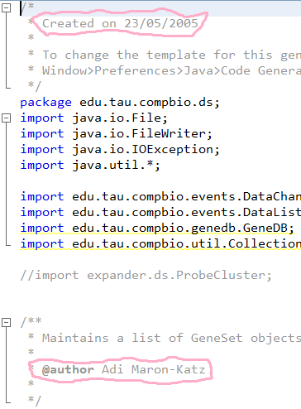
Scenario 2: Junk comments
If you just want to read the code to see how it works, these comments are irrelevant and distracting.
If you want to learn about the code’s history, they do not tell the whole story.
They may even be out of date!

Slide 11
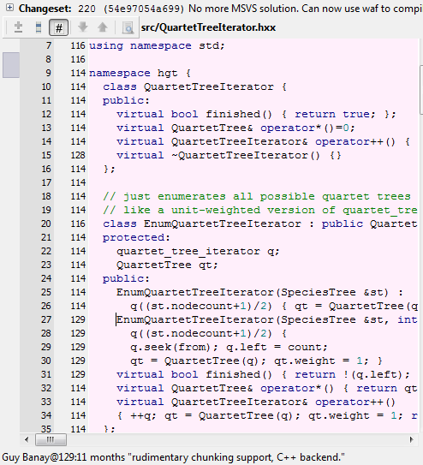
Scenario 2: Junk comments
With versioning in place, you can see for each line of code:
The version in which it was last changed
Who made that change
What they had to say about it (the Commit Message)
All without having to keep and maintain any source-code comments

Slide 12
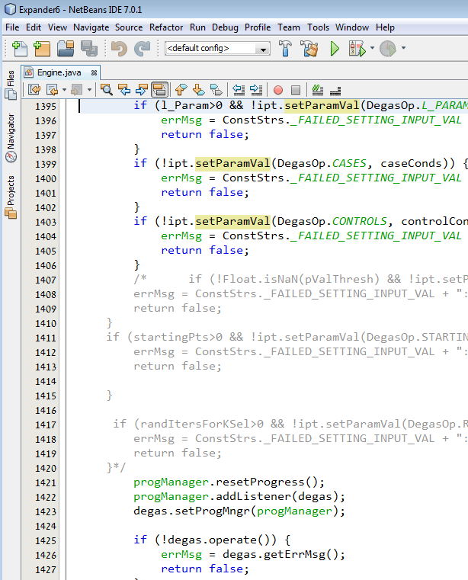
Scenario 3: Commented-out sourcecode
In non-version-controlled codebases you might find that someone commented out some source-code instead of outright deleting it, “in case we need it later”.
With version control, you don’t need to keep such clutter around; If you ever want some old code back, it’s just a checkout away.

Slide 13
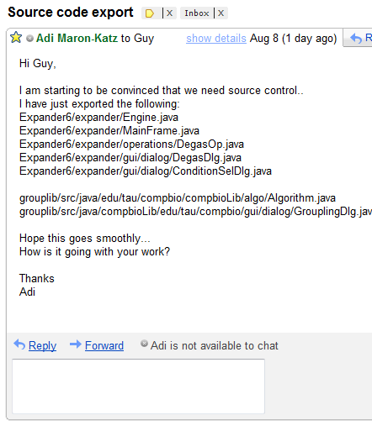
Scenario 4: Collaboration
This is how Adi and I coordinate our work on Expander.
It works. For now…
But what if we accidentally forget to list a file?
What if both of us try to export changes at the same time and end up clobbering each other’s files?
What if someone else needed to see this message, but didn’t?

Slide 14
Scenario 4: Collaboration
A version control system automatically keeps track of changes. Why keep a list manually when we can have the computer do it for us?
It implements atomic commits, making sure nothing gets clobbered and changes get merged as necessary.
And anyone can automatically get a list of all the changes that were pushed to the central repository ever since he made his own clone.
Notes:
I promised some tragic loss. Ask Eyal to share his anecdote after this slide?

Slide 15
Periodic snapshots are not a substitute for proper version control!
Older versions are not kept indefinitely – you can restore a version from last week, but not from a previous decade.
A snapshot may not even contain a coherent version: maybe it was taken when you were in the middle of a change.
Snapshots do not include commit messages that tell you what’s in them.

Slide 16
What else is it good for?
Any kind of document can be put under version control, not just source-code.
Some features, such as diff, merging, and annotation work best with textual formats.
To get the most out of version control for your texts, prefer LaTeX, HTML, etc. over Word, PDF, and the like.

Slide 17
Making the most out of DVCS
Workflows, best practices, tips and tricks

Slide 18
Commit early and often
Remember the difference between a commit and a push:
Commit is a local operation that makes a permanent record of your changes, without sharing them with others.
Push makes the changes you have already committed to your local repository available in another repository.
So don’t be afraid to commit early and often!

Slide 19
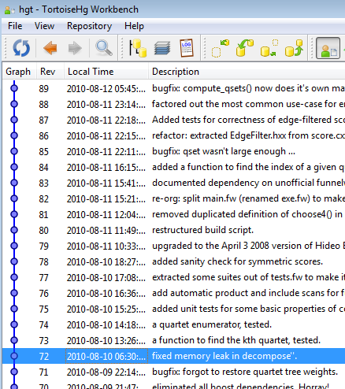
Commit early and often
Commit every time you complete a meaningful unit of work: add a function, refactor a class, revise a few paragraphs of text…
If you make several unrelated changes, commit each separately.
It is not unusual to make 7 or more commits in a single day.
Notes:
Aside: the log can provide a morale boost at the end of the day
Aside: I made multiple commits just working on this presentation

Slide 20
Writing a good commit message
Treat the first line of your commit message as the subject line of an email: keep it short and self-contained.
Say why you did what you did. Were you fixing a bug? Implementing a feature? Refactoring a module in preparation for further modifications?
The first line is usually all you need. If you find yourself writing a multi-line commit message it is often a sign that you made multiple changes, each deserving its own commit.

Slide 21
Collaboration: Inflicting your code on the innocent
Shared repository workflow: Multiple developers push changes from their local repository to a shared central repository whenever the changes are ready to see the light of day (typically when they compile and don’t break anything).
This workflow is most similar to how non-distributed version control systems like SVN and CVS work.

Slide 22
Collaboration: Inflicting your code on the innocent
Gatekeeper workflow: One developer “owns” the mainline repository. When another thinks that his changes are ready for inclusion, he sends a “pull request” to the owner. The owner is in charge of pulling the changes from the developer’s repository and integrating them into the mainline.
This is how many free software projects work.

Slide 23
What goes inside a repository?
Include
Do not include
Source-code
Documentation
License and copyright information
Anything needed to build the software (Makefile, build.xml, etc.)
Rule of thumb: if it’s made by a human, put it in.
Compiler-generated files (*.exe, *.dll, *.class, *.jar, etc.)
Automatically created backup files (some editors leave around files like this~ and #this#)
Large datafiles that can be downloaded from the internet
Rule of thumb: if it can be automatically generated, keep it out.

Slide 24
How much goes in one repository?
Unlike SVN, Mercurial does not support “partial checkouts”. Whenever you clone a repository, you get all of the code and all of the history.
So the recommended practice is to have a separate repository for each project. One for Expander, one for compbioLib, One for HiDe…

Slide 25
Where to put the repositories?
Our own servers
A hosting service
Everything is under our own control. We are not dependant on any outside forces.
But what if our servers get eaten by a swarm of rabid mice?
Makes it easy to expose the code to outsiders should the need arise
It’s free! (because we are part of a university)
Very nice web-based interface
But what if their servers get hit by a meteor?

Slide 26
For maximum safety, we will use both.

Slide 27
Where to put the repositories?
During the normal course of work, we will push changes from our local repositories to central repositories hosted remotely on the group’s Bitbucket account.
A cronjob will periodically update locally-hosted clones of the central repositories.

Slide 28
Questions?

