Slide 1
Pathway-Based Classification of Cancer Subtypes
Shinuk Kim1, Mark Kon1,2*, Charles DeLisi1
1Bioinformatics program, Boston University, Boston, MA 02215, USA
2Department of Mathematics and Statistics, Boston University, Boston, MA 02215 USA

Slide 2
Intro
The input: supervised (categories) gene expression data.
The goal: finding gene signatures or pathway signatures that are accurate and similar given data sets of the same disease.
The idea: use pathway information together with GSEA.

Slide 3
GSEA (Subramanian et al. 2005)
GSEA tests for enrichment of some group S among N background genes.
Rank order N genes in D to form L={g1, ..., gN } (for example, using correlation with a phenotype or profile of interest ).
Evaluate the fraction of genes in S (“hits”) weighted by their correlation and the fraction of genes not in S (“misses”) present up to a given position i in L:

Slide 4
GSEA (Subramanian et al. 2005)
The enrichment score of S is s the maximum deviation from zero:

Slide 5
GSEA (Subramanian et al. 2005)
If p is 0, the score is the Kolmogorov-Smirnov statistic for comparing two distributions (that is, the maximal difference between two CDFs).
Significance estimation is done by permuting phenotypes.
Let ES(S,π) be the ES score of S given a fixed permutation π.

Slide 6
GSEA (Subramanian et al. 2005)
Calculate the normalize scores (done with the same S, therefore adjust for variation in gene set size):

Slide 7
GSEA (Subramanian et al. 2005)
Use this null distribution to compute an FDR q value, for a given NES(S)= α ≥ 0. The FDR is the ratio of the percentage of all (S,π) with NES(S,π)≥ 0, whose NES(S,π)≥ α divided by the percentage of observed S with NES(S)≥ α and similarly if NES(S)= α ≤ 0:

Slide 8
GSEA (Subramanian et al. 2005)
The bottom line: we can rank pathways by their normalized enrichment score (q).
For each pathway we get a set of chosen genes (the “hits” of the maximal deviation).

Slide 9
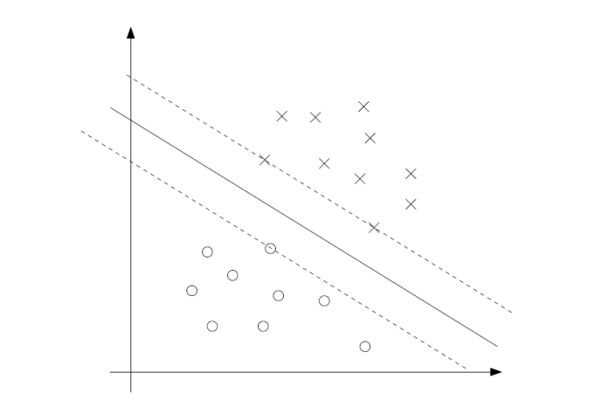
Reminder: linear classification
Algorithms that look for a separating hyper-plane. For Example: SVM
A separating hyper-plane consists feature weights and intercept.
The weights of the features can be used for feature extraction\selection

Slide 10
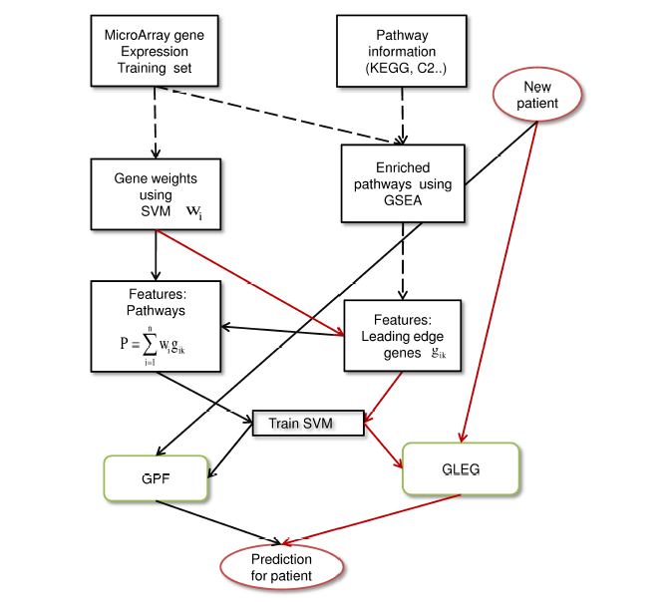
Integration of pathways and classification

Slide 11
The proposed methods
CLEG: using GSEA leading edge genes as features.
GFP: using GSEA enriched pathways as features.
SPF: using pathway features determined by SVM.
The methods use the top 20 up-regulated and top 20 down-regulated pathways, determined by GSEA.

Slide 12
CLEG
Use the selected edge genes from the 40 pathways selected in the GSEA step as features.
Train SVM using the selected features.

Slide 13
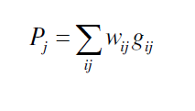
GPF
For every selected pathway, construct a feature, using a linear combination of the selected edge genes.
The weight of every gene is the weight assigned by running SVM on the complete data set.

Slide 14
SPF
Alternative method for constructing pathway features.
Use SVM directly instead of GSEA.
For every pathway, a feature Pj is constructed using the top 20 differential genes within the pathway (using Fisher score)
Run SVM on the constructed pathway, rank the pathways using SVM weights (in absolute score).
Select the top 20.
Remark: why not 40 as selected by GFP?

Slide 15
Data sets
KEGG pathways.
Breast cancer metastasis data - metastasized within 5 years vs. not metastasized : Wang data set (93, 186) and Van De Vijver (79, 216).
Ovarian cancer:
Resistance to Platinum therapy: complete vs. incomplete response (85,34)
Two sources on the same patients (UNC and the broad):
Short term vs. long term survival (22,22)
Early stage vs. late stage (10,49)

Slide 16
Accuracy comparisons
The methods were compared to:
Selection of the top differential genes (SG)
Selection of the top differential genes that appear in KEGG (SKG).
Run GPF on random pathways (RPF)
Score: average accuracy over 10 repeats of down sampling for same size of classes and LOOCV.
Reciprocal analysis: select features in one data set and test on the other ( again, with down sampling of the data sets)

Slide 17
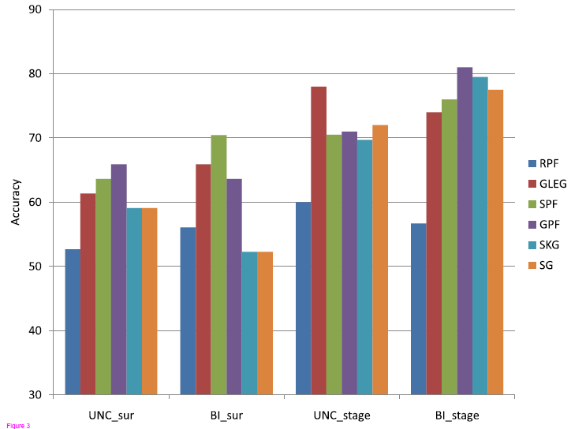
Results: Ovarian data sets

Slide 18
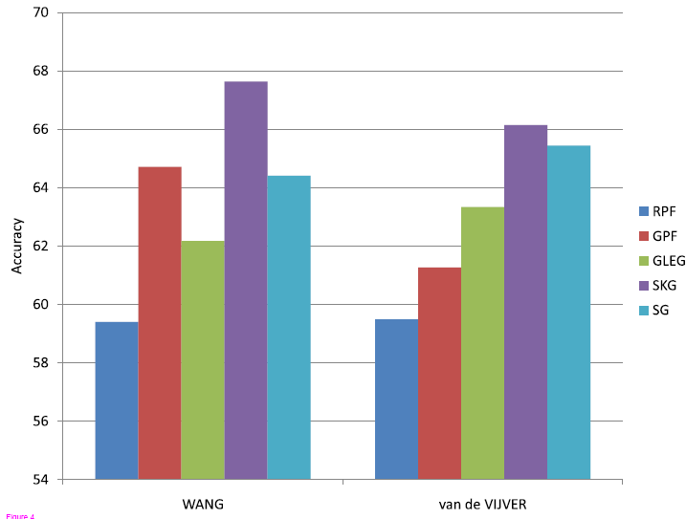
Results: breast cancer

Slide 19
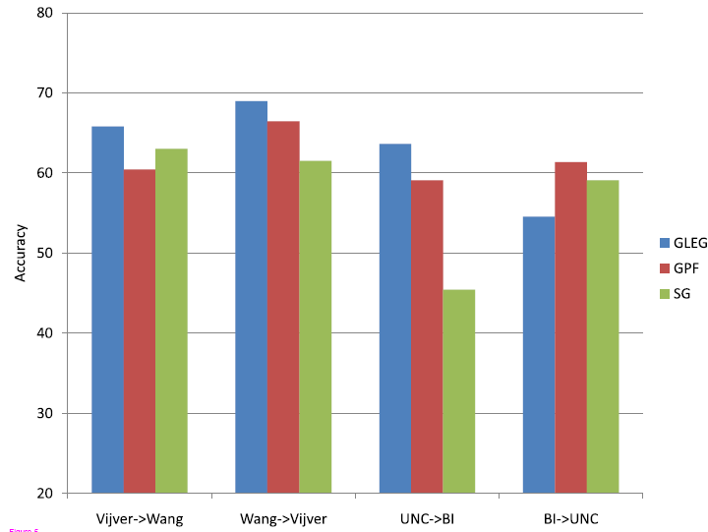
Reciprocal analysis

Slide 20
Major comments
There are at least 5 known methods that integrate pathways and classification examples:
Pathway selection: Tian et al. (2005) calculated a score T by averaging the t-test statistic scores of all pathway member genes.
Pathway features: Guo et al. (2005) summarized the expression levels of member genes by using simple statistics like mean and median.
Pathway selection and gene selection: Lee et al. (2008) used a greedy algorithm for selection of genes and pathways. For every pathway, output the average profiles of selected genes. Iteratively, add the most differential gene until no addition increases the discriminative score.

Slide 21
Major comments
The authors did not use standard FS methods in the comparisons (e.g. SVM-RFE, information gain).
Down sampling is crucial here, why not ROC or AUPR without down sampling (more standard procedure).
Not all methods are shown in the reciprocal analysis.

Slide 23
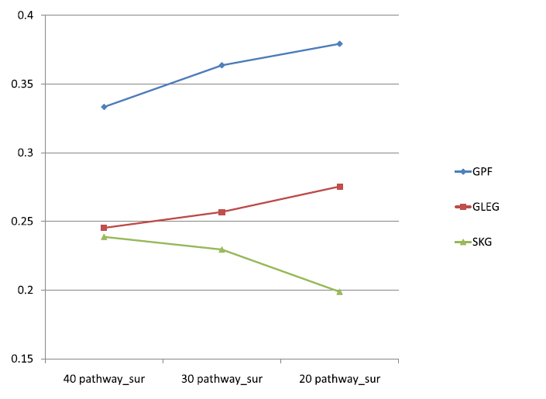
Stability analysis
Use the Jaccard coefficient for measuring the similarity between two sets (the size of the intersection / the size of the union)

Slide 24
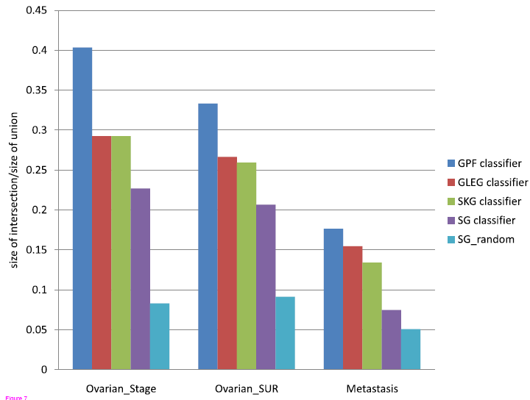
Stability comparisons

Slide 25
Major comments
As in the accuracy analysis, the authors do not compare with other known methods.
GPF signatures are composed of pathways that are selected from KEGG pathways, (background size is ~200). The CLEG and SKG methods select genes that are part of some pathway in KEGG( background size ~ 4000). The SG method selects genes from the data set (background size ~ 10000).
This suggests that one can expect the following order of stability to occur by chance: GFP > CLEG,SKG > SG

Slide 26
Suggested alternatives
Separate stability analysis by the methods’ background. For example compare SKG and CLEG separately.
Use scores that take the background into account, for example: hyper geometric score or Chi square test for dependence.

Slide 27
Suggested alternatives
Using the genes as raw objects for stability comparisons seems to simplifying.
For example: if the selected signatures have the same functionalities but the intersection size is 0, do we really want to assign a bad score?
Many papers suggested calculating genes similarity based on closeness of functionalities. For example Wang et al. (2007) used the GO DAG structure for calculating genes similarity scores.

